Slide 1
Initial Design Presentation Group B Harbourmasters
By Adam, Caitlyn, Connor, Dominik & Ryan
Notes:
1

Slide 2
Our Jobs:
It’s our job to send out Pilot ships to help guide other ships to their designated berth (as decided by the port masters bookings).
Get a list of all incoming and outgoing ship appointments from the port masters.
Receive hails from Captains of ships to arrange bringing them into port when they reach port. (assuming they have a booking raising some form of exception if they don’t)
Collect data on the tides and manage whether a ship can come into port if the correct tide conditions are met (raising an exception if the tides aren’t appropriate for the ship coming into port)
Notes:
2
So from our perspective here is how we would imagine our jobs. Managing and checking the tides for each ship incoming and going out of port, Piloting each ship in and out. Making contact with Port masters to get their booking schedule for berths and ships and having a open API request for the ship liner to make contact with us once they are ready to come into and leave port

Slide 3
Our Jobs:
We want to collect a list of appointments we get about the ship coming into port and the berth they have been assigned to.
We also manage the ship locations once they are in the port.
Finally once a ship is ready to leave port we dispatch a pilot ship to pilot them out of the port and into open ocean again checking tides and that no other ships are coming in.
Notes:
3

Slide 4
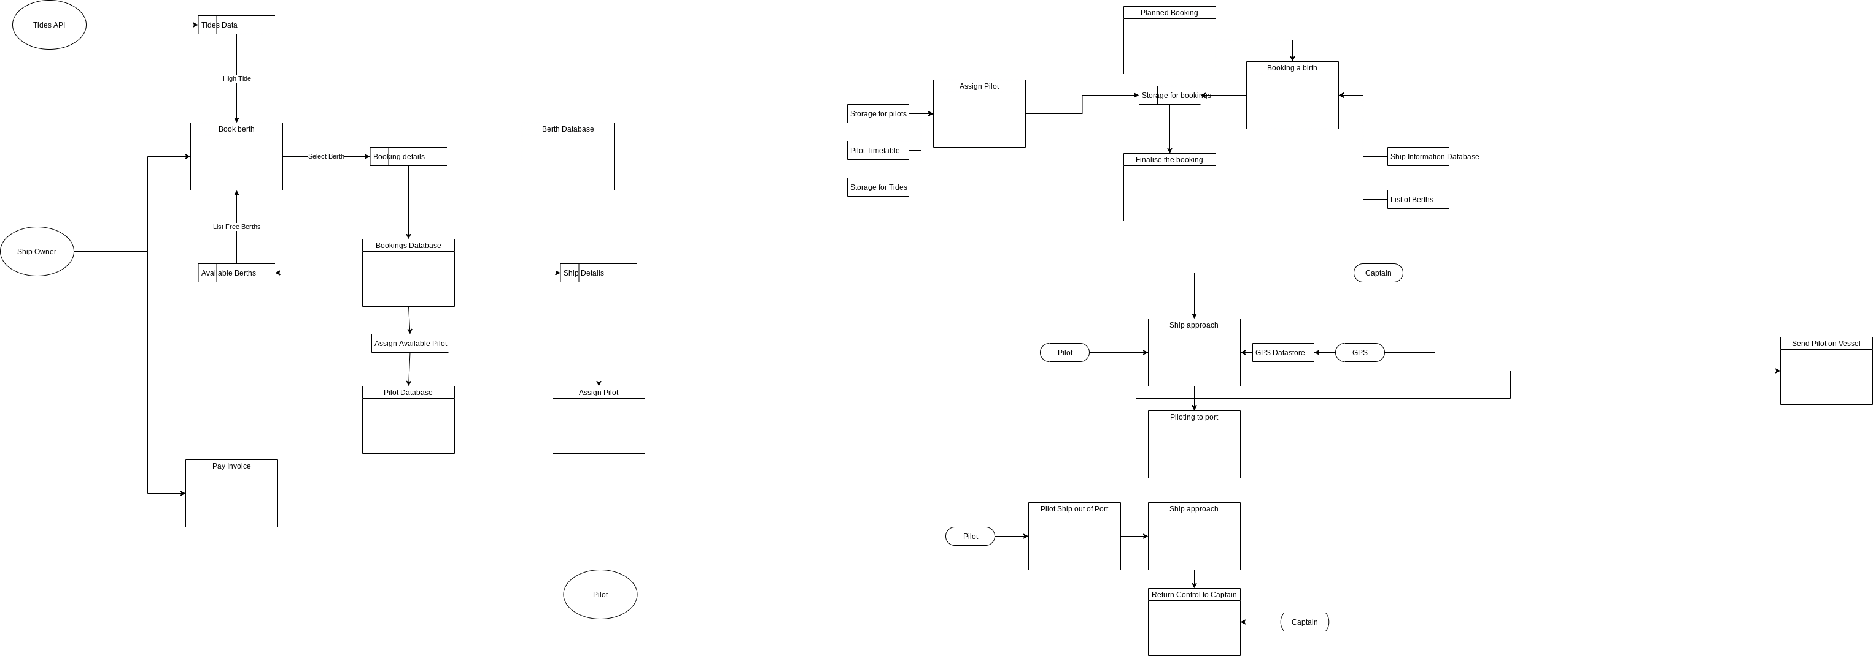
Our DFD
Notes:
So here is our DFD. This is still potentially subject to minor changes, based upon where the group finally agree where each companies responsibilities begins and ends. As from what we understand it, the port master would book ships and assign the berths they would stop at. We would then get a list of books from them and assign pilots to each ship booking. Wait for the ship to contact us when it’s ready to come into port and check it against the booking list. Bringing it into port and to the destination berth if it has a booking and the tides are right. Raising a valid exception if these conditions aren’t met. The ship would then be piloted out of port once the stevedores at the port finished with job. Then we would collect payment.

Slide 5
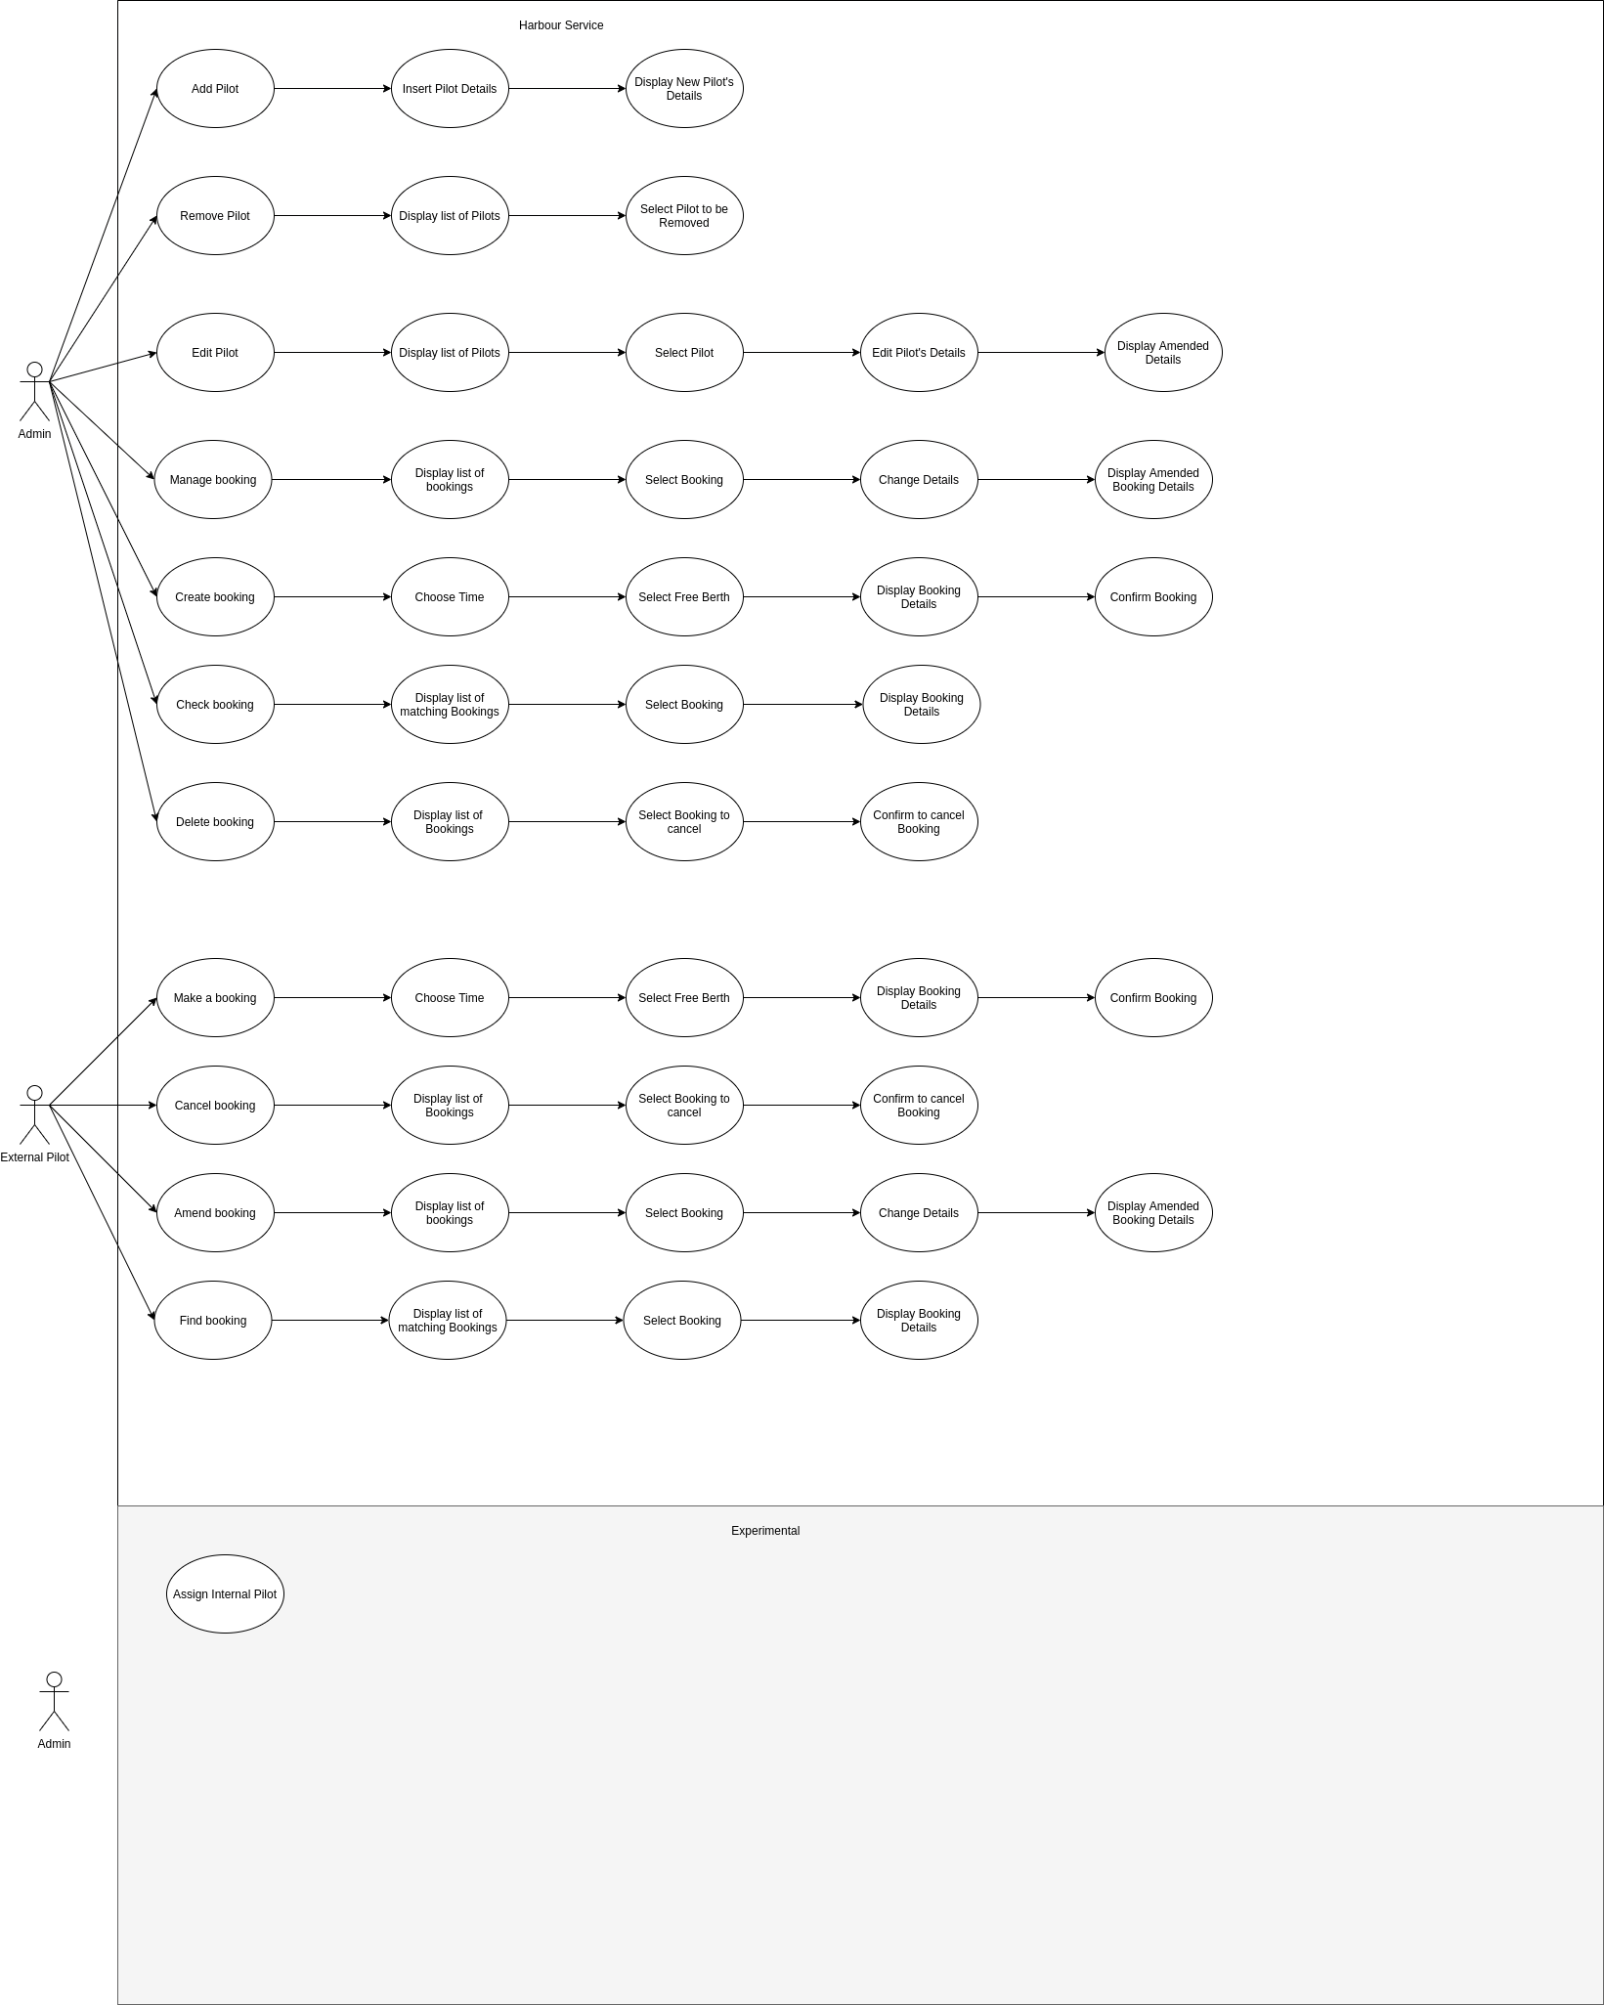
Use Cases:
Our use case is fairly simple at the moment as on a basic sense it is very simple in how it works but basically our admins have all permissions and will be able to do anything on the system.
The pilots will only be able to view and manage processes related to their bookings.

Slide 6
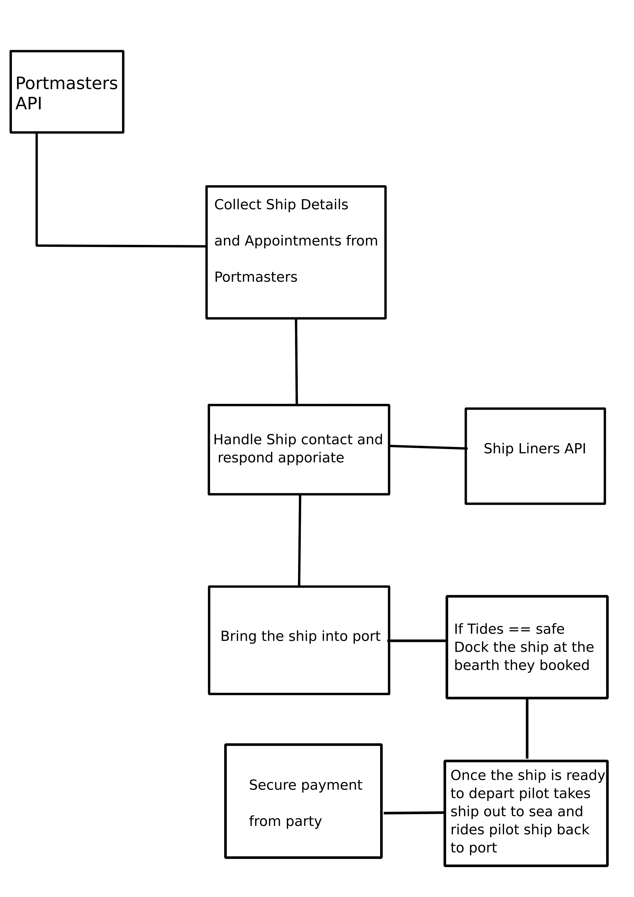
Initial System Models
We will require a few different objects and classes for this project to work firstly we will need a booking class that will be generated when we import the ship/berth bookings from the postmaster.
Which we will then use the data provided by the port master to chose which pilot to assign and to get ship details once the ship is ready to enter port to check the tides.
Then the same in reverse once the ships services have been rendered by the port and they are ready to leave to open ocean again.
Notes:
6
For our system we would want to collect data from the port master API. About the booking and the ship details. Then wait for a ship to make contact with us through out API requesting to come into port. We would then cross reference this with the bookings we collected and if they are present let them in if not raise a relevant exception. If they have an appointment we would move onto checking the tides and trying steps to bring them into port.

Slide 7
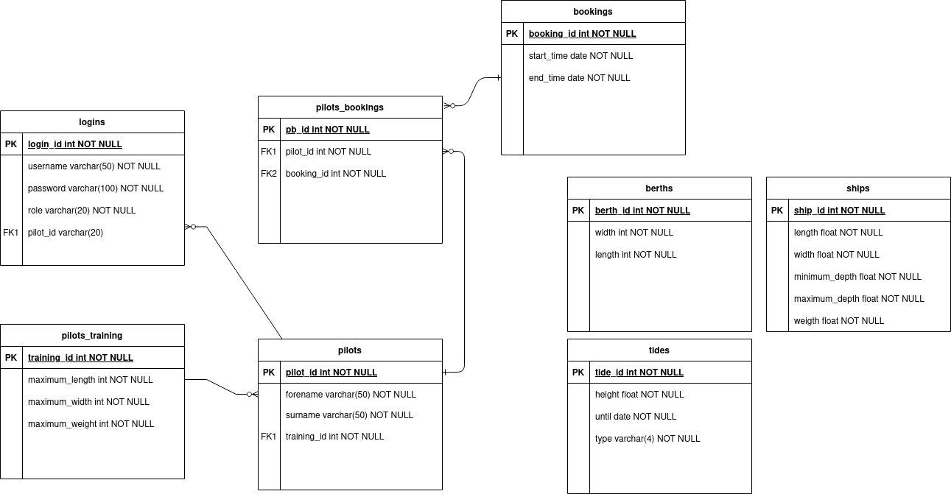
Entity Model
Notes:
7
Our Entity model is shown here and on a basic sense we would have a login system for each pilot and each pilot’s account would have a level training linked to them. i.e. piloting a small ferry likely isn’t the same as piloting a cruise liner and this would allow use to check and assign pilots based on their qualifications to pilot such vessels. Then each pilot would have a booking they are associated with. Where the start and end time of that booking represent the time for the ship to come into port and to leave port. Which each booking having a berth and ship object that would be used when cross referencing the tides next to the ship class to check if it can come in and for which berth we are taking the ship to.

Slide 8
Functional and non function requirements
Functional:
Obtain bookings from Port masters API for ships. Including berths & and ship class(for tides calculation).
User Ship: Hails us when they arrive at port to be guided in. (we check tides and class of ship and if they have a booking)
Guide them into port if they have a booking. Send them away of they don’t.
Guide them out once they are done in port and receive payment. For services rendered
Non-Functional:
Reliability e.g. isn’t likely to suffer from bugs or glitches due to bad code
Consistency & predictability
API response time optimisation
Succinct Documentation
Receive data from other APIS
Notes:
8

Slide 9
Test Requirements
Testing the API should be very simple. As we will craft dummy/fake API calls. All providing predefined hardcoded information. That we know what the answer should be to. Allowing for us to test various cases and ensure the API returns and respond as expect and that the code is bug free. Allowing for use to check how it respond to undefined input.
Then we will likely want to run a “real world test” using everyone’s API together. Creating dummy calls across each API and testing how it transfers between the APIs and ensure that the results are as expected
Notes:
9
Testing the API will be carried out on a cycle basis where we will implement a new feature and a series of tests for it. Running it through each of these tests checking to make sure it returns expected output aka “successfully”. Then once all the APIS where finished we would obviously want to run an initial test will all our APIS checking for errors and unexpected behaviour. Then once this was successful we could move onto trying to deploy our APIs

Slide 10
Deployment Requirements
For deployment to take place there are a few pre-requisites need to occur. To ensure the software is ready to be deployed.
Firstly every companies API needs to be completed at least enough so that tests can be run with them.
Each company needs to agree with each other. Exactly where everyone's responsibility begins and ends. Once that is done we can begin work on the more vague outward facing calls to each other’s API
All tests need to return successfully and any bugs that are found need to be patched before and after(maintaining the software) deployment takes place.
Notes:
10
So it goes without saying to actually deploy our software we need to meet a few requirements firstly it relies on the other companies APIS being completed and in working order. That we have past all of our tests successfully and that they return the expected results. With little to no unexpected behaviour as unexpected behaviour could lead to major hard to find errors later down the line.

Slide 11
Outline of project plan
Complete internal facing parts of the API e.g. the tides, pilot objects and other internal structures and functions. i.e. parts that do not require the other companies
Once the other companies have agreed upon a structure for data to take, we will begin developing our agreed outward facing API calls i.e. the parts of the API that relies on the other companies. Along with calls to other companies API’s
Then once all companies have test their APIs we can begin to try and ingrate them and make them work together.
Notes:
11
Our plan is fairly simple even before we come to a full consensus with the other groups we plan to begin by working on the internal parts of our API. I.E. the parts that do not matter on agreements with the other companies. Then once we have all reach an consensus on these things we would begin working on our outward facing API calls. (we would be using dummy fake calls to imitate your API until the groups agree on a common DFD and everyone's jobs.

Slide 12
Technological evaluation:
This technology is potentially very valuable for us as an organisation. As we can implement it in every port our company is present in.
Implementing only the internal parts where other smart port companies are not present and potentially the whole system where other smart port companies are present and compatibility between APIs exist.
It would allow for our company to provide high skilled jobs for software engineering teams. To continue developing and improve this system.
Whilst also allowing our company to run more efficiently generating more profits, in the process. As lower cost due to less admin staff would need to be hired to do theses tasks by hand also likely reducing the number of errors due to simple human mistakes. Overall making a much better method for our company to run
Notes:
12
Implementing smart port technology is potentially very profitable for our company(s) as it would. Allow for our company to run with lower administration costs as we wouldn’t have to hire as many people to manage these soon to be automated systems along with allowing our company to provide some higher skilled jobs maintaining the system and making updates to the code as and when needed. Also hopefully by automating this and making use of wireless technology requests can be sent fast speeding up the whole process increasing the volume of ships we can process in one day increasing every companies profits.

