Slide 1
Harbour Master – Group B Early API Design
Connor, Dominik, Ryan, Caitlyn, Adam

Slide 2
Which REST endpoints are we responsible for?
- /api/bookPilot (for the Shipping Team)
For the shipping team to reserve a pilot for handling any inbound ships, we would obviously need some sort of endpoint for booking. This endpoint is used fairly early on within the entire smart port system.
- POSSIBLY /api/callPilot (for the Stevedore Team)
If required, will request a pilot to lead the ship from the berth out of port.

Slide 3
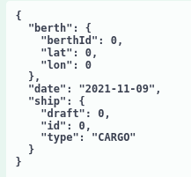
/api/bookPilot (POST) - Requirements
- Berth
BerthId
Lat + Lon
- Date
- Ship:
Draft
Id
Type
It may be possible that a ‘turn-around time’ is also given with the initial booking.

Slide 4
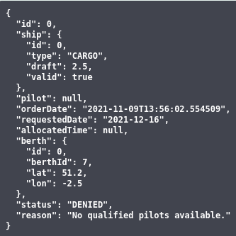
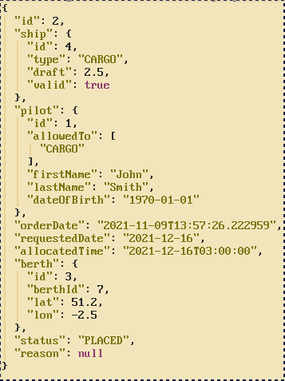
/api/bookPilot - Response
Attempting to make a booking for a type of ship no pilots are available to handle on that day will automatically deny the order with a user-friendly reason.
If a pilot is available to handle the given ship type on the given date, an order is placed, and a time is allocated.

Slide 5


Looking up order information
Once a booking has been made, the shipping team are able to look up their order using the ID that they were given. It contains a copy of all the information that was given originally with some additional variables such as 'orderDate' and 'status'.
Currently, one is only able to look up their order via ID and cancel the booking. In the future, we will offer more order functions via an order controller, such as requesting to make amendments.

Slide 6
Analysis of /api/bookPilot
After extensive discussion with the shipping team, we believe that the design of /api/bookPilot is in a state where both parties know what to expect from one another.
One of the major flaws of our endpoint’s design is that the shipping team are required to have a berth booking ready before attempting to make a booking for a pilot. In a real-world scenario, it would be more ideal to have a pilot booked before the berth – what good would a berth without a pilot be?
A possible solution, though adding slight complexity, would be to have an order placed when /api/bookPilot is called (with a pilot assigned) without a berth assigned. Once the shipping team have secured a berth, they could then call another endpoint of ours, say /api/confirmBerth, which then adds the berth to the order and sets it to ‘CONFIRMED’ as opposed to simply ‘PLACED’. This solution feels quite hacky due to needing two endpoints to handle a single booking, but it is the best that we can come up with at the moment.
This flaw may be a non-issue, though we would need to talk with the shipping team once more to confirm this.

Slide 7
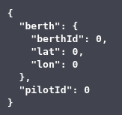
(Possibly) /api/callPilot
/api/callPilot is an endpoint that is to be used by the Stevedore team so that they can call when they have completed their work with a ship and need it to be led out.
Our current plan for this endpoint requires the berthId, lat, and lon so that the pilot knows where to go to retrieve the ship.
A pilot ID is also required due to pilots having different training levels. Calling the pilot that originally led this ship in guarantees that they have the ability.

Slide 8
Which REST endpoints do we require from others?
We require:
- /api/shipArrived (from the Stevedore team)

Slide 9
/api/shipArrived
/api/shipArrived is an endpoint that the Stevedores would expose for us to tell them when a new ship has arrived and at which berth.
We could give them the ‘ship id’, the ‘berth id’, and a ‘pilot id’.
- Ship ID: used so that they can look up their booking with the Shipping team to find out how much cargo, waste, and whatever else needs to be dealt with; we don’t have that information.
- Berth ID: needed so that they know which berth the ship has been brought in to. We may not need to give them a berth ID as they can also look it up with the booking via ship ID.
- Pilot ID: If we do go with the API design of us exposing /api/callPilot, then they’ll need the same pilot to lead the ship out.

Slide 10
Where do we currently stand?
At the moment, we have a proof-of-concept system available under /project of our repository with:
- A working swagger-ui setup.
- /api/bookPilot working as far as demonstrated in this presentation.
- /order/find and /order/cancel endpoints.
- /api/createPilot also implemented for testing /api/bookPilot – checks are in place for finding capable pilots.
- A tide system that is able to find the tide at any time and load it into the system.
- A very rough ‘fake’ GPS system.
- Unit tests written and passing for CRUD operations and any additional service functions (such as getTideAt).
- A working Github Actions workflow after collaborating with the integration team.

Slide 11
What do we plan to achieve before the end of Sprint 3?
We intend to:
- Fully confirm the API design of other groups so that we tailor our program towards it early.
- Implement the communication with other group’s endpoints via REST.
- Implement our scheduling system.
- Create more REST endpoints to handle pilot / tide controllers.
- Add a ‘party’ system that only permits authenticated parties to call certain endpoints.
- Fully complete the fake GPS system for finding the locations of inbound ships.

