Slide 1

Sprint 2. Skeleton Mock Implementation
Team: Port Application A
Members: Aleksandrs Bogackins, Yoan Markov, James Richardson, Navjit Singh

Slide 2
Project plan

Slide 3
Feature description

Slide 4
Technology evaluation
MySQL 8 | Version 5.7 is EOL in 2023 version 8 is production ready, has the benefit of being able to handle UUID’s
GitHub Actions | CI/CD for build, test and deploy
Junit 5 | Unit will be used as our testing framework
Docker | Consistent isolated environment for development testing and deployment it will also works well with our CI/CD choice

Slide 5
Technology evaluation
Spring Boot | Framework will be used to develop our application, well documents and mature framework
Tomcat 7 | The default webserver for Spring Boot,
JSP/WAR | Allowing for rapid development and is also platform and server independent
Swagger | API documentation
Postman | Sending queries to the REST server to ensure the working connection

Slide 6
Test plan

Slide 7
Deployment Flow & requirements
GitHub
Actions script

Slide 8
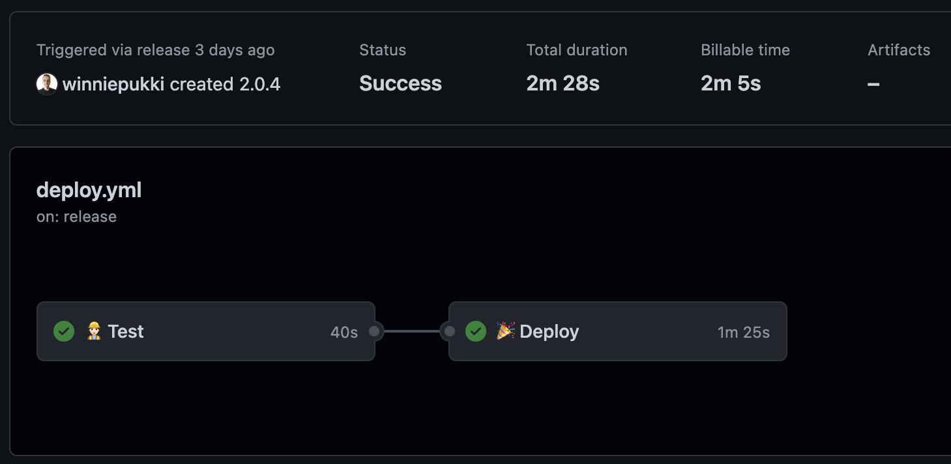
Deployment Flow & requirements
The development team creates a new release that triggers the deployment action
The deployment action initiates
The pre-defined test command expects to succeed

Slide 9
Thank you!
Team: Port Application A
Members:
Aleksandrs Bogackins
Yoan Markov
James Richardson
Navjit Singh

