Slide 1

Sprint 2. Skeleton Mock Implementation
Team: Port Application A
Members: Aleksandrs Bogackins, Yoan Markov, James Richardson, Navjit Singh

Slide 2
Project plan
Create the API
Generate the DB with the dummy dataset
Test the CRUD services (Port, Booking, Dock)
Develop the application and test the Front-end
Test the communication between other external services (Harbormaster, Stevedores, Ship owners)

Slide 3
Feature description
GET 1.1
/api/isBerthAvailable – Is the specific berth available at the given time
/api/getAvailableBerthsList – Get all available berths
POST 1.1
/api/createPort – Create a new port
/api/createBooking – Create a new booking
/api/updateBooking – Update the existing booking
/api/cancelBooking – Cancel the existing booking

Slide 4
Technology evaluation
MySQL 8 | Version 5.7 is EOL in 2023 version 8 is production ready, has the benefit of being able to handle UUID’s
GitHub Actions | CI/CD for build, test and deploy
Junit 5 | Unit will be used as our testing framework
Docker | Consistent isolated environment for development testing and deployment it will also works well with our CI/CD choice
cPanel / AWS | Used as the deployment environment to test application in the real-world production and predict / reflect on the integration behaviour

Slide 5
Technology evaluation
Spring Boot | Framework will be used to develop our application, well documents and mature framework
Tomcat 7 | The default webserver for Spring Boot
JSP/WAR | Allowing for rapid development and is also platform and server independent
Swagger | API documentation
Postman | Sending queries to the REST server to ensure the working connection

Slide 6
Test plan (abstract)
Each major group of features or feature combinations should be tested using the JUnit library with the pre-defined careful identification of the expected result and the input data:
Each function, feature or factory
The Port Application interface as the overall system
REST related features and how do they interact with other services
DB connection and is healthy status check
Does the application build successfully and does not contain any broken code or packages (Linting, etc.)

Slide 7
Deployment Flow & requirements
GitHub | Stores the application files and configuration
Actions script | CD script for build, test and deploy
Test Pass | The CD pipeline must pass to deploy the application
Production environment | Hosting that receives the build files (AWS, cPanel, etc.)
Deployment script | A custom script, or the ARM template

Slide 8
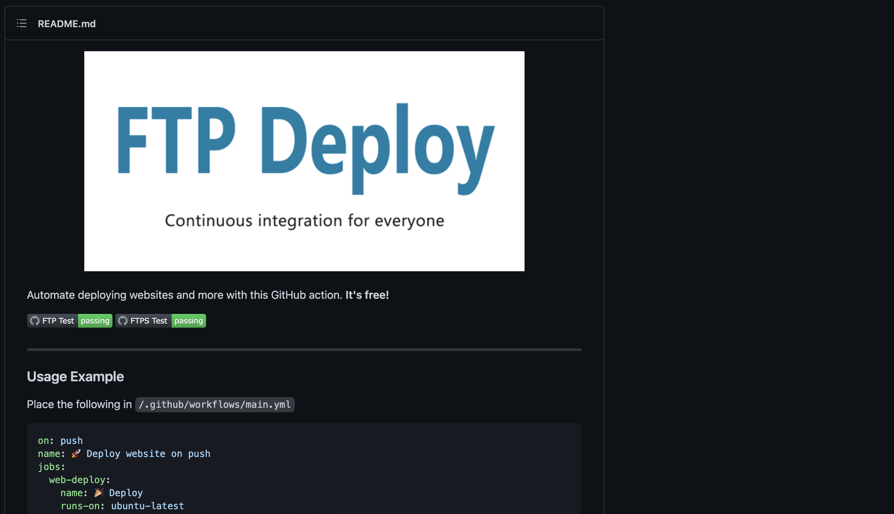
SamKirkland /ftp-deploy-action
https://github.com/SamKirkland/FTP-Deploy-Action

Slide 9
Deployment requirements
Dev team
Version Control
Build & Tests
Deployment
Check in
Req. (rel., push)
Trigger
Feedback
Check in
Trigger
Trigger
Step-based 1.. 2..
Feedback
Check in
Trigger
Approval
Sync files
Feedback

Slide 10
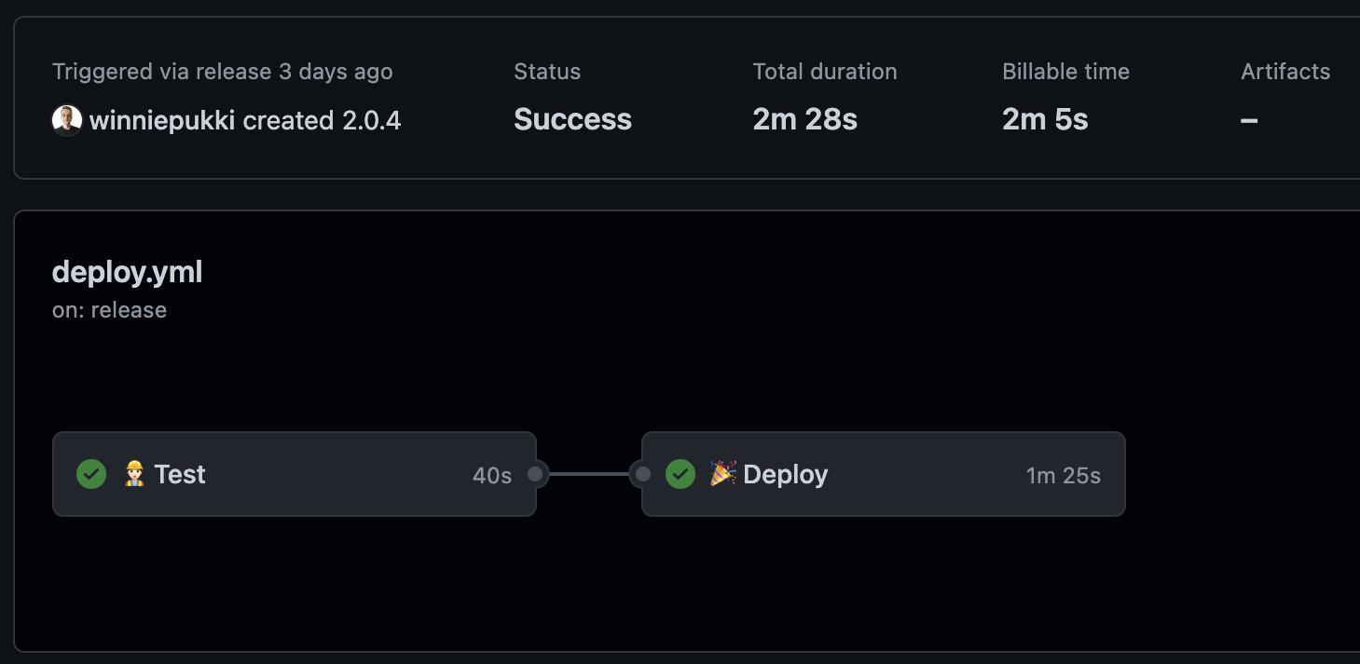
Deployment Flow & requirements
The dev team creates a new release that triggers the deployment action 🚀
The deployment action initiates ⏳
The pre-defined test command is expected to succeed 🧪
Starting the delivery (sync files with the remote store) 🚢
Celebrate!

Slide 11
Thank you!
Team: Port Application A
Members:
Aleksandrs Bogackins
Yoan Markov
James Richardson
Navjit Singh

