Slide 1


Slide 2
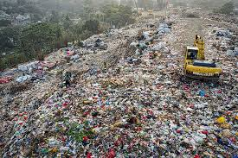
The Problem
Millions of students lack affordable notebooks.
Plastic waste pollutes communities for hundreds of years.
About 3 billion trees are cut down for paper packaging.

Slide 3
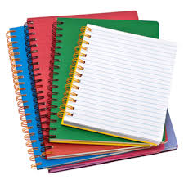
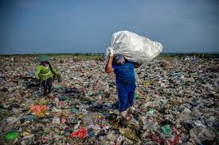
Our Solution
Convert plastic waste into durable notebooks
Blended with banana stem fiber and sawdust
Affordable, tree-free, locally produced

Slide 4
How Waste2Learn Works
Plastic waste collection and washing.
Shredding plastic waste
Melt the shredded plastic waste
Mixing with powdered Banana stem & Sawdust.
Sheet Pressing
Cutting & Binding

Slide 5
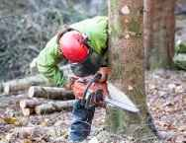
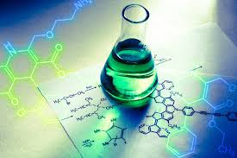
Why Waste2Learn?
No trees are cut.
Stronger and longer-lasting than paper.
Uses waste instead of mined materials.

Slide 6
Business Model & Cost Price
Sell notebooks to schools and NGOs
Low-cost locally fabricated machines
Pilot-first to prove demand and profit
We estimate to sell one note book for $0.4

Slide 7
Business Model & Cost Price

Slide 8
Amount We Need For Startup
MVP product: sheet we need $3300 to be able to make 1000 Notebooks and also the system that makes the books.
Established company: HULT Prize amount we will build a well company around the world with great impact

Slide 9


Impact & SDGs
1,000 notebooks remove up to 1 ton of plastic waste
Reduced deforestation
Green jobs created

Slide 10

Who Gains Profit
The community
Environment
Waste2Learn

Slide 11



What We Have Done So Far
Done deep research about this project
Created the right formula for the MVP product
We partner an education based startup business OCTALEARN, FARMERS and CARPENTERS.

Slide 12
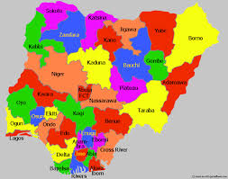

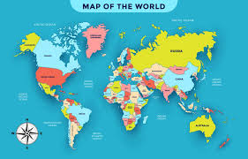
Market Distribution Plan
Six states in Nigeria
Four Countries in Nigeria
Four Countries in Nigeria

Slide 13

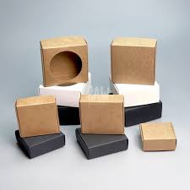
Our Vision
Turn waste into learning materials.
Reduce cutting down of trees to produce notebooks.
While notebooks are our entry product for education, the same material can produce packaging material.

Slide 14
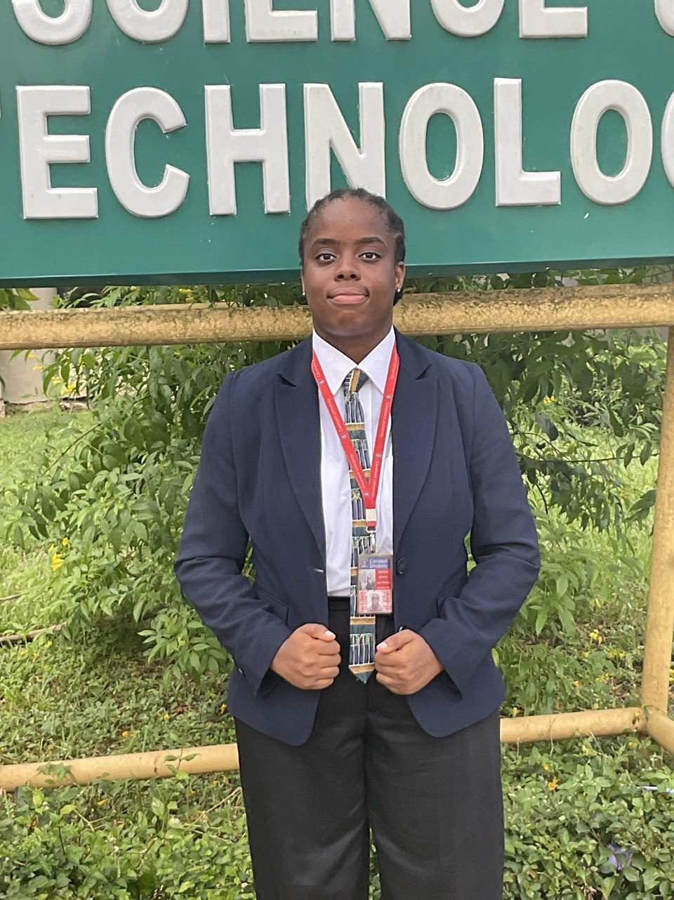
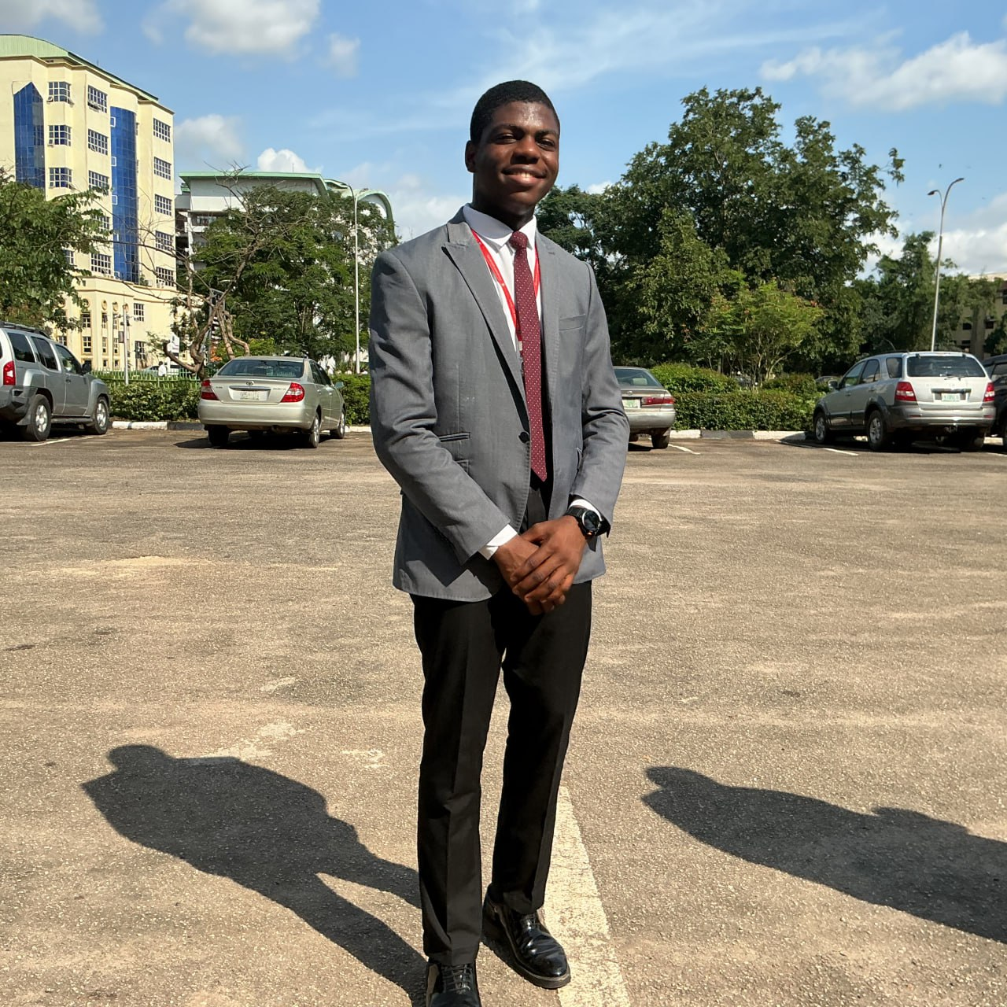
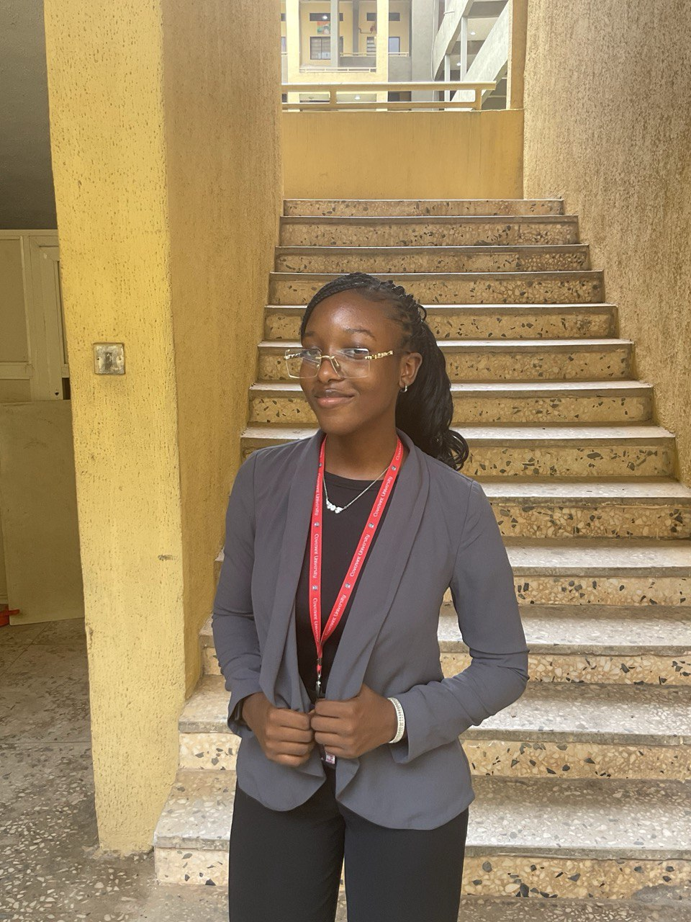
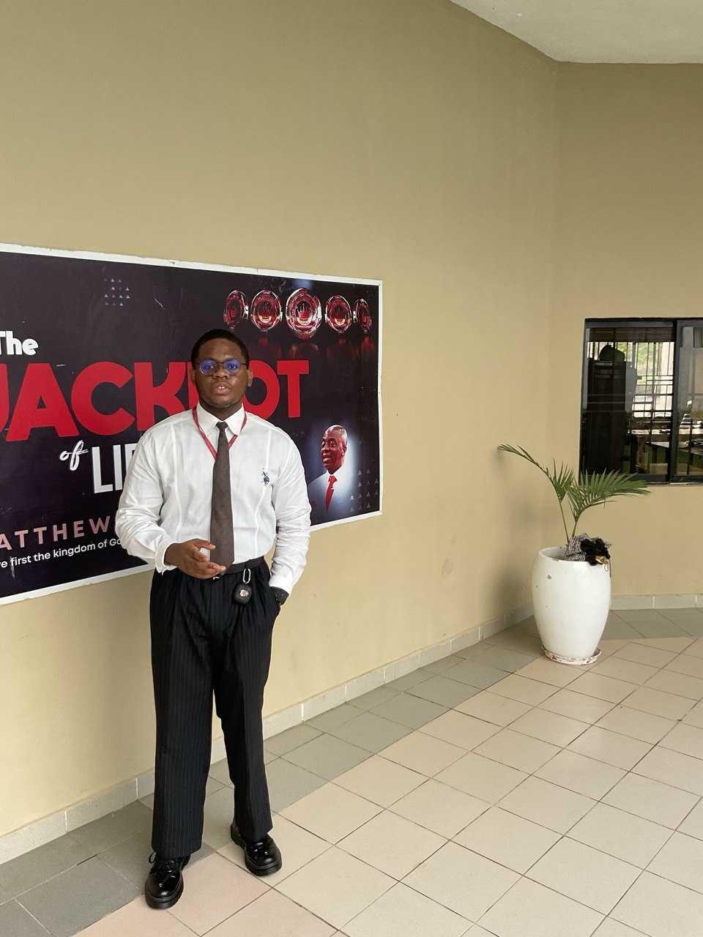
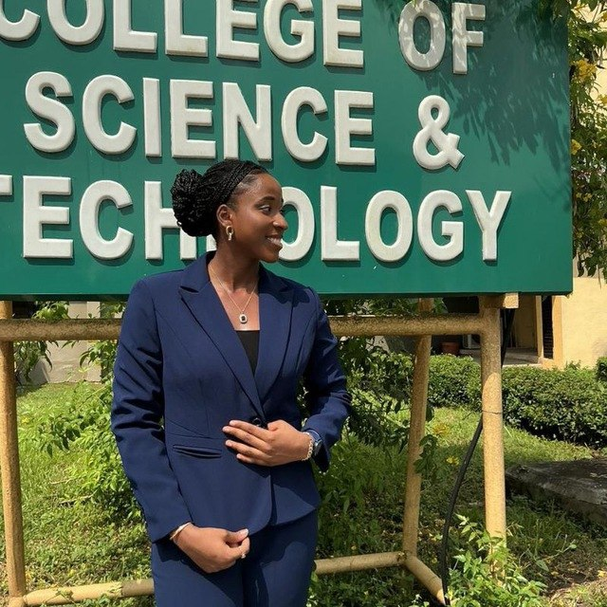
IHESIULO AKUNNA COMFORT
FOUNDER
EKEMEZIE EMMANUEL
SYSTEM ENGINEER
IKE VICTORIA
MATERIAL SCIENTIST
MMEKA DUBEM
FINANCIAL MANAGER
ADIGHIJE CHINONSO
DISTRIBUTION MANAGER

Slide 15
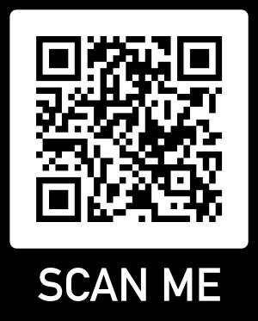

THANK YOU
JOIN US
LET’S CONVERT WASTE INTO FORTUNE

