Slide 1
Day 1

Slide 2
Evolution of Containers

Slide 3
Evolution of Containers
Client Requirement:
"We need to improve our application deployment process. Our current infrastructure is slow, resource-intensive, and difficult to scale. We have heard about virtualization and containers, but we are unsure which approach best fits our needs. Can you explain the evolution from traditional servers to virtualization and containers, highlighting the benefits and trade-offs of each?"

Slide 4
Traditional Physical Servers (Pre-Virtualization Era)
How It Works: Each application runs on a dedicated physical server with its own operating system and resources (CPU, RAM, storage).
Challenges:
Resource Inefficiency
Scalability Issues
High Maintenance Costs

Slide 5
Virtualization (Hypervisor-Based Approach)
How It Works: Virtualization introduces a hypervisor (e.g., VMware, Hyper-V, KVM) that allows multiple virtual machines (VMs) to run on a single physical server. Each VM has its own OS, libraries, and dependencies.
Benefits:
Better Resource Utilization
Faster Provisioning
Isolation
Challenges
Overhead
Slower Boot Time

Slide 6
Containers (Docker & Kubernetes)
How It Works: Containers virtualize at the application level rather than the OS level. A container runtime (e.g., Docker) allows applications and their dependencies to run in isolated environments, sharing the same OS kernel.
Benefits:
Lightweight
Fast Startup Time
Portability
Consistent

Slide 7
Virtual Machines v/s Container
Virtual Machine | Container
Separates OS from its underlying hardware | Separates application from its underlying OS
Heavy | Extremely lightweight
Requires their own guaranteed resources | Resources requirements are less
Takes a lot more time to start comparatively | Takes seconds to boot up and start running
Consumes large amount of CPU and memory which makes it complex for scaling | Provides faster results with less resource utilization
Can run different kernels on different guests | Containers use the same kernel

Slide 8
Introduction to Containerization with Docker

Slide 9
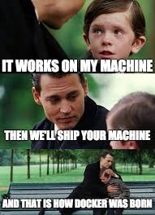
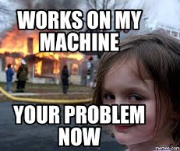

Slide 10
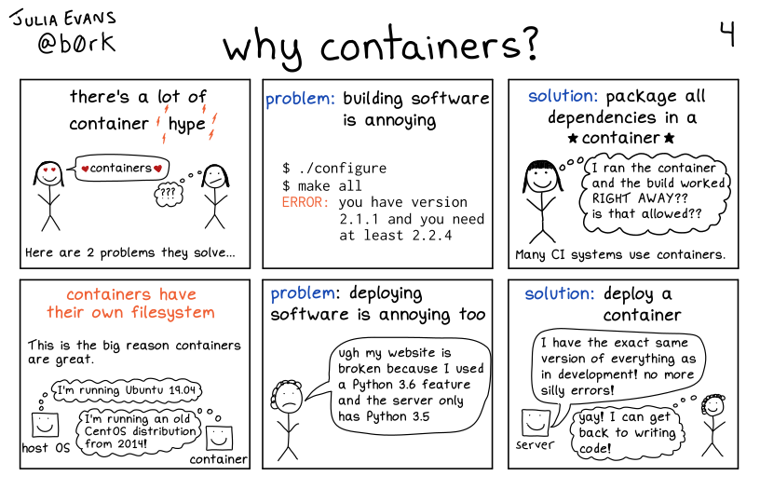
Why containers

Slide 11
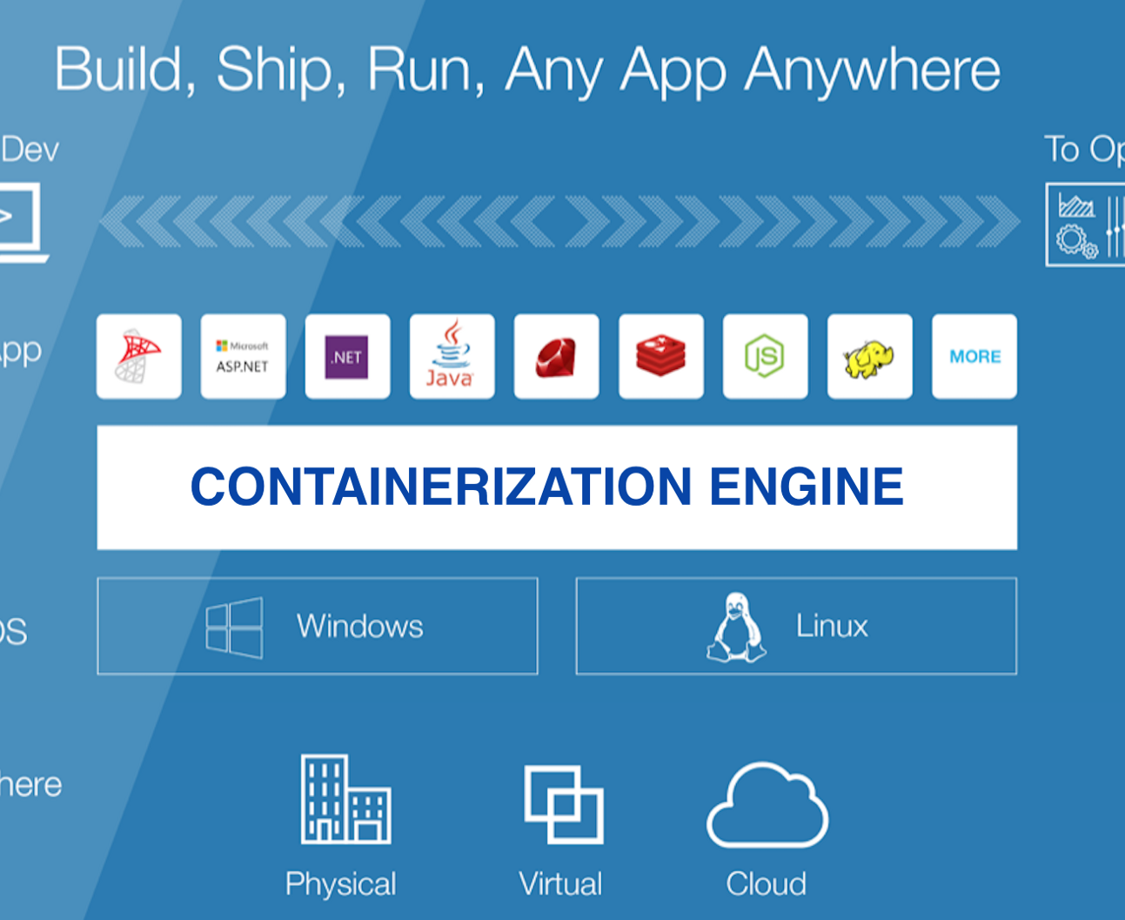
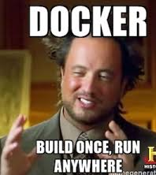
Docker

Slide 12
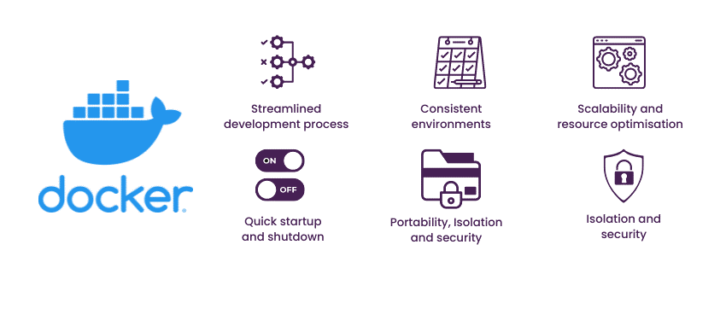

Slide 13
Docker Terminologies
Container
Container Runtime
Docker Image
Docker Registry

Slide 14
Why is Docker the Most Popular Container Engine?
Docker Engine
Simple CLI (docker run, build, ps) & Docker Desktop UI
All-in-one: image building, runtime, networking, storage, Docker Compose
Massive ecosystem (Docker Hub with 8M+ images, cross-platform, many integrations)
Podman
No built-in support for Docker Compose (uses podman-compose)
Less widely adopted than Docker
Fewer third-party integrations
Containerd
No built-in tools for building images (docker build equivalent)
Lacks CLI tools for easy container management
CRI-O
Not designed for standalone development or CI/CD
No built-in image-building tools (requires Buildah)

Slide 15
Docker Architecture

Slide 16
Docker Case Study
Hotstar → Used Docker & Kubernetes to handle massive traffic spikes.
Amazon → Migrated to Docker-based microservices for scalability.
PayPal → Standardized development environments with Docker.
Spotify → Managed large-scale microservices efficiently with Docker & Kubernetes.

Slide 17
Lab 1 - Demo

Slide 18
Day 1 - Summary
Evolution of containers
Virtual Machine vs Containers
Terminologies: Container, Container Runtime, Container Image
Introduction to Docker
Docker vs other tools
Docker Architecture
Why Docker - Advantages
Features, Uses, Properties of Containers
Real time use cases for docker - Amazon, hotstar
Lab 1

Slide 19
Day 2

Slide 20
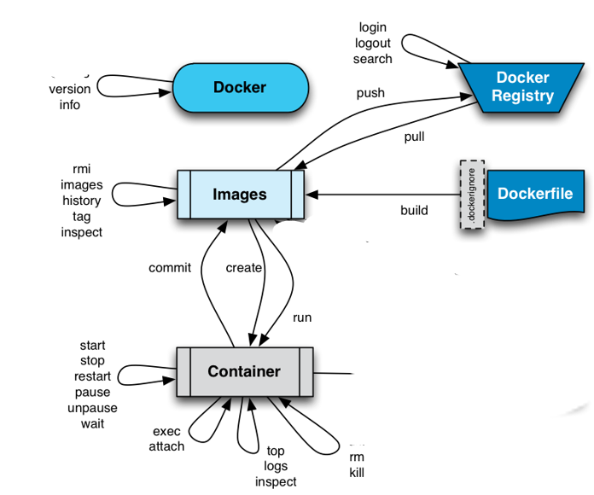

Slide 21


Port Mapping
Host Port : Container Port
Container 1 Web App
Host Port
Container Port
Host Machine IP : Host Port
x.x.x.x
Host Machine
x.x.x.x

Slide 22
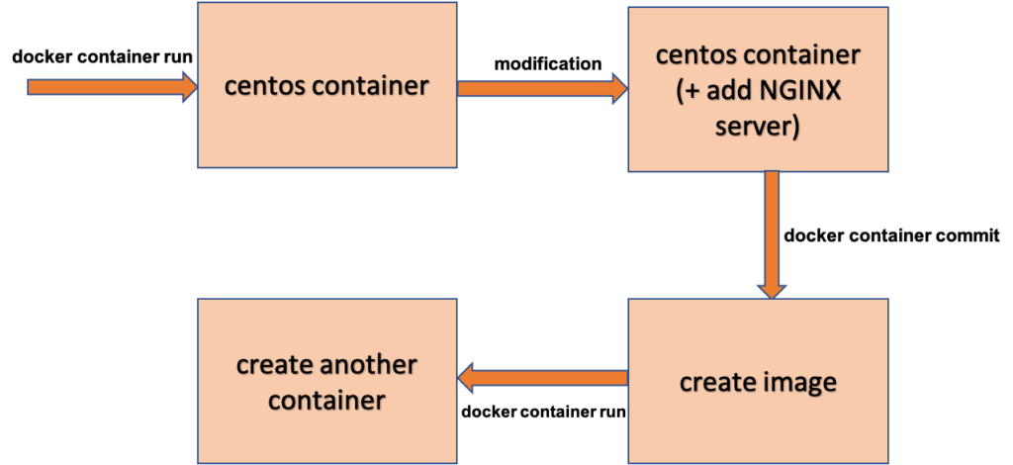
Docker Commit

Slide 23
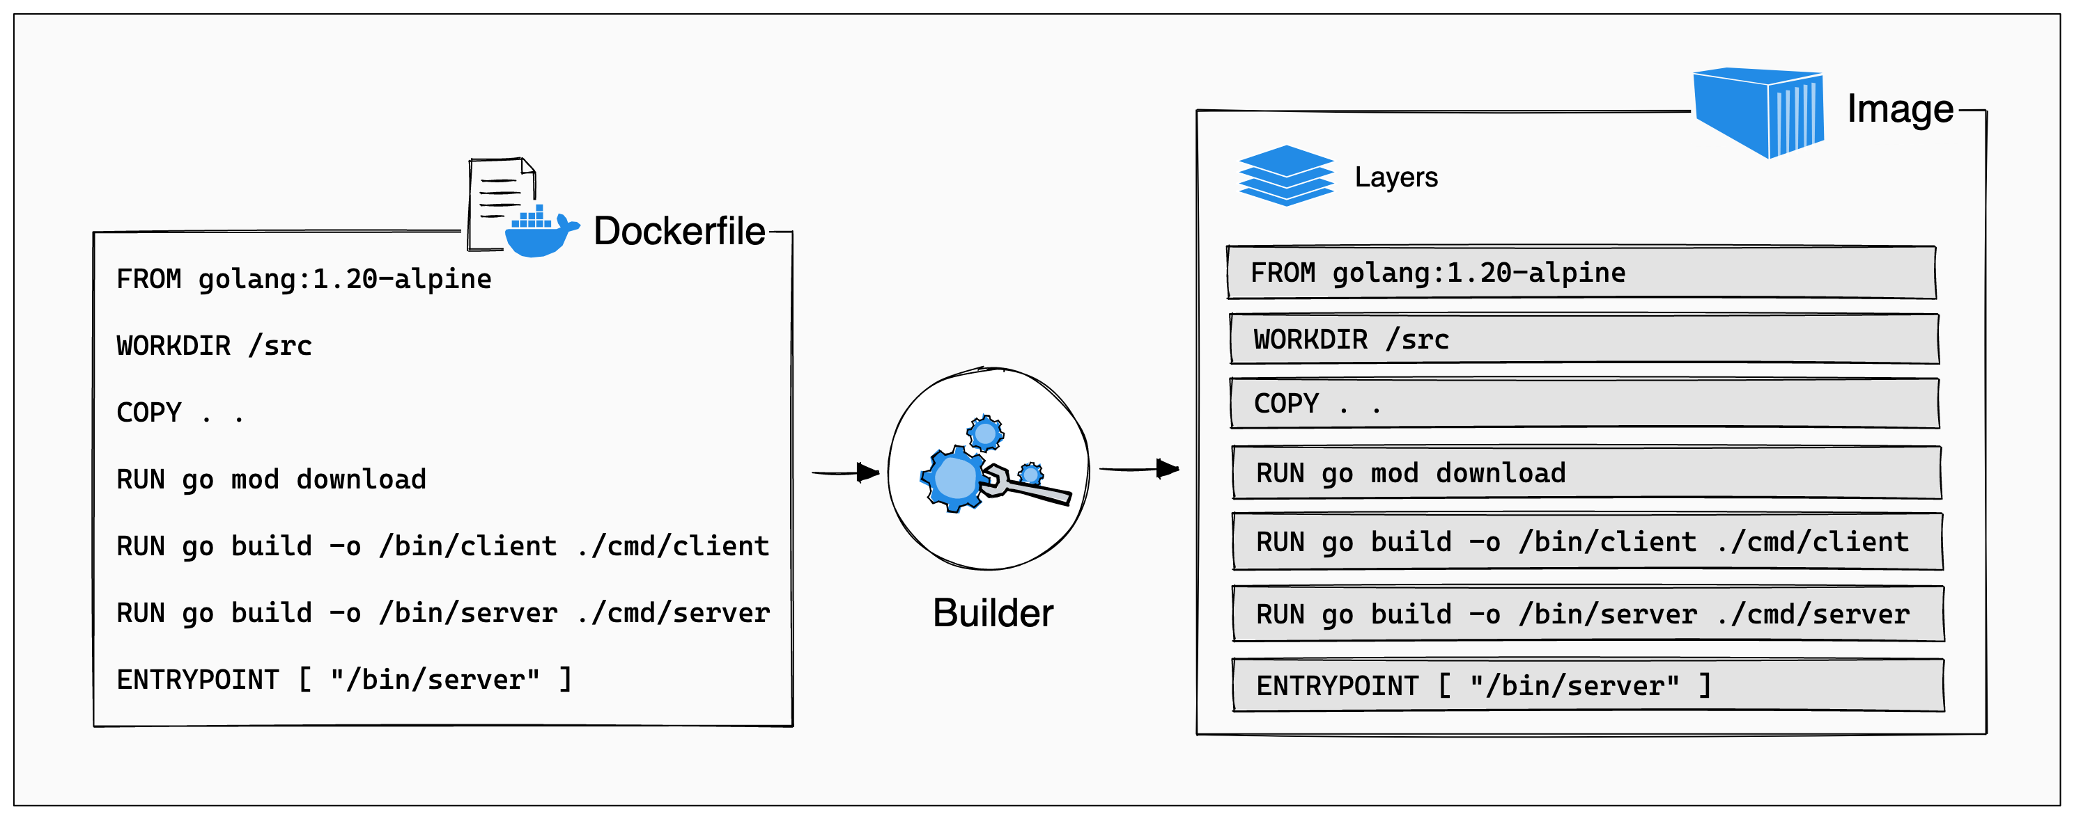

Slide 24
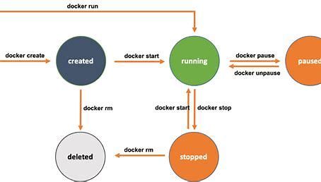

Slide 25
Docker Images
Docker Image is an inert, immutable file
Is a snapshot of a container
Images are made up of RO layers
Images are versioned using tags
Docker run creates a Container from a given Image

Slide 26
Docker Containers
Containers are read-write layer on top of an Image
Containers use copy-on-write (CoW) strategy
Read-write layer will hide the underlying file, but will not destroy it
When a container is deleted, all the changes made will be lost
Unless user creates another read-only layer (i.e. new image)

Slide 27
Docker Image Commands
Build / Pull
Create / Download a docker image
Create a container from the image
Save container as image
Upload image to central repository
Stop the container
Delete a container
Run
Commit
Push
Stop
Remove

Slide 28
Day 2 - Summary
Docker Commands
Docker Lifecycle
Primary & Secondary Shell
Port Mapping
Docker Commit
Docker images - COW
Lab 2,3

Slide 29
Lab 2,3 - Demo

Slide 30
Day 3

Slide 31
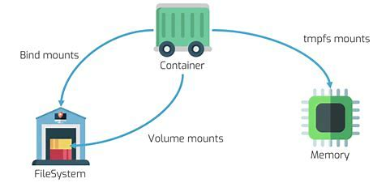
Data Persistence - Docker
Volumes
Mount Point

Slide 32
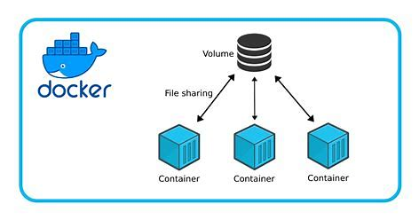

Slide 33
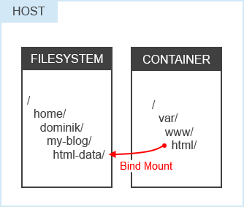
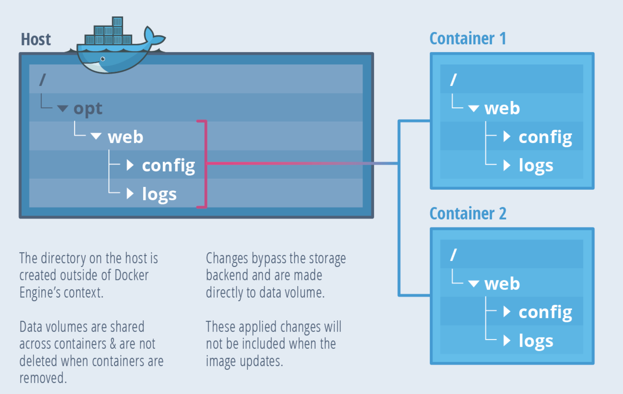
Bind Mount
-v srcpath:destpath
--mount type=bind src,target
Source: TheNewStack

Slide 34
Use Cases
A bind mount in Docker is a way to link a directory or file on the host machine to a directory or file in a container. This allows the container to access and modify the files on the host system directly.
Bind mounts link a specific path on the host to a path in the container.
Flexibility: They can be used for various purposes, such as sharing configuration files, source code, or logs between the host and the container.
Bind mounts can offer better performance compared to Docker volumes, especially for development environments where frequent file changes occur.
Usage: To use a bind mount, you specify the -v or --mount flag in the docker run command, followed by the source and destination paths.
Example command:
docker run -v /path/on/host:/path/in/container my-image

Slide 35
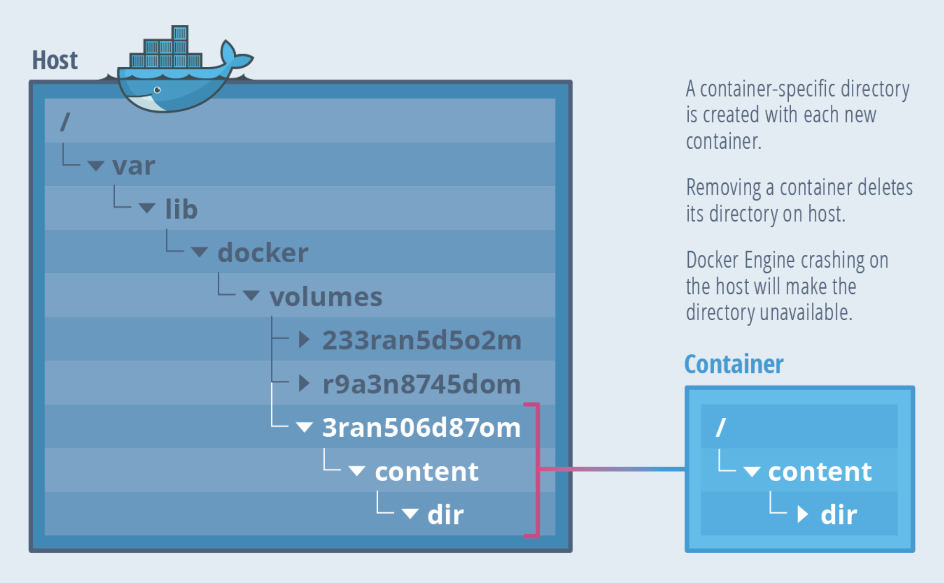
Volume Mount
Volumes are managed by Docker
Isolated from other services of host machine

Slide 36
Docker Volumes
Advantages:
Easy backup and migration
Easy to manage using Docker CLI and Docker API
Single volume can be shared across multiple containers
Supports both Linux and Windows environments
Commands:
docker volume create sample-vol
docker volume ls
docker volume inspect sample-vol
docker volume rm sample-vol

Slide 37
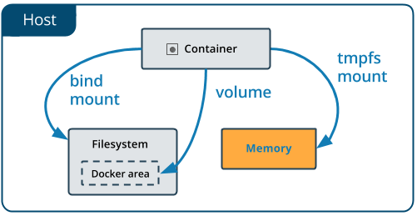
tmpfs Mount
Linux only feature
When the container stops, the tmpfs mount is removed, and files written there won’t be persisted
Cannot share between containers
Source: http://docs.docker.com

Slide 38
tmpfs Mount
tmpfs is a temporary mount between container and the host system’s memory
tmpfs mount doesn’t provide data persistency
The mount is removed when the container stops, and the files will not be persisted.
Files are created outside containers writable layer and are not stored in the host filesystem

Slide 39
Use Cases
If you don’t want your data to be persisted
If you have “secure data” that must be erased on stopping the container
If your application needs to process huge amount of data with maximum performance

Slide 40
Docker Volumes
docker run -v /path/on/host:/path/in/container my-image
docker run –d –p 80:80 –name test2 –mount src,dest nginx
docker run –d –it –-name test3 --mount type=tmpfs,destination nginx

Slide 41
Labs
Lab 4:
Volume Mount lab
Lab 5:
Bind Mount lab
Lab 6:
tmpfs lab

Slide 42
Day 4

Slide 43
Docker Networking

Slide 44
Docker Networks
Docker by default, provides three types of networks :
none
host
bridge
$ docker network ls
NETWORK ID NAME DRIVER
7fca4eb8c647 bridge bridge
9f904ee27bf5 none null
cf03ee007fb4 host host

Slide 45
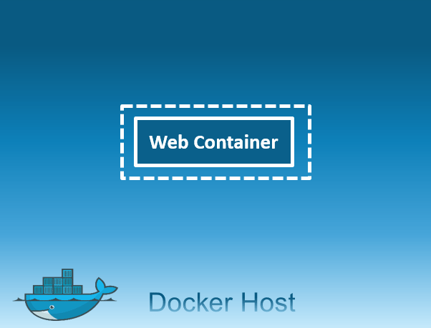
Network Flag: none
Container will not have access to any external routes
Container doesn’t have access to any other containers as well
Container will only have a local loopback interface
Example:
docker run -it --name=test2 --net=none ubuntu /bin/bash

Slide 46
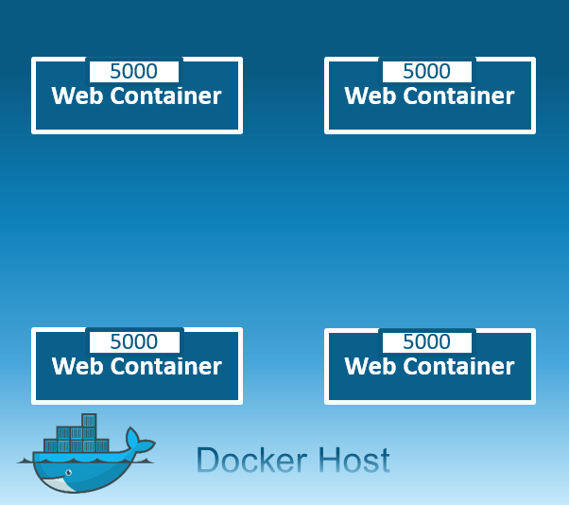
Network Flag: host
Share the host’s network stack and all interfaces
Full access to local network services and is therefore considered insecure
The container’s host name will match the host name on the host system
Example:
docker run -it --name=test2 --net=host ubuntu /bin/bash

Slide 47
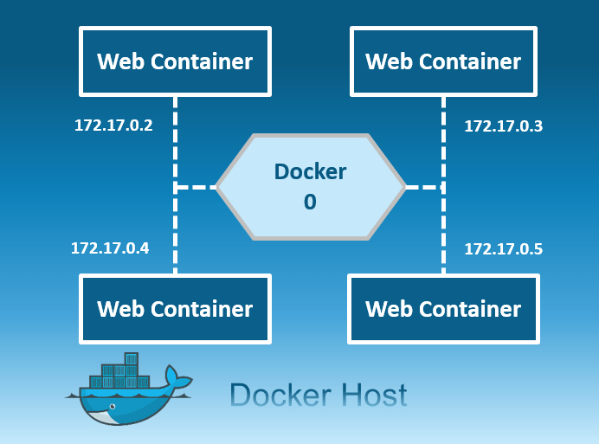
Network Flag: bridge
Connect the container to the bridge via veth interfaces
Automatically created when docker starts
docker0 is the default bridge network
Example:
$ docker run -it --name=test2 ubuntu /bin/bash
$ docker network inspect bridge

Slide 48
Default Network
docker0 created automatically on the host machine and docker run adds containers to this network
Docker creates a subnet and gateway for the bridge network
Subnet CIDR block selected randomly from a private range that are not in use on host machine
The network itself isolates the containers from external networks
Note:
Docker does not support automatic service discovery on default bridge
We can ping to container in same network
We can ping external network like google.com

Slide 49
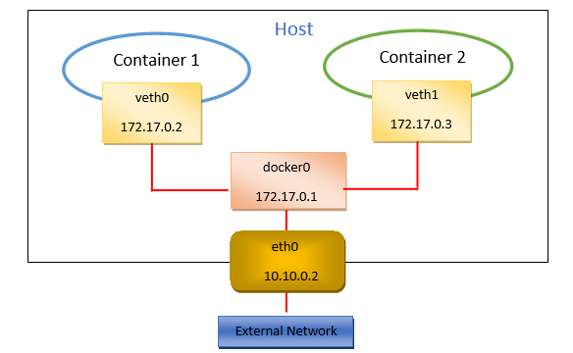
Docker0 Bridge Network

Slide 50
Dockerfile

Slide 51
Docker Images
Been using pre-built images
What if we need custom images ?
Run base container, update, upgrade and install all required software, make an image
Drawbacks ?
Why not ‘code’ our custom image and build it ?
Dockerfile

Slide 52
Dockerfile
Dockerfile is a text document that contains a list of instructions a user could call on the command line to assemble an image
INSTRUCTION arguments
Docker can build images automatically by reading the instructions
docker build
Each line / instruction results in a separate RO layer

Slide 53

Docker Image layers
$ docker image ls
compute hash
192 MB
FROM ubuntu:18.04
FROM ubuntu:18.04
72300a873c2c
1 MB
FROM ubuntu:18.04
RUN apt-get-update && apt install –y apache2
RUN apt-get-update && apt install –y httpd
b10f9aa98db
1 MB
COPY index.html /var/www/html
851356ecf618
CMD [“httpd-foreground”]
120 MB
CMD [“service apache2 start && sleep 3600”]
4176fe04cefe
70 MBc
4176fe04cefe
Dockerfile

Slide 54
Common Dockerfile Instructions
FROM
RUN
ENV
ADD / COPY
EXPOSE
ENTRYPOINT
CMD
https://docs.docker.com/engine/reference/builder/#usage

Slide 55
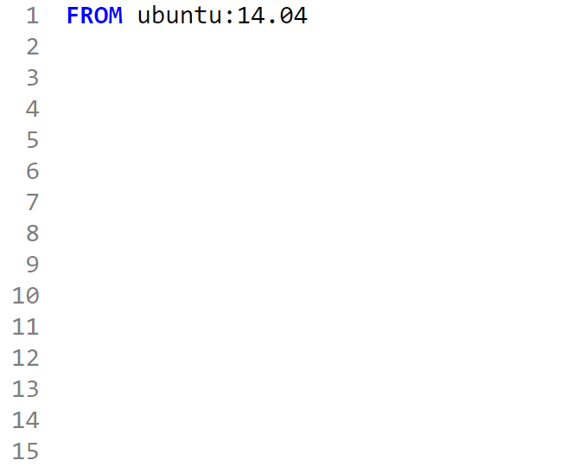
FROM
Must start with FROM
Specifies the Base Image from which you are building
Base image on which the subsequent instructions will be executed
Pulls image from public registry, if no registries are mentioned

Slide 56
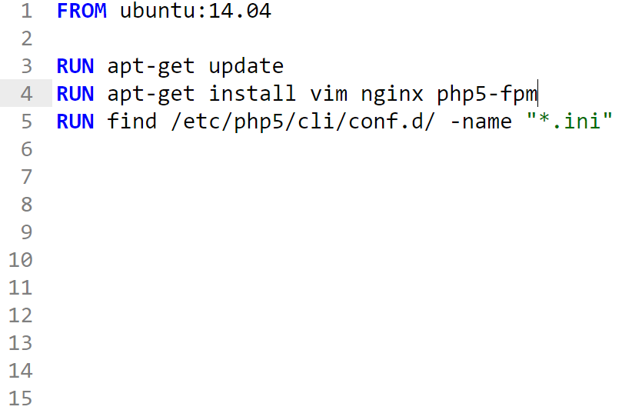
RUN
RUN instruction will execute any commands in a new layer on top of the current image and commit the results.

Slide 57
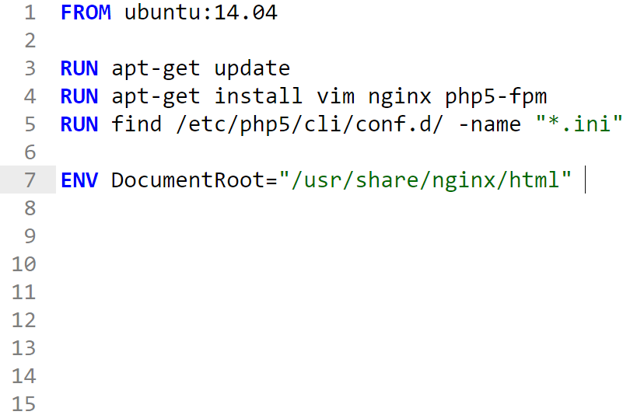
ENV
ENV instruction sets the environment variable <key> to the value <value>.
This value will be used in the environment for all subsequent instructions in the Dockerfile

Slide 58
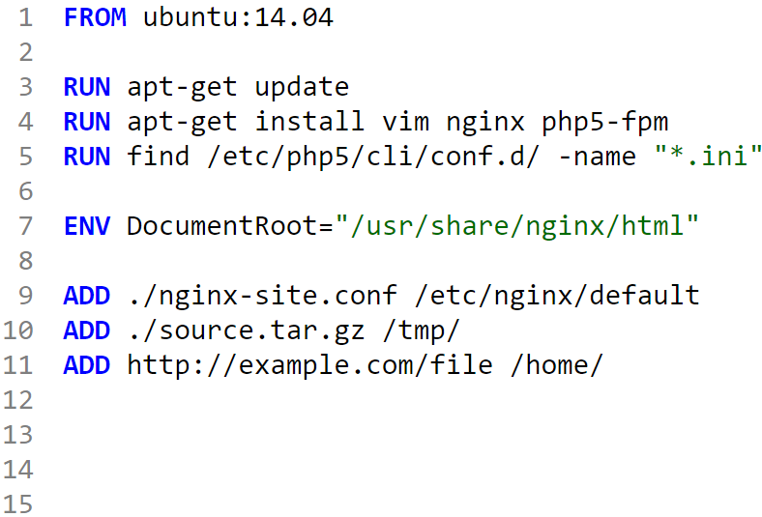
ADD/COPY
Copies file from a source path to a destination path in the container
Some compressed formats will be uncompressed
Source can be a URL as well
COPY can also be used for copying files/directory from host

Slide 59
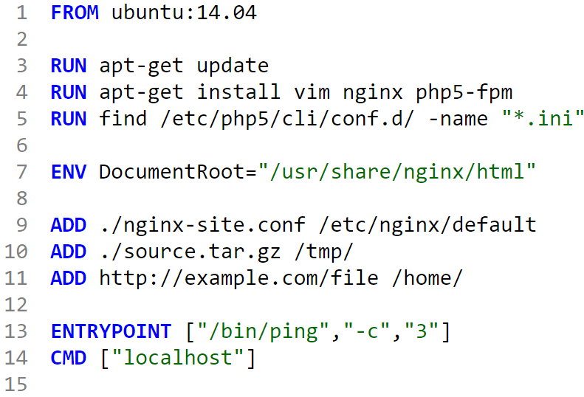
ENTRYPOINT
ENTRYPOINT allows you to configure a container that will run as an executable
Execute and Shell format
ENTRYPOINT ["executable", "param1", "param2"] (exec form, preferred)
ENTRYPOINT command param1 param2 (shell form)
Only the last ENTRYPOINT instruction in the Dockerfile will have an effect

Slide 60
CMD
Main purpose of a CMD is to provide defaults for an ENTRYPOINT
3 Forms
Only the last CMD instruction in the Dockerfile will have an effect

Slide 61
ENTRYPOINT and CMD
Both CMD and ENTRYPOINT instructions define what command gets executed when running a container
There are few rules that describe their co-operation:
Dockerfile should specify at least one of CMD or ENTRYPOINT commands
ENTRYPOINT should be defined when using the container as an executable
CMD should be used as a way of defining default arguments for an ENTRYPOINT command
CMD will be overridden when running the container with alternative arguments
https://docs.docker.com/engine/reference/builder/#cmd
https://docs.docker.com/engine/reference/builder/#entrypoint

Slide 62
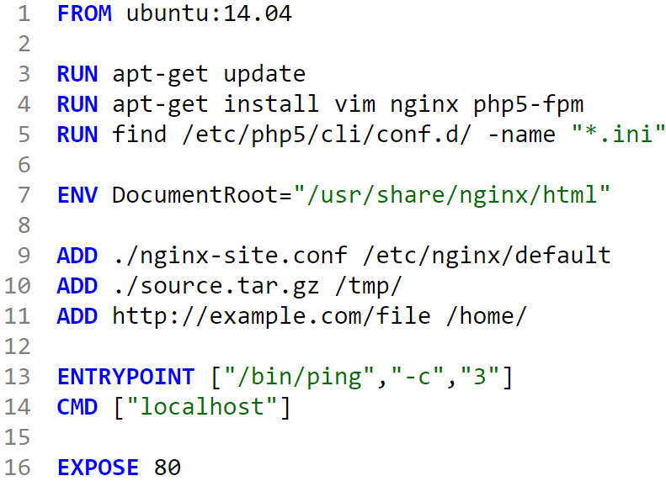
EXPOSE
EXPOSE instruction informs Docker that the container listens on the specified network ports at runtime.
You can specify protocol as well

Slide 63
Docker build
Build an image on the host using Dockerfile
$ docker build -t repo/myapp .
$ docker build -t repo/myapp -f /path/to/a/Dockerfile .

Slide 64
DockerHub

Slide 65
DockerHub
Docker Hub is a cloud-based repository where you can create, test, store, and distribute Docker container images.
It's widely used for sharing containerized applications and collaborating with others.
Steps to Push an Image to Docker Hub
Sign in to Docker Hub and log in via Docker CLI.
Create a Docker image using a Dockerfile.
Tag the Docker image with your Docker Hub username and repository name.
Push the image to Docker Hub using the docker push command.
Verify the image on Docker Hub.

