Slide 1
Day 1

Slide 2
Evolution of Containers

Slide 3
Evolution of Containers
Client Requirement:
"We need to improve our application deployment process. Our current infrastructure is slow, resource-intensive, and difficult to scale. We have heard about virtualization and containers, but we are unsure which approach best fits our needs. Can you explain the evolution from traditional servers to virtualization and containers, highlighting the benefits and trade-offs of each?"

Slide 4
Traditional Physical Servers (Pre-Virtualization Era)
How It Works: Each application runs on a dedicated physical server with its own operating system and resources (CPU, RAM, storage).
Challenges:
Resource Inefficiency
Scalability Issues
High Maintenance Costs

Slide 5
Virtualization (Hypervisor-Based Approach)
How It Works: Virtualization introduces a hypervisor (e.g., VMware, Hyper-V, KVM) that allows multiple virtual machines (VMs) to run on a single physical server. Each VM has its own OS, libraries, and dependencies.
Benefits:
Better Resource Utilization
Faster Provisioning
Isolation
Challenges
Overhead
Slower Boot Time

Slide 6
Containers (Docker & Kubernetes)
How It Works: Containers virtualize at the application level rather than the OS level. A container runtime (e.g., Docker) allows applications and their dependencies to run in isolated environments, sharing the same OS kernel.
Benefits:
Lightweight
Fast Startup Time
Portability
Consistent

Slide 7
Virtual Machines v/s Container
Virtual Machine | Container
Separates OS from its underlying hardware | Separates application from its underlying OS
Heavy | Extremely lightweight
Requires their own guaranteed resources | Resources requirements are less
Takes a lot more time to start comparatively | Takes seconds to boot up and start running
Consumes large amount of CPU and memory which makes it complex for scaling | Provides faster results with less resource utilization
Can run different kernels on different guests | Containers use the same kernel

Slide 8
Introduction to Containerization with Docker

Slide 9
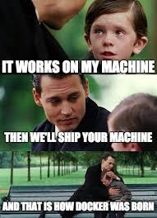
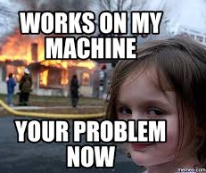

Slide 10
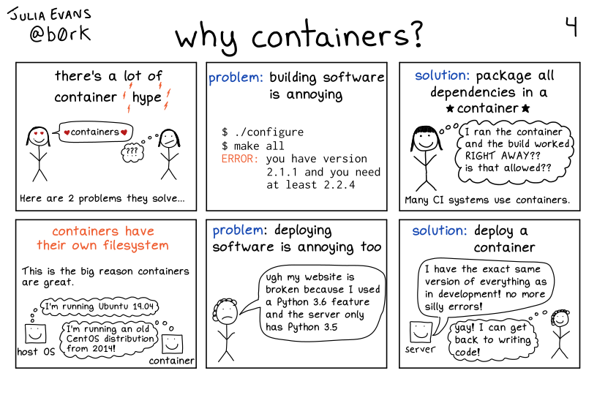
Why containers

Slide 11
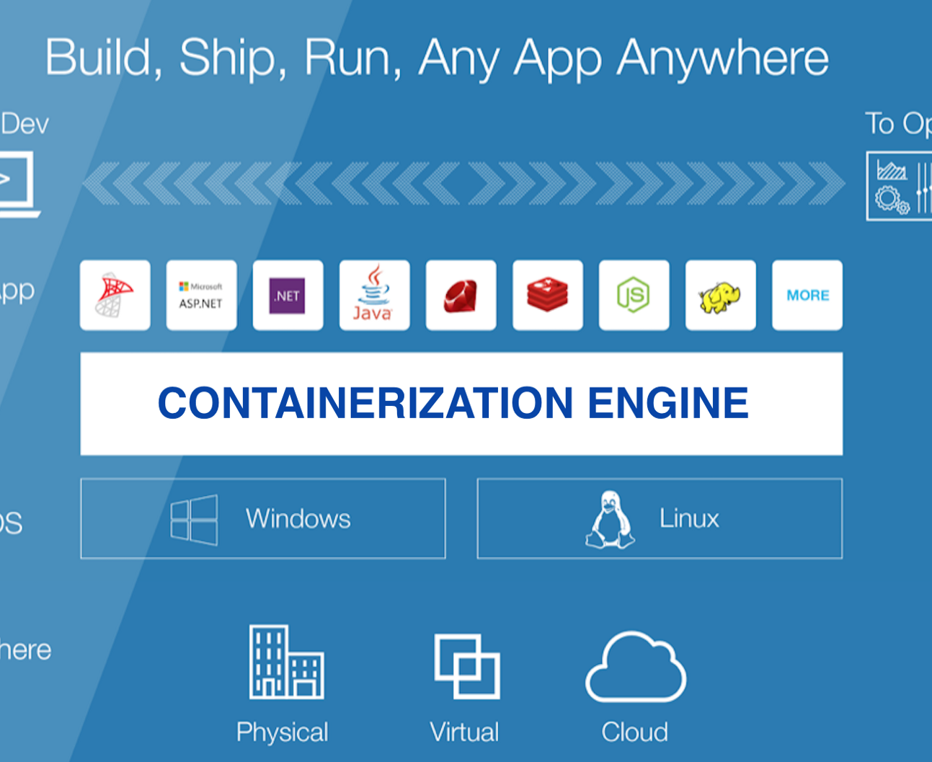
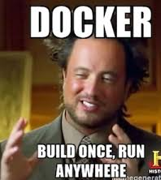
Docker

Slide 12
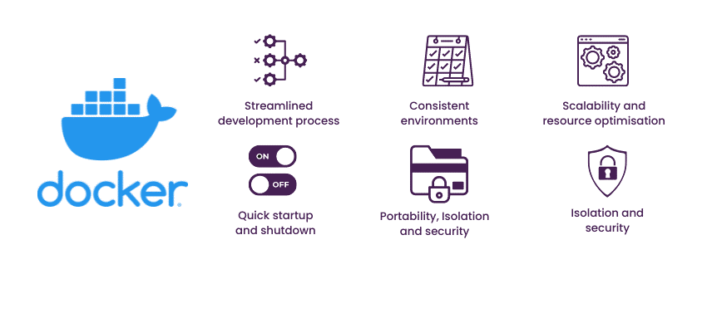

Slide 13
Docker Terminologies
Container
Container Runtime
Docker Image
Docker Registry

Slide 14
Why is Docker the Most Popular Container Engine?
Docker Engine
Simple CLI (docker run, build, ps) & Docker Desktop UI
All-in-one: image building, runtime, networking, storage, Docker Compose
Massive ecosystem (Docker Hub with 8M+ images, cross-platform, many integrations)
Podman
No built-in support for Docker Compose (uses podman-compose)
Less widely adopted than Docker
Fewer third-party integrations
Containerd
No built-in tools for building images (docker build equivalent)
Lacks CLI tools for easy container management
CRI-O
Not designed for standalone development or CI/CD
No built-in image-building tools (requires Buildah)

Slide 15
Docker Architecture

Slide 16
Docker Case Study
Hotstar → Used Docker & Kubernetes to handle massive traffic spikes.
Amazon → Migrated to Docker-based microservices for scalability.
PayPal → Standardized development environments with Docker.
Spotify → Managed large-scale microservices efficiently with Docker & Kubernetes.

Slide 17
Lab 1 - Demo

Slide 18
Day 1 - Summary
Evolution of containers
Virtual Machine vs Containers
Terminologies: Container, Container Runtime, Container Image
Introduction to Docker
Docker vs other tools
Docker Architecture
Why Docker - Advantages
Features, Uses, Properties of Containers
Real time use cases for docker - Amazon, hotstar
Lab 1

Slide 19
Day 2

Slide 20
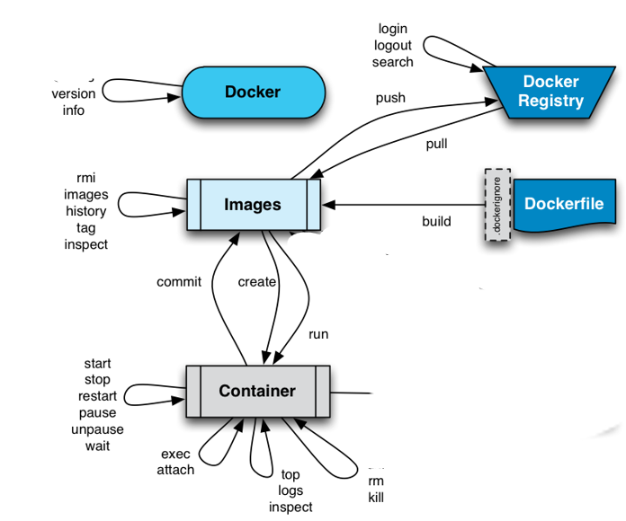

Slide 21


Port Mapping
Host Port : Container Port
Container 1 Web App
Host Port
Container Port
Host Machine IP : Host Port
x.x.x.x
Host Machine
x.x.x.x

Slide 22
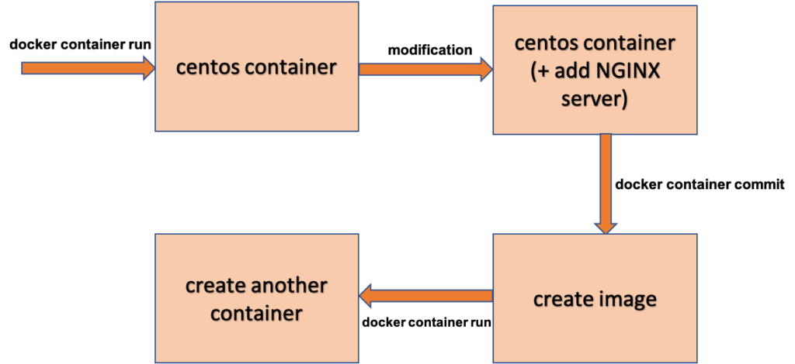
Docker Commit

Slide 23
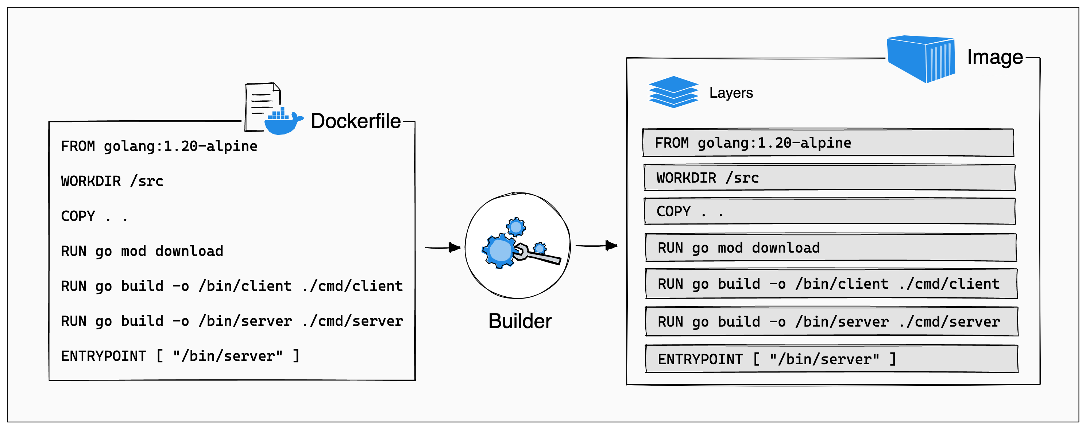

Slide 24
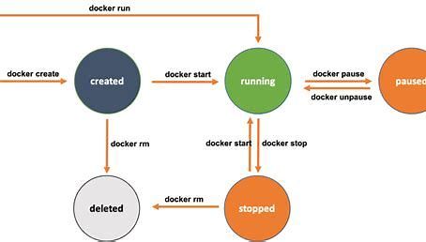

Slide 25
Docker Images
Docker Image is an inert, immutable file
Is a snapshot of a container
Images are made up of RO layers
Images are versioned using tags
Docker run creates a Container from a given Image

Slide 26
Docker Containers
Containers are read-write layer on top of an Image
Containers use copy-on-write (CoW) strategy
Read-write layer will hide the underlying file, but will not destroy it
When a container is deleted, all the changes made will be lost
Unless user creates another read-only layer (i.e. new image)

Slide 27
Day 2 - Summary
Docker Commands
Docker Lifecycle
Primary & Secondary Shell
Port Mapping
Docker Commit
Docker images - COW
Lab 2,3

Slide 28
Lab 2,3 - Demo

