Slide 1
Javascript-based SBGN tools: Newt/SBGNViz.js and libSBGN.js
Presented by: Augustin Luna
Dana-Farber Cancer Institute
aluna@jimmy.harvard.edu

Slide 2

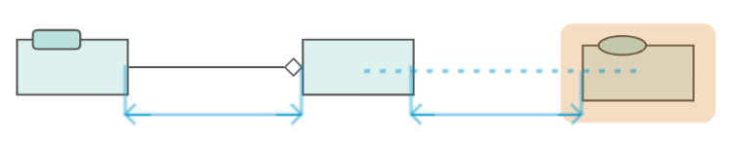
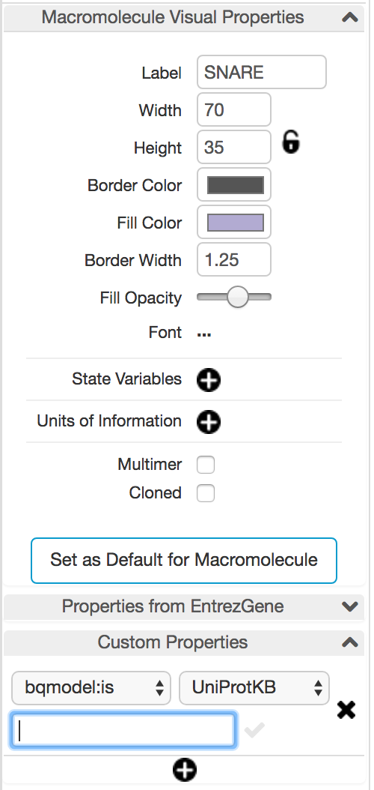
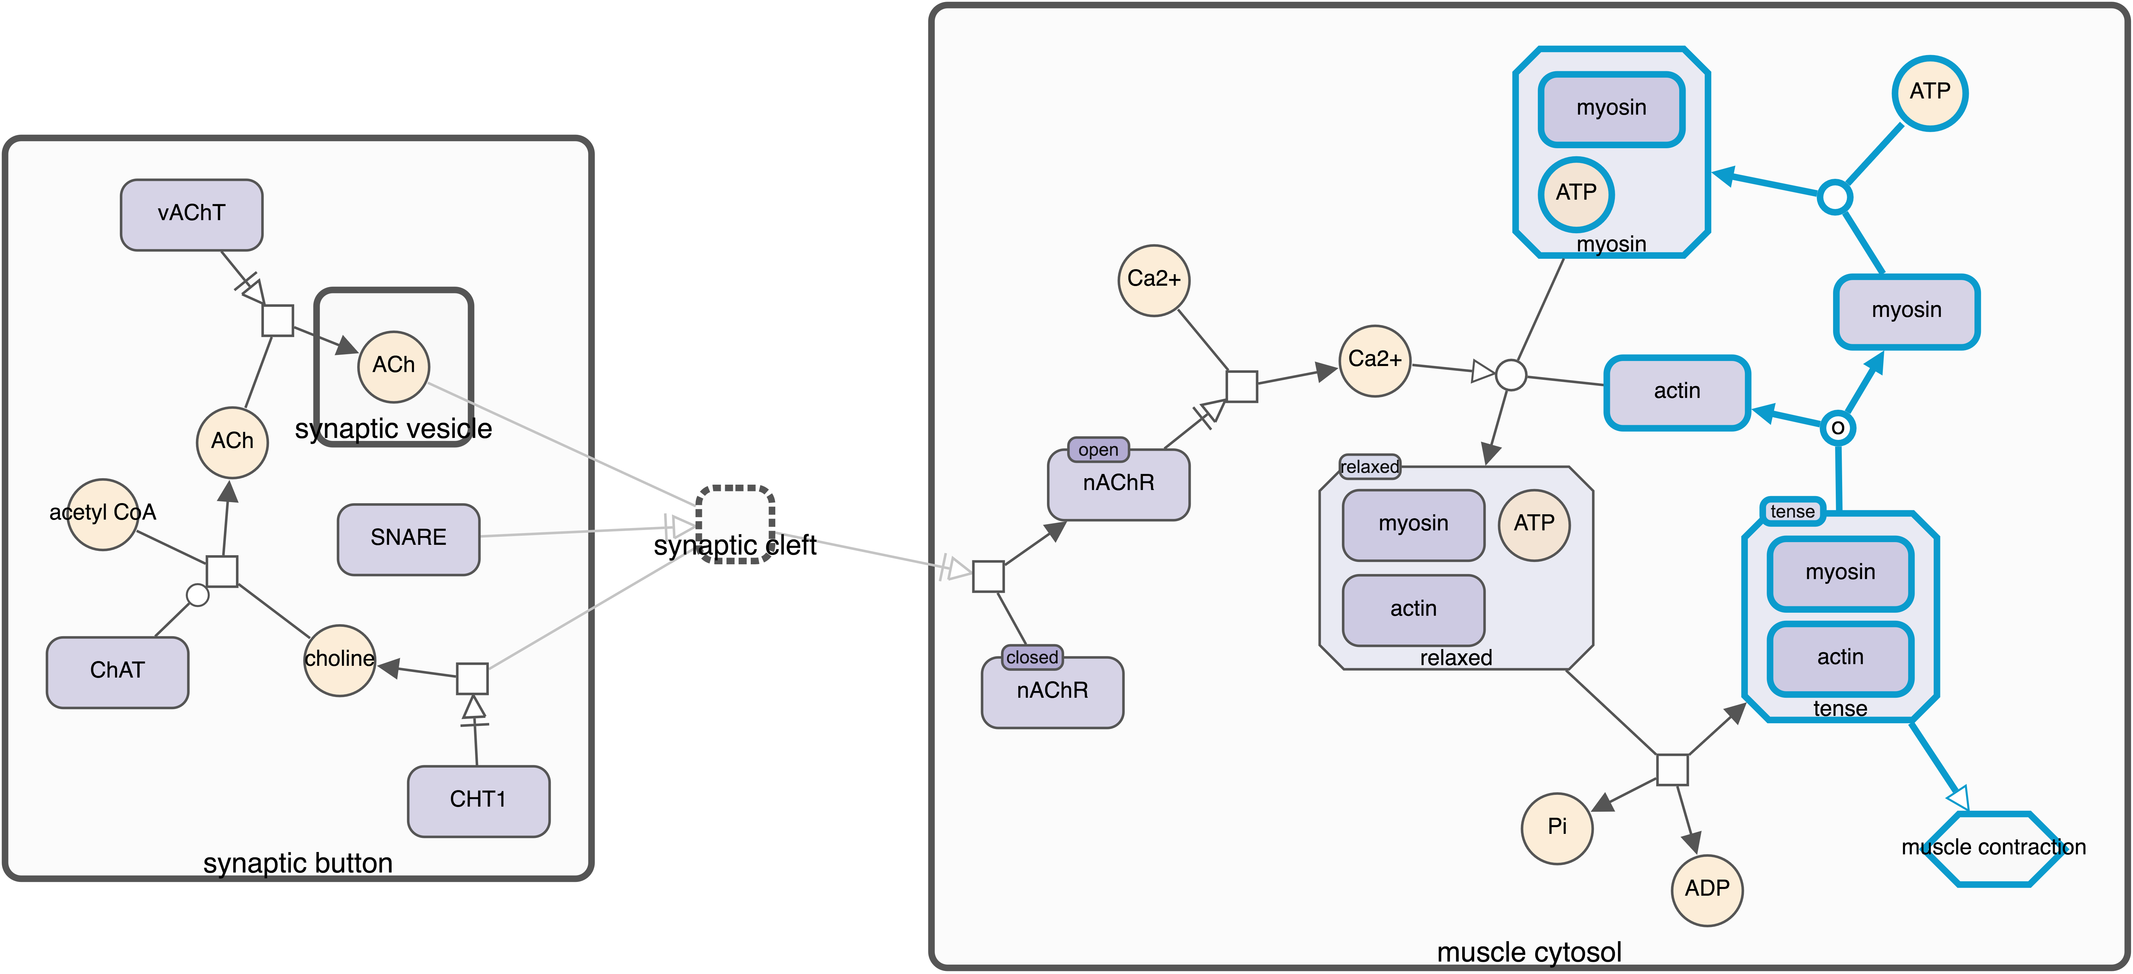
a web viewer & editor for SBGN maps
Full automated global and incremental layout support for compound structures
Alignment and distance guideline support
PD and AF support
Collapsed compartments/complexes and hidden neighborhood for complexity management
Highlight, search by label facilities
Query and visualize PathwayCommons
SBGN import/export
Object inspection and annotation
Code Repos: https://github.com/iVis-at-Bilkent/newt; https://github.com/PathwayCommons/pathways-search;
Notes:
Newt is a new open source, web based viewer and editor for SBGN maps.
SBGN maps (PD and AF) can be imported from SBGML or exported to SBGNML or as images (PNG, JPG; SVG coming soon)
SBGN glyphs can be inspected, interactively edited and annotated
Part of the map can be highlighted
Objects may be searched by label
Full support for compound structures (compartments and complexes) including automatic layout
Complexity management (expand-collapse and hide-show) support with incremental layout (rearrangement)
Alignment and distance guidelines for convenient manual layout of glyphs
Querying support for maps in PathwayCommons

Slide 3

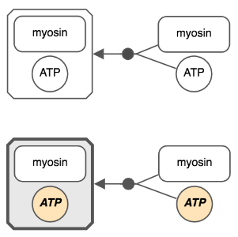
libsbgn.js
Alpha
Aims to be fully compliant with SBGN specification
Used in Newt / SBGNViz
Repo: https://github.com/eisbm/libsbgn.js
var libsbgnjs = require('libsbgn.js');
// parsing
var sbgn = libsbgnjs.Sbgn.fromXML(sbgnml);
var glyphs = sbgn.map.glyphs; // -> [glyph1, glyph2...]
// serializing
var sbgnml = sbgn.toXML();
SBGN-ML
+ Annotation extension (based on SBML)
+ Render extension (based on SBML)
Can store metadata through RDF using:
MIRIAM resources
BioModels.net qualifiers
…
And arbitrary key-value properties!
Allows to attach any kind of data to any
SBGN element.
Can store:
Fonts
Colors
Line width
Text alignment

Slide 4
Acknowledgements
libsbgn.js
Ludovic Roy (EISBM)
Alexander Mazein (EISBM)
Pathway Commons Viewer
Max Franz (U Toronto)
Dylan Fong (U Toronto)
Igor Rodchenkov (U Toronto)
Gary Bader (U Toronto)
Chris Sander (DFCI)
sbgnviz.js
Metin Can Siper (Bilkent U)
Istemi Bahceci (Bilkent U)
Ugur Dogrusoz (Bilkent U)
Emek Demir (OHSU)

