Slide 1
Semantic Annotations for COMBINE

Slide 2
The Plan
Plans are useless, but planning is indispensable

Slide 3
The Plan
Plans are useless, but planning is indispensable
Definitions / The Vision
Goals of a working group on Semantic Annotation
Summary of work toward Nature BioTech position paper
Demo of SemGen as one example

Slide 4
Semantic Annotation
What?
Encoding the biological meaning of model or data elements
A “glossary”, linking terms to knowledge resources
Why?
Language independent knowledge representation
Improved comprehension and search
Model merging

Slide 5
Vision
Knowledge resources
Source code
Annotations

Slide 6
Vision
Knowledge resources
Source code
Annotations

Slide 7
Vision
Knowledge resources
Source code
Annotations
Notes:
Knowledge resources include ChEBI, FMA, OPB, GO, Uniprot, SNOMED, etc.

Slide 8

Vision
Source code
Annotations
COMBINE Archive

Slide 9
Vision: Data Annotation?
Data file
Annotations
Is this what NuML does?
COMBINE Archive

Slide 10
Vision
Source code
Annotations
COMBINE Archive

Slide 11


Vision
Source code
Annotations
COMBINE Archive

Slide 12
Vision
Benefits:
Language agnostic: SBML, CellML, NeuroML, MATLAB
Enables intelligent search
Enables model merging
Matches models to Data
IF we develop a significant library of annotated models.
Notes:
Put in a “GASP, even Matlab??”

Slide 13
Proposal: A working group
Annotation working group goals:
Develop that seed library of annotated models
Promote a more consistent approach to annotation
Develop a software library for tool builders (that would leverage COMBINE archives)
Explore automation and semi-automation of annotation
Establish which resources should be used for which entities.

Slide 14
Nature BioTech submission
Leads: Max Neal & Dagmar Waltemath
Currently 24 authors
Complete draft exists; discussed yesterday
Perspective pieces are “normally” < 3000 wds
Notes:
Presubmission inquity last Sept, received the green light on Sept 21
Currently at 24 authors.
Received a lot of email comments from many of these co-authors
Our current draft is at 6300 words.

Slide 15
Nature BioTech submission
Leads: Max Neal & Dagmar Waltemath
Currently 24 authors
Complete draft exists; discussed yesterday
Perspective pieces are “normally” < 3000 wds
Can’t include everything!
Notes:
Presubmission inquity last Sept, received the green light on Sept 21
Currently at 24 authors.
Received a lot of email comments from many of these co-authors
Our current draft is at 6300 words.

Slide 16
Submission content
Annotations are needed
Annotation standards are lacking
How do we get more annotation? Carrots and sticks…
Carrots:
Demonstrations of capabilities
??

Slide 17
Submission: Recommendations
Use RDF, identifiers.org and BioModels qualifiers
Put annotations in separate file (COMBINE Archives)
Document which knowledge resources to use
Ensure that annotations are re-usable
Create a software library

Slide 18
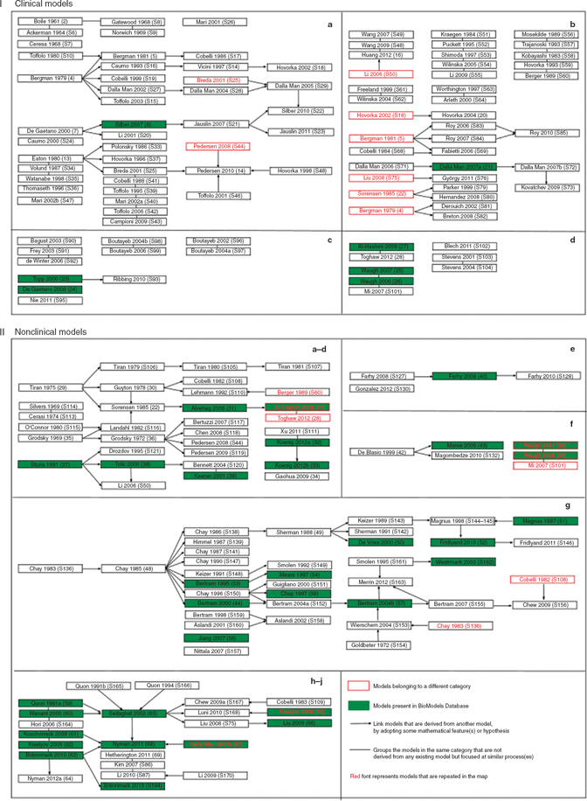
Model evolution
Versioning, extraction, merging of Beta cell electrophysiology models:
(From “The impact of mathematical modeling on the understanding of diabetes and related complications”, by Ajmera, Swat, Laibe, Le Novère and Chelliah, 2013)

Slide 19
Model evolutions
Versioning, extraction, merging of Beta Cell electrophysiology models:
(From “The impact of mathematical modeling on the understanding of diabetes and related complications”, by Ajmera, Swat, Laibe, Le Novère and Chelliah, 2013)

Slide 20
Example benefit: The Jiang – Pederson demo

Slide 21
Pedersen et al. 2005 beta cell model
Glucose
Glycolysis
Voltage-gated K⁺ channel
K_{ATP} channel
ATP
Voltage-gated Ca²⁺ channel
???
SERCA
Ca²⁺
Ca²⁺ leak
Calcium-activated K⁺ channel
Mitochondria
ER
Insulin granules
exocytosis
Pedersen MG, Bertram R, Sherman A. Intra- and Inter-Islet Synchronization of Metabolically Driven Insulin Secretion. Biophysical Journal, 89:107-119, 2005.
Notes:
Mention (failure of) reproducibility

Slide 22
Jiang et al. 2007 beta cell metabolism
Glucose
Glycolysis
NADH
Malate
Pyruvate
ATP
TCA
cycle
Resp. Chain
Mitochondria
Jiang N, Cox RD, Hancock JM. A kinetic core model of the glucose-stimulated insulin secretion network of pancreatic beta cells. Mammalian Genome. Jul;18(6-7):508-20, 2007.

Slide 23
Target beta cell model merge
Glucose
Glycolysis
Voltage-gated K⁺ channel
NADH
Malate
Pyruvate
K_{ATP} channel
ATP
TCA
cycle
Resp. Chain
Voltage-gated Ca²⁺ channel
SERCA
Ca²⁺
Ca²⁺ leak
Calcium-activated K⁺ channel
ER
Mitochondria
Insulin granules
exocytosis
pedersen_bertram_sherman_2005
Jiang et al. 2007 (BioModels #279)
Notes:
Preview this as goal earlier. Mention that is the only point of overlap. Does anyone know of a better BIOMD to use?

Slide 24
CellML + SBML composition
2. extract Pedersen transport dynamics
Pedersen
Pedersen
Pedersen
transport
CellML
SemSim
SemSim
Pedersen
transport
+Jiang
Pedersen
transport
+Jiang
Jiang
Jiang
SemSim
CellML
SBML
SemSim
1. create SemSim versions of models & annotate
4. encode merged model for simulation
3. merge SemSim models

Slide 25
Other ideas
What about the BiGG repository?
What about Reactome, BioCyc (via BioPAX)?

Slide 26
Discussion!

