Slide 1
The Distributions Package
Lucian Smith

Slide 2
Recap: Two things
Allows you to ‘overwrite’ a function definition to be a draw from a distribution
Allows you to annotate an element with information about its uncertainty (stdev, range, etc.)

Slide 3
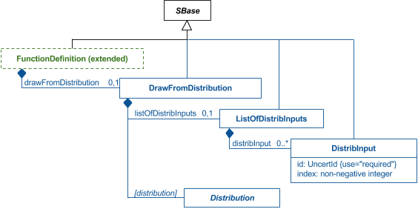
The Function Definition

Slide 4
The Function Definition
<functionDefinition id="normal">
<distrib:drawFromDistribution>
<distrib:listOfDistribInputs>
<distrib:distribInput distrib:id="mu" distrib:index="0"/>
<distrib:distribInput distrib:id="sdev" distrib:index="1"/>
</distrib:listOfDistribInputs>
<distrib:normalDistribution>
<distrib:mean distrib:var="mu"/>
<distrib:stddev distrib:var="sdev"/>
</distrib:normalDistribution>
</distrib:drawFromDistribution>
</functionDefinition>

Slide 5
The Function Definition
<initialAssignment symbol="x">
<math xmlns="http://www.w3.org/1998/Math/MathML">
<apply>
<ci> normal </ci>
<cn> 3 </cn>
<cn> 0.2 </cn>
</apply>
</math>
</initialAssignment>

Slide 6
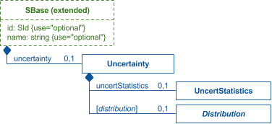
Extended SBase

Slide 7
Extended SBase
<species id="s1" compartment="C" initialAmount="3.22“
hasOnlySubstanceUnits="true"
boundaryCondition="false" constant="false">
<distrib:uncertainty>
<distrib:uncertStatistics>
<distrib:standardDeviation distrib:value="0.3"/>
</distrib:uncertStatistics>
</distrib:uncertainty>
</species>

Slide 8
What’s changed?

Slide 9
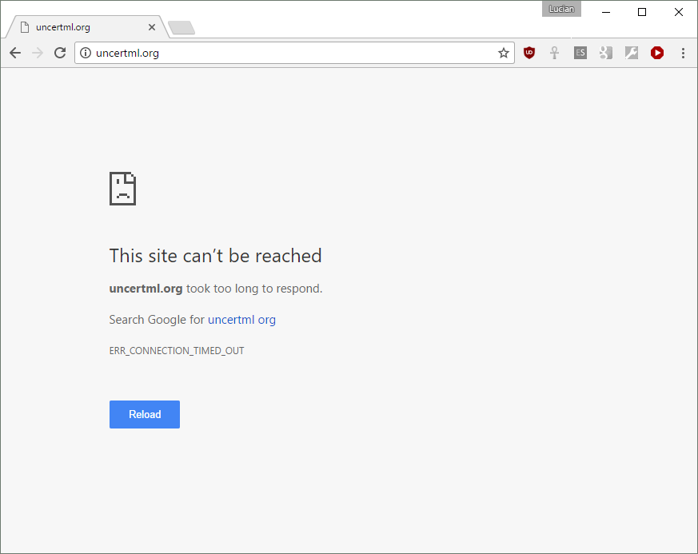
UncertML is dead!
(Long live UncertML)

Slide 10
Two Replacement Options:
Define particular distributions explicitly in the ‘distrib’ spec.
Define a way to reference externally-defined distributions (i.e. ProbOnto).

Slide 11
Solution: use both!
One set of ‘common’ distributions, defined in the spec itself.
An additional way to reference external definitions
Could reduce to only one if people wanted

Slide 12
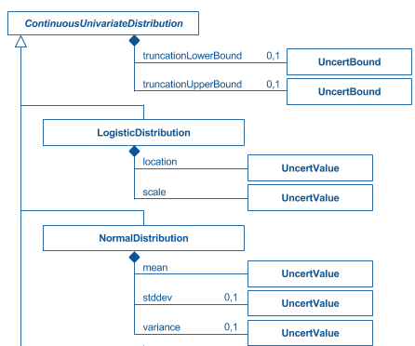
Pre-defined distributions
…and many many more.

Slide 13
Pre-defined distributions
<functionDefinition id="normal">
<distrib:drawFromDistribution>
<distrib:listOfDistribInputs>
<distrib:distribInput distrib:id="mu" distrib:index="0"/>
<distrib:distribInput distrib:id="sdev" distrib:index="1"/>
</distrib:listOfDistribInputs>
<distrib:normalDistribution>
<distrib:mean distrib:var="mu"/>
<distrib:stddev distrib:var="sdev"/>
</distrib:normalDistribution>
</distrib:drawFromDistribution>
</functionDefinition>

Slide 14
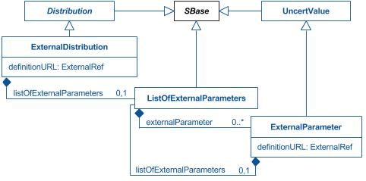
External distributions

Slide 15
External distributions
<functionDefinition id="Exponential2">
<distrib:drawFromDistribution>
<distrib:listOfDistribInputs>
<distrib:distribInput id="beta" distrib:index="0"/>
</distrib:listOfDistribInputs>
<distrib:externalDistribution name="Exponential 2"
distrib:definitionURL="http://www.probonto.org/ontology#PROB_k0000353">
<distrib:listOfExternalParameters>
<distrib:externalParameter name="Beta" distrib:var="beta"
distrib:definitionURL="http://www.probonto.org/ontology#PROB_k0000362"/>
</distrib:listOfExternalParameters>
</distrib:externalDistribution>
</distrib:drawFromDistribution>
</functionDefinition>

Slide 16
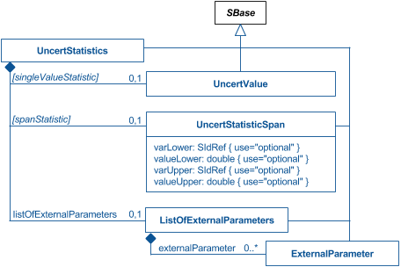
Uncertainty

Slide 17
Uncertainty (predefined)
<species id="s1" compartment="C" initialAmount="3.22“
hasOnlySubstanceUnits="true"
boundaryCondition="false" constant="false">
<distrib:uncertainty>
<distrib:uncertStatistics>
<distrib:standardDeviation distrib:value="0.3"/>
</distrib:uncertStatistics>
</distrib:uncertainty>
</species>

Slide 18
Uncertainty (external)
<species id="s1" compartment="C" initialAmount="3.22“
hasOnlySubstanceUnits="true"
boundaryCondition="false" constant="false">
<distrib:uncertainty>
<distrib:uncertStatistics>
<distrib:listOfExternalParameters>
<distrib:externalParameter name=“stddev" distrib:val=“0.3"
distrib:definitionURL="https://en.wikipedia.org/wiki/Standard_deviation"/>
</distrib:listOfExternalParameters>
</distrib:uncertStatistics>
</distrib:uncertainty>
</species>

Slide 19
Outstanding Decisions

Slide 20
Is hybrid approach OK?
Keep hybrid
Keep predefined; ditch external
Keep external; ditch predefined

Slide 21
Which distributions to keep?
My plan:
See what people implement
Keep those; ditch the rest
If one person implemented something, ask everyone else to implement that, too.

Slide 22
Namespace!
"http://www.sbml.org/sbml/level3/distrib/version1"
vs.
"http://www.sbml.org/sbml/level3/version1/distrib/version1"
vs.
"http://www.sbml.org/sbml/level3/version2/distrib/version1"

Slide 23
Negative Binomial
The possible formulations are Option 1 observing k failures before obtaining the r^{th} success (most common) Option 2 obtaining r successes until k failures have occurred Option 3 number of trials (successes or failures), n, required before the r^{th} success occurs.
From the ProbOnto 2.5 specification
Option 2 in spec now; was in UncertML
Option 1 may have more computational support: switch?

Slide 24
Resources

Slide 25
The Specification
http://sbml.org/Documents/Specifications/SBML_Level_3/Packages/distrib
http://sourceforge.net/p/sbml/code/HEAD/tree/trunk/specifications/sbml-level-3/version-1/distrib/sbml-level-3-distrib-package-proposal.pdf?format=raw

Slide 26
A Test Suite
https://github.com/luciansmith/stochastic-distrib-test-suite
Same format as SBML stochastic test suite (itself modeled after Darin’s stochastic test suite).
Tests each distribution, and variations to many distributions (truncation, alternate formulations)

