Slide 1
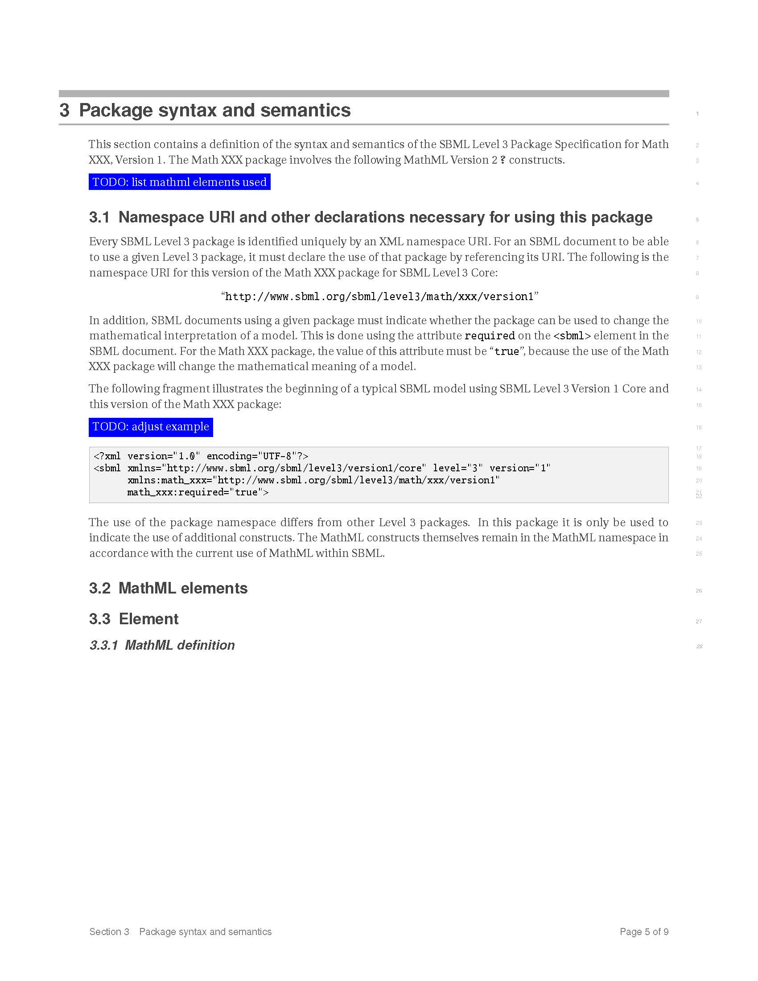
SBML L3 Math package(s)
template specification
https://sourceforge.net/p/sbml/code/HEAD/tree/trunk/specifications/sbml-level-3/version-1/math/specifications/template/sbml-level3-template-math-specification.pdf
Framework tex files
Replace ‘xxx’ in macros.tex to get the correct package name
Fill in information where the ‘To Do’

Slide 2
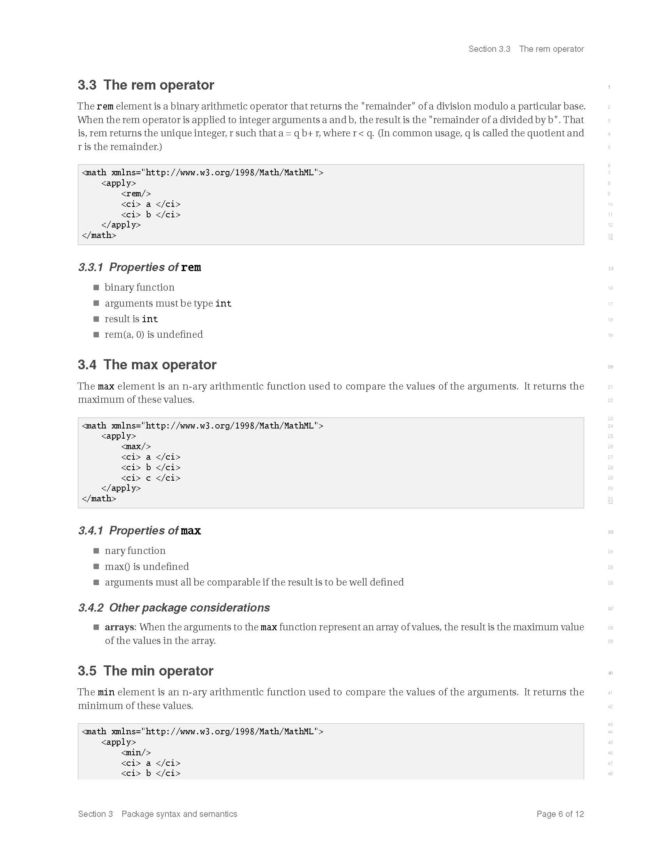
SBML L3 Math package(s)
L3V2 ‘extras’ specification
https://sourceforge.net/p/sbml/code/HEAD/tree/trunk/specifications/sbml-level-3/version-1/math/specifications/math-v2extras/sbml-level3-math-v2extras-version1.pdf

Slide 3
SBML L3 Math package(s)
Issue #1 Namespaces
http://www.sbml.org/sbml/level3/math/xxx/version1
Do we need the SBML version ? Is leaving it out going to cause issues for software ?
How descriptive do we need ‘xxx’ to be ? I used v2-extras !

Slide 4
SBML L3 Math package(s)
Issue #2 Number of specifications
One specification with several ‘sub specifications’
Several specifications – each dealing with one ‘sub-spec’
Advantage:
All in one place
Not overwhelming in number of specs
Disadvantage:
Time to put together is greater
Some bits may never be implemented
May be overwhelming in content !
Advantage:
Quicker to produce
Only produce what is going to implemented (supply on demand)
Disadvantage:
Overwhelming in number of specs (once they are done)
Someone looking for something new may give up as it does not yet exist

Slide 5
SBML L3 Math package(s)
Issue #3 Arrays
The arrays package already adds vector/selector to MathML subset
Should we
Take it out of arrays into its own math-arrays package which arrays package will depend on
Leave it in arrays AND have a separate package math-arrays

