Slide 1
libSBML
Frank Bergmann and Sarah Keating

Slide 2
Getting started ...

Slide 3
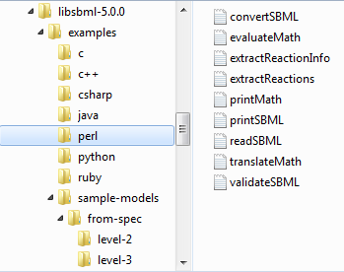

Slide 5
#!/usr/bin/perl
use File::Basename;
use blib '../../src/bindings/perl';
use LibSBML;
use strict;
my $filename = shift()
|| do { printf STDERR "\n usage: @{[basename($0)]}<filename>\n\n";
exit (1);
};
my $rd = new LibSBML::SBMLReader();
my $d = $rd->readSBML($filename);
$d->printErrors();
my $m = $d->getModel() || exit (2);
my $level = $d->getLevel();
my $version = $d->getVersion();
printf("\n");
printf("File: %s (Level %u, version %u)\n",
basename($filename), $level, $version);
printf( " ");
($level == 1) ? printf("model name: %s\n", $m->getName()) : printf(" model id: %s\n",
$m->isSetId() ? $m->getId() : '(empty)');
printf( " compartments: %d\n", $m->getNumCompartments () );
printf( " species: %d\n", $m->getNumSpecies () );
printf( " parameters: %d\n", $m->getNumParameters () );
printf( " reactions: %d\n", $m->getNumReactions () );
printf( "\n" );

Slide 6
#!/usr/bin/perl
use File::Basename;
use blib '../../src/bindings/perl';
use LibSBML;
use strict;
my $filename = shift()
|| do { printf STDERR "\n usage: @{[basename($0)]}<filename>\n\n";
exit (1);
};
my $rd = new LibSBML::SBMLReader();
my $d = $rd->readSBML($filename);
$d->printErrors();
my $m = $d->getModel() || exit (2);
my $level = $d->getLevel();
my $version = $d->getVersion();
printf("\n");
printf("File: %s (Level %u, version %u)\n",
basename($filename), $level, $version);
printf( " ");
($level == 1) ? printf("model name: %s\n", $m->getName()) : printf(" model id: %s\n",
$m->isSetId() ? $m->getId() : '(empty)');
printf( " compartments: %d\n", $m->getNumCompartments () );
printf( " species: %d\n", $m->getNumSpecies () );
printf( " parameters: %d\n", $m->getNumParameters () );
printf( " reactions: %d\n", $m->getNumReactions () );
printf( "\n" );

Slide 7
#!/usr/bin/perl
use File::Basename;
use blib '../../src/bindings/perl';
use LibSBML;
use strict;
my $filename = shift()
|| do { printf STDERR "\n usage: @{[basename($0)]}<filename>\n\n";
exit (1);
};
my $rd = new LibSBML::SBMLReader();
my $d = $rd->readSBML($filename);
$d->printErrors();
my $m = $d->getModel() || exit (2);
my $level = $d->getLevel();
my $version = $d->getVersion();
printf("\n");
printf("File: %s (Level %u, version %u)\n",
basename($filename), $level, $version);
printf( " ");
($level == 1) ? printf("model name: %s\n", $m->getName()) : printf(" model id: %s\n",
$m->isSetId() ? $m->getId() : '(empty)');
printf( " compartments: %d\n", $m->getNumCompartments () );
printf( " species: %d\n", $m->getNumSpecies () );
printf( " parameters: %d\n", $m->getNumParameters () );
printf( " reactions: %d\n", $m->getNumReactions () );
printf( "\n" );

Slide 8
#!/usr/bin/perl
use File::Basename;
use blib '../../src/bindings/perl';
use LibSBML;
use strict;
my $filename = shift()
|| do { printf STDERR "\n usage: @{[basename($0)]}<filename>\n\n";
exit (1);
};
my $rd = new LibSBML::SBMLReader();
my $d = $rd->readSBML($filename);
$d->printErrors();
my $m = $d->getModel() || exit (2);
my $level = $d->getLevel();
my $version = $d->getVersion();
printf("\n");
printf("File: %s (Level %u, version %u)\n",
basename($filename), $level, $version);
printf( " ");
($level == 1) ? printf("model name: %s\n", $m->getName()) : printf(" model id: %s\n",
$m->isSetId() ? $m->getId() : '(empty)');
printf( " compartments: %d\n", $m->getNumCompartments () );
printf( " species: %d\n", $m->getNumSpecies () );
printf( " parameters: %d\n", $m->getNumParameters () );
printf( " reactions: %d\n", $m->getNumReactions () );
printf( "\n" );

Slide 9
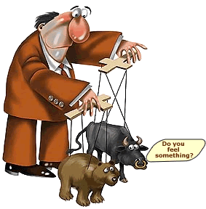
Manipulating SBML – the API

Slide 10
Components in SBML specification

Slide 11
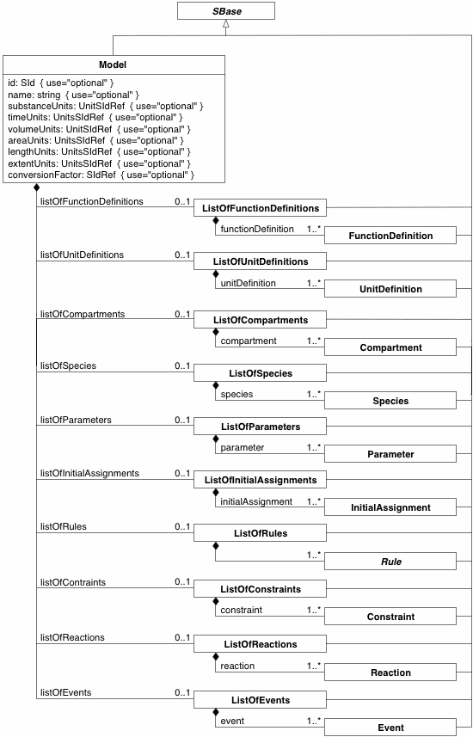
Components in SBML specification

Slide 12
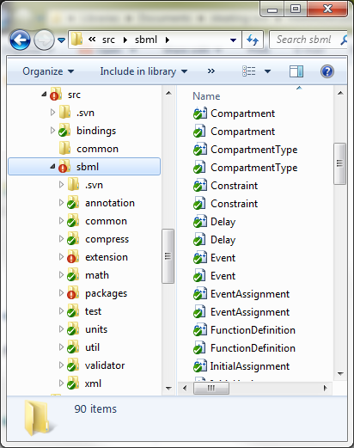

Slide 13
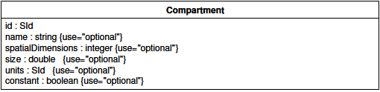
SBase
<compartment id="Yeast" units="litre" constant="true"/>

Slide 14
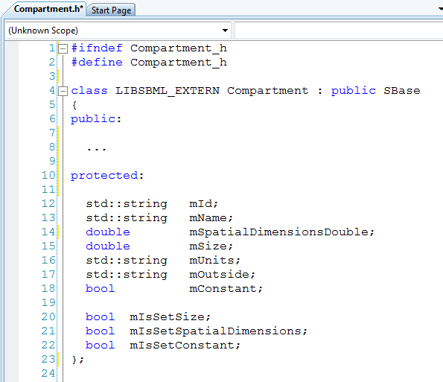

Slide 15
SBase

Slide 16
Attribute API
isSetSize? true
COMPARTMENT
setSize(1.0)
mSize = 1.0
mSize
getSize = 1.0
unSetSize

Slide 17
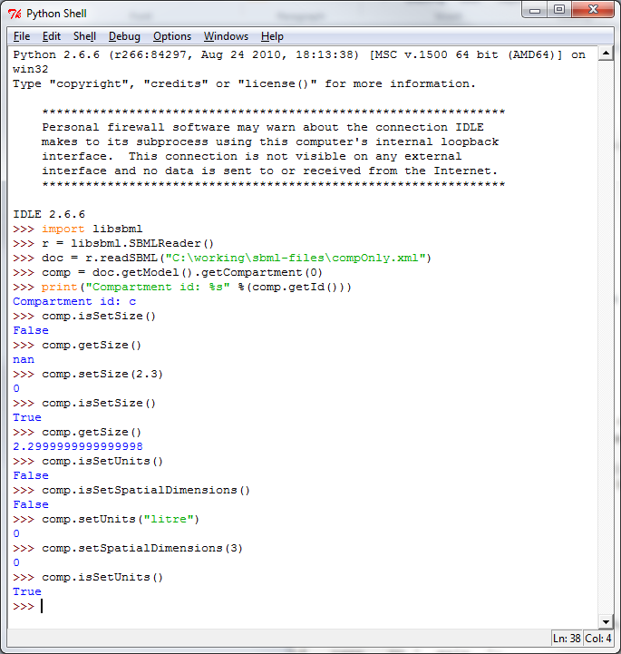

Slide 18


Slide 19
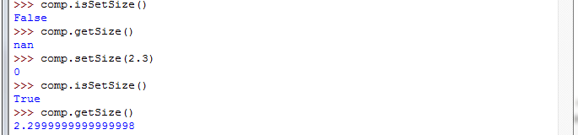

Slide 20
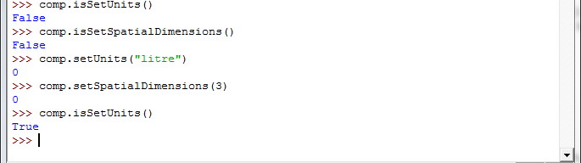

Slide 21
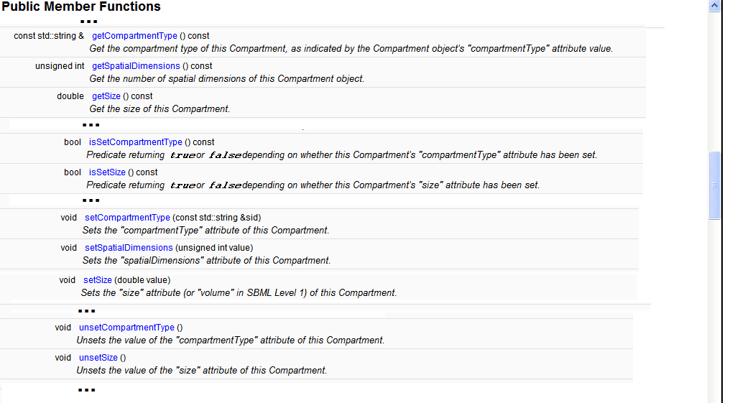

Slide 22
ListOf…Elements

Slide 23
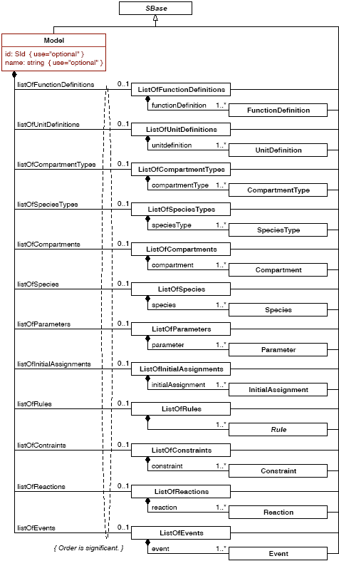

Slide 24
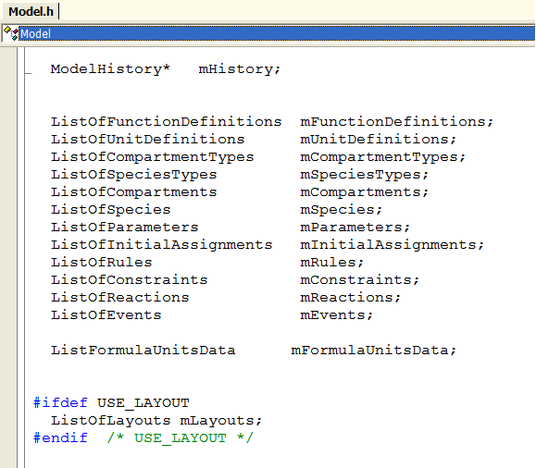

Slide 25
ListOf…Elements
getElementTypeCode()
SBML_SPECIES
getElement(“t”) = a3
getNumElements = 4
a1
a2
a3 id=“t”
a4
getElement(1) = a2
a5
addElement(a5)

Slide 26
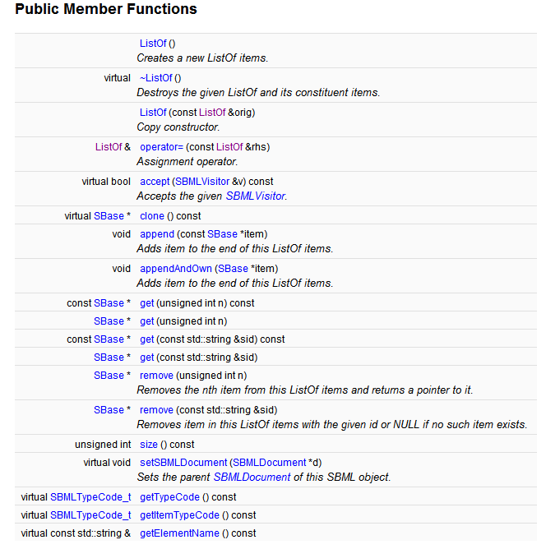

Slide 27
Which reactions produce a particular species ?
unsigned int n;
Model* model = document->getModel();
std::string speciesId;
for (n = 0; n < model->getNumSpecies(); n++)
{
if (model->getSpecies(n)->getName() == "Glucose-6-Phosphate")
{
speciesId = model->getSpecies(n)->getId();
break;
}
}
ListOfReactions * myReactions = new ListOfReactions();
for (n = 0; n < model->getNumReactions(); n++)
{
Reaction * r = model->getReaction(n);
if (r->getProduct(speciesId) != NULL)
{
myReactions->appendAndOwn(r);
}
}
cout << "Reactions containing Glucose-6-Phosphate as a product:\n";
for (n = 0; n < myReactions->size(); n++)
{
cout << "Reaction id: " << myReactions->get(n)->getId() << endl;
}

Slide 28
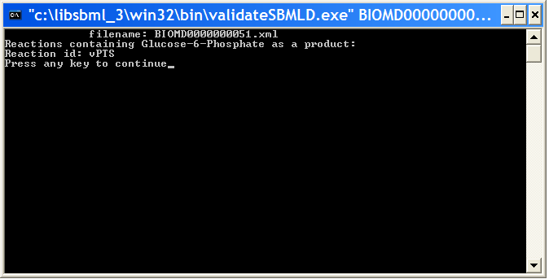

Slide 29

Creating SBML – the API

Slide 30
use blib '../../src/bindings/perl';
use LibSBML;
use strict;

Slide 31
use blib '../../src/bindings/perl';
use LibSBML;
use strict;
# create the namespace for the level and version of SBML
my $sbmlns = new
LibSBML::SBMLNamespaces(3, 1);
# create the document
my $document=new
LibSBML::SBMLDocument($sbmlns);

Slide 32
my $document=new LibSBML::SBMLDocument($sbmlns);
# create the Model
my $model=$document->createModel();
$model->setId("TestModel");

Slide 33
my $document=new LibSBML::SBMLDocument($sbmlns);
my $model=$document->createModel();
# create the Compartment
my $compartment=
$model->createCompartment();
$compartment->setId("Compartment_1");
$compartment->setConstant(1);

Slide 34
my $document=new LibSBML::SBMLDocument($sbmlns);
my $model=$document->createModel();
my $compartment=$model->createCompartment();
# create the Species
my $species1=$model->createSpecies();
$species1->setId("Species_1");
$species1->setCompartment
($compartment->getId());
$species1->setHasOnlySubstanceUnits(0);
$species1->setBoundaryCondition(0);
$species1->setConstant(0);

Slide 35
my $document=new LibSBML::SBMLDocument($sbmlns);
my $model=$document->createModel();
my $compartment=$model->createCompartment();
my $species1=$model->createSpecies();
my $species2=$model->createSpecies();
# create the Reactions
my $reaction1=$model->createReaction();
$reaction1->setId("Reaction_1");
$reaction1->setReversible(0);
$reaction1->setFast(0);

Slide 36
my $reaction1=$model->createReaction();
$reaction1->setId("Reaction_1");
$reaction1->setReversible(0);
$reaction1->setFast(0);
# create the Reactant
my $reference1=$reaction1->createReactant();
$reference1->setSpecies($species1->getId());
$reference1->setId("SpeciesReference_1");
$reference1->setConstant(0);

Slide 37
my $reaction1=$model->createReaction();
my $reference1=$reaction1->createReactant();
# create the Product
my $reference2= $reaction1->createProduct();
$reference2->setSpecies($species2->getId());
$reference2->setId("SpeciesReference_2");
$reference2->setConstant(0);

Slide 38
my $reaction1=$model->createReaction();
my $reference1=$reaction1->createReactant();
my $reference2= $reaction1->createProduct();
# create the KineticLaw
my $kineticLaw=
$reaction1->createKineticLaw();
my $KLmath=
LibSBML::parseFormula(‘species2 * 2’);
$kineticLaw->setMath($KLmath);

Slide 39
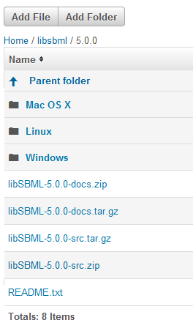
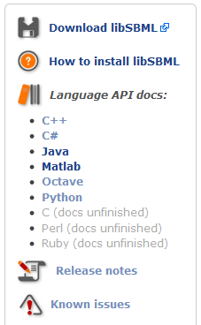
Documentation
ONLINE
DOWNLOAD

Slide 40
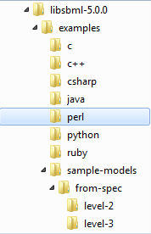
Getting started ...

Slide 41
http://sbml.org/Software/libSBML/Tutorials

