Slide 1
SBGN PD
Current status, future changes and unresolved issues
Harmony 2011
NYC

Slide 2
PD Specification
Level 1 Version 1: Sep 2008
  Original specification
Level 1 Version 1.1: Sep 2009
  Fixed inconsistencies
  Typos
  Clarified “ontology” of glyphs
  Nomenclature changes for consistency with other languages
Level 1 Version 1.2: Oct 2010
Level 1 Version 1.3: Feb 2011
  Minor changes of clarity
  Document errors
Level 1 Version 2.0 Apr/May 2011

Slide 3
What’s in Version 2.0
New/Modified Glyphs
Resolving semantic “issues”
Enumerated rules
Improve organisation/clarity of the spec

Slide 4
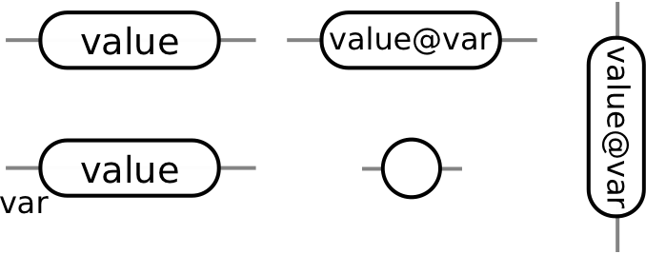

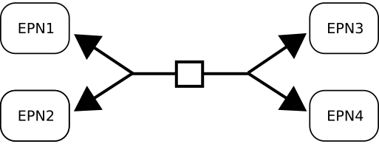

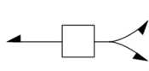

Level 1 Version 2.0: Glyphs
State Glyph Change
New Annotation Glyph
Reversible Arc
Empty Set

Slide 5
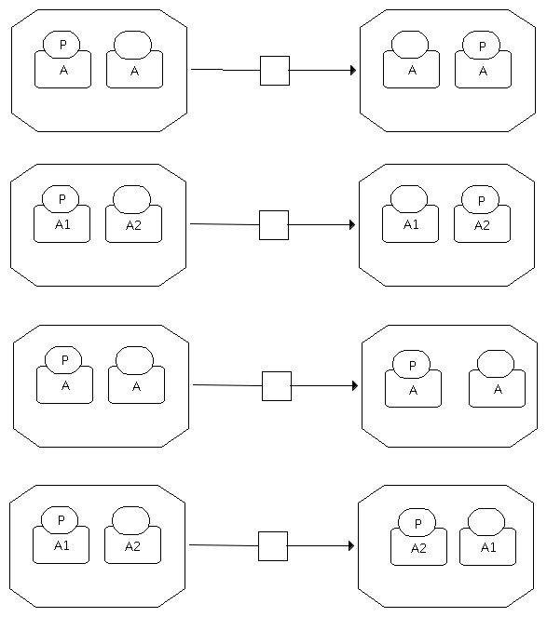
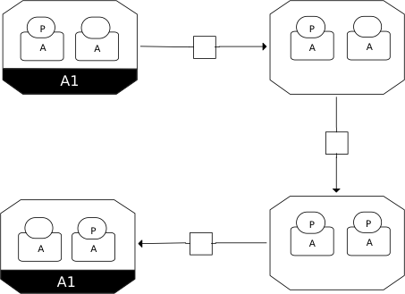
Level 1 Version 2.0: Semantics
Subunits are not EPNS
Synthetic Unique Names
Confusing but correct?

Slide 6
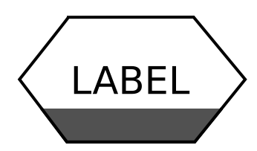
Level 1 Version 2.0: Semantics
Process Duplication
A
A
ZZZ
ZZZ
B
B
YYY
YYY
C
C
XXX
XXX
LABEL

Slide 7
Level 1 Version 2.0: Semantics
Source and Sink => Empty Set
A
Source
Empty Set
P
A
Sink

Slide 8
Level 1 Version 2.0: Spec
Focus more on EPN types rather than glyphs
  Integrate clone marker section
  Integrate multimer section
Integrate semantic rules into glyphs
Enumerate rules – facilitate computational validation

Slide 9
Road Map for PD
Level 1 Version 2.0
  Draft for Review: May 2011
  RFC: 2-3 Weeks
  Release June 2011
Tool support!
Level 2 Version 1.0
  Theme: RISC notation?
  Start work in Harmony 2012?
  Release First Draft COMBINE 2012?

Slide 10
ER Issues
Delay
Can arrow come from entity
Can’t define initial state
Outcome not an Entity

