Slide 1
Community Building and Outreach
Robin Haw
robin.haw@oicr.on.ca

Slide 2




















Combine and Harmony Meetings

Slide 3
Community Building
Interoperability
  Who was missing from this meeting?
    People, Groups, Projects, Programs and Organizations
How do we co-ordinate larger (and smaller) group discussions?
  Two meetings – Combine and Harmony
Data providers
  Promoting data exchange
  Discussion amongst pathway, model, systems biology databases, etc
Standards – How do ‘non-expert’ people engage?
  Outreach strategies
    Should we defined targets, goals, and milestones? -> End Users

Slide 4
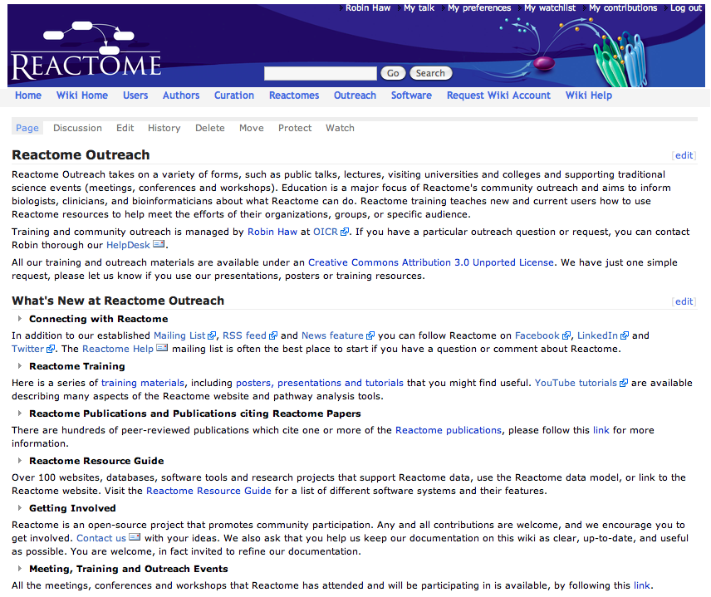
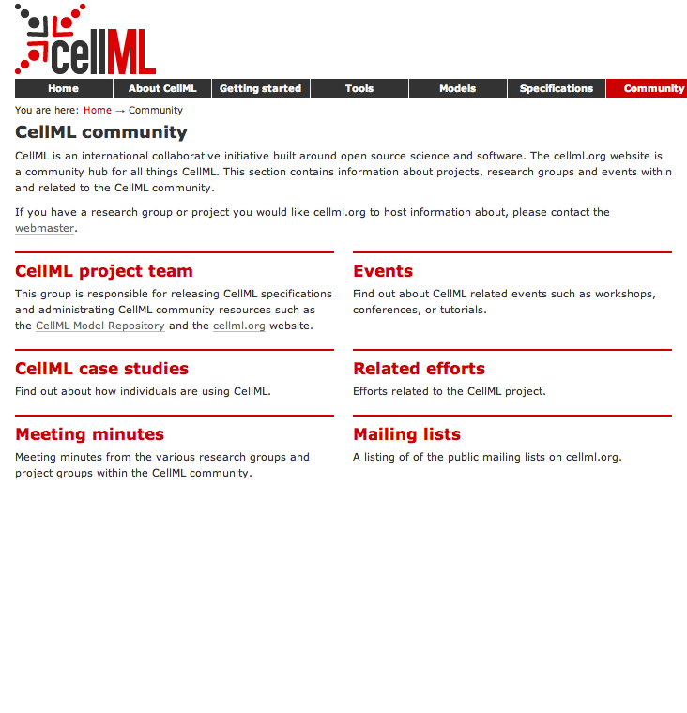
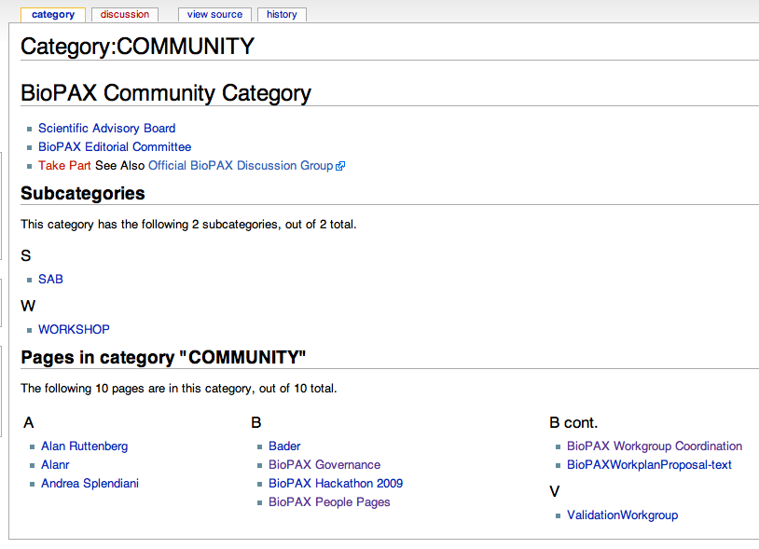
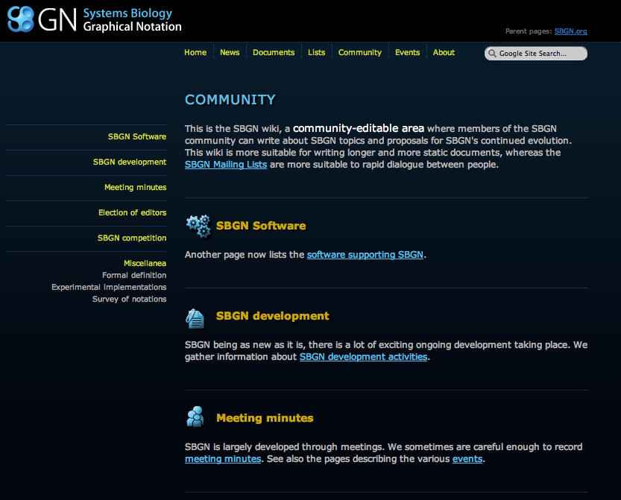
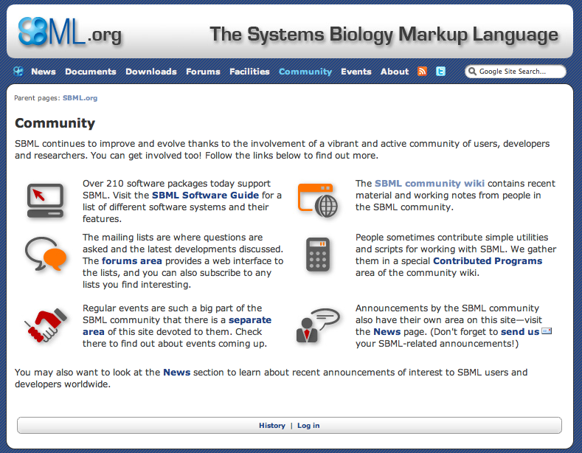
End User Outreach

Slide 5
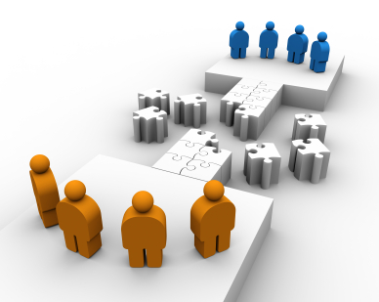
Outreach Questions?
Should we be coordinating and sharing outreach?
How do we coordinate these activities?
Who belongs to your/our community?
  Who are your/our end users?
  What do the users think about your/our data, software, data spec?
  What do your/our users want?
Funding?
Discussions with Journals, Industry, Pharma?
……..?

