Slide 1
SBGN-ER vs rule-based modeling
Michael Blinov
Center for Cell Analysis and Modelling
University of Connecticut Health Center

Slide 2
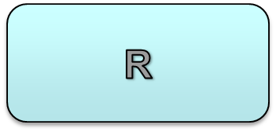
Models and SBGN-ER are sometimes orthogonal, and annotations can connect them!
P
U
PP
R(ITAM~U) <-> R(ITAM~P) k1,k2
R(ITAM~P) <-> R(ITAM~PP) k3,k4
R(ITAM~PP) -> R(ITAM~U) k5
ITAM
Michael Blinov

Slide 3
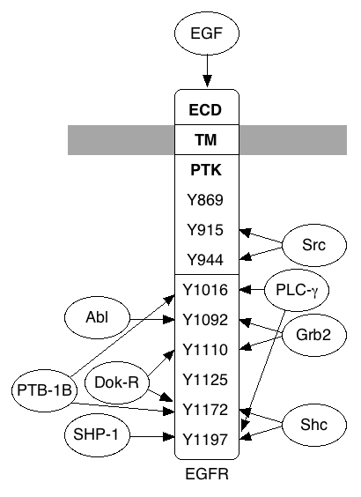
How SBGN-ER can handle combinatorial complexity?
Epidermal growth factor receptor (EGFR)
9 sites ⇒ 2⁹=512 phosphorylation states
Each site has ≥ 1 binding partner
⇒ more than 3⁹=19,683 total states
EGFR must form dimers to become active
⇒ more than 1.9×10⁸ states
…but the number of entities and entity relationships is relatively small – case for SBGN-ER and rule0based modeling.

Slide 4
Rule-based approach
Biomolecules represented as collections of functional components
EGFR
ecd
EGF
tmd
Y1092
~U~P
Y1172
~U~P
System evolves by reaction rules, that specify which biomolecules and
their components affect kinetics of interactions. Rules correspond to
knowledge, hypothesis or assumptions
ecd
EGF
tmd
k₊₁
+
Condition: ecd is free
k₋₁
Context: tmd is free
Unshown components Y1092 and
Y1172 do not affect interaction

Slide 5
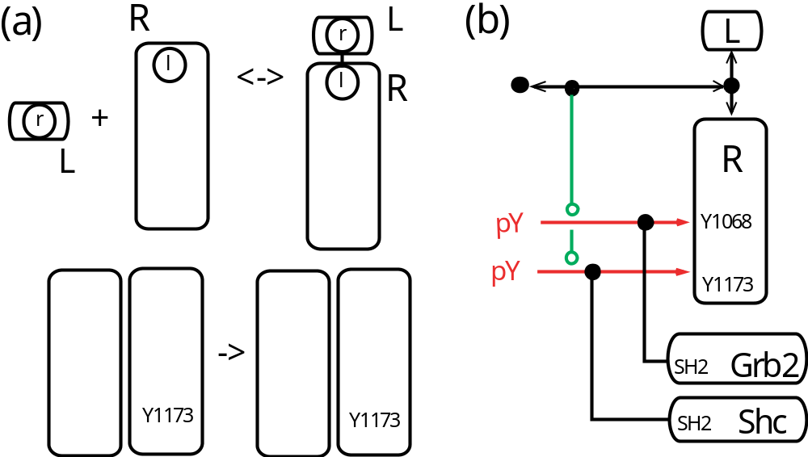
Models and SBGN-ER seem to work perfectly together!
Michael Blinov

Slide 6
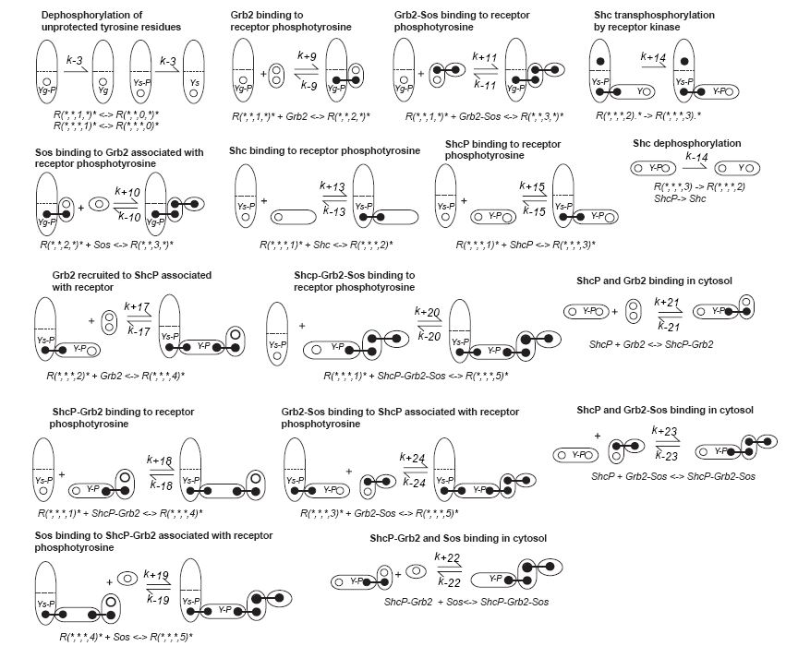
Michael Blinov

Slide 7
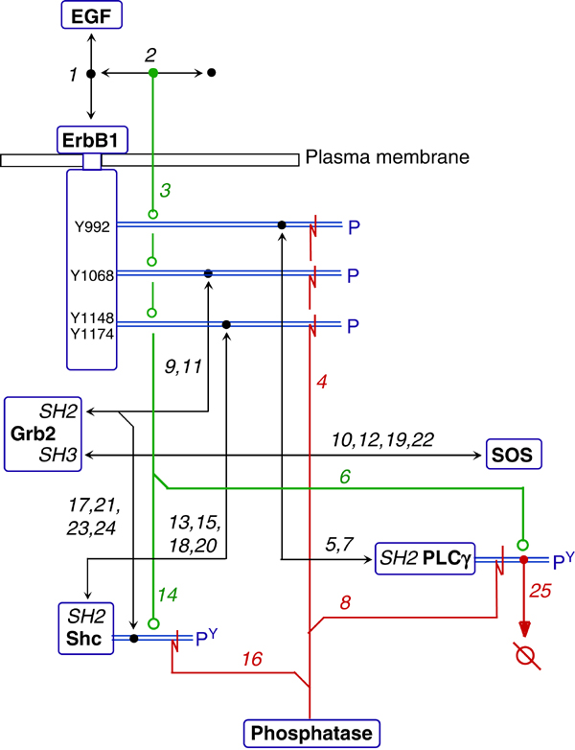
1.MIM seems to be a winner.
2. But details are encoded in annotations
3. SBGN-ER would be more cluttered…
Michael Blinov

Slide 8

Models and SBGN-ER seem to work perfectly together!
Y1
Y2
Y3
R.R(Y~U) -> R.R(Y~P) p X 9 sites
R(Y~P) -> R(Y~U) d X 9 sites
R(Y~P) + A(sh2) <-> R(Y~P!1).A(sh2!1) kb,kd
Y4
Y5
Y6
Y7
Michael Blinov

Slide 9
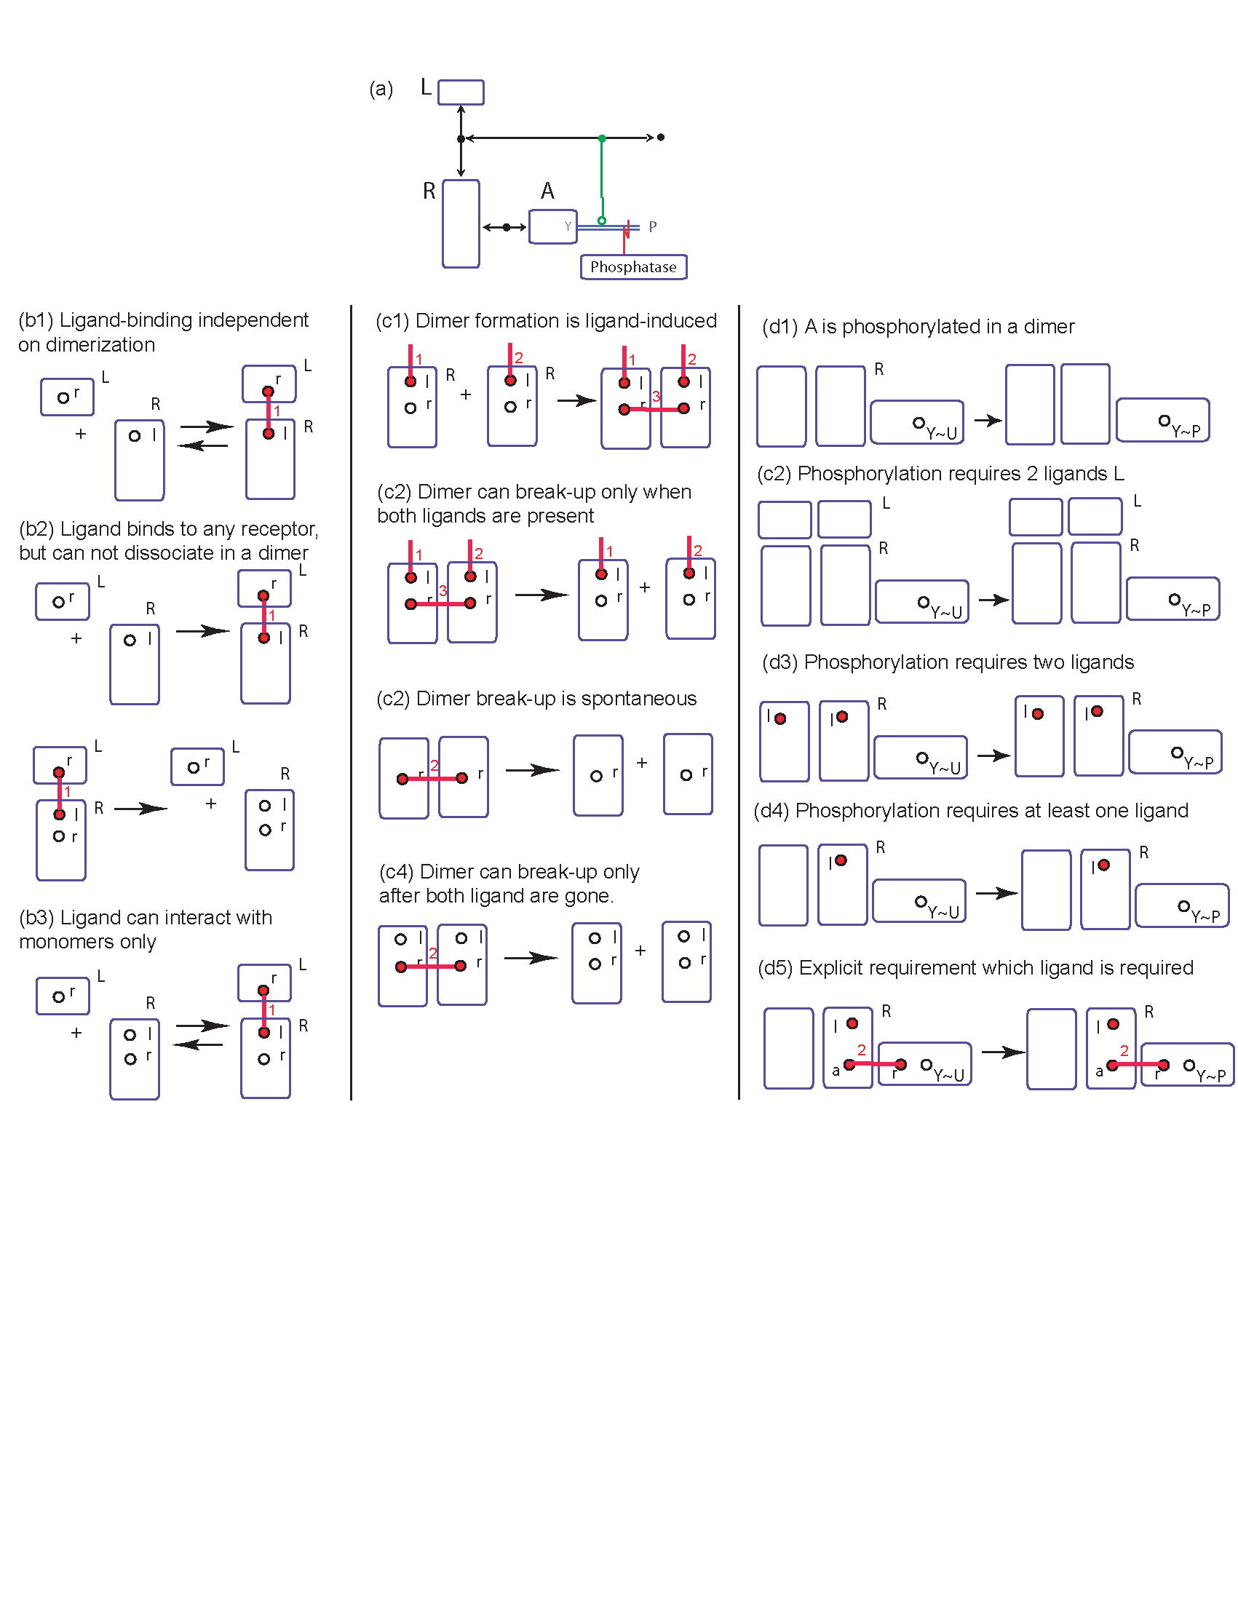
Michael Blinov

Slide 10
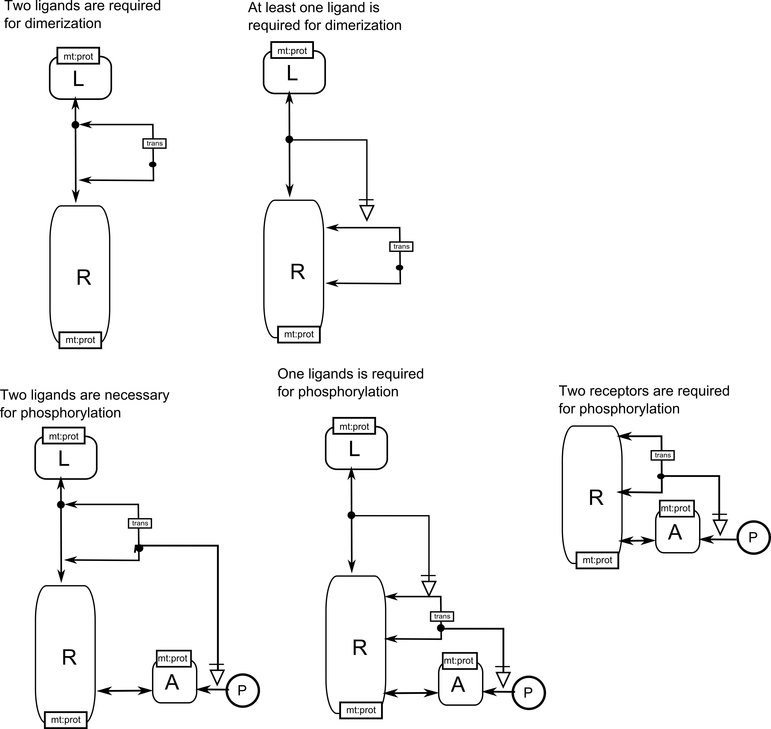
Specifying stoichiometry

Slide 11



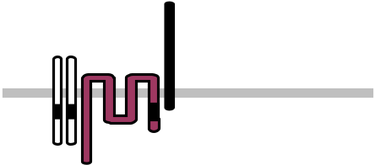

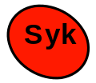

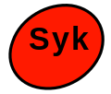
Early Events in FcεRI receptor Signaling
Multivalent antigen binds to IgE on cell surface forming aggregates
Tyrosine kinase Lyn associates with receptors and transphosphorylates ITAM tyrosines
Phosphorylated ITAMs recruit Syk and additional Lyn
Syk is transphosphorylated by Lyn or Syk
Phosphorylation of Syk is critical for downstream events (“activation”)
antigen
P
P
P
P
P
P
Notes:
Here is our picture of the events in IgE-mediated signaling we are trying to model. First, multivalent antigens cross-link receptors at the cell surface. Then, the protein tyrosine kinase Lyn, which associates weakly with the receptor, primarily through the β chain, transphosphorylates other receptors in the aggregate. Phosphorylated ITAMs then serve as high-affinity binding sites for the SH2 domains of Lyn and Syk, another PTK critical for signaling. Lyn and Syk associated with the receptor can transphosphorylate associated Syk on adjacent receptors, which is critical for downstream events. Our model ends at this Syk activation. While this appears to be a relatively straightforward sequence of events, there is a great deal of complexity lurking below the surface.

Slide 12
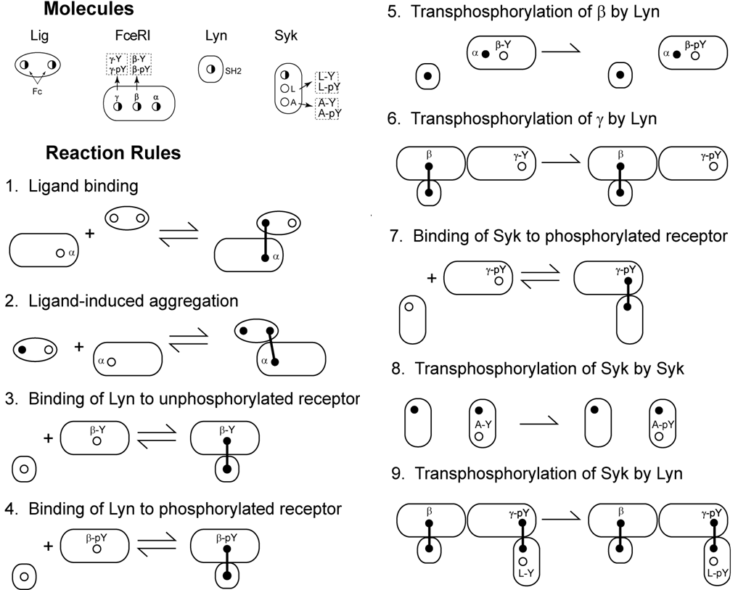

Slide 13
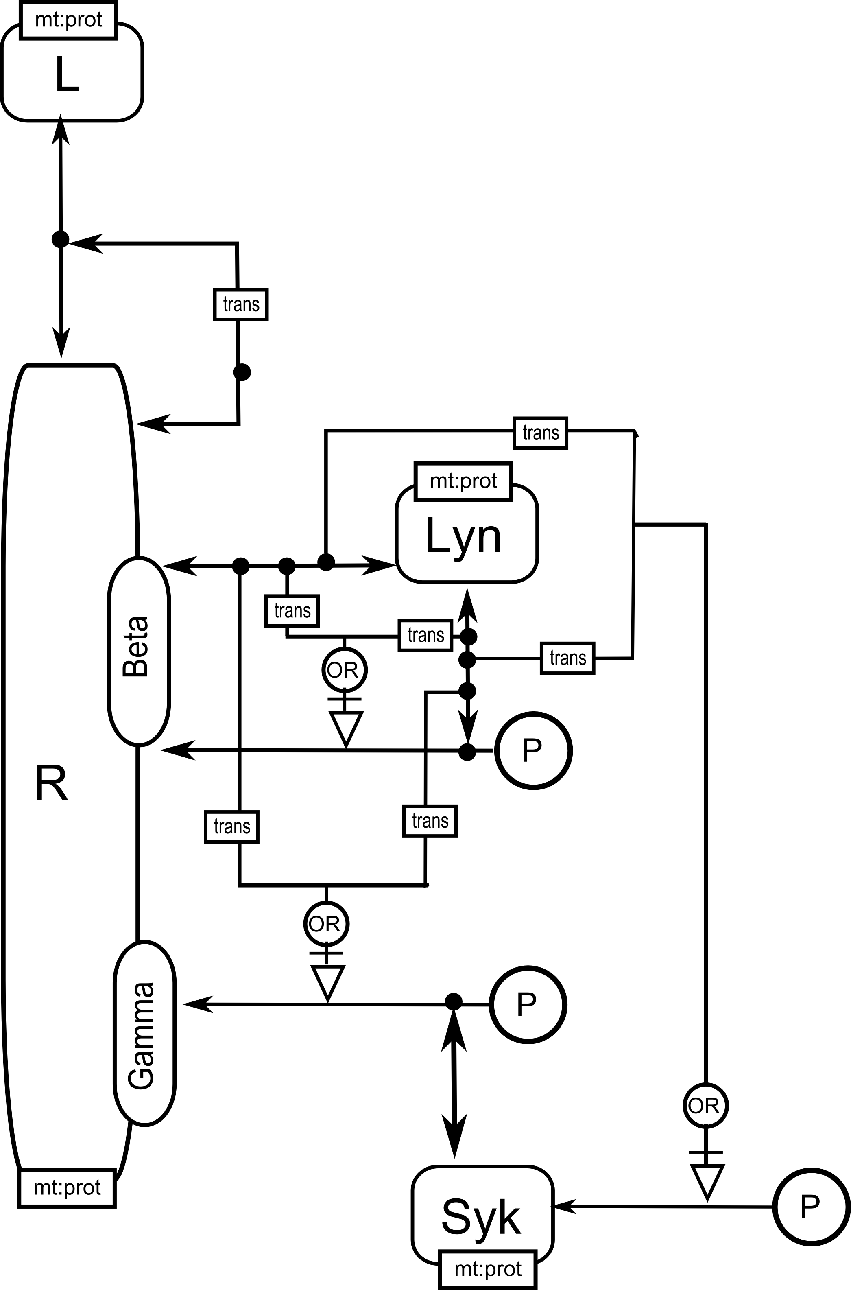

Slide 14
Issues
Geometry is often essential, but cis and trans are not enough to express it.
Separate interactions often require different context. Showing it on the same diagram is undesirable. How can we show what is essential and what is context?
Domains are required.

Slide 15
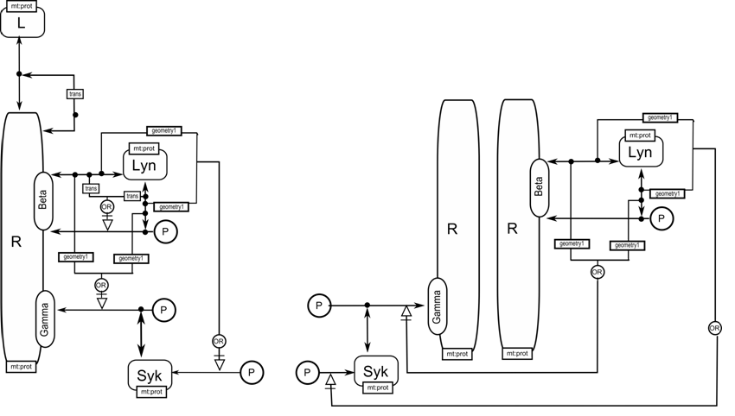
Specifying topology

Slide 16
Suggestions for SBGN
Strict rules for annotations!
Different levels of details (like MIM): Explicit, Heuristic, Combinatorial.
Separate interactions often require different context. Showing it on the same diagram is undesirable. How can we show what is essential and what is context?
Think about human vs machine readability.

Slide 17
Suggestions for libSBGN:
Draw SBGN-PD for BioPAX
Draw simplest unconditional ER diagrams – analogue of contact maps.
Michael Blinov

