Slide 2
‘Mike Hucka’s Lament’
‘OWL city’
(or:)
music by Adam Young ( as ‘Owl City’)
lyrical adaptation by Lucian Smith

Slide 3



Notes:
**It’s been my fervent wish
For **ten million biologists
To save their models as SBML
No one would find it strange,
‘cause then they could exchange
semantics and the math
with rates of change

Slide 4


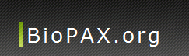







Notes:
**I’d like to make myself believe
That COMBINE standards slowly
will interoperate on a level
I have never seen
ML’s and RDFs and ontologies

Slide 5
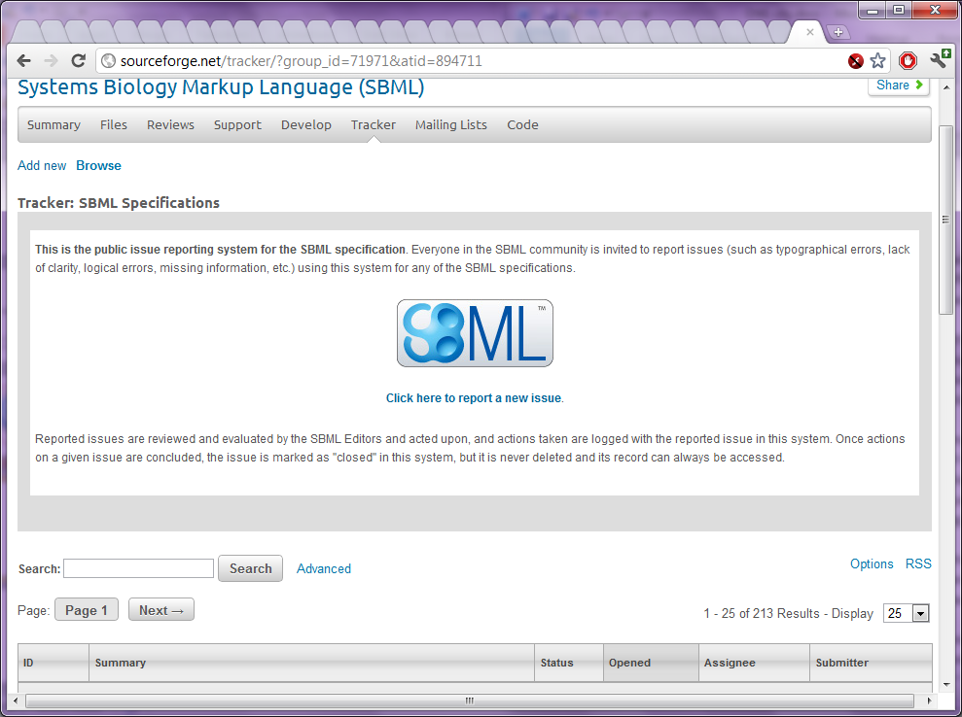
(a gross exaggeration!)
Notes:
I feel my conscience tug
from ten thousand open bugs **
All sitting in their trackers on the web
One wants to annotate,
some metabolic rate
But he just can’t with Windows 98…

Slide 6

Notes:
I’d like to make myself believe
That COMBINE standards slowly
will interoperate on a level
I have never seen
ML’s and RDFs and ontologies
(and graphics)

Slide 7
Audience participation time!
If you know the echo, sing along!
Lyrics: ‘Please take me away from here’
Notes:
I’m reading oh so many specs
()
switch gears, one breakout to the next
()
If I tell you that I’m at theirs
()
Can I go hide out on the stairs?

Slide 8
???
2010
2008
2006
2004
2004
2002
(no!)
2000
Notes:
It’s been eleven years,
I’ve had you as my peers
I wonder will you ever let me leave? **

Slide 9
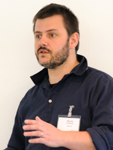
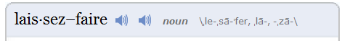
1 : To leave well enough alone
Notes:
But I sometimes get a scare
when ** Nicolas Le Novére
seems to eschew the doctrine of ** laissez faire

Slide 10
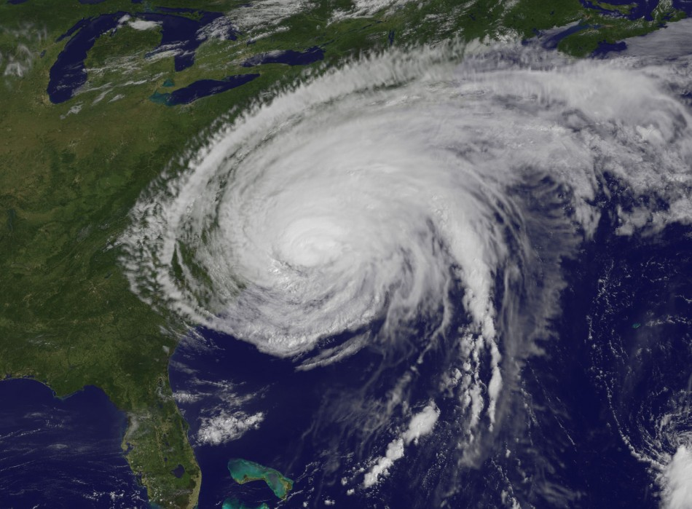
Notes:
I'd like to make myself believe
That hurricanes turn ** slowly
It's hard to say that I’d rather stay
Away when it’s Irene
That’s flooding my apartment to the seams
(while I’m in Cleveland)
‘Cause I know that nature I can beat
But all these standards meetings

Slide 11



AAArrrghh!!
DECAFFEINATED
CAFFEINATED
Notes:
Are hard to take though I’d rather stay
**awake when I’m asleep
‘cause I’ve been two full days without caffeine
(those bastards)

Slide 12


Notes:
I know that **Nature I can beat
I’m not so sure of ** Science
I hope and pray and **know some day

Slide 13


Notes:
the best we can achieve:
COMBINE a full-fledged ** funding agency?
**

