Slide 1


alpha release available at
http://wwwdev.ebi.ac.uk/biomodels-alpha

Slide 2
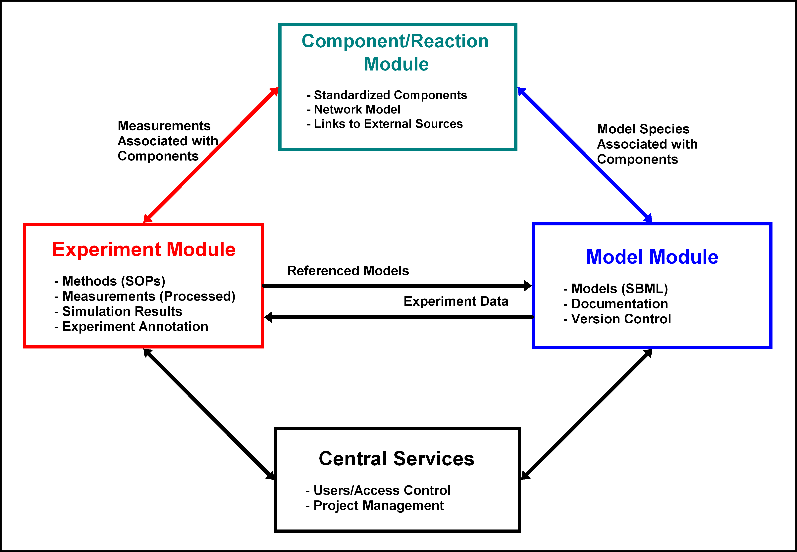
The Data in Systems Biology

Slide 3
History
A local biomodels was needed (e.g. at DKFZ)
in 2010: we tried to use the former biomodels code
But code was hard to extend or even to install
User restricted access: no way
JUMMP project was created
Early 2011
Common project between DKFZ and EBI
Opensource project

Slide 4
Approach
Approach: Refactoring
Actual Biomodels is still working properly
Just the Code base requires modern software
design
Requirements:
Refactoring all old functionality
User management
Providing new enhancements
Proper User interface

Slide 5
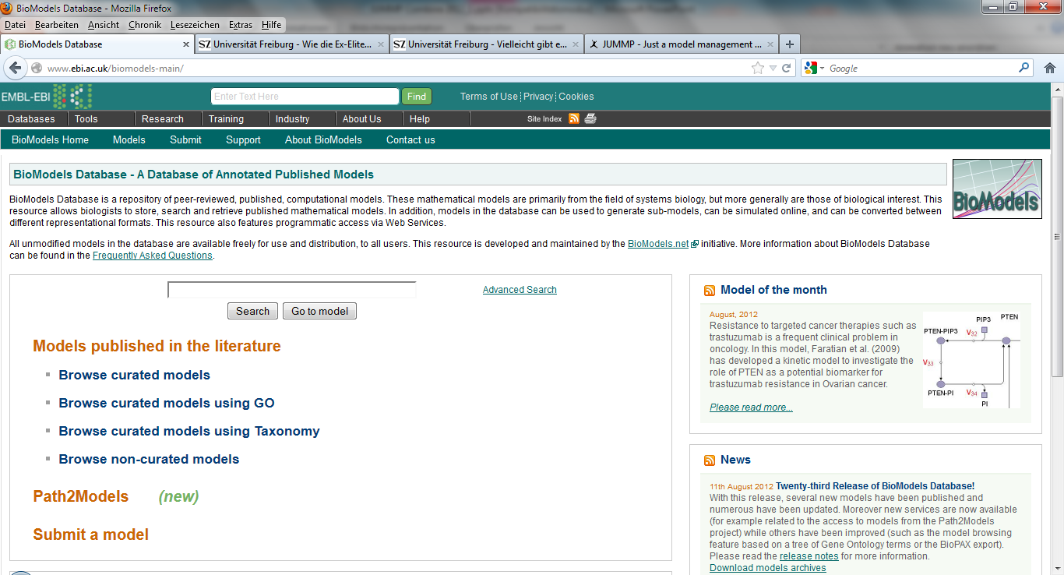
Current biomodels
www.ebi.ac.uk/biomodels

Slide 6
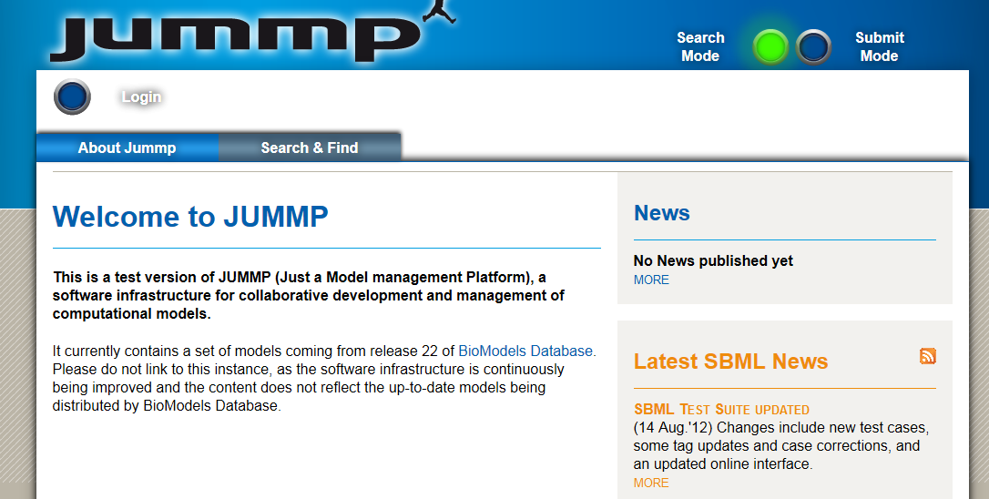

Slide 7
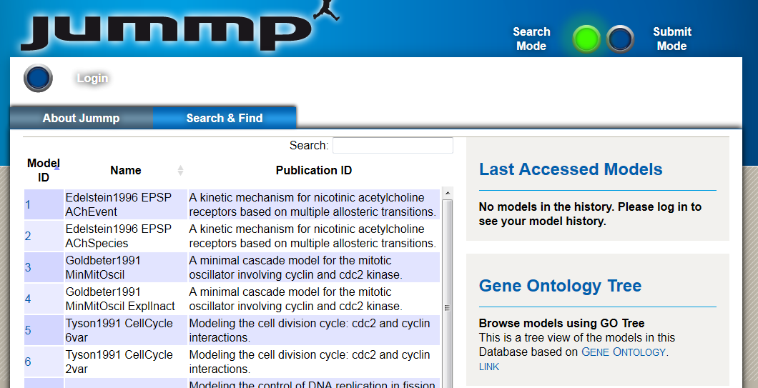
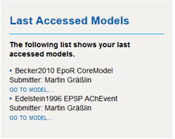

Slide 8
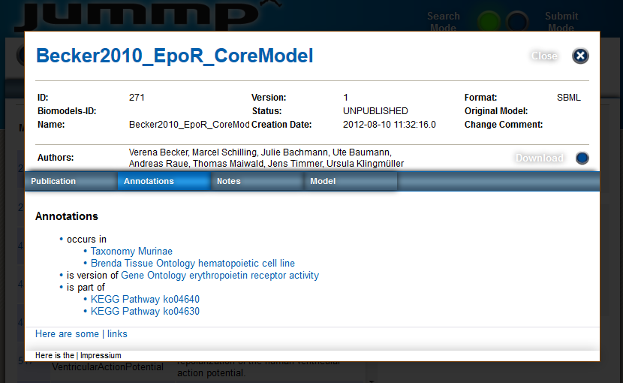

Slide 9
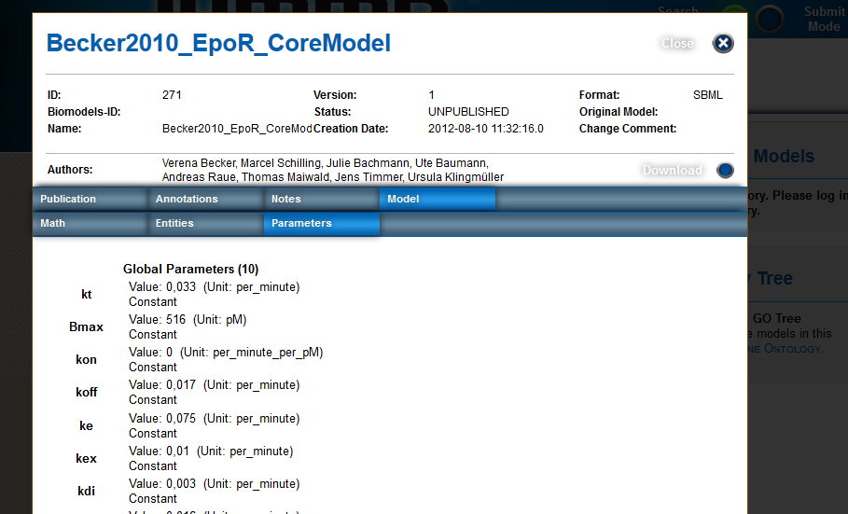

Slide 11
Next steps
More functionality in UI
Version control (backend from Rostock group)
Advanced search (backend from Rostock group)
Reaction graph, format conversions (SBFC)
Submission of a new (or already existing) model
Curation part (mainly for EBI)
….
Path2Models in JUMMP
Challenge
Provision of JUMMP for DKFZ
Loading locale models (not yet published)
Starting with Lungsys consortium

Slide 12
Schedule
Making JUMMP available for download (war)
Next month
Providing survey
Getting your feedback
Probably in autumn
Going productive
Next Harmony

Slide 13
DKFZ/Bioquant:
Jürgen Eils
Martin Gräßlin,
Jochen Schramm
EBI:
Nicolas le Novere
Camille Laibe
Mihai Glont
University of Rostock:
Ron Henkel
Robert Hälke
https://bitbucket.org/jummp/jummp/

Slide 14


















NGS Partners
Imaging Partners
SB Partners
- European Pancreas Center
NCT
DKFZ
NGFN (Pancreas Net, Engine
and Brain Tumor Net
ICGC Pedbrain, Prostate and
Maligne Lymphoma
DEEP (IHEC)
DKTK
HIPO
Viroquant
Bioquant
Biochemistry Center Heidelberg
NGFN ENGINE
Medsys and cancersys
EU Mitocheck
- EBI
SBCancer
Forsys
Bioquant
Medsys and Cancersys
eBio
SYSMO
VIROQUANT

