Slide 1
Representing PK/PD Models using SB standards.
Stuart Moodie, Maciej Swat, Nicolas le Novère
EMBL-EBI, Hinxton, UK
COMBINE: Aug 2012
Toronto

Slide 2
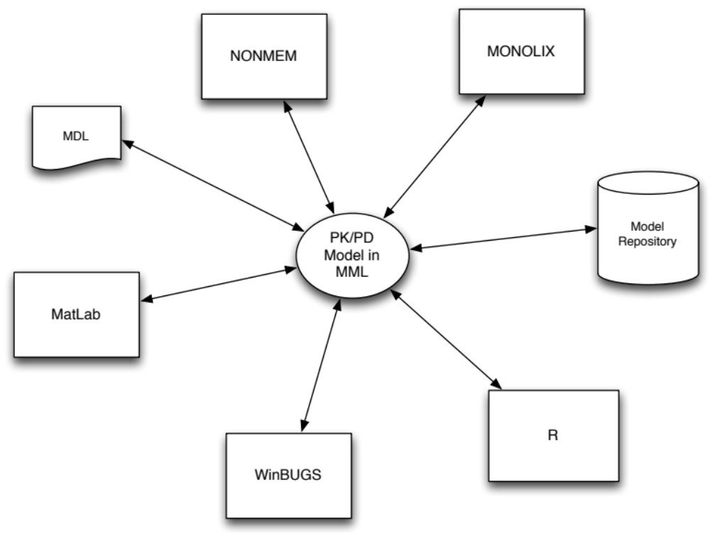
Model Exchange

Slide 3
Developing the Specification
MML
definition
xml
test cases
build prototype implementation
expand definition
refine definition
Code generator/translator
No
tests
work?
Yes
Executable Model

Slide 4
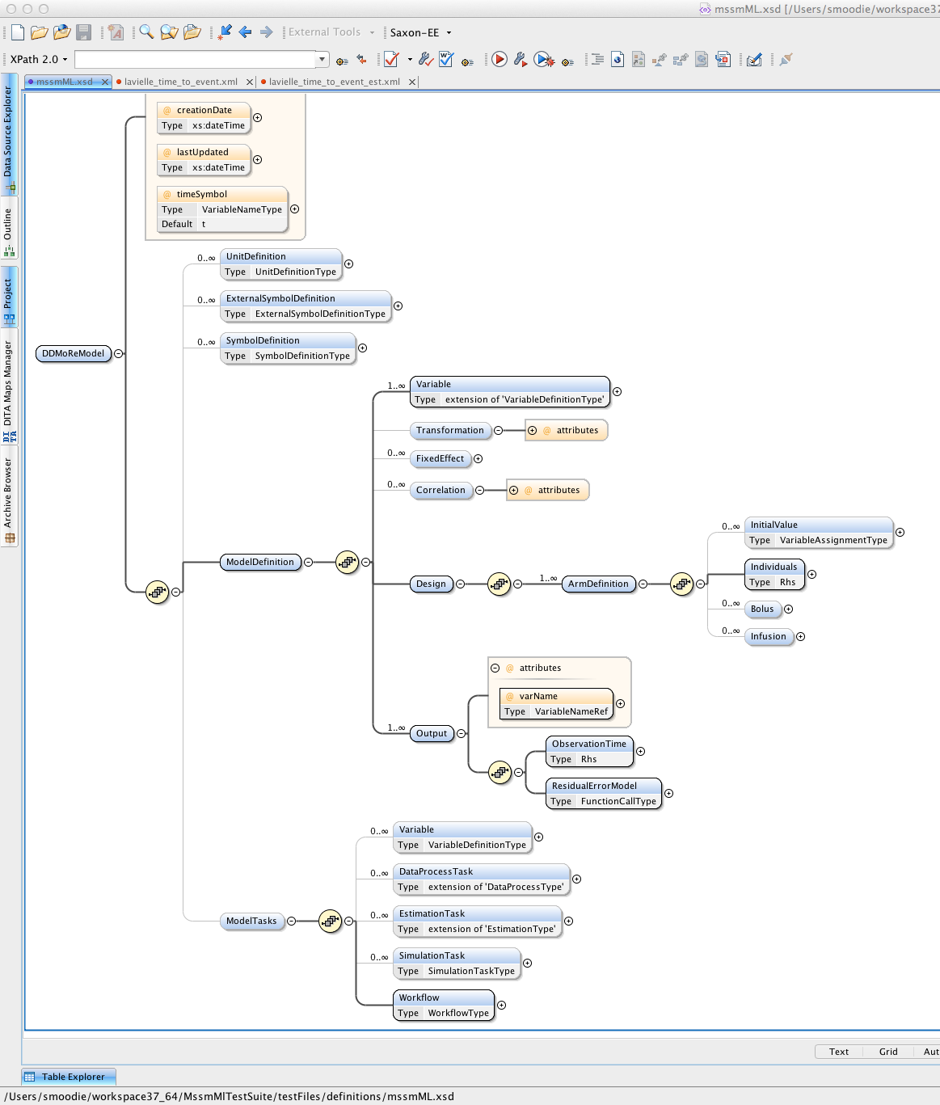
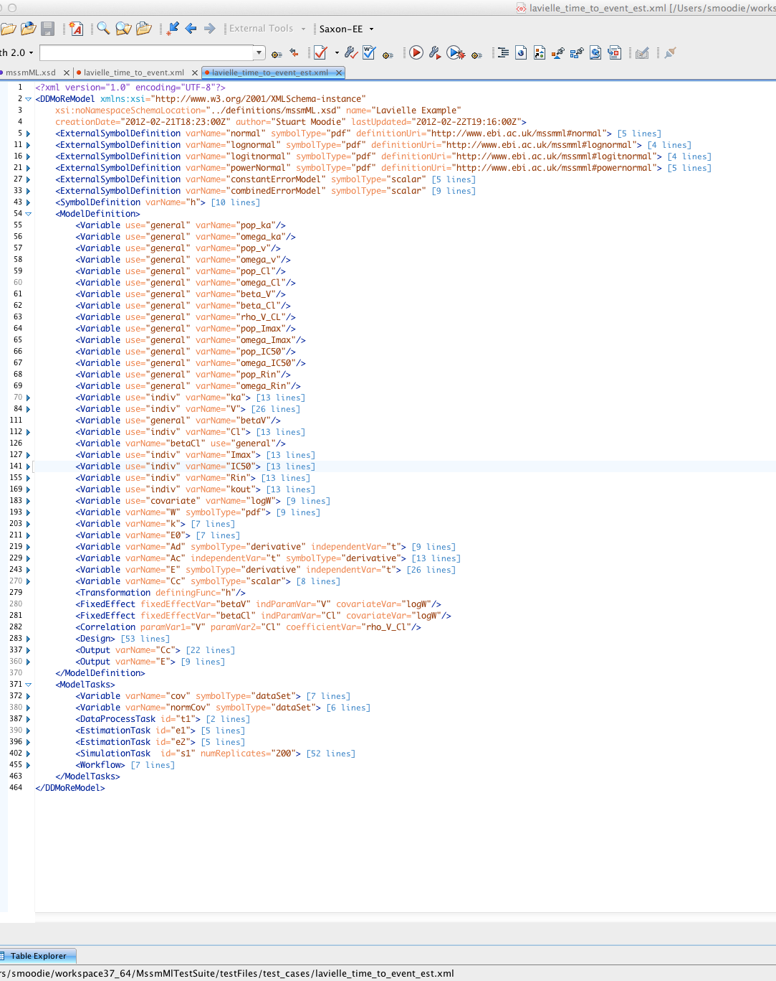
Examples
Notes:
XML code
Tree structure

Slide 5
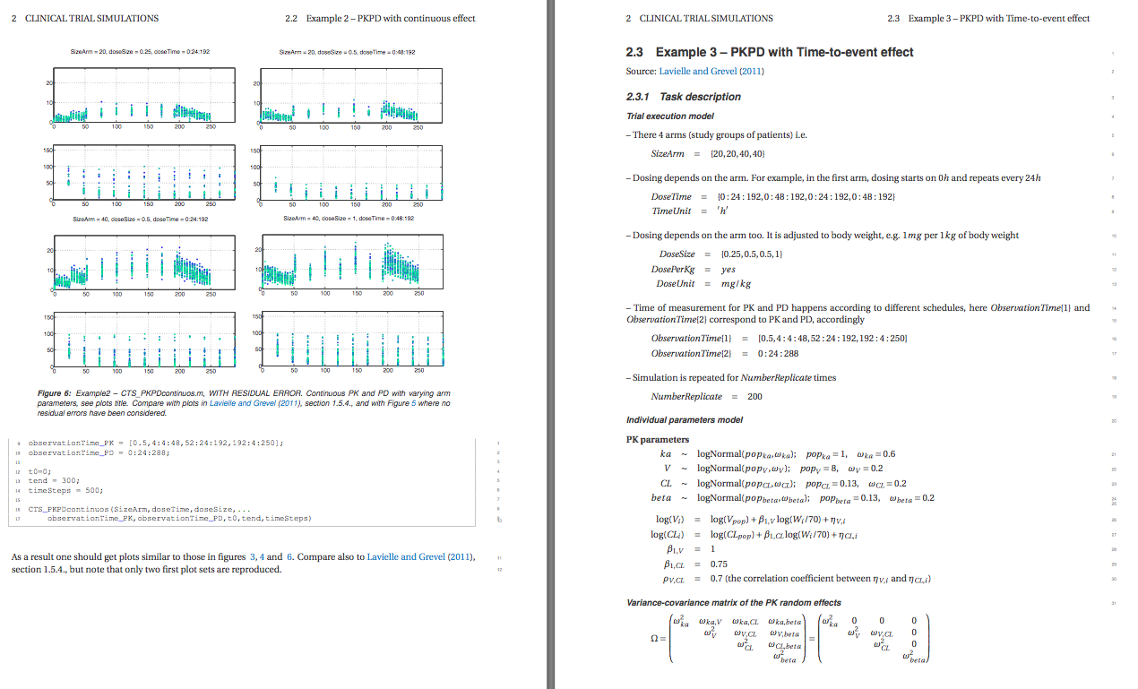
Test Cases
Notes:
Compare with original references
VISUAL CHECK

Slide 6







Outcome
libMML (WP 2.3: API)
MML
specification
DDMoRe ML
SBML
NuML
SED-ML
CellML
PharML

Slide 7
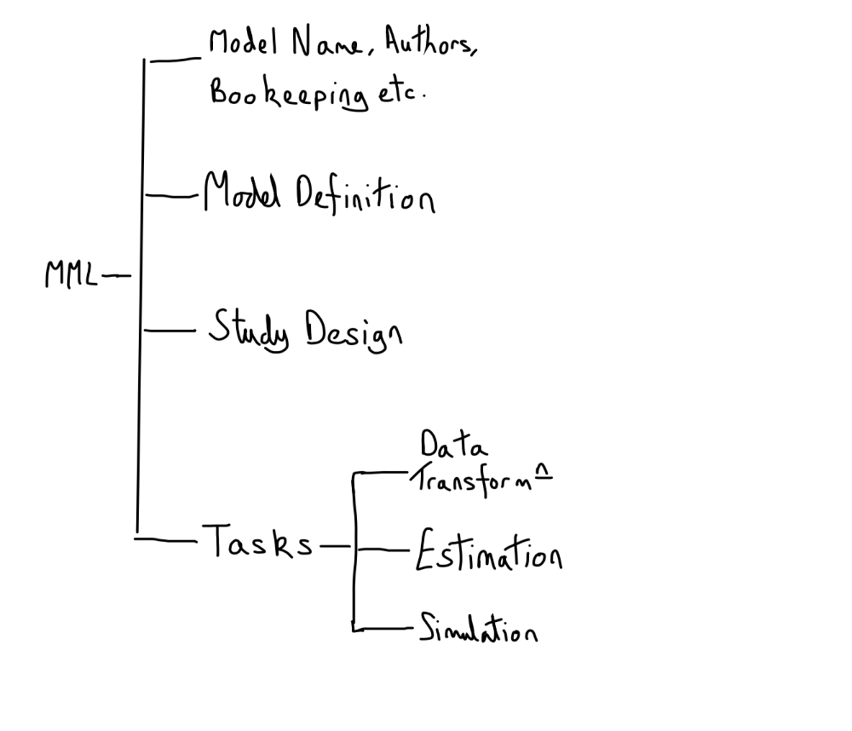
MML Organization

Slide 8
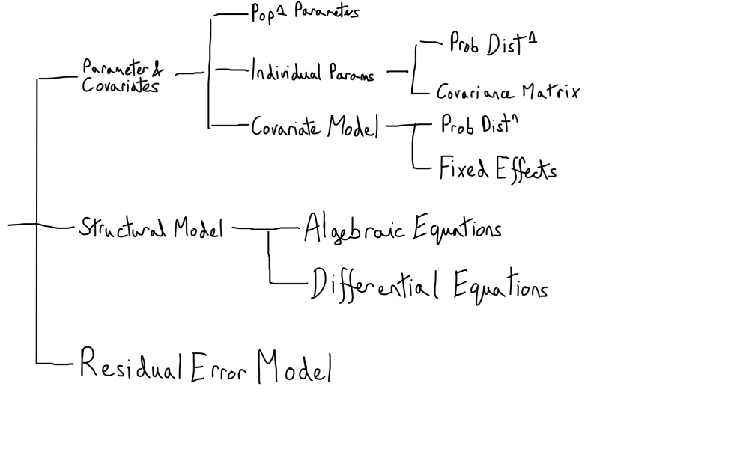
Model Definition

Slide 9
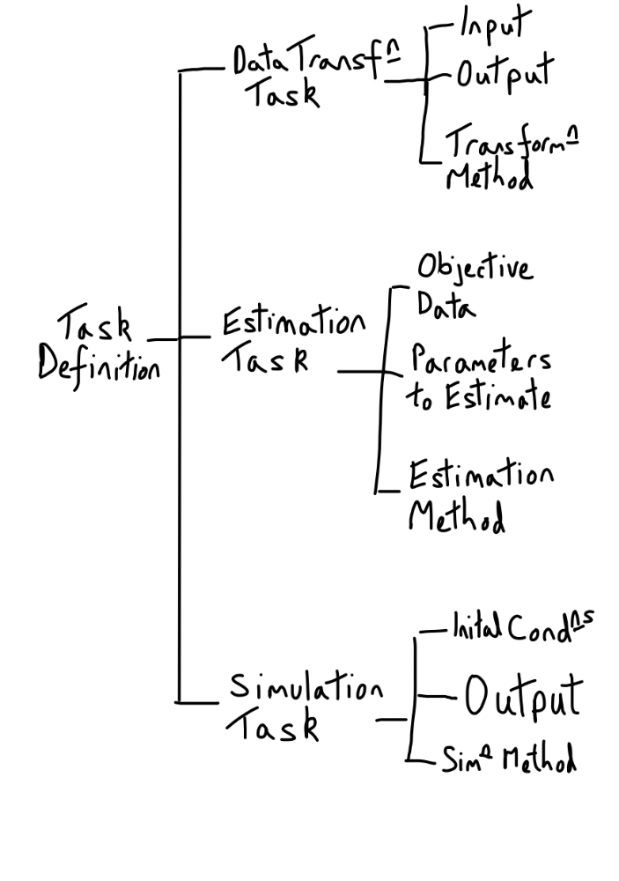
Tasks/Workflow

Slide 10
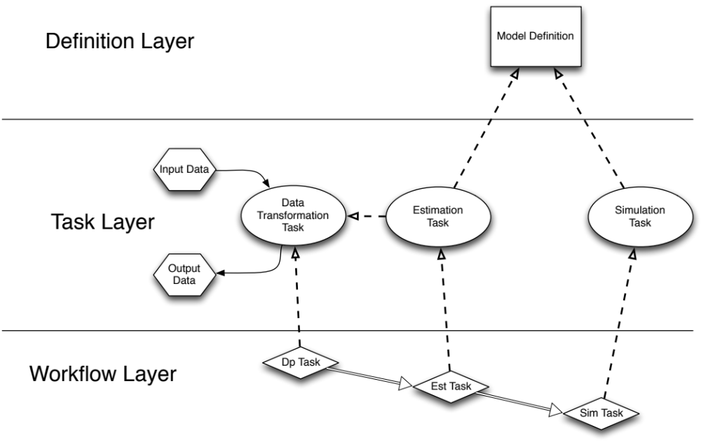
MML Structure Overview

Slide 11
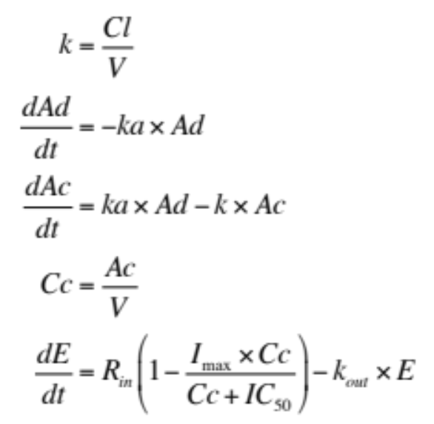

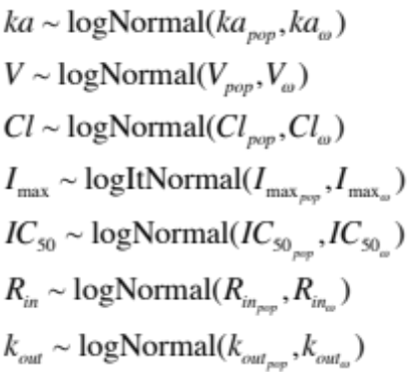
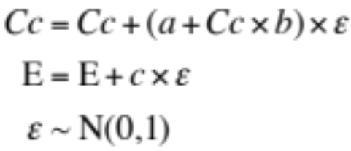
Example: Clinical Trial – continuous effect
Structural Model
Covariate
Individual Parameter
Residual Error Model
Combined Error Model
Constant Error Model

Slide 12
Example: Clinical Trial – continuous effect
4 Study Arms
Output:
  Cc: [0.5, 4:4:48, 52:24:192, 192:4:250]
  E: 0:24:288
Repeat: 200 times
Arm | # patients | dose mg/kg | dosing times (h)
1 | 20 | 0.25 | 0:24:192
2 | 20 | 0.5 | 0:48:912
3 | 40 | 0.5 | 0:24:192
4 | 40 | 1.0 | 0:48:192

Slide 13
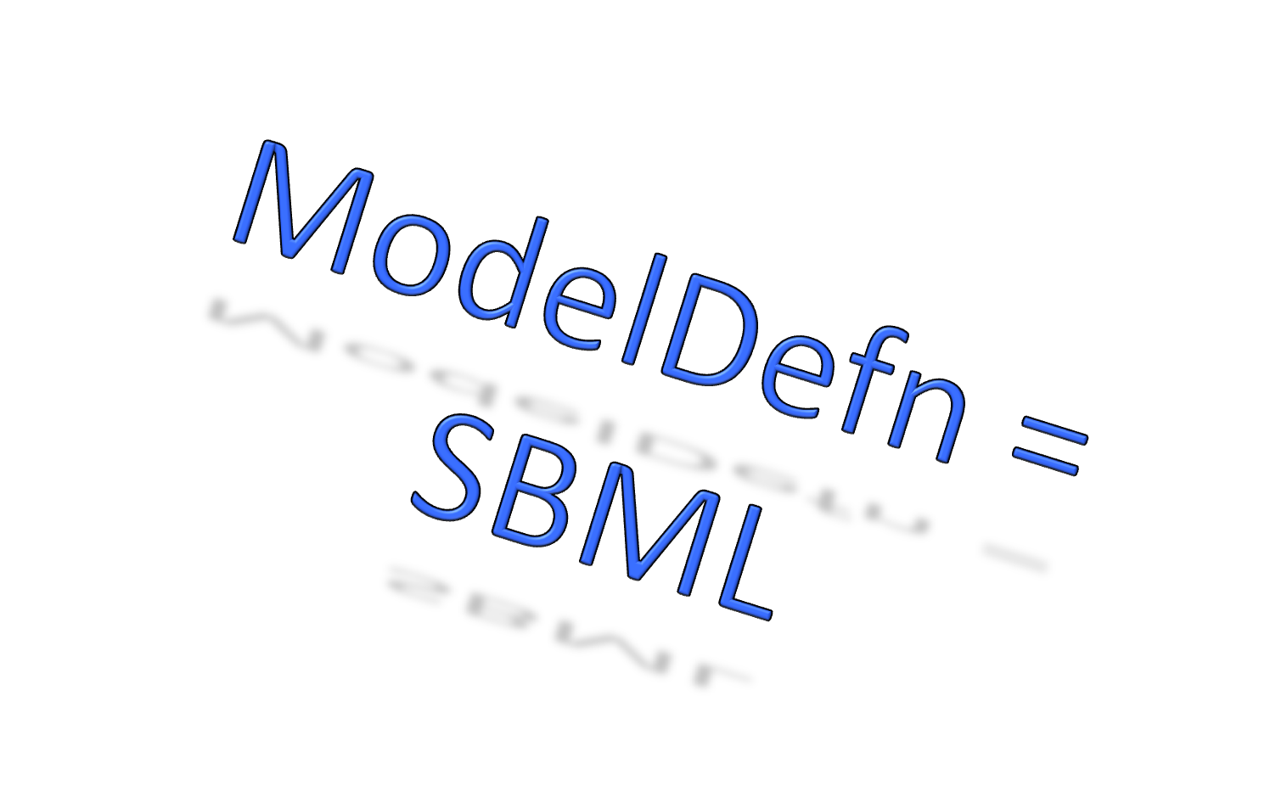
Example: Clinical Trial – continuous effect
Structural Model
Covariate
Individual Parameter
Residual Error Model
Combined Error Model
Constant Error Model

Slide 14
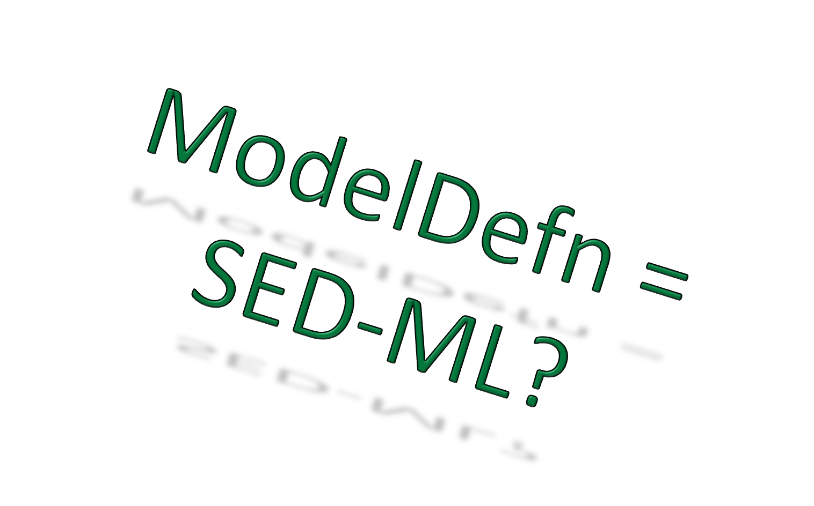
Example: Clinical Trial – continuous effect
4 Study Arms
Output:
  Cc: [0.5, 4:4:48, 52:24:192, 192:4:250]
  E: 0:24:288
Repeat: 200 times
Arm | # patients | dose mg/kg | dosing times (h)
1 | 20 | 0.25 | 0:24:192
2 | 20 | 0.5 | 0:48:912
3 | 40 | 0.5 | 0:24:192
4 | 40 | 1.0 | 0:48:192

Slide 15
New Functionality Required
SBML
  distrib (probability distributions)
  arrays (covariance matrices, correlated distns)
SED-ML
  Needs to be more expressive! Nested proposal is not enough!
  We will need support for more parameter estimation too.
Combine Archive
  Relate together structural model, study design & initial conditions, results & objective data for parameter estimation.

Slide 16
Acknowledgments
DDMoRe Colleagues
SBML community
SED-ML community
Sarah Keating
Grant funding: DDMoRe Consortium funded by the IMI
“The research leading to these results has received support from the Innovative Medicines Initiative Joint Undertaking under grant agreement n° 115156, resources of which are composed of financial contributions from the European Union's Seventh Framework Programme (FP7/2007-2013) and EFPIA companies’ in kind contribution. The DDMoRe project is also supported by financial contribution from Academic and SME partners. This work does not necessarily represent the view of all DDMoRe partners.”

Slide 17

Questions?

