Slide 1
Semantic Interoperability Framework
(RICORDO project)
Sarala M. Wimalaratne

Slide 2


Towards achieving semantic interoperability
Different types of data and models
Ontologies
....
....
Clinical data
metadata
CellType
Image data
PATO
Signal data
FMA
Biological models
GO
Master headline

Slide 3
Semantic interoperability framework features
Semantic search engine for data and models
Support knowledge discovery through reasoning over large biological ontologies
Enable standardisation and integration of biological annotations in data and models
Master headline

Slide 4


Towards achieving semantic interoperability
Different types of data and models
Ontologies
....
....
metadata
CellType
Clinical data
PATO
Image data
FMA
Signal data
GO
Biological models
Data sources
RDF triple store
OWL knowledge base
Master headline

Slide 5
Semantic interoperability framework
Community wide applications
(Eg: BioModels, DDMoRE, OpenCOR)
Reference UI
RDF Services (API/WS)
OWL Services (API/WS)
Data sources
RDF triple store
OWL knowledge base
Data and models
Metadata -RDF annotations
OWL Ontologies
Master headline

Slide 6
Reasoner workflow
Retrieving and adding ontology terms
Query
Deployable OWL services
OWL knowledge base
[Pellet OWLlink]
Results
API
ricordo-owlkb.jar
Web services
ricordo-owlkb-ws.war
OWL-EL Ontologies
key
requests
responses
Master headline

Slide 7
OWLKb Services
Developed using Java/Spring
Spring configurations can be changed to use different reasoners
Provides a config.properties file to configure OWL file sources, server port etc
owlkb API is available at http://www.ebi.ac.uk/~maven/m2repo_snapshots/
Source code - https://github.com/sarala (ricordo-owlkb, ricordo-owlkb-ws)
Master headline

Slide 8
OWLKb WS
Example WS instance is running at http://www.ebi.ac.uk/ricordo-owlkb-ws/.
The KB consists of OWL-EL versions of
  FMA (Rosse and Mejino, 2007)
  PATO (Gkoutos et al., 2005)
  GO (Ashburner et al., 2000)
  Cell Type (Bard et al., 2005)
  ChEBI (De Matos et al., 2010)
  HPO and its class definitions (Robinson and Mundlos, 2010; Gkoutos et al., 2009)
Uses Pellet OWLlink for underlying knowledge base management
OWL-EL converter at http://code.google.com/p/el-vira/
Master headline

Slide 9
RDF repository workflow
Setting up a RDF store
Set up a RDF store and load metadata
Retrieving and adding metadata
RDF triple store
[virtuoso]
Query
Deployable RDF services
Results
API
ricordo-rdfstore.jar
Web services
ricordo-rdfstore-ws.war
Metadata -RDF annotations
key
requests
responses
Master headline

Slide 10
RDF store services
Developed using Java/Spring
Spring configurations can be changed to use different RDF stores
A config.properties file to configure SPARQL template files, server port etc
rdfstore API is available at http://www.ebi.ac.uk/~maven/m2repo_snapshots/
Source code - https://github.com/sarala (ricordo-rdfstore, ricordo-rdfstore-ws)
Master headline

Slide 11
RDF store WS
Example WS instance is running at http://www.ebi.ac.uk/ricordo-rdfstore-ws/.
Virtuoso API for underlying RDF store management
The RDF store consists of all curated BioModels in RDF
Master headline

Slide 12
Reference User Interface
RefUI allows users to interact with the knowledge base and metadata using the services
RefUI supports a number of functionalities including:
  annotation of resources
  definition of complex terms using ontology terms and relations
  semantic querying of resources
Source code - https://github.com/sarala (ricordo-refui)
Example instance is running at http://www.ebi.ac.uk/ricordo-refui/Ricordo.html#ricordoapp
Master headline

Slide 13
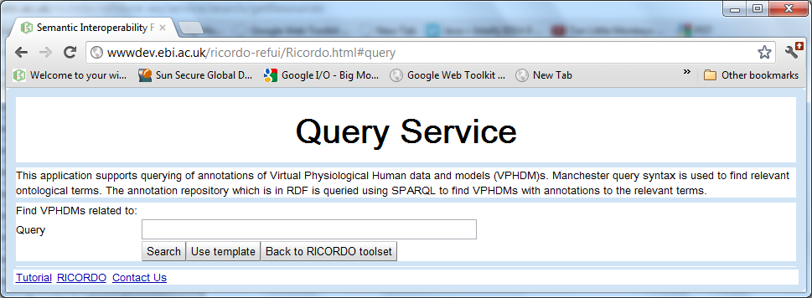
Reference UI - Query service application
Query service allows searching for data and models based on their ontological annotations.
Master headline

Slide 14
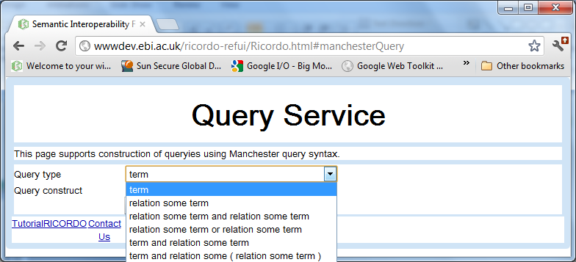
Reference UI - Query service application
The application allows the user to select templates to construct query terms.
Each template has a particular form to specify the query term.
Master headline

Slide 15
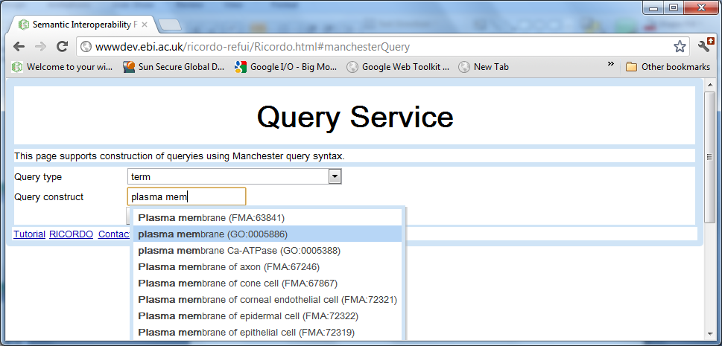
Reference UI - Query service application
Auto complete field(s) are provided for users to find relevant ontological terms.
Master headline

Slide 16
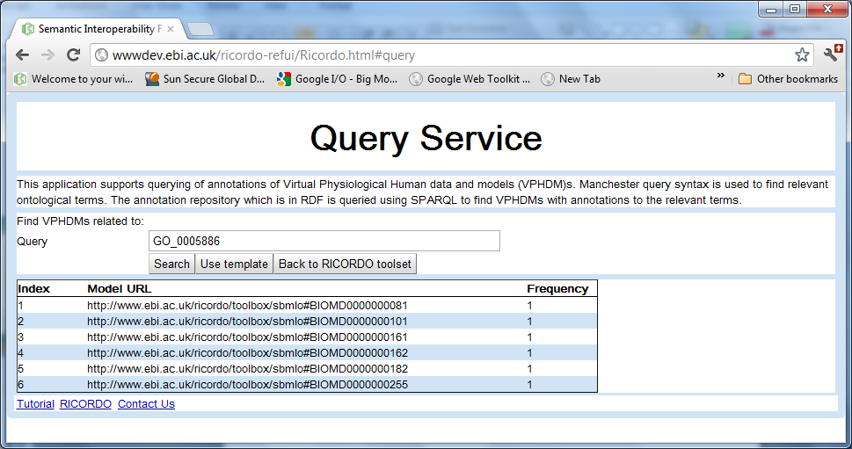
Reference UI - Query service application
The application queries the dataset of annotations for data and models that are related to the term in the query field.
Master headline

Slide 17
Next iteration
OWL/RDF Services
OWL/RDF Services
OWL/RDF Services
BioModels
DDMoRE
OpenCOR
Global search
web application
Master headline

Slide 18
Acknowledgements
Funding
  RICORDO - http://www.ricordo.eu/
  DDMoRe - http://www.ddmore.eu/
  Open PHACTS - http://www.openphacts.org/
Master headline

