Slide 1

Moving on with
Standard interoperability
For modelling in biology

Slide 2
Computational modelling left the niches
Metabolic networks Fung et al. A synthetic gene-metabolic oscillator. Nature 2005; Herrgård et al. A consensus yeast metabolic network reconstruction obtained from a community approach to systems biology. Nat Biotechnol 2008
Signalling pathways Bray et al. Receptor clustering as a cellular mechanism to control sensitivity. Nature 1998; Bhalla ad Iyengar. Emergent properties of signaling pathways. Science 1998; Schoeberl et al. Computational modeling of the dynamics of the MAP kinase cascade activated by surface and internalized EGF receptors. Nat Biotechnol 2002; Hoffmann et. The IκB-NF-κB signaling module: temporal control and selective gene activation. Science 2002; Smith et al. Systems analysis of Ran transport. Science 2002; Bhalla et al. MAP kinase phosphatase as a locus of flexibility in a mitogen-activated protein kinase signaling network. Science 2002; Nelson et al. Oscillations in NF-κB Signaling Control the Dynamics of Gene Expression. Science 2004; Werner et al. Stimulus specificity of gene expression programs determined by temporal control of IKK activity. Science 2005; Sasagawa et al. Prediction and validation of the distinct dynamics of transient and sustained ERK activation. Nat Cell Biol 2005; Basak et al. A fourth IkappaB protein within the NF-κB signaling module. Cell 2007; McLean et al. Cross-talk and decision making in MAP kinase pathways. Nat Genet 2007; Ashall et al. Pulsatile Stimulation Determines Timing and Specificity of NF-κB-Dependent Transcription. Science 2009; Becker et al. Covering a broad dynamic range: information processing at the erythropoietin receptor. Science 2010
Gene regulatory networks McAdams and Shapiro. Circuit simulation of genetic networks. Science 1995; Yue et al. Genomic cis-regulatory logic: Experimental and computational analysis of a sea urchin gene. Science 1998; Von Dassow et al. The segment polarity network is a robust developmental module. Nature 2000; Elowitz and Leibler. A synthetic oscillatory network of transcriptional regulators. Nature 2000; Shen-Orr et al, Network motifs in the transcriptional regulation network of Escherichia coli. Nat Genet 2002; Yao et al. A bistable Rb-E2F switch underlies the restriction point. Nat Cell Biol 2008; Friedland. Synthetic gene networks that count. Science 2009
Pharmacometrics models Labrijn et al. Therapeutic IgG4 antibodies engage in Fab-arm exchange with endogenous human IgG4 in vivo. Nat Biotechnol 2009
Physiological models Noble. Modeling the heart from genes to cells to the whole organ. Science 2002; Izhikevich and Edelman. Large-scale model of mammalian thalamocortical systems. PNAS 2008
Infectious diseases Perelson et al. HIV-1 dynamics in vivo: Virion clearance rate, infected cell life-span, and viral generation time. Science 1996; Nowak. Population dynamics of immune responses to persistent viruses. Science 1996; Neumann et al. Hepatitis C viral dynamics in vivo and the antiviral efficacy of interferon-alpha therapy. Science 1998

Slide 3

Computational models on the rise
models
relationships
800
160000
600
120000
400
80000
200
40000
0
0
Apr 2005
Feb 2012
BioModels Database growth since its creation
http://www.ebi.ac.uk/biomodels/

Slide 4
Rising interest from new stakeholders
“Biologists”: computational models look “useful”, “serious”
Publishers: computational articles are respectable, and can be published in high profile journals
Funding agencies: Models could help with the major challenges (read “science that can be sold to citizen/electors”): Health, Food, Energy...
Industries: Models could help with the major challenges (read “new opportunities to make money”): Pharmas, crops, biofuels ...

Slide 5
Many alternative modelling approaches
Neurobiology
State-Transitions, cable
Approximation (PDE)
Physiology
Biochemistry
Process
Descriptions
(ODE, Monte-Carlo)
Rule-based models
Qualitative models
Variable description
(ODE, PDE)
Cell automata
Multi-agents,
Matrix models
Developmental
biology, plant biology
Pharmacometrics
PK/PD, statistical
models

Slide 6










Parallel and redundant efforts
Physiology
Neurobiology
Systems Biology
NDTF
BioPAX
FieldML
Developmental
biology, plant biology
Pharmacometrics

Slide 7
Mathematical
biology
Models
Networks
Pathways
Biological
engineering
OMICS

Slide 8
What if the world-wide web was built like this?
leisure
art and design
business
literacy
natural sciences

Slide 9





The correct way to do it
Personal info: vCard
Presentation: CSS
Semantics: RDF
Graphics: SVG
Display: HTML

Slide 10




Existing standards interoperability
BioPAX

Slide 11
So many meetings ...
BioPAX face 2 face
SBML forum
SBGN meeting
SBML hackathon
BioModels training camp
SuperHackathon
CellML workshop
NeuroML workshop

Slide 12
Multiple involvements
Authors on several publications describing “our” standards:
Mirit Aladjem (BioPAX, SBGN), Frank Bergmann (SBGN, SED-ML), Emek Demir (BioPAX, SBGN), Mélanie Courtot (SBGN, SBO/KiSAO), Andrew Finney (BioPAX, SBML, SBO/KiSAO), Igor Goryanin (SBGN, SBML), Stefan Hoops (SBO/KiSAO, SED-ML), Michael Hucka (BioPAX, SBGN, SBML, SBO/KiSAO, SED-ML), Peter Hunter (CellML, SBML), Nick Juty (SBML, SBO/KiSAO), Douglas Kell (SBGN, SBO/KiSAO), Hiroaki Kitano (SBML, SBGN), Fedor Kolpakov (SBGN, SED-ML), Nicolas Le Novère (BioPAX, SBGN, SBML, SBO/KiSAO, SED-ML), Pedro Mendes (SBO/KiSAO), Huaiyu Mi (BioPAX, SBGN), David Nickerson (CellML, SED-ML), Poul Nielsen (CellML, SBML), Sven Sahle (SBGN, SED-ML), Herbert Sauro (SBGN, SBML), Jacky Snoep (SBGN, SBO/KiSAO), Alice Villéger (SBGN, SBO/KiSAO), Dagmar Waltemath (SBO/KiSAO), Sarala Wimalaratne (BioPAX, SBGN, SBO/KiSAO)

Slide 13

Overarching standardisation structure
The “WorldWide Web consortium” of modelling in biology http://co.mbine.org/

Slide 14
Mission 1: Coordinating meetings
Annual COMBINE forums
  COMBINE 2010: October 6–9, Edinburgh, 81 attendees
  COMBINE 2011: September 3-7, Heidelberg, 89 attendees
  COMBINE 2012: August 15-19, Toronto
  COMBINE 2013: Date unknown, location unknown
  http://www.surveymonkey.com/s/combine-harmony-hosting-interest
The Hackathons on Resources for Modeling in Biology
  HARMONY 2011: April 18-22, New-York City, 59 attendees
  HARMONY 2012; May 21-25, Maastricht, 60 registrations
  HARMONY 2013: Date unknown, location unknown
  http://www.surveymonkey.com/s/combine-harmony-hosting-interest

Slide 15
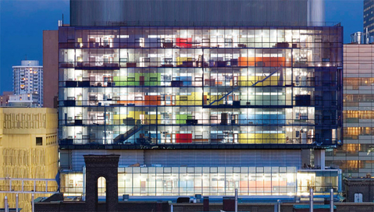
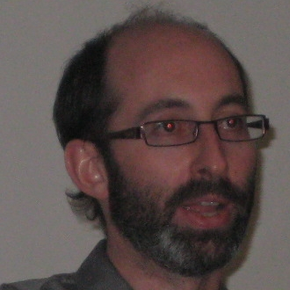
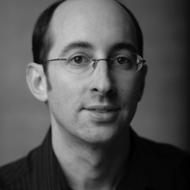

COMBINE forum 2012
August 15 to 19 2012, before ICSB
Donnelly center, Toronto
Organizer: Gary Bader
http://co.mbine.org/events/COMBINE_2012

Slide 16




Mission 2: Coordinating standards development
CORE STANDARDS: Efforts fulfilling COMBINE criteria and aiming at following COMBINE rules and interoperate with other COMBINE standards
ASSOCIATED EFFORTS: Standards that are not representation formats, but aiming at enrich or bridge the core standards
RELATED EFFORTS: Formats developed by other communities, that complement or interoperate with COMBINE formats, and that we would like to see joining COMBINE or collaborating closely to COMBINE
BioPAX
FieldML
NuML
PSI-MI

Slide 17
COMBINE does NOT aim to take over the development of the standard formats, but help coordinating and supporting this process

Slide 18
Mission 3:
Developing Standard Operating Procedures
Technical requirements
  Which format covers what portion of the modeling space
  Which technical solutions exist, and should be used by the formats
  How do formats interface and interoperate
  How to specify and document formats
  ...
Governance
  How to initiate and maintain standardisation efforts
  How to communicate with users and developers
  How to develop a democratic and robust governance
  ...

Slide 19
New: Format specification infrastructure
Each format comes with many different flavors, described in many different specification documents.
Format specifications are distributed in different ways, through different websites.
The means of distribution for format specifications evolve over time, making hard to consistently refer to them.
Trying to find reliable third parties proved difficult (e.g. Nature Precedings).
We need a consistent way of naming specification documents

Slide 20
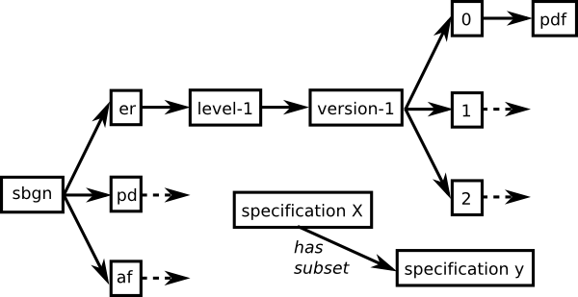
New: Format specification infrastructure
sbgn.er.level-1.version-1.0.pdf

Slide 21

Identification and retrieval of specification documents
http://identifiers.org/combine.specifications/sbgn
http://identifiers.org/combine.specifications/sbgn.er
http://identifiers.org/combine.specifications/sbgn.er.level-1
http://identifiers.org/combine.specifications/sbgn.er.level-1.version-1
http://identifiers.org/combine.specifications/sbgn.er.level-1.version-1.0
http://identifiers.org/combine.specifications/sbgn.er.level-1.version-1.0.pdf
http://co.mbine.org/specifications/sbgn
http://co.mbine.org/specifications/sbgn.er
redirects
http://co.mbine.org/specifications/sbgn.er.level-1
http://co.mbine.org/specifications/sbgn.er.level-1.version-1
http://co.mbine.org/specifications/sbgn.er.level-1.version-1.0
http://co.mbine.org/specifications/sbgn.er.level-1.version-1.0.pdf
http://co.mbine.org/standards/sbgn
http://co.mbine.org/standards/sbgn.er
alias
http://co.mbine.org/standards/sbgn/er/level-1/version-1/2
http://co.mbine.org/standards/sbgn/er/level-1/version-1/2
http://co.mbine.org/standards/sbgn/er/level-1/version-1/0
sbgn.er.level-1.version-1.0.pdf

Slide 22
Identification and retrieval of specification documents
http://identifiers.org/combine.specifications/sbgn
http://identifiers.org/combine.specifications/sbgn.er
http://identifiers.org/combine.specifications/sbgn.er.level-1
http://identifiers.org/combine.specifications/sbgn.er.level-1.version-1
http://identifiers.org/combine.specifications/sbgn.er.level-1.version-1.0
http://identifiers.org/combine.specifications/sbgn.er.level-1.version-1.0.pdf
http://co.mbine.org/specifications/sbgn
http://co.mbine.org/specifications/sbgn.er
redirects
http://co.mbine.org/specifications/sbgn.er.level-1
http://co.mbine.org/specifications/sbgn.er.level-1.version-1
http://co.mbine.org/specifications/sbgn.er.level-1.version-1.0
http://co.mbine.org/specifications/sbgn.er.level-1.version-1.0.pdf
http://co.mbine.org/standards/sbgn
http://co.mbine.org/standards/sbgn.er
Responsibility
of format editors!
http://co.mbine.org/standards/sbgn/er/level-1/version-1/2
alias
http://co.mbine.org/standards/sbgn/er/level-1/version-1/2
http://co.mbine.org/standards/sbgn/er/level-1/version-1/0
sbgn.er.level-1.version-1.0.pdf

Slide 23
Identification and retrieval of specification documents
http://identifiers.org/combine.specifications/sbgn
http://identifiers.org/combine.specifications/sbgn.er
http://identifiers.org/combine.specifications/sbgn.er.level-1
http://identifiers.org/combine.specifications/sbgn.er.level-1.version-1
http://identifiers.org/combine.specifications/sbgn.er.level-1.version-1.0
http://identifiers.org/combine.specifications/sbgn.er.level-1.version-1.0.pdf
http://co.mbine.org/specifications/sbgn
http://co.mbine.org/specifications/sbgn.er
redirects
http://co.mbine.org/specifications/sbgn.er.level-1
This never
changes
http://co.mbine.org/specifications/sbgn.er.level-1.version-1
http://co.mbine.org/specifications/sbgn.er.level-1.version-1.0
http://co.mbine.org/specifications/sbgn.er.level-1.version-1.0.pdf
http://co.mbine.org/standards/sbgn
http://co.mbine.org/standards/sbgn.er
alias
http://co.mbine.org/standards/sbgn/er/level-1/version-1/2
This can
change over
time
http://co.mbine.org/standards/sbgn/er/level-1/version-1/2
http://co.mbine.org/standards/sbgn/er/level-1/version-1/0
sbgn.er.level-1.version-1.0.pdf

Slide 24
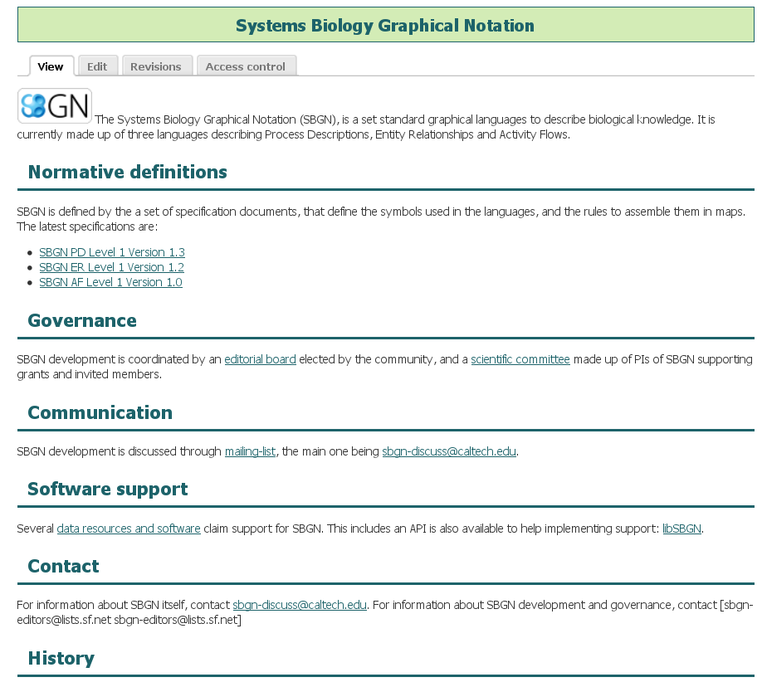
http://co.mbine.org/standards/sbgn

Slide 25
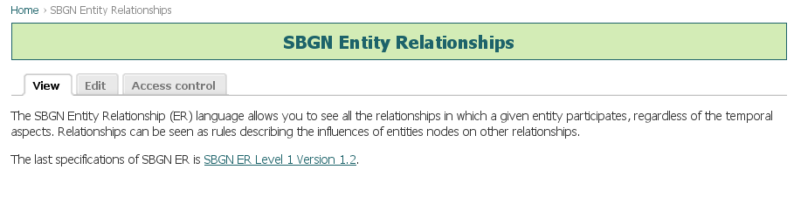
http://co.mbine.org/standards/sbgn/er

Slide 26
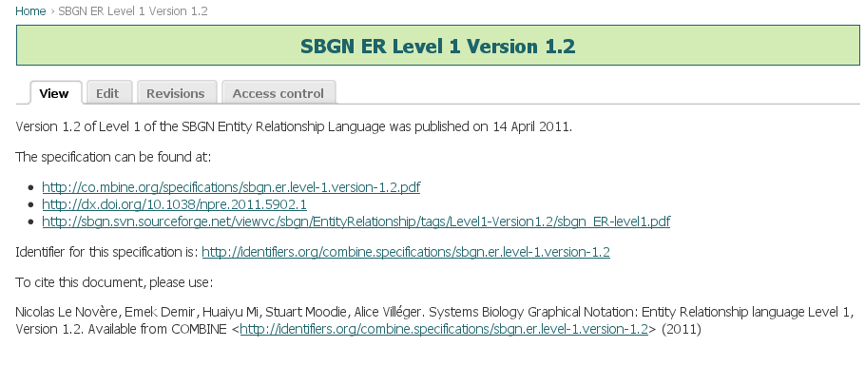
http://co.mbine.org/standards/sbgn/er/level-1/version-1/2

Slide 27
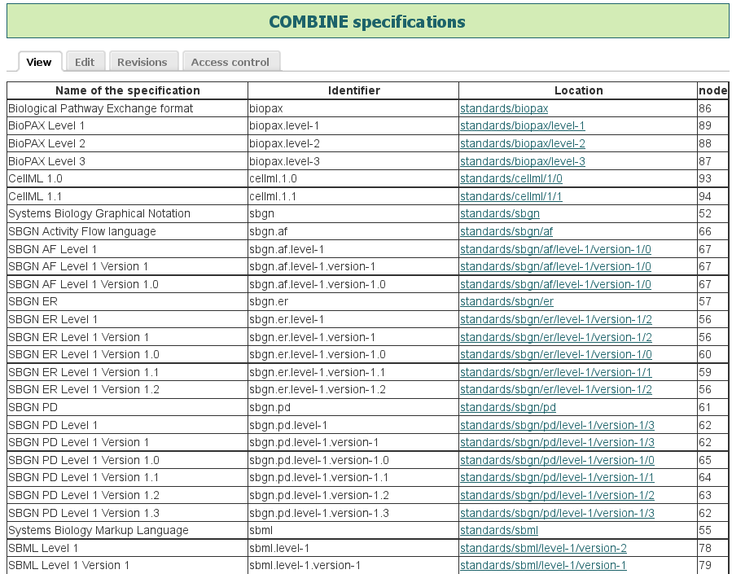

Slide 28
New: COMBINE archive
Most software can only open one file at a time. E.g. COPASI imports an SBML file, CellDesigner opens one SBML file. When one downloads a file from a repository, or as a supplementary material, it is often a given file, either model description or representation.
The SBML comp package will need to access several files
SED-ML files refer to models
NuML will need to be linked to model and simulation descriptions
In order to enrich SBGN maps, one may need information contained in BioPAX, SBML or NuML files
With other types of models, such as PKPD or physiological, the equations are not sufficient.

Slide 29

Two alternative and complementary solutions
The COMBINE archive is a format under discussion that would contain, in a single file, various documents, or references to documents, necessary for the description of a model and all associated data and procedures. This could includes model descriptions, simulation descriptions, visual representations, data files and metadata information.
Mainly aimed at
containing all the necessary files
locally, although
a mechanism to include references to remote material is included. Based on regular XML specifications, including vCard, Dublin Core. Draft under development.
The idea is to have a
distributed handling
of all the necessary
files retrieved via
semantic web technologies. Statement of interest for the moment.

Slide 30
Mission 4: Recognised voice
COMBINE aims to become a “standardisation” body
  This means a quality label. A “COMBINE standard” is a guarantee of stability, community endorsement, support etc.
  COMBINE production can be used in SOPs at other organisations
  COMBINE must be an actor on par with CSG, FGED, INCF, PSI etc.
Single point of contact with user organisations including Industry
  Tool developers (General platforms or specific tools)
  Publishers
  Pharmaceutical industry
A point of contact for funding bodies
A point of contact for legal entities, e.g. government and regulatory bodies

Slide 31
Where to find more information?
Communities
http://biopax.org/
Semantics
Coordination
http://sbgn.org/
http://co.mbine.org/
http://sbml.org/
http://biomodels.net/biomodels/
http://sed-ml.org/
http://biomodels.net/kisao
http://biomodels.net/sbo
http://biomodels.net/
http://biomodels.net/teddy
http://biomodels.net/miase
http://biomodels.net/miriam

Slide 32
Open standards, software and repositories for modeling in biology
OpenMod
Application for an Integrated Project to the EU Commission ICT VPH call 9
16 partner organisations. Coordination by EMBL
Maintenance and further development of mature formats: SBML, CellML, NeuroML, SBGN, SED-ML
Development of emerging or new formats, including NuML, FieldML, SBGN topo, multi-scale descriptions, COMBINE archive (called OMEX in the grant), Next generation model descriptions
Metadata and ontologies
APIs and converters for all the above
Documentation and training material for all the above
Implementation of support by repositories and development of search systems
Development of software showcases
Funding includes COMBINE forums and HARMONYs

Slide 33






Acknowledgements
SBML editors: Frank Bergmann, Andrew Finney, Stefan Hoops,
Michael Hucka, Nicolas Le Novère, Sarah Keating, Chris Myers,
Sven Sahle, Herbert Sauro, Jim Schaff, Lucian Smith, Darren Wilkinson
SBGN editors: Emek Demir, Nicolas Le Novère, Huaiyu Mi, Stuart Moodie,
Falk Schreiber, Anatoly Sorokin, Alice Villéger
BioPAX editors: Emek Demir, Peter D'Eustachio, Huaiyu Mi,
Oliver Ruebenacker, Andrea Splendiani
SED-ML editors: Richard Adams, Franck Bergmann, Nicolas Le Novère,
Andrew Miller, David Nickerson, Dagmar Waltemath
Metadata: Mélanie Courtot, Nick Juty, Camille Laibe, Anna Zhukova
The whole community of Computational Systems Biology

