Slide 1

Extending SBOL for Combinatorial Design
Nicholas Roehner
Lattice Automation, Inc.
Notes:
‹#›

Slide 2
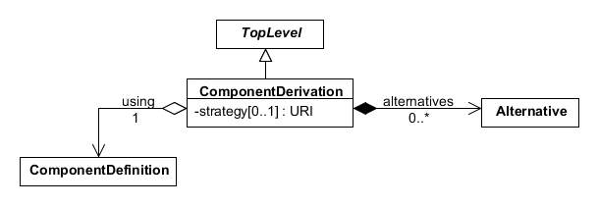
ComponentDerivation Class

Slide 3
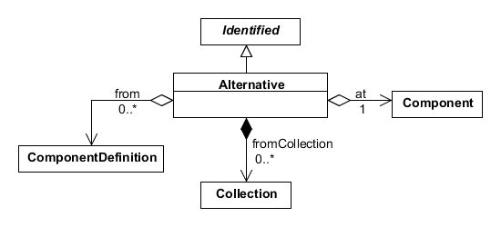
Alternative Class

Slide 4
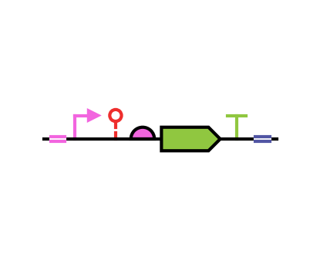
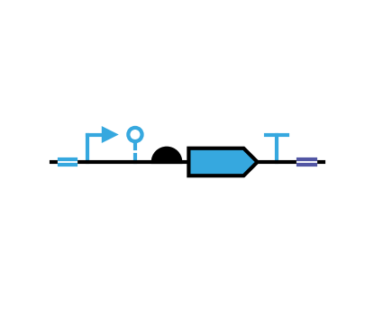
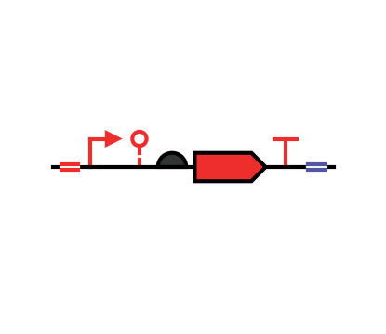
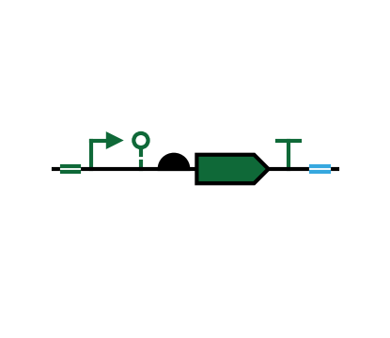
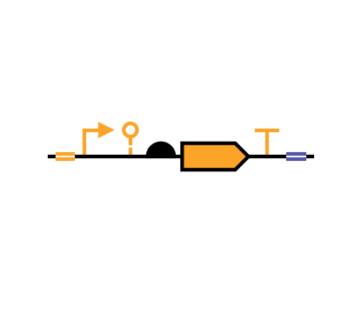
New Classes Enable Specification of NxNx… Designs
x
x
x

Slide 5
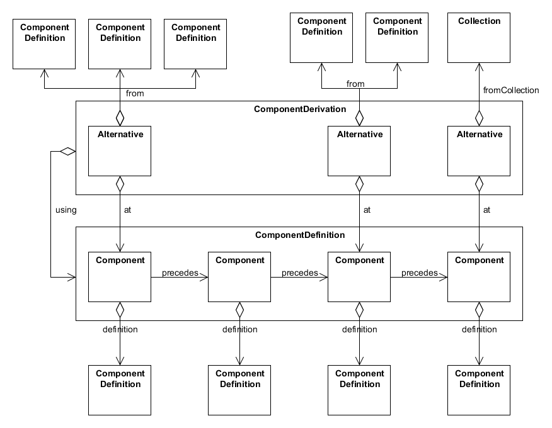
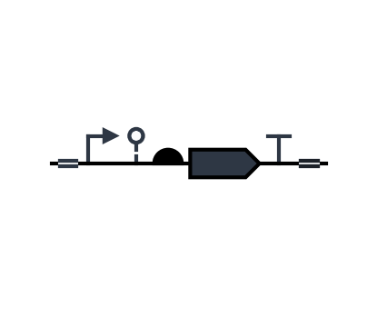
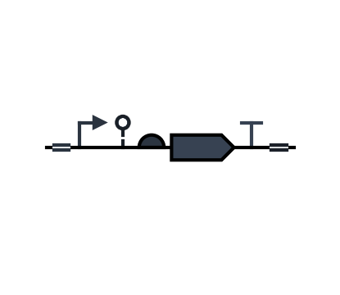

Slide 6
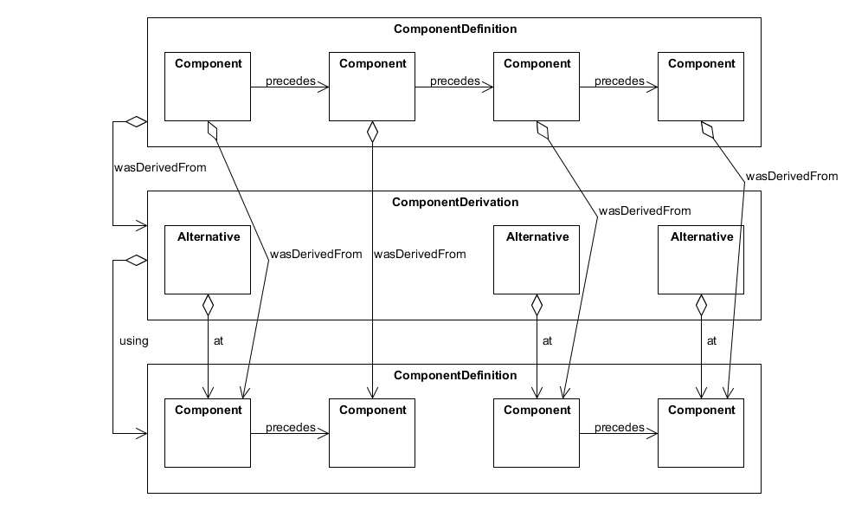
Example of Derived ComponentDefinition

Slide 7
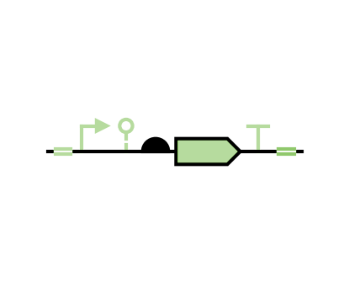
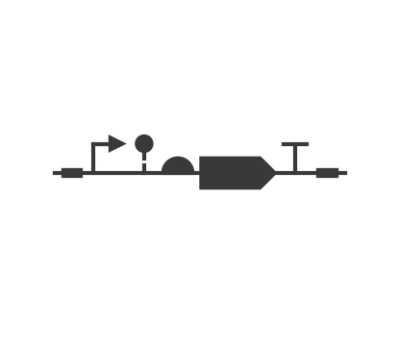
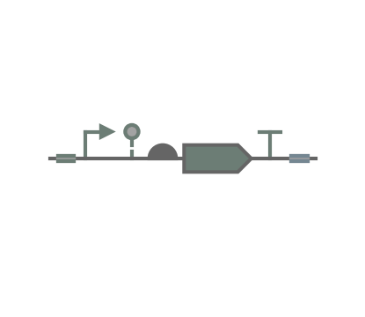
How to Encode Choice Between NxNx… Designs?

Slide 8
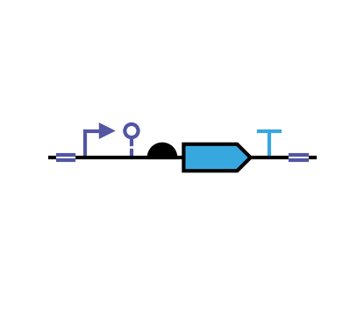
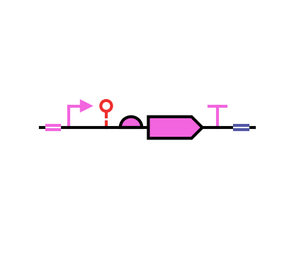
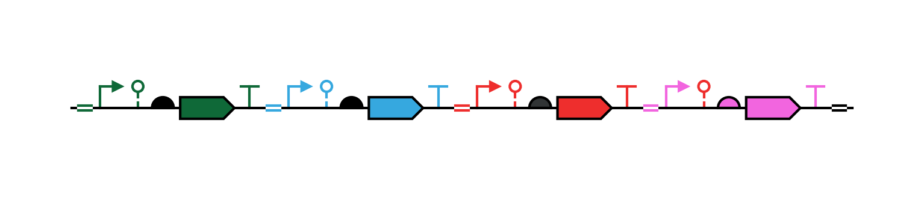
Real Use Case - Design Space for Combinatorial Biosynthesis
Encodes 1,512 pathway designs adhering to rules implicit in graph structure
Rules dictate inclusion and exclusion of different enzyme classes

Slide 9
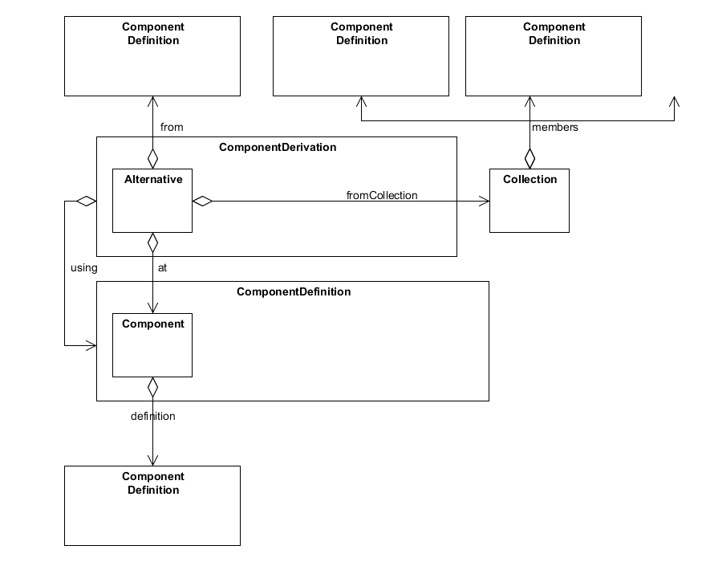
… 79

Slide 10
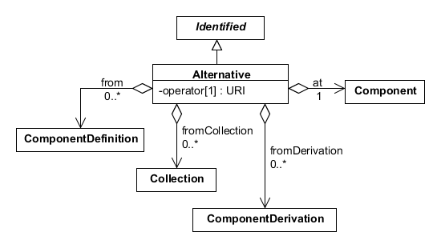
Alternative Class v2

Slide 11
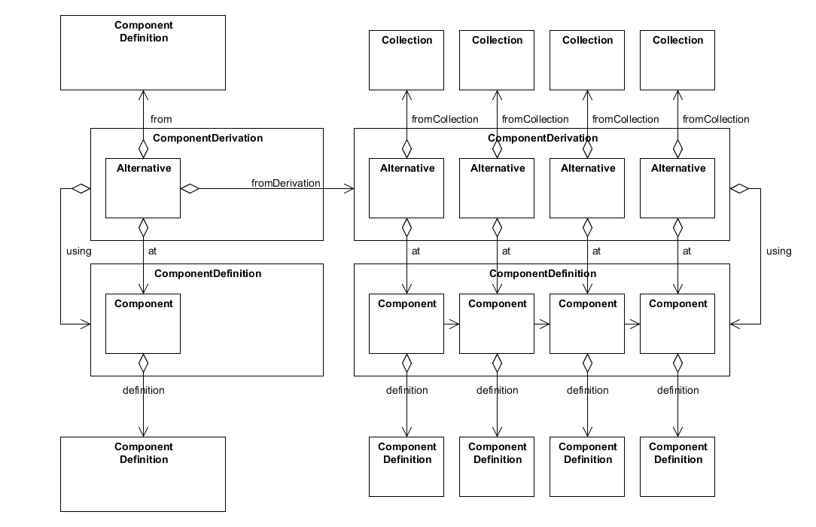

Slide 12
How to Encode One or More?

Slide 13
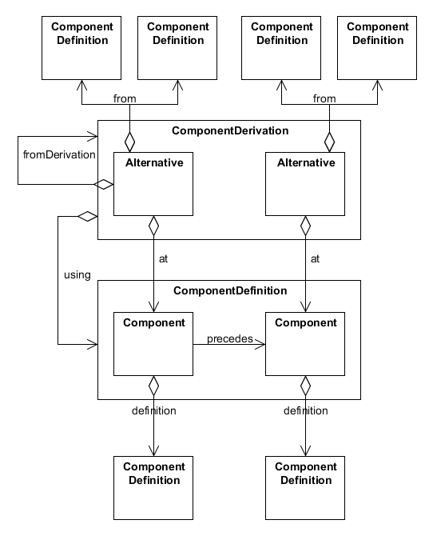

Slide 14
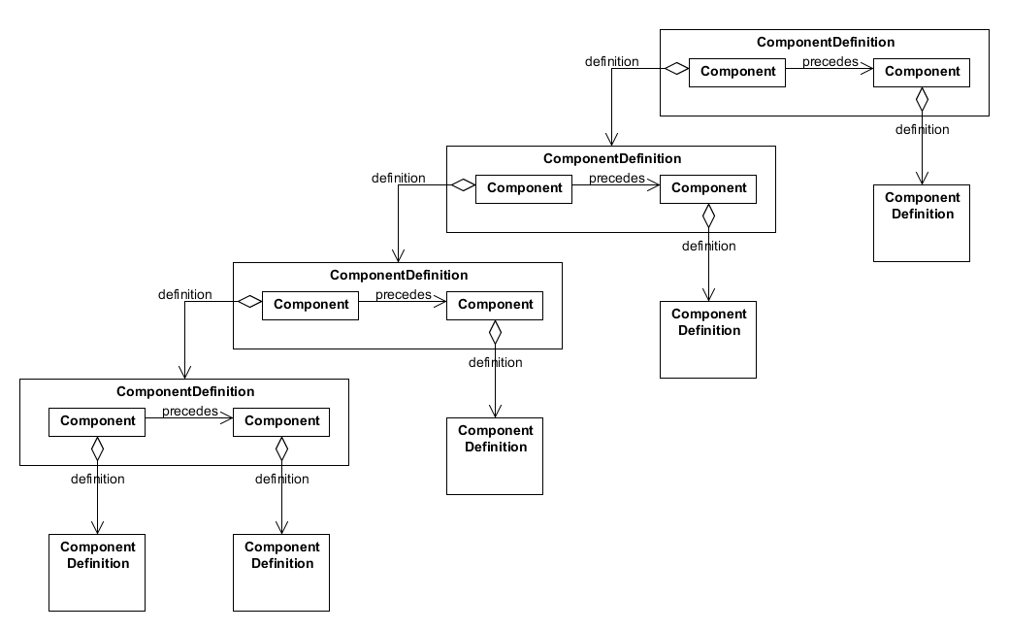
Example of Recursively Derived ComponentDefinition
Pro: Doesn’t require additional properties, allows for context-free patterns (?)
Con: Structure of derived ComponentDefinition matches parse tree

Slide 15
Alternative Class v3 - No Cyclic Component Derivation Allowed

Slide 16
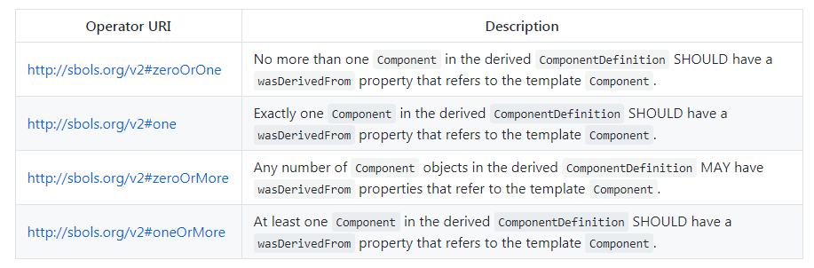
Operator Property

Slide 17
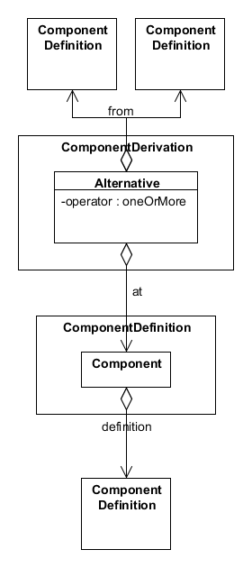

Slide 18
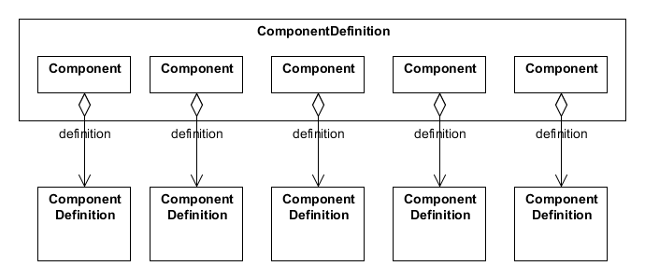
Pro: Structure of ComponentDefinition derived for one-or-more is more natural, pattern is defined more explicitly through properties
Con: Structure of derived ComponentDefinition still reflects parse tree (albeit to a lesser degree) since you need a new parent CD every time you branch or repeat.

