Slide 1
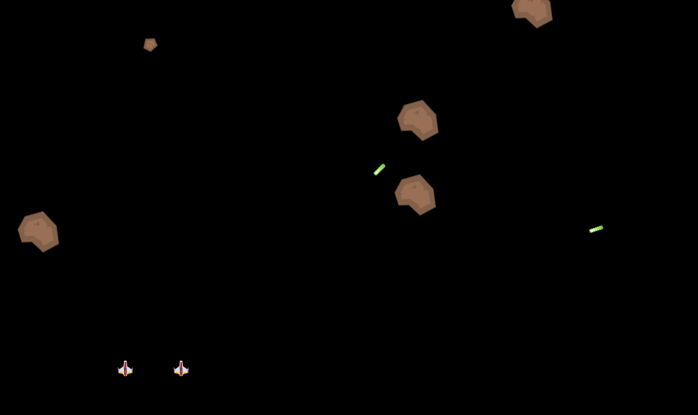
Space shooter multiplayer
Alan
Sami

Slide 2

Overview
Game Architecture (General Workflow)
Network Overview
Multiplayer Network Handling
Game Handler
Player
Bullets
Asteroids & Spawning

Slide 3

Game Architecture
Game Handler
Spawns
Players
Spawns
Bullets
Depends
Asteroid Factory
Asteroids
Spawns

Slide 4
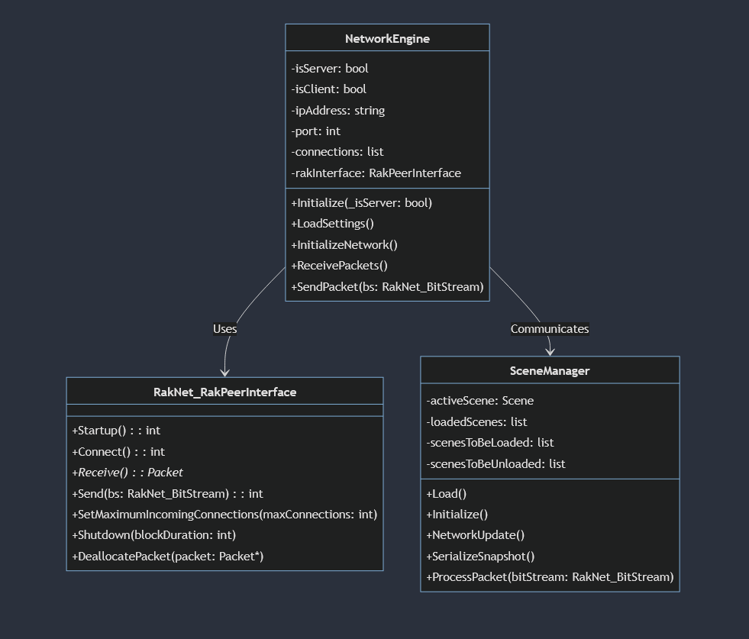
Network Overview
Engine Side

Slide 5
Network Overview
Game Handler (Works on Server, Checks for Client Connections and Handles Game State)
Asteroid Factory & Player (Uses RPC to Spawn Bullets and Asteroids)
Bullets and Asteroids (Uses RPC for movement, delta pos calculated on server and passed to client)

Slide 6
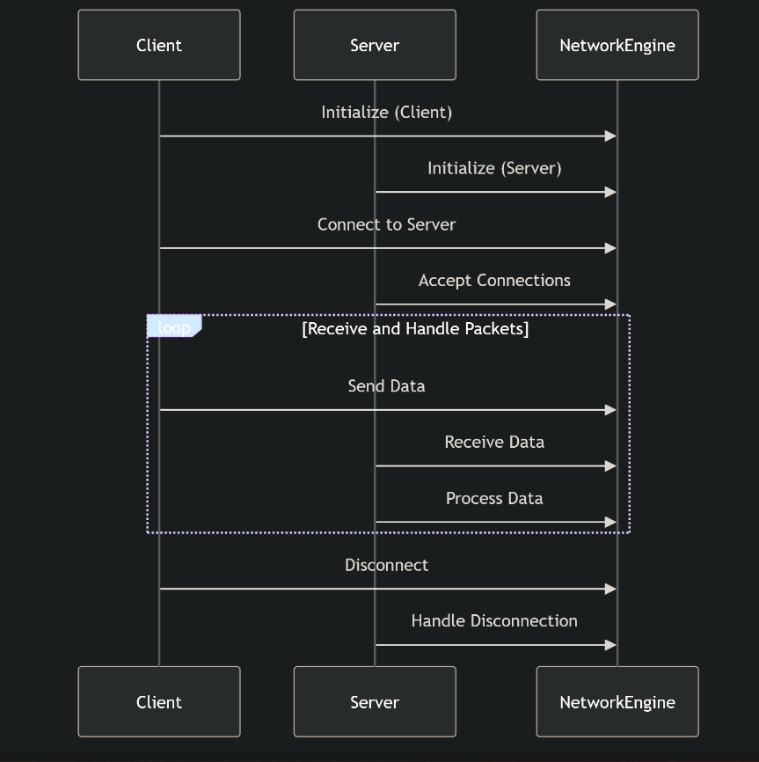
Multiplayer Network Handling

Slide 7
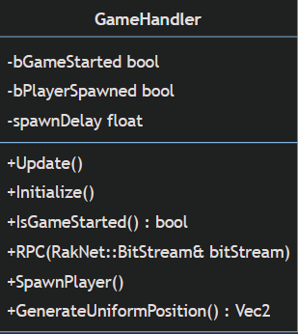
Game Handler
Present in Scene on Startup
Tracks No. Players and Game State
Update Game State when min players joins
Spawns' player ships when client connects

Slide 8
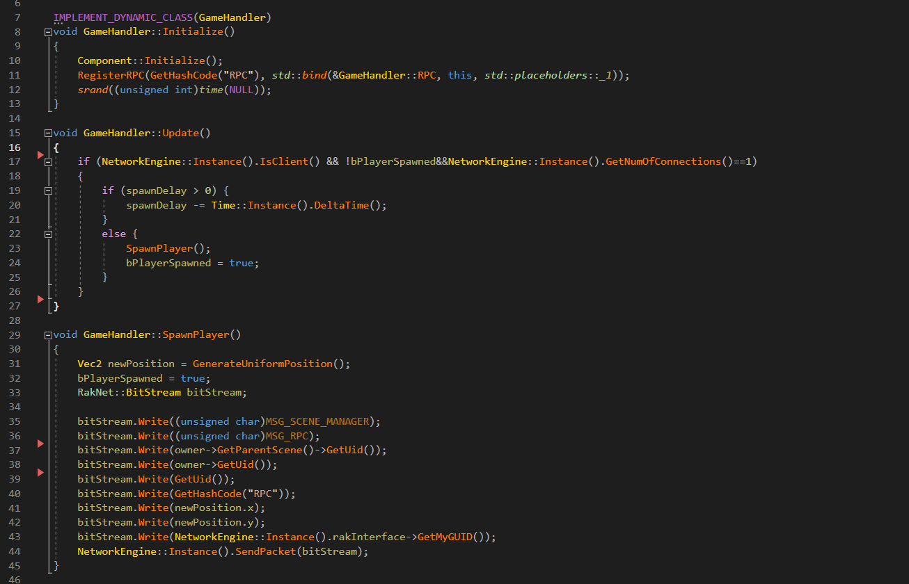
Game Handler

Slide 9
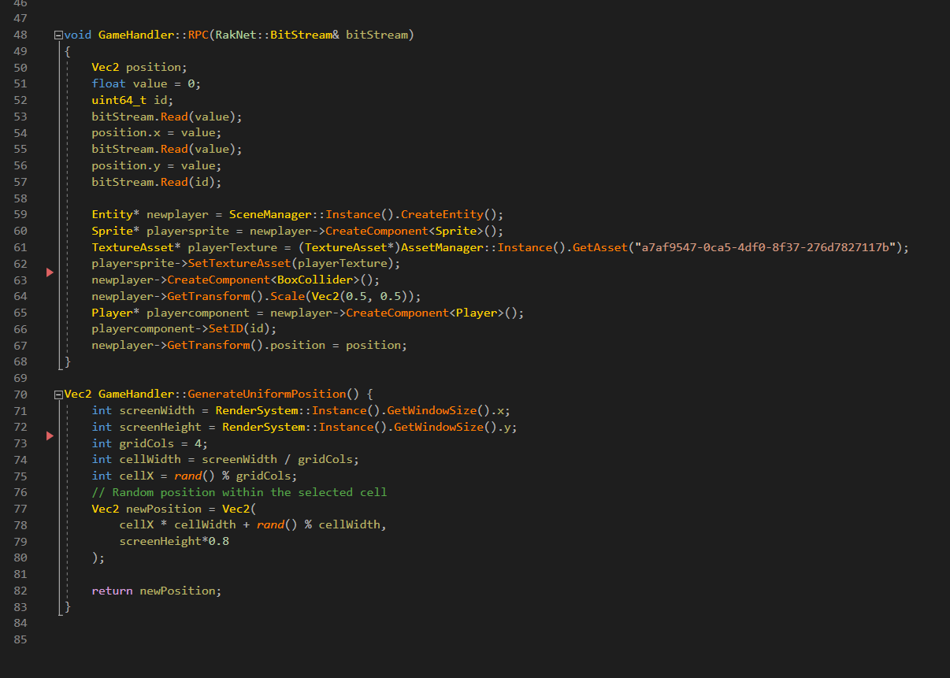
Game Handler

Slide 10
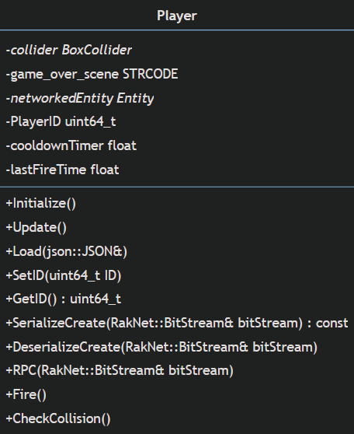
Player
Spawned on Server in response to client connection
Sends RPCs to Spawn Bullets

Slide 11
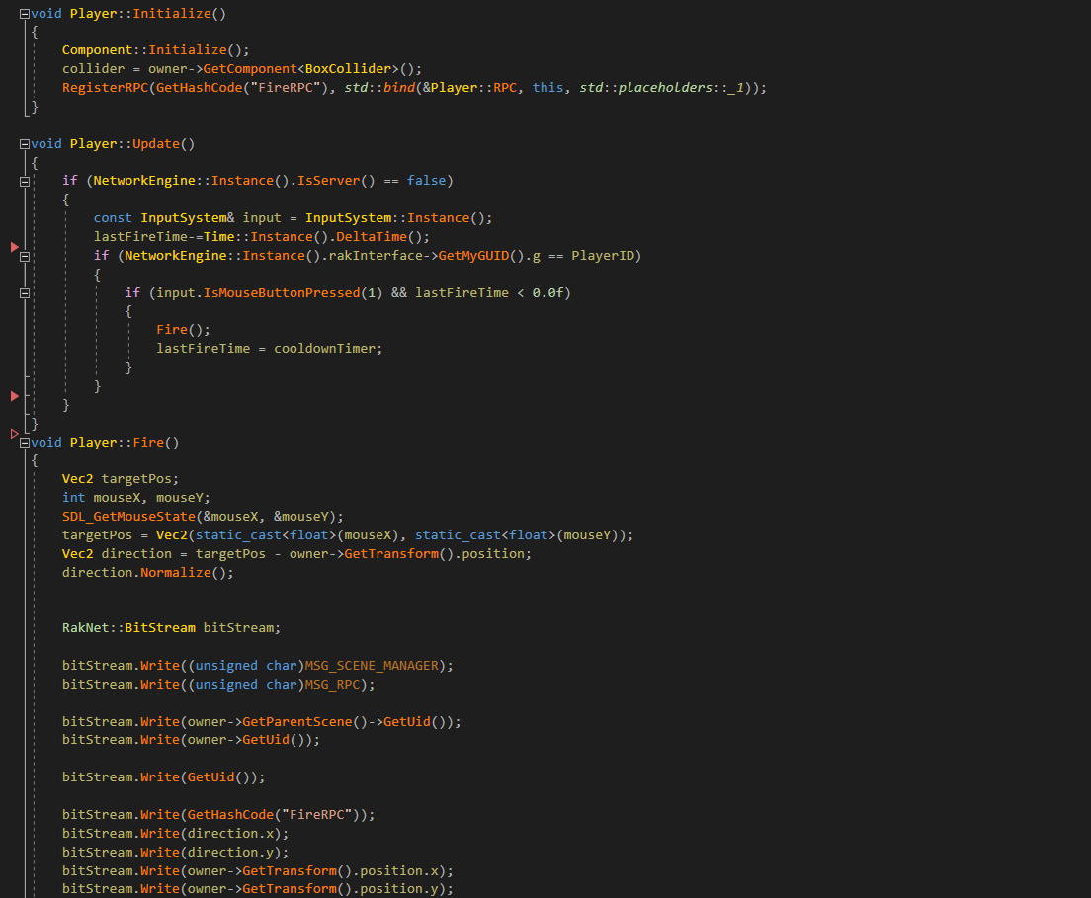
Player

Slide 12
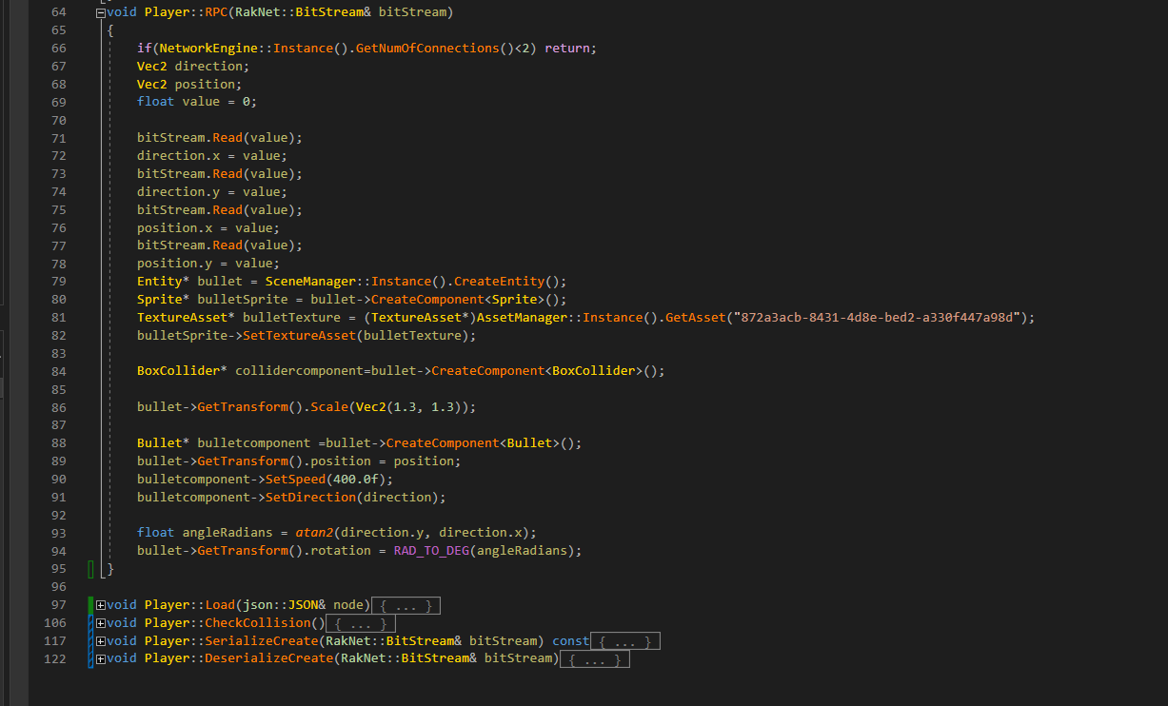
Player

Slide 13
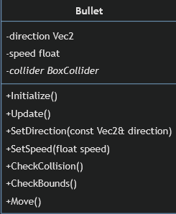
Bullets
Simple Entities spawned on Server and Replicated across the network
Uses RPCs for movement
Uses prediction for smooth movement

Slide 14
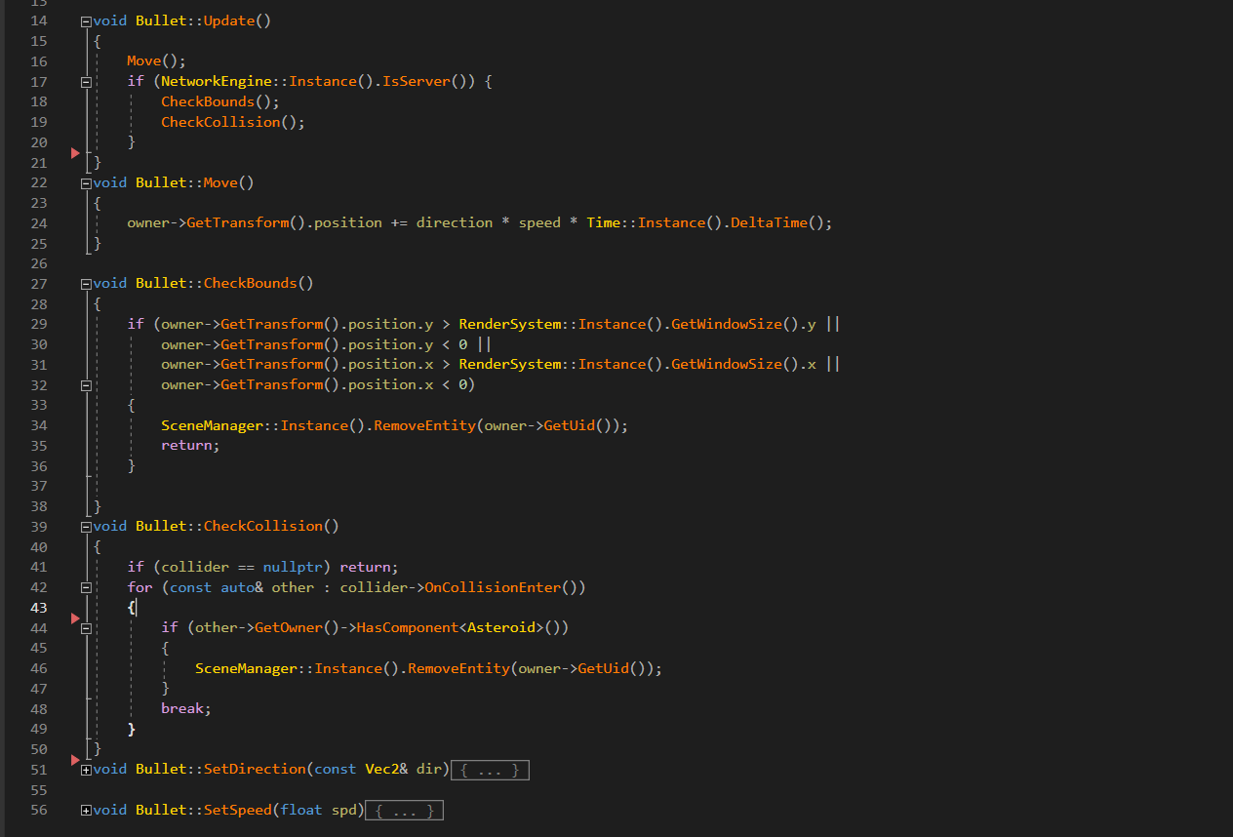
Bullets

Slide 15
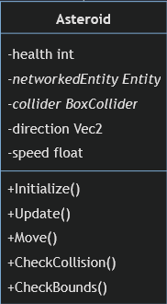
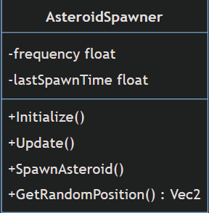
Asteroids & Spawning
Asteroid Spawner relies on Game Handler for Game State and accordingly spawn asteroids
Uses RPCs for spawning
Asteroids are like projectiles in terms of functioning

Slide 16
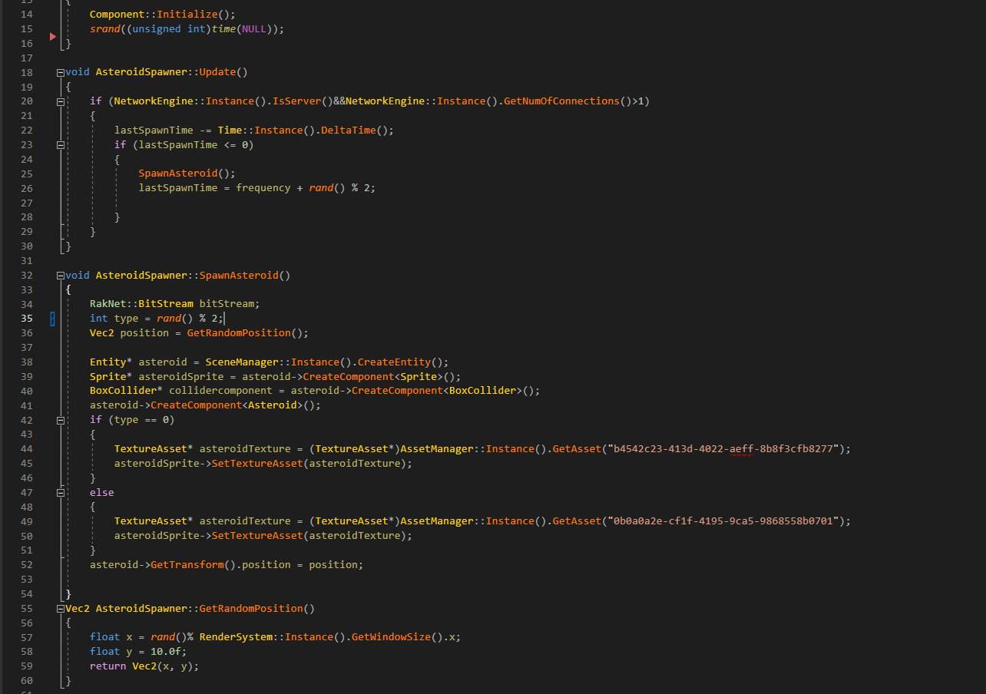
Spawning

Slide 17
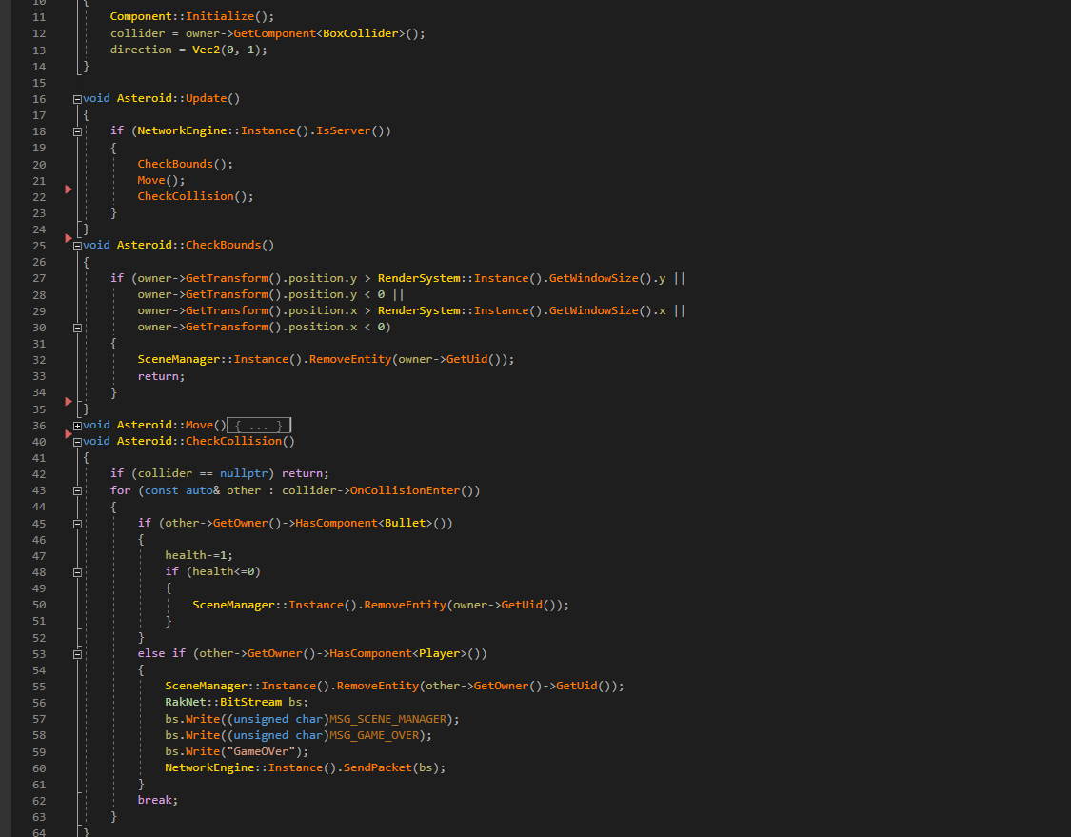
Asteroids

