Slide 1
PART 4
DATA STORAGE AND QUERY

Slide 2
Introduction to Chapter10 and Chapter11
In view of physical DB, two issues should be addressed
  data organization in DBS, i.e. physical storage structure of data — Chapter10
  data access in DBS — Chapter11
目标
1. 开发数据库应用系统时，根据DBMS提供的机制，选择合适的数据库物理结构
2. 在数据库表上合理设置索引，提高数据查询速度
参见：实验7. 数据库物理设计

Slide 3
Chapter 10
Storage and File Structure

Slide 4
Main Contents in This Chapter
File organization (at physical level, §10.5)
Organization of records in files (at logical level, §10.6 ),
i.e. file structures
Data-dictionary Storage (§10.7)
Data Buffer (§10.8)
Appendix A. 10-I. Physical storage media in DBS (§10.1—§10.4)
  Overview of Physical Storage Media
  Magnetic Disk and Flash Storage
  RAID
  Tertiary Storage
略

Slide 5
文件逻辑/物理组织 in Operating System Concepts
逻辑结构：
流式文件, 基于记录文件
物理结构：以block为单位，进行存储
contiguous, linked, indexed

Slide 6
10.5 File Organization
The database is stored as a collection of DB files.
Each file is a sequence of records. A record is a sequence of fields.
One approach:
  assume record size is fixed
  each file has records of one particular type only
  different files are used for different relations
  This case is easiest to implement; will consider variable length records later.
Notes:
数据库映射到文件的一种方法是：定长的记录；另一种方法是变长记录形式

Slide 7
File Organization (conmt.)
Each file is a sequence of records, and a relational table is a set of tuples
/*以元组为单位的DB逻辑文件在以记录为单位的OS物理文件中如何实现??
How to represent the tuple as the record in files?
  fixed-length records
  variable-length records

Slide 8

10.5.1 Fixed-Length Records
Simple approach:
  Store record i starting from byte n ∗ (i – 1), where n is the size of each record.
  Record access is simple but records may cross blocks
    Modification: do not allow records to cross block boundaries
instructor(ID, name, dept, salary)
Notes:
块是存储分配和数据传输的基本单位。
每个文件分成定长的存储单元，成为块。
每个块通常包含N条记录。

Slide 9
Fixed-Length Records
Deletion of record i:
alternatives:
  move records i + 1, . . ., n
  to i, . . . , n – 1
  move record n to i
  do not move records, but
  link all free records on a
  free list
all records are stored in a contiguous space

Slide 10

Deleting record 3 and compacting

Slide 11

Deleting record 3 and moving last record

Slide 12

Free Lists
Store the address of the first deleted record in the file header.
Use this first record to store the address of the second deleted record, and so on
Can think of these stored addresses as pointers since they “point” to the location of a record.
More space efficient representation: reuse space for normal attributes of free records to store pointers. (No pointers stored in in-use records.)

Slide 13
10.5.2 Variable-Length Records
Variable-length records arise in database systems in several ways:
  Storage of multiple record types in a file, e.g. Multitable Clustering File Organization in 10.6.2
  Record types that allow variable lengths for one or more fields such as strings (varchar)
  Record types that allow repeating fields, e.g. multi-set, multi-value attribute (used in some older data models).
E.g. type account-list = record
branch-name: char(22)
account-info: array[1.. ∞] of
record
account-number : char(10)
balance : real
end
end
Notes:
多表聚簇文件组织

Slide 14
Variable-Length Records
Attributes in the record are stored in order
  fixed length attributes at first, and then the variable-length attributes
Variable length attributes represented by fixed size (offset, length), with actual data stored after all fixed length attributes
Null values represented by null-value bitmap

Slide 15

instructor: ID(varch) name(varch) dept(varch) salary(int)
ID
name
dept
salary
Fig. record 0 is stored in contiguous 46 bytes (0-45)
Variable length attributes represented by fixed size (offset, length), with actual data stored after all fixed length attributes
Null values represented by null-value bitmap
The slotted page (e.g. SQL Server2005) structure is often used to organize variable-length records
Notes:
变长记录的表示：
通常包含两部分，初始部分是定长属性，接下来是变长属性。
对于变长属性，在记录的开头给出一个对值（偏移量，长度），偏移量：变长属性在记录中的位置；长度：属性的字节长度。

Slide 16

Variable-Length Records: Slotted Page Structure
The storage space is divided into fixed-sized slotted pages, and records are allocated to slotted pages, e.g. MS SQL Server
r_{i+3}
r_{i+2}
r_{i+1}
r_{i}
Fig. record_{i} to record_{i+3} in a page
Slotted page header contains
  number of record entries
  end of free space in the block
  location and size of each record
Notes:
分槽的页结构：用于在块中组织记录，用于处理在块中存储变长记录的问题。

Slide 17
Records can be moved around within a page to keep them contiguous with no empty space between them
  e.g. r_{i} is deleted
  entry in the header must be updated
Pointers should not point directly to record — instead they should point to the entry for the record in header
  e.g. the pointer to r_{i}
r_{i+3}
r_{i+2}
r_{i+1}
r_{i}

Slide 18
10.6 Organization of Records in Files
/* 文件包括多个记录，这些记录在磁盘上的存放属于文件(记录)结构问题，即纪录的组织结构
/*对于某种结构的文件如何去查找、插入、删除记录，属于文件的存取方法
/*文件的记录结构决定了文件的存取方法
At the logical file level, from viewpoints of users, DB file can be viewed as a set of records, these records are logically organized in one of the following ways
  heap, sequential, hash, clustering
  logical organization of records also determine for file users how to access the records, i.e. access methods

Slide 19
Organization of Records in Files
Heap – a record can be placed anywhere in the file where there is space
Sequential – store records in sequential order, based on the value of the search key of each record
Hashing – a hash function computed on some attribute of each record; the result specifies in which block of the file the record should be placed
Records of each relation may be stored in a separate file. In a multitable clustering file organization records of several different relations can be stored in the same file
  Motivation: store related records on the same block to minimize I/O

Slide 20
Heap File Organization
Any record can be placed anywhere in the file where there is space for the record
There is no ordering of records
Typically, there is a single file for a relation
/* 一般以纪录的输入顺序为序，决定了文件中记录顺序
/*纪录的存储顺序与记录中的主键无关

Slide 21
10.6.1 Sequential File Organization
Records are logically ordered by search-keys, that is, records are stored in sequential order, based on the value of the search key of each record
  it is desirable that the records are also physically stored in search-key order, or as close to search-key order as possible
    to minimize the number of block accesses in sequential processing
From viewpoints of DB, sequential access to the file
Need to reorganize the file from time to time to restore
sequential order

Slide 22

Sequential File Organization
Suitable for applications that require sequential processing of the entire file
The records in the file are ordered by a search-key

Slide 23

Deletion – use pointer chains
Insertion –locate the position where the record is to be inserted
  if there is free space insert there
  if no free space, insert the record in an overflow block
  In either case, pointer chain must be updated
Need to reorganize the file
from time to time to restore
sequential order

Slide 24
10.6.2 Clustering File Organization
/*一个DB文件可以存储来自多个关系的纪录。不同关系中有联系的纪录存放在同一block中，以提高查找和I/O速度
  Store several relations in one file using a multitable clustering file organization, i.e. records of several different relations are stored in the same file
  motivation: store related records on the same block to minimize I/O

Slide 25



Multitable Clustering File Organization
/一个DB文件存储来自多个关系的纪录。不同关系中有联系的纪录存放在同一block中，以提高查找和I/O速度
department
instructor
multitable clustering
of department and
instructor

Slide 26

Multitable Clustering File Organization
good for queries involving department instructor, and for queries involving one single department and its instructors
bad for queries involving only department
results in variable size records
Can add pointer chains to link records of a particular relation

Slide 27
Hashing File Organization
The file records are stored in a number of buckets, the #bucket is the address of the record
A hash function on some attributes of file records (i.e. search key) is used to determine the addresses of the records in the file
Hash function
  h : {search key} → {physical address of the records}
  the result of the function specifies in which block/bucket of the file the record should be placed

Slide 28
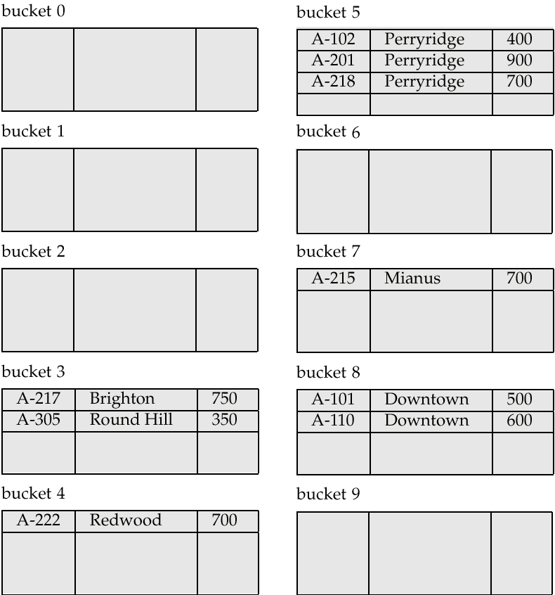
Hash file organization of account file, using branch-name as
the search key

Slide 29
10.7 Data Dictionary Storage
The Data dictionary (also called system catalog) stores metadata; that is, data about data, such as
Information about relations
  names of relations
  names, types and lengths of attributes of each relation
  names and definitions of views
  integrity constraints
User and accounting information, including passwords
Statistical and descriptive data
  number of tuples in each relation

Slide 30
Data Dictionary Storage (cont.)
Physical file organization information
  how relation is stored (sequential/hash/…)
  physical location of relation
Information about indices (Chapter 11)

Slide 31

Relational Representation of System Metadata
Relational representation on disk
Specialized data structures designed for efficient access, in memory

Slide 32
10.8 Buffer Management
略
A database file is partitioned into fixed-length storage units called blocks. Blocks are units of both storage allocation and data transfer.
Database system seeks to minimize the number of block transfers between the disk and memory. We can reduce the number of disk accesses by keeping as many blocks as possible in main memory.
Buffer – portion of main memory available to store copies of disk blocks.
Buffer manager – subsystem responsible for allocating buffer space in main memory
  e.g. in MS SQL Server, the buffer size is an adjustable parameter that has impact on the system performance, e.g. throughput

Slide 33
10.8.1 Buffer Manager
Programs call on the buffer manager when they need a block from disk
  1. if the block is already in the buffer, buffer manager returns the address of the block in main memory
  2. if the block is not in the buffer, the buffer manager
    allocates space in the buffer for the block
      Replacing (throwing out) some other block, if required, to make space for the new block.
      Replaced block written back to disk only if it was modified since the most recent time that it was written to/fetched from the disk.
    reads the block from the disk to the buffer, and returns the address of the block in main memory to requester.

Slide 34
10.8.2 Buffer-Replacement Policies
Most operating systems replace the block least recently used (LRU strategy)
Idea behind LRU – use past pattern of block references as a predictor of future references
Queries have well-defined access patterns (such as sequential scans), and a database system can use the information in a user’s query to predict future references
  LRU can be a bad strategy for certain access patterns involving repeated scans of data

Slide 35
Buffer-Replacement Policies
  LRU can be a bad strategy for certain access patterns involving repeated scans of data
    For example: when computing the join of 2 relations r and s by a nested loops
    for each tuple tr of r do
    for each tuple ts of s do
    if the tuples tr and ts match …
  Mixed strategy with hints on replacement strategy provided
  by the query optimizer is preferable

Slide 36
Buffer-Replacement Policies (Cont.)
Pinned block – memory block that is not allowed to be written back to disk.
Toss-immediate strategy – frees the space occupied by a block as soon as the final tuple of that block has been processed
Most recently used (MRU) strategy – system must pin the block currently being processed. After the final tuple of that block has been processed, the block is unpinned, and it becomes the most recently used block.

Slide 38
Appendix A
§10.1-10.4 Physical Storage Media
略
10-I-1. Storage-device hierarchy (§10.1)
As shown in Fig.10.1
Hierarchy
  primary storage, secondary storage, tertiary storage
Performance index
  reliability, speed, capacity, cost

Slide 39

Performance Indicators
Reliability
Speed
Capacity
Cost
fast
small
high
primary
storage
volatile
nonvolatile
secondary
storage
tertiary
storage
slow
large
low
Fig.11.1 Storage-device hierarchy

Slide 40
Storage Hierarchy (Cont.)
primary storage: Fastest media but volatile (cache, main memory).
secondary storage: next level in hierarchy, non-volatile, moderately fast access time
  also called on-line storage
  E.g. flash memory, magnetic disks
tertiary storage: lowest level in hierarchy, non-volatile, slow access time
  also called off-line storage
  E.g. magnetic tape, optical storage

Slide 41
11-I-2 Magnetic Disk
The disk structure is shown in Fig.11.2
Access time is taken as the performance measures of disks
  the time it takes from when a read or write request is issued to when data transfer begins
Access time includes
  seek time – time it takes to reposition the arm over the correct track.
    4 to 10 milliseconds on typical disks
  rotational latency – time it takes for the sector to be accessed to appear under the head.
    4 to 11 milliseconds on typical disks (5400 to 15000 r.p.m.)

Slide 42

11-I-2 Magnetic Disk
(3)
(5)
seeking
(4)
(1)
rotation
磁柱
(2)
Fig.11.2 Moving-head disk mechanism

Slide 43
Magnetic Disks
Read-write head
  Positioned very close to the platter surface (almost touching it)
  Reads or writes magnetically encoded information.
Surface of platter divided into circular tracks
  Over 50K-100K tracks per platter on typical hard disks
Each track is divided into sectors.
  A sector is the smallest unit of data that can be read or written.
  Sector size typically 512 bytes
  Typical sectors per track: 500 to 1000 (on inner tracks) to 1000 to 2000 (on outer tracks)

Slide 44
Magnetic Disks
To read/write a sector
  disk arm swings to position head on right track
  platter spins continually; data is read/written as sector passes under head
Head-disk assemblies
  multiple disk platters on a single spindle (1 to 5 usually)
  one head per platter, mounted on a common arm.
Cylinder i consists of i^{th} track of all the platters

Slide 45
Magnetic Disks (Cont.)
Disk controller – interfaces between the computer system and the disk drive hardware.
  accepts high-level commands to read or write a sector
  initiates actions such as moving the disk arm to the right track and actually reading or writing the data
  Computes and attaches checksums to each sector to verify that data is read back correctly
    If data is corrupted, with very high probability stored checksum won’t match recomputed checksum
  Ensures successful writing by reading back sector after writing it
  Performs remapping of bad sectors

Slide 46

Disk Subsystem
Multiple disks connected to a computer system through a controller
  Controllers functionality (checksum, bad sector remapping) often carried out by individual disks; reduces load on controller
Disk interface standards families
  ATA (AT adaptor) range of standards
  SATA (Serial ATA)
  SCSI (Small Computer System Interconnect) range of standards
  SAS (Serial Attached SCSI)
  Several variants of each standard (different speeds and capabilities)

Slide 47
Disk Subsystem
Disks usually connected directly to computer system
In Storage Area Networks (SAN), a large number of disks are connected by a high-speed network to a number of servers
In Network Attached Storage (NAS) networked storage provides a file system interface using networked file system protocol, instead of providing a disk system interface

Slide 48
Performance Measures of Disks
Access time – the time it takes from when a read or write request is issued to when data transfer begins. Consists of:
  Seek time – time it takes to reposition the arm over the correct track.
    Average seek time is 1/2 the worst case seek time.
      Would be 1/3 if all tracks had the same number of sectors, and we ignore the time to start and stop arm movement
    4 to 10 milliseconds on typical disks
  Rotational latency – time it takes for the sector to be accessed to appear under the head.
    Average latency is 1/2 of the worst case latency.
    4 to 11 milliseconds on typical disks (5400 to 15000 r.p.m.)

Slide 49
Performance Measures of Disks
Data-transfer rate – the rate at which data can be retrieved from or stored to the disk.
  25 to 100 MB per second max rate, lower for inner tracks
  Multiple disks may share a controller, so rate that controller can handle is also important
    E.g. SATA: 150 MB/sec, SATA-II 3Gb (300 MB/sec)
    Ultra 320 SCSI: 320 MB/s, SAS (3 to 6 Gb/sec)
    Fiber Channel (FC2Gb or 4Gb): 256 to 512 MB/s

Slide 50

外部传输速率
内部传输速率
disk drive
track
on-board cache: set of blocks
Fig. 11.11.0 on-board in device controller

Slide 51
Overview and Disk Structure (cont.)
外部传输速率
  硬盘缓存cache（磁盘控制器中的I/O 寄存器）与内存间的传输速率
  也称为：突发数据传输速率、接口速率
内部传输速率
  磁头在盘片上读写数据速率，如50MB/s
  也称为：（最大最小）持续传输速率

Slide 52
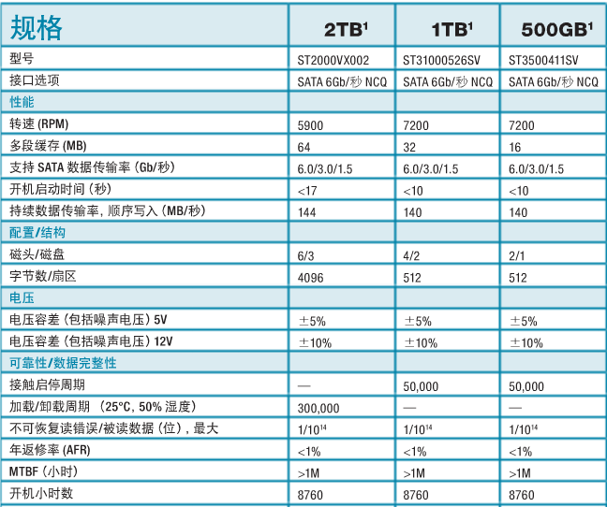
Segate(希捷) SV35 Series
——面向视频监控的高性能、大容量硬盘
硬盘和内存
间cache/buffer
外部传输速率
内部传输速率
平均寻道
时间 8.5ms
Operating System Concepts - Chapter12 Mass Storage Structures -

Slide 53
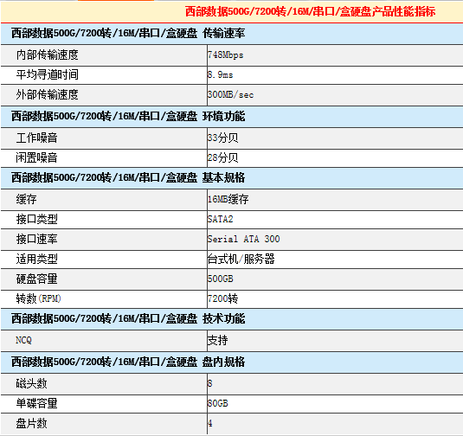
Operating System Concepts - Chapter12 Mass Storage Structures -

Slide 54
Performance Measures (Cont.)
Mean time to failure (MTTF) – the average time the disk is expected to run continuously without any failure.
  Typically 3 to 5 years
  Probability of failure of new disks is quite low, corresponding to a
  “theoretical MTTF” of 500,000 to 1,200,000 hours for a new disk
    E.g., an MTTF of 1,200,000 hours for a new disk means that given 1000 relatively new disks, on an average one will fail every 1200 hours
  MTTF decreases as disk ages

Slide 55
Optimization of Disk-Block Access
Block – a contiguous sequence of sectors from a single track
  data is transferred between disk and main memory in blocks
  sizes range from 512 bytes to several kilobytes
    Smaller blocks: more transfers from disk
    Larger blocks: more space wasted due to partially filled blocks
    Typical block sizes today range from 4 to 16 kilobytes
Disk-arm-scheduling algorithms order pending accesses to tracks so that disk arm movement is minimized
  elevator algorithm:

Slide 56
Optimization of Disk Block Access (Cont.)
File organization – optimize block access time by organizing the blocks to correspond to how data will be accessed
  E.g. Store related information on the same or nearby cylinders.
  Files may get fragmented over time
    E.g. if data is inserted to/deleted from the file
    Or free blocks on disk are scattered, and newly created file has its blocks scattered over the disk
    Sequential access to a fragmented file results in increased disk arm movement
  Some systems have utilities to defragment the file system, in order to speed up file access

Slide 57
Optimization of Disk Block Access (Cont.)
Nonvolatile write buffers speed up disk writes by writing blocks to a non-volatile RAM buffer immediately
  Non-volatile RAM: battery backed up RAM or flash memory
    Even if power fails, the data is safe and will be written to disk when power returns
  Controller then writes to disk whenever the disk has no other requests or request has been pending for some time
  Database operations that require data to be safely stored before continuing can continue without waiting for data to be written to disk
  Writes can be reordered to minimize disk arm movement

Slide 58
Optimization of Disk Block Access (Cont.)
Log disk – a disk devoted to writing a sequential log of block updates
  Used exactly like nonvolatile RAM
    Write to log disk is very fast since no seeks are required
    No need for special hardware (NV-RAM)
File systems typically reorder writes to disk to improve performance
  Journaling file systems write data in safe order to NV-RAM or log disk
  Reordering without journaling: risk of corruption of file system data

Slide 59
Flash Storage
NOR flash vs NAND flash
NAND flash
  used widely for storage, since it is much cheaper than NOR flash
  requires page-at-a-time read (page: 512 bytes to 4 KB)
  transfer rate around 20 MB/sec
  solid state disks: use multiple flash storage devices to provide higher transfer rate of 100 to 200 MB/sec

Slide 60
Flash Storage
  erase is very slow (1 to 2 millisecs)
    erase block contains multiple pages
    remapping of logical page addresses to physical page addresses avoids waiting for erase
      translation table tracks mapping
        also stored in a label field of flash page
      remapping carried out by flash translation layer
    after 100,000 to 1,000,000 erases, erase block becomes unreliable and cannot be used
      wear leveling

Slide 61
RAID
RAID: Redundant Arrays of Independent Disks
  disk organization techniques that manage a large numbers of disks, providing a view of a single disk of
    high capacity and high speed by using multiple disks in parallel,
    high reliability by storing data redundantly, so that data can be recovered even if a disk fails

Slide 62
RAID
The chance that some disk out of a set of N disks will fail is much higher than the chance that a specific single disk will fail.
  E.g., a system with 100 disks, each with MTTF of 100,000 hours (approx. 11 years), will have a system MTTF of 1000 hours (approx. 41 days)
  Techniques for using redundancy to avoid data loss are critical with large numbers of disks
Originally a cost-effective alternative to large, expensive disks
  I in RAID originally stood for ``inexpensive’’
  Today RAIDs are used for their higher reliability and bandwidth.
    The “I” is interpreted as independent

Slide 63
Improvement of Reliability via Redundancy
Redundancy – store extra information that can be used to rebuild information lost in a disk failure
E.g., Mirroring (or shadowing)
  Duplicate every disk. Logical disk consists of two physical disks.
  Every write is carried out on both disks
    Reads can take place from either disk
  If one disk in a pair fails, data still available in the other
    Data loss would occur only if a disk fails, and its mirror disk also fails before the system is repaired
      Probability of combined event is very small
        Except for dependent failure modes such as fire or building collapse or electrical power surges

Slide 64
Improvement of Reliability via Redundancy
Mean time to data loss depends on mean time to failure,
and mean time to repair
  E.g. MTTF of 100,000 hours, mean time to repair of 10 hours gives mean time to data loss of 500*10⁶ hours (or 57,000 years) for a mirrored pair of disks (ignoring dependent failure modes)

Slide 65
Improvement in Performance via Parallelism
Two main goals of parallelism in a disk system:
  1. Load balance multiple small accesses to increase throughput
  2. Parallelize large accesses to reduce response time.
Improve transfer rate by striping data across multiple disks.
Bit-level striping – split the bits of each byte across multiple disks
  In an array of eight disks, write bit i of each byte to disk i.
  Each access can read data at eight times the rate of a single disk.
  But seek/access time worse than for a single disk
    Bit level striping is not used much any more

Slide 66
Improvement in Performance via Parallelism
Block-level striping – with n disks, block i of a file goes to disk (i mod n) + 1
  Requests for different blocks can run in parallel if the blocks reside on different disks
  A request for a long sequence of blocks can utilize all disks in parallel

Slide 67

RAID Levels
Schemes to provide redundancy at lower cost by using disk striping combined with parity bits
  Different RAID organizations, or RAID levels, have differing cost, performance and reliability characteristics
RAID Level 0: Block striping; non-redundant.
  Used in high-performance applications where data loss is not critical.
RAID Level 1: Mirrored disks with block striping
  Offers best write performance.
  Popular for applications such as storing log files in a database system.

Slide 68
RAID Level 2: Memory-Style Error-Correcting-Codes (ECC) with bit striping.
RAID Level 3: Bit-Interleaved Parity
  a single parity bit is enough for error correction, not just detection, since we know which disk has failed
    When writing data, corresponding parity bits must also be computed and written to a parity bit disk
    To recover data in a damaged disk, compute XOR of bits from other disks (including parity bit disk)

Slide 69
RAID Level 3 (Cont.)
  Faster data transfer than with a single disk, but fewer I/Os per second since every disk has to participate in every I/O.
  Subsumes Level 2 (provides all its benefits, at lower cost).
RAID Level 4: Block-Interleaved Parity; uses block-level striping, and keeps a parity block on a separate disk for corresponding blocks from N other disks.
  When writing data block, corresponding block of parity bits must also be computed and written to parity disk
  To find value of a damaged block, compute XOR of bits from corresponding blocks (including parity block) from other disks.

Slide 70
RAID Level 4 (Cont.)
  Provides higher I/O rates for independent block reads than Level 3
    block read goes to a single disk, so blocks stored on different disks can be read in parallel
  Provides high transfer rates for reads of multiple blocks than no-striping
  Before writing a block, parity data must be computed
    Can be done by using old parity block, old value of current block and new value of current block (2 block reads + 2 block writes)
    Or by recomputing the parity value using the new values of blocks corresponding to the parity block
      More efficient for writing large amounts of data sequentially
  Parity block becomes a bottleneck for independent block writes since every block write also writes to parity disk

Slide 71

RAID Level 5: Block-Interleaved Distributed Parity; partitions data and parity among all N + 1 disks, rather than storing data in N disks and parity in 1 disk.
  E.g., with 5 disks, parity block for nth set of blocks is stored on disk (n mod 5) + 1, with the data blocks stored on the other 4 disks.

Slide 72
RAID Level 5 (Cont.)
  Higher I/O rates than Level 4.
    Block writes occur in parallel if the blocks and their parity blocks are on different disks.
  Subsumes Level 4: provides same benefits, but avoids bottleneck of parity disk.
RAID Level 6: P+Q Redundancy scheme; similar to Level 5, but stores extra redundant information to guard against multiple disk failures.
  Better reliability than Level 5 at a higher cost; not used as widely.

Slide 73
Choice of RAID Level
Factors in choosing RAID level
  Monetary cost
  Performance: Number of I/O operations per second, and bandwidth during normal operation
  Performance during failure
  Performance during rebuild of failed disk
    Including time taken to rebuild failed disk
RAID 0 is used only when data safety is not important
  E.g. data can be recovered quickly from other sources
Level 2 and 4 never used since they are subsumed by 3 and 5

Slide 74
Choice of RAID Level
Level 3 is not used anymore since bit-striping forces single block reads to access all disks, wasting disk arm movement, which block striping (level 5) avoids
Level 6 is rarely used since levels 1 and 5 offer adequate safety for most applications

Slide 75
Choice of RAID Level (Cont.)
Level 1 provides much better write performance than level 5
  Level 5 requires at least 2 block reads and 2 block writes to write a single block, whereas Level 1 only requires 2 block writes
  Level 1 preferred for high update environments such as log disks
Level 1 had higher storage cost than level 5
  disk drive capacities increasing rapidly (50%/year) whereas disk access times have decreased much less (x 3 in 10 years)
  I/O requirements have increased greatly, e.g. for Web servers
  When enough disks have been bought to satisfy required rate of I/O, they often have spare storage capacity
    so there is often no extra monetary cost for Level 1!

Slide 76
Choice of RAID Level (Cont.)
Level 5 is preferred for applications with low update rate,
and large amounts of data
Level 1 is preferred for all other applications

Slide 77
Hardware Issues
Software RAID: RAID implementations done entirely in software, with no special hardware support
Hardware RAID: RAID implementations with special hardware
  Use non-volatile RAM to record writes that are being executed

Slide 78
Hardware Issues
  Beware: power failure during write can result in corrupted disk
    E.g. failure after writing one block but before writing the second in a mirrored system
    Such corrupted data must be detected when power is restored
      Recovery from corruption is similar to recovery from failed disk
      NV-RAM helps to efficiently detected potentially corrupted blocks
        Otherwise all blocks of disk must be read and compared with mirror/parity block

Slide 79
Hardware Issues
Latent failures: data successfully written earlier gets damaged
  can result in data loss even if only one disk fails
Data scrubbing:
  continually scan for latent failures, and recover from copy/parity
Hot swapping: replacement of disk while system is running, without power down
  Supported by some hardware RAID systems,
  reduces time to recovery, and improves availability greatly

Slide 80
Hardware Issues
Many systems maintain spare disks which are kept online, and used as replacements for failed disks immediately on detection of failure
  Reduces time to recovery greatly
Many hardware RAID systems ensure that a single point of failure will not stop the functioning of the system by using
  Redundant power supplies with battery backup
  Multiple controllers and multiple interconnections to guard against controller/interconnection failures

Slide 81
Optical Disks
Compact disk-read only memory (CD-ROM)
  Removable disks, 640 MB per disk
  Seek time about 100 msec (optical read head is heavier and slower)
  Higher latency (3000 RPM) and lower data-transfer rates (3-6 MB/s) compared to magnetic disks
Digital Video Disk (DVD)
  DVD-5 holds 4.7 GB , and DVD-9 holds 8.5 GB
  DVD-10 and DVD-18 are double sided formats with capacities of 9.4 GB and 17 GB
  Blu-ray DVD: 27 GB (54 GB for double sided disk)
  Slow seek time, for same reasons as CD-ROM

Slide 82
Optical Disks
Record once versions (CD-R and DVD-R) are popular
  data can only be written once, and cannot be erased.
  high capacity and long lifetime; used for archival storage
  Multi-write versions (CD-RW, DVD-RW, DVD+RW and DVD-RAM) also available

Slide 83
Magnetic Tapes
Hold large volumes of data and provide high transfer rates
  Few GB for DAT (Digital Audio Tape) format, 10-40 GB with DLT (Digital Linear Tape) format, 100 GB+ with Ultrium format, and 330 GB with Ampex helical scan format
  Transfer rates from few to 10s of MB/s
Tapes are cheap, but cost of drives is very high
Very slow access time in comparison to magnetic and optical disks
  limited to sequential access.
  Some formats (Accelis) provide faster seek (10s of seconds) at cost of lower capacity

Slide 84
Magnetic Tapes
Used mainly for backup, for storage of infrequently used information, and as an off-line medium for transferring information from one system to another.
Tape jukeboxes used for very large capacity storage
  Multiple petabyes (10¹⁵ bytes)

Slide 85
Appendix B
Data Organization and Access in DBS
Data organization in DBS
Data access in DBS
  in small DBS
  in medium or large scale DBS

Slide 86
Appendix B —I
Data Organization in DBS
略
DBS provides the services of data organization and access for DBS user
From viewpoints of DBS users, data is organized as
  relational tables, tuples, and attributes
    user-oriented logical organization of data
From viewpoints of operating systems, data is stored as OS file, also known as DB file
  DB file is logically organized as a sequence of records (P415,§11.6)
  DB file resides on secondary storages, i.e. disks, in unit of block

Slide 87
Appendix B—I
Data Organization in DBS (cont.)
DBS数据的基本逻辑单位—元组/数据行与OS文件中数据的基本逻辑单位—文件记录的对应关系
  1个元组对应于文件系统的1个逻辑记录
    fixed-length record: §11.6.1
    variable-length record: §11.6.2
  1个关系表对应于1个OS文件，或1个文件存储多个关系表的数据
record与磁盘基本存储单位—block的对应关系关系
  in DBS, 1个block包含多个文件逻辑记录

Slide 88
Appendix B —I I
Data Access in DBS
在一些小型关系数据库系统（如dbase、Foxbase）中，关系表被存储在单独的文件中，DBMS利用OS文件系统作为其DBMS物理层实现基础，利用OS文件系统实现数据组织与访问
  操作系统为DB分配所需的磁盘block
    有可能将逻辑上相邻的数据分配到磁盘上不同的区域，导致连续访问时效率下降
  用户对DB文件数据的访问需要借助于OS文件系统提供的文件结构和存取路径
    DBMS对OS依赖太大，不利于数据库系统的移植

Slide 89
Appendix B —I I
Data Access in DBS (cont.)
  DBS数据访问过程中，DBMS的storage management （Fig.1.4) 、OS文件系统、I/O子系统完成如下地址变换
    DB关系表中元组/数据行 到 DB文件中数据的逻辑地址（文件名，记录号）间的映射
    DB文件记录号到外设上数据物理地址（记录所在的物理块号和具体地址）的映射
  Fig. A.1

Slide 90
DBMS
OS file subsystem and I/O subsystem
relational table
OS logical file
secondary storage,
e.g. disk
tables
/ tuples
/attributes
logical address
: #record, or index
physical address
: platter/cylinder
/track/sector
block_{1i}
record₁
block_{2i}
tuple₁
record₂
block₁
tuple₂
record₃
block_{3i}
tuple₃
DB
user
record
block
…
…
…
tuple_{m-1}
record_{n-1}
block_{k-1,i}
tuple_{m}
record_{n}
Block_{k,i}
Relations, tuples, and
attributes in DBS
DB file in secondary storage
Fig.A.1 Data Access in DBS-I

Slide 91
Appendix B —III
Data Access in DBS
一些现代大型关系数据库系统，如SQL Server、Oracle等，为了适应数据的动态变化、提供数据快速访问路径，DB数据仍然以DB文件的方式存在，但对DB文件的管理并不直接依赖于OS文件系统
在创建数据库时，DBMS向OS一次性申请所需磁盘空间，在此磁盘存储空间中，DBMS独立地为数据库中的数据设计存储和访问结构
  分配管理DB文件，提供数据访问机制
SQL Server as Case Study
  Fig.A.3, Fig.A.4, Fig.A.5
  借鉴了操作系统虚拟内存管理技术中page/frame的思想

Slide 92
Appendix B —III
Data Access in DBS (cont.)
SQL Server中，一个用户数据库由用于存储表(table)和索引(index)的磁盘存储空间构成，这些空间被分配在一个或多个操作系统文件上
数据库被划分许多逻辑页(page)，每个逻辑页大小为8KB
  每个数据库文件由多个从0开始连续编号的页组成。 每个页逻辑上划分为许多从1开始连续编号的槽(slot)，每个槽用于存放一个数据库表中的数据行/元组/纪录
页头：96字节
槽1
…
Fig. A.3 Page in SQL Server
槽n
行偏移组
Database System Concepts - Chapter 11 Storage and File Structures -

Slide 93
Appendix B —III
Data Access in DBS (cont.)
对于1个DB表中的数据行/元组/纪录，SQL Server用该表所在的数据库文件ID、数据行所在页ID和槽ID来标识
  数据行的逻辑地址： <文件ID, 页ID, 槽ID>
SQL Server以盘区为单位，为DB文件的页分配磁盘上的物理存储空间
  盘区大小为64K，占用8个连续的页
  DB文件中数据行/元组/纪录物理地址：数据行所在盘区的物理地址，如block#
SQL Server利用全局分配映象GAM和共享全局分配映象S GAM 这2个数据结构纪录每个盘区的使用情况
  是否空闲、是否共享

Slide 94
Appendix B —III
Data Access in DBS (cont.)
SQL Server利用索引分配映象IAM数据结构纪录每个数据库文件的页与该页所在物理盘区间的对应关系
SQL Server利用索引实现对关系表中的数据行/元组的访问
  Index: search key → <文件ID, 页ID, 槽ID>
  SQL Server可对关系表的主键自动建立索引
SQL Server数据存储与访问机制
  Fig. A.4
  2级地址映射
    基于索引的search key → 逻辑地址：<文件ID, 页ID, 槽ID>
    基于IAM的数据行逻辑地址→数据行物理地址（盘区物理地址）

Slide 95
DBMS
relational table
secondary storage,
e.g. disk
tables
/ tuples
/attributes
logical address
: #file, #page, #slot
physical address
: #盘区
page₁
盘区_{1,i}
tuple₁
page₂
盘区_{2, i}
tuple₂
page₃
tuple₃
Index
IAM
DB
user
…
…
…
盘区_{k-1, i}
tuple_{m-1}
page_{n-1}
tuple_{m}
page_{n}
盘区_{k, i}
Relations, tuples, and
attributes in DBS
DB file in secondary storage
Fig.A.4 Data Access in SQL Server

