Slide 1
PART 4
DATA STORAGE AND QUERY

Slide 2
Chapter 11
Indexing and Hashing

Slide 3
Basic Concepts
Ordered Indices
(
B⁺-Tree Index Files
B-Tree Index Files
)
Static Hashing
Dynamic Hashing
Comparison of Ordered Indexing and Hashing
Index Definition in SQL
Multiple-Key Access
略

Slide 4
Contents in This Chapter
Basic concepts and classification of indexing
  ordered indices, hash indices
Properties/types of ordered indices
  primary/clustering indices, secondary/non-clustering indices
  dense indices, sparse indices
  single-level indices, multi-level indices (e.g. B⁺-tree, B-tree)
Hash indices
  hash functions
  static hash, dynamic hash

Slide 5
目 标！！！
学会正确建立、管理索引，提高数据访问速度
  索引类型
  select、insert、update时的索引管理
了解索引对select/update/insert/delete的影响
实验7. 数据库物理设计
实验8. 查询优化

Slide 6
§11.1 Basic Concepts
How to locate tuples/records in DB file quickly?
Indexing (索引技术) mechanisms
  used to speed up access to desired data
  e.g. for relation instructor(ID, name, dept_name, salary)
  shown in Fig.11.1, the index
  dept_name → physical address of record (i.e.tuple) in DB file instructor
Search Key
  attributes or a set of attributes used to look up the records in a file
  e.g. dept_name

Slide 7

instructor(ID, name, dept_name, salary)
logical file
instructor
index file
indexed file
Note: the file instructor is logically a sequential file, but its records may be stored non-contiguously or non-ordered on the disk
76766
98345
58583
physical
file instructor
10101
12121
15151
45565
76543
22222
83821
32343
33465
Fig. 11.1 DB indexed file instructor and its index file

Slide 8
Basic Concepts (cont.)
An index file consists of records (called index entries) of the form
Index files are typically much smaller than the original file
Indexing
  mapping from search-key to storage locations of the file records,
  i.e. search-key → storage locations of the records in disks
search-key
pointer

Slide 9
ordered indices
hash indices
{索引项}
index entry
r(R), R (A, B, S, …. , , D)
a₁
b₁
s₁
…
d₁
a₂
b₂
s₂
…
d₂
h(s₁)
s₁
s₂
s₃
.
.
s_{i}
.
.
s_{j}
.
s_{n}
a₃
b₃
s₃
…
d₃
s₁
s₂
s₃
.
.
s_{i}
.
.
s_{j}
.
s_{n}
s₁
s₂
s₃
…
s_{i}
…
s_{m}
…
…
…
…
…
…
a_{i}
b_{i}
s_{i}
…
d_{i}
…
…
…
…
…
h(s_{i})
散列
函数H
a_{j}
b_{j}
s_{j}
…
d_{j}
…
…
…
…
…
…
…
a_{m}
b_{m}
s_{m}
…
d_{m}
…
…
…
…
…
…
a_{n-1}
b_{n-1}
s_{n-1}
…
d_{n-1}
h(s_{n})
a_{n}
b_{n}
s_{n}
…
d_{n}
搜索键
(search key)
搜索键
(search key)
索引文件
(index file)
数据文件
（主文件、被索引文件indexed file）
图 11.0.1 索引技术(indexing)及其分类

Slide 10
Basic Concepts (cont.)
Two basic kinds of indices:
  ordered indices: the index file is used to store the index entries in which the search key of the records and the address of the records are stored in sorted order
  hash indices: the “hash function” is used to map the the search key of the records to the address of the records
  the records are stored in the “buckets”, the number of the bucket is as the address of the records and is determined by the hash function

Slide 11
Basic Concepts (cont.)
Access types supported efficiently. E.g.,
  records with a specified value in the attribute
  or records with an attribute value falling in a specified range of values.
Access time
Insertion time
Deletion time
Space overhead（空间开销）
Notes:
用于索引评价的几个要素：
Access time（访问时间）：用该技术找到一个特定数据项或数据项集所需的时间。
Insertion time（插入时间）：插入一个新数据项所需时间。这个值包括找到插入这个新数据项的正确位置所需的时间和更新索引结构所需的时间。
Deletion time（删除时间）：删除一个新数据项所需时间。这个值包括找到待删除项所需的时间和更新索引结构所需的时间。
Space overhead（空间开销）：一个索引结构所占用的额外存储空间。

Slide 12
§11.2 Ordered Indices
DBS files with indexing mechanism include two parts :
  indexed file, in which data records are stored
  index file, in which index entries are included
  e.g. Fig.11.1
The indexed file can be organized as
  sequential file
  heap file
  hash file
  clustering file

Slide 13
Ordered Indices (cont.)
Ordered index (in index file)
  the index entries in the index file are stored in some sorted order, for instance, in accordance with the order of the search key
  /* 索引项的排列顺序与(被索引文件中)搜索键的排列顺序一致
  e.g. in Fig.11.1( ) , the index file is sorted by dept_name

Slide 14
§11.2.1 Primary and Secondary Indices
Primary/clustering index (in the index file)
  considering a index file and its corresponding indexed file.
  the indexed file is a sequential file, and the index whose search key also specifies the sequential order of the indexed file
  /* 索引文件的搜索键所规定的顺序与被索引的顺序文件中的纪录顺序一致
  e.g. in Fig.11.1 , (dept_name, address of records) defines the same orders of the records as that in sequential indexed file instructor
  note: also called clustering index

Slide 15
Primary and Secondary Indices (cont.)
The search key of a primary index is usually but not necessarily the primary key
  e.g. in Fig. 11.1, dept-name is not the primary key of instructor

Slide 16
Primary and Secondary Indices (cont.)
聚集索引 vs 主索引
在实际数据库系统中，如SQL Server、DB2等，
  聚集索引：
  索引文件的搜索键所规定的顺序与被索引的顺序文件中的纪录顺序一致
  主索引：
  建立在主键（主属性上）的索引
  当一个表定义了主键后，DBMS会自动为该表在主键上建立聚集索引，该索引同时又是主索引

Slide 17
Primary and Secondary Indices (cont.)
  一个表上只能建立一个聚集索引，也只能有一个主索引。
  — why？ 数据文件根据索引项进行排序，只能有一种排列顺序
  但可以建立多个非聚集索引
  如果一个表上没有定义主键，则不会有主索引；但可以为该表建立一个聚集索引
  主索引一定是聚集索引，但聚集索引不一定是主索引

Slide 18
Primary and Secondary Indices (cont.)
实验：对比分析
  在没有定义主键的关系表中插入数据：
  在关系表所在数据库文件中，各个元组/行/记录顺序一般是无序，取决于数据插入顺序——heap文件
  e.g. select * from tablename
  在有主键的关系表中插入数据：
  数据库文件是有序的，按照主键顺序排列

Slide 19
11.2.4 Primary and Secondary Indices (cont.)
Secondary index
  an index whose search key specifies an order different from the sequential order of the file.
  also called non-clustering index
  e.g. Fig.11.5 , secondary index on balance field of account
Secondary indices have to be dense indices
Index-sequential file (索引顺序文件)
  ordered sequential file with a primary/clustering index on the search key
  e.g. Fig.11.1
Notes:
辅助索引，也成为非聚集索引

Slide 20

buckets
Secondary index on salary field of instructor
Index record points to a bucket that contains pointers to all the actual records with that particular search-key value.
Secondary indices have to be dense
Notes:
辅助索引必须是稠密的，因为文件记录不是顺序存放的。
利用一个附加的桶（间接指针层）来实现非候选码的搜索码上的辅助索引。

Slide 21
11.2.1 Dense and Sparse Indices
Dense index
  the index record in the index file appears for every search-key value in the indexed file（文件中的每个搜索码值有一个索引记录）
  each value of search-key in the indexed file corresponds to an index entry in the index file
  e.g. Fig.11.1
  dense index on dept_name, with instructor file sorted on dept_name

Slide 22
Dense and Sparse Indices
In a dense primary index, the index record contains the search-key value and a pointer to the first record with that search-key value
  the rest of the records with the same search-key value would be stored sequentially after the first record
  e.g. Fig.11.1, search-key value “Comp.Sci” corresponds to three records in the file

Slide 23
Dense and Sparse Indices (cont.)
Sparse Index
  index file contains index entries for only some search-key values in the indexed file（只为搜索码的某些值建立索引记录）
  e.g. Fig.11.3
To locate a file record with search-key value K
  find index entry with largest search-key value ≤ K
  search file sequentially starting at the record to which this index entry points

Slide 24

Dense and Sparse Indices
index file
indexed file
Fig.11.3 Sparse index for the file instructor

Slide 25
Primary vs Secondary Indices
Indices offer substantial benefits when searching for records.
BUT:
Updating indices imposes overhead on database modification --when a file is modified, every index on the file must be updated
Sequential scan using primary index is efficient, but a sequential scan using a secondary index is expensive
  Each record access may fetch a new block from disk
  Block fetch requires about 5 to 10 milliseconds（毫秒）, versus about 100 nanoseconds（纳秒） for memory access

Slide 26
11.2.2 Multi-level Indices
The index file may be very large, and cannot be entirely kept in memory
If primary index does not fit in memory, access becomes expensive.
Solution: treat primary index kept on disk as a sequential file and construct a sparse index on it.
  outer index – a sparse index of primary index file
  inner index – the primary index file
If even outer index is too large to fit in main memory, yet another level of index can be created, and so on.

Slide 27
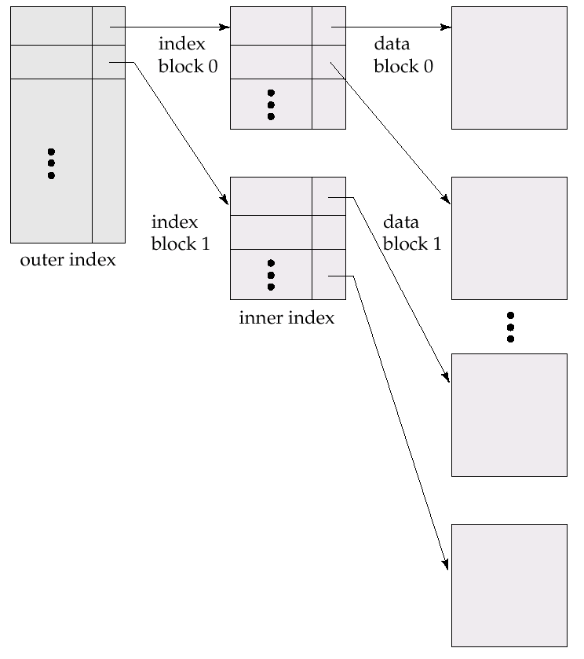
B⁺-tree indices and B-tree indices are two types of efficient multi-level indices, and widely used in DBS and MS file systems
index file
Fig. 11.5
Two-level sparse index
Note: similar to hierachical page tables or file indexs in OS
indexed file
Notes:
Inner index: 内层索引，主索引，放在disk上；
Outer index：外层索引，稀疏索引，放在主存中

Slide 28
11.2.5 Indices on Multiple Keys
Composite search keys are search keys containing more than one attribute
  E.g. (dept_name, salary)
Lexicographic ordering （字典序） : (a₁, a₂) < (b₁, b₂) if either
  a₁ < b₁, or
  a₁=b₁ and a₂ < b₂
  E.g.
  create index Mutiple-index on takes(course_id, semester, year )

Slide 29
左前缀原则
Suppose we have an index on combined search-key
(dept_name, salary).
With the where clause
where dept_name = “Finance” and salary = 80000
the index on (dept_name, salary) can be used to fetch only records that satisfy both conditions.
Can also efficiently handle
where dept_name = “Finance” and salary < 80000
Can also efficiently handle
where dept_name = “Finance”

Slide 30
左前缀原则
But cannot efficiently handle
1.
where dept_name < “Finance” and balance = 80000
  may fetch many records that satisfy the first but not the second condition
  the index is not used efficiently
2.
where balance = 80000
  the index is not used for query

Slide 31
11.3/11.4 B⁺-Tree/B-Tree Index Files
略
B⁺-tree indices are an alternative to indexed-sequential file
Extensively used multi-level index, with advantages
  automatically reorganizes itself with small, local, changes, in the face of insertions and deletions.
  reorganization of entire file is not required to maintain performance.

Slide 32

Example of B⁺-Tree

Slide 33
B⁺-Tree Index Files (Cont.)
A B⁺-tree is a rooted tree satisfying the following properties:
All paths from root to leaf are of the same length
Each node that is not a root or a leaf has between ⎡n/2⎤ and n children.
A leaf node has between ⎡(n–1)/2⎤ and n–1 values
Special cases:
  If the root is not a leaf, it has at least 2 children.
  If the root is a leaf (that is, there are no other nodes in the tree), it can have between 0 and (n–1) values.

Slide 34
B⁺-Tree Node Structure
Typical node
  K_{i} are the search-key values
  P_{i} are pointers to children (for non-leaf nodes) or pointers to records or buckets of records (for leaf nodes).
The search-keys in a node are ordered
K₁ < K₂ < K₃ < . . . < K_{n–1}
(Initially assume no duplicate keys, address duplicates later)

Slide 35

Leaf Nodes in B⁺-Trees
Properties of a leaf node:
For i = 1, 2, . . ., n–1, pointer P_{i} points to a file record with search-key value K_{i},
If L_{i}, L_{j} are leaf nodes and i < j, L_{i}’s search-key values are less than or equal to L_{j}’s search-key values
P_{n} points to next leaf node in search-key order

Slide 36
Non-Leaf Nodes in B⁺-Trees
Non leaf nodes form a multi-level sparse index on the leaf nodes. For a non-leaf node with m pointers:
  All the search-keys in the subtree to which P₁ points are less than K₁
  For 2 ≤ i ≤ n – 1, all the search-keys in the subtree to which P_{i} points have values greater than or equal to K_{i–1} and less than K_{i}
  All the search-keys in the subtree to which P_{n} points have values greater than or equal to K_{n–1}

Slide 37

Example of B⁺-tree
B⁺-tree for instructor file (n = 6)
Leaf nodes must have between 3 and 5 values
(⎡(n–1)/2⎤ and n –1, with n = 6).
Non-leaf nodes other than root must have between 3 and 6 children (⎡(n/2⎤ and n with n =6).
Root must have at least 2 children.

Slide 38
B⁺-trees Performance
Since the inter-node connections are done by pointers, “logically” close blocks need not be “physically” close.
The non-leaf levels of the B⁺-tree form a hierarchy of sparse indices.
The B⁺-tree contains a relatively small number of levels
    Level below root has at least 2* ⎡n/2⎤ values
    Next level has at least 2* ⎡n/2⎤ * ⎡n/2⎤ values
    .. etc.
  If there are K search-key values in the file, the tree height is no more than ⎡ log_{⎡n/2⎤}(K)⎤
  thus searches can be conducted efficiently.
Insertions and deletions to the main file can be handled efficiently, as the index can be restructured in logarithmic time (as we shall see).

Slide 39

Queries on B⁺-Trees
Find record with search-key value V.
  C=root
  While C is not a leaf node {
    Let i be least value s.t. V ≤ K_{i}.
    If no such exists, set C = last non-null pointer in C
    Else { if (V= K_{i} ) Set C = P_{i +1} else set C = P_{i}}
    }
  Let i be least value s.t. K_{i} = V
  If there is such a value i, follow pointer P_{i} to the desired record.
  Else no record with search-key value k exists.

Slide 40
Queries on B⁺⁻Trees (Cont.)
If there are K search-key values in the file, the height of the tree is no more than ⎡log_{⎡n/2⎤}(K)⎤.
A node is generally the same size as a disk block, typically 4 kilobytes
  and n is typically around 100 (40 bytes per index entry).
With 1 million search key values and n = 100
  at most log₅₀(1,000,000) = 4 nodes are accessed in a lookup.
Contrast this with a balanced binary tree with 1 million search key values — around 20 nodes are accessed in a lookup
  above difference is significant since every node access may need a disk I/O, costing around 20 milliseconds

Slide 41
Insertion on B⁺-Trees
Find the leaf node in which the search-key value would appear
If the search-key value is already present in the leaf node
  Add record to the file
  If necessary add a pointer to the bucket.
If the search-key value is not present, then
  add the record to the main file (and create a bucket if necessary)
  If there is room in the leaf node, insert (key-value, pointer) pair in the leaf node
  Otherwise, split the node (along with the new (key-value, pointer) entry) as discussed in the next slide.

Slide 42
Insertion (Cont.)
Splitting a leaf node:
  take the n (search-key value, pointer) pairs (including the one being inserted) in sorted order. Place the first ⎡n/2⎤ in the original node, and the rest in a new node.
  let the new node be p, and let k be the least key value in p. Insert (k,p) in the parent of the node being split.
  If the parent is full, split it and propagate the split further up.
Splitting of nodes proceeds upwards till a node that is not full is found.
  In the worst case the root node may be split increasing the height of the tree by 1.
Result of splitting node containing Brandt, Califieri and Crick on inserting Adams
Next step: insert entry with (Califieri,pointer-to-new-node) into parent

Slide 43
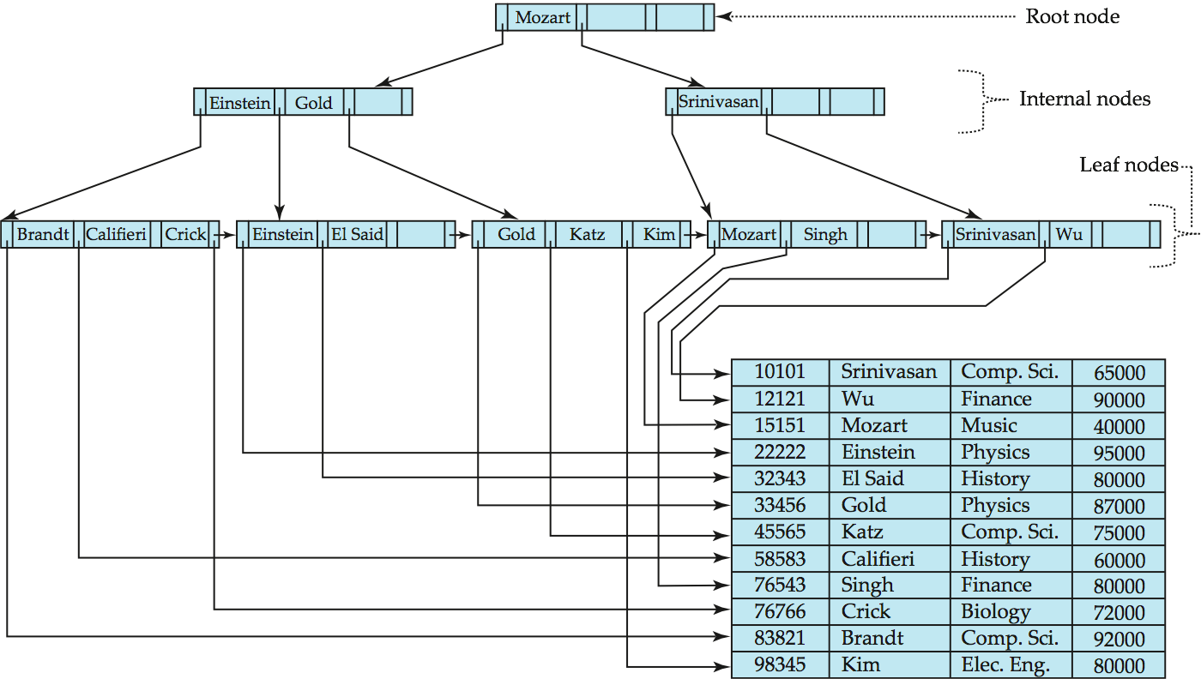
B⁺-Tree Insertion
B⁺-Tree before and after insertion of “Adams”

Slide 44
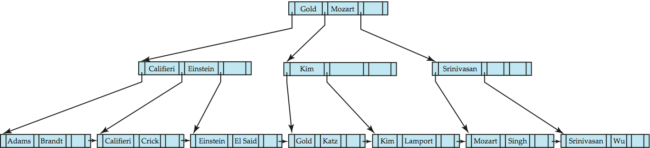
B⁺-Tree Insertion
B⁺-Tree before and after insertion of “Lamport”

Slide 45
Insertion in B⁺-Trees
Splitting a non-leaf node: when inserting (k,p) into an already full internal node N
  Copy N to an in-memory area M with space for n+1 pointers and n keys
  Insert (k,p) into M
  Copy P₁,K₁, …, K _{⎡n/2⎤-1},P _{⎡n/2⎤} from M back into node N
  Copy P_{⎡n/2⎤+1},K _{⎡n/2⎤+1},…,K_{n},P_{n+1} from M into newly allocated node N’
  Insert (K _{⎡n/2⎤},N’) into parent N
Califieri
Adams Brandt Califieri Crick
Adams Brandt
Crick

Slide 46
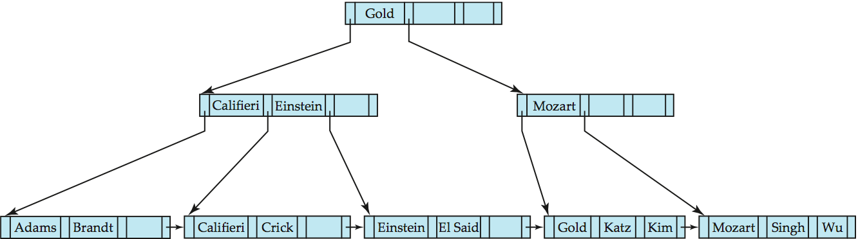
Examples of B⁺-Tree Deletion
Before and after deleting “Srinivasan”
Deleting “Srinivasan” causes merging of under-full leaves

Slide 47
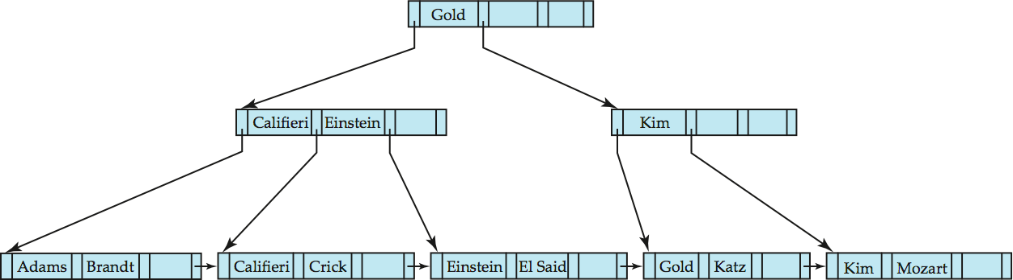
Deletion of “Singh” and “Wu” from result of previous example
Leaf containing Singh and Wu became underfull, and borrowed a value Kim from its left sibling
Search-key value in the parent changes as a result

Slide 48
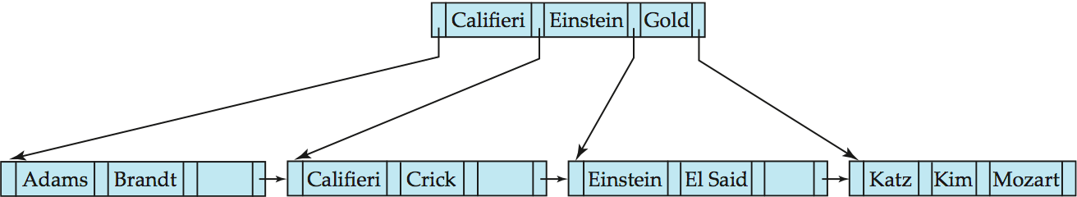
Before and after deletion of “Gold” from earlier example
Node with Gold and Katz became underfull, and was merged with its sibling
Parent node becomes underfull, and is merged with its sibling
  Value separating two nodes (at the parent) is pulled down when merging
Root node then has only one child, and is deleted

Slide 49
Deletion on B⁺-Trees
Find the record to be deleted, and remove it from the main file and from the bucket (if present)
Remove (search-key value, pointer) from the leaf node if there is no bucket or if the bucket has become empty
If the node has too few entries due to the removal, and the entries in the node and a sibling fit into a single node, then merge siblings:
  Insert all the search-key values in the two nodes into a single node (the one on the left), and delete the other node.
  Delete the pair (K_{i–1}, P_{i}), where P_{i} is the pointer to the deleted node, from its parent, recursively using the above procedure.

Slide 50
Otherwise, if the node has too few entries due to the removal, but the entries in the node and a sibling do not fit into a single node, then redistribute pointers:
  Redistribute the pointers between the node and a sibling such that both have more than the minimum number of entries.
  Update the corresponding search-key value in the parent of the node.
The node deletions may cascade upwards till a node which has ⎡n/2⎤ or more pointers is found.
If the root node has only one pointer after deletion, it is deleted and the sole child becomes the root.

Slide 51
B⁺-Tree File Organization
Index file degradation problem is solved by using B⁺-Tree indices.
Data file degradation problem is solved by using B⁺-Tree File Organization.
The leaf nodes in a B⁺-tree file organization store records, instead of pointers.
Leaf nodes are still required to be half full
  Since records are larger than pointers, the maximum number of records that can be stored in a leaf node is less than the number of pointers in a nonleaf node.
Insertion and deletion are handled in the same way as insertion and deletion of entries in a B⁺-tree index.

Slide 52
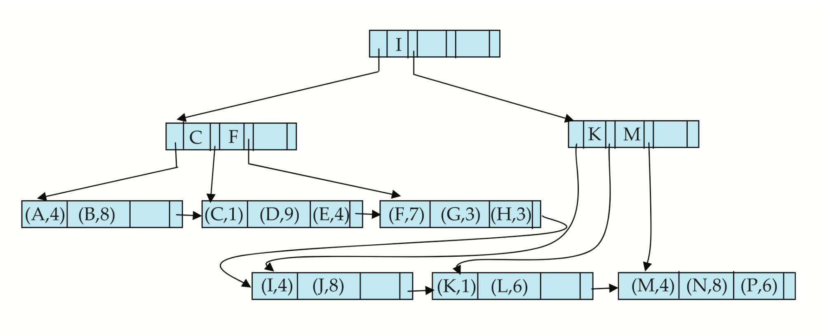

Example of B⁺-tree File Organization
Good space utilization important since records use more space than pointers.
To improve space utilization, involve more sibling nodes in redistribution during splits and merges
  Involving 2 siblings in redistribution (to avoid split / merge where possible) results in each node having at least entries

Slide 53
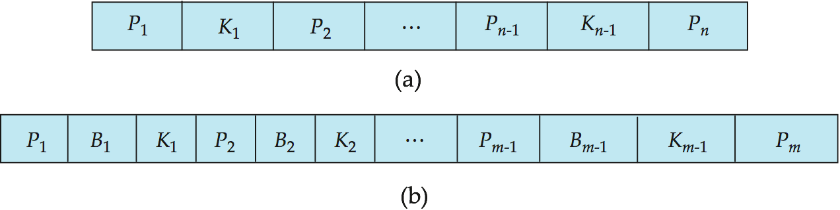
B-Tree Index Files
B-tree allows search-key values to appear only once; eliminates redundant storage of search keys.
Search keys in nonleaf nodes appear nowhere else in the B-tree; an additional pointer field for each search key in a nonleaf node must be included.
Generalized B-tree leaf node
Nonleaf node – pointers Bi are the bucket or file record pointers

Slide 54
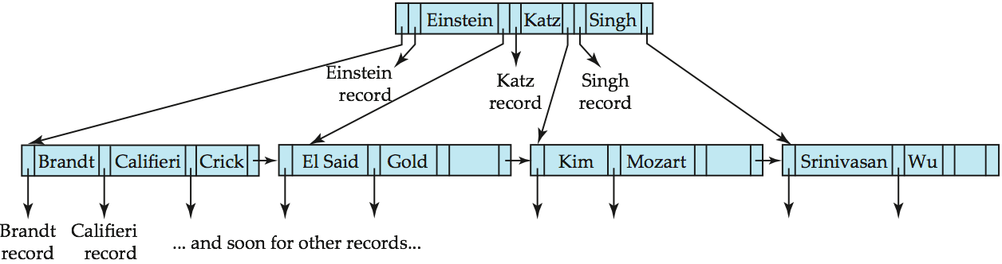
B-tree (above) and B+-tree (below) on same data

Slide 55
B-Tree Index Files (Cont.)
Advantages of B-Tree indices:
  May use less tree nodes than a corresponding B⁺-Tree.
  Sometimes possible to find search-key value before reaching leaf node.
Disadvantages of B-Tree indices:
  Only small fraction of all search-key values are found early
  Non-leaf nodes are larger, so fan-out is reduced. Thus, B-Trees typically have greater depth than corresponding B⁺-Tree
  Insertion and deletion more complicated than in B⁺-Trees
  Implementation is harder than B⁺-Trees.

Slide 56
§11.5/6 Hashing Index Files
The file records are stored in a set of buckets
  a bucket is a unit of storage containing one or more records (a bucket is typically a disk block).
Hash function h
  a function from the set of all search-key values K in a file to the set of all bucket addresses, i.e. the set of the addresses of file records
  typical hash functions perform computation on the internal binary representation of the search-key.
Hash file organization
  obtaining the bucket of a record directly from its search-key value using a hash function

Slide 57
Sparse Use in Practice！
PostgreSQL supports hash indices, but discourages use due to poor performance
Oracle supports static hash organization, but not hash indices
SQLServer supports only B⁺-trees

Slide 58
Example of Hash File Organization
Hash file organization of instructor file, using dept_name as key
(See figure in next slide.)
There are 10 buckets,
The binary representation of the ith character is assumed to be the integer i.
The hash function returns the sum of the binary representations of the characters modulo 10
  E.g. h(Music) = 1 h(History) = 2
  h(Physics) = 3 h(Elec. Eng.) = 3
Notes:
散列函数：先计算码中字符的二进制表示的总和，然后返回该总和与桶的个数的模

Slide 59

Example of Hash File Organization
Hash file organization of instructor file, using dept_name as key (see previous slide for details).

Slide 60
Hash Indices
Hashing can be used not only for file organization, but also for index-structure creation.
A hash index organizes the search keys, with their associated record pointers, into a hash file structure.
Strictly speaking, hash indices are always secondary indices
  if the file itself is organized using hashing, a separate primary hash index on it using the same search-key is unnecessary.
  However, we use the term hash index to refer to both secondary index structures and hash organized files.

Slide 61
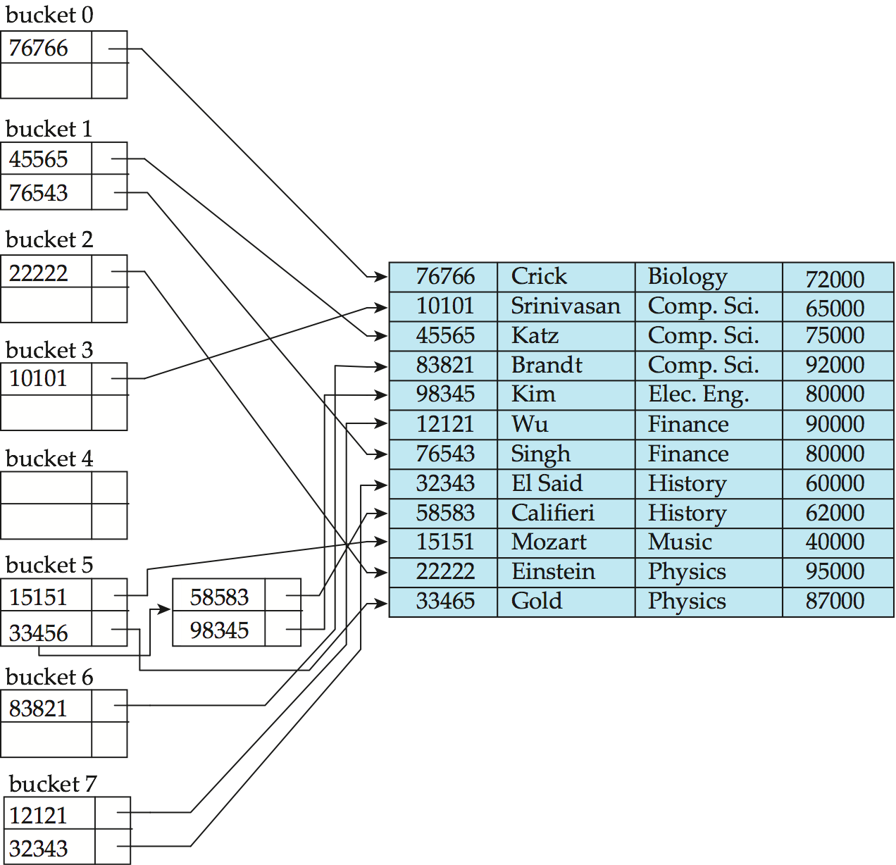
Example of Hash Index
search-key
h
hash index on instructor, on attribute ID

Slide 62
Static Hashing vs Dynamic Hashing
Static hashing
  hash function h cannot be modified, while being used
Dynamic hashing
  hash function h to be modified dynamically

Slide 63
11.8 Comparison of
Ordered Indexing and Hashing
Expected type of queries:
  Hashing is generally better at retrieving records having a specified value of the key, e.g. ID=10121
  If range queries are common, e.g. age between 17 and 25, ordered indices are to be preferred
In practice:
  PostgreSQL supports hash indices, but discourages use due to poor performance
  Oracle supports static hash organization, but not hash indices
  SQLServer supports only B⁺-trees

Slide 64
§11.10 Index Definition and Usage
in SQL
Create an index
  create index <index-name> on <relation-name>
  <attribute-list>)
  E.g.: create index b-index on branch(branch-name)
create cluster index
create noncluster index
create unique index
To drop an index
  drop index <index-name>

Slide 65
强制使用/不使用索引 in SQL Server
参见“实验7. 数据库物理设计”

Slide 66
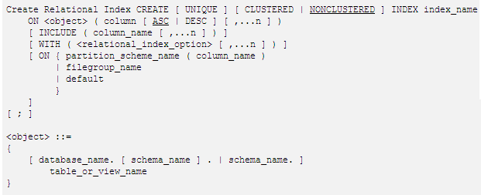
Create relational index in SQL Server2008

Slide 67
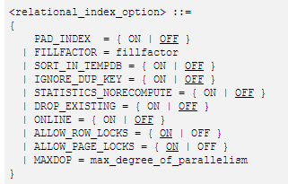

Slide 68
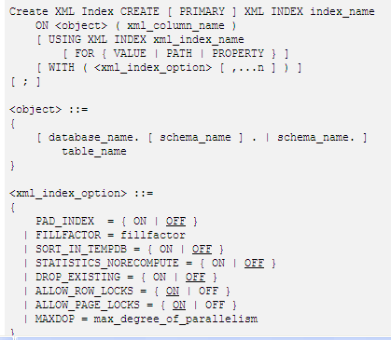

Slide 69
聚集索引
对表（堆）创建聚集索引或删除和重新创建现有聚集索引时，要求数据库具有额外的可用工作区来容纳数据排序结果和原始表或现有聚集索引数据的临时副本。有关详细信息，请参阅确定索引的磁盘空间要求。有关聚集索引的详细信息，请参阅创建聚集索引

Slide 70
唯一索引
如果存在唯一索引，数据库引擎 会在每次插入操作添加数据时检查重复值。可生成重复键值的插入操作将被回滚，同时数据库引擎 显示错误消息。即使插入操作更改多行但只导致出现一个重复值时，也是如此。
如果在存在唯一索引并且 IGNORE_DUP_KEY 子句设置为 ON 的情况下输入数据，则只有违反 UNIQUE 索引的行才会失败。有关唯一索引的详细信息，请参阅创建唯一索引。

