Slide 1
PART 3
DATA STORAGE AND QUERY

Slide 2
Chapter 12
Query Processing

Slide 3
Introduction
Query
  one or more operations on a database, or requests for DB access
  a high-level database language (e.g. SQL, QUEL, declarative ) statement, or a sequence of statements
Query processing (P531)
  (DBMS’ ) activities involved in extracting data from a database, including parsing and translation, query optimization, and evaluation（执行）
Programs compiling and executing vs. Query processing
  refer to Fig. 12.0.1

Slide 4
C, Pascal programs
query
程 序 编 译 / 编译器
词法/语法/语义分析
Query processing / DBMS
扫描和语法/语义分析
中间代码生成
关系代数表达式&查询树
Chapter.12, 13
(中间)代码优化
查询优化
(§12)
(优化后)查询执行计划
目标代码生成
查询代码生成
(§13)
目标程序代码
查询计划执行的代码
process / thread
事务处理 / DBMS
transaction
程序执行 /
进程管理
&进程调度
并发控制
死锁处理
事务管理
&事务调度
并发控制
恢复技术
Chapter.
14, 15, 16
死锁处理
OS
(§16)
(§14)
(§15)
Fig. 12.0.1

Slide 5
Chapter 12: Query Processing
Overview
Measures of Query Cost
Selection Operation
Sorting
Join Operation
Other Operations
Evaluation of Expressions

Slide 6
Main Parts Chapter 12
Basic steps in query processing, §12.1 Overview
Measures of query cost, §12.2
Evaluating of individual relational algebra operations,
§12.3- §12.6
  selection, sorting, join, project, set operations, …
  Evaluating of expression, i.e. a sequence of relational algebra operations, §12.7

Slide 7
§12.1 Overview
Steps in query processing
  Fig.12.1

Slide 8

1. Parsing and translation
2. Optimization
3. Evaluation
Users
Database System
e.g.
select
DBMS
metadata in data dictionary
DB file
Fig.12.1 Steps in query processing

Slide 9
Overview (cont.)
Step1.Parsing and translation
  translate the query into a parser-tree representation
    parser checks syntax, verifies the correctness of the relations in the query
    parser also replaces the view in the query with the relations on which this view is built on
  the parser-tree is then translated into relational algebra expression

Slide 10
Overview (cont.)
Step2. Query Optimization
  amongst all equivalent query evaluation plans, choose the one with lowest cost
  the cost is estimated using statistical information in data dictionary
    e.g. the number of tuples in each relation, size of tuples, etc

Slide 11
Step2. Optimization
A relational algebra expression may have many equivalent expressions
  E.g., σ_{salary<75000}(∏_{salary}(instructor)) is equivalent to
  ∏_{salary}(σ_{salary<75000}(instructor))
Each relational algebra operation can be evaluated using one of several different algorithms
  e.g. the select operation can be evaluated using one of A1, A2, …, A11 algorithms in §12.3
  e.g. merge join, hash join operation
Correspondingly, a relational-algebra expression can be evaluated in many ways

Slide 12
Step2. Optimization
  Annotated expression specifying detailed evaluation strategy is called an evaluation-plan, such as index, evaluation algorithms, etc.
  e.g., can use an index on salary to find instructors with salary < 75000,
  or can perform complete relation scan and discard instructors with salary ≥ 75000
∏_{salary}: A00
σ_{salary<2500} ; use index1
A5
instructor
Fig. 12.2 A query-evaluation plan

Slide 13
Overview (cont.)
Step3. Evaluation plan execution
  the query-execution engine takes a optimized query-evaluation plan, executes that plan, and returns the answers to the query

Slide 14
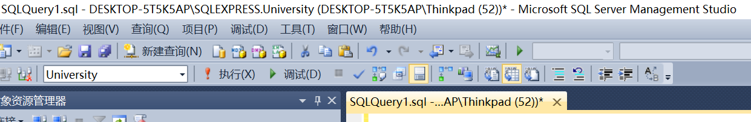
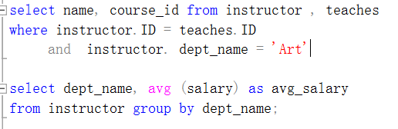
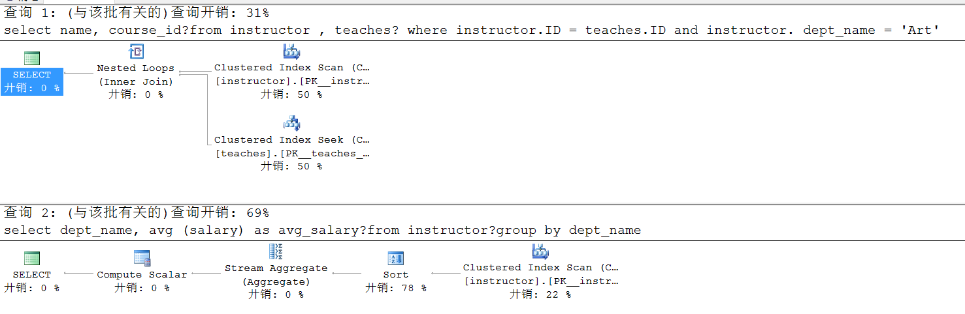

Slide 15
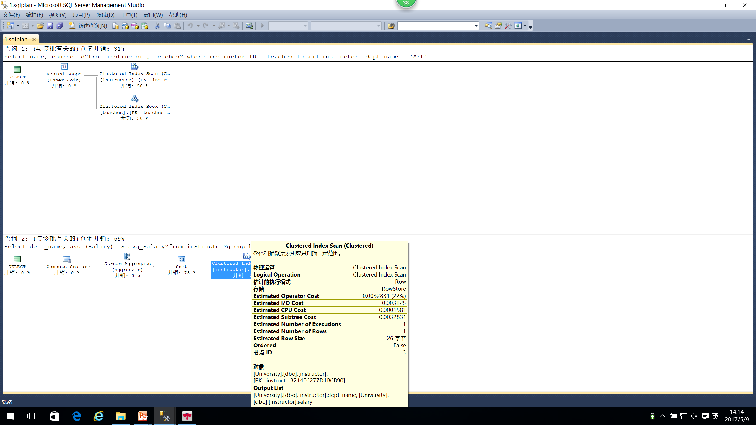

Slide 16
§13.2 Measures of Query Costs
Cost is generally measured as total elapsed time for answering query
  many factors contribute to time cost
    disk accesses, CPU, or even network communication
Typically disk access is the predominant cost, and is also relatively easy to estimate. Measured by taking into account
  number of seeks * average-seek-cost
  number of blocks read * average-block-read-cost
  number of blocks written * average-block-write-cost
    cost to write a block is greater than cost to read a block
      data is read back after being written to ensure that the write was successful

Slide 17
Measures of Query Cost (cont.)
For simplicity we just use the number of block transfers from disk and the number of seeks as the cost measures
  t_{T} – time to transfer one block
  t_{S} – time for one seek
  cost for b block transfers plus S seeks
  b * t_{T} + S * t_{S}
We ignore CPU costs for simplicity
  real systems do take CPU cost into account
We do not include cost to writing output to disk in our cost formulae

Slide 18
Measures of Query Cost (Cont.)
Several algorithms can reduce disk IO by using extra buffer space
  Amount of real memory available to buffer depends on other concurrent queries and OS processes, known only during execution
    We often use worst case estimates, assuming only the minimum amount of memory needed for the operation is available
Required data may be buffer resident already, avoiding disk I/O
  But hard to take into account for cost estimation

Slide 19
§12.3 Selection Operation
Selection operation on a relation r by file scan
  locating and scanning the file in which r is stored to retrieving the file records satisfying the selection conditions
E.g. ∏_{salary}(σ_{salary<2500}(instructor))

Slide 20
Selection Operation
Types of query conditions (查询条件类型)
  equality(等值), e.g.balance = 100
  range (范围), e.g. balance between 50 and 400
  comparison (比较), e.g. balance >300
Several file scan algorithms
  linear search/scan – A1
  selections using indices – A2, A3, A4
  selections involving comparisons – A5, A6
  complex selections – A7, A8, A9, A10

Slide 21
A1: File scan by linear search
Algorithm A1 (linear search).
Scan each file block and test all records to see whether they satisfy the selection condition.
  cost estimate = b_{r} block transfers + 1 seek
    b_{r} denotes number of blocks containing records from relation r
  if selection is on a key attribute, can stop on finding record
    cost = (b_{r} /2) block transfers + 1 seek
    —必须扫描全部blocks，方能找到全部满足查询条件的数据

Slide 22
A1: File scan by linear search
Linear search can be applied regardless of
    selection condition or
    ordering of records in the file, or
    availability of indices
Note: binary search generally does not make sense since data is not stored consecutively
  except when there is an index available,
  and binary search requires more seeks than index search

Slide 23
Selections Using Indices
Index scan – search algorithms that use an index
—— e.g. in SQL Server, index seek
  selection condition must be on search-key of index,
  i.e. instructor(ID, name, dept-name, salary)
A2 (primary index, equality on key such as ID).
Retrieve a single record that satisfies the corresponding equality condition, using a B⁺-tree as the clustering/primary index
  Cost = (h_{i} + 1) * (t_{T} + t_{S})
  h_{i} : height of the tree
  t_{T} : time to transfer one block
  t_{S} : time for one seek

Slide 24
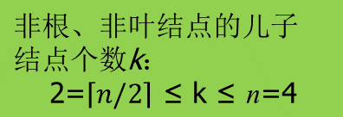

Example of
B⁺-Tree (n=4)
Not a
primary index!!
n: degree or branching factor
12 records
instructor(ID, name, dept_name, salary)

Slide 25
Selections Using Indices
A3 (primary index, equality on nonkey)
Retrieve multiple records.
  Records will be on consecutive blocks
    Let b = number of blocks containing matching records
  Cost = h_{i} * (t_{T} + t_{S}) + t_{S} + t_{T} * b

Slide 26
Selections Using Indices
A4 (secondary index, equality on nonkey).
  retrieve a single record if the search-key is a candidate key, e.g. name in instructor
    cost = (h_{i} + 1) * (t_{T} + t_{S})
  retrieve multiple records if search-key is not a candidate key
    each of n matching records may be on a different block, e.g. salary in instructor - next slide
    cost = (h_{i} + n) * (t_{T} + t_{S})
      can be very expensive!

Slide 27

buckets
instructor(ID, name, dept_name, salary)
99540 Wan Comp.Sci 87000
Fig. 11.6 Secondary index on salary field of instructor

Slide 28
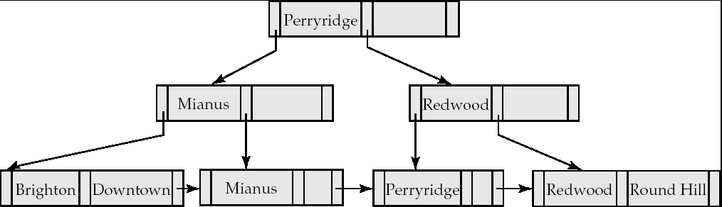
聚集索引树：索引+数据
访问方式：
1. 聚集索引查找seek，e.g. branch-name, 二分查找
2. 聚集索引扫描sacn, e.g. account-number，线性扫描
.
seek
scan

Slide 29
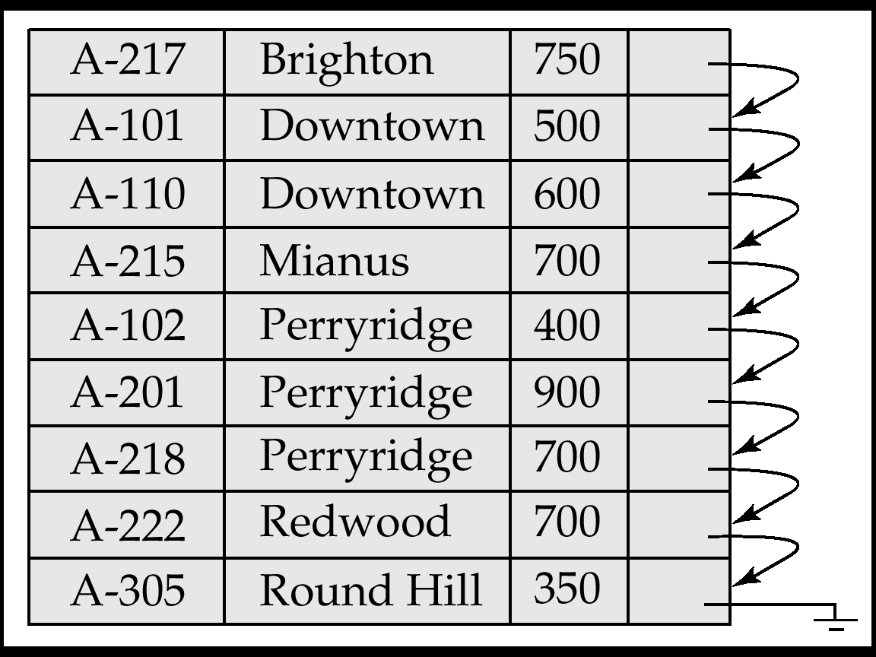
未建立索引，堆文件
访问方式：线性扫描、表扫描
Account(account_number, branch-name, balance)

Slide 30

instructor(ID, name, dept_name, salary)
logical file
instructor
index file
indexed file
Note: the file instructor is logically a sequential file, but its records may be stored non-contiguously or non-ordered on the disk
76766
98345
58583
physical
file instructor
10101
12121
15151
45565
76543
22222
83821
32343
33465
Fig. 11.1 DB indexed file instructor and its index file

Slide 31
Selections Involving Comparisons
- Range Search
Can implement selections of the form σ_{A≤V} (r) or σ_{A ≥ V}(r) by using
  a linear file scan,
  or by using indices in the following ways:
A5 (primary index, comparison). (Relation is sorted on A)
    For σ_{A ≥ V}(r) use index to find first tuple ≥ v and scan relation sequentially from there
    For σ_{A≤V} (r) just scan relation sequentially till first tuple > v; do not use index
  e.g. σ_{ID ≥ 22222} (instructor) in

Slide 32
Selections Involving Comparisons
A6 (secondary index, comparison).
    For σ_{A ≥ V}(r) use index to find first index entry ≥ v and scan index sequentially from there, to find pointers to records.
    For σ_{A≤V} (r) just scan leaf pages of index finding pointers to records, till first entry > v
    In either case, retrieve records that are pointed to
      requires an I/O for each record
      Linear file scan may be cheaper

Slide 33
Implementation of Complex Selections
- Conjunction
Conjunction: σ_{θ1}∧ _{θ2}∧. . . _{θn}(r)
A7 (conjunctive selection using one index).
  Select a combination of θ_{i} and algorithms A1 through A7 that results in the least cost for σ_{θi} (r).
  Test other conditions on tuple after fetching it into memory buffer.
A8 (conjunctive selection using composite index).
  Use appropriate composite (multiple-key) index if available.

Slide 34
Implementation of Complex Selections
- Conjunction
A9 (conjunctive selection by intersection of identifiers).
  Requires indices with record pointers.
  Use corresponding index for each condition, and take intersection of all the obtained sets of record pointers.
  Then fetch records from file
  If some conditions do not have appropriate indices, apply test in memory.

Slide 35
Algorithms for Complex Selections
Disjunction:σ_{θ1}∨ _{θ2} ∨. . . _{θn} (r).
A10 (disjunctive selection by union of identifiers).
  Applicable if all conditions have available indices.
    Otherwise use linear scan.
  Use corresponding index for each condition, and take union of all the obtained sets of record pointers.
  Then fetch records from file
Negation: σ_{¬θ}(r)
  Use linear scan on file
  If very few records satisfy ¬θ, and an index is applicable to θ
    Find satisfying records using index and fetch from file

Slide 36
Other Operations
Sorting, join, projection, set operations (e.g. union, intersection, set-difference), aggregation, and duplicate elimination are implemented on the basis of the operation select
  sorting,
  e.g. merge sort
  join,
  (block/indexed) nested-loop join, merge join, hash join
  project, distinct, order by, outer join, aggregation

Slide 37
§12.7 Evaluation of Expressions
How to evaluate an expression containing multiple evaluation primitives
  key: how to process intermediate computing results
  e.g. ∏_{sarlay}(σ_{salary<2500}(instructor))
Two strategies, that is materialization(实体化/物化) and pipeline are used for expression evaluation

Slide 38

Materialization
Temp数据库
Fig. 12.0.2 Pictorial representation of an expression

Slide 39
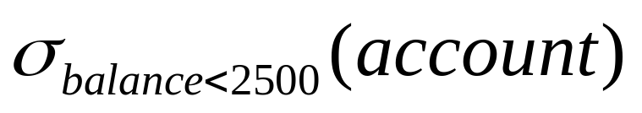
Materialization (cont.)
Principles
  start from the lowest-level, i.e. at the bottom of the tree, evaluate one operation at a time
  the results of each evaluation (i.e. intermediate computing results) are stored in temporal relations on the disk for subsequent evaluation
    serial evaluating
E.g., in Fig.12.0.2, compute and store in a temporal relation
at first;
salary
instructor

Slide 40
Materialization (cont.)
Cost of writing results to disk and reading them back can be quite high
Approximately,
overall cost =
  sum of costs of individual operations +
  cost of writing intermediate results to disk

Slide 41
Pipelined（流水线）
Principles of pipelined evaluation
  evaluate several operations simultaneously in a pipeline, with the results of one operation passed to the next, without the need to store temporary relations in disk
    parallel evaluating
Much cheaper than materialization:
    no need to store a temporary relation to disk
E.g., in the expression tree in Fig.12.0.2, don’t store result of
  don’t store result of selection, pass tuples directly to projection.
salary
instructor
Notes:
利用流水线，通过减少查询执行中产生的临时文件数，可提高查询执行的效率。

Slide 42
instructor
σ_{salary<2500}
……
∏_{salary}
:
……
∏_{salary}(σ_{salary<2500})
salary<2500
salary≥2500

