Slide 1
PART 4
DATA STORAGE AND QUERY

Slide 2
Chapter 13
Query Optimization

Slide 3
Main parts in Chapter 13
§13.1 Overview
  why optimization needed
§13.2 Transformation of relational expressions
  equivalence rules
§13.4 Choice of evaluation plans — Query optimization
  cost-based optimization,§13.4.1/13.4.2
  heuristic optimization, §13.4.3

Slide 4
§13.1 Overview
A SQL query statement may corresponds to several equivalent expressions ( or query evaluation plans ), each of which may have different costs
Query optimization is needed to choice an efficient query-evaluation plan with lower costs
E.g.1. select *
from r, s
where r.A = s.A
σ_{r.A=s.A} (r ╳ s) is much slower than r s

Slide 5
Overview (cont.)
E.g.2 Find the names of all instructors in the Music department together with the course title of all the courses that the instructors teach

Slide 6

Overview (cont.)
Alternative ways of evaluating a given query
  Equivalent expressions
  Different algorithms for each operation

Slide 7

Overview (cont.)
An evaluation plan defines exactly what algorithm is used for each operation, and how the execution of the operations is coordinated.

Slide 8
Overview (cont.)
Cost difference between evaluation plans for a query can be enormous
  E.g. seconds vs. days in some cases

Slide 9
Overview (cont.)
The procedures of optimization
  generating the equivalent expressions/query trees, by transforming of relational algebra expressions according to equivalence rules in§13.2
  generating alternative evaluation plans, by annotating the resultant equivalent expressions with implementation algorithms for each operations in the expressions
  choosing the optimal (that is, cheapest) or near-optimal plan based on the estimated cost, by
    cost-based optimization
    heuristic optimization

Slide 10
Overview (cont.)
The cost of operations is needed to estimate based on:
  Statistical information about relations. Examples:
    number of tuples, number of distinct values for an attribute
  statistics estimation for intermediate results
    to compute cost of complex expressions
  cost formulae for algorithms, computed using statistics

Slide 11
§13.2 Transformation of Relational Expressions
Definition. Two relational algebra expressions are equivalent, if on every legal database instances, the two expression generate the same set of tuples

Slide 12

Fig.13.0.1 Schema diagram for the University database

Slide 13
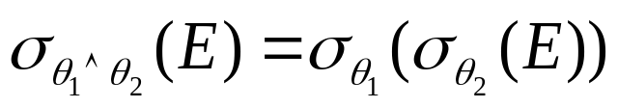
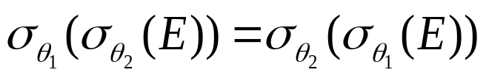
Equivalence Rules (cont.)
Rule1.(选择串接律, 将1个选择操作分解为2个选择操作) Conjunctive（合取） selection operations can be deconstructed into a sequence of individual selections
合取选择运算可分解为单个选择运算的序列。
  e.g. refer to
Rule2. (选择交换律) Selection operations are commutative（交换律） :

Slide 14
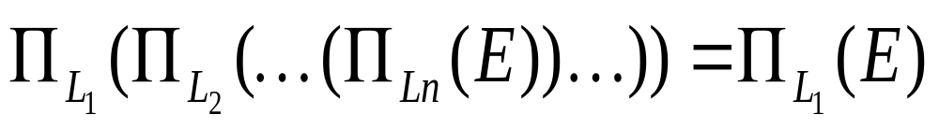
Equivalence Rules (cont.)
Rule3. (投影串接律) Only the final operation in a sequence of project operations is needed
  note: it is required that L₁⊆ L₂⊆ ….⊆ L_{n}
  e.g. ∏ _{{ID}} { ∏ _{{ID, name}} (instructor) }
  = ∏ _{{ID}} (instructor)
…
…

Slide 15
Equivalence Rules (cont.)
Rule4. (以连接操作代替选择和笛卡尔乘积) Selections can be combined with Cartesian products and theta joins
  a. σ_{θ}(E₁ ╳ E₂) = E₁ _{θ} E₂
  note: definition of θ join
  b. σ_{θ1}(E₁ _{θ2} E₂) = E₁ _{θ1∧ θ2} E₂
  e.g. σ _{dept-name=“Music”}( instructor teaches) =
  instructor (dept-name=“Music) ∧ (instructor.ID=teaches.ID) teaches
By Rule4, the number of operations can be reduced, and the costs of the right-hand expressions are less than that of the left-hand expressions
  often used in heuristic query optimizing

Slide 16
Equivalence Rules (cont.)
!!! Rule5 (连接操作可交换) Theta join operations are commutative
E_{1 θ} E₂ = E₂ _{θ} E₁
  Fig. 13.3
  !! the expression with smaller size should be arranged as the left one in the operation

Slide 17
r
s
连接属性A
t₁.A
t₂.A
t₁
t₂
|r|=m
|s|=n
原理： 针对r中元组t₁，检查s中的元组t₂.A，t₁.A=t₂.A ?
方法：
For r中每个元组t₁， //*扫描
按照t₁.A，查找s中满足t₁.A=t₂.A的元组t₂，
合并元组t₁和t₂

Slide 18
假设
1. |r|=m，|s|=n
2. m<n, n/m =k >1
给定r中的元组t₁，采用B/B⁺树索引、二分搜索机制，根据t₁.A，查找s中满足t₁.A=t₂.A的元组t₂，所需cost正比于树高，为：
O(lgn)
r s的cost为： O(m + mlgn)
s r的cost为： O(n + nlgm)
如果没有索引：
O(m + m * n) vs O(n + n * m)

Slide 19
m+ mlgn vs n + nlgm
m<n, n/m =k >1, n=k*m
nlgm - mlgn
= k*mlgm – m(lgk*m )
= k*mlgm – mlgk- mlgm
= (k-1)mlgm – mlgk
一般情况下，(k-1)mlgm > mlgk
E.g. |r|=m=500，|s|=n=1000, k = n/m =2
(k-1)mlgm =500lg500 > mlgk=500lg2

Slide 20
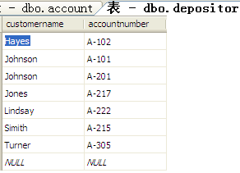
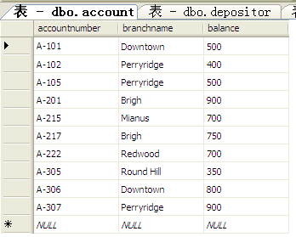
r: depositor, |r| = 7
s: account, |s| = 10
select *
from depositor inner join account
on depositor.accountnumber=account.accountnumber
select *
from account inner join depositor
on account.accountnumber=depositor.accountnumber

Slide 21
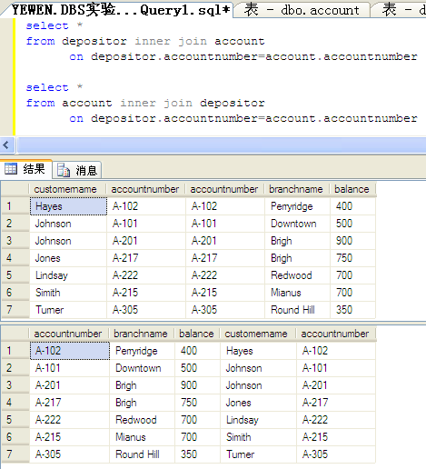

Slide 22
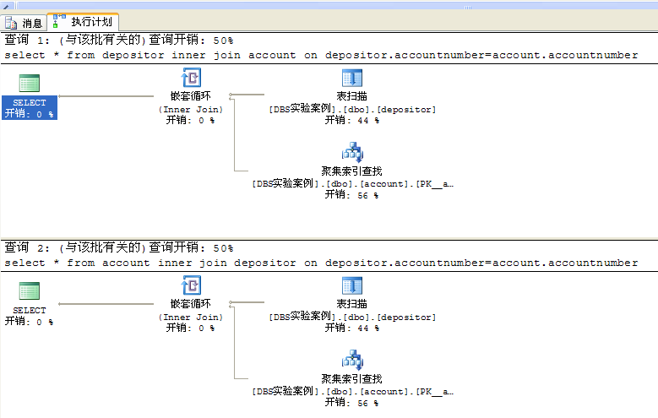
SQL Server查询优化器自动选择元组数少的depositor作为连接操作的outer关系，两条语句的查询执行计划、执行成本一样！！！

Slide 23

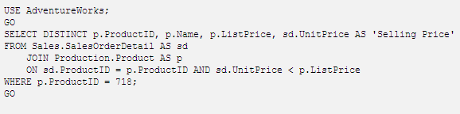
Innner Join in SQL Server

Slide 24
Equivalence Rules (cont.)
Rule6. (连接操作的结合率, associative)
a. natural join operations are associative
(E1 E2) E3 = E1 (E2 E3)
b. Theta joins are associative in the following manner:
(E_{1 θ1} E₂) _{θ2∧ θ 3} E₃ = E_{1 θ1∧ θ3} (E₂ _{θ2} E₃)
, where θ₂ involves attributes from only E₂ and E₃
Notes:
连接顺序重排
简化中间计算结果

Slide 25
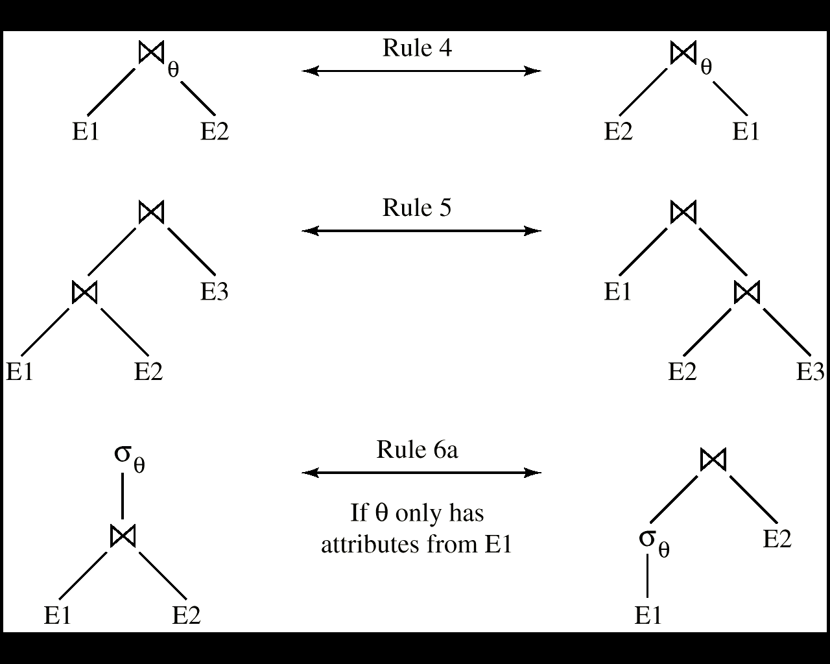
Rule 5
Rule 6a
Rule 7a
Fig.13.3 Pictorial Depiction of Equivalence Rules

Slide 26
Equivalence Rules (cont.)
Rule7. Selection operation distributes over theta-join(选择操作对于连接操作的分配率,选择条件下移)
  a. when all the attributes in θ₀ involve only the attributes of one of the expressions , e.g. E₁, being joined
  σ_{θ0}(E₁ _{θ} E₂) = (σ_{θ0}(E₁)) _{θ} E₂
  b. when θ ₁ involves only the attributes of E₁, and θ₂ involves only the attributes of E₂
σ_{θ1}∧_{θ2} (E₁ _{θ} E₂) = (σ_{θ1}(E₁)) _{θ} (σ_{θ2} (E₂))
  e.g. in Fig.13.0.2

Slide 27

When Rule7 is applied, the size of relations participating in theta-join operation is reduced, thus evaluation costs are reduced
branch
account
Fig.14.0.2 An example of Rule7
Notes:
参与连接的关系大小减少了，因而代价就小了
先选择再连接更好：不满足选择条件的元组不参与连接操作，效率提高了

Slide 28
Equivalence Rules (cont.)
Rule8. Projection operation distributes over theta-join(投影操作对于连接操作的分配率,投影下移)
  a. L₁ and L₂ are the attributes of E₁ and E₂ respectively. if join condition θ involves only attributes in L₁ ∪ L₂, then
Notes:
连接条件中如果只包含L1和L2中的属性，可分配，从而可进一步减少参与连接操作的属性集。

Slide 29
E1:
instructor (ID, name, dept-name, salary)
E2:
department(dept-name, building, budget)
L1
L2
  ∏ _{{dept-name, ID} ∪} _{{dept-name, salary}}
instructor
department
  ∏_{{dept-name, ID}}
  ∏ _{{dept-name, salary}
instructor
department
Fig.13.0.3 An example of Rule 8a
Notes:
先投影出连接属性和结果属性

Slide 30
Equivalence Rules (cont.)
  b. consider a join E_{1 θ} E₂
    let L₁ and L₂ be sets of attributes from E₁ and E₂, respectively
    let L₃ be attributes of E₁ that are involved in join condition θ, but are not in L₁ ∪ L₂, and
    let L₄ be attributes of E₂ that are involved in join condition θ, but are not in L₁ ∪ L₂.
Notes:
属性约简：由结果属性和连接属性参与计算

Slide 31
E1:
instructor (ID, name, dept-name, salary)
L1
L2
E2:
department(dept-name, building, budget)
  ∏ _{{name} ∪} _{{ building}}
θ
  ∏ _{{name} ∪} _{{ building}}
salary> budget
L3
L4
instructor
department
salary> budget
  ∏ _{{name, salary}}
  ∏ _{{building, budget}}
只选后续用到的属性！
instructor
department
Fig.13.0.4 An example of Rule 8b
Notes:
只保留连接属性和结果属性，即只选后续用到的属性

Slide 32
Equivalence Rules (cont.)
Rule9. The set operations union and intersection are commutative 集合并和交满足交换律
E₁ ∪ E₂ = E₂ ∪ E₁
E₁ ∩ E₂ = E₂ ∩ E₁
set difference is not commutative
Rule10. Set union and intersection are associative（结合律）
(E₁ ∪ E₂) ∪ E₃ = E₁ ∪ (E₂ ∪ E₃)
(E₁ ∩ E₂) ∩ E₃ = E₁ ∩ (E₂ ∩ E₃)

Slide 33
Equivalence Rules (cont.)
Rule11. (选择操作对于集合并、交、差的分配率) The selection operation distributes over ∪, ∩ and –.
  σ_{θ} (E₁ – E₂) = σ_{θ} (E₁) – σ_{θ}(E₂)
    similarly for ∪ and ∩ in place of –
  σ_{θ} (E₁ – E₂) = σ_{θ}(E₁) – E₂
    similarly for ∩ in place of –, but not for ∪
Rule12. (投影操作对于集合并的分配率) The projection operation distributes over union
Π_{L}(E₁ ∪ E₂) = (Π_{L}(E₁)) ∪ (Π_{L}(E₂))

Slide 34
Example One: Pushing Selections
Query: Find the names of all instructors in the Music department, along with the titles of the courses that they teach
  Π_{name, title}(σ_{dept_name= “Music”}
  (instructor (teaches Π_{course_id, title} (course))))
Transformation using rule 7a.
  Π_{name, title}((σ_{dept_name= “Music”}(instructor))
  (teaches Π_{course_id, title} (course)))
Performing the selection as early as possible reduces the size of the relation to be joined.
Notes:
先选择再连接，选择可减小参与连接的关系大小。

Slide 35
Example Two：Multiple Transformations
Find the names of all instructors in the Music department who have taught a course in 2009, along with the titles of the courses that they taught
  Π_{name, title}(σ_{dept_name= “Music”∧year = 2009}
  (instructor (teaches Π_{course_id, title} (course))))
Transformation using join associatively (Rule 6a):
  Π_{name, title}(σ_{dept_name= “Music”∧year = 2009}
  ((instructor teaches) Π_{course_id, title} (course)))
Second form provides an opportunity to apply the “perform selections early” rule, resulting in the subexpression
σ_{dept_name = “Music”} (instructor) σ _{year = 2009} (teaches)

Slide 36
Example Three: Pushing Projections
Consider: Π_{name, title}(σ_{dept_name= “Music”} (instructor) teaches)
Π_{course_id, title} (course))))
When we compute
(σ_{dept_name = “Music”} (instructor） teaches)
we obtain a relation whose schema is:
(ID, name, dept_name, salary, course_id, sec_id, semester, year)
Push projections using equivalence rules 8a and 8b; eliminate unneeded attributes from intermediate results to get:
Π_{name, title}(Π_{name, course_id} (
σ_{dept_name= “Music”} (instructor) teaches))
Π_{course_id, title} (course))))
Performing the projection as early as possible reduces the size of the relation to be joined.

Slide 37
13.2.3 Join Ordering（连接次序）
For all relations r_{1,} r_{2,} and r₃,
(r₁ r₂) r₃ = r₁ (r₂ r₃ )
If r₂ r₃ is quite large and r₁ r₂ is small, we choose
(r₁ r₂) r₃
so that we compute and store a smaller temporary relation.

Slide 38
Example
Consider the expression
Π_{name, title}(σ_{dept_name= “Music”} (instructor) teaches
Π_{course_id, title} (course))
Could compute teaches Π_{course_id, title} (course) first, and join result with
σ_{dept_name= “Music”} (instructor)
but the result of the first join is likely to be a large relation.
Only a small fraction of the university’s instructors are likely to be from the Music department
  it is better to compute
σ_{dept_name= “Music”} (instructor) teaches
first.
Notes:
中间结果为小的关系的，先进行计算

Slide 39
§13.3 Estimating Statistics of Expression Results
略
How to estimate the cost of an operation p
  estimating the size of the resultant relations produced by the operation p, according to statistics in the catalog about the relations on which the operation is conducted
    e.g. ∏_{customer-name}(σ_{balance<2500}(account) customer)
  computing the cost of the operation in terms of disk access, by means of the cost formulae shown in chapter13
    disk access is the predominant cost, and the number of block transfers from disk is used as a measure of the actual cost of evaluation.

Slide 40
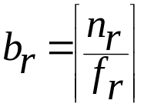
13.3.1 Statistics in Catalog for Optimization
n_{r}: number of tuples in a relation r
b_{r}: number of blocks containing tuples of r
l_{r}: size of a tuple of r in bytes
f_{r}: blocking factor of r
  the number of tuples of r that fit into one block
If tuples of r are stored together physically in a file, then:

Slide 41
Statistics in Catalog for Optimization (cont.)
V(A, r): number of distinct values that appear in r for attribute A
  same as the size of ∏_{A}(r), | ∏_{A}(r)|
Statistics about indices, such as heights of B⁺-trees, that is HT_{i}, and the number of leaf pages in the indices, are also in catalog

Slide 42
Statistics in Catalog for Optimization (cont.)
An example for statistical information
  n_{account} = 10000 (account has 10,000 tuples)
  f_{account}= 20 (20 tuples of account fit in one block)
  V(branch-name, account) = 50 (50 branches)
  V(balance, account) = 500 (500 different balance values)
  assume the following indices exist on account
    a clustered/primary, B⁺-tree index for the attribute branch-name
    a secondary, B⁺-tree index for the attribute balance

Slide 43
13.3.2 Selection Size Estimation
The size estimation of the result of a selection operation depends on the selection predicates, that is single equality predicate, single comparison predicate, and combination of predicates
Equality selection σ_{A=a} (r)
  assuming uniform distribution of values in relations, and the value a appears in attribute A of some record in r
  the selection is estimated to have
    n_{r} / V(A, r) tuples satisfying A=a
    ⎡n_{r} /V(A, r) /f_{r}⎤ blocks that these tuples occupy

Slide 44
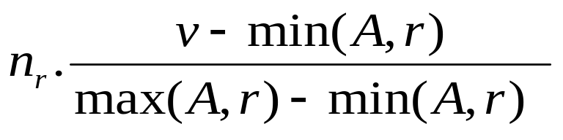
Selection Size Estimation (cont.)
Comparison selections σ_{A≤v}(r)
  the lowest and highest values of attributes, that is min(A, r) and max(A, r), are available in catalog
  the estimated number of records/tuples satisfying comparison condition A≤ V
    0, if v < min(A, r)
    n_{r}, if v ≥ max(A, r)
    , otherwise
  in absence of statistical information, the cost is assumed to be
  n_{r} / 2

Slide 45
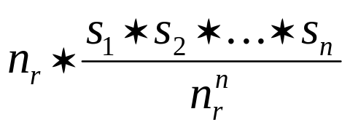
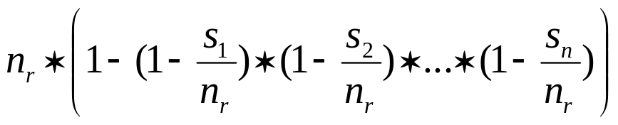
Selection Size Estimation (cont.)
The selectivity of a condition θ_{i} is the probability that a tuple in the relation r satisfies θ_{i} . If s_{i} is the number of satisfying tuples in r, the selectivity of θ_{i} is given by s_{i} /n_{r}.
Conjunction: σ_{θ1∧ θ2∧. . . ∧ θn} (r). The estimate for number of
tuples in the result is:
Disjunction:σ_{θ1∨} _{θ2 ∨. . . ∨} _{θn} (r). Estimated number of tuples:
Negation: σ_{¬θ}(r). Estimated number of tuples:
n_{r} – size(σ_{θ}(r))

Slide 46
13.4 Choice of Evaluation Plans
— Query optimization
How to generate the evaluation plan for a relational algebra expression with lower or the lowest cost
  generating of the optimized query trees
  selecting
    implementation algorithms for each operations in the tree
    pipeline or materialization strategy for the expression
E.g. Fig.13.2

Slide 47
Fig.13.2 An evaluation plan

Slide 48
Choice of Evaluation Plans
Must consider the interaction of evaluation techniques when choosing evaluation plans
  choosing the cheapest algorithm for each operation independently may not yield best overall algorithm. E.g.
    merge-join may be costlier than hash-join, but may provide a sorted output which reduces the cost for an outer level aggregation.
    nested-loop join may provide opportunity for pipelining

Slide 49
Choice of Evaluation Plans
Query optimization
  choosing the evaluation plan with lowest or the lower cost
Practical query optimizers incorporate elements of the following two broad approaches:
  1. Cost-based (13.4.1, 13.4.2)
  Search all the plans and choose the best plan in a
  cost-based fashion.
  2. heuristic optimization (13.4.3)
  Uses heuristics to choose a plan
Practical query optimizers incorporate elements of these two approaches

Slide 50
13.4.1 Cost-Based Join Order Selection
The join operator is the basis for multiple table query, and its cost is expensive
For a relational algebra expression with several join operation
, the join order influences the query cost of the expression.
Consider finding the best join-order for r₁ r₂ . . . r_{n}.
There are (2(n – 1))!/(n – 1)! different join orders for above expression. With n = 7, the number is 665280, with n = 10, the number is greater than 176 billion!
No need to generate all the join orders. Using dynamic programming, the least-cost join order for any subset of
{r₁, r₂, . . . r_{n}} is computed only once and stored for future use.

Slide 51





Join Order Selection by Dynamic Programming
No need to generate all the join orders. Using dynamic programming, the least-cost join order for any subset of
{r₁, r₂, . . . r_{n}} is computed only once and stored for future use
方法：
P600, Fig.13.7;
类似于《算法设计与分析》中的矩阵连乘积

Slide 52
13.4.2 Cost-based Optimization with Equivalence Rules
Cost-based optimization
  search all?? the possible plans and choose the best plan
  a optimal plan with the minimum costs can be obtained
Cost-based optimization is expensive
Physical equivalence rules allow logical query plan to be converted to physical query plan specifying what algorithms are used for each operation.

Slide 53
Cost-based Optimization with Equivalence Rules
Efficient optimizer based on equivalent rules depends on
  A space efficient representation of expressions which avoids making multiple copies of subexpressions
  Efficient techniques for detecting duplicate derivations of expressions
  A form of dynamic programming based on memoization, which stores the best plan for a subexpression the first time it is optimized, and reuses in on repeated optimization calls on same subexpression
  Cost-based pruning techniques that avoid generating all plans
Pioneered by the Volcano project and implemented in the SQL Server optimizer

Slide 54
13.4.3 Heuristic Optimization
Heuristic optimization
  uses heuristics (or heuristic rules) to choose a better plan
  to reduce the number of choices that must be made in a cost-based fashion
  a suboptimal plan with lower costs can be obtained
Principles
transforms the query-tree by heuristics to reduce cost
  perform selection early to reduce the number of tuples
  perform projection early to reduces the number of attributes
  substitute Cartesian product and selection with join

Slide 55
Heuristic Optimization (cont.)
  perform most restrictive selection and join operations before other similar operations
    the most restrictive operations generate resulting relations with smallest size
Heuristic optimization used in some versions of Oracle

Slide 56
Steps in Heuristic Optimization
Step1 使用rule1( )，将conjunctive selection 分解为多个单独的选择操作，以使单个选择操作尽可能沿查询树下移（尽早执行选择操作，以减少中间计算结果）
Step2 根据选择操作的交换率和分配率，利用rule2, rule7.a, rule7.b, rule11， 将查询树上的每个选择操作尽可能移向叶节点，以便尽早执行选择操作
Step3 根据连接操作的结合律和交换率，使用rule6( )，重新安排查询树中的叶结点，使得具有restrictive selection特征的叶结点先执行
  restrictive selection：执行此操作后，产生的结果关系最小（所含元组最少）

Slide 57
Steps in Heuristic Optimization
(cont.)
Step4 利用rule4.a( ), 以连接操作代替相邻的选择和笛卡尔乘积操作
Step5 利用rule3, 8.a, 8.b,12, 将查询树上的投影操作尽可能下移，以便尽早执行投影操作，减少中间计算结果
Step6 将最后的查询树分解为多个子树，使子树中的各操作可以采用流水线方式执行，以减少对外设的访问次数
  e.g. Fig.13.2
重点：前5步 ！！！

Slide 58
Example One
Given
  S(S#, sname, age, sex)
  C(C#, cname, teacher)
  SC(S#, C#, grade)
Find all the students, who are male, and get grades more than 90 when they learn some one course
Step1. SQL statement
  SELECT DISTINCT sname
FROM S, SC
WHERE S.s# = SC.s# AND sex=M AND grade > 90
selection conditions
join condition

Slide 59
Example One (cont.)
Principles
select A1, A2, …, An
from r₁, r₂, …, r_{n}
where P
corresponds to
∏_{A1, A2, …, An} (σ_{P} ( r₁ ╳ r₂ ╳ …╳ r_{n} ) )

Slide 60
Example One (cont.)
Step2. Initial Relational algebra expression
  E1 =
Π_{sname}(σ _{s.s#=sc.s#} ∧ _{sex=M ∧grade>90} (S ╳ SC ) )
或：Π_{sname}(σ_{sex=M ∧grade>90} (S SC ) )
Step3. Initial query tree
  Fig. 14.0.5 (a), E1
Step4. By means of Rule1, Rule7b, distribute σ operations over relation S and SC
  Fig. 13.0.5 (b), E2

Slide 61
Π_{sname}
Π_{sname}
σ_{s.s#=sc.s#}
σ_{s.s#=sc.s# ∧ sex=M ∧grade>90}
╳
╳
σ_{sex=M}
σ_{grade>90}
SC (S#, C#, grade)
S
(S#, sname, age, sex)
S
SC
(a) Initial query tree
E1
（b）E2

Slide 62
Example One (cont.)
Step5. By means of Rule4.a, replace selection and Cartesian product with natural join
  Fig. 13.0.5 (c), E3
Step6. !! By means of Rule8b, distribute Π operations over relation S and SC
  Fig. 13.0.5 (d),
The final optimized expression E4 that is equivalent to initial expression E1 is
  Π_{sname} {Π_{sname, S#} (σ_{sex=M} (S))
  σ_{grade>90} (Πgrade, S# (SC)) }

Slide 63
Π_{sname}
Π_{sname}
s.s#=sc.s#
s.s#=sc.s#
σ_{sex=M}
σ_{grade>90}
Π_{sname, S#}
Π_{S#}
σ_{grade>90}
σ_{sex=M}
SC (S#, C#, grade)
S
(S#, sname, age, sex)
S
(S#, sname, age, sex)
SC(S#, C#, grade)
（c）E3
（d）E4

Slide 64
Example Two
Consider the following insurance database, where the primary keys are underlined,
  Person(driver-id, name, address)
  Car(license, model, year)
  Accident(report-number, date, location)
  Participated(driver-id , license, report-number, damage-amount)

Slide 65
Example Two (cont.)
Problems
  Give a SQL statement to find out the driver name, license, report-number of the accidents which happened in Beijing and before May 3, 2008
  Give the initial query tree for this query, and construct an optimized and equivalent relational algebra expression for it by means of heuristic optimization

Slide 66
Example Two (cont.)
Step1. SQL statement
  Select name, license, Accident.report-number
  From Person, Participate, Accident
  Where Person.driver_id = Participate.driver_id AND
  Accident.report_number = Participate.report_number
  AND Location=Beijing AND date < 5/3/2008
Step2. Initial expression
Π name, license, Accident.report-number
(σ Person.driver_id = Participate.driver_id AND Accident.report_number = Participate.report_number AND Location=Beijing AND date < 5/3/2003
(Person ╳ Participate ╳ Accident )

Slide 67
Π name, license, Accident.report-number
σ Person.driver_id = Participate.driver_id AND Accident.report_number = Participate.report_number AND Location=Beijing AND date < 5/3/2003
╳
╳
Person
Participate
Accident
(a) initial query tree

Slide 68
Π name, license, Accident.report-number
Accident.report.number = Participate.report_number
Π _{name, license,}
_{report-number}
Π_{Accident.report_number}
Person.driver_id = Participate.driver_id
_{Location=Beijing}
_{AND date < 5/3/2003}
_{driver_id,}
_{name}
_{driver_id,}
_{license,}
_{report-number}
Accident
(report-number, date ,location)
Participate
(driver-id, license, report-number, damage-amount)
Person
(driver-id, name, address)
(b) optimal query tree

Slide 69
Example Three
Consider the following relations in banking enterprise database, where the primary keys are underlined
  branch (branch-name, branch-city, assets),
  loan ( loan-number, branch-name , amount)
  borrower( customer-name, loan-number, borrow-date)
  customer (customer-name, customer-street, customer-city)
  account (account-number, branch-name, balance)
  depositor (customer-name, account-number , deposit-date)

Slide 70
Example Three (cont.)
For the query “ Find the names of all customers who have an loan at any branch that is located in Brooklyn and have assets more than $100,000, requiring that loan-amount is less than $1000”
  give an SQL statement for this query
  given a initial query tree for the query, and convert it into an optimized query tree by means of heuristic optimization

Slide 71
Example Three (cont.)
SQL
select customer-name
from borrower, loan, branch
where loan.loan-number=borrower.loan-number
and branch.branch-name=loan.branch-name
and branch-city=”Brooklyn”
and assets>100000 and amount<1000

Slide 72
Π _{customer-name}
Π _{customer- name, loan-number}
Π_{loan.loan-number}
Π_{loan.loan-number}
_{,branch-name}
Π_{branch-name}
_{amount< 1000}
_{branch-city=”Brooklyn”}
_{AND assets>100000}
borrower ( customer-name,
loan-number, borrow-date)
loan( loan-number, branch-name , amount)
Branch (branch-name,
branch-city, assets)

Slide 73
实际DBS中的查询优化
教科书上的选择、投影操作下移的实现方式
实际平台下（如SQL Server）与后面的连接操作结合在一起做，避免多次关系代数操作：
1. 采用pipeline，在对参与连接运算的关系扫描过程中完成符合条件的元组—选择
2. 再选出后续步骤需要的属性—投影

Slide 74
哈希匹配
Π _{customer-name}
嵌套循环inner join
表扫描
Π _{customername, accountnumber}
Π_{account.accountnumber}
聚集索引扫描
聚集索引查找
Π_{account.accountnumber}
_{,branchname}
Π_{branchname}
_{balance< 1000}
基于索引
depositor ( customername,
accountnumber, accessdate)
_{branchcity=‘Brooklyn’}
_{AND assets>100000}
account( accountnumber, branchname , balance)
branch (branchname,
branchcity, assets)

Slide 75
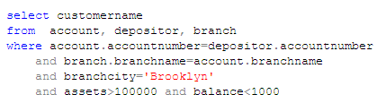
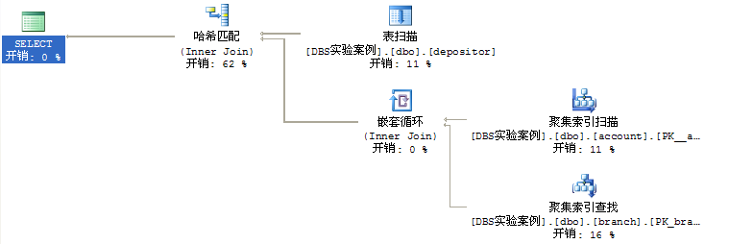

Slide 76
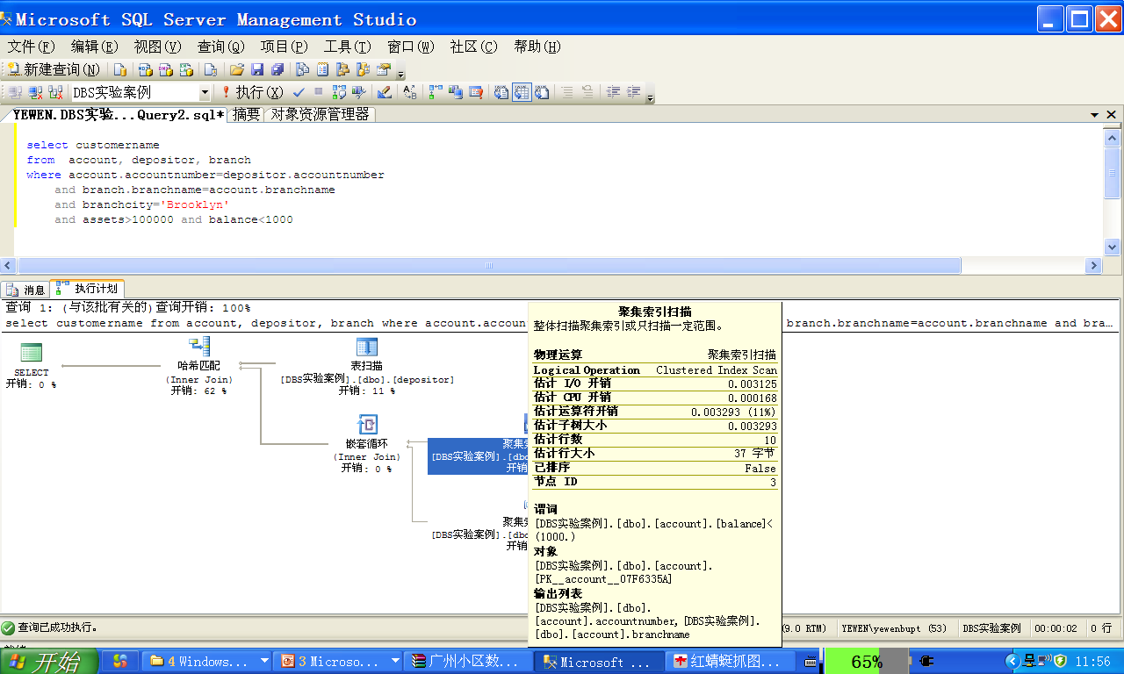
选择下移
投影下移

Slide 77
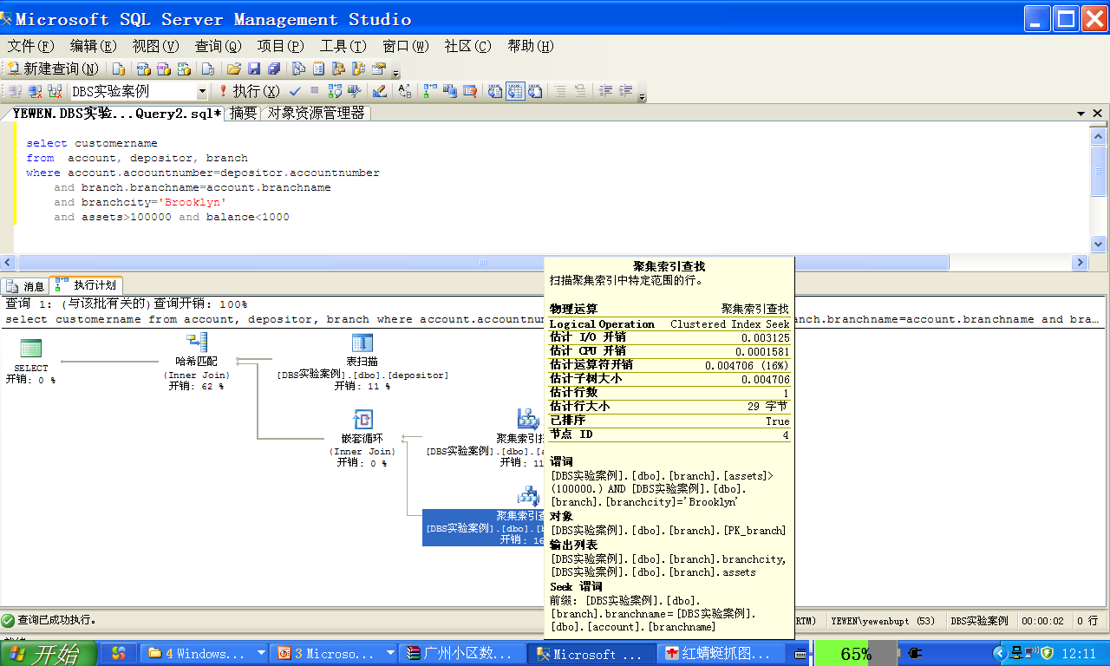
选择下移
投影下移？

Slide 78
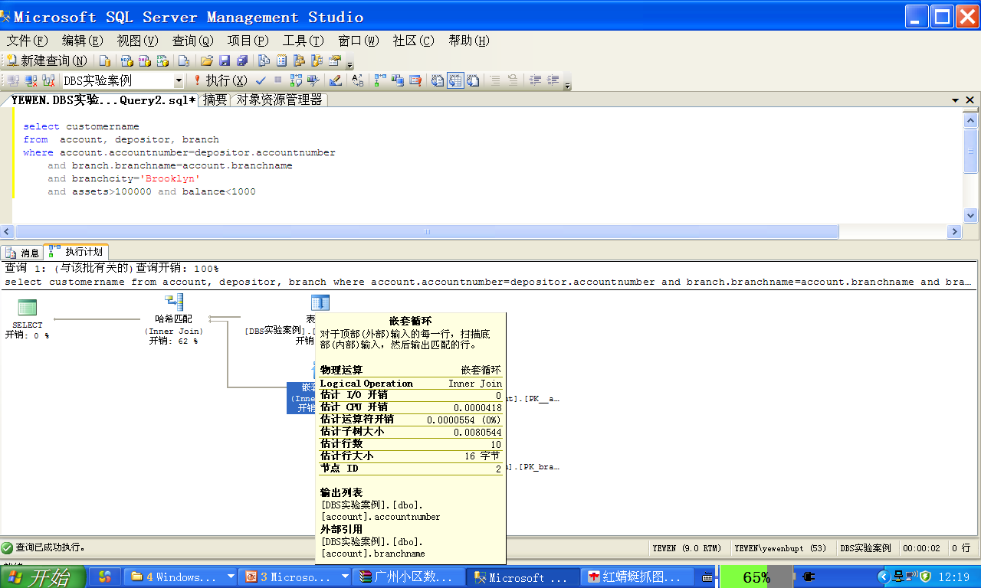
连接实现方式
投影下移

Slide 79
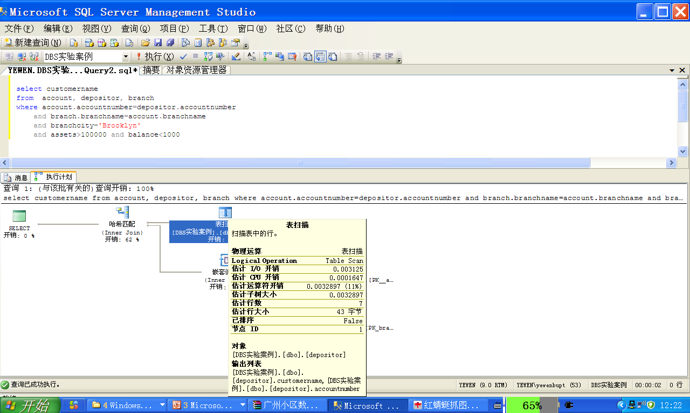
投影下移？

Slide 80
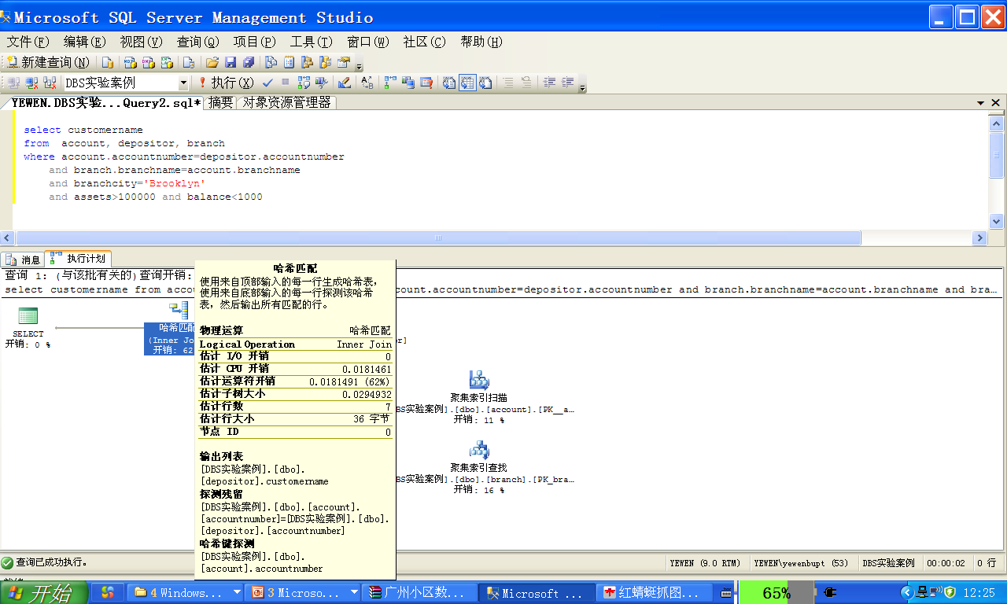
连接+投影

Slide 81
Example Four (cont.)
给定如下关系数据库
Employee(Employee#, Name, Address, Super-E#, E-D#)
Department(D#, Dname, manager#, depart-location)
Project(P#, Pname, Plocation, P-D#)
查询：对于每个在“哈尔滨”进行的工程项目，列出其工程项目号P# ，工程所属部门号P-D#, 该部门领导的名字Name和地址Address
要求：写出该查询的SQL语句；转换为关系代数表达式并利用启发式方法进行查询优化；给出优化后的关系代数表达式。
Select P#, P-D#, Name, Address)
From Project, Department, Employee
Where Plocation =哈尔滨 AND P-D#= D#
AND manager# = Employee#

Slide 82
Π _{P#, P-D#, Name, Address}
Π _{employee#, name, address}
Π _{P#, P-D#, manager#}
Employee
Π _{P#, P-D#}
Π_{D#, manager#}
_{P-location=“哈尔滨”}
Department
Project

Slide 83
作业1
Consider the following schema, where the primary keys are underlined ,
Suppliers (supplier-id, supplier-name, city, telephone, address)
Parts ( parts-id, parts-name, parts-color)
Catalog (supplier-id, parts-id, price )
.
(1) Give an SQL statement to find out the name and telephone of the suppliers who supply a red part whose price is below $2000.
(2) Translate this SQL statement into an initial query tree, and give an optimized query tree for it, by means of heuristic query optimization.

Slide 84
作业2
Consider the database University given in the textbook,
(1) Give a SQL statement to find some students and list their names and departments that they belong to. It is required that their total credits (presented by tot_cred) are more than 40, their departments are located in Building 3, and they take the course identified by ‘2016CSDBS’. (3 points)
(2) For the SQL statement in (1), give an optimized query tree. (7 points)

Slide 85
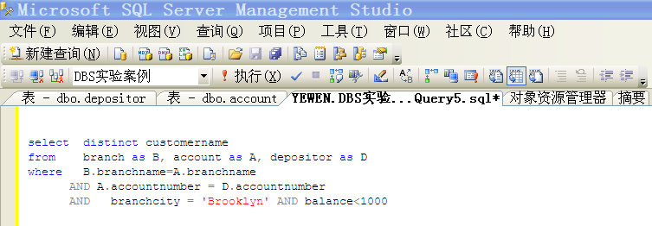
Appendix A SQL Server平台下
观察比较SQL语句查询执行计划
显示估计的查询执行计划

Slide 86
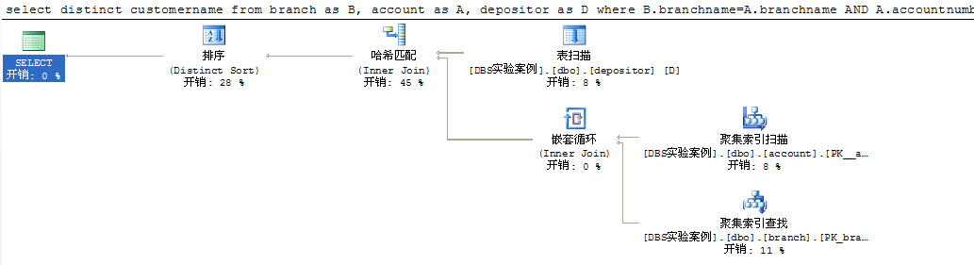
A1算法；
outer relation
13.5.5 hash join，
Fig. 13.8
A1算法；
outer relation
13.4
13.5.2 indexed nested loop join，
在内关系branch的连接属性branchname上建有索引
13.3.2 A3算法;
inner relation, holded in main memory

Slide 87
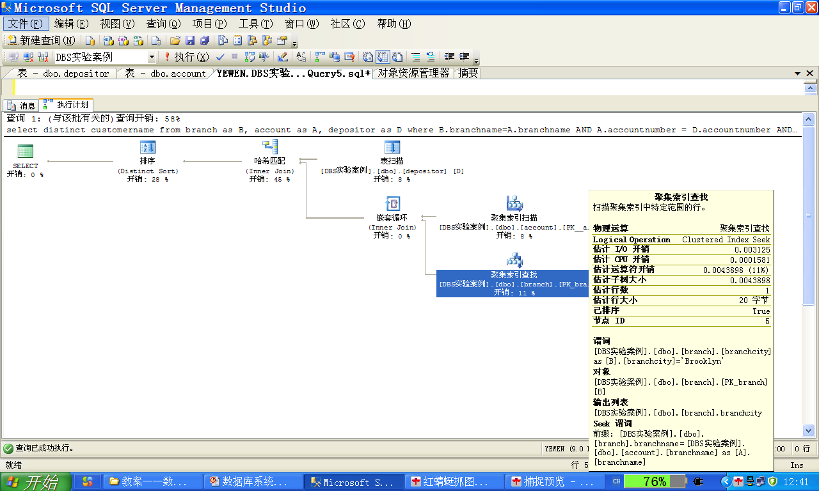
Database System Concepts - Chapter 14 Query Optimization -

Slide 88
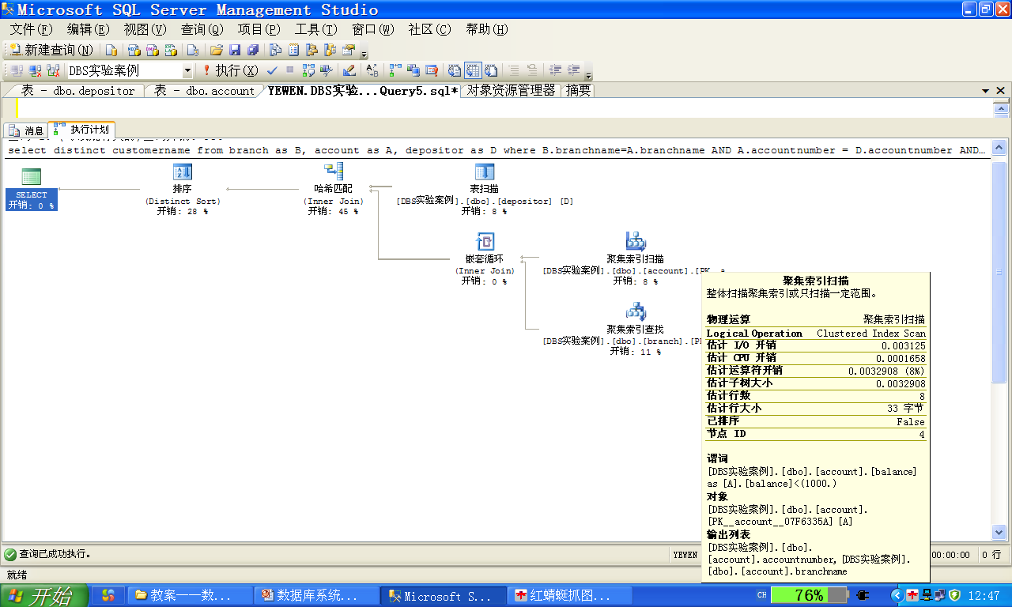
Database System Concepts - Chapter 14 Query Optimization -

Slide 89
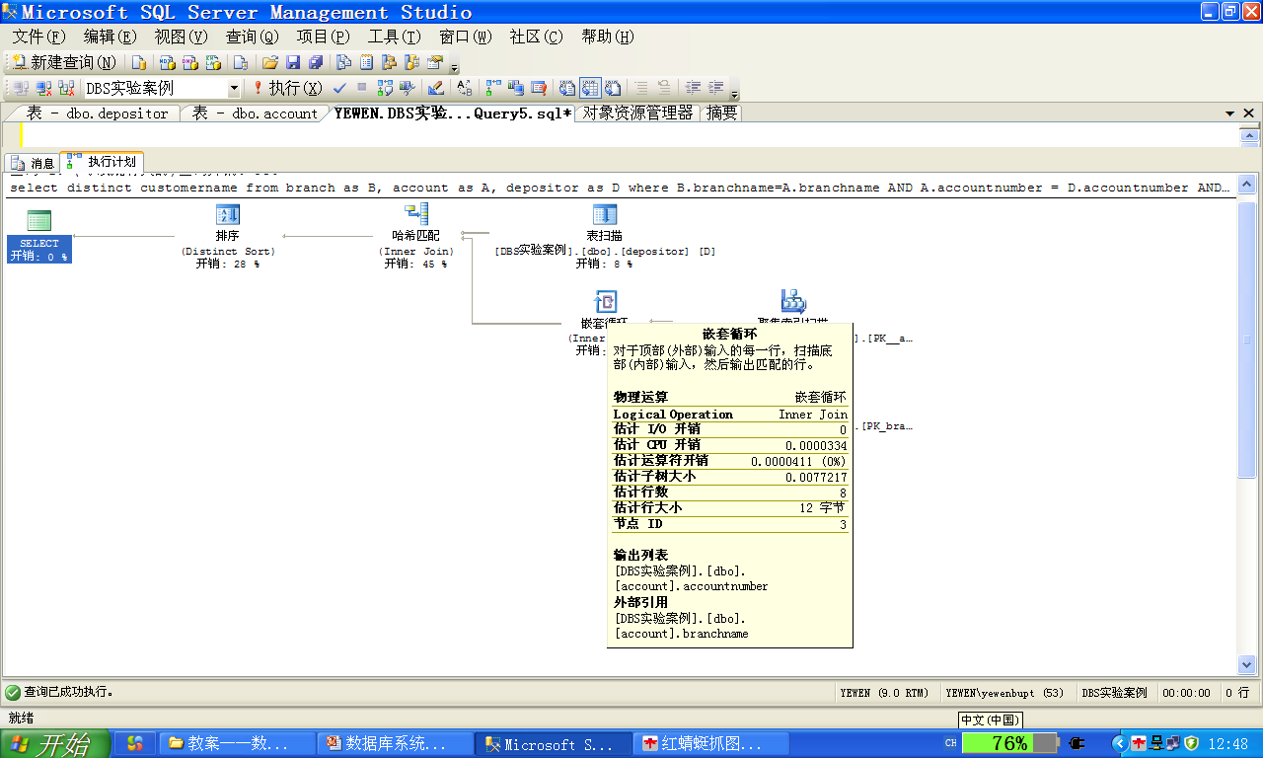
May 2014
Database System Concepts - Chapter 14 Query Optimization -

Slide 90
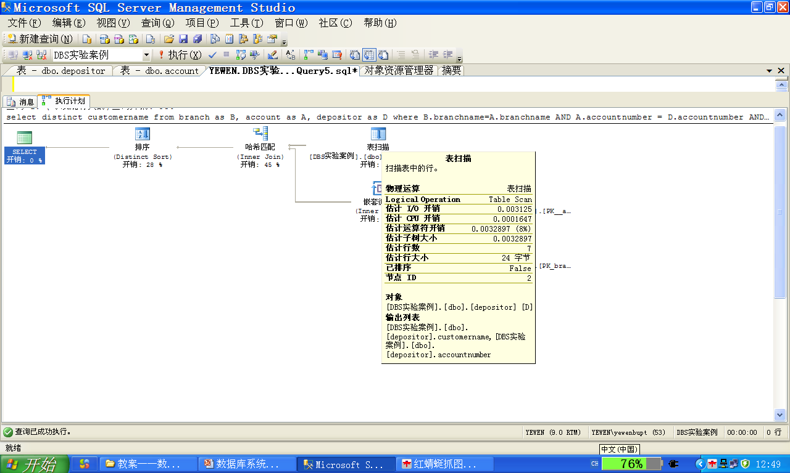
May 2014
Database System Concepts - Chapter 14 Query Optimization -

Slide 91
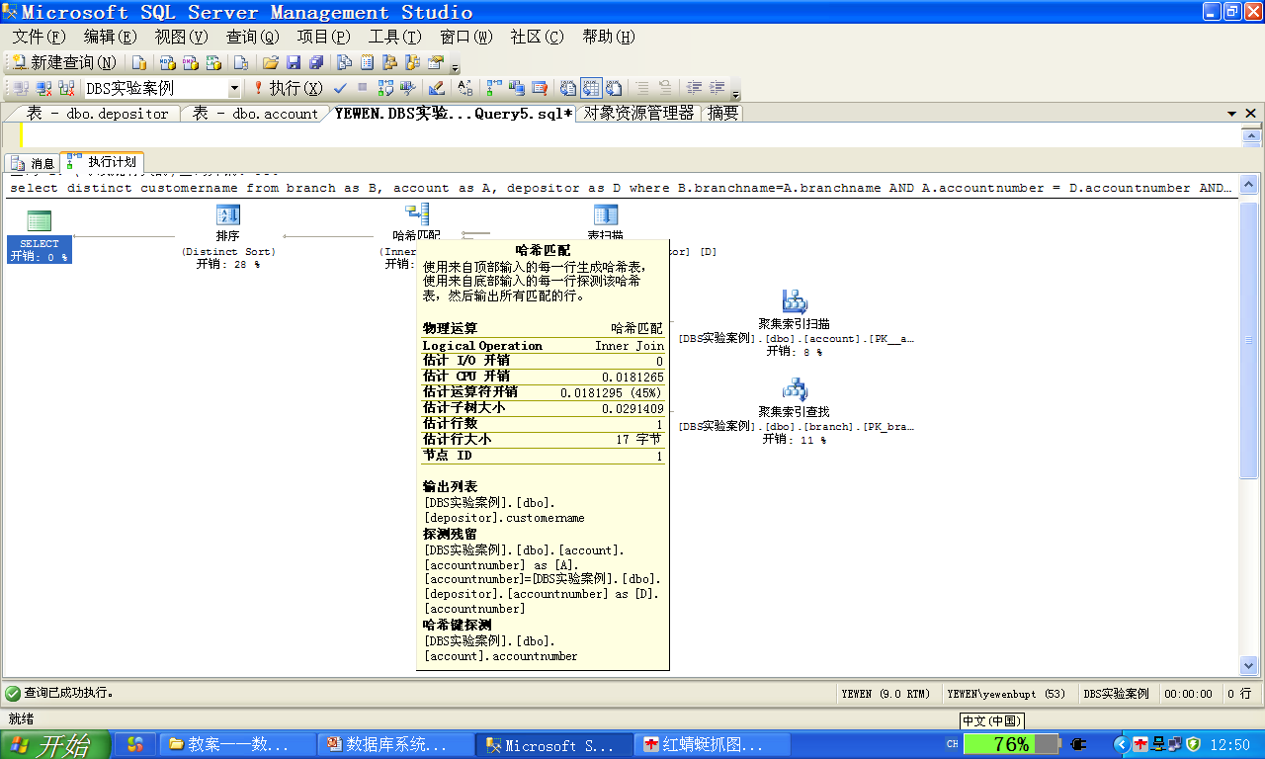
13.5.5 hash join，
Fig. 13.8
May 2014
Database System Concepts - Chapter 14 Query Optimization -

Slide 92
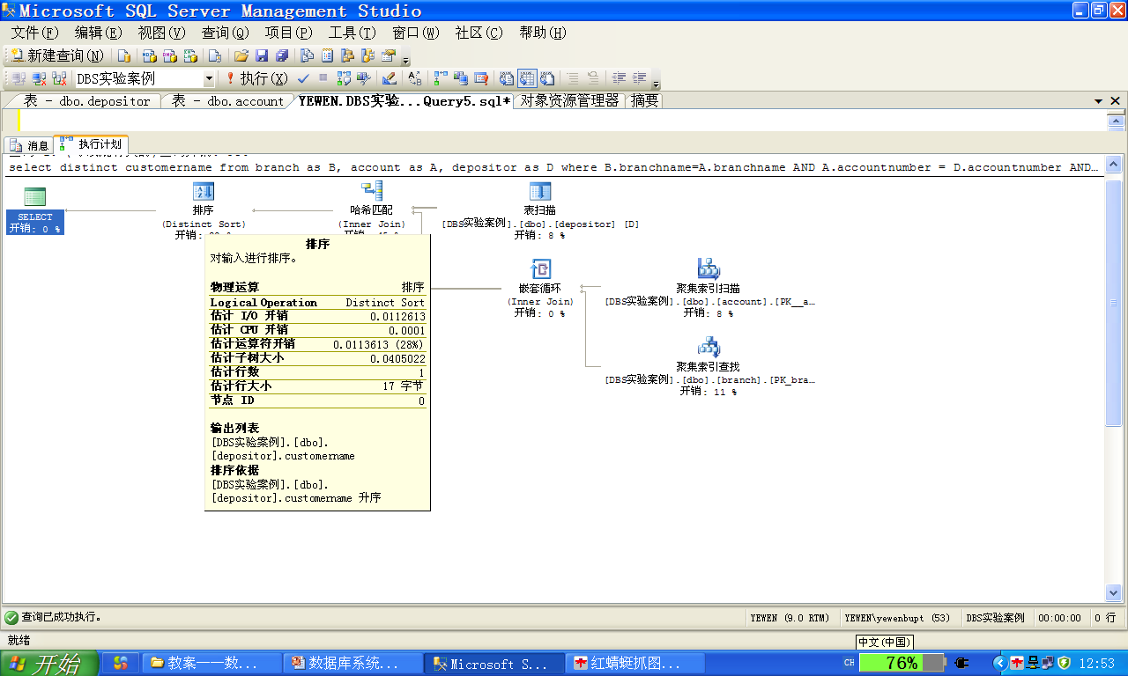
13.4
May 2014
Database System Concepts - Chapter 14 Query Optimization -

Slide 93
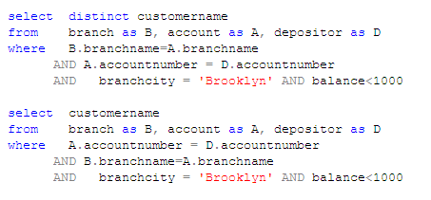
比较2条SQL语句查询成本
同时提交1批（2条）查询语句：

Slide 94
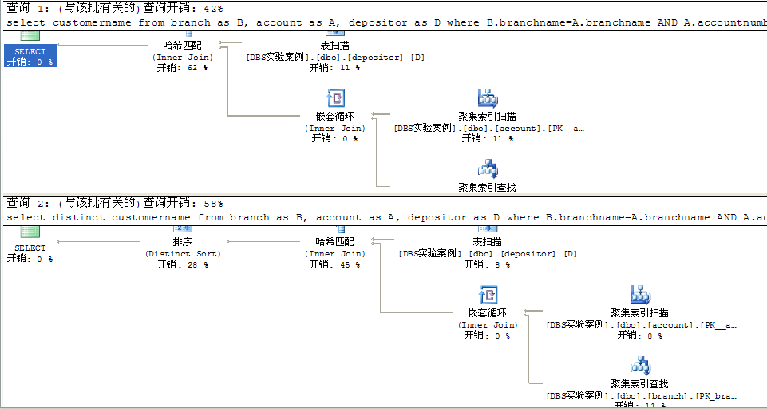
该批次中2条查询语句的成本之比： 42% vs. 58%

Slide 95
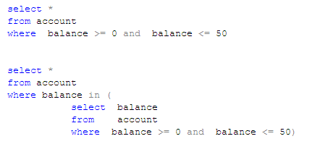

Slide 96
