Slide 1
PART 5
TRANSACTION MANAGEMENT

Slide 2
Chapter 15
Concurrency Control

Slide 3
Introduction to Chapter 15
Concurrency control of processes
  多个进程对共享资源的使用：互斥使用
  OS中的进程并发控制（互斥与同步）机制：
  软件方法，硬件方法，信号量，管程
  信号量方法： wait(S)
critical section
signal(S)
  锁/lock S：二元信号量，实现对共享资源的互斥使用，{0，1} 表示资源使用情况，锁操作控制进程的执行和等待
  deadlock handling
    deadlock prevention, deadlock avoidance, deadlock detection and recovery
Notes:
确保隔离性的方法之一是要求对数据项进行互斥访问。
实现该需求的最常用方法是指允许事务访问当前该事务持有锁的数据项。

Slide 4
Introduction to Chapter 15 (cont.)
Transaction concurrency control
  /*根据可串行化基本原理, 采用以下机制控制多个进程对共享数据的互斥访问 , 实现对事务的并发调度
    lock-based protocols (§15.1)
    multi- granularity schemes (多粒度，§15.3)
    {multi-version schemes (多版本，§15.6)
    timestamp-based protocols (§15.4)
    validation-based protocols (验证，§15.5) }
    deadlock handling (§15.2)
    deadlock prevention
    deadlock detection and recovery
Notes:
重点讲述前两种并发控制协议。

Slide 5
§15.1 Lock-based Protocol
Principles
/*用二元信号量“lock”控制并发事务{T_{i}}对共享数据Q的访问
  T_{i}存取Q时，先向DBMS申请对Q加锁
  如果此时Q未被其它事务加锁，则T_{i}加锁成功，继续执行对Q的访问
  如果此时Q已经被其它事务加锁，则T_{i}等待，直至Q上的锁被释放， T_{i}获得锁后继续执行
  T_{i}执行完对Q的操作后，解锁Q
  DBMS根据lock-compatibility matrix将lock授予请求的事务
  事务执行过程: 申请锁——加锁——读写——解锁

Slide 6
Lock-based Protocol
共享数据Q
  1.逻辑单元：
  属性值，属性值集合，元组，关系，索引项，整个索引，数据库DB
  2. 物理单元：数据页，索引页，数据块extent

Slide 7
15.1-1 Locks
A lock is a mechanism to control concurrent access to a data item
  a transaction is allowed to access a data item only if it is currently holding a lock at that item
Data items can be locked in two modes :
  exclusive (X) mode. Data item can be both read as well as
written. X-lock is requested using lock-X instruction
  shared (S) mode. Data item can only be read. S-lock is
requested using lock-S instruction
Lock requests are made to the concurrency-control manager by the programmer. Transaction can proceed only after request is granted.
Lock primitives
  lock-S(Q), unlock-S(Q)； lock-X(Q), unlock-X(Q);

Slide 8
Locks (cont.)
Concurrency-control manager/scheduler in DBMS grants lock to transactions who want to access Q according to lock-compatibility matrix
  assuming that T_{i} requests a lock of mode A on data item Q on which another transaction T_{j} currently holds a lock of mode B, if T_{i} can be granted a lock of mode A, then mode A is compatible with mode B
T_{j}
T_{i}
B
 | S | X
S | true | false
X | false | false
A
Fig.15.1 Lock-compatibility matrix

Slide 9
Locks (cont.)
In accordance with Fig.15.1, several shared locks can be held simultaneously (by different transactions) on shared data item Q;
When T_{i} requests a lock of mode A to operate on data item Q, e.g. S(Q) related to read(Q), while Q is already locked in a incompatible mode B byT_{j}, e.g. X(Q) related to write(Q), then
  T_{i} must wait until the lock in mode B held by T_{j} is released, the lock is then granted to T_{i}
If a lock cannot be granted, the requesting transaction is made to wait till all incompatible locks held by other transactions have been released. The lock is then granted

Slide 10
15.1-1 Locks (cont.)
Procedures of T_{i}’s executing to access a data item Q
  (1) other operations in T_{i}
  (2) request a lock S(Q) or X(Q), by the primitive lock-S(Q) or lock-X(Q)
  (3) wait for concurrency-control manager’s granting of the lock requested;
  (4) whenever obtaining the lock, make access on Q;
  (5) after finishing data access on Q, release lock on Q, by unlock-S(Q) or unlock-X(Q);
  (6) other operations;

Slide 11
T_{i}
T_{j}
lock-X(Q)
read(Q)
lock-S(R)
read(R)
unlock(R)
write(Q)
lock-X(R)
waiting
…
obtaining the lock
write(R)

Slide 12
AntiExamples
T₁: transfer $50 from account-B to account-A, Fig.15.2
T₂: display the total amount of A and B, Fig.15.3
T₁ and T₂ unlock data item A and B immediately after its final access of that data
Initially, A=100, B=200
T1: lock-X(B);
read(B);
B:=B-50;
write(B);
unlock(B);
lock-X(A);
read(A);
A:=A+50;
write(A);
unlock(A);
T2: lock-S(A);
unlock(A);
lock-S(B);
read(B);
unlock(B);
display(A+B)

Slide 13
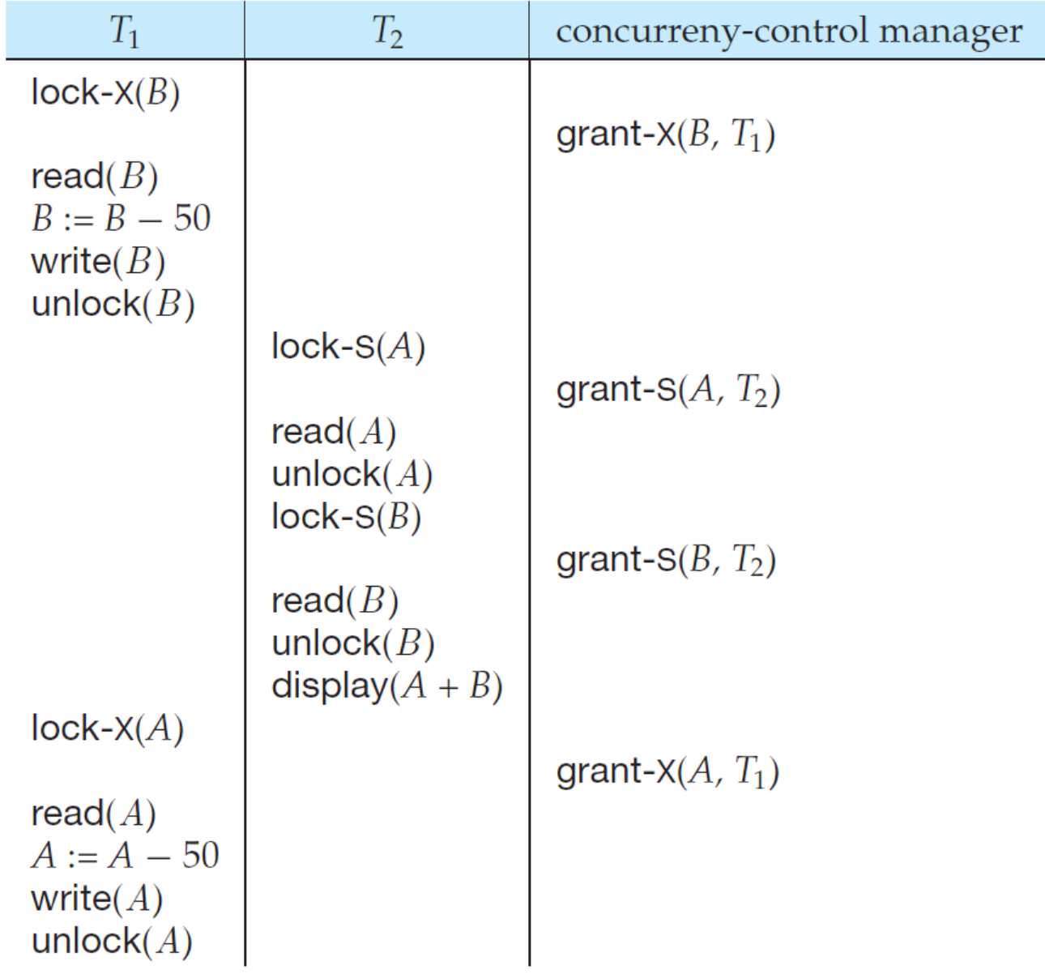
For the concurrent schedule S1 (given in Fig.15.4) on T₁ and T₂ , an inconsistent result display(A+B) = 250 exist, why?
  T₁ unlocked data item B too early, as a result of which T₂ saw a inconsistent state

Slide 14

AntiExamples (cont.)
T₃: transfer $50 from account-B to account-A, Fig.16.5
T₄: display the total amount of A and B, Fig.16.6
T₃ and T₄ unlock data item A and B at the end of transaction
Initially, A=100, B=200
The concurrent schedule S2 (given in Fig.15.7) on T₃ and T₄ leads to deadlock
A
T₃
T₄
B
Notes:
发生死锁：T3和T4互相等待

Slide 15
Locking protocol
As revealed by the examples, in lock-based schemes, the orders of granting locks to and revoking locks from transactions must be limited to avoid inconsistent DB states and starvation of transactions
Locking protocol
  set of rules followed by all transactions while requesting and releasing locks
Locking protocols restrict the set of possible schedules, and lead to a subset of all possible conflict serializable schedules
Notes:
为了解决上述两个问题：避免不一致性状态和死锁问题，需要设计并发控制协议，保证调度的冲突可串行化。

Slide 16
15.1-3 Two Phase Locking Protocol/2PL
This protocol ensures conflict-serializable schedules
In accordance with 2PL, each transaction T_{i} issues lock and unlock requests in two phases
  growing phase: T_{i} may obtain locks, but may not release any locks
  shrinking phase:T_{i} may release locks, but may not obtain any locks
  when T_{i} begins, it enters growing phase
  when T_{i} releases its first lock by unlock, it enters shrinking phase, and is not allowed to apply for locks, i.e. not allowed to enter growing phase

Slide 17
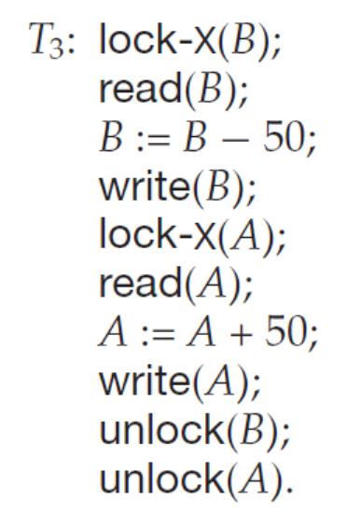
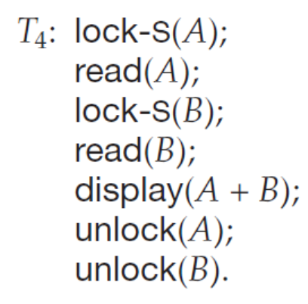
T₂: lock-S(A);
read (A);
unlock(A);
lock-S(B);
read (B);
unlock(B);
display(A+B)
transaction
not following
transaction following 2PL

Slide 18
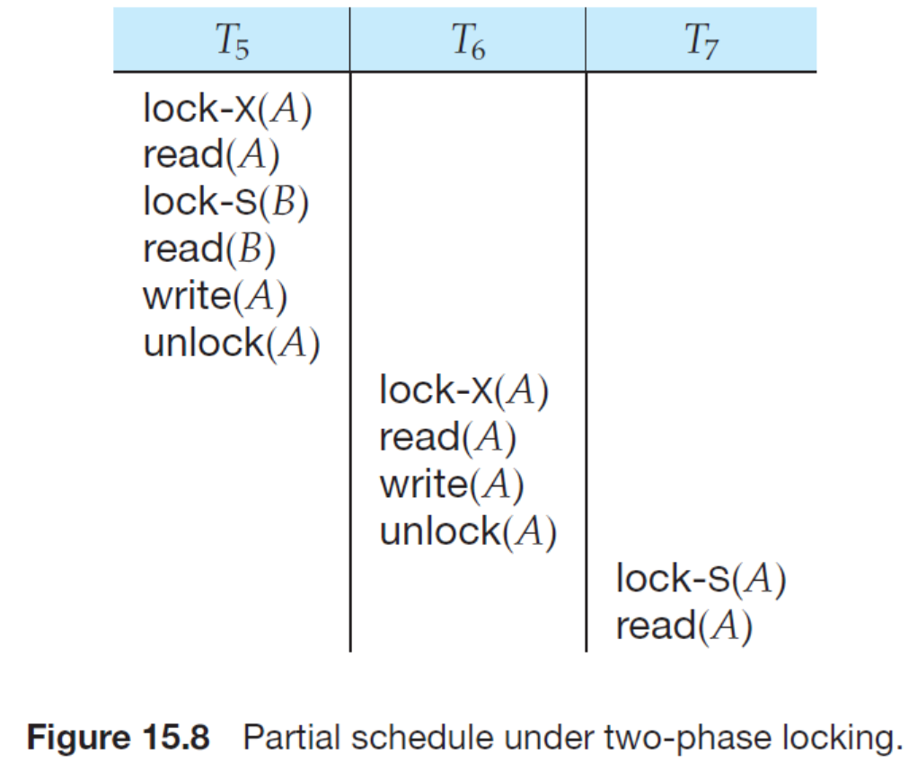

Slide 19
Two Phase Locking Protocol (cont.)
The protocol assures serializability. It can be proved that the transactions can be serialized in the order of their lock points (i.e., the point where a transaction acquired its final lock).
Lock point
  the point in the transaction/schedule where the transactions has obtain its final lock, but has not yet unlock any locks
E.g. lock-point in T₅ in Fig.15.0.1

Slide 20
Two Phase Locking Protocol (cont.)
T₅
Lock-X(A)
read (A)
Lock-S(B)
read (B)
Unlock (B)
write (A)
Unlock (A)
growing
phase
lock
point
Shrinking
phase
Fig.15.0.1 Partial schedule under two-phase locking

Slide 21
!! Properties of 2PL
2PL guarantees conflict serializability, i.e. generates conflict serializable concurrent schedules
2PL does not ensure freedom from deadlock
2PL does not avoid cascading rollback

Slide 22
Two Phase Locking Protocol (cont.)
Given a concurrent schedule S in line with 2PL, S is equivalent to a serial schedule S’, such that
  the ordering of lock points of each transactions in S is the same as the ordering of transactions in S’
E.g. S3 in Fig.15.0.1 is conflict serializable, and equivalent to <T₅; T₆’ >
  the lock point of T₅ is before the lock point of T₆’

Slide 23
T₅
Lock-X(A)
read (A)
Lock-S(B)
read (B)
Unlock (B)
write (A)
Unlock (A)
T₆’
Lock-X(B)
read (B)
write (B)
Unlock (B)
LP5
Lock-X(B)
waiting
LP6’
Fig. 15.0.1 A concurrent schedule S3 under 2PL protocol constraints

Slide 24
How to construct the schedules
in line with 2PL
/*给定若干事务, 构造满足2PL的并发调度S！！
  为各事务添加加锁和解锁操作，各事务应满足2PL要求，即事务内部分为生长和收缩2个阶段
  根据各事务的锁点位置和锁的互斥性 (相容关系)，安排各事务的并发执行
  S中各事务的growing phase和shrinking phase 应尽可能错开，不允许访问同一数据的2个事务（冲突事务）同时处于growing phase
E.g. A concurrent schedule S4 in Fig.15.0.2

Slide 25
T₅
Lock-X(A)
read (A)
Lock-S(B)
read (B)
Unlock (B)
write (A)
Unlock (A)
T₆’
Lock-X(B)
read (B)
write (B)
Unlock (B)
G
G
S
S
S4 is equivalent to <T6’;T5>
Fig. 15.0.2 A concurrent schedule S4 under 2PL protocol constraints

Slide 26
How to construct the schedules
in line with 2PL (cont.)
E.g. Construct a concurrent schedule that is equivalent to < T7;T8 >
  step1. 分别为T7和T8加锁操作, 构成T7’和T8’
T₇
read (A)
read (B)
write (A)
T₇’
Lock-X(A)
read (A)
Lock-S(B)
read (B)
Unlock (B)
write (A)
Unlock (A)
T₈
read (B)
write (B)
read (C)
T₈’
Lock-X(B)
read (B)
Lock-S(C)
write (B)
read (C)
Unlock (B)
Unlock (C)
Fig.15.0.3-1 A concurrent schedule S5

Slide 27
  step2. 根据锁的相容性构造调度，假设T₇’的锁点先于T₈’的锁点
T₇’
Lock-X(A)
read (A)
Lock-S(B)
read (B)
Unlock (B)
write (A)
Unlock (A)
T₈’
Lock-X(B)
read (B)
Lock-S(C)
write (B)
read (C)
Unlock (B)
Unlock (C)
Fig.15.0.3-2 A concurrent schedule S5

Slide 28
Strict 2PL protocol
There are two types of enhanced 2PL protocols, that is, strict 2PL and rigorous 2PL
Strict (严格) 2PL protocol
  all X-locks taken by a transaction are held until that transaction commits, that is, all X-locks can only be unlocked at the end of the transaction
  leading to cascadeless and serializable schedules

Slide 29
E.g. schedule S6 in Fig.16.0.4
T₁
Lock-X(A)
read (A)
Lock-S(B)
read (B)
Unlock (B)
write (A)
…..
Unlock (A)
growing phase
lock
point
shrinking phase
Fig.16.0.4 A schedule S6 under strict 2PL

Slide 30
Rigorous 2PL protocol
Rigorous (强制) 2PL protocol
  all X-locks and S-locks taken by a transaction are held until that transaction commits
    leading to transactions are serialized in the order in which they commit
Schedule S7 in Fig.16.0.5
Most DBMS implement either strict or rigorous 2PL protocol.

Slide 31
Rigorous 2PL protocol (cont.)
T₁
Lock-X(A)
read (A)
Lock-S(B)
read (B)
write (A)
…
Unlock (A)
Unlock (B)
growing phase
lock
point
shrinking phase
Fig.16.0.5 A schedule S7 under rigorous 2PL

Slide 32
15.1.4 Implementation of Locking
A lock manager can be implemented as a separate process to which transactions send lock and unlock requests
The lock manager replies to a lock request by sending a lock grant messages (or a message asking the transaction to roll back, in case of a deadlock)
The requesting transaction waits until its request is answered
The lock manager maintains a data-structure called a lock table to record granted locks and pending requests
The lock table is usually implemented as an in-memory hash table indexed on the name of the data item being locked

Slide 33

Lock Table
Dark blue rectangles indicate granted locks; light blue indicate waiting requests
Lock table also records the type of lock granted or requested
New request is added to the end of the queue of requests for the data item, and granted if it is compatible with all earlier locks
Unlock requests result in the request being deleted, and later requests are checked to see if they can now be granted
If transaction aborts, all waiting or granted requests of the transaction are deleted
  lock manager may keep a list of locks held by each transaction, to implement this efficiently

Slide 34
§15.3 Multiple Granularity
Granularity of data items
  the size of the data items to be accessed
  the size of the data items on which synchronization (e.g locking) is performed
Multiple granularity
  allow data items, which are accessed by transactions, to be of various sizes
  define a hierarchy of data granularities, where the small granularities are nested within larger ones
Notes:
通过多粒度封锁机制，可以提高并发效率，减少系统开销。
比如访问整个数据库时，不需要对数据库中的每个数据项进行加锁，比较耗时，只需对整个数据库一次加锁即可；
另一方面，访问数据库中的某些数据项时，只需对这些个数据项加锁即可，不需封锁整个数据库，否则影响整个系统的并发性。
因此，为了提高并发控制的效率，可采用多粒度的封锁机制，允许对不同粒度的数据项进行加锁。
数据项的不同粒度可以用层次化的结构来表达，每层表达不同的粒度。

Slide 35
Multiple Granularity (cont.)
  /*在关系数据库中可以加锁的数据对象
  1.逻辑单元：
  属性值、属性值集合、元组、关系、索引项、整个索引、整个数据库
  2. 物理单元：数据页、索引页、数据块, file
  SQL Server 加锁粒度/对象：

Slide 36
Multiple Granularity (cont.)
Multiple granularity can be represented graphically as a tree
  refer to Fig. 16.16
Granularity of locking
  level in tree where locking is done
  — fine granularity， lower in tree
  — coarse granularity, higher in tree
  each node in the tree can be locked individually by lock primitives, e.g. lock_S(Q), lock_X(Q)
  in addition, when a transaction locks a node in the tree explicitly, it implicitly locks all the node‘s descendents（后代） in the same mode

Slide 37



自上而下四级加锁: DB– table- row- attribute
T₁
USE StuDB
Update Student
Set S#=S#+1
Where age>22
unlock
unlock
unlock
unlock
①
√
StuDB
②
④
√
S#
√
③
age=30
age=15
S#
√
age=25
age=10
table Student

Slide 38

Fig. 16.16 Example of Granularity Hierarchy
T_{i}
T_{j}
The levels, starting from the coarsest (top) level are
  database
  area, e.g. extent, page in SQL Server
  file
  record

Slide 39
Multiple Granularity (cont.)
For example, in Fig. 16.16 ( ), T_{i} has locked F_{b} in the exclusive mode explicitly
  if T_{j} wishes to get a shared or exclusive lock on record r_{b1}, then it has to wait
  if T_{k} wishes to lock the entire database, that is, to lock the root node, it will not succeed

Slide 40
Multiple Granularity (cont.)
Granularity of locking vs Concurrency
  fine granularity : high concurrency, high locking overhead
  coarse granularity: low locking overhead, low concurrency
  /*锁粒度与事务并发执行的程度和 DBMS并发控制的开销密切相关
  — 锁粒度越大，系统中可以被加锁的数据项就越少，事务并发执行度也越低，但同时系统开销也小；
  — 当锁粒度比较小时，事务并发度高，但系统开销也较大
  实际数据库系统中，多个事务并发执行时，DBMS自动为事务访问的数据项选择加锁粒度

Slide 41
Multiple Granularity (cont.)
说明：
从并行效率和管理成本角度，绝大多数数据库系统的最小加锁粒度是行级锁

Slide 42
transaction T_{i} :
update Student
set grade=4
where age>10
transaction T_{j} :
update Student
set grade=6
where age < 5
表级锁
表级锁
Student
行级锁
grade | ID | name | age
1 | 21 | 1 | 12
2 | 22 | 2 | 7
3 | 0 | 3 | 8
6 | 4 | 3 | 1
…………
12 | 2 | 7 | 3
23 | 4 | 8 | 9
行级锁

Slide 43
Multiple Granularity (cont.)
如果对较低级别的某个结点资源加锁，从树根到该结点的直接父节点都必须设置体现出该封锁模式的意向锁，以避免2个事务因封锁不同级别的资源而产生潜在的冲突！！
→意向锁
Notes:
系统如何判定能否给一个请求节点加锁呢？需要设置意向锁，避免在整棵树上进行扫描。
对申请加锁的节点的祖先节点都加上意向锁，这样每次其他事务再申请加锁时，从根节点开始扫描，如果有意向锁，
则要根据锁的相容性矩阵，判定能否再加锁还是需要等待。

Slide 44
Intention Lock Modes
If a node is locked in an intension mode, explicit locking is being done at a lower level of the tree
  intension locks are put on all the ancestors of a node before that node is locked explicitly
With respect to the multiple granularity scheme, in addition to S and X lock modes, there are three additional lock modes
  intention-shared (IS):
  if a node is locked in a IS mode, then explicit locking is being done at a lower level of the tree, but only with shared locks

Slide 45
Intention Lock Modes (cont.)
  intention-exclusive (IX):
  if a node is locked in a IX mode, then explicit locking is being done at a lower level of the tree, but with exclusive or shared locks
  shared and intention-exclusive (SIX):
  if a node is locked in a SIX mode,
  the subtree rooted by that node is locked explicitly in shared mode
  and explicit locking is being done at a lower level with exclusive-mode locks.
Intention locks allow a higher level node to be locked in S or X mode without having to check all descendent nodes.

Slide 46
DB: SIX
SIX
table1: S
S
S
tuple: X
X
X
table2: S
tuple: X

Slide 47
update table1
set A=A+1
where A>10
update table1
set A=A+1;
select * from table2
DB: SIX
DB: IX
table1: S
table1: X
tuple: X
table2: S
table2: S
tuple: X

Slide 48
Intention Lock Modes (cont.)
S, X : 局部, e.g. tuple
IS, IX, SIX: 整体, e.g. DB, table
Assuming that T_{i} requests a lock of mode A on data item Q on which another transaction T_{j} currently holds a lock of mode B, if T_{i} can be granted a lock of mode A, then mode A is
  refer to Fig. 16.17

Slide 49
Compatibility Matrix with
Intention Lock Modes
E.g.
T_{i} want to access on the table student;
T_{j} is now accessing on student
现有T_{j}
请求T_{i}
IS
IX
S
S IX
X
IS
✓
✓
✓
✓
×
IX
✓
✓
×
×
×
DB
S
×
×
×
table
✓
✓
SIX
✓
×
×
×
×
row
X:
update
insert
bulk insert
X
×
×
×
×
×
S, X : 局部
IS, IX, SIX: 整体
Fig. 16.17 Compatibility matrix

Slide 50
IS on DB
IS on table
S on tuple
IS on DB
S on table
select ID
from student
where age>0
select ID
from student
IX/SIX on DB
IX on table
X on tuple
IX/SIX on DB
X on table
update student
set ID:=ID+1
where age >20
delete
from student
where age>0
update student
set ID:=ID+1
delete
from student

Slide 51
多粒度锁协议要求加锁按自顶向下（根到叶）的顺序，释放锁按照自底向上（叶到根）的顺序
T_{i}对数据项Q的加锁规范
e.g.数据对象层次：DB——table student——rows in student
Q为表student
1. 遵循Fig.16.17的锁模式相容矩阵
2. 根结点, e.g. DB, 首先加锁, e.g. IS, IX
3. 仅当T_{i}当前对Q (e.g. student)的父结点(e.g. DB)持有IX、IS锁时， T_{i}对结点Q可加S或IS型锁，e.g.
—— T_{i}当前对DB持有IX、IS锁，表明需要对DB中student等
表写或读
—— T_{i}当可进一步对student加S锁，请求对student整体读；
或进一步对student加IS锁，请求读student中某些行读

Slide 52
4.仅当T_{i}当前对Q的父结点持有IX、SIX锁时，T_{i}对结点Q可加X、IX、SIX型锁，e.g.
—— T_{i}当前对DB持有IX、SIX锁，表明需要对DB中student等
表写；
或：需要对DB中student等表读，对这些表中的某些行写
—— T_{i}当可进一步对student加X锁，请求对student整体写；
或：进一步对student加IX锁，请求读student中某些行写；
或：进一步对student加SIX锁，请求读student中某些行读，
并对该行中某些属性写;
  5. T_{i} 可以对结点Q加锁， 仅当T_{i} 以前没有对任何结点解锁 ，即T_{i} 满足2PL.
6. T_{i}可对结点Q解锁，仅当T_{i}不持有Q的子结点的锁

Slide 53
DB
DB加锁——表加锁——行加锁
SIX/IX
√
Student
IS
r_{k}
IX
√
IS
T₁
T₂
S: 不允许×
X
T₁: update/where age=5
T₂: select/where age=5

Slide 54




自上而下加锁
IX/SIX
X
S
IS
T₁
T₂
①
USE StuDB
Update S
Set S#=S#+1
Where age>22
Select *
From S
Where age<15
unlock
unlock
unlock
unlock
√
②
USE StuDB
Select *
From S
Where
age=25 or
age=10
unlock
unlock
unlock
StuDB
③
④
√
age=30
⑤
⑦
age=12
⑧
age=25
×
⑥
√
age=10
table S

Slide 55
SQL语句涉及到的加锁级别(maybe)
USE StuDB
Update S
Set S#=S#+1
Where age>22
Select S#
From S
Where age<15
表所在DB, e.g. IX
表, e.g. IX
行中属性/列, e.g. X
表中行, e.g. IX
行中属性/列, e.g. S
表, e.g. IS
表中行, e.g. S

Slide 56
Multiple Granularity Locking Scheme
Transaction T_{i} can lock a node Q, using the following rules
  the lock compatibility matrix in Fig. 16.17 must be observed
  the root of the tree must be locked first, and may be locked in any mode.
  a node Q can be locked by T_{i} in S or IS mode only if the parent of Q is currently locked by T_{i} in either IX or IS mode
  a node Q can be locked by T_{i} in X, SIX, or IX mode only if the parent of Q is currently locked by T_{i} in either IX or SIX mode.

Slide 57
Multiple Granularity Locking Scheme
(cont.)
  T_{i} can lock a node only if it has not previously unlocked any node (that is, T_{i} is two-phase).
  T_{i} can unlock a node Q only if none of the children of Q are currently locked by T_{i}.
Observe that locks are acquired in root-to-leaf order, whereas they are released in leaf-to-root order
Multiple Granularity Locking ensure serializability!!

