Slide 1
PART 2
RELATIONAL DATABASES

Slide 2
Chapter 3
Introduction to SQL

Slide 3
Three Parts in Chapter 3
Structured Query Language
most widely used query language in use, commercially,
as the standard of query languages
Usage of SQL
  data definition: §3.2, DDL
  data query/retrieve: §3.3——§3.8, Select clause
  data manipulation: § 3.9 Modification of the Database
Notes:
SQL语言实现的数据操作功能：数据定义；数据查询和检索；数据操纵（更新，增删改）；此外，还包括数据的控制功能，如安全性控制，完整性控制等。

Slide 4
§3.1 Overview
Database query languages
  commercial implementation of pure relational operations in DBS
  interactive tools for users to develop , use/access, and maintain（维护） DBS
    DBS access: create, retrieval, insert, delete, update, etc
“Query”
  generalized （广义的）definition
  define, retrieve, modify, control etc. on DB
Notes:
Pure纯语言是数据库查询语言的理论基础，是基于关系运算实现数据库的查询

Slide 5
History
SQL, Structured Query Language
  most widely used query language in use, commercially
  on the basis of the relational algebra （关系代数）and the tuple relational calculus（元组关系演算）
IBM Sequel language developed as part of System R project at the IBM San Jose Research Laboratory in 1970s; Renamed Structured Query Language (SQL)
As the standard of query languages, ANSI and ISO standard SQL:
  SQL-86, SQL-89, SQL-92, SQL:1999
  the recent versions: SQL:2003/2006/2008, with the ability to process XML data
Notes:
SQL最早的版本由IBM开发，最初叫做Sequel
ANSI：美国国家标准化组织
ISO：国际标准化组织

Slide 6
History
Commercial systems offer most, if not all, SQL-92 features, plus varying feature sets from later standards and special proprietary features.
  Not all examples here may work on your particular system.
Notes:
大多数的商业数据库系统支持SQL-92标准，也存在一些后续版本的标准中的一些特征。
书中的例子不一定完全适用于你的某个特定的数据库系统，但是遵循通用的标准，语法结构和特征，以及关键词基本都差不多，只是个别语法细节不同，需要
参考具体的数据库系统的用户使用手册。

Slide 7
Parts in SQL
  Data definition language (DDL)
  define, delete, modify on schemas, views and index
  view definition
  Data-manipulation language (DML)
  query/retrieve, insert , delete, update on tuples in DB
  Integrity（完整性）
  specify integrity constraints in DB
  Transaction management
  authorization: security control, specifying access rights
  embedded and dynamic SQL
  for database access, by application programs
Notes:
静态SQL: 在编译阶段就可以确定数据库要做什么事情。
动态SQL：sq语句在编译时无法确定，只有等到程序运行起来，在执行的过程中才能确定，这种SQL叫做动态SQL。例如每一种数据库软件都有能够执行SQL语句的界面，那个界面接收的SQL就是动态SQL，因为数据库厂商在做这个界面时，并不知道用户会输入哪些SQL，只有在该界面执行后，接收了用户的实际输入，才知道SQL是什么。

Slide 8
Parts in SQL
Basic operators in SQL
data query | Select
data manipulation | Insert, Delete, Update
data definition | Create, Drop, Alter (on schema)
data control | Grant, Revoke (in Chapter 4)
transaction processing | begin transaction, commit, rollback
指针/游标控制语言（CCL） | DECLARE CURSOR，FETCH INTO和UPDATE WHERE CURRENT
Notes:
Create：创建数据库结构（模式结构）
游标是一个指向上下文的句柄（handle）或指针。

Slide 9

3.1 Background (cont.)
Case study used in this chapter
Fig. 3.1 Schema of the University database
return
Notes:
学生选课，针对选修的每一门课，不是简单地通过course-id进行标识，而是具体到某个学年某个学期的某个课程段。

Slide 10
§3.2 Data Definition
DDL in SQL allows the specification（规范） of information about each relation, including
  the schema for each relation or view -----create table/view
  the domain of values associated with each attribute
  integrity constraints
  And as we will see later, also other information such as
  The set of indices（索引） to be maintained for each relations.
  Security and authorization information for each relation
  The physical storage structure of each relation on disk

Slide 11
3.2.1 Domain Types in SQL
char(n). Fixed length character string, with user-specified length n.
varchar(n). Variable length character strings, with user-specified maximum length n.
int. Integer (a finite subset of the integers that is machine-dependent).
smallint. Small integer (a machine-dependent subset of the integer domain type).
numeric(p,d). Fixed point number（定点数）, with user-specified precision of p digits（位）, with d digits to the right of decimal point（小数点）. (ex., numeric(3,1), allows 44.5 to be stores exactly, but not 444.5 or 0.32)

Slide 12
Domain Types in SQL
real, double precision. Floating point and double-precision floating point numbers, with machine-dependent precision.
float(n). Floating point number, with user-specified precision of at least n digits.
More are covered in Chapter 4

Slide 13
Date/Time Types in SQL (Cont.) Examples
date. Dates, containing a (4 digit) year, month and date
  E.g. date ‘2001-7-27’
time. Time of day, in hours, minutes and seconds.
  E.g. time ’09:00:30’ time ’09:00:30.75’
timestamp: date plus time of day
  E.g. timestamp ‘2001-7-27 09:00:30.75’
Interval: period of time
  E.g. Interval ‘1’ day
  Subtracting a date/time/timestamp value from another gives an interval value
  Interval values can be added to date/time/timestamp values

Slide 14
Null values are allowed in all the domain types. Declaring an attribute to be not null prohibits null values for that attribute.
create domain construct in SQL-92 creates user-defined domain types 自定义类型
  create domain person-name char(20) not null
Notes:
Null：不存在或不知道

Slide 15
注意
在Oracle, DB2等大型商用数据库系统中，关系表的属性的名字只能取英文名，不支持中文属性名
  SQL Server支持中英文属性名
  开发大型数据库应用时，程序所访问的表中的属性名字最好取为英文名，便于应用程序的可移植性！！

Slide 16
3.2.2 Schema Definition (cont.)
An SQL relation is defined using the create table command
create table r (A₁ D₁, A₂ D₂, ..., A_{n} D_{n},
(integrity-constraint₁),
...,
(integrity-constraint_{k}))
  r is the name of the relation
  each A_{i} is an attribute name in the schema of relation r
  D_{i} is the data type of values in the domain of attribute A_{i}

Slide 17
Integrity Constraints in Create Table
not null
primary key (A₁, ..., A_{n} )
foreign key (A_{m}, ..., A_{n} ) references r
check (P), where P is a predicate
Example:
create table instructor (
ID char(5),
name varchar(20) not null,
dept_name varchar(20),
salary numeric(8,2),
primary key (ID),
foreign key (dept_name) references department,
check(salary >0) );
Key 一定不能用空值
primary key declaration on an attribute automatically ensures not null

Slide 18
More Relation Definitions
create table student (
ID varchar(5),
name varchar(20) not null,
dept_name varchar(20),
tot_cred numeric(3,0),
primary key (ID),
foreign key (dept_name) references department);
create table takes (
ID varchar(5),
course_id varchar(8),
sec_id varchar(8),
semester varchar(6),
year numeric(4,0),
grade varchar(2),
primary key (ID, course_id, sec_id, semester, year) ,
foreign key (ID) references student,
foreign key (course_id, sec_id, semester, year) references section);
  Note: sec_id can be dropped from primary key above, to ensure a student cannot be registered for two sections of the same course in the same semester

Slide 19
And more still
create table course (
course_id varchar(8),
title varchar(50),
dept_name varchar(20),
credits numeric(2,0),
primary key (course_id),
foreign key (dept_name) references department);

Slide 20
Schema Definition (cont.)
A newly created table is empty initially, we can use insert command to load data into the table
  insert into branch
values (‘Perryridge’, ‘Blooklyn’, 8000)
The delete command removes tuples from the table
  delete from branch

Slide 21
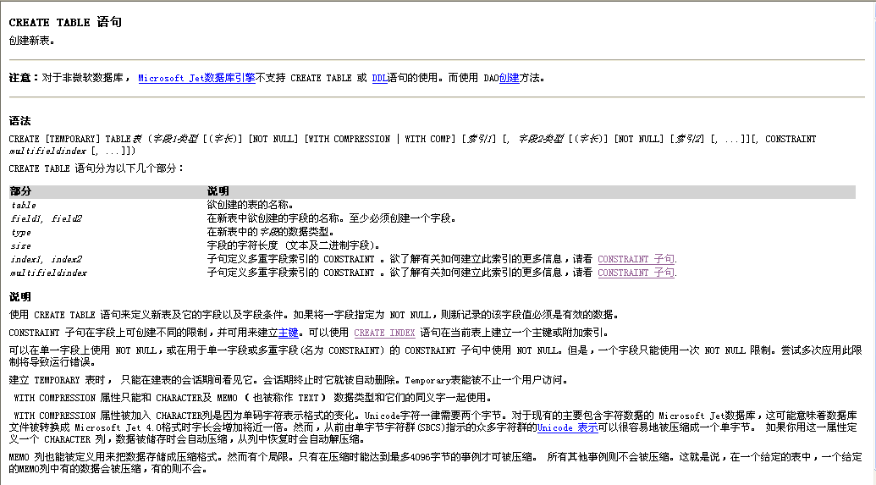
create table in SQL Server

Slide 22
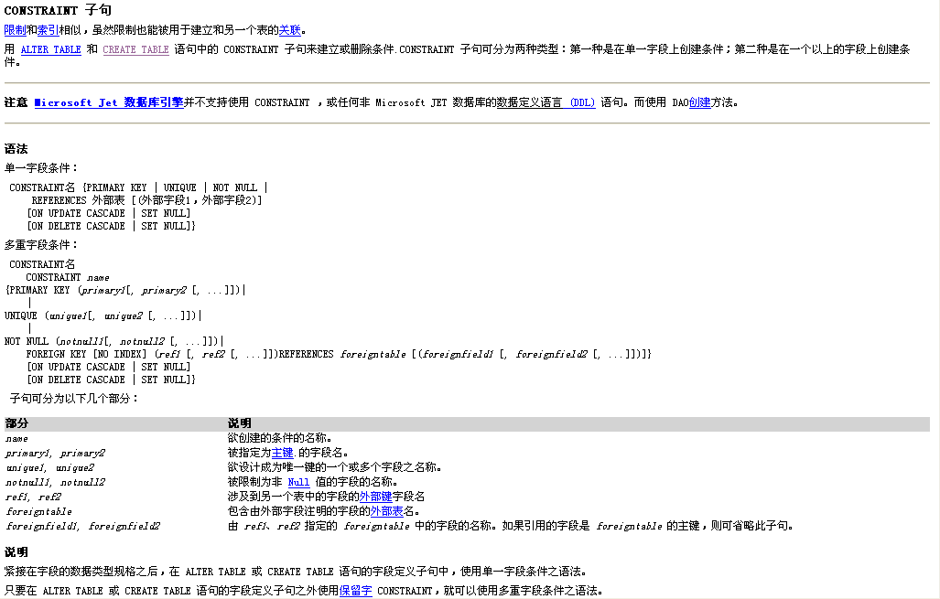

Slide 23
Schema Definition (cont.)
The drop table command deletes all information (tuples and schema) about the dropped relation from the database
  drop table r
  compared to delete from r
The alter table command is used to add or delete/drop attributes to an existing relation
  alter table r add A D
    where A is the name of the attribute to be added to relation r and D is the domain of A
    all tuples in the relation are assigned null as the value for the new attribute
    e.g. alter table instructor add age char(30)

Slide 24
§3.2.2 Schema Definition (cont.)
  alter table r drop A
    where A is the name of an attribute of relation r
    e.g. alter table instructor drop age
    dropping of attributes not supported by some databases

Slide 25
§3.3 Basic structure
— Select query
A typical SQL query has the form
select A₁, A₂, ..., A_{n}
from r₁, r₂, ..., r_{m}
where P
  A_{i} represents attributes
  r_{i} represents relations
  P is a predicate（谓词）
This query is equivalent to the relational algebra expression
∏ _{A1, A2, ..., An}(σ_{P} (r₁ x r₂ x ... x r_{m}))
  the result of an SQL query is a relation
For more details about complete syntax definition for Select clause, refer to Appendix A. Syntax Definition of Select Clause
query result :
A₁ | A₂ | … | … | A_{n}
* | * | * | * | *
* | * | * | * | *
* | * | * | * | *
* | * | * | * | *
* | * | * | * | *
t₁
t₂
t_{k}

Slide 26
31. Query on a Single Relation
---The select, where Clause
The select clause lists the attributes desired in the result of a query
  corresponds to the projection operation of the relational algebra
Example: find the names of all instructors:
select name
from instructor
  in the “pure” relational algebra syntax, the query would be
 ∏ _{name}(instructor)
NOTE: SQL names are case insensitive (i.e., you may use upper- or lower-case letters.)
  E.g., Name ≡ NAME ≡ name
  Some people use upper case wherever we use bold font.
Notes:
3

Slide 27
The select Clause (Cont.)
SQL allows duplicates in relations as well as in query results.
To force the elimination of duplicates, insert the keyword distinct after select.
Find the department names of all instructors, and remove duplicates
select distinct dept_name
from instructor
The keyword all specifies that duplicates should not be removed.
select all dept_name
from instructor
Notes:
4

Slide 28
The select Clause (Cont.)
An asterisk（星号） in the select clause denotes “all attributes”
select *
from instructor
An attribute can be a literal with no from clause
select ‘437’
  Results is a table with one column and a single row with value “437”
  Can give the column a name using:
  select ‘437’ as FOO
An attribute can be a literal with from clause
select ‘A’
from instructor
  Result is a table with one column and N rows (number of tuples in the instructors table), each row with value “A”
Notes:
5

Slide 29
The select Clause (Cont.)
The select clause can contain arithmetic（算数） expressions involving the operation, +, –, , and /, and operating on constants or attributes of tuples.
  The query:
  select ID, name, salary/12
  from instructor
  would return a temporal relation that is the same as the instructor relation, except that the value of the attribute salary is divided by 12.
  Can rename “salary/12” using the as clause:
  select ID, name, salary/12 as monthly_salary
Notes:
5

Slide 30
The where Clause
The where clause specifies conditions that the result must satisfy
  corresponding to the selection predicate p in the relational algebra operation σ_{p}
E.g. To find all instructors in Comp. Sci. dept
select name
from instructor
where dept_name = ‘Comp. Sci.'
Notes:
5

Slide 31
The where Clause
The where clause specifies conditions that the result must satisfy
  corresponding to the selection predicate p in the relational algebra operation σ_{p}
To find all instructors in Comp. Sci. dept
select name
from instructor
where dept_name = ‘Comp. Sci.'
Comparison results can be combined using the logical connectives and, or, and not
  To find all instructors in Comp. Sci. dept with salary > 80000
  select name
  from instructor
  where dept_name = ‘Comp. Sci.' and salary > 80000
Comparisons can be applied to results of arithmetic expressions, e.g. age mod10=0.
Notes:
6

Slide 32
3.3.2 Query on multiple relations
——The from Clause
The from clause lists the relations involved in the query
  Corresponds to the Cartesian product operation of the relational algebra.
Find the Cartesian product instructor X teaches
select *
from instructor, teaches
  generates every possible instructor – teaches pair, with all attributes from both relations.
  For common attributes (e.g., ID), the attributes in the resulting table are renamed using the relation name (e.g., instructor.ID)
Cartesian product not very useful directly, but useful combined with where-clause condition (selection operation in relational algebra).
Notes:
8

Slide 33



Cartesian Product
instructor
teaches

Slide 34
Examples
Find the names of all instructors who have taught some course and the course_id
  select name, course_id
  from instructor , teaches
  where instructor.ID = teaches.ID
Find the names of all instructors in the Art department who have taught some course and the course_id
  select name, course_id
  from instructor , teaches
  where instructor.ID = teaches.ID and instructor. dept_name = ‘Art’
Notes:
9
通过连接条件，将多张表的数据关联到一张表中，进而在这一张大表中通过进一步的查询条件进行筛选。

Slide 35
Query on multiple relations (cont.)
注意事项
  from 子句中包括多个关系表时，一定要在where子句中加入连接条件！
  防止出现耗时费力的多表笛卡尔积操作
  实际应用中，对频繁执行的SQL查询，其from子句中的表的个数不要过多，如不要超过4个！
  避免耗时费力的多表连接操作。
  如果频繁执行的SQL查询涉及的查询数据存放在N≥4张表中，可以考虑将这N张表中的数据进行合并
Notes:
8

Slide 36
3.3.3 natural join
SQL also supports “natural join” in the from subclause
  E.g. Find the names of all instructors in the Art department who have taught some course and the course_id
  select name, course_id
  from instructor natural join teaches
  where instructor. dept_name = ‘Art’
Notes:
8
通过笛卡尔积和选择条件，基于多表共有的属性进行多表连接，是一种通用的情况。为了简化编程者工作，SQL支持自然连接运算。

Slide 37
3.4 Additional Basic Operations
3.4.1 The Rename Operation
The SQL allows renaming relations and attributes using the as clause:
old-name as new-name
E.g. select name as instructor_name
from instructor
Keyword as is optional and may be omitted
instructor as T ≡ instructor T
Notes:
9
属性重命名

Slide 38
Tuple Variables
Tuple variables are defined in the from clause via the use of the as clause ——关系的别名/简称
Find the names of all instructors who have a higher salary than
some instructor in ‘Comp. Sci’.
  select distinct T.name
  from instructor as T, instructor as S
  where T.salary > S.salary and S.dept_name = ‘Comp. Sci.’
Notes:
9
关系重命名：建立自连接时常常会用到关系的重命名。
当涉及到在同一张表的同一个属性上进行值的比较时，往往会用到自连接和重命名，将同一张表视为两张表进行处理，相当于拷贝一份。

Slide 39
Tuple Variables (cont.)
E.g.2 Find the names of all instructors whose salary is greater than at least one instructor in the Biology department
  /*涉及到对instructor关系中属性salary的不同值的比较
  select distinct T.name
  from instructor as T, instructor as S
  where T. salary > S. salary and S.dept_name = ‘Biology’
    /*利用T和S区分不同的instructor!!!!!, 实现了对同一属性的不同值的比较
Notes:
10

Slide 40
3.4.2 String Operations
SQL includes a string-matching operator for comparisons on character strings. The operator like uses patterns that are described using two special characters:
  percent ( % ). The % character matches any substring.
  underscore ( _ ). The _ character matches any character.
Find the names of all instructors whose name includes the substring “dar”.
select name
from instructor
where name like '%dar%'
Match the string “100%”
like ‘100 \%' escape '\'
in that above we use backslash (\) as the escape（转义) character.
Notes:
模式匹配运算符：%（匹配任意长度的字符串）；_ （匹配单个字符）

Slide 41
String Operations (Cont.)
Patterns are case sensitive.
Pattern matching examples:
  ‘Intro%’ matches any string beginning with “Intro”.
  ‘%Comp%’ matches any string containing “Comp” as a substring.
  ‘_ _ _’ matches any string of exactly three characters.
  ‘_ _ _ %’ matches any string of at least three characters.
SQL supports a variety of string operations such as
  Concatenation（串接） (using “||”)
  converting from upper to lower case (and vice versa)
  finding string length, extracting substrings, etc.

Slide 42
3.4.3 Attribute Specification
The asterisk symbol “*” can be used in the select clause to denote “all attributes”
  select *
  from instructor , teaches
  where instructor.ID = teaches.ID
  select instructor.*
  from instructor , teaches
  where instructor.ID = teaches.ID

Slide 43
3.4.4 Ordering the Display of Tuples
The order by clause causes the tuples in the result of query to appear in sorted order, i.e. ascending order or descending order, denoted by keywords asc or desc respectively
  ascending order is the default
List in alphabetic order the names of all instructors
select distinct name
from instructor
order by name
We may specify desc for descending order or asc for ascending order, for each attribute; ascending order is the default.
  Example: order by name desc
Can sort on multiple attributes
  Example: order by dept_name, name

Slide 44
3.4.5 Where Clause Predicates
SQL includes a between comparison operator
Example: Find the names of all instructors with salary between $90,000 and $100,000 (that is, ≥ $90,000 and ≤ $100,000)
  select name
  from instructor
  where salary between 90000 and 100000
Tuple comparison
  select name, course_id
  from instructor, teaches
  where (instructor.ID, dept_name) = (teaches.ID, ’Biology’);
Notes:
7
where (instructor.ID, dept_name) = (teaches.ID, ’Biology’);
SQL支持用多元组的形式表达多个属性之间的对应比较关系。在元组上可以运用比较运算符。

Slide 45
Duplicates
Viewing relations with duplicates as multisets, SQL can define not only what tuples will appear in the result of a query, but also how many copies of these tuples appear in the result
The duplicate semantics of select clause is based on multiset versions of the relational algebra operators
SQL不主动删除重复，除非用distinct
For more details, refer to Appendix C Duplicates in Select Clause

Slide 46
§3.5 Set Operations
In SQL, the set operations union, intersect, and except operate on relations and correspond to the relational algebra operators ∪, ∩, and −
  each of the above operations automatically eliminates duplicates
  to retain（保留） all duplicates use the corresponding multiset versions union all, intersect all and except all
Find courses that ran in Fall 2009 or in Spring 2010
(select course_id from section where sem = ‘Fall’ and year = 2009)
union
(select course_id from section where sem = ‘Spring’ and year = 2010)

Slide 47
Set Operations (cont.)
Find courses that ran in Fall 2009 and in Spring 2010
(select course_id from section where sem = ‘Fall’ and year = 2009)
intersect
(select course_id from section where sem = ‘Spring’ and year = 2010)
Find courses that ran in Fall 2009 but not in Spring 2010
(select course_id from section where sem = ‘Fall’ and year = 2009)
except
(select course_id from section where sem = ‘Spring’ and year = 2010)

Slide 48
Set Operations (Cont.)
To find the largest salary of all instructors,
Step1. Find the salaries of all instructors that are less than the largest salary.
  select distinct T.salary
  from instructor as T, instructor as S
  where T.salary < S.salary
Step2. Find all the salaries of all instructors
  select distinct salary
  from instructor
Step3.
  (select “second query” )
  except
  (select “first query”)
Notes:
9

Slide 49
§3.6 Null Values
It is possible for tuples to have a null value, denoted by null, for some of their attributes
  null signifies an unknown value or that a value does not exist.
The predicate is null can be used in Select clause to check for null values
E.g. Find all instructors who appear in the instructor relation with null value for salary
  select name
  from instructor
  where salary is null
The result of any arithmetic expression involving null is null
  e.g. 5 + null returns null

Slide 50
Null Values (cont.)
Any comparison with null returns unknown
  e.g. 5 < null, null <> null , null = null
In where clause, three-valued logic using the truth value unknown (i.e. null, introduced in SQL 1999)
  OR
    (unknown or true) = true, (unknown or false) = unknown
    (unknown or unknown) = unknown
  AND
    (true and unknown) = unknown,
    (false and unknown) = false,
    (unknown and unknown) = unknown
Notes:
SQL将涉及控制的任何比较运算的结果视为unknown。Unknown创建了除true和false之外的第三个逻辑值。

Slide 51
Null Values (cont.)
  NOT
    (not unknown) = unknown
  “P is unknown” evaluates to true if predicate P evaluates to unknown
Result of where clause predicate P is treated as false if it evaluates to unknown
Null values and aggregates
  all aggregate operations except count(*) ignore tuples with null values on the aggregated attributes

Slide 52
Null Values (cont.)
聚集一般忽略空值
E.g. Total all instructor salaries
select sum (salary)
from instructor
  if there are null values in salary attributes, above statement ignores null amounts
  the result is null if there is no non-null salary
惟一例外： count(*) 计算 元组个数，含空值的元组也计数

Slide 53
§3.7 Aggregate Functions
The following aggregate functions operate on the set (or multiset) of values of a column of a relation, and return a value
  avg: average value,
  min: minimum value,
  max: maximum value,
  sum: sum of values,
  count: number of values
  these functions corresponds to
  _{G1, G2, …, Gn} g _{F1( A1), F2( A2),…, Fn( An)} (E)
Notes:
G1， G2，…Gn表示分组属性；F1（A1）表示聚集函数。
举例：查询计算机系教师的平均工资；查询选修了数据库课程的学生平均成绩

Slide 54
Aggregate Functions (cont.)
How to conduct group by subclause and aggregate function
Select {A₁, A₂, ., A_{i}}, ag_fun(A_{i+1}),…, ag_fun(A_{i+k})
From r₁, r₂, ..., r_{m}
Where P1
{ Group by A₁, A₂, ., A_{i}
{ having P2 } }
  notes:
    P1 is defined on all attributes of r₁, r₂, ..., r_{m}
    P2 is defined on A₁, A₂, ., A_{i},.., A_{j} ,… , A_{k}, …, A_{n}, as the constraints on the group formed by Group by A₁, A₂, A_{j}
    attributes in the select clause outside of aggregate functions must appear in group by list
Notes:
分组聚集：有时候我们不仅将聚集函数作用在单个元组集上，也希望将其作用在一组元组集上。Group by可以实现这个愿望。
Group by：子句中给出一个或多个属性用来构造分组。分组属性上取值相同的元组将被分成一组。

Slide 55
Aggregate Functions (cont.)
  step1. temporal relation T1 is derived from
  Select A₁, A₂,…., A_{i},..., A_{j} , .., A_{i+k}
From r₁, r₂, ..., r_{m}
Where P1
  step2. T1 is grouped on A₁, A₂, ., A_{i} , resulting in temporal relation T2
  step3.
  if having subclause exists,
  then the group, which is not in accordance with P2, is
  filtered out of T2
  step4. for each group, conduct ag_fun on A_{i+1},…, A_{i+k}
  Select A₁, A₂, ., A_{i} , ag_fun(A_{i+1}),…, ag_fun(A_{i+k})
From T2
Notes:
分组聚集执行过程如上。

Slide 56
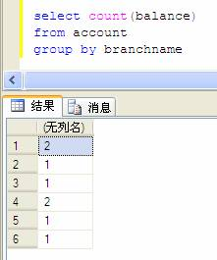

Slide 57
Aggregate Functions (cont.)
E.g.1 Find the average salary of instructors in the Computer Science department
  select avg (salary)
  from instructor
  where dept_name= ’ Comp. Sci.’;
  /*定义在多重集合上的计算
ID | name | dept_name | salary
45565 | Jian | Comp. Sci | $100
74281 | Ye | Comp. Sci | $250
98753 | Du | Comp. Sci | $340
54123 | Lin | Comp. Sci | $200
avg

Slide 58
3.5 Aggregate Functions (cont.)
E.g.2 Find the number of tuples in the course relation
  select count (*)
  from course
E.g.3 Find the total number of instructors who teach a course in the Spring 2010 semester
  select count (distinct ID)
  from teaches
  where semester = ’Spring’ and year = 2010/*删除重复元组

Slide 59


Aggregate Functions – Group By
Find the average salary of instructors in each department
  select dept_name, avg (salary) as avg_salary
  from instructor
  group by dept_name;
avg_salary

Slide 60
注意！
Attributes in select clause outside of aggregate functions must appear in group by list
  /* erroneous query */
  select dept_name, ID, avg (salary)
  from instructor
  group by dept_name;
Notes:
ID属性没有出现在group by子句中，故是错误的。

Slide 61
Aggregate Functions – Having Clause
Find the names and average salaries of all departments whose average salary is greater than 42000
select dept_name, avg (salary)
from instructor
group by dept_name
having avg (salary) > 42000;
Note: predicates in the having clause are applied after the
formation of groups whereas predicates in the where
clause are applied before forming groups

Slide 62
Null Values and Aggregates
Total all salaries
select sum (salary )
from instructor
  Above statement ignores null amounts
  Result is null if there is no non-null amount
All aggregate operations except count(*) ignore tuples with null values on the aggregated attributes
What if collection has only null values?
  count returns 0
  all other aggregates return null

Slide 63
§3.8 Nested (嵌套)
Subqueries
嵌套查询： 中间结果，便于构思化大为小， 化繁为简。
DBMS实现时，要优化，不一定要保留中间值
SQL provides a mechanism for the nesting of subqueries, to implement more complex query
A subquery is a select-from-group expression that is nested within another query
The nesting can be done in the following SQL query
select A₁, A₂, ..., A_{n}
from r₁, r₂, ..., r_{m}
where P
as follows:
  A_{i} can be replaced be a subquery that generates a single value.
  r_{i} can be replaced by any valid subquery
  P can be replaced with an expression of the form:
  B <operation> (subquery)
  Where B is an attribute and <operation> to be defined later.

Slide 64
Nested (嵌套) Subqueries
The subquery is often nested in the where clause/having clause , from clause
Subquery in the where clause/having , perform tests for
  set membership
  set comparisons
  set cardinality
  duplicate tuples
Notes:
子查询嵌套在where子句中，通常用于对集合的成员资格、集合的比较以及集合的基数进行检查。

Slide 65
3.8.1 Set Membership
Find courses offered in Fall 2009 and in Spring 2010
select distinct course_id
from section
where semester = ’Fall’ and year= 2009 and
course_id in (select course_id
from section
where semester = ’Spring’ and year= 2010);
Notes:
集合成员资格检查：
连接词in：测试元组是否是集合中的成员，集合是由select子句产生的一组值构成的。
举例：Find courses offered in Fall 2009 and in Spring 2010
之前的方法：用集合交实现
另一种方法：查找在2009年秋季开课的所有课程，看它是否也是2010年春季开课的课程集合中的成员。

Slide 66
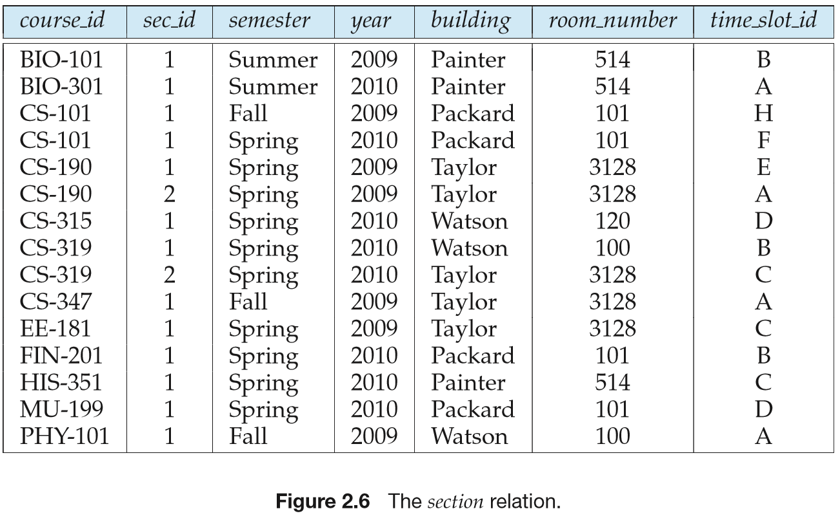
语句执行过程：
1)从头至尾，依次扫描section中每一行；
2)对section中每一行，
a. 判断其semester、year是否满足查询条件
b. 执行嵌入在where子句中的select查询，得到10年春季的course_id集 合；
3) 判断本行的course_id是否在此集合中，决定本行的course_id是否所需查询结果

Slide 67
说明：上述语句的执行效率较低，why?!
被嵌入的select子句可能多次重复执行
实际应用中应尽量避免membership操作，参见“数据库物理设计及查询优化”

Slide 68
Set Membership
Find courses offered in Fall 2009 but not in Spring 2010
select distinct course_id
from section
where semester = ’Fall’ and year= 2009 and
course_id not in (select course_id
from section
where semester = ’Spring’ and year= 2010);

Slide 69
Set Membership (Cont.)
Find the total number of (distinct) students who have taken course sections taught by the instructor with ID 10101
select count (distinct ID)
from takes
where (course_id, sec_id, semester, year) in
(select course_id, sec_id, semester, year
from teaches
where teaches.ID= 10101);
Note: Above query can be written in a much simpler manner.
The formulation above is simply to illustrate SQL features.
Notes:
前面的例子是在单属性关系中测试成员资格，sql也支持测试任意关系的成员资格。

Slide 70
3.8.2 Set Comparison – “some” Clause
Find names of instructors with salary greater than that of some (at least one) instructor in the Biology department.
select distinct T.name
from instructor as T, instructor as S
where T.salary > S.salary and S.dept name = ’Biology’;
Same query using > some clause
select name
from instructor
where salary > some (select salary
from instructor
where dept name = ’Biology’);
Notes:
找出满足下面条件的所有教师的姓名，他们的工资至少比biology系某一个教师的工资要高。
至少比某一个要大：用>some表示。

Slide 71
3.8.2 Set Comparison – “some” Clause
SQL allows < some/all, <= some/all, >= some/all, =some/all, and <>some/all comparisons
  for more details, refer to Appendix D Some/All Set Comparisons

Slide 72
Set Comparison-all (cont.)
Find the names of all instructors whose salary is greater than the salary of all instructors in the Biology department.
select name
from instructor
where salary > all (select salary
from instructor
where dept name = ’Biology’);
Notes:
>all：比所有的都大。

Slide 73
3.8.3 Test for Empty Relations
E.g. Find all students who take all the courses that takes by ZhangLi
  /查询选修了“ZhangLi”所选修的全部课程的同学
  方法:
  1. 计算ZhangLi选修课程集合X
  2. 对每个学生，计算他选修的课程集合Y，
  3. 判断Y是否包含X
SQL uses exists, not exists and except constructs to test whether or not a subquery (, which is a set of tuples) is nonempty or not respectively,
  exists r ⇔ r ≠ Ø
  not exists r ⇔ r = Ø
  except: X – Y
  X – Y = Ø ⇔ X ⊆ Y（Y包含X）
  集合包含，X ⊆ Y ⇔ ( X – Y ) = Ø ⇔ not exists ( X except Y ) X ⊆ Y ⇔ not exists (X except Y )
Notes:
空关系测试：测试一个子查询的结果中是否存在元组。

Slide 74
Test for Empty Relations(cont.)
Yet another way of specifying the query “Find all courses taught in both the Fall 2009 semester and in the Spring 2010 semester”
select course_id
from section as S
where semester = ’Fall’ and year = 2009 and
exists (select *
from section as T
where semester = ’Spring’ and year= 2010
and S.course_id = T.course_id);
Correlation name（相关名称） – variable S in the outer query
Correlated subquery（相关子查询） – the inner query
Notes:
相关子查询：使用了来自外层查询相关名称的子查询

Slide 75
Use of “not exists” Clause
Find all students who have taken all courses offered in the Biology department.
select distinct S.ID, S.name
from student as S
where not exists ( (select course_id
from course
where dept_name = ’Biology’)
except
(select T.course_id
from takes as T
where S.ID = T.ID));
First, nested query lists all courses offered in Biology
Second, nested query lists all courses a particular student took
Note that X – Y = Ø ⇔ X ⊆ Y
Note: Cannot write this query using = all and its variants
Notes:
not exists结构：测试子查询结果集中是否不存在元组。
可以使用not exists结构模拟集合包含操作，我们可将“关系A包含关系B”写成not exists （B except A）

Slide 76
3.8.4Test for Absence of Duplicate Tuples
The unique construct tests whether a subquery has any duplicate tuples in its result.
The unique construct evaluates to “true” if a given subquery contains no duplicates
  /* 如果作为参数的子查询结果中无重复元组，则unique返回true
Find all courses that were offered at most once in 2009
  select T.course_id
  from course as T
  where unique (select R.course_id
  from section as R
  where T.course_id= R.course_id
  and R.year = 2009);
Notes:
重复元组存在性测试：sql提供一个布尔函数unique，用于测试一个子查询的结果中是否存在重复元组。
举例：找出所有在2009年最多开设一次的课程

Slide 77
3.8.5 Subqueries in the From Clause
SQL allows a subquery expression to be used in the from clause
Find the average instructors’ salaries of those departments where the average salary is greater than $42,000.”
  select dept_name, avg_salary
  from (select dept_name, avg (salary) as avg_salary
  from instructor
  group by dept_name)
  where avg_salary > 42000;
Note that we do not need to use the having clause
Another way to write above query
  select dept_name, avg_salary
  from (select dept_name, avg (salary)
  from instructor
  group by dept_name) as dept_avg (dept_name, avg_salary)
  where avg_salary > 42000;

Slide 78
3.8.6 With Clause
The with clause provides a way of defining a temporary relation whose definition is available only to the query in which the with clause occurs
  /* 将1个复杂查询分解为若干步，每个视图定义1个各步的中间计算结果
Find all departments with the maximum budget
with max_budget (value) as
(select max(budget)
from department)
select department.name
from department, max_budget
where department.budget = max_budget.value;
找出所有最高budget的department（可能不只一个
视图max-budget(value) = { 200000}, e.g.
定义局部视图
//取子集作为中间逻辑结果
Notes:
With子句：定义临时关系，这个定义只对包含with子句的查询有效。
With子句：定义了一个临时关系max_budget，此关系在随后的查询中马上被用到了。With子句在sql：1999标准中引用了，目前许多DBS都支持。
With子句使得查询在逻辑上更加清晰，当然上述查询也可以使用嵌套查询建立等价查询，但是那样会复杂很多，而且也不易看懂。

Slide 79
Complex Queries using With Clause
Find all departments where the total salary is greater than the average of the total salary at all departments
with dept _total (dept_name, value) as
(select dept_name, sum(salary)
from instructor
group by dept_name),
dept_total_avg(value) as
(select avg(value)
from dept_total)
select dept_name
from dept_total, dept_total_avg
where dept_total.value > dept_total_avg.value;
Notes:
分别建立了两个临时关系

Slide 80
3.8.7 Scalar（标量） Subquery
——Subqueries in the Select Clause
Scalar subquery is one which is used where a single value is expected
List all departments along with the number of instructors in each department
select dept_name,
(select count(*)
from instructor
where department.dept_name = instructor.dept_name)
as num_instructors
from department;
Runtime error if subquery returns more than one result tuple
Notes:
标量子查询：返回单个值的表达式，该子查询只返回包含单个属性的单个元组。
上述例子：子查询只返回单个值，因为使用了不带group by 的count聚集函数。此例也说明了相关变量的实用，即使用在外层查询的from子句中关系中的属性，例如
上例中的department.dept_name

Slide 81
3.9 Modification of the Database
Deletion of tuples from a given relation.
Insertion of new tuples into a given relation
Updating of values in some tuples in a given relation

Slide 82
Deletion
Delete all instructors
delete from instructor
Delete all instructors from the Finance department
delete from instructor
where dept_name= ’Finance’;
Delete all tuples in the instructor relation for those instructors associated with a department located in the Watson building.
delete from instructor
where dept name in (select dept name
from department
where building = ’Watson’);

Slide 83
Deletion (Cont.)
Delete all instructors whose salary is less than the average salary of instructors
delete from instructor
where salary < (select avg (salary)
from instructor);
  Problem: as we delete tuples from instructor, the average salary changes
  Solution used in SQL:
  1. First, compute avg (salary) and find all tuples to delete
  2. Next, delete all tuples found above (without
  recomputing avg or retesting the tuples)
Notes:
在执行任何删除之前先进行所有元组的测试是至关重要的，先通过测试确定待删除的所有元组，然后一起删除。

Slide 84
Insertion
Add a new tuple to course
insert into course
values (’CS-437’, ’Database Systems’, ’Comp. Sci.’, 4);
or equivalently
insert into course (course_id, title, dept_name, credits)
values (’CS-437’, ’Database Systems’, ’Comp. Sci.’, 4);
Add a new tuple to student with tot_creds set to null
insert into student
values (’3003’, ’Green’, ’Finance’, null);

Slide 85
Insertion (Cont.)
Add all instructors to the student relation with tot_creds set to 0
insert into student
select ID, name, dept_name, 0
from instructor
The select from where statement is evaluated fully before any of its results are inserted into the relation.
Otherwise queries like
insert into table1 select * from table1
would cause problem
Notes:
看一下

Slide 86
Updates
Increase salaries of instructors whose salary is over $100,000 by 3%, and all others by a 5%
  Write two update statements:
  update instructor
  set salary = salary * 1.03
  where salary > 100000;
  update instructor
  set salary = salary * 1.05
  where salary <= 100000;
  The order is important
  Can be done better using the case statement (next slide)

Slide 87
Case Statement for Conditional Updates
Same query as before but with case statement
update instructor
set salary = case
when salary <= 100000 then salary * 1.05
else salary * 1.03
end

Slide 88
Updates with Scalar（标量） Subqueries
Recompute and update tot_creds value for all students
update student S
set tot_cred = (select sum(credits)
from takes, course
where takes.course_id = course.course_id and
S.ID= takes.ID.and takes.grade <> ’F’ and
takes.grade is not null);
Sets tot_creds to null for students who have not taken any course
Instead of sum(credits), use:
case
when sum(credits) is not null then sum(credits)
else 0
end
Notes:
看一下

Slide 89
Update on Multiple Tables！！
务必掌握，实际中应用很多!
不同DBMS平台下的多表update语句语法定义不相同
Student(S#, Sname, age …, C#, Grade, …),
Sgrade(S#, C#, Grade)
利用Sgrade的内容，更新Student
update Student as A
set Grade=B.Grade
from Sgrade as B
where A.S#=B.S# and A.C#=B.C#
Notes:
看一下

Slide 90
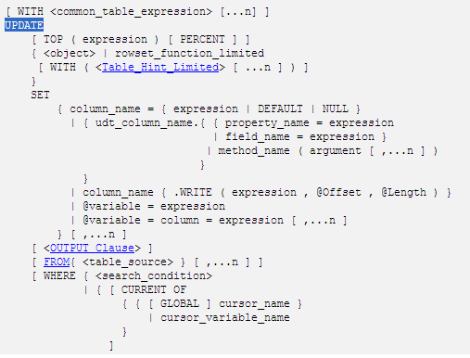
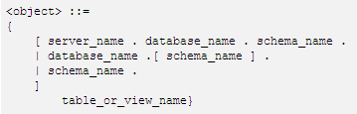

Update in SQL Server
指定将要更新的行数或行百分比。expression 可以为行数或行百分比。
返回单个值的变量、文字值、表达式或嵌套 select 语句（加括号）。expression 返回的值替换 column_name 或 @variable 中的现有值。
指定将表、视图或派生表源用于为更新操作提供条件。
Notes:
看一下

Slide 91
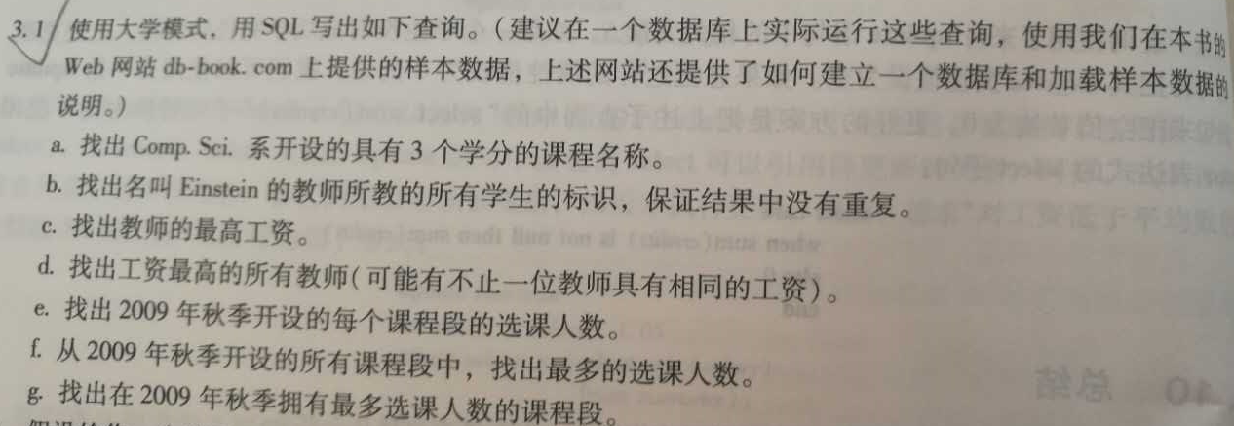
Excises
Notes:
看一下

Slide 92
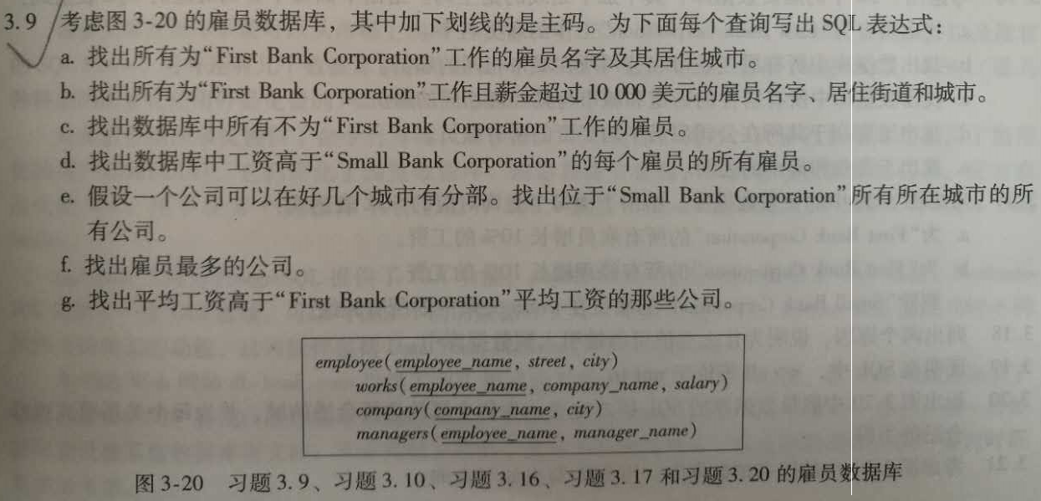
Excises
Notes:
看一下

Slide 93
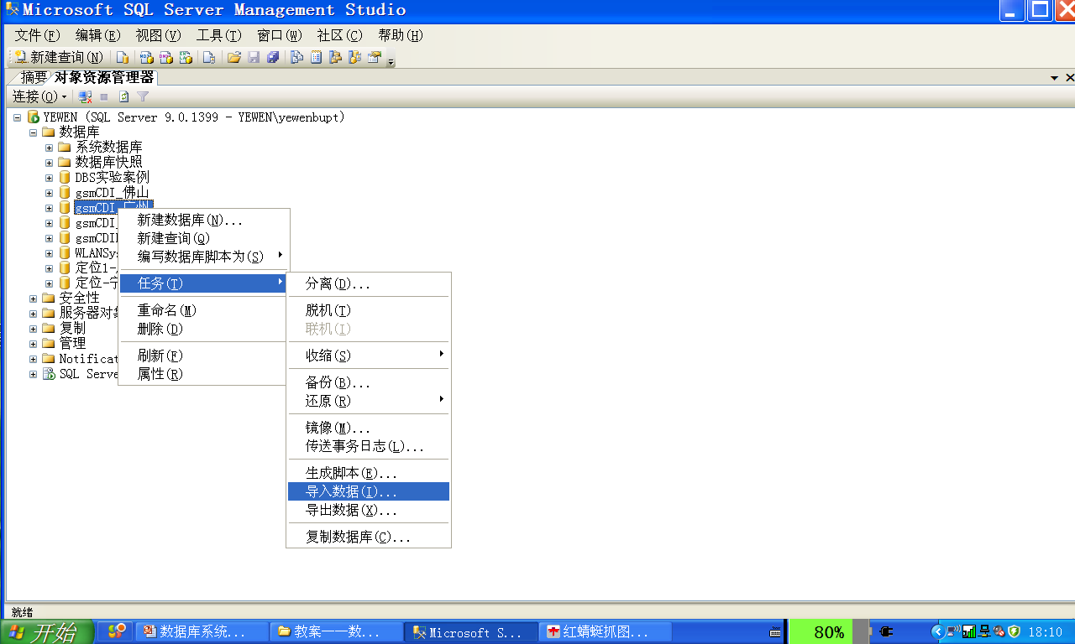
附录 0
实际数据库平台/DBMS导入/插入数据方法
实际数据库平台/DBMS数据导入方式
  insert 语句，向DB中现有关系表导入数据
  利用DBMS提供的交互界面，e.g. SQL Server Management Studio，批量导入，直接将Excel等数据文件中的内容导入现有关系表
Database System Concepts - Chapter3 SQL -

Slide 94
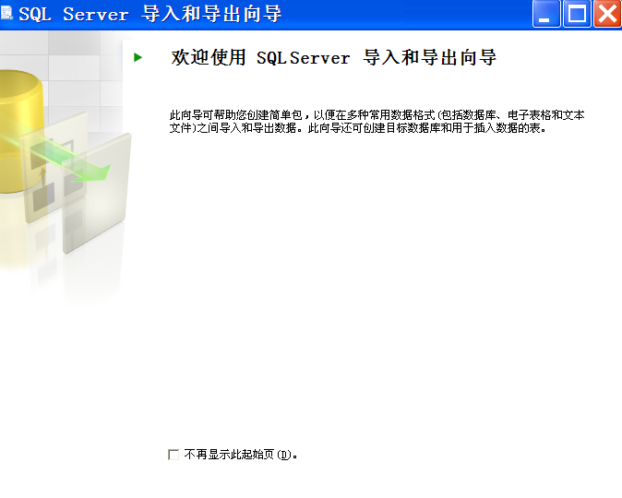

Slide 95
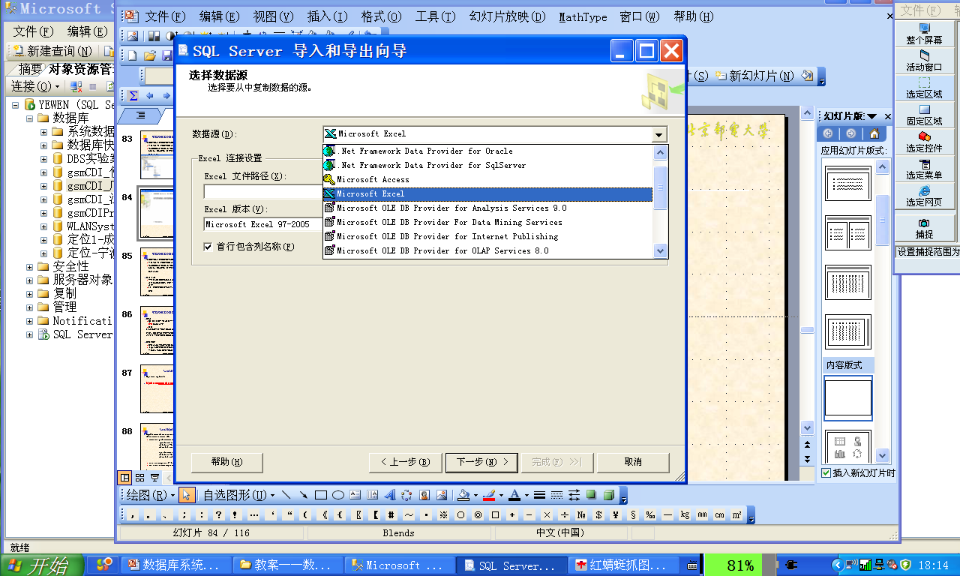
Database System Concepts - Chapter3 SQL -

Slide 96
实际数据库平台/DBMS插入数据的方法
实际数据库平台/DBMS数据导入方式
  insert 语句，向DB中现有关系表导入数据
  利用DBMS提供的交互界面，e.g. SQL Server Management Studio，批量导入，直接将Excel等数据文件中的内容导入现有关系表
注意事项
  一定要先在DB中创建关系表，如用create table语句、平台提供的表创建功能，然后再将外部文件中的数据导入关系表中
  即：向DB中导入数据之前，数据所导入的关系表必须已经存在

Slide 97
实际数据库平台/DBMS插入数据的方法
说明
  QL Server允许将Excel文件中数据批量导入事先在DB中不存在的关系表中
  方法：
1）先创建与文件名对应的关系表，表中属性与文件中列一一对应，属性数据类型取一般取为变长字符串
2）将文件中数据导入刚创建的关系表中
存在问题：
  导入关系表中的数据都变成字符串型，不合理
  e.g. Excel中存放电信话务数据，接通率、掉话率、话务量等属性，都属于数值型属性，不是字符串类型

Slide 98
Appendix A
Syntax Definition of Select Clause
The Select clause is defined as
Select {ALL | DISTINCT } <column expression1> {,
<column expression1> }
From <table_name or view_name> {,
<table_name or view_name> }
{ Where < conditional expression1 > }
{ Group by < column_name1 >
HAVING{ < conditional expression2 > } }
{ Order by <column_name2 > {ASC | DESC } }

Slide 99
Appendix A
Syntax Definition of Select Clause (cont.)
The sub-clauses in the Select clause correspond to relational algebra operations
  select sub_clause --- projection
  from sub_clause ---Cartesian product
  where sub_clause --- select predicate
  group sub_clause --- group and aggregate functions (§3.4)
  order sub_clause --- ordering query result

Slide 100
Appendix A
Syntax Definition of Select Clause (cont.)
The computation procedure of Select clause is as follows
  selecting tuples that satisfy conditions defined by where sub_clause from base tables or views listed in from sub_clause
  according to column expression listed in select sub_clause , selecting attributes from these tuples , and forming a result table as query result
  if group sub_clause exist, grouping the result table on the basis of conditional expression2 , conducting group/aggregate functions on each groups, and outputting every groups as query results.

Slide 101
Appendix A
Syntax Definition of Select Clause (cont.)
  if HAVING appears, only outputting groups that satisfy column_name1 as query results.
  if order sub_clause exist, sorting the result table or groups in descending or ascending orders.
  if distinct appears in select sub_clause , eliminating duplicates of tuples in the result table.

Slide 102
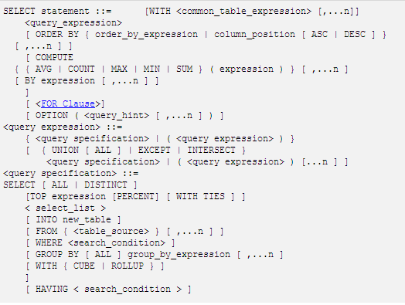
Select in SQL Server

Slide 103
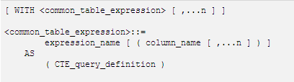
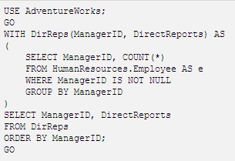
公用表达式，i.e. 临时视图

Slide 104
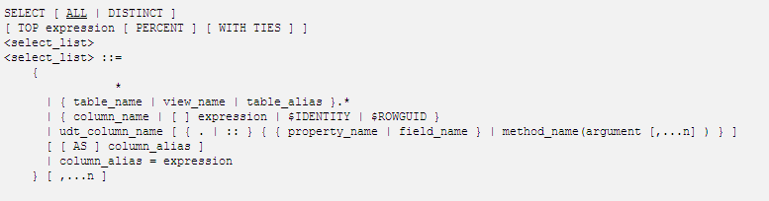
Select 子句
标识列、行号
TOP expression [ PERCENT ] [ WITH TIES ]
  指示只能从查询结果集返回指定的第一组行或指定的百分比数目的行；
  expression 可以是指定数目或百分比数目的行。
  e.g. TOP 5, TOP 3%

Slide 105
Appendix B
String Operations in SQL
SQL specifies strings by enclosing them in single quotes, e.g. ‘Perryridge’
SQL introduces a series of operations on strings, of which the most commonly used operation is pattern-matching using the operator like for comparisons on character strings
Patterns are described using two special characters
  percent (%). The % character matches any substring
  underscore (_). The _ character matches any character
E.g. find the names of all customers whose street includes the substring “Main”.
Notes:
10

Slide 106
Appendix B
String Operations in SQL (cont.)
select customer-name
from customer
where customer-street like ‘%Main%’
Match the name “Main%”
like ‘Main\%’ escape ‘\’
  escape: 定义转义字符‘\’，匹配所有以“Main%”开头的字符串
SQL also supports a variety of string operations such as
  concatenation (using “||”)
  converting from upper to lower case (and vice versa)
  finding string length, extracting substrings, etc.

Slide 107
Appendix C
Duplicates in Select Clause
In relations with duplicates, SQL can define not only what tuples will appear in the result of a query, but also how many copies of these tuples appear in the result
The duplicate semantics of select clause is based on multiset versions of the relational algebra operators
Given multiset relations r₁ and r₂
  σ_{θ} (r₁)
    if there are c₁ copies of tuple t₁ in r₁, and t₁ satisfies selections σ_{θ,}, then there are c₁ copies of t₁ in σ_{θ} (r₁)
  Π_{A}(r)
    for each copy of tuple t₁ in r₁, there is a copy of tuple Π_{A}(t₁) in Π_{A}(r₁) where Π_{A}(t₁) denotes the projection of the single tuple t₁.

Slide 108
Appendix C
Duplicates in Select Clause (cont.)
  r₁ x r₂
    if there are c₁ copies of tuple t₁ in r₁ and c₂ copies of tuple t₂ in r₂, there are c₁ x c₂ copies of the tuple t₁. t₂ in r₁ x r₂
E.g. suppose multi-set relations r₁ (A, B) and r₂ (C) are as follows:
r₁ = {(1, a) (2,a)} r₂ = {(2), (3), (3)}
, then Π_{B}(r₁) would be {(a), (a)}, while Π_{B}(r₁) × r₂ would be
{(a,2), (a,2), (a,3), (a,3), (a,3), (a,3)}

Slide 109
Appendix C
Duplicates in Select Clause (cont.)
SQL duplicate semantics
select A₁,, A₂, ..., A_{n}
from r₁, r₂, ..., r_{m}
where P
  is equivalent to the expression
Π _{A1,, A2, ..., An}(σ_{P} (r₁ × r₂ × ... × r_{m}))
    using the multiset version of relational operators Π, σ, and ×

Slide 110
Appendix D
Some/All Set Comparisons
Definition of some set comparisons
  F <comp> some r ⇔ ∃ t ∈ r (F <comp> t)
    where <comp> can be: <, ≤, >, =, ≠
  e.g.
r
0
(5< some
) = true
(5 < some tuple in the relation)
5
6
(5< some
0
) = false
5
0
) = true
(5 = some
5
0
(5 ≠ some
) = true (since 0 ≠ 5)

Slide 111
Appendix D
Some/All Set Comparisons (cont.)
(= some) ≡ in
however, (≠ some) ≡ not in
> some : greater than at least one
Definition of all set comparisons
  F <comp> all r ⇔ ∀ t ∈ r (F <comp> t)
    where <comp> can be: <, ≤, >, =, ≠
(≠ all) ≡ not in
however, (= all) is not equal to in

Slide 112
Appendix D
Some/All Set Comparisons (cont.)
E.g.
r
0
(5< all
) = false
5
6
6
(5< all
) = true
10
4
(5 = all
) = false
5
4
) = true ( 5 ≠ 4 and 5 ≠ 6)
(5 ≠ all
6

Slide 113
Have a break

