Slide 1
PART 2
RELATIONAL DATABASES

Slide 2
Chapter 4
Intermediate SQL

Slide 3
Join Expressions（连接表达式）
Views
Transactions
Integrity Constraints
SQL Data Types and Schemas
Authorization
  Security in SQL
先讲4.5 扩展的数据类型

Slide 4

return

Slide 5
4.1 Joined Expressions
Join operations take two relations and return as a result another relation.
A join operation is a Cartesian product which requires that tuples in the two relations match (under some condition). It also specifies the attributes that are present in the result of the join
The join operations are typically used as subquery expressions in the from clause

Slide 6

Joined Relations
Join condition – defines which tuples in the two relations match, and what attributes are present in the result of the join.
Join type – defines how tuples in each relation that do not match any tuple in the other relation (based on the join condition) are treated.
Notes:
连接类型：定义没有匹配成功的元组如何处置，根据处置方式的不同，连接类型不同，包括内连接，左外连接，右外连接，全连接。
Using（A1，A2, …,An）中的A1，A2, …,An表示连接属性

Slide 7


Natural Join operations
For the following two relations
course
prereq

Slide 8
Natural Join operations
select *
from course natural join prereq
select *
from course join prereq on course.course_id=prereq. course_id
Observe that, course natural join prereq on course_id
prereq information is missing for CS-315 and
course information is missing for CS-437

Slide 9
Outer Join
An extension of the join operation that avoids loss of information.
Computes the join and then adds tuples form one relation that does not match tuples in the other relation to the result of the join.
Uses null values.
Notes:
使用空值，来保留连接中丢失的元组。

Slide 10

Left Outer Join
  course natural left outer join prereq
select *
from course natural left outer join prereq
Notes:
左外连接：取出左侧关系中所有与右侧关系的任一元组都不匹配的元组，用空值填充所有来自右侧关系的属性，再把产生的元组加到自然连接的结果上。

Slide 11

Right Outer Join
course natural right outer join prereq
select *
from course natural right outer join prereq
Notes:
右外连接：用空值填充来自左侧关系的所有与右侧关系的任一元组不匹配的元组，将结果加到自然连接的结果上。

Slide 12

Full Outer Join
course natural full outer join prereq
select *
from course natural full outer join prereq
Notes:
全外连接：填充左侧关系中与右侧关系的任一元组都不匹配的元组，又填充右侧关系中与左侧关系的任一元组都不匹配的元组，并把结果加到自然连接的结果上。

Slide 13


Joined Relations – Examples
course inner join prereq on
course.course_id = prereq.course_id
What is the difference between the inner join mentioned above, and a natural join?
course left outer join prereq on
course.course_id = prereq.course_id
Notes:
再看一下！！区分inner join和natural join的区别

Slide 14
Joined Relations – Examples
course natural right outer join prereq
course natural full outer join prereq using (course_id)
Notes:
再看一下！！区分inner join和natural join的区别

Slide 15
4.2 Views
In some cases, it is not desirable for all users to see the entire logical model (that is, all the actual relations stored in the database.)
Consider a person who needs to know an instructors name and department, but not the salary. This person should see a relation described, in SQL, by
select ID, name, dept_name
from instructor
A view provides a mechanism to hide certain data from the view of certain users.
Any relation that is not of the conceptual model but is made visible to a user as a “virtual relation” is called a view.
Notes:
满足用户的个性化需求；
安全性需求：屏蔽私密信息
视图：虚拟关系，数据还是存储在关系表中

Slide 16
Views (cont.)
E.g. Views definition
Views = projection on one or more relations
view5
view4
view1
view2
view3
….
….
….
….
table r1
table r2

Slide 17
Views (cont.)
The view is also known as the virtual relation/table
  only the definition of the view itself is stored in DBS, the tuples of the view is stored in the relations on which the view is defined
  evaluation of a view is reduced to evaluation of the relation-algebra expression that define the view
Note:
differences between the with clause and the create view clause
Materialized views (实体化/物化视图)
  both the definition and data of the views are stored in DBS
Notes:
注意：with和create view的区别；
物化视图？

Slide 18
View Definition
A view is defined using the create view statement which has the form
create view v as <query expression >
where <query expression> is any legal SQL expression. The view name is represented by v.
Once a view is defined, the view name can be used to refer to the virtual relation that the view generates.
View definition is not the same as creating a new relation by evaluating the query expression
  Rather, a view definition causes the saving of an expression; the expression is substituted into queries using the view.
Notes:
视图定义时，定义视图的子查询只是存储在数据字典中，而不会执行这个查询；只有当后续基于视图进行查询时，
该查询才会执行。

Slide 19
Example Views
A view of instructors without their salary
create view faculty as
select ID, name, dept_name
from instructor
Find all instructors in the Biology department
select name
from faculty
where dept_name = ‘Biology’
Create a view of department salary totals
create view departments_total_salary(dept_name, total_salary) as
select dept_name, sum (salary)
from instructor
group by dept_name;

Slide 20
Views Defined Using Other Views
create view physics_fall_2009 as
select course.course_id, sec_id, building, room_number
from course, section
where course.course_id = section.course_id
and course.dept_name = ’Physics’
and section.semester = ’Fall’
and section.year = ’2009’;
create view physics_fall_2009_watson as
select course_id, room_number
from physics_fall_2009
where building= ’Watson’;
Notes:
基于视图基础上的视图定义

Slide 21
View Expansion
Expand use of a view in a query/another view
create view physics_fall_2009_watson as
(select course_id, room_number
from (select course.course_id, building, room_number
from course, section
where course.course_id = section.course_id
and course.dept_name = ’Physics’
and section.semester = ’Fall’
and section.year = ’2009’)
where building= ’Watson’;
Notes:
视图扩展，或视图展开，在基于视图的视图定义时，用子查询替换视图定义，直到所有视图都展开为止。

Slide 22
Views Defined Using Other Views
One view may be used in the expression defining another view
A view relation v₁ is said to depend directly on a view relation v₂ if v₂ is used in the expression defining v₁
A view relation v₁ is said to depend on view relation v₂ if either v₁ depends directly to v₂ or there is a path of dependencies from v₁ to v₂
A view relation v is said to be recursive（递归） if it depends on itself.

Slide 23
View Expansion
A way to define the meaning of views defined in terms of other views.
Let view v₁ be defined by an expression e₁ that may itself contain uses of view relations.
View expansion of an expression repeats the following replacement step:
repeat
Find any view relation v_{i} in e₁
Replace the view relation v_{i} by the expression defining v_{i}
until no more view relations are present in e₁
As long as the view definitions are not recursive, this loop will terminate

Slide 24
Update of a View
Add a new tuple to faculty view which we defined earlier
insert into faculty values (’30765’, ’Green’, ’Music’);
This insertion must be represented by the insertion of the tuple
(’30765’, ’Green’, ’Music’, null)
into the instructor relation

Slide 25
Some Updates cannot be Translated Uniquely
create view instructor_info as
select ID, name, building
from instructor, department
where instructor.dept_name= department.dept_name;
insert into instructor_info values (’69987’, ’White’, ’Taylor’);
    which department, if multiple departments in Taylor?
    what if no department is in Taylor?
Most SQL implementations allow updates only on simple views
  The from clause has only one database relation.
  The select clause contains only attribute names of the relation, and does not have any expressions, aggregates, or distinct specification.
  Any attribute not listed in the select clause can be set to null
  The query does not have a group by or having clause.

Slide 26
And Some Not at All
create view history_instructors as
select *
from instructor
where dept_name= ’History’;
What happens if we insert (’25566’, ’Brown’, ’Biology’, 100000) into history_instructors?
Notes:
默认情况下，上述更新是可执行的。但是可以在视图定义最后加上“with check option”，这样不满足视图定义子查询中where条件的视图更新操作将会被拒绝。
当关系模式结构发生改变时，该操作会产生错误，属性不对应。

Slide 27
Materialized Views
Materializing a view: create a physical table containing all the tuples in the result of the query defining the view
If relations used in the query are updated, the materialized view result becomes out of date
  Need to maintain the view, by updating the view whenever the underlying relations are updated.

Slide 28
§4.4 Integrity Constraints
Integrity constraints guard against accidental damage to the database, by ensuring that authorized changes to the database do not result in a loss of data consistency
Classification of integrity constraints and some examples
  refer to Fig.4.0.1
  An instructor name can not be null
  No two instructors can have the same instructor ID
  Every department name in the course relation must have a matching department name in the department relation

Slide 29
 | attribute-level | tuple-level | relation-level
static | data type data format, e.g. YY.MM.DD domain constraints, e.g.1 null value, e.g. not null | constraints among attributes values e.g.2 mapping cardinality constraints | entity integrity e.g.3 referential integrity functional dependency (§8) statistical constraints e.g.6
dynamic | constraints on updating of attribute values or attribute definition e.g.4 | constraints among attributes values e.g.5 | transaction constraint: atomy, consistency, isolation, durability (§ 14, 15, 16)

Slide 30
Some Examples of Integrity Constraints
E.g.1 “ the salary of manager should not be lower than $1000” in Employee
E.g.2 table T (x, y, z ), z =x+y, z is a derived attributes from x and y.
E.g.3 “the student# for table student should not be null”
E.g.4 ”the age of students should only be added”
E.g.5 when employee tuples is modified, new.sal > old.sal + 0.5*age
E.g.6 statistical constraints: in table employee , “the salary of manager should be four times more than that of workers”

Slide 31
4.4.1-4 Constraints on a Single Relation
An SQL relation is defined using the create table command
create table r (A₁ D₁, A₂ D₂, ..., A_{n} D_{n},
(integrity-constraint₁),
...,
(integrity-constraint_{k}))
  r is the name of the relation
  each A_{i} is an attribute name in the schema of relation r
  D_{i} is the data type of values in the domain of attribute A_{i}

Slide 32
Constraints on a Single Relation (cont.)
The allowed integrity constraints include
  primary key
  not null
  unique
  check (P ), where P is a predicate
not null
  Declare name and budget to be not null
name varchar(20) not null
budget numeric(12,2) not null

Slide 33
Constraints on a Single Relation (cont.)
The Unique Constraint is as follows
unique ( A₁, A₂, …, A_{m})
  it states that the attributes
A1, A2, … Am
form a candidate key
  candidate keys are permitted to be null (in contrast to primary keys)
  e.g. create table customer
  (customer-id char(15)
  customer-name char(15)
  customer-city char(30),
  primary key (customer-id)
  unique (customer-name)

Slide 34
Constraints on a Single Relation (cont.)
The check clause is applied to relation declaration as well as to domain declaration
  check (P), where P is a predicate
  e.g.
ensure that semester is one of fall, winter, spring or summer:
create table section (
course_id varchar (8),
sec_id varchar (8),
semester varchar (6),
year numeric (4,0),
building varchar (15),
room_number varchar (7),
time slot id varchar (4),
primary key (course_id, sec_id, semester, year),
check (semester in (’Fall’, ’Winter’, ’Spring’, ’Summer’))
);

Slide 35
4.4.5-6 Referential Integrity
Referential Integrity (关联/参照完整性)
  ensures that a value that appears in one relation for a given set of attributes also appears for a certain set of attributes in another relation
  E.g. If “Biology” is a department name appearing in one of the tuples in the instructor relation, then there exists a tuple in the department relation for “Biology” (next slide)

Slide 36

Math
where is‘Math’?

Slide 37
Referential Integrity (cont.)
Definition of referential integrity/subset dependecies
  Let r₁(R₁) and r₂(R₂) be relations with primary keys K₁ and K₂ respectively, refer to Fig. 4.0.2
    e.g. r₁: department(dept_name, building, budgt)
    r₂: course(course_id, title, dept_name, credits),
  the subset α of R₂ (e.g. dept_name) is a foreign key (from r₂, e.g. course) referencing K₁ in relation r₁ (e.g. dept_name in department) , if for every t₂ in r₂ there must be a tuple t₁ in r₁ such that
  t₁[K₁] = t₂[α]
    note: α = K1⊆ R2

Slide 38
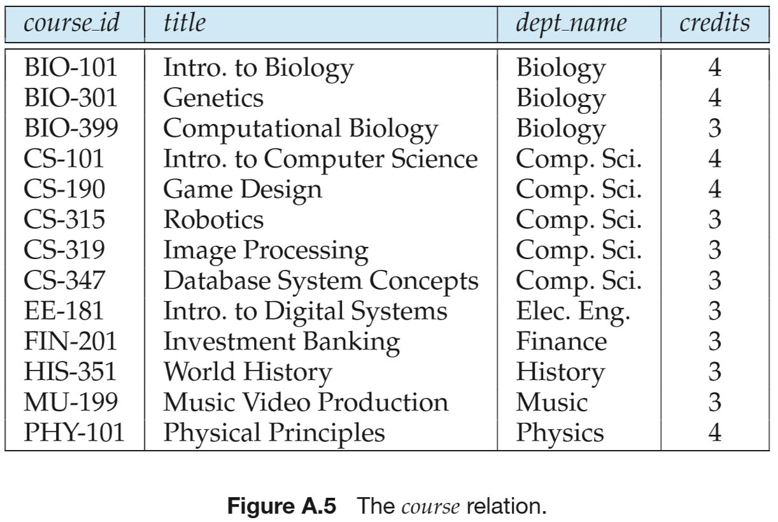
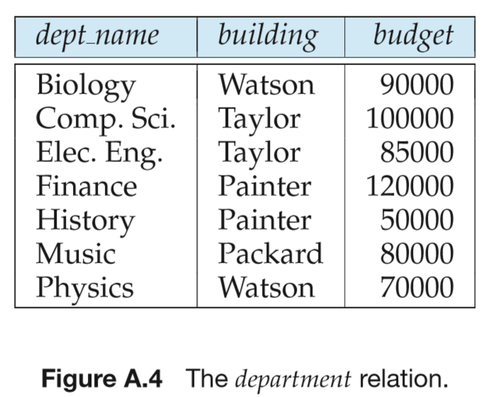
r₂
r₁
return

Slide 39
4.2.5 Referential Integrity (cont.)
  referential integrity constraint also called subset dependency since it can be written as
  ∏_{α} (r₂) ⊆ ∏_{K1} (r₁)
    e.g. ∏_{dept_name} (course) ⊆ ∏_{dept_name} (department)
  a foreign key α of table r₂ references the primary key attributes K₁ of the referenced table r₁
A good DB design should ensures that any relation schema R₂ (and its any tuples) can only reference other relation schema R₁ through its foreign key

Slide 40
Referential Integrity (cont.)
The primary key, candidate keys and foreign keys can be specified as parts of the SQL create table statement:
  the primary key clause lists attributes that comprise the primary key.
  the unique key clause lists attributes that comprise a candidate key.
  the foreign key clause lists the attributes that comprise the foreign key and the name of the relation referenced by the foreign key.
  By default, a foreign key references the primary key attributes of the referenced table.

Slide 41
Cascading Actions in Referential Integrity
create table course (
course_id char(5) primary key,
title varchar(20),
dept_name varchar(20) references department
)
create table course (
…
dept_name varchar(20),
foreign key (dept_name) references department
on delete cascade
on update cascade,
. . .
)
alternative actions to cascade: set null, set default

Slide 42
Cascading Actions in Referential Integrity
The delete/update operations on the referenced relation department will result in the delete/update on the referencing relation course
DBMS
Bio
Bio
r₁
r₂

Slide 43
Integrity Constraint Violation During Transactions
E.g.
  create table person (
  ID char(10),
  name char(40),
  mother char(10),
  father char(10),
  primary key ID,
  foreign key father references person,
  foreign key mother references person)
How to insert a tuple without causing constraint violation ?
  insert father and mother of a person before inserting person
  OR, set father and mother to null initially, update after inserting all persons (not possible if father and mother attributes declared to be not null)
  OR defer constraint checking (next slide)

Slide 44
实验要求
以SQL Server为平台，定义2张表间的无级联modification、有级联modification的外键关联，
判断：当增/删/改一张表中的主键、外键值时，DBMS的反应

Slide 45
（知乎话题）
数据库系统设计时，是否使用外键？！
外键反映了不同数据项间的逻辑关联和约束关系，是一种客观存在
  e.g. dept_name in the table department, course
对外键的处理方式反映了对这种数据相互间关系的处理态度，需要根据实际情况而定，考虑数据完整性、处理效率等多种因素
  并非简单的“需要外键”，“不设外键”（e.g. 部分MySQL课程、MySQL社区的论点）

Slide 46
（知乎话题）
数据库系统设计时是否使用外键？！
方式1：设置数据库表的外键
  优点：
  DBMS自动维护数据间的关联、约束关系
  缺点：
  数据导入、增删改时，多个表间的相互关联，保证了数据一致性、完整性，但影响到整体数据处理效率（额外的DBMS处理开销）
  ——e.g.插入一条dept_name不存在的course元组，失败，并影响前面已经成功插入的数据——局部错误影响整体

Slide 47
（知乎话题）
数据库系统设计时是否使用外键？！
方式2：不设置外键，由应用程序在业务逻辑层维护数据一致性、完整性
  优点
  1）避免局部错误影响整体进度；
  2）业务逻辑层的数据一致性处理的速度可以比较快，e.g. 将数据提至内存中批量处理
  缺点：对应用层业务处理程序设计的额外要求
上述2种方式用在对数据一致性完整性要求高的场景下，e.g. 银行
方式3：不设置外键，业务层应用逻辑也不处理数据间一致性
  牺牲数据的正确性，换取数据处理的效率
  e.g. 大数据应用场景下，对数据精度、正确性要求不高

Slide 48
4.4.7 Complex Check Conditions and Assertions
In the SQL standard, the some construct such as check and assertion are defined to specify the complex integrity constraints.
  However, they not currently supported by most database systems (?)
E.g. For the relation section, the time_slot_id in each tuple should be is actually the identifier of a time_slot in the time_slot relation. This constraint can be defined as
check (time_slot_id in (select time_slot_id from time_slot))
check in create table
create table student (
ID varchar(5),
name varchar(20) not null,
dept_name varchar(20),
tot_cred numeric(3,0),
primary key (ID),
foreign key (dept_name) references department)
check(tot_cred>0)
Notes:
复杂check条件与断言。目前没有被大多数数据库系统支持。
Check子句中的谓词可以是包含子查询的任意谓词。检测开销较大。

Slide 49
Complex Check Conditions and Assertions (cont.)
An assertion is a predicate expressing a condition that we wish the database always to satisfy
  e.g. domain constraints, referential-integrity constraint
An assertion in SQL takes the form
create assertion <assertion-name> check <predicate>
  Also not supported by anyone, e.g. SQL Server等数据库系统似乎不支持创建assertion !!!
Why ？
When an assertion is made, the DBMS tests it for validity. Any modification to DB is allowed only if it does not cause that assertion to be violated
  this testing may introduce a significant amount of overhead, hence assertions should be used with great care
Notes:
一个断言：就是一个谓词，表达了我们希望数据总能满足的一个条件。域约束和参照完整性约束就是断言的特殊形式。

Slide 50
Complex Check Conditions and Assertions (cont.)
For each tuple in the student relation, the value of the attribute tot_cred must equal the sum of credits of courses that the student has completed successfully
create assertion credits_earned_constraints check
( not exists (select ID
from student
where tot_cred
<> select sum(credits)
from takes natural join course
where student.ID=takes.ID
and grade is not null and grade<>’F’)
)

Slide 51
§4.5 SQL Data Types and Schemas
4.5.1 Data and Time Types in SQL
In addition to the basic data types, e.g. char(n), varchar(n), int, smallint, numeric(p, d), real, double precision, float(n), the other built-in data types include
  date: Dates, containing a (4 digit) year, month and date
    e.g. date ‘2017-7-27
  time: Time of day, in hours, minutes and seconds
    e.g. time ‘09:00:30.75
  timestamp: date plus time of day
    e.g. timestamp ‘2017-7-27 09:00:30.75’
  interval: period of time
    if x and y are of type date, then x-y is an interval whose value is the number of days from date x to date y
    e.g. interval ‘1’ day=‘2017-7-27’ – ‘2017-7-28’

Slide 52
Built-in Data Types in SQL (cont.)
cast e as t
  convert a character string (or string valued expression) e to the type t , e.g. date/time/timestamp
  e.g. cast ‘2017-07-20’ as date
  e.g. cast ‘09:00:30.75’ as time
For a day or time value d, its individual fields can be extracted
  e.g. extract (year from 2017-07-20) =2017
  e.g. extract (timezone_hour from 2017-7-27 09:00:30.75) =09

Slide 53
4.5.4 Large-Object Types
Large objects (photos, videos, CAD files, etc.) are stored as a large object
blob: binary large object （二进制大型对象）
  the object is a large collection of uninterpreted binary data, whose interpretation is left to an application outside of the database system
clob: character large object
  the object is a large collection of character data
When a query returns a large object, a pointer is returned rather than the large object itself !

Slide 54
Large-Object Types (cont.)
E.g.
book_view clob(10KB)
image blob(10MB)
movie blob(2GB)
Now, Oracle, DB2, and SQL Server also support the XML data type integrated in relational schemas, i.e. the attributes of XML data type in relational tables
e.g. Create table book
book_id int primary key
book_view clob(10KB)
image blob(10MB)
movie blob(2GB)
catalog XML

Slide 55
4.5.5 User-defined Types
The create type clause can be used to define new user-defined types
  e.g. create type Dollars as numeric (12,2) final
  create table department
  (dept_name varchar (20),
  building varchar (15),
  budget Dollars);
cast, i.e. convert, values of one type to another domain
  cast (department.budgt to numeric(12.2))
  , then the expression
  (department.budgt + 20)
  can be evaluated

Slide 56
Domains
create domain construct in SQL-92 creates user-defined domain types
  create domain person_name char(20) not null
Types and domains are similar. Domains can have constraints, such as not null, specified on them.
create domain degree_level varchar(10)
constraint degree_level_test
check (value in (’Bachelors’, ’Masters’, ’Doctorate’));

Slide 57
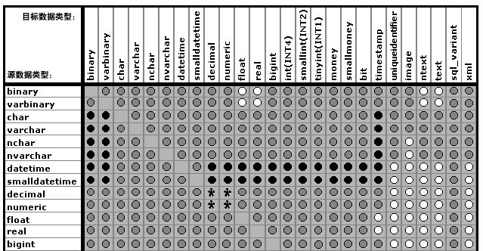
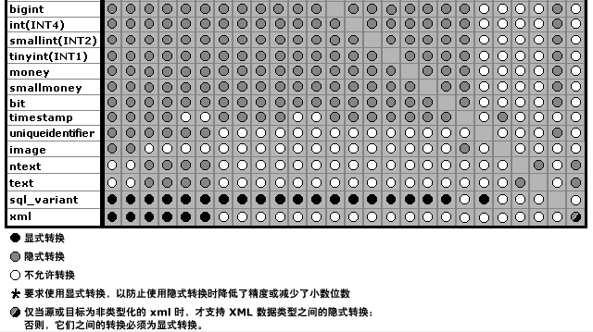
SQL Server2005
类型转换

Slide 58
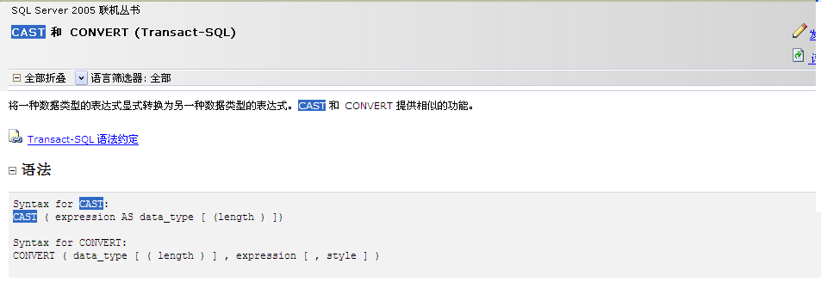

Slide 59
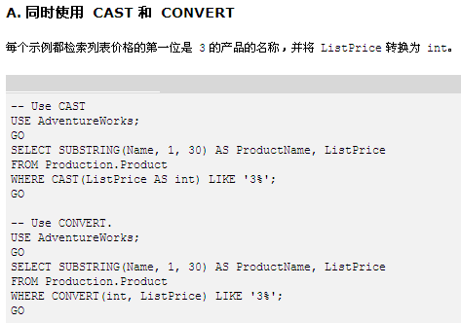

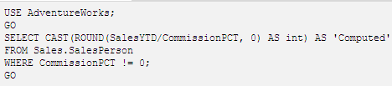
varchar, e.g. 350.00

Slide 60
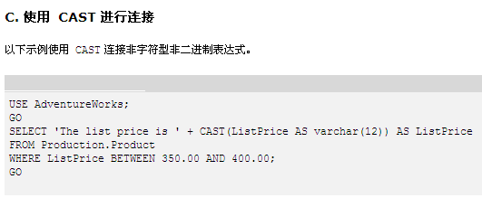
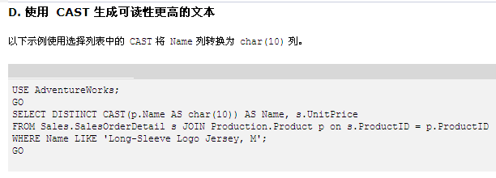
float
varchar

Slide 61
4.5.2 Default Values
create table student
(ID varchar (5),
name varchar (20) not null,
dept_name varchar (20),
tot_cred numeric (3,0) default 0,
primary key (ID))
insert into student(ID, name, dept_name)
values (‘12789’, ‘Newman’, ‘Comp.Sci’)

Slide 62
4.5.3 Index Creation
create table student
(ID varchar (5),
name varchar (20) not null,
dept_name varchar (20),
tot_cred numeric (3,0) default 0,
primary key (ID))
create index studentID_index on student(ID)
Indices are data structures used to speed up access to records with specified values for index attributes
  e.g. select *
  from student
  where ID = ‘12345’
  can be executed by using the index to find the required record, without looking at all records of student
  More on indices in Chapter 11

Slide 63
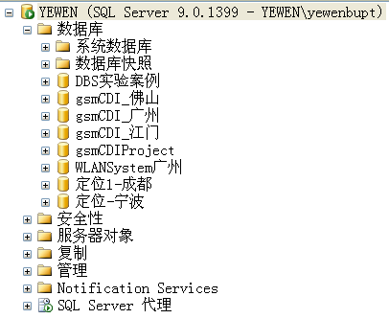
4.5.5 Schemas, Catalogs, and Environments
How to name the relations in DB, or how to specify the names of the relations in DB
The three-level hierarchy for naming relations
  catalogs（全文目录）, each of which can contain schemas;
  The catalog is also called database
  schemas（架构）, in which the relations and views are stored
  the Schema object represents an ownership context for a Microsoft SQL Server database object.
  relations and views
  e.g. a three-part name for the relation
  catalog5.bank_schema.account
Notes:
再看下！！

Slide 64
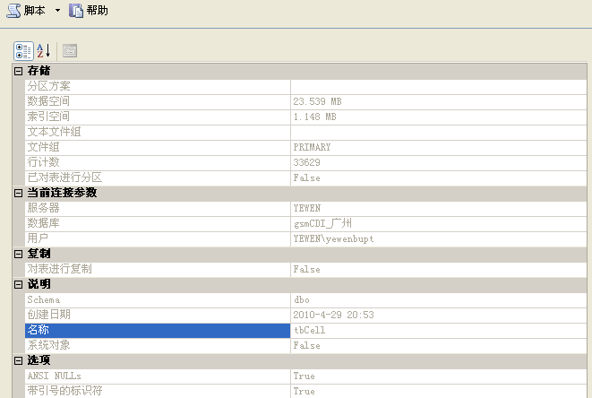
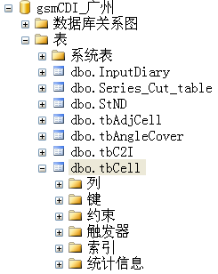
Schemas, Catalogs, and Environments
右键属性
SQL environments, including
  connection, catalog, schema, user identifier
Notes:
再看下！！

Slide 65
§4.6 Authorization
Forms of authorization on parts of the database include
  Read - allows reading, but not modification of data
  Insert - allows insertion of new data, but not modification of existing data
  Update - allows modification, but not deletion of data Delete - allows deletion of data
Forms of authorization to modify the database schema (covered in Chapter 8)
  resources - allows creation of new relations
  alteration - allows addition or deletion of attributes in a relation
  drop - allows deletion of relations
  index

Slide 66
Authorization Specification in SQL
The grant statement is used to confer authorization
grant <privilege list>
on <relation name or view name> to <user list>
<user list> is:
  a user-id
  public, which allows all valid users the privilege granted
  a role (more on this in Chapter 8)
Granting a privilege on a view does not imply granting any privileges on the underlying relations.
The grantor of the privilege must already hold the privilege on the specified item (or be the database administrator).

Slide 67
Privileges in SQL
select: allows read access to relation,or the ability to query using the view
  Example: grant users U₁, U₂, and U₃ select authorization on the instructor relation:
grant select on instructor to U₁, U₂, U₃
insert: the ability to insert tuples
update: the ability to update using the SQL update statement
delete: the ability to delete tuples.
all privileges: used as a short form for all the allowable privileges

Slide 68
Revoking Authorization in SQL
The revoke statement is used to revoke authorization.
  revoke <privilege list>
  on <relation name or view name> from <user list>
Example:
  revoke select on branch from U₁, U₂, U₃
<privilege-list> may be all to revoke all privileges the revoker may hold.
If <revokee-list> includes public, all users lose the privilege except those granted it explicitly.

Slide 69
Roles
create role instructor;
grant instructor to Amit;
Privileges can be granted to roles:
  grant select on takes to instructor;
Roles can be granted to users, as well as to other roles
  create role teaching_assistant
  grant teaching_assistant to instructor;
    Instructor inherits all privileges of teaching_assistant
Chain of roles
  create role dean;
  grant instructor to dean;
  grant dean to Satoshi;
Notes:
权限可以授予给角色，同一个角色的所有用户拥有相同的权限。
支持把角色授予给用户

Slide 70
Authorization on Views
create view geo_instructor as
(select *
from instructor
where dept_name = ’Geology’);
grant select on geo_instructor to geo_staff
Suppose that a geo_staff member issues
  select *
  from geo_instructor;
What if
  geo_staff does not have permissions on instructor?
  creator of view did not have some permissions on instructor?

Slide 71
Other Authorization Features
references privilege to create foreign key
  grant reference (dept_name) on department to Mariano;
  why is this required?
transfer of privileges
  grant select on department to Amit with grant option;
  revoke select on department from Amit, Satoshi cascade;
  revoke select on department from Amit, Satoshi restrict;
Etc. read Section 4.6 for more details we have omitted here.
Notes:
Restrict：防止级联收回权限。

Slide 72
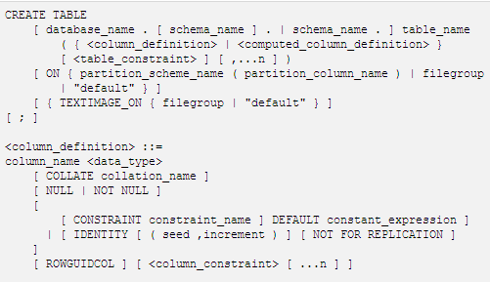
Appendix A create table in T-SQL
分区
文件组
物理设计

Slide 73
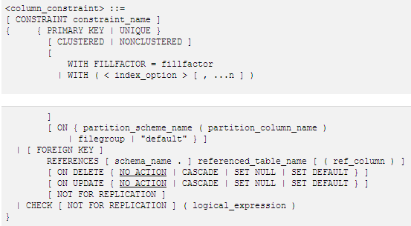
聚集/非聚集索引
（物理设计）
外键

Slide 74
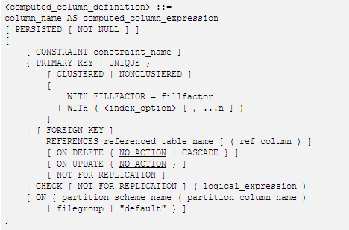
派生属性

Slide 75
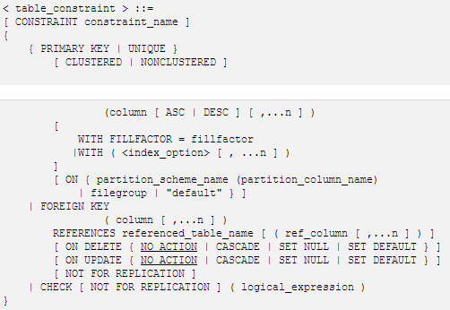

Slide 76
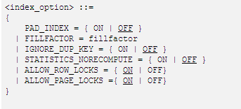
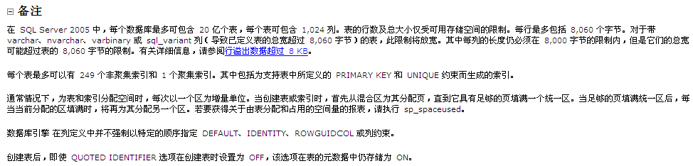
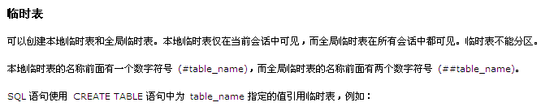

Slide 77
Appendix B 实际系统中的外键定义
DBMS不会自动生成外键，需要用户显示定义外键
    e.g.1
    r₁: department(dept_name, building, budgt)
    r₂: course(course_id, title, dept_name, credits),
    e.g.2
    branch(branch-name, branch-city, assets),
    account(account-number, branch-name, balance)
如何在已经创建的关系表中，加入外键定义？？
  create assertion ? ——SQL Server不支持
  Alter

Slide 78
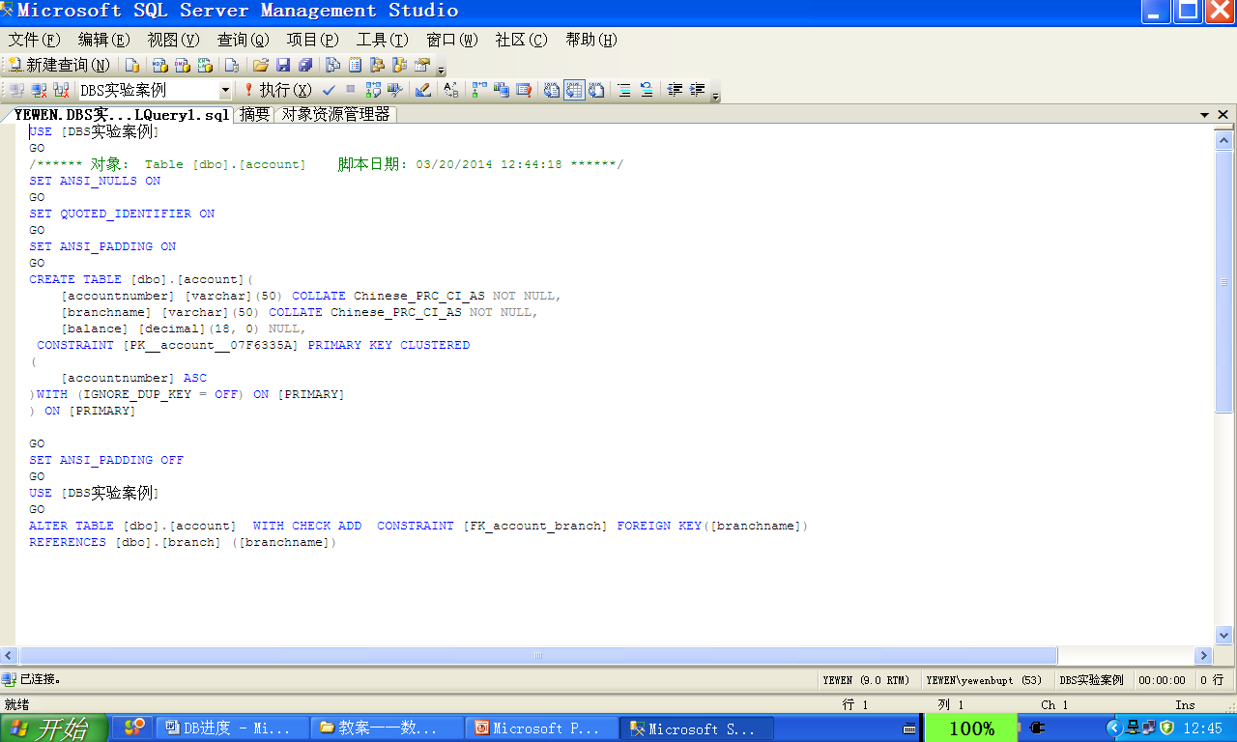

Slide 79
注意：
如何在已经创建的关系表中，加入外键定义？？
  在SQL Server 2005 Manager Studio下，通过图形界面，手动创建

Slide 80
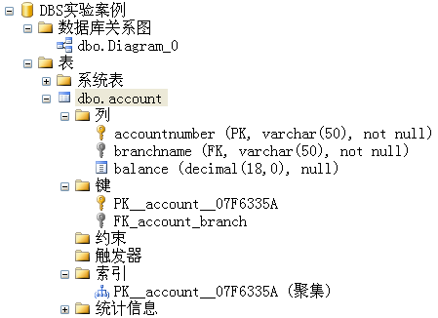
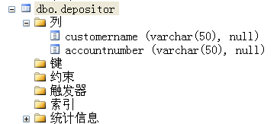
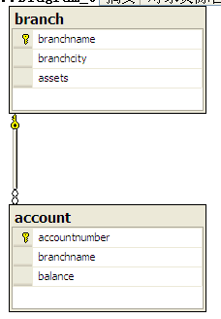
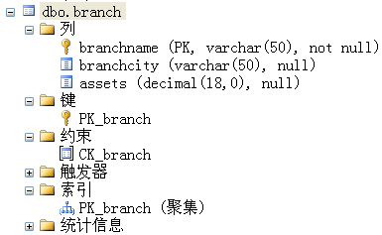
assert>0
开始时，没有定义depositor-account外键

Slide 81
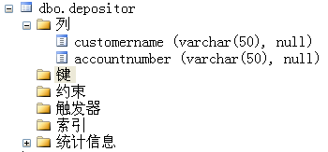
在depositor中添加主键、外键
点击右键：
新建外键

Slide 82
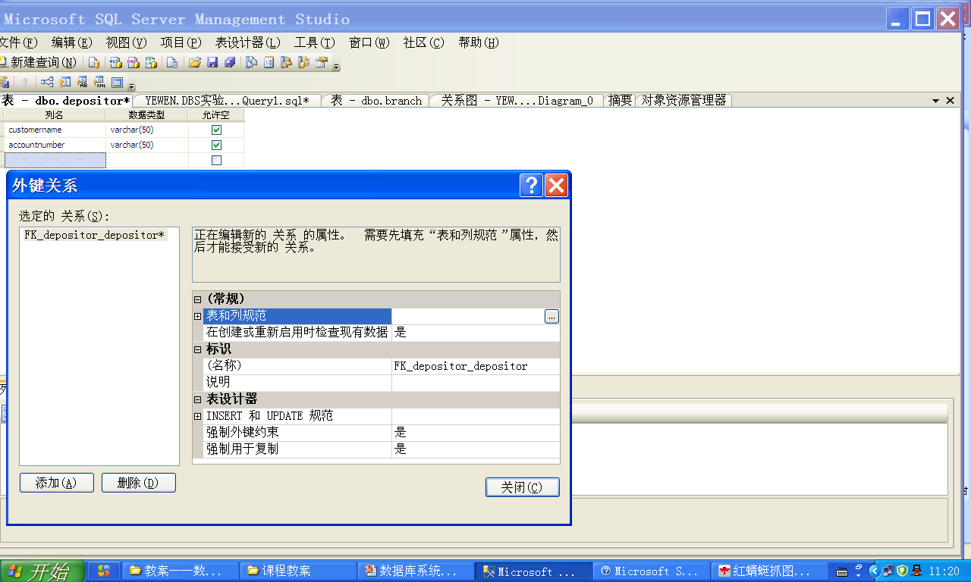
默认外键名字
点击：
创建外键

Slide 83
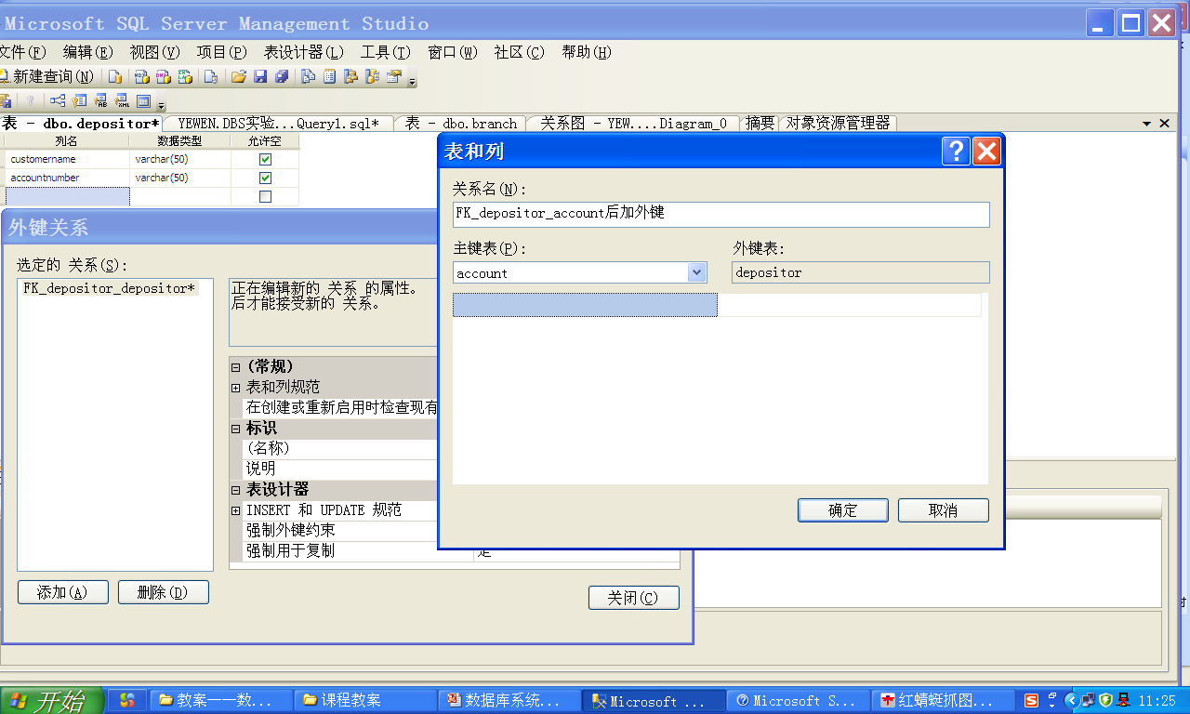
重新定义外键名字
选择被参照关系

Slide 84
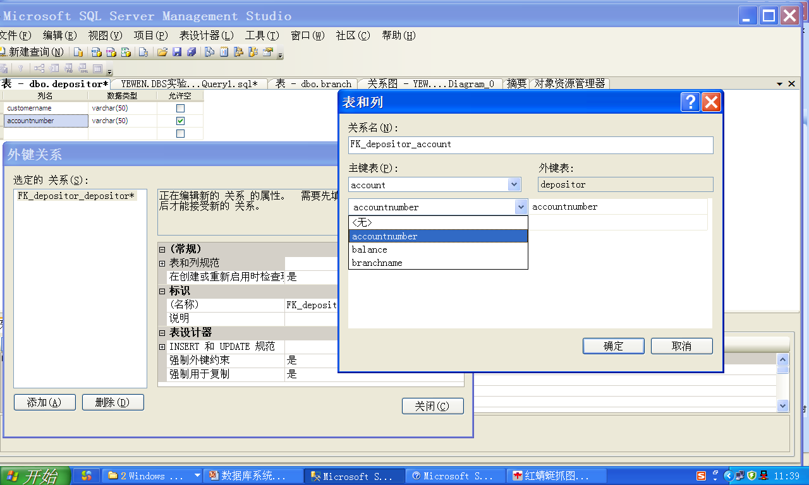
选择参照关系depositor的外键、
被参照关系account及其主键

Slide 85
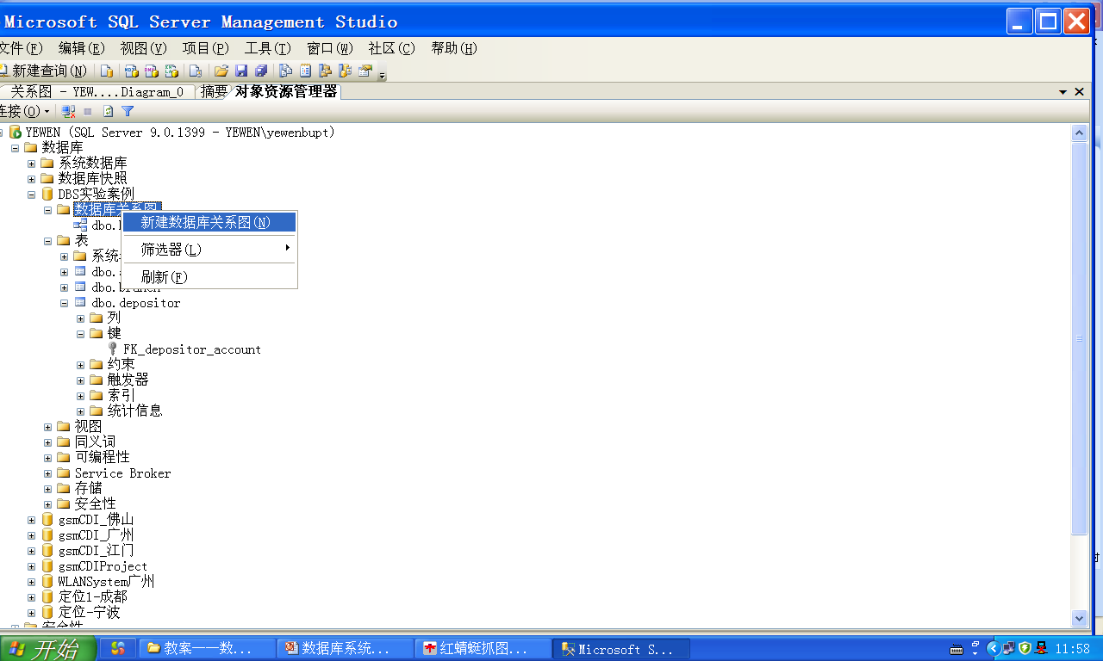
更新模式图

Slide 86
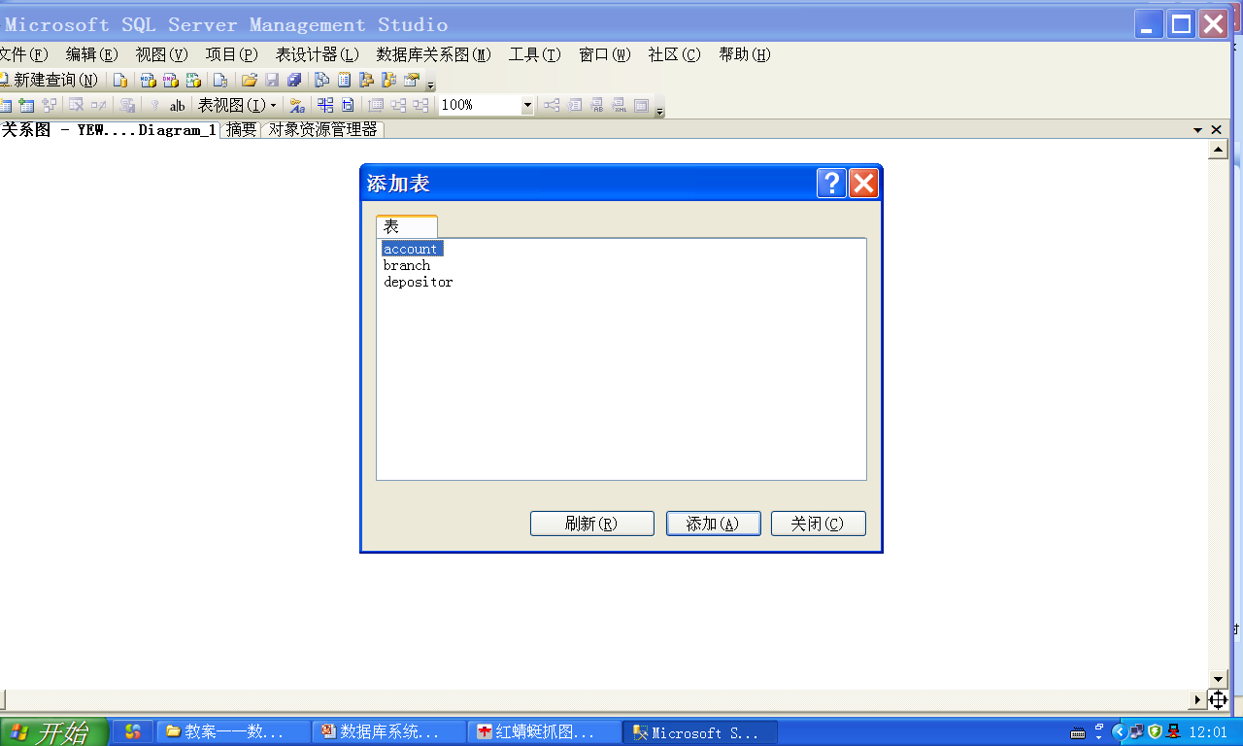
依次将3张表添加到模式图，刷新

Slide 87
