Slide 1
PART 2
RELATIONAL DATABASES

Slide 2
Chapter 6
Formal Relational Query Language

Slide 3
Main Parts in Chapter 6
Categories of relational operations
relational operations/arithmetic
relational calculus
relational algebra
(6.1 授课内容)
tuple relational calculus
domain relational calculus
  tuple relational calculus (元组关系演算,§6.2)
  domain relational calculus (域关系演算, §6.3)

Slide 4
Main Parts in Chapter 6
Relational algebra
  fundamental operations (§6.1.1-2)
  additional operations (§6.1.3)
  extended operations (§6.1.4)

Slide 5

Fig. Schema Diagram

Slide 6
用处？！
SQL语言的理论基础
实际DBMS环境下，观察SQL语句的查询执行计划——表示为关系代数操作，分析、判断、优化SQL语句
  提高SQL语句执行效率，保证数据库系统性能
  — 数据库系统维护优化
E.g. 观察select语句的查询执行计划不同，比较同一查询的不同实现方式
Notes:
查询处理过程：首先要将SQL查询表达式转化为关系代数表达式，并在此基础上进行查询优化，获取最优的查询执行计划进行执行。
同一个查询，可转化为不同的关系代数表达式，而且每个关系操作又可能对应不同的算法，因此对应不同的查询执行计划。需要针对这些关系代数表达式，
进行分析，判断和优化SQL语句，提高执行效率，优化系统性能。

Slide 7
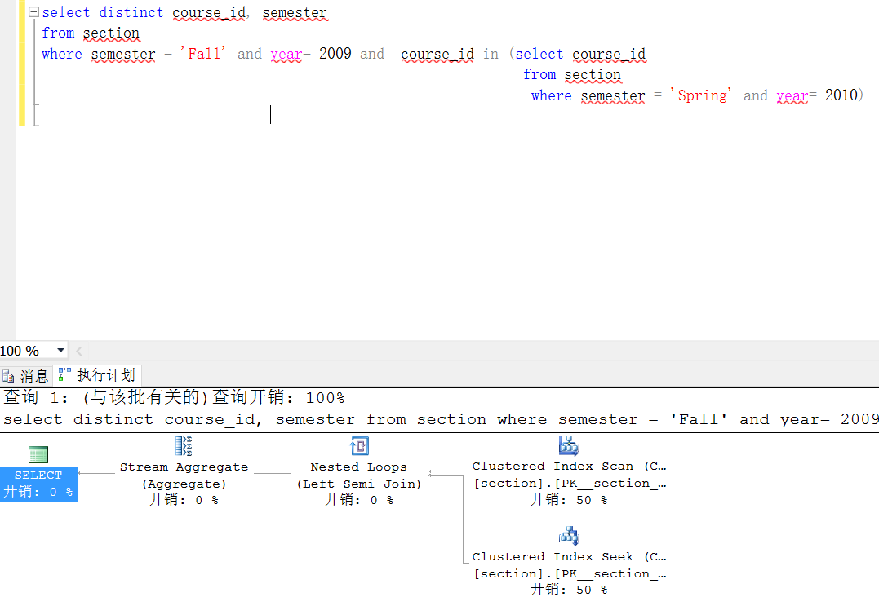

Slide 8
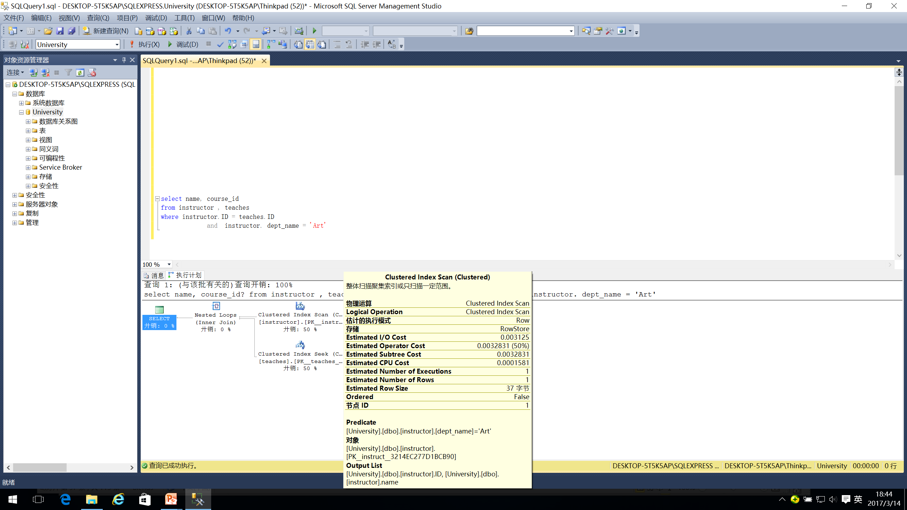
自下而上执行查询树
中的关系代数操作

Slide 9
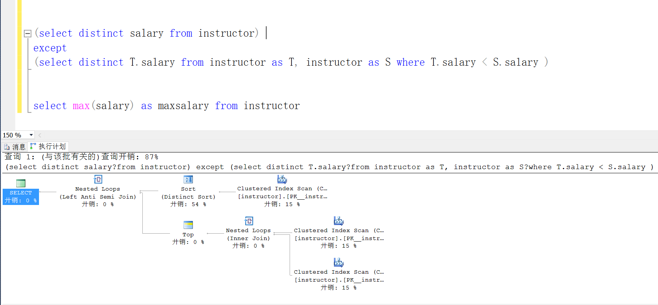
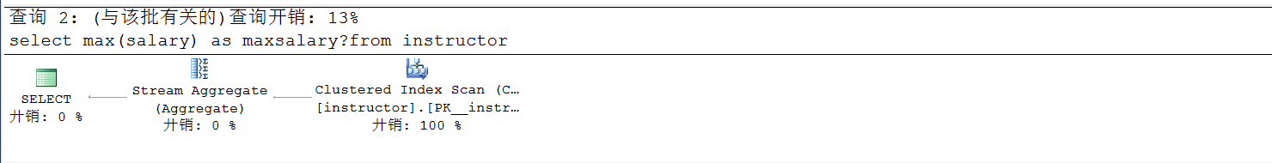
查询1: cost=87
查询2: cost=13
自下而上执行查询树
中的关系代数操作

Slide 10
6.1 Relational Algebra
6.1.1 Fundamental Operations
Six basic operators
  select: σ
  project: ∏
  union: ∪
  set difference: –
  Cartesian product: x
  rename: ρ
The operators take one or two relations as inputs and produce a new relation as a result.

Slide 11
Select Operation
Notation: σ _{p}(r)
p is called the selection predicate
Defined as:
σ_{p}(r) = {t | t ∈ r and p(t)}
Where p is a formula in propositional calculus consisting of terms connected by : ∧ (and), ∨ (or), ¬ (not)
Each term is one of:
<attribute> op <attribute> or <constant>
where op is one of: =, ≠, >, ≥. <. ≤
Example of selection: σ _{dept_name=“Physics”}(instructor)
SQL statement
Select *
From r
Where P

Slide 12
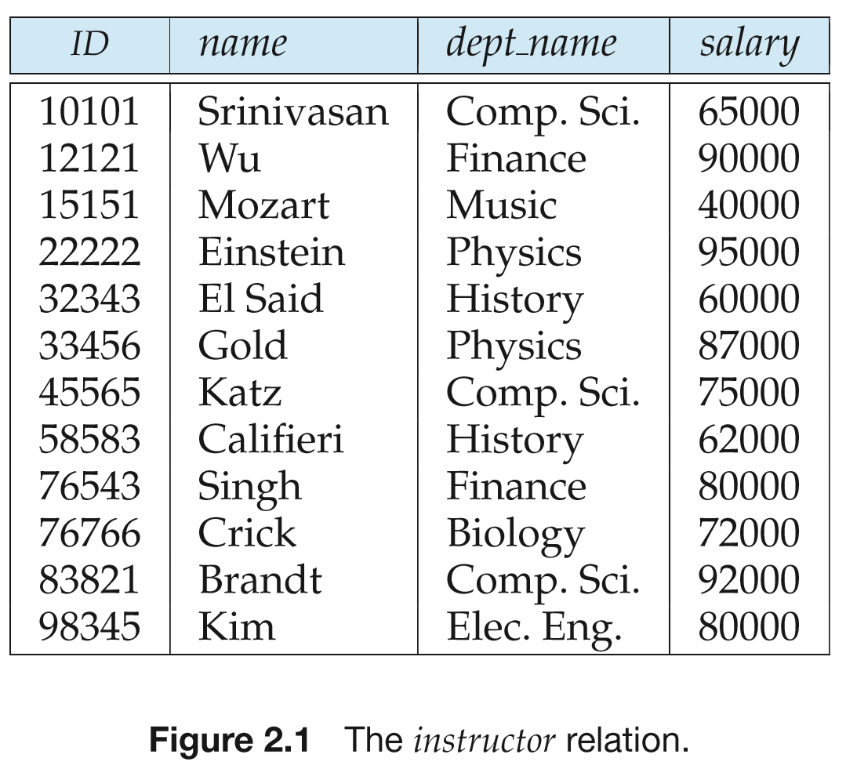
Example of selection: σ _{dept_name=“Physics”}(instructor)

Slide 13

Project Operation
SQL statement
Select A₁, A₂ , A_{k}
From r
Notation:
where A₁, A₂ are attribute names and r is a relation name.
The result is defined as the relation of k columns obtained by erasing the columns that are not listed
Duplicate rows removed from result, since relations are sets
Example: To eliminate the dept_name attribute of instructor
∏_{ID, name, salary} (instructor)

Slide 14
Composition Operations
Several relational algebra operations can be composed together into a relational algebra expression
E.g.2. ∏_{Id, name, salary}(σ _{dept_name=“Physic’} (instructor))

Slide 15
Union Operation
Notation: r ∪ s
Defined as:
r ∪ s = {t | t ∈ r or t ∈ s}
For r ∪ s to be valid.
1. r, s must have the same arity (same number of attributes)
2. The attribute domains must be compatible (example: 2nd column
of r deals with the same type of values as does the 2nd
column of s)
SQL statement
r Union s
r Union All s

Slide 16
Union Operation
Example: to find all courses taught in the Fall 2009 semester, or in the Spring 2010 semester, or in both
∏_{course_id} (σ _{semester=“Fall” Λ year=2009} (section)) ∪
∏_{course_id} (σ _{semester=“Spring” Λ year=2010} (section))

Slide 17
Set Difference Operation
Notation r – s
Defined as:
r – s = {t | t ∈ r and t ∉ s}
Set differences must be taken between compatible relations.
  r and s must have the same arity
  attribute domains of r and s must be compatible
Note: r ∩ s = r – (r – s)
SQL statement
r Except s

Slide 18
Set Difference Operation
Example: to find all courses taught in the Fall 2009 semester, but not in the Spring 2010 semester
∏_{course_id} (σ _{semester=“Fall” Λ year=2009} (section)) −
∏_{course_id} (σ _{semester=“Spring” Λ year=2010} (section))

Slide 19
Cartesian-Product Operation
Notation r ╳ s
Defined as:
r ╳ s = {t | t = t₁ t₂ and t₁∈ r and t₂ ∈ s }
Assume that attributes of r(R) and s(S) are disjoint. (That is, R ∩ S = ∅).
If attributes of r(R) and s(S) are not disjoint, then renaming must be used.

Slide 20
Cartesian-Product
E.g.1
SQL Statement:
Select *
From r, s
Cartesian-product operation on relation r and s
r ╳ s = {t | t = t₁ t₂ and t₁∈ r and t₂ ∈ s }
A
B
C
D
E
A
B
C
D
E
t₁
α
β
1
2
α
β
β
γ
10
10
20
10
a
a
b
b
α
α
α
α
β
β
β
β
1
1
1
1
2
2
2
2
α
β
β
γ
α
β
β
γ
10
10
20
10
10
10
20
10
a
a
b
b
a
a
b
b
t₂
t
r
s
Fig.6.05
r ╳ s

Slide 21
Cartesian-Product
For relation r(R) and s(S), r ╳ s is a relation whose schema is R’ , which is the concatenation of R and S
  R (A₁, A₂, …, A_{m}), S(B₁, B₂, …, B_{n})
  R’ (A₁, A₂, …, A_{m}, B₁, B₂, …, B_{n})
  for t ∈ r ╳ s , there are t₁ ∈ r and t₂ ∈ s, such that
  t[R] = t₁[R]
  t[S] = t₂[S]
  assume that attributes of r(R) and s(S) are disjoint. i.e. {A₁, A₂, …, A_{m}} ∩ {B₁, B₂, …, B_{n}} = ∅
  if attributes of r(R) and s(S) are not disjoint, then renaming must be used.

Slide 22
Fundamental Operations vs Select statement in SQL
A typical SQL query has the form
select A₁, A₂, ..., A_{n}
from r₁, r₂, ..., r_{m}
where P
  A_{i} represents attributes
  r_{i} represents relations
  P is a predicate
Equivalent to the relational algebra expression
∏ _{A1, A2, ..., An}(σ_{P} (r₁ x r₂ x ... x r_{m}))

Slide 23
Rename Operation
The rename operation on relation r or relational algebra expression E
ρ _{x} (r) , ρ _{x} (E)
  renaming r or E as X
If a relational-algebra expression E has arity n, then
ρ_{x} _{(A1, A2, …, An)} (E)
returns the result of expression E under the name X, and with the attributes renamed to A1, A2, …., An
E.g. ρ_{s} _{(A1, A2, …, An)} ( r (B₁, B₂, …, B_{n})) = s (A₁, A₂, …, A_{n})

Slide 24
Rename Operation
– An Example
Find the highest salary in the univsersity
Principle
  /*将对一个关系instructor中同一个属性salary的不同取值的比较转换为利用换名操作、迪卡尔乘积和选择操作对关系instructor和它的副本ρ _{d} (instructor)在同一属性salary上取值的比较, refer to Fig.6.0.6
Step1.
  instructor ╳ ρ _{d} (instructor)
Step2. all tuples that have non-largest salary values in instructor relation:
σ _{instructor.salary < d.salary} (instructor ╳ ρ _{d} (instructor))
  the result are tuple t₂, t₃, t₆
Notes:
当涉及到同一个关系中相同属性的值的比较时，通常会用到rename操作加以区分，将同一个关系上的运算转换为两个关系之间的运算。相当于同一个关系复制一份。

Slide 25
Rename Operation
– An Example (cont.)
ins.ID | ins.name | ins.salary
120005 | Zhang | 1000
130007 | Wang | 2000
198032 | Li | 3000
d.ID | d.name | d.salary
120005 | Zhang | 1000
130007 | Wang | 2000
198032 | Li | 3000
(a) instructor
(b) d =
ρ _{d} (instructor)
Fig.2.06-1 relation instructor and d

Slide 26
instructor
d
ins.ID | ins.name | ins.salary | d.ID | d.name | d.salary
120005 | Zhang | 1000 | 120005 | Zhang | 1000
120005 | Zhang | 1000 | 130007 | Wang | 2000
120005 | Zhang | 1000 | 198032 | Li | 3000
t₂
t₃
130007 | Wang | 2000 | 120005 | Zhang | 1000
130007 | Wang | 2000 | 130007 | Wang | 2000
130007 | Wang | 2000 | 198032 | Li | 3000
198032 | Li | 3000 | 120005 | Zhang | 1000
198032 | Li | 3000 | 130007 | Wang | 2000
198032 | Li | 3000 | 198032 | Li | 3000
t₆
Fig.2.06-2 instructor ╳ ρ _{d} (instructor)

Slide 27
Rename Operation
– An Example (cont.)
Step3. all non-largest salary values in relation instructor
  ∏_{instructor.salary}(
  σ _{instructor.salary < d. salary} (instructor ╳ ρ _{d} (instructor))
  the result is {1000, 2000}
Step4. All largest balance values in relation account
  ∏_{salary} (instructor) —
  ∏ _{instructor.salary} (
  σ _{instructor.salary < d. salary} (instructor ╳ ρ _{d} (instructor))
  the result is {1000, 2000, 3000} — {1000, 2000} = {3000}

Slide 28
Rename Operation
– An Example (cont.)
This query can also be solved by Select statement in SQL, by means of
  tuple variables in §3.3.5?
  set comparison in §3.7.2?
  aggregate function max in §3.5?
Homework and Questions
  是否可用下式代替step4中的查询表达式
  ∏_{instructor.salary} (
  σ _{instructor .salary >= d.salary} (instructor ╳ ρ _{d} (instructor)) ) )
  如何求解 “Find the smallest salary in the university ”

Slide 29
6.1.2 Formal Definition of Relational Algebra
Relational algebra expression E is defined as follows
  a basic expression is
    a relation r in the database, or
    a constant relation C= {c₁, c₂, .., c_{n}}, which is written by listing its tuples in the relation
  a general expression is defined as:
  if E₁ and E₂ are relational algebra expressions, then
    E₁∪ E₂
    E₁— E₂
    E₁ ╳ E₂

Slide 30
Formal Definition of Relational Algebra (cont.)
    σ_{p} (E₁)
    ∏s (E₁),
    ρ_{x} (E₁ )
    are all relational algebra expressions

Slide 31
6.1.3 Additional Operations
Additional operations
  ∩, set-intersection（集合交）
  ∞, natural-join （自然、外连接）
  ←，assignment（赋值）
With respect to querying powers, additional operations are equivalent with fundamental operations, i.e. can be replaced (or re-represented ) by the six basic operations operations
  a additional operation can be replaced/re-represented by basic operations
  additional operations simplify representations of queries

Slide 32
6.1.3.1 The Set-Intersection Operation
For relation r and s, set-intersection operation on r and s is defined as
r ∩ s ={ t | t ∈ r and t ∈ s }
  r, s have the same arity
  attributes of r and s are compatible
r ∩ s = r - (r - s)
SQL statement
  intersect

Slide 33
6.1.3.2 The Natural-join Operation
E.g.1
A
B
C
D
B
D
E
(1)
α
β
γ
α
δ
1
2
4
1
2
α
γ
β
γ
β
a
a
b
a
b
(1)
1
3
1
2
3
a
a
a
b
b
α
β
γ
δ
∈
r
s
A
B
C
D
E
(1)
α
α
α
α
δ
1
1
1
1
2
α
α
γ
γ
β
a
a
a
a
b
α
γ
α
γ
δ
r s
Fig.6.07

Slide 34
Natural-join (cont.)
For relations r(R) and s(S), assuming R∩S = {A₁, A₂, …, A_{n} }, the natural join of r and s, denoted by r s , is a relation on schema R∪S,
r s =
∏_{R∪S} (σr.A1=s.A1∧r.A2=s.A2 ∧…∧r.An=s.An ( r ╳ s ))
E.g.1 (cont.)
R = (A, B, C, D), S = (B, D , E ), r(R) and s(S),
  r s =
  ∏_{r.A, r.B, r.C, r.D, s.E} (σ_{r.B = s.B ∧ r.D = s.D} (r ╳ s))
  defined on the schema (A, B, C, D, E)

Slide 35
2.3.2 The Natural-join Operation
(cont.)
Natural-join operation combine σ and ╳ on some relations into one operation
  to improve execution efficiency of query
  for more details, refer to Query Optimization in Chapter13

Slide 36
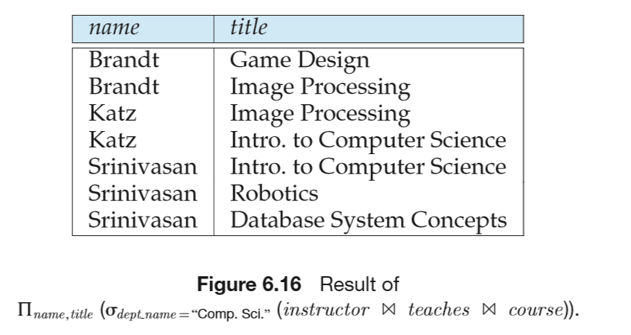
Natural-join
E.g.2 Find the names of all instructors in the Comp.Sci department together with the course titles of all courses the instructors teach

Slide 37
Natural-join
  Select customer-name, loan_number, amounts
  From borrower natural_join loan
Properties of natural join
  r ( s t ) =( r s ) t
  if R ∩S = Φ, then r(R) s(S) = r(R) ╳ s(S)

Slide 38
6.1.3.3 The Assignment Operation
Assign (←) relation algebra expression E to a relational variable var_r, i.e. denoting E as var_r.
var_r ← E
The assignment operation (←) provides a convenient way to express complex queries
E.g. Write r ÷ s as
temp1 ← ∏_{R-S} (r)
temp2 ← ∏_{R-S} ((temp1 × s) – ∏_{R-S,S} (r))
result = temp1 – temp2

Slide 39
Assignment (cont.)
Assignment must always be made to a temporary relation variable
  assignments to permanent relations constitute a database modification

Slide 40
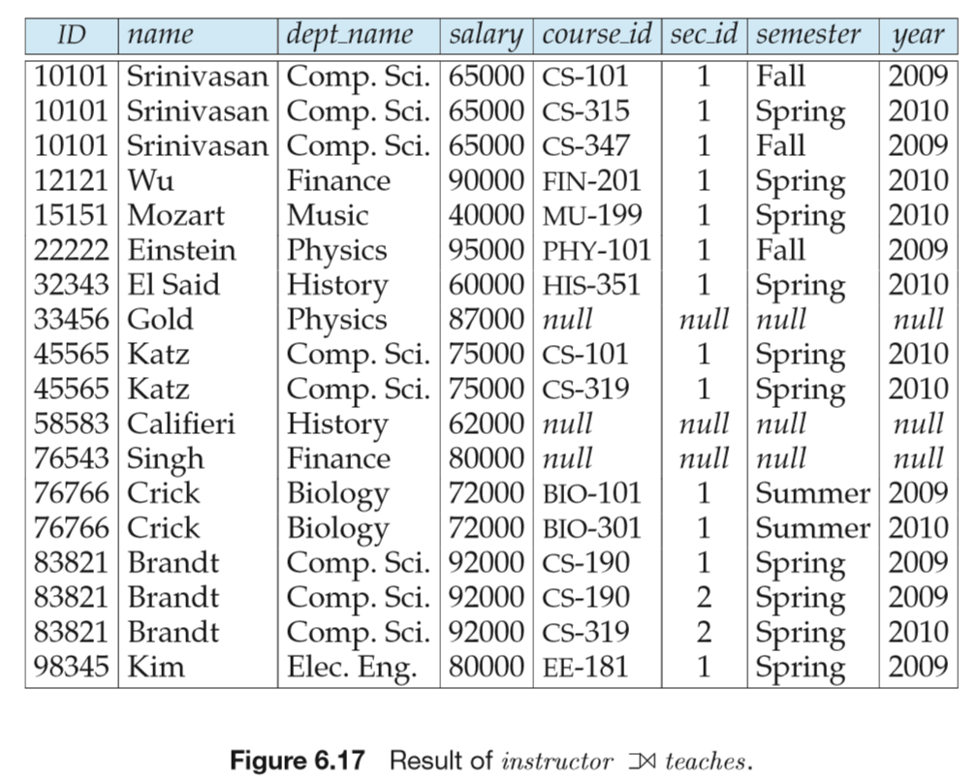
6.1.3.4 Outer join
The outer join operation is an extension of the join operation to deal with missing information

Slide 41
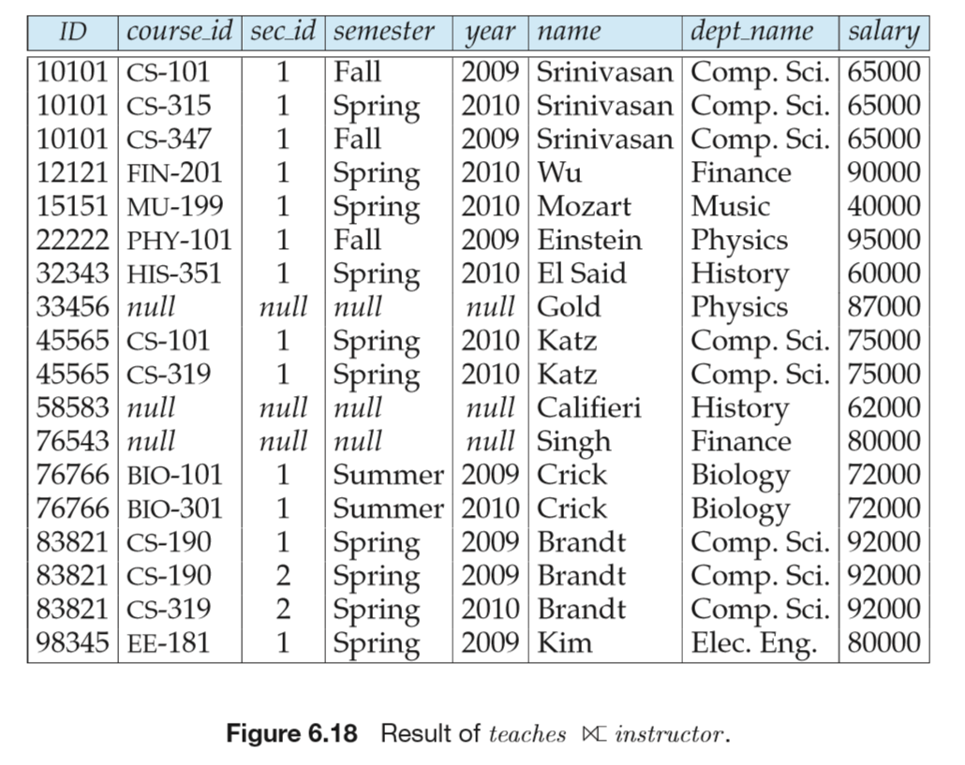
Outer join

Slide 42
§6.1.4 Extended Relational Algebra Operations
Generalized project, aggregate functions
  these operations extends query powers of basic and additive relational algebra operations
6.1.4.1 Generalized Project (一般化/扩展投影操作)
Generalized project extends the projection operation by allowing arithmetic functions to be used in the projection list.
∏ _{F1, F2, …, Fn}(E)
, where
  E is any relational-algebra expression
  each of F₁, F₂, …, F_{n} are arithmetic expressions involving constants and attributes in the schema of E.

Slide 43
2.4.1 Generalized Project (cont.)
  involving arithmetic operation on values of different attributes in one relation,
  e.g. E.A_{i} — E.A_{j}
E.g.
∏_{ID,} _{name, department_name,} _{salary/12} (instructor)

Slide 44
6.1.4.2 Aggregation Function
Aggregation functions
  mapping of a collection of attribute values in a relation r into a single value, i.e. attribute domains → domain
  avg: average value
  min: minimum value
  max: maximum value
  sum: sum of values
  count: number of values
A convenient scheme for computing and comparing of the values in one attribute of the relation, in contrast with

Slide 45
Aggregate Functions in SQL
group by subclause and aggregate function
Select { A₁, A₂, ., A_{i} ,} ag_fun(A_{i+1}),…, ag_fun(A_{i+k})
From r₁, r₂, ..., r_{m}
Where P1
{ Group by A₁, A₂, ., A_{i}
{ having P2 } }
  notes:
    P1 is defined on all attributes of r₁, r₂, ..., r_{m}
    P2 is defined on A₁, A₂, ., A_{i},.., A_{j} ,… , A_{k}, …, A_{n}, as the constraints on the group formed by Group by A₁, A₂, A_{j}
Notes:
举例：
如：查询各门课程的平均成绩；
又如：查询选修了数据库这门课程的女生同学和男生同学的平均成绩分别时多少，输出出来
需要首先进行分组，基于分组属性；
然后在每个分组上基于聚集函数（统计函数）进行统计，结果可重命名，用as命名为新属性名。
在不分组的情况下，聚集函数是作用在所有的查询结果上。
注意：where和having的区别：前者作用在所有的查询结果，后者作用在每个分组上。

Slide 46
Aggregation Function (cont.)
Aggregate operation in relational algebra
_{G1, G2, …, Gn} g _{F1( A1), F2( A2),…, Fm( Am)} (E)
  E is any relational-algebra expression
  G1, G2 …, Gn is a list of attributes on which to group (may be empty)
    a list of attributes in E on which to group (分组) , i.e. tuples in E are classified into several groups E₁, E₂, …, E_{n}, each group E_{i} is a subset of E, and tuples in each group E_{i} have the same values for G1,G2,…,Gn
  if G1, G2,…,Gn do not appears, aggregations are conducted on all tuples in E, that is, E are not classified into groups
Notes:
举例：
如：查询各门课程的平均成绩；
又如：查询选修了数据库这门课程的女生同学和男生同学的平均成绩分别时多少，输出出来
需要首先进行分组，基于分组属性；
然后在每个分组上基于聚集函数（统计函数）进行统计。
在不分组的情况下，聚集函数是作用在所有的查询结果上。

Slide 47
§2.2.2 Aggregation Function (cont.)
  each A_{i} is an attribute on which to conduct aggregation functions F_{i}
    also the attribute names for aggregation results
  aggregation functions F_{i} , e.g. avg, count, min, max, sum
  computing procedure
    separating E into groups on the basis of G1, G2 …, Gn
    computing F₁, F₂,…, F_{n} on each group, and return computing results denoted as A₁, A₂, …, A_{n}

Slide 48
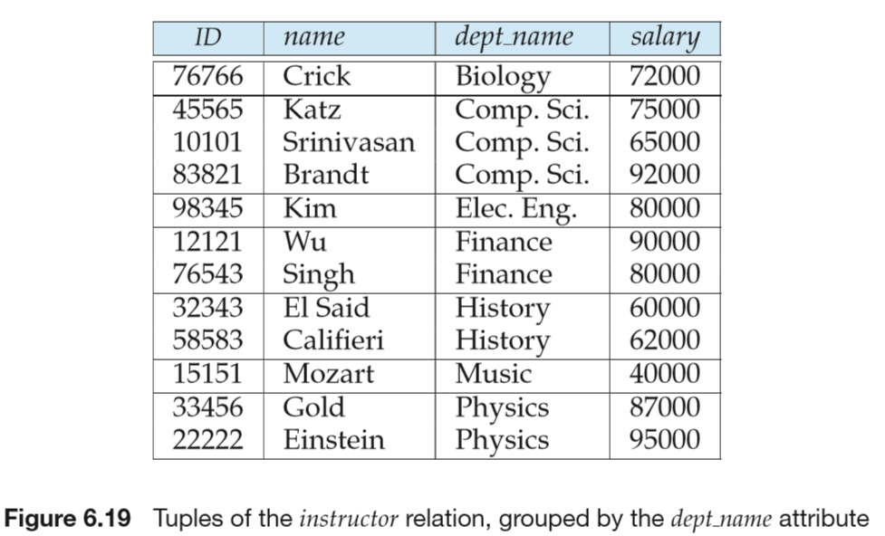
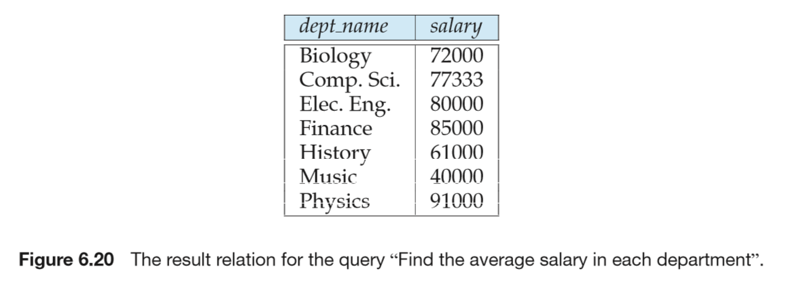

Slide 49
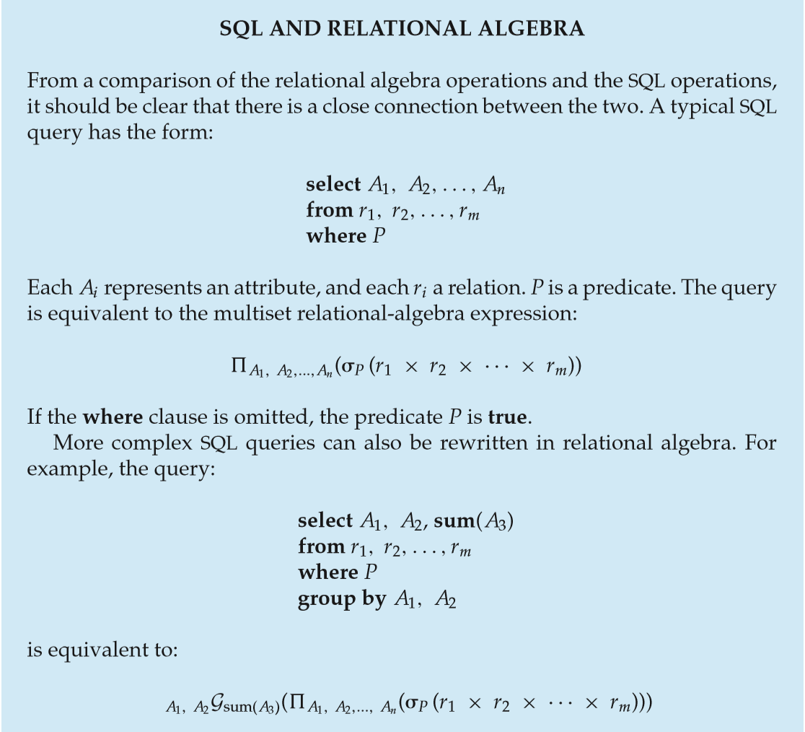
Notes:
该页为sql语句和关系代数操作的对应关系。

Slide 50
Have a rest

