Slide 1
Part Two
Database Design

Slide 2
Chapter 7
Database Design and E-R Model

Slide 3
Design Process
Modeling
Constraints
E-R Diagram
Design Issues
Weak Entity Sets
Extended E-R Features
Design of the Bank Database
Reduction to Relation Schemas
Database Design
UML

Slide 4
Parts in Chapter 7
Part 1. DB/DBS/DBAS design process (§7.1/7.10 + Supplementary)
  DB design phases (§7.1)
  requirement analysis, conceptual design, logical design, physical design
  DBAS life-cycle model (生命周期模型)
Part 2. The Entity-Relationship Model
  basic E-R model
    modeling elements (§7.2.1-7.2.3): entity sets, relationship sets, attributes
    constraints (§7.3.1-7.3.3): mapping cardinality, participation constraint, keys
    weak entity sets(§7.5.6)
    removing redundant attributes in entity sets (§7.4)
    E-R diagram(§7.5.1-7.5.5) and alternative notations(§7.9)

Slide 5
Parts in Chapter 7
  extended E-R Features (§7.8)
    (§7.8.1-7.8.4) OO features in E-R model, i.e specialization, generalization, attributes inheritance, constraints on generalization
    (§7.8.5) aggregation: relationship among relationships
Part 3. Reduction to Relational Schemas(§7.6, 7.8.6)
  mapping elements in E-R model to that in relational models, i.e. conceptual schema →initial logical schema
Part 4. E-R design issues (§7.7)
  when applying E-R model to model the objects in real worlds, some issues (considerations and principles) should be addressed, to guarantee DBS effectiveness and efficiency for data

Slide 6

E-R Diagram for a University Enterprise

Slide 7
§7.1 Overview of the Design Process
Database design consists of two sequential phases
  analyzing of user requirements
    what data should be stored in the database
    what operations/transaction, such as insert, delete, update and retrieve are needed to conducted on these data
  designing of DB schemas , in accordance with the three-level of data abstract (refer to Fig. 1.1)
    conceptual design
    logical design, at the logical level and view level
    physical design, at the physical level
  refer to Fig.1.0.1

Slide 8
Application areas/problems
in real worlds
Requirements analysis
Specification of user requirements (需求分析说明书)
Conceptual DB design
DB conceptual schema , i.e. E-R diagram (chapter 6)
initial relational schema generating(§7.6)
Logical DB design
relational schema normalizing (chapter 8)
DB logical schema , i.e. relational data schema
Physical DB design
DB physical schema,
e.g. physical storage structure and access method (chapter 10, 11)
Fig. 7.0.1 DB design phases

Slide 9
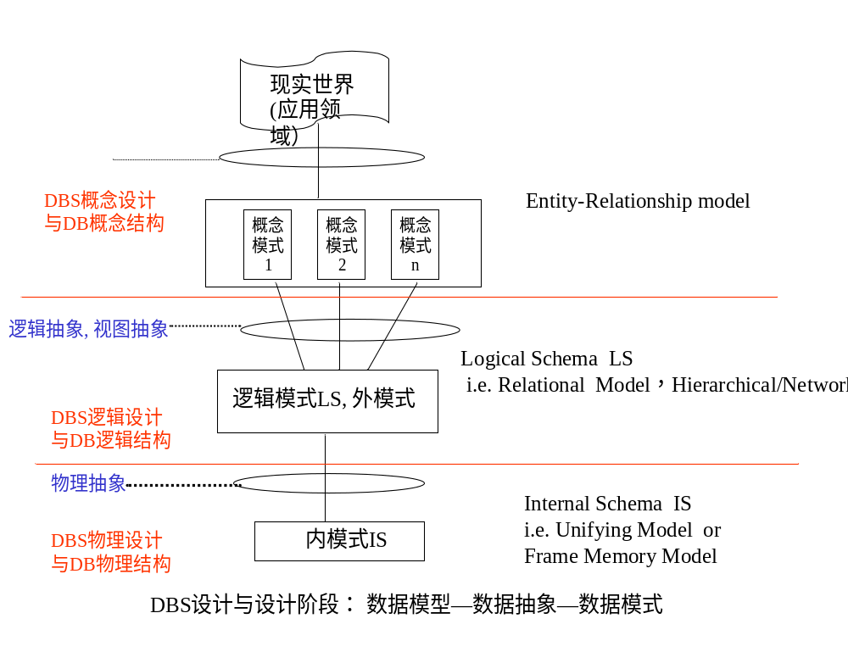

Slide 10
Overview of the Design Process (cont.)
数据库应用系统DBAS设计
  DB, DBMS, users, application programs
  refer to Fig. 7.0.2 电信网管系统示意图
DBAS设计
  refer to Fig. 7.0.3 DBAS 生命周期模型
  参照软件工程中软件开发瀑布模型原理，DBAS的生命周期由项目规划、需求分析、系统设计、实现与部署、运行管理与维护等5个基本活动组成
  根据DBAS的软件组成和各自功能，分为数据组织与存储设计、数据访问与处理设计、应用设计三条设计主线，分别用于设计数据库、数据库事务和应用程序

Slide 11
Overview of the Design Process (cont.)
  根据数据库系统三级模式结构，DBAS设计阶段分为概念设计、逻辑设计、物理设计三个步骤，每一步设计内容涵盖了三条设计主线

Slide 12
人机界面模块
配置管理
性能管理
故障管理
安全管理
计费管理
配置数据
访问事务
性能数据
访问事务
故障数据
访问事务
安全数据
访问事务
计费数据
访问事务
ODBC/JDBC 数据库接口
SQL SERVER/DB2数据库管理系统
数据库DB：
配置数据、性能数据、故障数据
、安全数据、计费数据
Fig. 7.0.2 电信网管系统示意图

Slide 13
项目规划
规划与分析
数据组织与存储
数据访问与处理
应用 程序
性能/存储/安全需求
需求分析
数据项分析
数据流与事务分析
程序需求分析
概念
设计
DB概念模式设计
系统总体设计
设计
逻辑
设计
DB逻辑模式设计
事务概要设计
程序概要设计
物理
设计
DB物理模式设计
事务详细设计
程序详细设计
构造原型(可选)
系统实现
系统实现
和部署
数据转换与加载
系统测试、部署与交付
运行维护
系统运行维护
Fig. 7.0.3 DBAS 生命周期模型

Slide 14
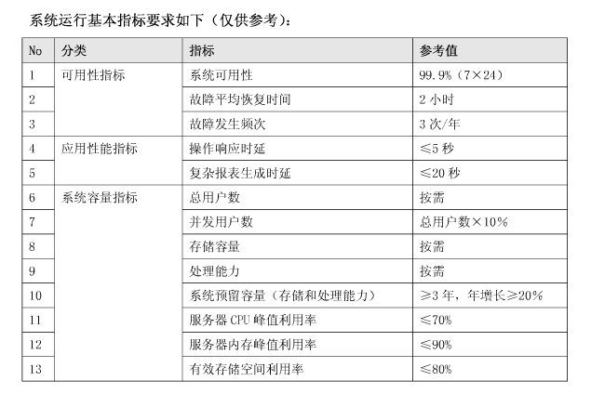
中国移动网管支撑系统规范CMOSS2.0——性能指标要求

Slide 15
7.2 The Entity-Relationship Model
The ER data mode was developed to facilitate database design by allowing specification of an enterprise schema that represents the overall logical structure of a database.
The ER model is very useful in mapping the meanings and interactions of real-world enterprises onto a conceptual schema. Because of this usefulness, many database-design tools draw on concepts from the ER model.
The ER data model employs three basic concepts:
  entity sets,
  relationship sets,
  attributes.
The ER model also has an associated diagrammatic representation, the ER diagram, which can express the overall logical structure of a database graphically.

Slide 16
7.2.1 Entity Sets（实体集，实体型）
An entity is an object that exists and is distinguishable from other objects.
  Example: specific person, company, event, plant
An entity set is a set of entities of the same type that share the same properties.
  Example: set of all persons, companies, trees, holidays
An entity is represented by a set of attributes; i.e., descriptive properties possessed by all members of an entity set.
  Example:
  instructor = (ID, name, street, city, salary )
  course= (course_id, title, credits)
A subset of the attributes form a primary key of the entity set; i.e., uniquely identifying each member of the set.

Slide 17
Entity Sets (cont.)
A entity consists of all values of its all attributes
  e.g. Fig 7.1
Entity-set
customer-set = {< ID-value, name-value, street - value,
city -value>
| ID-value ∈D₁, name-value ∈D₂,
street -value∈D₃, city -value D₄}
⊆ D₁ ╳ D₂ ╳ D₃ ╳ D₄

Slide 18

Entity Sets
instructor_ID instructor_name student-ID student_name

Slide 19
§7.2.2 Relationship Sets
A relationship is an association among several entities
  e.g. in Fig. 6.2
  Jone borrower L-17
  customer relationship loan
  entity set entity set
A Relationship set （联系集，联系型） is a set of relationship of the same type
  note: more than one relationship set among the same entity sets

Slide 20
§7.2.2 Relationship Sets
A relationship is an association among several entities
Example:
44553 (Peltier) advisor 22222 (Einstein)
student entity relationship set instructor entity
A relationship set is a mathematical relation among n ≥ 2 entities, each taken from entity sets
{(e₁, e₂, … e_{n}) | e₁ ∈ E₁, e₂ ∈ E₂, …, e_{n} ∈ E_{n}}
where (e₁, e₂, …, e_{n}) is a relationship
  Example:
  (44553,22222) ∈ advisor

Slide 21
Relationship Sets (cont.)
The entity sets E₁, E₂, …, E_{n} participate in relationship set R
A relationship instance in an E-R schema represents an association between the named entities in the real-world enterprise that is being modeled
  e.g. in Fig. 7.2, the relationship instance between Crick and the Tanaka

Slide 22

Relationship Set advisor
Fig.7.2

Slide 23

Relationship Sets (Cont.)
An attribute can also be associated with a relationship set.
For instance, the advisor relationship set between entity sets instructor and student may have the attribute date which tracks when the student started being associated with the advisor

Slide 24
Degree of a Relationship Set
binary relationship
  involve two entity sets (or degree two).
  most relationship sets in a database system are binary.
Relationships between more than two entity sets are rare. Most relationships are binary. (More on this later.)
  Example: students work on research projects under the guidance of an instructor.
  relationship proj_guide is a ternary relationship between instructor, student, and project

Slide 25
Relationship Sets (cont.)
∈⊇⊆
Role
  the functions that an entity plays in a relationship is called that entity’s role
teaching
听课者
讲授者
instructor
student

Slide 26
§7.2.3 Attributes
The domain or value set of the attribute
  the set of permitted values for the attribute
Attribute types:
  Simple and composite attributes.
  Single-valued and multivalued attributes
    Example: multivalued attribute: phone_numbers
  Derived attributes
    Can be computed from other attributes
    Example: age, given date_of_birth

Slide 27

Composite Attributes

Slide 28
Attributes (cont.)
Null value for a attribute means
  the attribute “ not applicable “ for the entity, not existing
  the value for the attribute exists, but is “unknown”

Slide 29
Redundant Attributes
Suppose we have entity sets:
  instructor, with attributes: ID, name, dept_name, salary
  department, with attributes: dept_name, building, budget
We model the fact that each instructor has an associated department using a relationship set inst_dept
The attribute dept_name appears in both entity sets. Since it is the primary key for the entity set department, it replicates information present in the relationship and is therefore redundant in the entity set instructor and needs to be removed.
BUT: when converting back to tables, in some cases the attribute gets reintroduced, as we will see later.

Slide 30
§7.3 Constraints
Semantic/constraints
  as integrity constraints in DBS, to maintain DBS consistency
Integrity constraints in E-R model, on E or R
  keys (§7.3.3)
  mapping cardinalities (§7.3.1)
  participation-constraints (§7.3.2)
  cardinality limits

Slide 31
7.3.1 Mapping Cardinalities
Mapping cardinalities
  semi-quantitatively expressing the number of entities to which another entity can be associated via a relationship set
For a binary relationship set R, the mapping cardinality must be one of the following types: Fig.7.5, Fig.7.6, from A to B
  one to one
  one to many
  many to one
  many to many

Slide 32

        注意many-to-one和one-to-many 定义和方向！
a₅
a₄
One to one
One to many
Note: some elements in A or B may not be mapped to any
elements in the other set
Fig. 7.5 Mapping cardinalities

Slide 33

        注意many-to-one和one-to-many 定义和方向！
b₄
Many to one
Many to many
Note: Some elements in A or B may not be mapped to any
elements in the other set
Fig. 7.6 Mapping cardinalities

Slide 34

Cardinality Constraints
We express cardinality constraints by drawing either a directed line (→), signifying “one,” or an undirected line (—), signifying “many,” between the relationship set and the entity set.
One-to-one relationship between an instructor and a student :
  A student is associated with at most one instructor via the relationship advisor
  A student is associated with at most one department via stud_dept

Slide 35
One-to-Many Relationship
one-to-many relationship between an instructor and a student
  an instructor is associated with several (including 0) students via advisor
  a student is associated with at most one instructor via advisor,

Slide 36
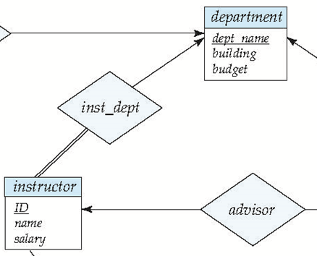
Many-to-One Relationships
In a many-to-one relationship between an instructor and a department,
  an instructor is associated with at most one department via inst_dept,
  and a department is associated with several (at least one) instructor via inst_dept

Slide 37
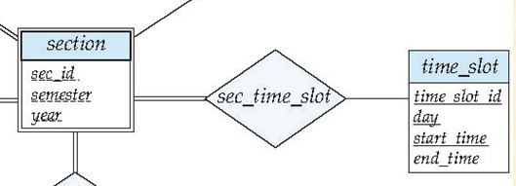
Many-to-Many Relationship
A section is associated with several (possibly 0) timeslots via sec_time_slot
A timeslot is associated with several (possibly 0) sections via sec_time_slot

Slide 38
7.3.3 Keys
Key is a set of attributes ( of a entity set or relationship set)
, in which there are one or more attributes
  the values of these attributes in one entity can be used to uniquely distinguish this entity from others , or
  the values of these attributes in one relationship are used to uniquely identify the relationship
Keys include
  superkey (超键), candidate key (候选键), primary key (主键)

Slide 39
Keys For Entity Sets
A super key of an entity set is a set of one or more attributes, whose values uniquely determine each entity in the entity set
  e.g. {instructor_id , instructor_name}
  the super key may contain extraneous attributes
    e.g instructor_name
A candidate key is the minimal super key
  non-redundant super key
    e.g. instructor-id is the candidate key of instructor

Slide 40
Keys For Entity Sets (cont.)
The primary key is a candidate key chosen by the database designer as the principal means of identifying entities within an entity set
  although several candidate keys may exist, one of the candidate keys is selected to be the primary key
  need to consider semantics of relationship set in selecting the primary key in case of more than one candidate key
构造关系表时，如果有多个候选键，最好选取数值型（int, float）候选键作为关系表主键，便于提高基于主键的查询速度
—不要选字符串型属性，如varchar、datetime
—e.g. studentname, instructorName

Slide 41
Keys For Relationship Sets
Keys for relationship sets R on entities E₁, E₂, …, E_{n}
  R = {(e₁, e₂, …, e_{n}) | e₁∈E₁,…, e_{n}∈E_{n}}
⊆E₁ ╳ E₂ ╳ … ╳ E_{n}
  , how to uniquely distinguish each relationship instances {(e₁, e₂, …, e_{n}) ?
  R is the combination of E₁, E₂, …, E_{n}, each E_{i} can be uniquely distinguished by primary_key(E_{i}), 1 ≤i ≤n, so the set of all attributes in primary_key(E₁), primary_key(E₂), …, primary_key(E_{n}) can be used to recognize (e₁, e₂, …, e_{n})

Slide 42
Keys For Relationship Sets (cont.)
The super_key for R
  primary_key(E₁) ∪ primary_key(E₂) ….∪ primary_key(E_{n})
  e.g. in Fig.7.3, (InstructorID, StudentIDr) is the super key of advisor
  note
    if the attribute names of primary-keys are not unique, the attributes with the same names should be renamed
The candidate keys for R
  minimal, non-redundant super keys

Slide 43
Keys For Relationship Sets (cont.)
The candidate keys or the primary key for a binary relationship set R among entity sets A and B can be decided as follows, in accordance with the mapping cardinality of R
  R is many-to-many,
  primary_key(R) = primary_key(A) ∪ primary_key(B)
  R is many-to-one from A to B, !!
  primary_key(R) = primary_key(A)
  R is one-to-many, !!
  primary_key(R) = primary_key(B)

Slide 44
Keys For Relationship Sets (cont.)
  R is one-to-one,
  primary_key(R) = primary_key(A)
  or: primary_key(R) = primary_key(B)

Slide 45
7.3.3 Participate Constraints
The participation of an entity E in a relationship R is total, if
  every entity in E participates in at least one relationship in R
  e.g. participation of instructor in inst_dept is total
    refer to Fig.7.15
    every instrctor must have a department associated to it via inst_dept
The participation of an entity E in a relationship R is partial, if
  some entities in E may not participate in any relationship in R
  e.g. participation of student in advisor is partial, because some students maybe have no advisors
    refer to Fig.7.15

Slide 46
Participate Constraints (cont.)
.
.
R
R
A
B
A
B
(a) partial participation
(b) total participation
Fig. 7.0.4 Total/participation participation

Slide 47

Cardinality Limits for Participation
(§7.5.2, pp277)
Cardinality limits (参与的基数界限) are used to express quantitative constraints on participation
E.g. instructor, student, advisor
  每个student最少有1个指导instructor，最多也只有1个指导instructor
  每个instructor最多可以指导多个student, 最少可以指导0个student
Fig.7.10
Instructor can advise 0 or more students. A student must have 1 advisor; cannot have multiple advisors
Notes:
什么是基数？--一个实体集中的实体与另外一个实体集中的多少个实体相联系

Slide 48
Cardinality Limits for Participation
/* 设联系R关联了entity sets A和B, 为定量地描述A参与R的 total/partial participation 和A中的entity与B中的entity的mapping cardinality, 引入实体参与联系的cardinality limits
A参与R的基数下界l_{A}和上界h_{A} , refer to Fig.7.0.5
  A中的每个实体a通过R关联了最少l_{A}个、最多h_{A}个B中实体b
    l_{A} : 对A中的每个实体a, B中至少有l_{A}个实体b通过R与其对应/关联
    h_{A}:对A中的每个实体a, B中至多有h_{A}个实体b通过R与其对应/关联

Slide 49
A
R
B
l_{A}….h_{A}
l_{B}….h_{B}
a₁
b₁
b₂
a₂
b₃
…
b_{j}
a₃
…
…
b_{n-1}
a_{m}
b_{n}
l_{A}=1, h_{A}=3
l_{B}=0, h_{B} =2
Fig.7.0.5 Illustration for cardinality limits

Slide 50
Cardinality Limits for Participation
(cont.)
Note
  A maximum value of * indicates no limit
  in some textbooks, < l_{A} ,h_{A} > is put at the side of the entity B
Cardinality limits vs total/partial participation
  A minimum value l_{A} =0: A is partial participation of R
  A minimum value l_{A} > 0: A is total participation of R, equivalent to double line

Slide 51
Cardinality Limits for Participation
(cont.)
Cardinality limits vs mapping cardinality
  设联系R关联了实体集A和B, 利用A的基数界限< l_{A} , h_{A}>中的h_{A} 、B的基数界限< l_{B} , h_{B}>中的h_{B} , 可推导出联系R的映射基约束
  < h_{B} , h_{A} > 表示了联系R的从A到B的映射基约束 !!!!
  e.g. in Fig.7.10 , considering mapping cardinality form instructor to student
    mapping cardinality form instructor to student an depends on <h_{student}, h_{instructor}>
    for student, h_{student}=1, for instructor, h_{instructor} =*
    so, <h_{student}, h_{instructor}> = <1, *>, and is one to many

Slide 52
Cardinality Limits for Participation
(cont.)
The associations between cardinality limits and the mapping cardinality are classified as follows, and illustrated by Fig.7.0.6

Slide 53
a₄
b₅
From A to B, one to one (1:1),
< l_{A} , h_{A} > = <1, 1>,
< l_{B} , h_{B} > = <0, 1>;
From A to B, one to many (1:2),
< l_{A} , h_{A} > = <0, 2>,
< l_{B} , h_{B} > = <1, 1>
Fig.7.0.6-1 Associations between cardinality
limits and mapping cardinality

Slide 54
Form A to B, many to one (2:1),
< l_{A} , h_{A} > = <1, 1>,
< l_{B} , h_{B} > = <1, 2>
Form A to B, many to many (2:2)
< l_{A} , h_{A} > = <1, 2>
< l_{B} , h_{B} > = <1, 2>

Slide 55
§7.5.6 Weak Entity Sets
An entity set that does not have a primary key is referred to as a weak entity set
  e.g. section(sec_id, semester, year) in Fig.7.14 in next slide, and Fig. 7.0.10
A weak entity set E₁ can only be distinguished through another (strong) entity set E₂, called identifying（标识）/owner（属主） entity set, which has association/ relationship R with E₁
  E₂ owns E₁ , E₁ must be related to E₂ via an instance of R, called the identifying relationship（标识性联系）.
  R is many-to-one ( or one-to-one) from the weak entity set E₁ to the identity set E₂

Slide 56

Weak Entity Sets (cont.)
  E₁ is of total participation in the relationship set R
  R is depicted using a double diamond
  weak entity set is depicted as double rectangles.
total
E₂
one
E₁
many
Fig.7.14 E-R diagram with a weak entity set

Slide 57
E₂:course
E₁:section/course-offering
(周1/1-2, Spring, 2017)
(#1, DBS, 3)
(周3/1-2, Spring, 2017)
(#2, Algorithm, 2)
(周3/1-2, Spring, 2017)
(周2/3-4, Autumn, 2016)
(#3, OS, 4)
(周4/1-2, Autumn, 2016)
one
many
Fig.7.0.10 A example of weak entity set
Notes:
Section：表示每门课程的一次开课

Slide 58
Weak Entity Sets (cont.)
The discriminator （分辨符）(or partial key) of a weak entity set is the set of attributes that distinguishes among all those entities in the weak entity set that depending on a particular strong entity
  e.g. sec_id, semester, year
  the discriminator of a weak entity set is underlined with a dashed line（虚线）
Notes:
例如：用sec_id, semester, year来标识每门课程的一次开课

Slide 59
Weak Entity Sets (cont.)
The primary key of a weak entity set is formed by the primary key of the strong entity set on which the weak entity set is existence dependent, plus the weak entity set’s discriminator
  primary key for weak entity set E₁
  = discriminator ∪ primary_key(E₂) .
  e.g. sec_id, semester, year, course_id
Weak entity set E₁ with several identifying entity sets E₂, E₃, .., E_{n}, primary key for weak entity set E₁ =
discriminator ∪ primary_key(E₂) ∪… primary_∪key(E_{n}) .

Slide 60
§7.5 E-R diagrams
Rectangles（矩形） represent entity sets
Diamonds（菱形） represent relationship sets
Lines link attributes to entity sets and entity sets to relationship sets.
Ellipses（椭圆） represent attributes
  double ellipses represent multivalued attributes
  Dashed（虚线） ellipses denote derived attributes（派生属性）
Underline indicates primary key attributes
Double rectangles represent weak entity sets

Slide 61

Relationship Sets with Attributes

Slide 62

Roles
Entity sets of a relationship need not be distinct
  Each occurrence of an entity set plays a “role” in the relationship
The labels “course_id” and “prereq_id” are called roles.

Slide 63
Cardinality Constraints
We express cardinality constraints by drawing either a directed line (→), signifying “one,” or an undirected line (—), signifying “many,” between the relationship set and the entity set.
One-to-Many Relationship

Slide 64

Total and Partial Participation
Total participation (indicated by double line): every entity in the entity set participates in at least one relationship in the relationship set
  participation of student in advisor relation is total
    every student must have an associated instructor
Partial participation: some entities may not participate in any relationship in the relationship set
  Example: participation of instructor in advisor is partial

Slide 65
Cardinality Limits
A line may have an associated minimum and maximum cardinality, shown in the form l..h, where l is the minimum and h the maximum cardinality
  A minimum value of 1 indicates total participation.
  A maximum value of 1 indicates that the entity participates in at most one relationship
  A maximum value of * indicates no limit.
Instructor can advise 0 or more students. A student must have 1 advisor; cannot have multiple advisors

Slide 66

Entity with Complex Attributes

Slide 67
Expressing Weak Entity Sets
In E-R diagrams, a weak entity set is depicted via a double rectangle.
We underline the discriminator of a weak entity set with a dashed line.
The relationship set connecting the weak entity set to the identifying strong entity set is depicted by a double diamond.
Primary key for section :
(course_id, sec_id, semester, year)

Slide 68
E-R diagrams (cont.)
标注规则！！！
  由联系发出的有向箭头指向one 所对应的实体，无向线段指向many端所对应的实体。
  只有在many-to-many的情况下，E-R图中联系与实体间的线段 全部是无向线段，其他三种情况下必出现有向线段

Slide 69

§7.7 E-R Design Issues
7.7.1 Use of entity sets vs. attributes
Mapping “thing/object” in real world into entity sets or attribute sets
  e.g. for instructor and phone objects in real world
    model 1. entity:
    instructor(ID, name, salary, phone-number)
    implying that employees have precisely one phone number each, unless phone-number is multivalued;
    how to represent the other properties of “phone” object ?
Fig.7.17 Alternatives for adding phone to the instructor entity set
Notes:
在数据库设计中，定义一组实体及他们的相互联系可能有多种不同的形式。
本节讨论数据库模式设计中的一些基本问题。
7.1 使用实体集还是属性

Slide 70
Fig.7.17 Alternatives for adding phone to the instructor entity set
    model 2. entity: instructor(ID, name, salary)
    phone(phone-number, location, …)
    relationship: inst-phone
Treating phone as an entity is more general, more information about phone can be modeled, e.g.
  Location
  plus multiple phone numbers

Slide 71
Entity Sets vs. Attributes (cont.)
Rule1. Not to use the primary-key of an entity set as an attributes of another entity set (to represent implicitly association between these two entity sets), it is better to use an relationship set to explicitly show this association
  e.g. for the entity student, do not use instructor.id as its attribute, instead of, representing association among student and instructor using relationship advisor

Slide 72
Entity Sets vs. Attributes (cont.)
Rule2. If E participate in R, not to designate the primary-key(E) as attributes of R, to avoid information redundancy
  for example, an ill modeling of advisor
inst_ID
student_ID
Fig.7.0.7 Anti-example:
Data redundancy in advisor
Notes:
不要将参与联系的实体集的主码作为联系集的属性，因为在联系集中已经隐含了这些主码属性。

Slide 73
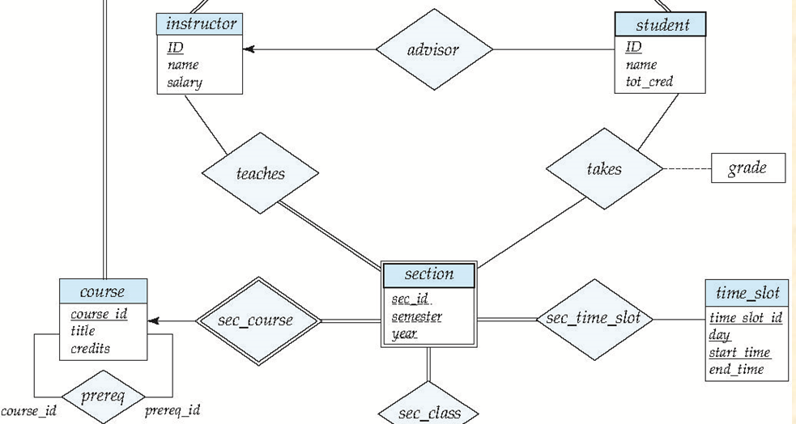
7.7.2 Use of Entity Set vs. Relationship Set
Rule3. Use the relationship set to describe the action occurring between entities
  e.g. students select courses
In Fig.7.15 the takes relationship is used to model the situation where a student takes a section of a course

Slide 74

Entities vs. Relationship sets
An alternative is to design a course-registration record, represented by a entity set named registration, for each course that each student takes
In Fig.7.18, more information can be associated with the entity set registration than the relationship set takes
Fig.7.18
Notes:
Registration：代表课程——注册记录的实体集
假设对于每个学生选的每门课有一个课程--注册记录。那么我们用一个registration实体集来描述课程—注册记录。这种方法可以适用于：
如果注册办公室通过课程—注册记录与其他额外信息相关联时，此时最好将其设置为一个实体。

Slide 75

7.7.3 Binary vs N-ary Relationship Sets
Rule4. Prefer to using the binary relationship set, and replace a non-binary relationship set by a number of binary relationship set if possible
  child-father-mother is replaced with
  child-father, child-mother and husband-wife

Slide 76
Binary vs N-ary Relationship Sets
Translating a non-binary relationship set into several binary relationship sets
  for 3-ary relationship set R = {(a_{i} , b_{i} , c_{i} ) | a_{i} ∈ A , b_{i} ∈ B，c_{i} ∈ C }among entity sets A, B , C, i.e. R ⊆ A ╳ B ╳ C, replace R by an entity set E = { e_{i} } and three binary relationship set R_{a}, R_{b}, R_{c}

Slide 77
C
C
A
R
B
R_{c}
Attr-R
A
R_{a}
E
R_{b}
B
Attr-R
e
(a)
(b)
Fig.7.0.8 Non-binary relationship set translating
Notes:
非二元联系转换为二元联系：
考虑一个抽象的三元联系集R，将实体集A, B, C联系起来。用实体集E来替代联系集R，并创建三个联系集Ra，Rb，Rc

Slide 78
Binary vs N-ary Relationship Sets
(cont.)
    E = { e_{i} } , | E |= | R |, i.e. each (a_{i} , b_{i} , c_{i} ) in R corresponds to one e_{i} in E, or E = { e_{i} }=R={(a_{i} , b_{i} , c_{i} ) }
    R_{a} = { (e_{i} , a_{i}) | e_{i} ∈E , a_{i} ∈ A }, relating E and A
    R_{b} = { (e_{i} , b_{i}) | e_{i} ∈E , b_{i} ∈ B } , relating E and B
    R_{c} = { (e_{i} , c_{i}) | e_{i} ∈E , c_{i} ∈ B }, relating E and C
    E has an identifying attribute e ( candidate key) to distinguish each e_{i} in E
    all attributes of R, i.e. attr-R, are assigned to E
  refer to Fig.7.0.8 (a) , (b)

Slide 79
Cardinality Constraints on Ternary Relationship
略
We allow at most one arrow out of a ternary (or greater degree) relationship to indicate a cardinality constraint
For exampe, an arrow from proj_guide to instructor indicates each student has at most one guide for a project
If there is more than one arrow, there are two ways of defining the meaning.
  For example, a ternary relationship R between A, B and C with arrows to B and C could mean
    1. Each A entity is associated with a unique entity from B and C or
    2. Each pair of entities from (A, B) is associated with a unique C entity, and each pair (A, C) is associated with a unique B
  Each alternative has been used in different formalisms
  To avoid confusion we outlaw more than one arrow

Slide 80
7.7.4 Placement of Relationship Attributes
The attributes of a relationship sets R may be associated with one of its participating entity sets
For the attribute attr-A in relationship set R between E₁ and E₂ (R ⊆ E₁ ╳ E₂ , if the cardinality of R is
  one-to-one : attr-A can be assigned as the attribute of either E₁ or E₂, rather than relationship set R
  one-to-many from E₁ to E₂ : attr-A can only be assigned as the attribute of the entity set E₂ (the many-side), rather than the relationship set R
Notes:
联系集属性的布局：
为简化起见，一对一或一对多的联系的属性可以放到一个参与该联系的实体集中，而不是放到联系集中。原因是：该属性可以由参与联系的某个实体集单独确定（ｍａｎｙ端实体）

Slide 81
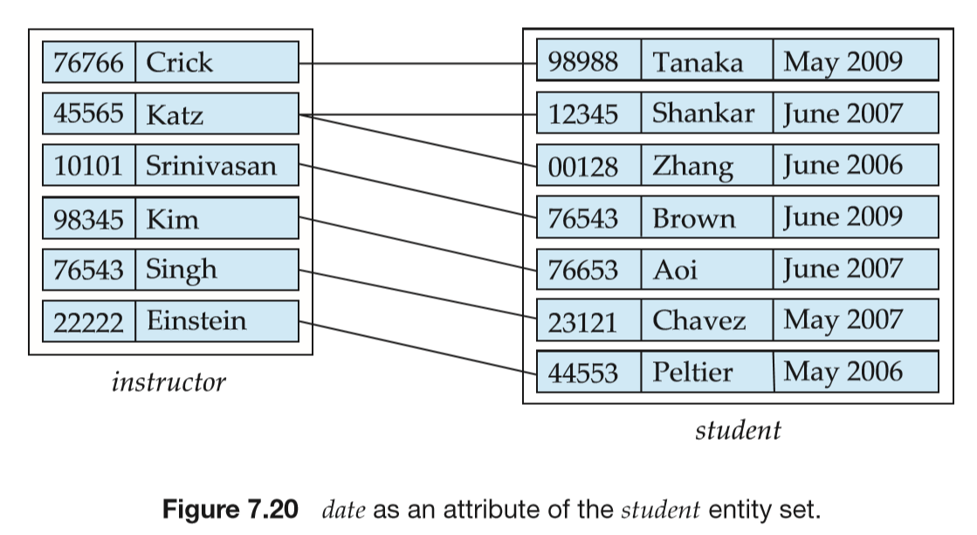
Placement of Relationship Attributes
    e.g. the relationship advisor in Fig.7.20 from instructor to student is one to many, the attribute date of advisor, which specifies when the instructor became the advisor of the student, can be made as an attribute of student, instead of the attribute of the relationship advisor

Slide 82

Placement of Relationship Attributes
    many-to-many: attr-A may only be assigned as the attribute of R, not of its participating entity sets E₁ or E₂
many
many
Fig.8.0.9 Access-date as attribute of the depositor relationship set
Notes:
多对多联系：当一个属性是由参与的实体集联合确定，而不是由单独的某个实体集确定时，该属性就必须放到多对多的联系集中。

Slide 83
§7.8 Extended E-R model
Object-oriented (OO) E-R
  specialization (特化，特殊化，例化）
  generalization (概括化，泛化，普遍化)
  attributes inheritance (属性继承）
7.8.1 Specialization
Specialization
  top-down design process of designating subgroups within an entity set, according to differences between entities in the entity set, each subgroup is distinctive from other entities in the set
Notes:
虽然基本的E－Ｒ概念已足以对大多数数据库特征建模，但数据库的某些方面可以通过对Ｅ－Ｒ模型进行扩展来更恰当地表述。
特化：一个实体集可以分为多个子集，子集中的实体在某些方面区别于实体集中的其他实体。根据实体集中多个可区分的特征进行特化。

Slide 84
Specialization (cont.)
Refer to Fig.7.21
These subgroupings become lower-level entity sets that may have attributes or may participate in relationships that do not apply to the higher-level entity set
In the E-R model, specialization is depicted by a triangle（三角形） component labeled ISA
  e.g. student “is a” person in Figure 7.21

Slide 85

R1
R2
Overlapping – employee and student
Disjoint – instructor and secretary
Fig. 7.21 Specialization and generalization
Notes:
在Ｅ－Ｒ图中，特化用从特化实体指向其高层实体的空心箭头来表示。称这种关系为ＩＳＡ关系，表示“ｉｓ ａ”
特征的Ｅ－Ｒ图的不同描述：
重叠特化（Overlapping）：一个实体集是否可能属于多个特化实体集
不相交特化（Disjoint）：一个实体集必须属于至多一个特化实体集。

Slide 86
7.8.2 Generalization
Generalization
  a bottom-up design process that combines a number of entity sets that share the same features into a higher-level entity set
  e.g. Fig.7.21
Specialization and generalization are simple inversions of each other; they are represented in an E-R diagram in the same way
  the terms specialization and generalization are used interchangeably
Notes:
特化：从初始实体集到一系列不同层次的实体子集的细化，－－－自顶向下的设计过程
概化：自底向上，多个实体集根据共同具有的特征综合成一个较高层的实体集。两个实体集之间的共性用概化来表达。
特化：强调同一实体集中不同实体间的差异
概化：强调多个实体集之间的共性特征和相似性

Slide 87
Superclass vs Subclass
The ISA relationship, or containment, is also referred to as superclass-subclass relationship
Superclass and subclass
  for the entity sets A and B, if A is the generalization of B, i.e. B is the specialization of A , then A is the superclass of B, and B is the subclass of A

Slide 88
7.8.3 Attribute Inheritance
A lower-level entity set inherits all the attributes and relationship participation of the higher-level entity set to which it is linked
  a higher-level entity’s attributes and relationship can apply to all of its lower-level entities

Slide 89
7.8.4 Constraints on Generation/Specialization
How to determine the membership of subclass/lower-level entities, i.e., how to divide superclass/higher-level entity set into lower-level entity sets
  condition-defined , attribute-defined generalization
    on the basis of explicit condition/predicate/attributes-value
    e.g. student_type= graduate, undergraduate
  user-defined
    e.g. all instructors are divided into four teams based on their assigned works, and each team becomes a subclass of the instructor entity set

Slide 90
Constraints on Specialization/Generalization
Completeness constraint -- specifies whether or not an entity in the higher-level entity set must belong to at least one of the lower-level entity sets within a generalization.
  total: an entity must belong to one of the lower-level entity sets, e.g. student generalization
  partial: an entity need not belong to one of the lower-level entity sets, e.g. .person specialization
Partial generalization is the default. We can specify total generalization in an ER diagram by adding the keyword total in the diagram and drawing a dashed line from the keyword to the corresponding hollow arrow-head to which it applies (for a total generalization), or to the set of hollow arrow-heads to which it applies (for an overlapping generalization).
The student generalization is total: All student entities must be either graduate or undergraduate. Because the higher-level entity set arrived at through generalization is generally composed of only those entities in the lower-level entity sets, the completeness constraint for a generalized higher-level entity set is usually total
Notes:
概化或特化的完整性约束：全部和部分

Slide 91
Constraints on Generation/Specialization (cont.)
    depicted in E-R diagram as
H-entity-set
H-entity-set
total
partial
L-entity-set-1
L-entity-set-2
L-entity-set-1
L-entity-set-2
Fig.7.0.12 Completeness constraints

Slide 92
6.7.4 Constraints on Generation/Specialization (cont.)
Constraints on whether or not a high-level entity may belong to more than one lower-level entity set within a single specialization, e.g. in Fig. 7.21
  disjoint
    a high-level entity can belong to only one lower-level entity set, i.e., L-entity-set-1 ∩ L-entity-set-2 = Φ
    E.g. instructor and secretary

Slide 93
Constraints on Generation/Specialization (cont.)
  overlapping
    a high-level entity can belong to more than one lower-level entity sets
    L-entity-set-1∩L-entity-set-2 ≠ Φ
    E.g. employee and student
  depicted in E-R diagram as
H-entity-set
H-entity-set
overlapping
disjoint
L-entity-set-1
L-entity-set-2
L-entity-set-1
L-entity-set-2
Fig.7.0.11 disjoint and overlapping in generalization

Slide 94

7.8.5 Aggregation
Aggregation
  to express relationship among relationships
  an abstraction (methodology) through which relationships are treated as high-level entities
Notes:
假设每位在项目中指导学生的教师需要记录月评估报告。我们将评估报告建模为一个实体evaluation。
记录一个evaluation对应的（student，project，instructor）的组合的方法是在四个实体集间建立一个四元联系eval_for。
上述方法的缺点：存在冗余，eval_for中的每个instructor, student, project 组合肯定也在proj_guide中。
因此建模上述情况的最好方法是：使用聚集。将三元联系proj_guide抽象成为一个实体集，然后和evaluation建立联系。

Slide 95

Aggregation (Cont.)

Slide 96
Examples
A database used in an ordering (订货，订购) system, which contains information about customers, products and orders
Two steps in DB design
  E-R modeling
  table reduction
For more details about this example, refer to Appendix D E-R Modeling and Table Reductions in Ordering Database

Slide 97
7.6 Reduction to Relational Schemas
Table = relation
Two steps in logical database design
  generating of the initial relational schema from the E-R diagram, as illustrated in§7.6
  relational schema normalization, in Chapter 8
Converting an E-R diagram to a table format is the basis for deriving a relational database design from an E-R diagram

Slide 98
Principles
An E-R diagram describing a database can be represented by a collection of relational tables
For each entity set and relationship set, there is a unique table which is assigned the name of the corresponding entity set or relationship set
Each table has a number of columns; the columns generally corresponding to entities’ or relationships’ attributes, and have unique names

Slide 99
7.6.1/3 Representation of Strong/Weak Entity Sets
A strong entity set reduces to a schema with the same attributes
student(ID, name, tot_cred)
A weak entity set becomes a table that includes a column for the primary key of the identifying strong entity set
section ( course_id, sec_id, sem, year )

Slide 100
Representation of Weak Entity Sets
For a weak entity set A(a₁, a₂,…, a_{m}), its owner entity set is B, primary-key (B) is b₁, b₂, …, b_{n}, then
  table A with one column for each attribute in {a₁, a₂,…, a_{m} }∪{b₁, b₂, …, b_{n} }
  the primary key of table A is the union of discriminator/partial key of weak entity set A and primary-key(B)

Slide 101
7.6.2 Representation of Entity Sets with Composite Attributes
Composite attributes（复合属性） are flattened out by creating a separate attribute for each component attribute
E.g. Given entity set instructor with composite attribute name with component attributes first_name, middle_initial and last_name, the schema corresponding to the entity set has three attributes:
  name_first_name, middle_initial and name_last_name
    Prefix omitted if there is no ambiguity (name_first_name could be first_name)

Slide 102
7.6.2 Representation of Entity Sets with Composite Attributes
Ignoring multivalued attributes, extended instructor schema is
  instructor(ID,
  first_name, middle_initial, last_name,
  street_number, street_name,
  apt_number, city, state, zip_code,
  date_of_birth)

Slide 103
Representation of Entity Sets with Multivalued Attributes
A multivalued attribute M of an entity E is represented by a separate schema EM
Schema EM has attributes corresponding to the primary key of E and an attribute corresponding to multivalued attribute M
Example: Multivalued attribute phone_number of instructor is represented by a schema:
inst_phone= ( ID, phone_number)
Each value of the multivalued attribute maps to a separate tuple of the relation on schema EM
  For example, an instructor entity with primary key 22222 and phone numbers 456-7890 and 123-4567 maps to two tuples:
  (22222, 456-7890) and (22222, 123-4567)

Slide 104
Example
For entity set customer(c-id, c-name, d-names, street, city), each entity customer may have several dependents, so d-names (i.e., dependent-name) is a multivalued attribute
c-id | c-name | d-names | street | city
321-12-2 | John | {Hayes, Adams} | North | Rye
322-10-4 | Smith | {Mary, Elice} | Spring | Princeton
Fig.6.0.18 Entity set customer with multivalued attribute

Slide 105
  the entity set customer is reduced into two tables
    c-table, which has no multivalued attribute d-names
    d-table, which has primary key {c-id, d-names}, and is as follows
c-id | c-name | street | city
321-12-2 | John | North | Rye
322-10-4 | Smith | Spring | Princeton

Slide 106
Reduction of Multivalued Attributes (cont.)
c-id | d-names
321-12-2 | Hayes
321-12-2 | Adams
322-10-4 | Mary
322-10-4 | Elice

Slide 107
7.6.4 Representation of Relationship Sets
Reduction of a relationship set into tables are strongly dependent on the mapping cardinality constraint and total/partial constraints related to this relationship set
A many-to-many relationship set is represented as a table with columns for the primary keys of the two participating entity sets, and any descriptive attributes of the relationship set

Slide 108
Example
instructor(ID, name, salary)
student(ID, name, tot_cred)
advisor(instrctor.ID, student.ID)
Fig.8.0.14 Reduced advisor table

Slide 109
Many-to-many
For relationship set R between entity set A and B, primary-key(A)∪primary-key(B) = {a₁, a₂,…, a_{m}}, descriptive attributes of R are b₁, b₂, …, b_{n}, then R can be reduced to
  table R with one column for each attribute in {a₁, a₂,…, a_{m} }∪{b₁, b₂, …, b_{n} }

Slide 110
Many-to-one/One-to-many
Many-to-one and one-to-many relationship sets that are total on the many-side can be represented by adding an extra attribute to the “many” side, containing the primary key of the “one” side
For a relationship sets R, which satisfies that (refer to Fig.7.0.15)
  many-to-one mapping from entity set A to B, and
  the many-side entity set A totally participates in R
  , then R should not be represented as an independent table, it can be reduced to the table A from entity set A, by
    adding the primary key of B into table A
    adding descriptive attributes of R into table A
For a one-to-many relationship sets R from A to B, the similar reduction can be conducted on the basis of table B.
Notes:
为什么不把联系加在one端？--主要是为了避免信息冗余，因为是一对多的关系，必然一个元组对应多个另一个关系的主码，产生大量冗余

Slide 111
A
R
B
r₁(a₁, b₁)
r₂(a₂, b₁)
b₁
b₂
b3
a₁
a₂
a₃
a₄
a₅
r₃(a₃, b₂)
r₄(a₄, b₂)
r₅(a₅, b₂)
total
partial
many
one
Fig. 7.0.15 A many-to-one relationship set R

Slide 112

Example
Instead of creating a schema for relationship set inst_dept, add an attribute dept_name to the schema arising from instructor
  instructor( ID, name, salary, dept_name)
  department(dept_name, building, budget)
foreign key referencing constraint between
instructor and department
one
total
many
Fig.6.0.16 E-R diagram

Slide 113
Many-to-one Relationship Sets
with partial participation
The relationship is reduced to a independent table
A(u₁, u₂, u₃)
R
B (v₁, v₂, …)
r₁{a₁, b₁}
r₂{a₂, b₁}
b₁
b₂
b3
a₁
a₂
a₃
a₄
a₅
r₃{a₃, b₂}
r₄{a₄, b₂}
r₅{a₅, b₃}
a₆
?
partial
partial
many
one
Fig.6.0.17-1 Why not reducing R into table A

Slide 114
在数据库系统中，尽可能避免关系表中的空值null
—用default value 代替null
If R={r₁, r₂, r₃, r₄, r₅} is reduced to table
A’(u₁, u₂, u₃ , v₁) ={a₁’, a₂’, a₃’, a₄’, a₅’, a₆’},
  a₆ does not participate in R
  thus, a₆’ will has null on the attribute v₁
Table A’ ={a₁’, a₂’, a₃’, a₄’, a₅’, a₆’}
u₁ | u₂ | u₃ | v₁
* | * | * | *
* | * | * | *
* | * | * | *
* | * | * | *
* | * | * | *
* | * | * | null
a₁’
a₂’
a₃’
a₄’
a₅’
a₆’
r₁{a₁, b₁}
r₂{a₂, b₁}
r₃{a₃, b₂}
r₄{a₄, b₂}
r₅{a₅, b₃}
Fig.7.0.17-2 Why not reducing R into table A

Slide 115
Reduction of one-to-one Relationship Sets
One-to-one relationship can be viewed as a specialized instance of many-to-one relationship.
For one-to-one relationship set R relating entity set A and B, assuming one of two entity sets, i.e. A is totally participating R, then
  R is represented by adding B’s primary key to the table A of entity set A
  R’s descriptive attributes are also added to table A

Slide 116
Reduction of Specialization/Generalization
Method 1:
  Form a schema for the higher-level entity
  Form a schema for each lower-level entity set, include primary key of higher-level entity set and local attributes
  Drawback: getting information about, an employee requires accessing two relations, the one corresponding to the low-level schema and the one corresponding to the high-level schema
schema attributes
person ID, name, street, city
student ID, tot_cred
employee ID, salary

Slide 117
Representing Specialization via Schemas
Method 2:
  Form a schema for each entity set with all local and inherited attributes
  Drawback: name, street and city may be stored redundantly for people who are both students and employees
schema attributes
person ID, name, street, city
student ID, name, street, city, tot_cred
employee ID, name, street, city, salary

Slide 118
Method 1:
  for the three entity sets, creating three tables
d₁, d₂, …,d_{j}
c₁, c₂, …, c_{k}
H-entity-set
a₁, a₂, …,a_{m}
overlapping OR partial
ISA
L-entity-set-1
L-entity-set-2
b₁,b₂, …,b_{n}
Fig.8.0.19 E-R diagram with generalization /specialization

Slide 119
Representation of Generalization (cont.)
  T₁ (c₁, c₂, …, c_{k}, d₁, d₂, …,d_{j}) for H-entity-set
  T₂ (a₁, a₂, …,a_{m}, c₁, c₂, …, c_{k} ) for L-entity-set1
  T₃ (b₁,b₂, …,b_{n} , c₁, c₂, …, c_{k} ) for L-entity-set2
  note:
    c₁, c₂, …, c_{k} are primary attributes of H-entity-set
    c₁, c₂, …, c_{k} are the foreign key from T₂ and T₃ referencing T₁, representing the association between H-entity-set and L-entity-set1/ L-entity-set2.

Slide 120
Representation of Generalization (cont.)
Method 2. if generalization is disjoint and complete, creating two tables
d₁, d₂, …,d_{j}
c₁, c₂, …, c_{k}
H-entity-set
a₁, a₂, …,a_{m}
disjoint AND complete
ISA
L-entity-set-1
L-entity-set-2
b₁,b₂, …,b_{n}
Fig.8.0.20 E-R diagram with generalization /specialization (II)

Slide 121
Representation of Generalization (cont.)
  T₂ (a₁, a₂, …,a_{m}, c₁, c₂, …, c_{k}, d₁, d₂, …,d_{j} ) for L-entity-set1
  T₃ (b₁,b₂, …,b_{n}, c₁, c₂, …, c_{k}, d₁, d₂, …,d_{j}) for L-entity-set2
  a₁, a₂, …,a_{m}, are attributes of L-entity-set1, b₁,b₂, …,b_{n} are attributes of L-entity-set2, and c₁, c₂, …, c_{k}, d₁, d₂, …,d_{j} are all attributes of H-entity-set
  replacing high-level entity set H-entity-set with T2 and T₃ of lower-level entity sets.

Slide 122

7.9 Symbols Used in E-R Notation
略

Slide 123
Symbols Used in E-R Notation (Cont.)

Slide 124

Alternative ER Notations
Chen, IDE1FX, …

Slide 125
Alternative ER Notations
Chen IDE1FX (Crows feet notation)

Slide 126
UML
UML: Unified Modeling Language
UML has many components to graphically model different aspects of an entire software system
UML Class Diagrams correspond to E-R Diagram, but several differences.
Notes:
E-R图对软件系统的数据表示部分建模。
UML：对整个软件系统进行建模，包括用户界面建模，系统功能模块建模和交互等。包括类图、用况图、活动图和实现图。

Slide 127

ER vs. UML Class Diagrams
*Note reversal of position in cardinality constraint depiction

Slide 128
ER vs. UML Class Diagrams
ER Diagram Notation
Equivalent in UML
*Generalization can use merged or separate arrows independent
of disjoint/overlapping

Slide 129
UML Class Diagrams (Cont.)
Binary relationship sets are represented in UML by just drawing a line connecting the entity sets. The relationship set name is written adjacent to the line.
The role played by an entity set in a relationship set may also be specified by writing the role name on the line, adjacent to the entity set.
The relationship set name may alternatively be written in a box, along with attributes of the relationship set, and the box is connected, using a dotted line, to the line depicting the relationship set.

Slide 130
注意
画E-R图时，mapping cardinality、participation和cardinality limits约束的画法必须统一，不允许混用
  反例
1..*
m
1

Slide 131
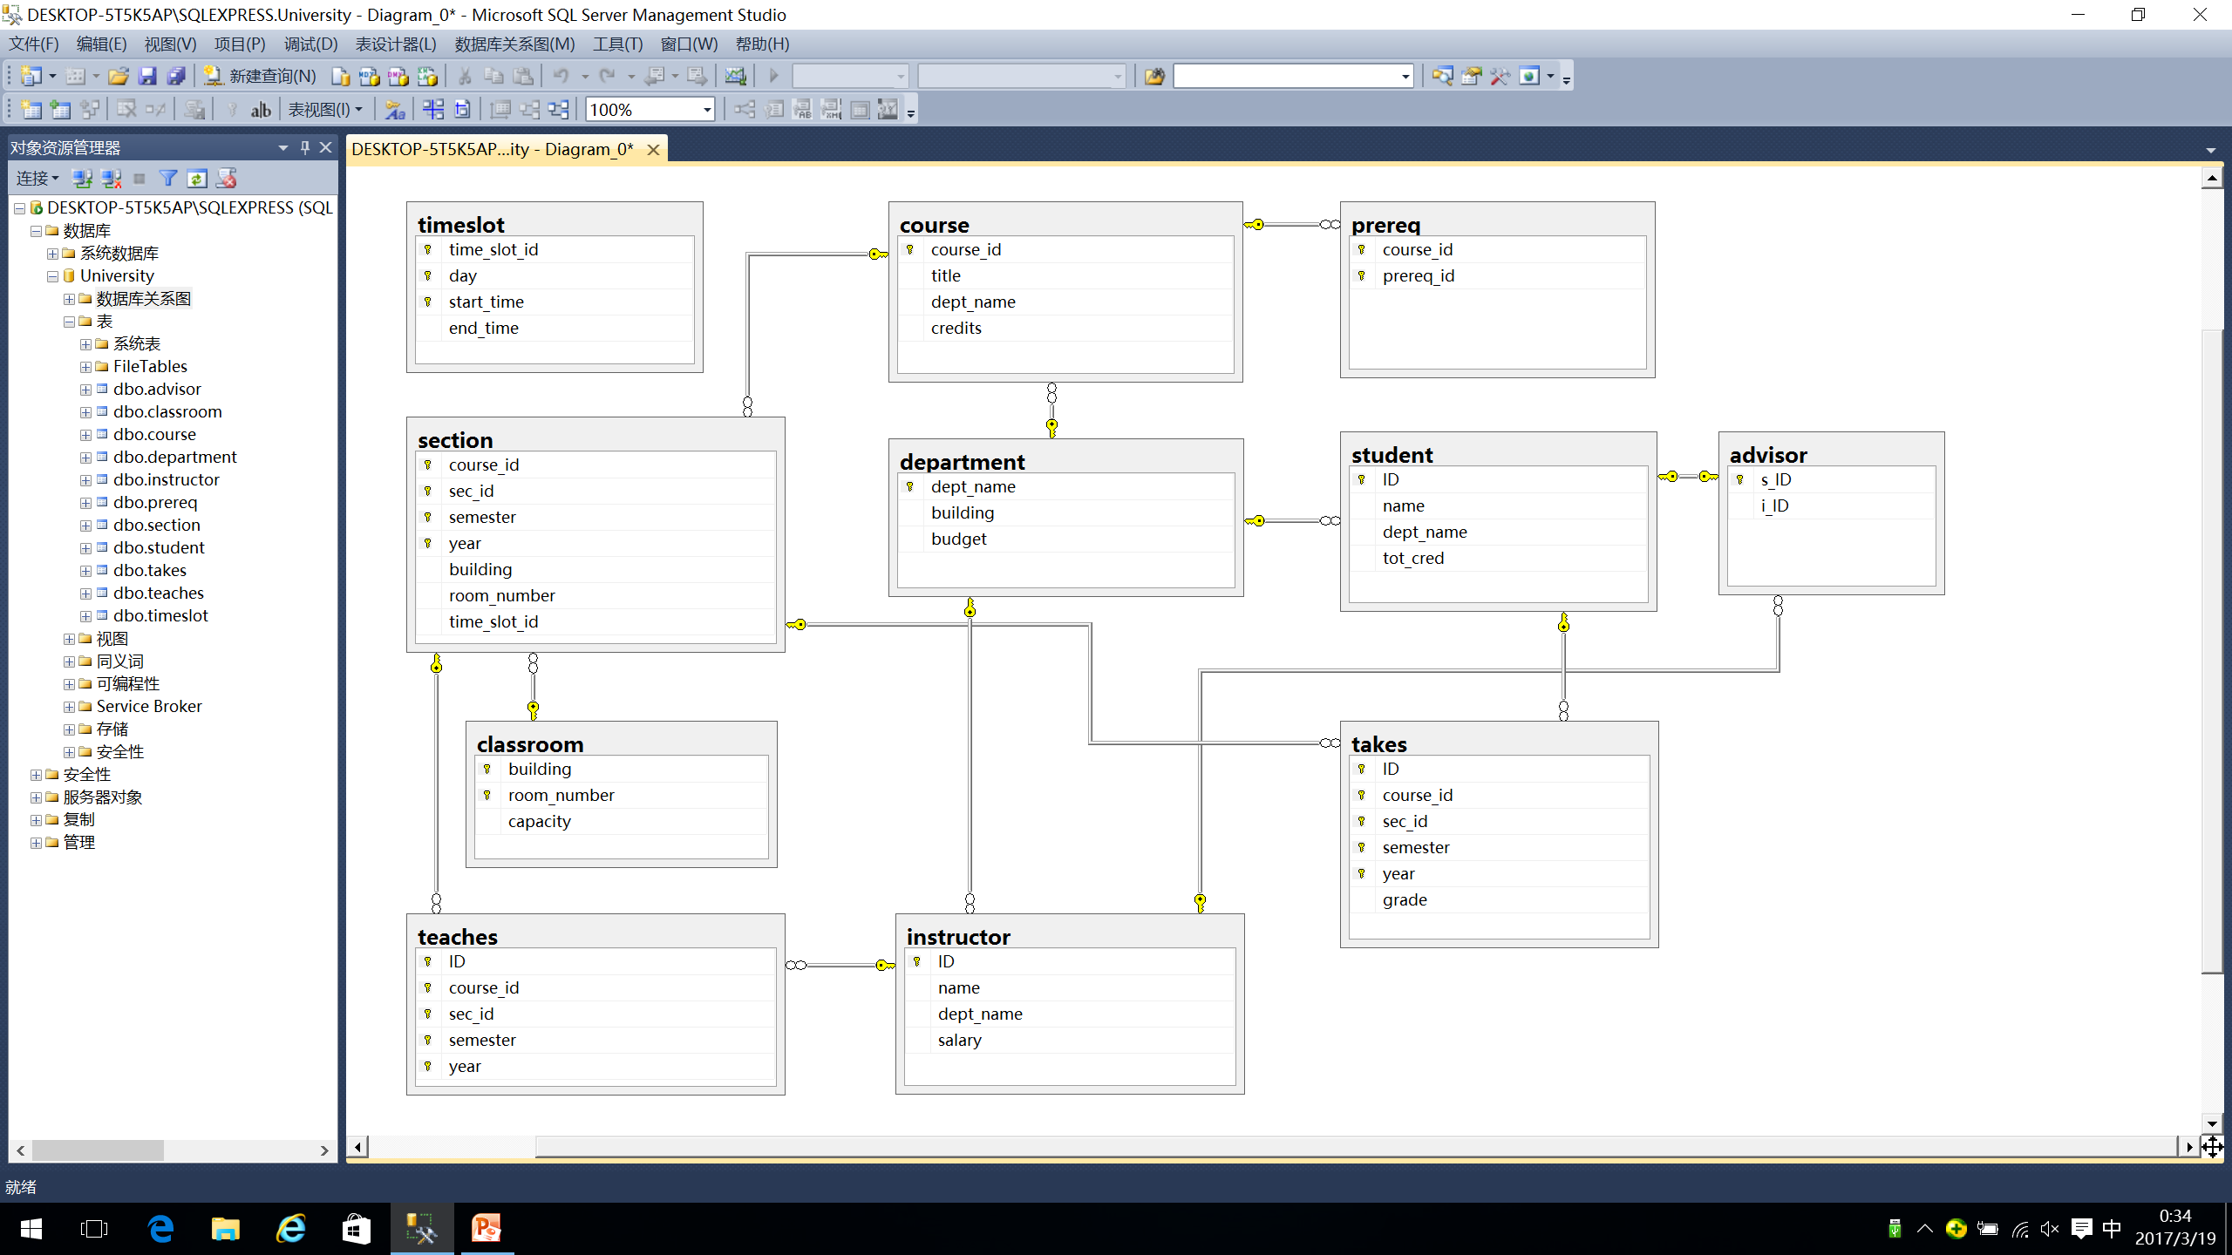
Schema Diagram in Relational Model
SQL Server生成的模式图
表示关系模式及其相互间的外键关联关系，不是E-R图！！

Slide 132
Excises
1. 将教材中的习题7.20中的E-R图（图7-29）转换为关系模式。
2. 将下页PPT中的数据需求用E-R图进行描述。

Slide 133
Consider the following information about the pharmacies, patients and drugs:
(1) Patients are identified by an SSN, and their names, addresses, and ages must be recorded.
(2) Doctors are identified by an SSN. For each doctor, the name, specialty, and years of experience must be recorded.
(3) Each pharmaceutical company (制药公司) is identified by name and has a phone number.
(4) For each drug, the trade name and formula（成份）must be recorded. Each drug is produced by a given pharmaceutical company, and the trade name identifies a drug uniquely from among the products of that company.
(5) Each pharmacy(药房) has a name, address, and phone number. Each pharmacy is identified by ID.
(6) Every patient has a primary doctor. Every doctor has at least one patient.
(7) Each pharmacy sells several drugs and has a price for each. A drug could be sold at several pharmacies, and the price could vary from one pharmacy to another.
(8) Doctors prescribe drugs for patients. A doctor could prescribe one or more drugs for several patients, and a patient could obtain prescriptions from several doctors. Each prescription has a date and a quantity associated with it.
(9) Pharmaceutical companies have long term contracts with pharmacies. A pharmaceutical company can contract with several pharmacies, and a pharmacy can contract with several pharmaceutical companies. For each contract, you have to store a start date, an end date.

Slide 134
Excises
6.2, 6.6：画出E-R图并转换成关系模式

Slide 135
Appendix D E-R Modeling and
Table Reductions in Ordering Database
A database used in an ordering (订货/订购) system contains information about customers, products and orders. The following information is to be included:
  for each customer
    customer-number, ship-to-addresses (several per customer), name, balance, discount
  for each order（订单）
    order number, customer number, ship-to address (one per order), date of ordering (including year, month, and day), products (several kinds per order), and quantity ordered of each product

Slide 136
Appendix D E-R Modeling and
Table Reductions in Ordering Database (cont.)
  for each kind of product
    product-number, name, manufacturing-plant, quantity on hand
  Entity sets: Customer, Order, Product and their attributes.
  In Customer, ship-to addresses is a multi-valued attribute, but in Order, ship-to addresses is a single-valued attribute. In Order, date is a composite attribute
Some constraints(i.e., integrity constraints) about this ordering system are as follows
  a customer may make one or more orders, and some customers may make no orders
  each order must be for one (and only one) customer

Slide 137
Appendix D E-R Modeling and
Table Reductions in Ordering Database (cont.)
  relationship sets
    relationship set make between Customer and Order
    Customer partly participate make, and Order totally participate make
    in relationship set make, mapping cardinality from Customer to Order is one-to-many
  each order must contain at least one kind of products
  a kind of product may appear in several orders, but some kinds of products may not be ordered by any customers
  relationship set
    relationship set contain between Order and Product, and

Slide 138
Appendix D E-R Modeling and
Table Reductions in Ordering Database (cont.)
    descriptive attributes quantity of ordered for relationship set contain
    Product partly participate contain, and Order totally participate contain
    In relationship set contain, mapping cardinality from Order to Product is many-to-many
E-R diagram of the ordering DB is shown in Fig. C.1

Slide 139
C-name
O-number
P-number
C-number
quantity
of ordered
balance
P-name
Customer
make
Order
contain
Product
address
address
date
quantity
on hand
discount
plant
day
year
month
Fig. C.1. E-R diagram of the ordering DB is shown in

Slide 140
Appendix D E-R Modeling and
Table Reductions in Ordering Database (cont.)
The E-R diagram in Fig. C.1 is then reduced to some relational tables, according to the methodologies mentioned in §6.9
For entity set Customer and its multi-valued attribute ship-to addresses, there are two tables
  customer=(C-number, c-name, discount, balance)
  ship-to-addresses = (C-number, ship-to-addresses)
For entity set Order and its composite attribute date which should be decomposed , there is a table
  order1=(O-number, ship-to-address, year, month, day)

Slide 141
Appendix D E-R Modeling and
Table Reductions in Ordering Database (cont.)
For entity set Product, there is a table
  product=(P-number, p-name, plant, quantity-on-hand)
For relationship set make, there are no descriptive attributes, mapping cardinality from Customer to Order is one-to-many, and Order totally participate make. So, make should not be reduced into a separate table, and can be represented by adding the primary key C-number of Customer , that is C-number into the table order
  order2=(O-number, C-number, ship-to-address, year, month, day)
  note: the primary key C-number is already in the table order

Slide 142
Appendix D E-R Modeling and
Table Reductions in Ordering Database (cont.)
Supposing mapping cardinality from Order to Product is many-to-many, for relationship set contain, there is a descriptive attribute quantity of ordered, contain should be represented as a separate table with columns for the primary keys of the two participating entity and descriptive attribute
  contain=(O-number, P-number, quantity of ordered) )
Supposing mapping cardinality from Order to Product is one-to-many, because Product at the many side only partly participate relationship set contain , contain should also be represented as a separate table
  contain=(O-number, P-number, quantity of ordered) )

Slide 143
Appendix D E-R Modeling and
Table Reductions in Ordering Database (cont.)
So, the E-R diagram in Fig. C.1 can be reduced into the following five tables
  customer=(C-number, c-name, discount, balance)
  ship-to-addresses = (C-number, ship-to-addresses)
  order=(O-number, C-number, ship-to-address, year, month, day)
  product=(P-number, p-name, plant, quantity-on-hand)
  contain=(O-number, P-number, quantity of ordered) )

Slide 144
Appendix E Example
Convert the following E-R diagram to the proper relation schemas and identify the primary key of each relation

Slide 145
c1
b4
a1
b1
a3
E1
R1
E2
b2
a2
b3
c2
R2
ISA
partial
E5
E3
E4
g2
g1
c3
c4
c5

Slide 146
Appendix E Example (cont. )
E1(a1, a3, g1), E12(a1, a2)
E2(b1, b3, b4)
R1(a1, b1, c1), R12(a1, b1, c2)
E3(b1, c3, c4) , E4(b1, c5)
E5(g1, g2)

Slide 147
c1
名
a1
学号
a3
E1
R1
学生
姓名
a2
姓
c2
R2
ISA
partial
E5
计算机
学生
信通院
学生
g2
g1
OS分数
DBS分数
通信原理分数

Slide 148
Have a break

