Slide 1
JHU School of Professional Studies (SPSBE)
Matrix SMS Letters
Notes:
Introduction to Best Practices for Letter Implementation
SPSBE went first in the JHU SMS Implementation
SPSBE’s approach is the most “traditional”
Had as many as 80 letters overall, but really more like 30 in production now

Slide 2
Letter Entity Naming Conventions
CommGroupRule
COMM GROUP NAME
ltrRulLetterRule
LETTER NAME LETTER
JHU_SPSBE_SMS_vwViewName
Notes:
Evolution to one-to-one relationship between entities
Notes.xls

Slide 3
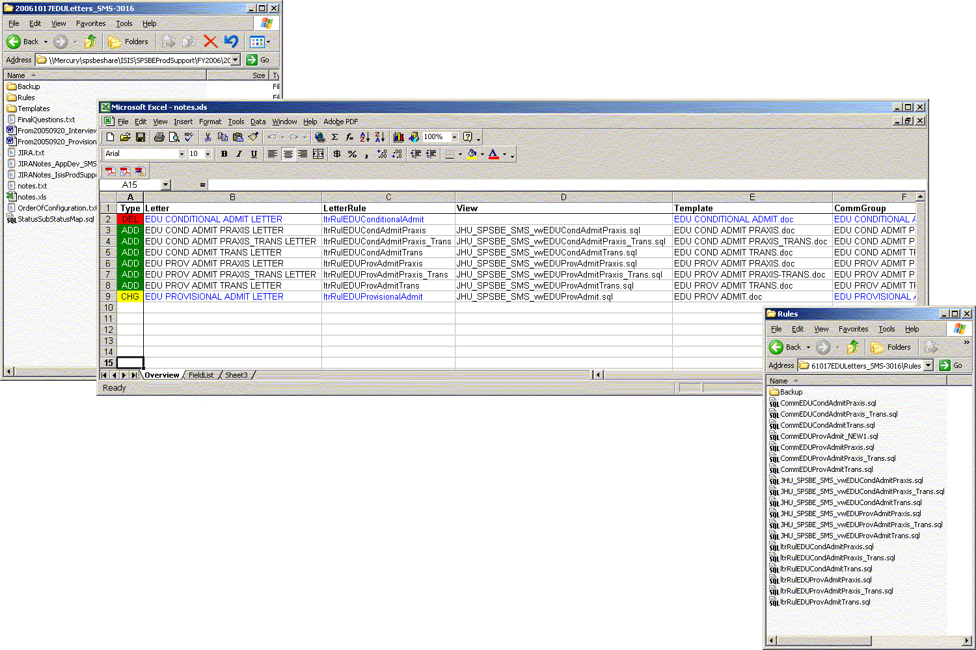
Notes.xls

Slide 4
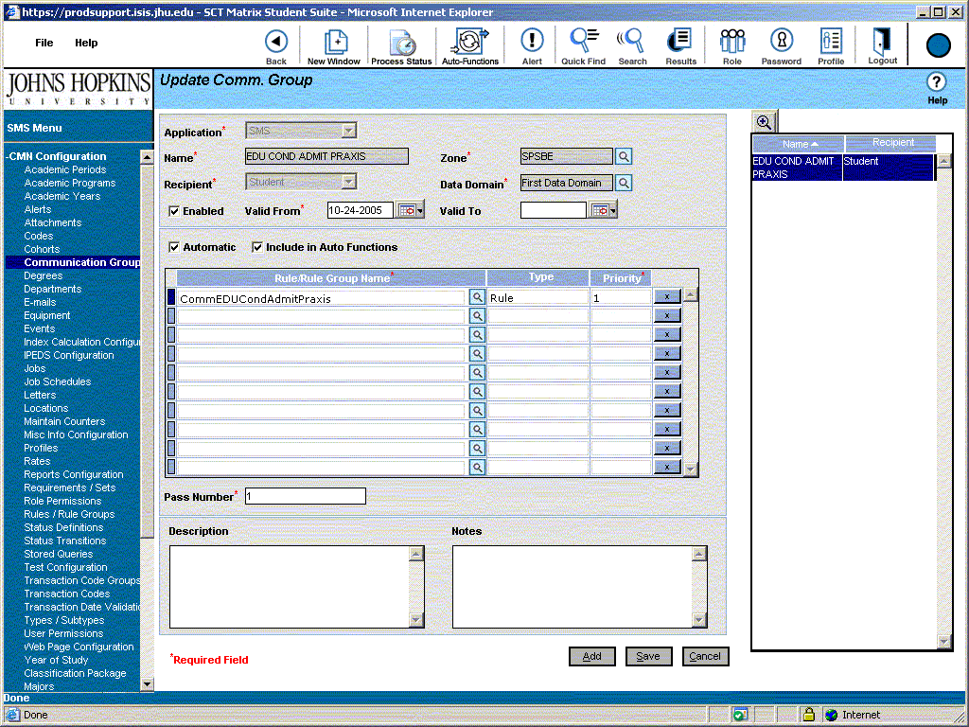
COMM GROUP NAME

Slide 5
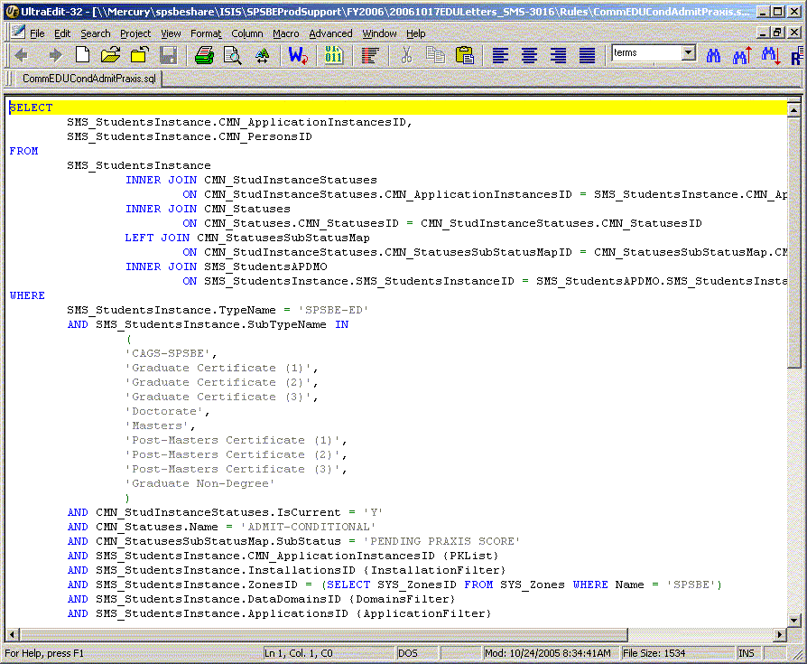
CommGroupRule

Slide 6
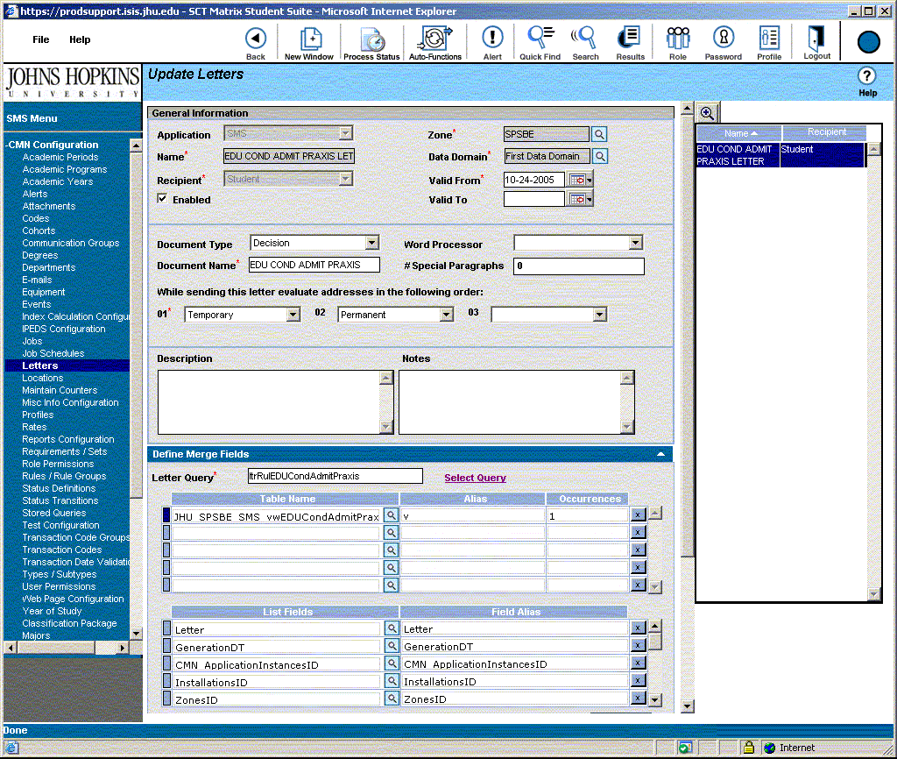
LETTER NAME LETTER

Slide 7
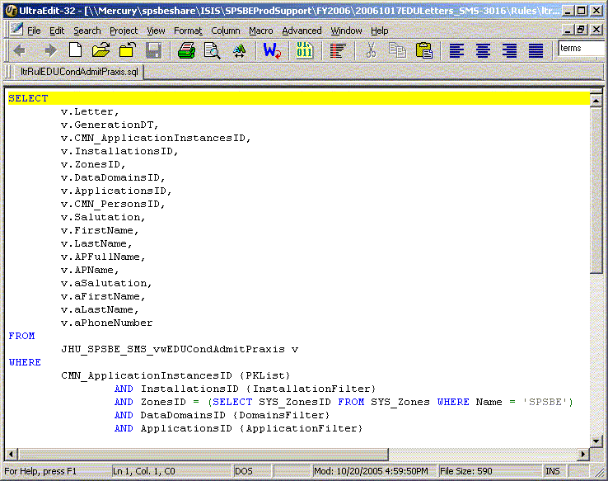
ltrRulLetterRule

Slide 8
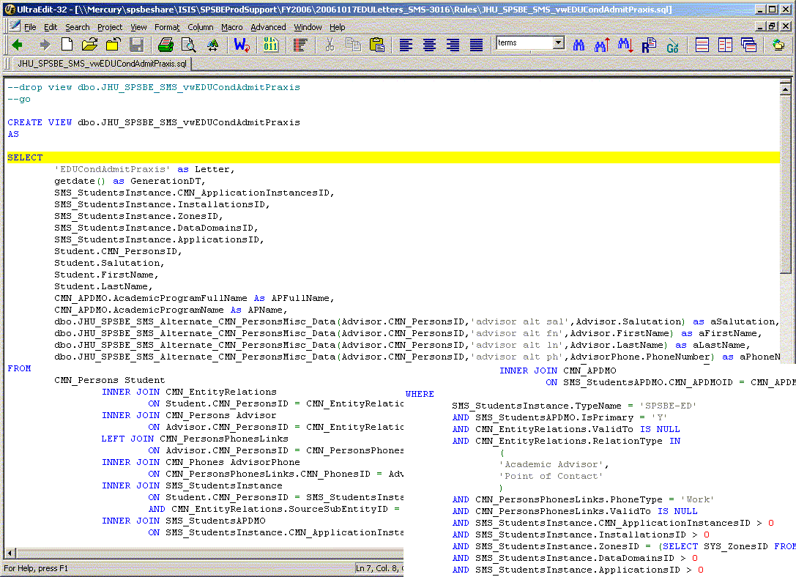
JHU_SPSBE_SMS_vwViewName

Slide 9
View Advantages
Closer to ANSI SQL (T-SQL)
  Comments
  More flexibility in aliasing
  UDFs and Case Statements
Performance
???
Abstraction of view plays into letter “Error Reporting”

Slide 10
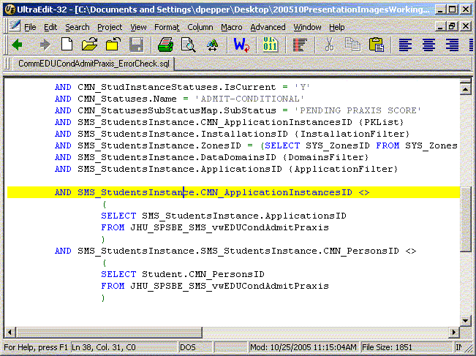
Alternate Letter: Error Checking
CommGroupRule_ErrorCheck

Slide 11
Obstacles and Dead Ends
SPSBE Auto-Merge Tool Shelved
Users weren’t consistently able to use SMS letters
Maintenance Proved as hard as implementation
Notes:
In the end it has been a process of slow evolution rather than a development model

Slide 12
Alternative Approaches
JHU Nursing Mail-Merge against Excel Approach (Updated by MS Query)
JHU ASEN PHP Auto-Merge Online Approach
JHSPH Crystal Reports Enterprise Approach

