Slide 1
Syntax Analysis 1

Slide 2
Introduction
The purpose of syntax analysis is group the tokens together in a structure called the parse tree/syntax tree.
A parse tree can be generated for an input text that adheres to the grammar of the programming language.
A input text that does not adhere to the grammar is said to contain syntax errors
  The parsing process should report the syntax errors for such a text
In producing parsers, a notation suitable for human manipulation is transformed into a form suitable for machine execution.
The notation used that is suitable for human manipulation is context free grammars

Slide 3
Context Free Grammars (CFG)
Context free grammars can be used to describe a language.
  That is it defines the set of strings that belong to the language
A context free grammar also defines a structure over the strings in the language
A language is defined over some alphabet for example, the set of tokens generated by a lexer
  The symbols in the alphabet are called terminals
A CFG defines several sets of strings .
  Each set is denoted by a name which is called a nonterminal

Slide 4
Context Free Grammars (CFG)
The set of nonterminals is disjoint from the set of terminals.
One of the nonterminals are chosen to denote the language described by the grammar.
  This is called the start symbol of the grammar.
The sets are described by a number of productions.
Each production describes some of the possible strings that are contained in the set denoted by a nonterminal.

Slide 5
Context Free Grammars (CFG)
The set of nonterminals is disjoint from the set of terminals.
One of the nonterminals are chosen to denote the language described by the grammar.
  This is called the start symbol of the grammar.
The sets are described by a number of productions.
Each production describes some of the possible strings that are contained in the set denoted by a nonterminal.
A production has the form
  N→X₁…X_{n}
  Where N is a nonterminal and X₁…X_{n} are symbols either terminal or nonterminal

Slide 6
Context Free Grammars (CFG)
The intended meaning of this notation is to say that the set denoted by N contains strings that are obtained by concatenating strings from the sets denoted by X₁…X_{n}.
Example Grammar
  A→a
  A→aA
    This is equivalent to the regular expression a⁺
  A1→
  A1→aA
    This is equivalent to the regular expression a*.

Slide 7
Context Free Grammars (CFG)
Empty productions have an empty right hand side. Or have a ε symbol on the right hand side
Some languages that cannot be describe by regular expression can be described by context free grammars e.g.
  a^{n}b^{n} n≥0 cannot be describe by a regular expression
  It can however be describe by a CFG as
    S→ε
    S→aSb

Slide 8
Context Free Grammars (CFG)
When several nonterminals are used for the grammar, we need to specify which of these is the start symbol e.g.
  T→R
  T→aTa
  R→b
  R→bR
    T is start symbol
    The grammar denotes strings that a numbers of as followed by one of more bs then followed by the same number of as
  Short hand notation
    T→R | aTa
    R→b | bR

Slide 9
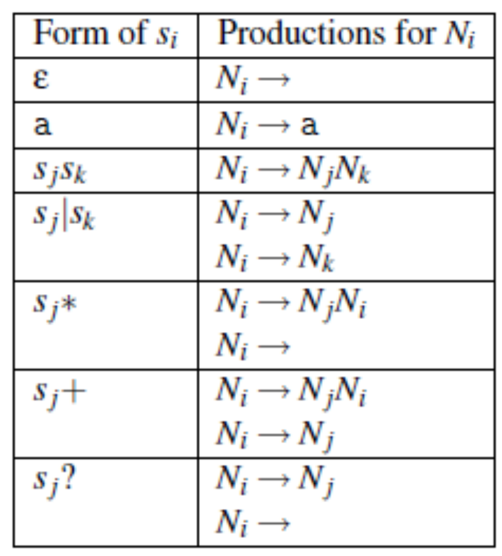
Context Free Grammars (CFG)
Figure 1: Converting regular expressions to CFG. Source: Mogensen, 2000

Slide 10
Context Free Grammars (CFG)
Example
  Create a CFG for (ab)*
  Create a CFG for [0-9]⁺
Example expression grammar
  Exp→ Exp + Exp
  Exp→ Exp - Exp
  Exp→ Exp * Exp
  Exp→ Exp / Exp
  Exp→ num
  Exp→ (Exp)
  Grammar 1

Slide 11
Context Free Grammars (CFG)
Example statement grammar
  Stat→id:=Exp
  Stat→Stat ; Stat
  Stat→ if Exp then Stat else Stat
  Stat→if Exp then Stat
Grammar 2

Slide 12
Context Free Grammars (CFG)
When writing the grammar of a programming language, one normally starts by dividing the constructs of a language into different syntactic categories.
A syntactic category is a sublanguage that embodies a particular concept
E.g.
  Expressions – calculation of values
  Statements – actions that occur in a particular sequence and change the state of the program
  Declarations – express properties of names used in other parts of the program
Each syntactic category is denoted by a nonterminal

Slide 13
Derivation
The basic idea of derivation is to consider productions as rewrite rules
Whenever we have a nonterminal, we can replace this by the right-hand side of any production in which the nonterminal appears on the left-hand side.
We can do this anywhere in a sequence of symbols (terminals and nonterminals) and repeat doing so until we have only terminals left.
The resulting sequence of terminals is a string in the language defined by the grammar.

Slide 14
Derivation
Formally Derivation is defined by the following rules
  αNβ=>αγβ where the is a production N→γ in the grammar
  α=>α
  α=>γ if there is β such that α=>β and β=>γ
Where γ, α and β are possibly empty sequences
Derivation can be used to formally define the language generated by a CFG
Definition: Given a context-free grammar G with start symbol S, terminal symbols T and productions P, the language L(G) that G generates is defined to be the set of strings of terminal symbols that can be obtained by derivation from S using the productions P, i.e., the set {w ∈ T*| S => w}

Slide 15
Derivation
Example
  T→R
  T→aTc
  R→ε
  R→RbR
Derive aaabbbccc using the above grammar
  T
  aTc //rule 2
  aaTcc // rule 2
  aaaTccc // rule 2
  aaaRccc // rule 1
  aaaRbRccc //rule 4
  aaaRbRbRccc // rule 4
  aaabbRbRccc // rule 3
  aaabbbRccc // rule 3
  aaabbbccc //rule 3

Slide 16
Derivation
Given a string containing nonterminals and optional nonterminals, to generate the next string in the sequence, we have to choose a nonterminal which to rewrite.
  If we always choose the leftmost nonterminal then the derivation is called leftmost derivation.
  A rightmost derivation always rewrites the leftmost nonterminal.

Slide 17
Syntax trees and Ambiguity
We can draw a derivation as a tree: The root of the tree is the start symbol of the grammar, and whenever we rewrite a nonterminal we add as its children the symbols on the right-hand side of the production that was used.
The leaves of the tree are terminals which, when read from left to right, form the derived string.
If a nonterminal is rewritten using an empty production, an ε is shown as its child.
This is also a leaf node, but is ignored when reading the string from the leaves of the tree.

Slide 18
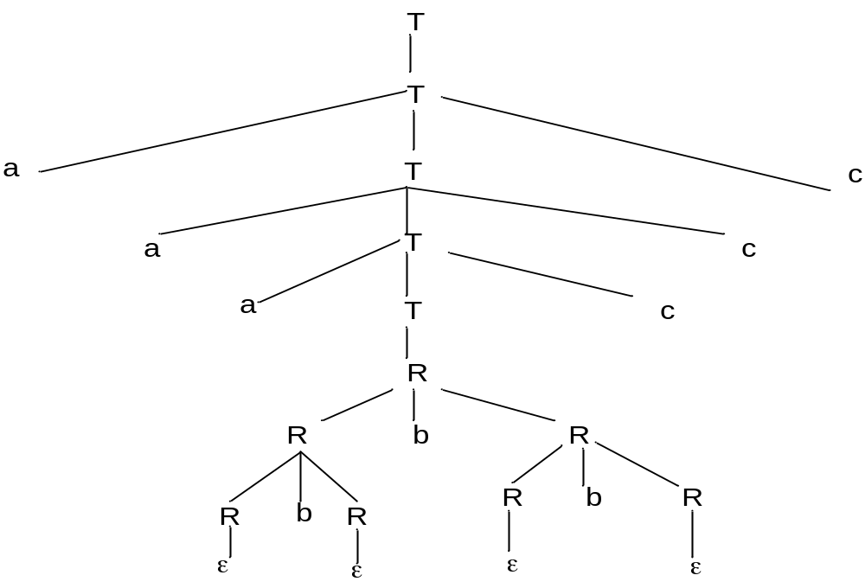
Syntax trees and Ambiguity
Figure 1 Syntax tree for aaabbbccc

Slide 19
Syntax trees and Ambiguity
The syntax tree adds structure to the string that it derives
It is this structure that is exploited in later phase of the compiler
For compilation, the derivation is backwards.
  We start with a string of terminals and want to produce a syntax tree.
  The process is called syntax analysis or parsing

Slide 20
Syntax trees and Ambiguity
A given nonterminal may have several productions
  The choice of production for a given nonterminal It can lead to the possibility of having several syntax trees for the same string
  In practice, only one of these trees represents the desired structure

Slide 21
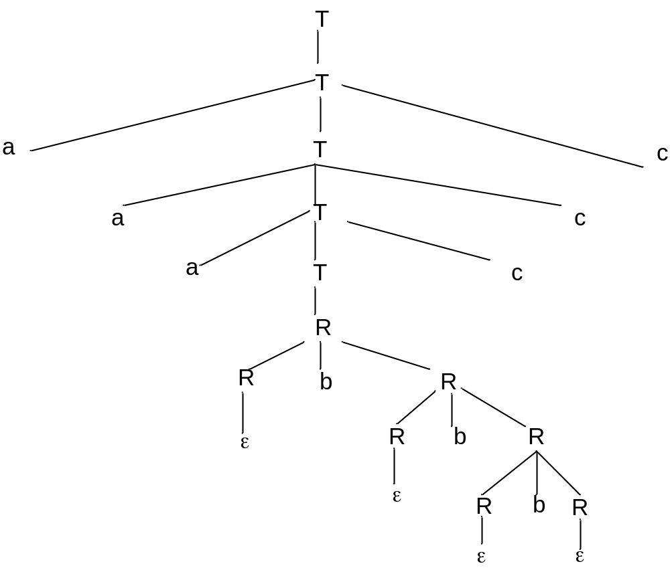
Syntax trees and Ambiguity
Figure 2: An Alternative Syntax tree
for aaabbbccc

Slide 22
Syntax trees and Ambiguity
When a grammar permits several different syntax trees for the same string, then the grammar is said to be ambiguous
It is desirable that a grammar be unambiguous so that it can generate the same structure every time for the same string
In most cases, an ambiguous can be rewritten to a unambiguous grammar that generates the same set of strings or external rules can be used to decide which of the many syntax trees is the right one

Slide 23
Syntax trees and Ambiguity
If we can find a string and show two alternative syntax trees for it, the it is prove that the grammar is ambiguous
  In practice, there is no formal way of finding such a string
The problem of showing if a grammar is ambiguous is undecidable i.e. there is no method that for all grammars can answer the question “is this grammar ambiguous”
In many cases, it is not difficult to detect and prove ambiguity
  For instance a production of the form
    N→NαN is ambiguous

Slide 24
Syntax trees and Ambiguity
  Exp→ Exp + Exp
  Exp→ Exp - Exp
  Exp→ Exp * Exp
  Exp→ Exp / Exp
  Exp→ num
  Exp→ (Exp)
  Grammar 1
Grammar one above can be used to describe arithmetic expressions.
Here num is a terminal (token) that describes all integer constants.
The parenthesis are also terminal symbols

Slide 25
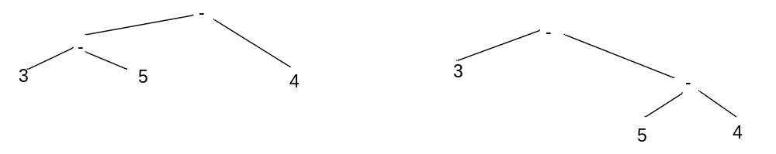
Syntax trees and Ambiguity
We can conclude that grammar 1 is ambiguous because it has expressions of the form N→NαN
Operator associativity describes the operator that an operands binds to when it is between two operators of the same type
Figure 3: Alternative syntax trees for the expression 3-5-4

Slide 26
Syntax trees and Ambiguity
Figure 3 shows that if the associativity of operators is not specified, the grammar becomes ambiguous hence grammar one is ambiguous.
The associativity of the subtraction operator is left to right
All operators in grammar 1 are taken to associate from left to right

Slide 27
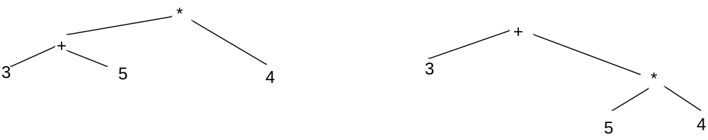
Syntax trees and Ambiguity
Operator precedence specifies which operator that an operands binds to if it is between two operands of the same type
Figure 4: Alternative syntax trees for the expression 3+5*4

Slide 28
Syntax trees and Ambiguity
Figure 4 shows that if the precedence of operators is not specified, the grammar becomes ambiguous hence grammar one is ambiguous.
The * operator has a higher precedence than + operator.
  Grammar 1 does not specify this
For figure 3 and 4, precedence and associativity rules can be used to select between the syntax trees.
Most parsers however desire that the arithmetic expressions grammar be unambiguous
The operator associativity and hierarchy is expressed in the grammar itself

Slide 29
Rewriting Ambiguous Expression Grammars
If we have the following ambiguous grammar
  E→E op E
  E→ num
If op is left associative, we can make the grammar left recursive by having a recursive reference only to the left of the operator
  E→E op E1
  E→E1
  E1→ num

Slide 30
Rewriting Ambiguous Expression Grammars
If op is right associative, we can make the grammar right recursive by having a recursive reference only to the right of the operator
  E→E1 op E
  E→E1
  E1→ num
Now there is only one pass tree for say
  3 op 4 op 5 (generate as exercise)

Slide 31
Rewriting Ambiguous Expression Grammars
If op is right associative, we can make the grammar right recursive by having a recursive reference only to the right of the operator
  E→E1 op E
  E→E1
  E1→ num
  Generate the parse tree for 3 op 4 op 5 as an exercise
Note that operators with the same precedence must have the same associativity for this to work e.g. + and – should have the same associativity

Slide 32
Rewriting Ambiguous Expression Grammars
Note that operators with the same precedence must have the same associativity for this to work e.g. + and – should have the same associativity
The following grammar for instance cannot generate the required strings
  E→E1 + E
  E→E – E1
  E→E1
  E1→ num
  E.g. try to generate the parse tree for 3 - 4 + 5

Slide 33
Rewriting Ambiguous Expression Grammars
If op is nonassiciative, then the grammar is handled by nonrecursive productions
  E→E1 op E1
  E→E1
  E1→ num
An example of a nonassociative operator is = (equality comparison)
This actually changes the grammar as it makes expressions of the form num op num op num illegal

Slide 34
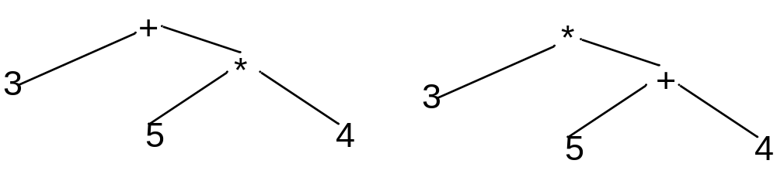
Rewriting Ambiguous Expression Grammars
We handle operators with different precedence by using a nonterminal for each precedence level.
The idea is that an operator cannot have subexpressions of lower a precedence level operator unless they (subexpressions) are inside parentheses.
  Given 3+5*4
Figure 5: The second parse tree is invalid because an operator of higher precedence has a subexpression formed using operators of lower precedence

Slide 35
Rewriting Ambiguous Expression Grammars
Exp→Exp+Exp2
Exp→Exp-Exp2
Exp→Exp2
Exp2→Exp2*Exp3
Exp2→Exp2/Exp3
Exp2→Exp3
Exp3→num
Exp3→(Exp)
Grammar 2

Slide 36
The Dangling-else problem
Languages like Pascal of C usually let the else part of a conditional statement to be optional
For example
  if p then if q then s1 else s2
According to the grammar below, the else part can match either if
  stmt→ if expr then stmt
  stmt→ if expr then stmt else stmt
  stmt→ other
    Where other stands for other type of statements

Slide 37
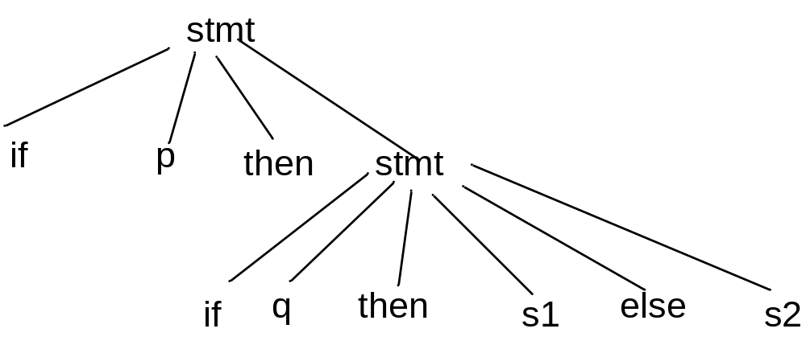
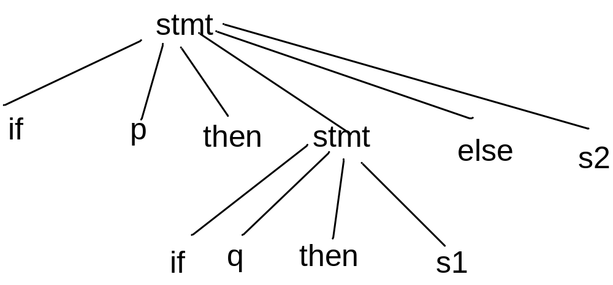
The Dangling-else problem
Figure 6a: Correct parse tree for if p then if q then s1 else s2
Figure 6b: incorrect parse tree for if p then if q then s1 else s2

Slide 38
The Dangling-else problem
if p then if q then s1 else s2
The else is supposed to match the closest if
To construct the required grammar, we use the observation that when an if and else match, all ifs that occur between these must have matching else
Hence we make two non terminals;
  One for matched conditionals (matched if)
  One for unmatched conditionals ( unmatched if)

Slide 39
The Dangling-else problem
stmt→stmt1; stmt
stmt→stmt1
stmt1→matched
stmt1→unmatched
matched→ if expr then matched else matched
matched →other
Unmatched →if expr then matched else unmatched
matched→ if expr then stmt1
Grammar 3: resolves the dangling else ambiguity

