Slide 1
Introduction to Knowledge Engineering
What is Knowledge Engineering?
History & Terminology

Slide 2
Data, information & knowledge
Data
  “raw signals”
    . . . - - - . . .
Information
  meaning attached to data
    S O S
Knowledge
  attach purpose and competence to information
  potential to generate action
    emergency alert → start rescue operation

Slide 3
Knowledge engineering
process of
  eliciting,
  structuring,
  formalizing,
  operationalizing
information and knowledge involved in a knowledge-intensive problem domain,
in order to construct a program that can perform a difficult task adequately

Slide 4
Problems in knowledge engineering
complex information and knowledge is difficult to observe
experts and other sources differ
multiple representations:
  textbooks
  graphical representations
  heuristics
  skills

Slide 5
Importance of proper knowledge engineering
Knowledge is valuable and often outlives a particular implementation
  knowledge management
Errors in a knowledge-base can cause serious problems
Heavy demands on extendibility and maintenance
  changes over time

Slide 6
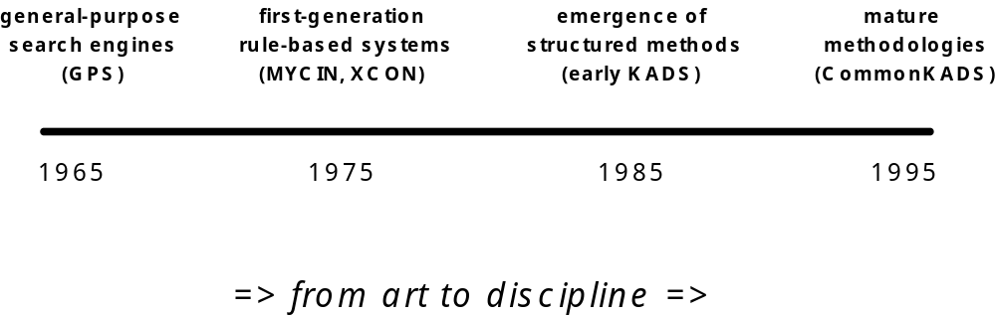
A Short History of
Knowledge Systems

Slide 7
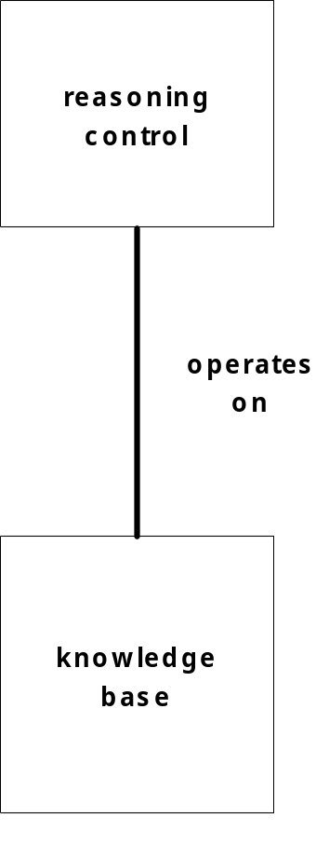
First generation “Expert” Systems
shallow knowledge base
single reasoning principle
uniform representation
limited explanation capabilities

Slide 8
Transfer View of KE
Extracting knowledge from a human expert
  “mining the jewels in the expert’s head”’
Transferring this knowledge into KS.
  expert is asked what rules are applicable
  translation of natural language into rule format

Slide 9
Problems with transfer view
The knowledge providers, the knowledge engineer and the knowledge-system developer should share
  a common view on the problem solving process and
  a common vocabulary
in order to make knowledge transfer a viable way of knowledge engineering

Slide 10
Rapid Prototyping
Positive
  focuses elicitation and interpretation
  motivates the expert
  (convinces management)
Negative
  large gap between verbal data and implementation
  architecture constrains the analysis hence: distorted model
  difficult to throw away

Slide 11
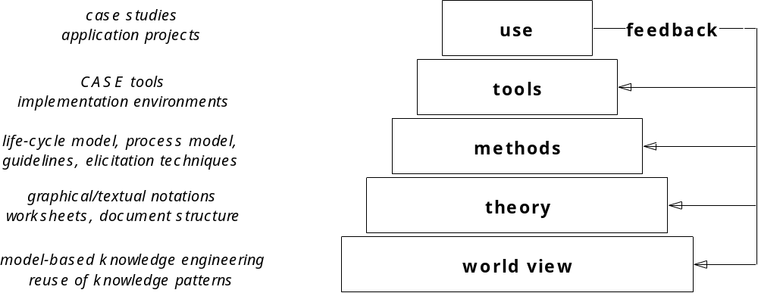
Methodological pyramid

Slide 12
World view: Model-Based KE
The knowledge-engineering space of choices and tools can to some extent be controlled by the introduction of a number of models
Each model emphasizes certain aspects of the system to be built and abstracts from others.
Models provide a decomposition of knowledge-engineering tasks: while building one model, the knowledge engineer can temporarily neglect certain other aspects.

Slide 13
CommonKADS principles
Knowledge engineering is not some kind of `mining from the expert's head', but consists of constructing different aspect models of human knowledge
The knowledge-level principle: in knowledge modeling, first concentrate on the conceptual structure of knowledge, and leave the programming details for later
Knowledge has a stable internal structure that is analyzable by distinguishing specific knowledge types and roles.

Slide 14
CommonKADS theory
KBS construction entails the construction of a number of models that together constitute part of the product delivered by the project.
Supplies the KBS developer with a set of model templates.
This template structure can be configured, refined and filled during project work.
The number and level of elaboration of models depends on the specific project context.

Slide 15
CommonKADS Model Set
Context
Organization
Task
Agent
Model
Model
Model
Concept
Knowledge
Communication
Model
Model
Artefact
Design
Model

Slide 16
Model Set Overview (1)
Organization model
  supports analysis of an organization,
  Goal: discover problems, opportunities and possible impacts of KBS development.
Task model
  describes tasks that are performed or will be performed in the organizational environment
Agent model
  describes capabilities, norms, preferences and permissions of agents (agent = executor of task).

Slide 17
Model Set Overview (2)
Knowledge model
  gives an implementation-independent description of knowledge involved in a task.
Communication model
  models the communicative transactions between agents.
Design model
  describes the structure of the system that needs to be constructed.

Slide 18
Principles of the Model Set
Divide and conquer.
Configuration of an adequate model set for a specific application.
Models evolve through well defined states.
The model set supports project management.
Model development is driven by project objectives and risk.
Models can be developed in parallel.

Slide 19
Models exist in various forms
Model template
  predefined, fixed structure, can be configured
Model instance
  objects manipulated during a project.
Model versions
  versions of a model instance can exist.
Multiple model instances
  separate instances can be developed
  example: ''current'' and ''future'' organization

Slide 20
The Product
Instantiated models
  represent the important aspects of the environment and the delivered knowledge based system.
Additional documentation
  information not represented in the filled model templates (e.g. project management information)
Software

Slide 21
Roles in knowledge-system development
knowledge provider
knowledge engineer/analyst
knowledge system developer
knowledge user
project manager
knowledge manager
N.B. many-to-many relations between roles and people

Slide 22
Knowledge provider/specialist
“traditional” expert
person with extensive experience in an application domain
can provide also plan for domain familiarization
  “where would you advise a beginner to start?”
inter-provider differences are common
need to assure cooperatio

Slide 23
Knowledge engineer
specific kind of system analyst
should avoid becoming an "expert"
plays a liaison function between application domain and system

Slide 24
Knowledge-system developer
person that implements a knowledge system on a particular target platform
needs to have general design/implementation expertise
needs to understand knowledge analysis
  but only on the “use”-level
role is often played by knowledge engineer

Slide 25
Knowledge user
Primary users
  interact with the prospective system
Secondary users
  are affected indirectly by the system
Level of skill/knowledge is important factor
May need extensive interacting facilities
  explanation
His/her work is often affected by the system
  consider attitude / active tole

Slide 26
Project manager
responsible for planning, scheduling and monitoring development work
liaises with client
typically medium-size projects (4-6 people)
profits from structured approach

Slide 27
Knowledge manager
background role
monitors organizational purpose of
  system(s) developed in a project
  knowledge assets developed/refined
initiates (follow-up) projects
should play key role in reuse
may help in setting up the right project team

Slide 28
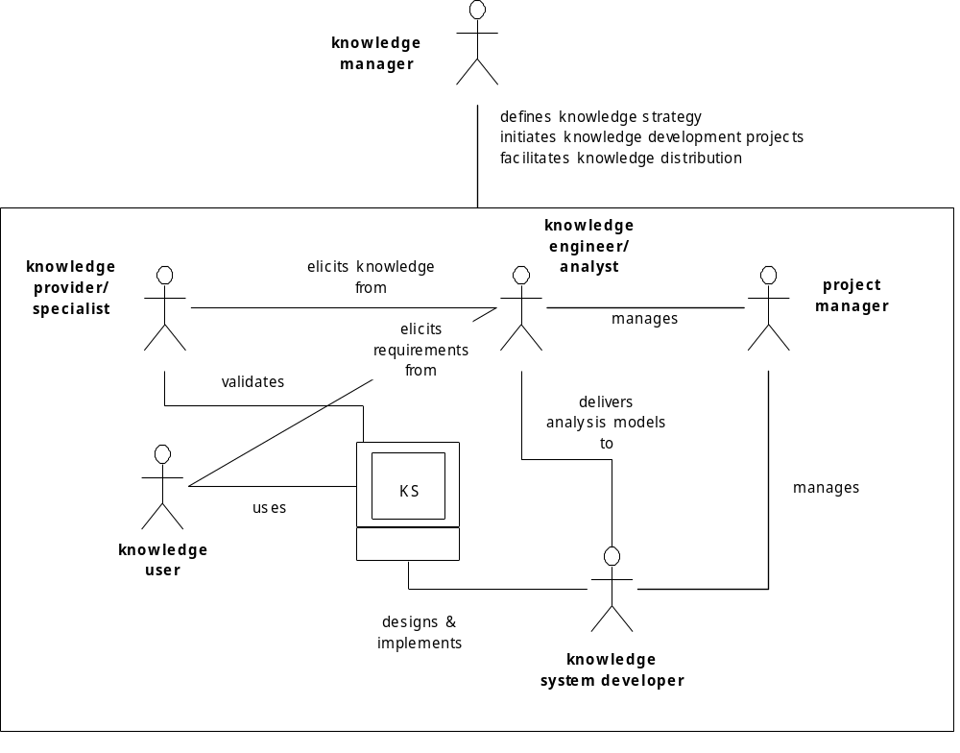
Roles in knowledge-system development

Slide 29
Terminology
Domain
  some area of interest
    banking, food industry, photocopiers, car manufacturing
Task
  something that needs to be done by an agent
    monitor a process; create a plan; analyze deviant behavior
Agent
  the executor of a task in a domain
    typically either a human or some software system

Slide 30
Terminology
Application
  The context provided by the combination of a task and a domain in which this task is carried out by agents
Application domain
  The particular area of interest involved in an application
Application task
  The (top-level) task that needs to be performed in a certain application

Slide 31
Terminology
knowledge system (KS)
  system that solves a real-life problem using knowledge about the application domain and the application task
expert system
  knowledge system that solves a problem which requires a considerable amount of expertise, when solved by humans.

