Slide 1
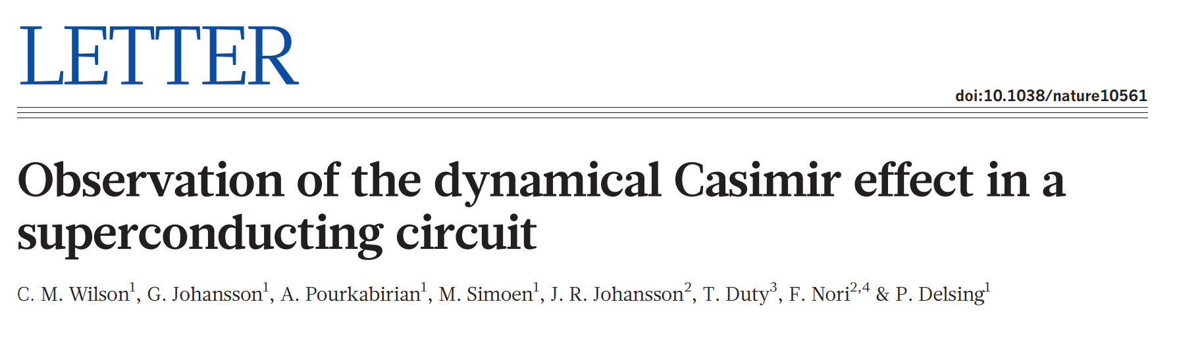
Journal club 2019/05/22
presenters : Qian Ding, Sissi Wang

Slide 2
Outline
Motivation
Vacuum Fluctuation
Dynamic Casmir Effect
Experimental Setup
Measurements and Observations
Broadband Photon Generation
Two-mode Squeezing
Conclusion and Comments

Slide 3
Motivation
Vacuum Fluctuation
Space of vacuum not empty
Virtual particles flitting in and out
Measurable consequences
Indirect evidences e.g. Lamb shift of atomic spectra
More direct observations – dynamic Casmir effect

Slide 4
Motivation
Dynamic Casmir Effect
two perfectly conducting mirrors in parallel
one mirror in relativistic motion (v/c not negligible)
mismatch of vacuum modes in time
EM field non-adiabatically excited out of the vacuum
(add figure mirrors)

Slide 5
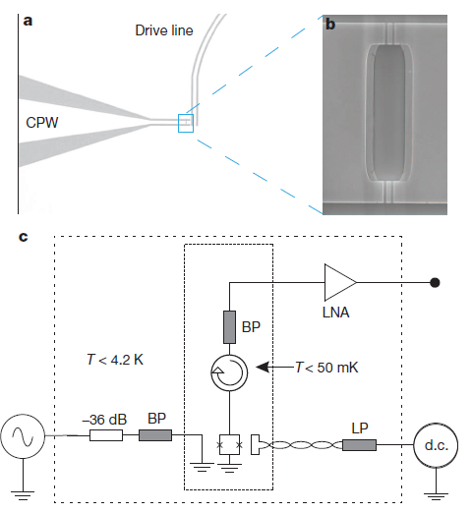
Experimental Setup
SQUID
two Josephson junctions
parametric inductor
change conductance – change transmission line length – moving mirror
filters (LP and BP)
exclude thermal radiation coupling to transmission line
output line - coplanar waveguide (CPW)

Slide 6
Experimental Setup
Output photon flux density

Slide 7
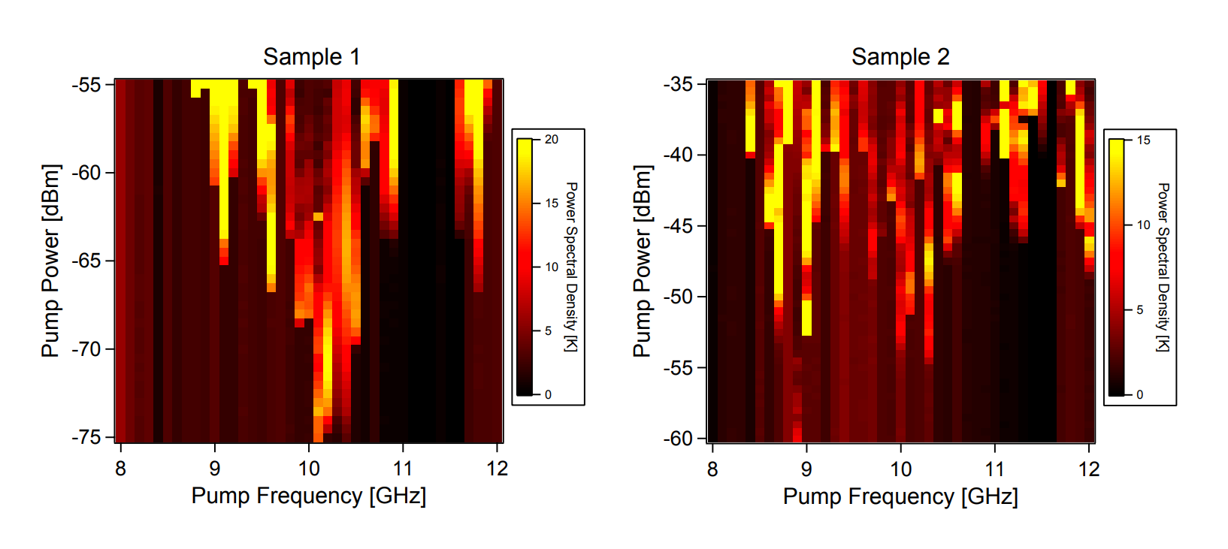
Measurements and Observations
Broadband Photon Generation
Measure at half the pump frequency
~43mm CPW
~0.1mm CPW

Slide 8
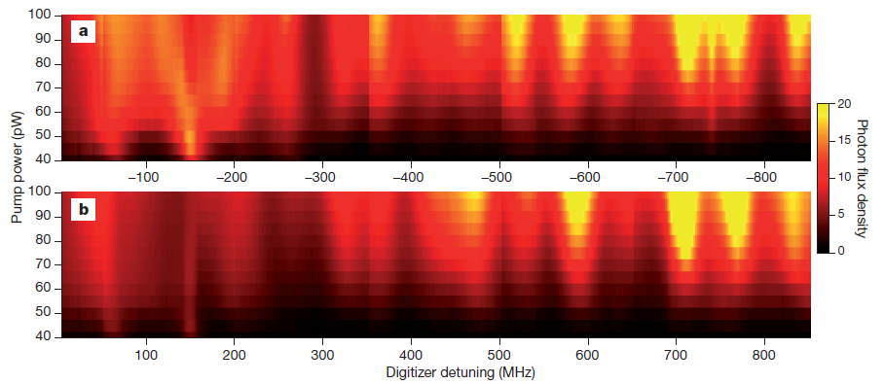
Measurements and Observations
Broadband Photon Generation
symmetric detuning at fixed drive frequency

Slide 9
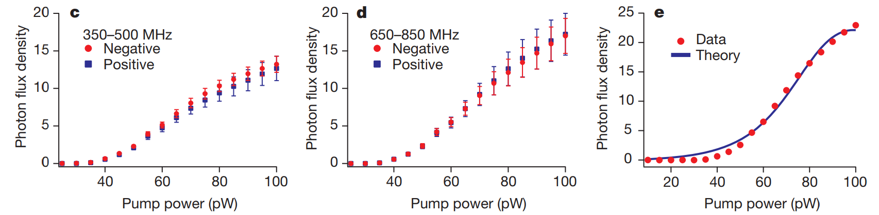
Measurements and Observations
Broadband Photon Generation
symmetric detuning averaged over frequency at fixed drive power

Slide 10
Measurements and Observations
Broadband Photon Generation
symmetric detuning averaged over frequency at fixed drive power

Slide 11
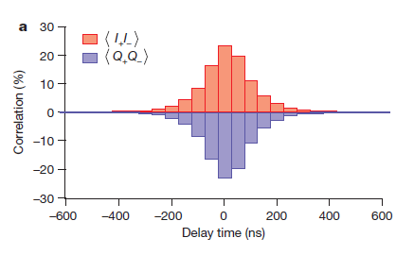


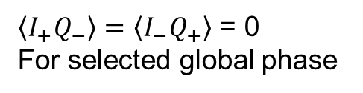
Measurements and Observations
Two-mode Squeezing
observe 25% cross-correlations (~1000x parasitic amplifier corr.)
$$σ_{2}∝ \left\langle I_{+}I_{−}\right\rangle −\left\langle Q_{+}Q_{−}\right\rangle$$
$$\left\langle I_{+}I_{−}\right\rangle = −\left\langle Q_{+}Q_{−}\right\rangle$$
$\left\langle I_{+}Q_{−}\right\rangle =\left\langle I_{−}Q_{+}\right\rangle$ = 0
For selected global phase

Slide 12
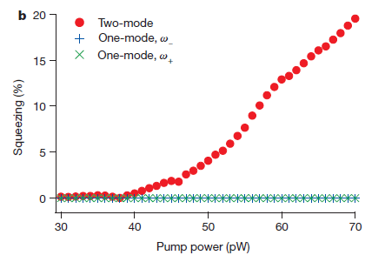

Measurements and Observations
Two-mode Squeezing
two-mode vs. single mode field squeezing
$$σ_{1}=\frac{\left\langle I^{2}\right\rangle −\left\langle Q^{2}\right\rangle }{\left\langle I^{2}\right\rangle +\left\langle Q^{2}\right\rangle }$$

Slide 13
Conclusion & Comments
Direct experimental observation of DCE

Slide 14
Thank you !

