Slide 1
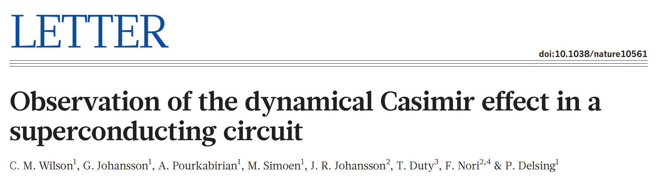
Journal club 2019/05/22
presenters : Qian Ding, Sissi Wang

Slide 2
Outline
Motivation
Vacuum Fluctuation
Dynamic Casmir Effect (DCE)
Experimental Setup
Measurements & Observations
Broadband Photon Generation
Two-mode Squeezing
Conclusion & Comments

Slide 3
Motivation
Vacuum fluctuation
from Heisenberg’s uncertainty principle
allows creation of virtual particles out of vacuum space
measurable consequences
indirect evidences e.g. Lamb shift of atomic spectra
direct observation of virtual photons - DCE

Slide 4
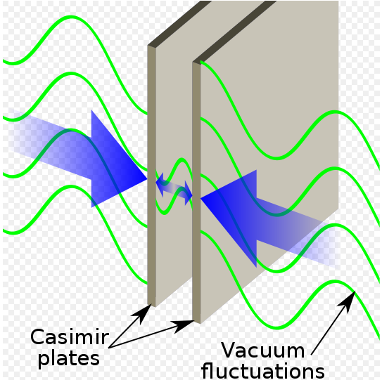
Motivation
Dynamic Casmir Effect
two metal plates in parallel, one in relativistic motion
vacuum modes mismatch in time
EM field non-adiabatically excited out – observe real photons

Slide 5
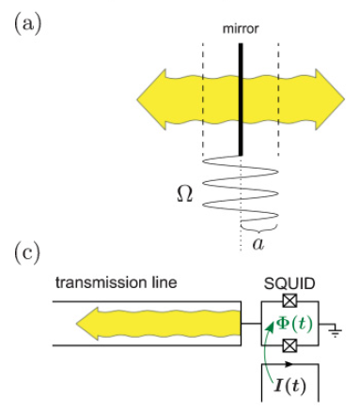
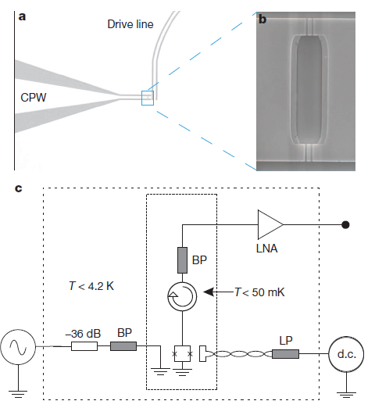
Experimental Setup
A coplanar waveguide (CPW) terminated by a SQUID
SQUID imposes time-dependent boundary condition
tune SQUID inductance by applying magnetic flux
corresponds to a single moving mirror in free space

Slide 6
Experimental Setup
2 parts: drive & measurement
filters : exclude thermal radiation coupling to CPW
circulator: separating input & output fields

Slide 7
Measurements and Observations
Generated photon flux density (weak drive regime)
where
Two mode squeezing (TMS)
boundary driven sinusoidally
pairwise generation of photons, symmetric about ꞷ_{d}/2
sideband EM field correlated – expect TMS

Slide 8
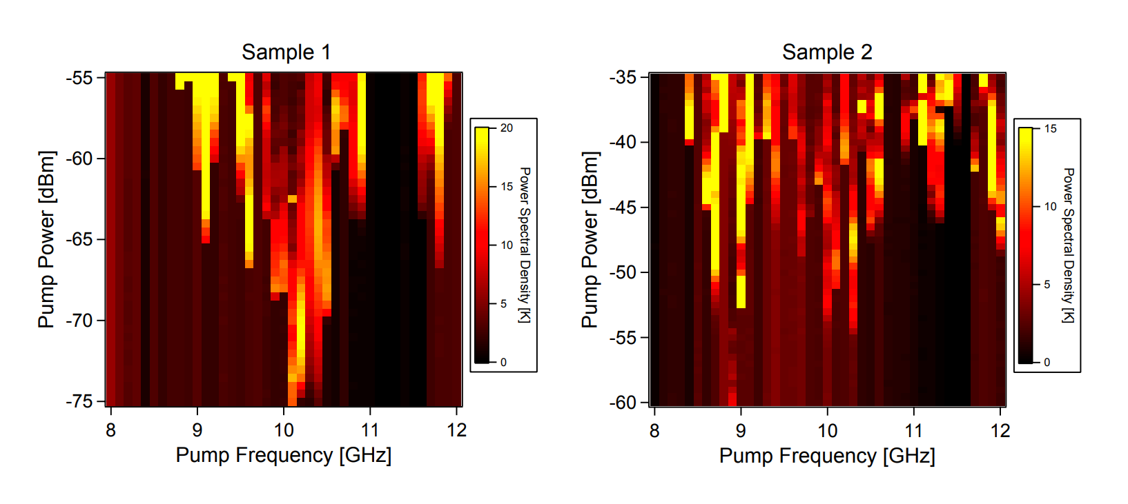
Measurements and Observations
Broadband Photon Generation
Measure at half the pump frequency
~43mm CPW
~0.1mm CPW

Slide 9
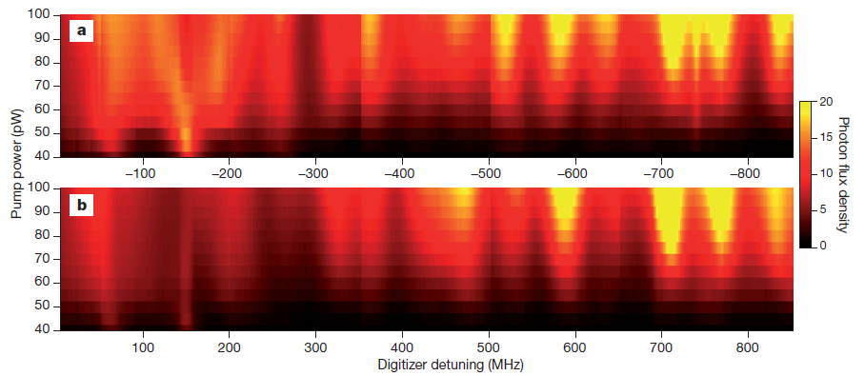
Measurements and Observations
Broadband Photon Generation
symmetric detuning at fixed drive frequency

Slide 10
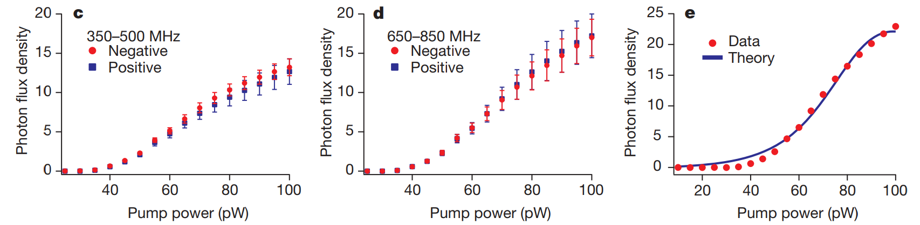
Measurements and Observations
Broadband Photon Generation
symmetric detuning averaged over frequency at fixed drive power

Slide 11
Measurements and Observations
Broadband Photon Generation
symmetric detuning averaged over frequency at fixed drive power

Slide 12
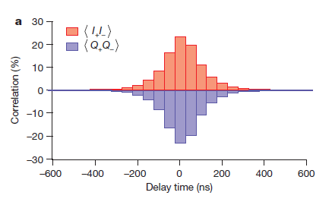


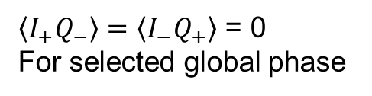
Measurements and Observations
Two-mode Squeezing
observe 25% cross-correlations (~1000x parasitic amplifier corr.)
$$σ_{2}∝ \left\langle I_{+}I_{−}\right\rangle −\left\langle Q_{+}Q_{−}\right\rangle$$
$$\left\langle I_{+}I_{−}\right\rangle = −\left\langle Q_{+}Q_{−}\right\rangle$$
$\left\langle I_{+}Q_{−}\right\rangle =\left\langle I_{−}Q_{+}\right\rangle$ = 0
For selected global phase

Slide 13
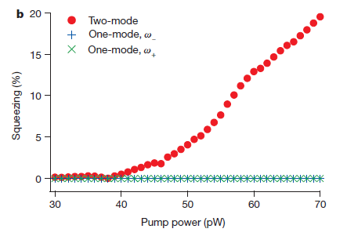

Measurements and Observations
Two-mode Squeezing
two-mode vs. single mode field squeezing
$$σ_{1}=\frac{\left\langle I^{2}\right\rangle −\left\langle Q^{2}\right\rangle }{\left\langle I^{2}\right\rangle +\left\langle Q^{2}\right\rangle }$$

Slide 14

Conclusion & Comments
Direct experimental observation of DCE
Thermal photons: $n_{in}≪1$at 50mK
Quantum correlation between output photons

Slide 15
Thank you !

Slide 16



Photon generation rate & TMS
Photon generation rate
TMS

