Slide 1
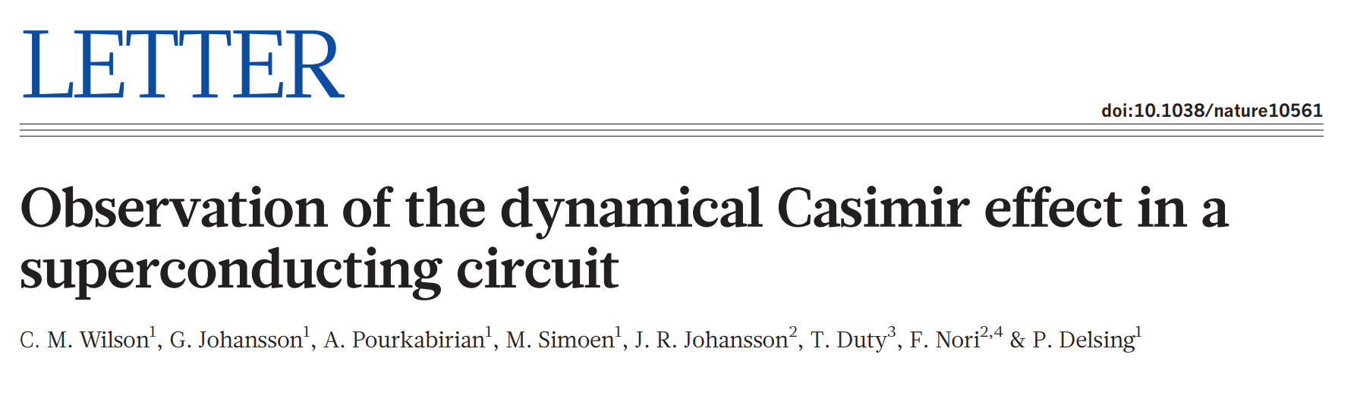
Journal club 2019/05/22
presenters : Qian Ding, Sissi Wang

Slide 2
Outline
Motivation
Vacuum Fluctuation
Dynamic Casmir Effect (DEC)
Experimental Setup
Measurements & Observations
Broadband Photon Generation
Two-mode Squeezing
Conclusion & Comments

Slide 3
Motivation
Vacuum fluctuation
temporary change in amount of energy in vacuum
creation of virtual particle pairs out of empty space
measurable consequences
indirect evidences e.g. Lamb shift of atomic spectra
direct observation of virtual photons - DEC

Slide 4
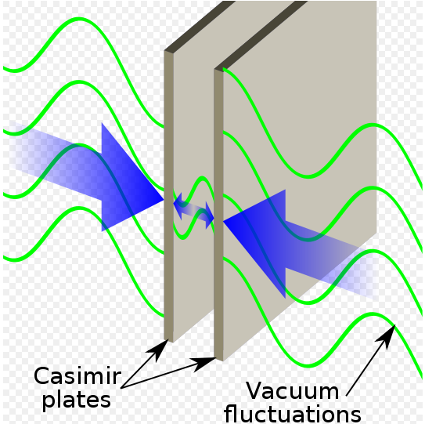
Motivation
Dynamic Casmir Effect
two metal plates in parallel
one in relativistic motion
vacuum modes mismatch in time, EM field non-adiabatically excited out
convert virtual photons into observable real photons

Slide 5
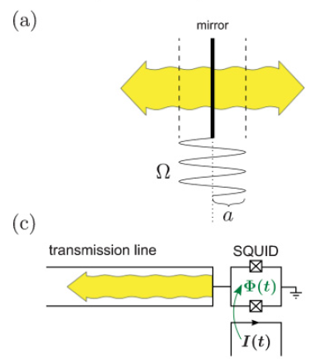
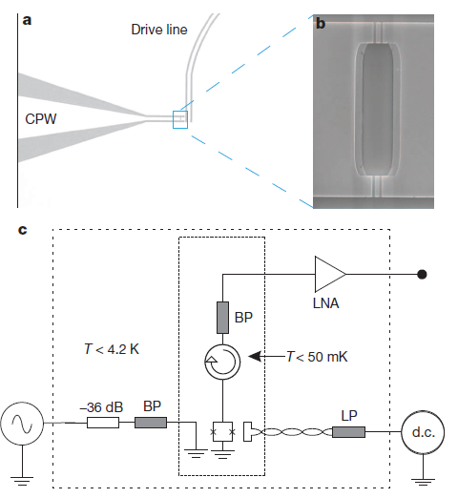
Experimental Setup
A coplanar waveguide (CPW) terminated by a SQUID
SQUID acts as a tuneable boundary condition in CPW
change inductance by applying magnetic flux
corresponds to a single moving mirror in free space

Slide 6
Experimental Setup
filters : exclude thermal radiation coupling to CPW
circulator: separating input & output fields

Slide 7
Experimental Setup
Output photon flux density
where
1st term - purely classical reflection
2nd term – upconversion of input field to drive frequency
3rd term – DEC radiation due to vacuum fluctuation

Slide 8
Measurements and Observations
Two mode squeezing (TMS)
boundary driven sinusoidally at frequency ꞷ_{d}
pairwise generation of photons, with freq. ꞷ₊ + ꞷ₋ = ꞷ_{d}
EM field at sideband frequencies correlated
exhibit quantum signature of TMS

Slide 9
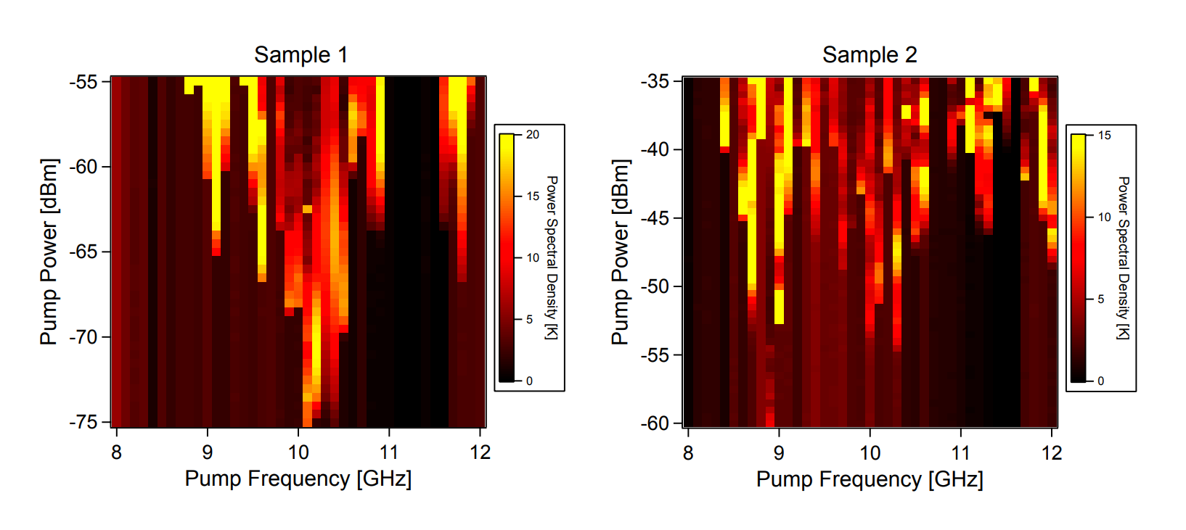
Measurements and Observations
Broadband Photon Generation
Measure at half the pump frequency
~43mm CPW
~0.1mm CPW

Slide 10
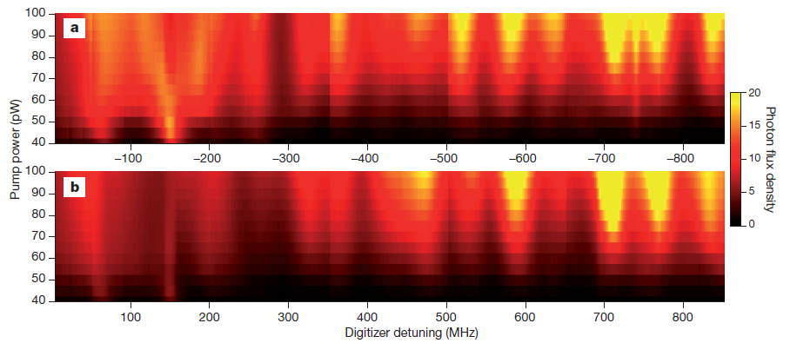
Measurements and Observations
Broadband Photon Generation
symmetric detuning at fixed drive frequency

Slide 11
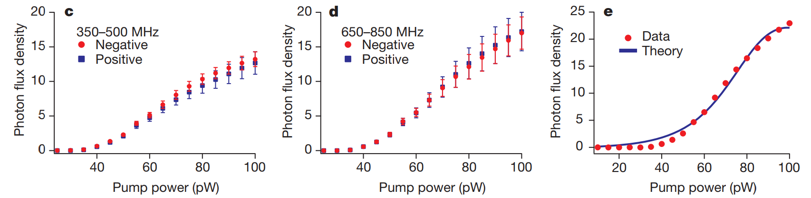
Measurements and Observations
Broadband Photon Generation
symmetric detuning averaged over frequency at fixed drive power

Slide 12
Measurements and Observations
Broadband Photon Generation
symmetric detuning averaged over frequency at fixed drive power

Slide 13
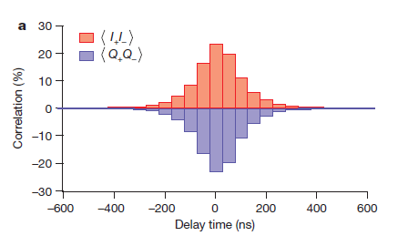


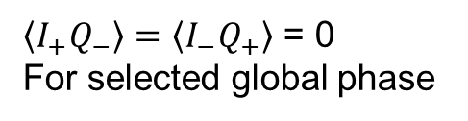
Measurements and Observations
Two-mode Squeezing
observe 25% cross-correlations (~1000x parasitic amplifier corr.)
$$σ_{2}∝ \left\langle I_{+}I_{−}\right\rangle −\left\langle Q_{+}Q_{−}\right\rangle$$
$$\left\langle I_{+}I_{−}\right\rangle = −\left\langle Q_{+}Q_{−}\right\rangle$$
$\left\langle I_{+}Q_{−}\right\rangle =\left\langle I_{−}Q_{+}\right\rangle$ = 0
For selected global phase

Slide 14
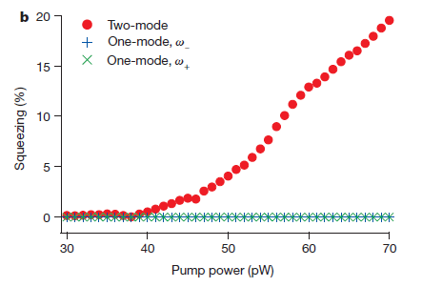

Measurements and Observations
Two-mode Squeezing
two-mode vs. single mode field squeezing
$$σ_{1}=\frac{\left\langle I^{2}\right\rangle −\left\langle Q^{2}\right\rangle }{\left\langle I^{2}\right\rangle +\left\langle Q^{2}\right\rangle }$$

Slide 15
Conclusion & Comments
Direct experimental observation of DCE

Slide 16
Thank you !

