Slide 1
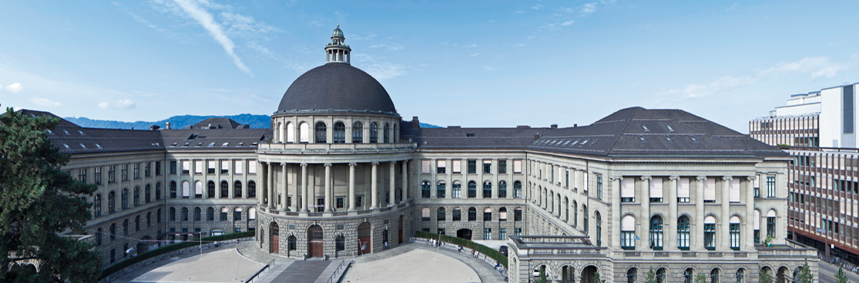
Observation of the dynamical Casmir effect on a superconducting circuit
presenters : Qian Ding

Slide 2
Outline
Motivation
Vacuum Fluctuation
Dynamic Casmir Effect
Experimental Setup
Measurements and Observations
Broadband Photon Generation
Two-mode Squeezing
Conclusion and Comments

Slide 3
Motivation
Vacuum Fluctuation
Space of vacuum not empty
Virtual particles flitting in and out
Measurable consequences
Indirect evidences e.g. Lamb shift of atomic spectra
More direct observations – dynamic Casmir effect

Slide 4
Motivation
Dynamic Casmir Effect
two perfectly conducting mirrors in parallel
one mirror in relativistic motion (v/c not negligible)
mismatch of vacuum modes in time
EM field non-adiabatically excited out of the vacuum
(add figure mirrors)

Slide 5
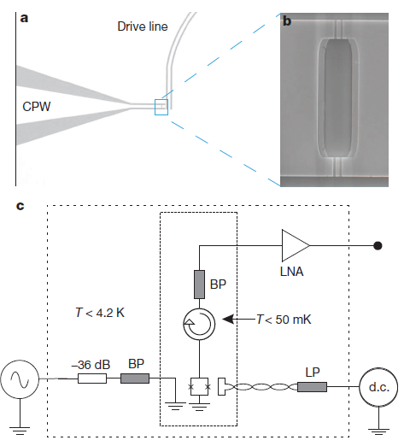
Experimental Setup
SQUID
two Josephson junctions
parametric inductor
change conductance – change transmission line length – moving mirror
filters (LP and BP)
exclude thermal radiation coupling to transmission line
output line - coplanar waveguide (CPW)

Slide 6
Experimental Setup
Output photon flux density

Slide 7
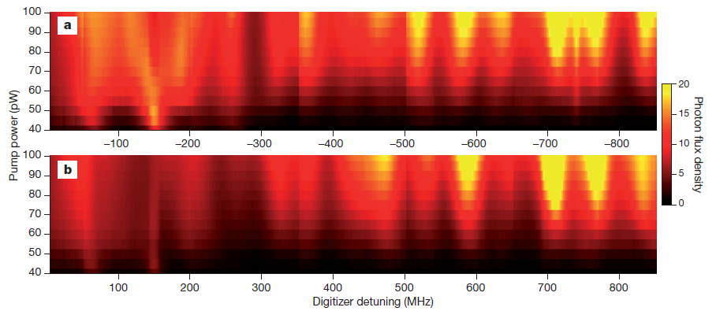
Measurements and Observations
Broadband Photon Generation
symmetric detuning at fixed drive frequency

Slide 8
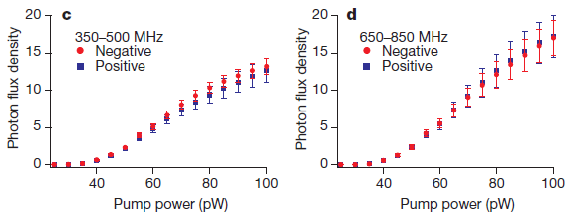
Measurements and Observations
Broadband Photon Generation
symmetric detuning averaged over frequency at fixed drive power

Slide 9
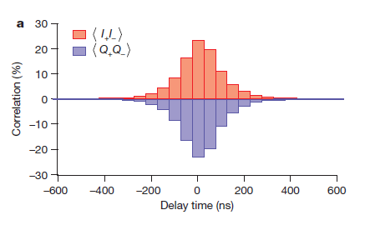
Measurements and Observations
Two-mode Squeezing
observe clear cross-correlations

Slide 10
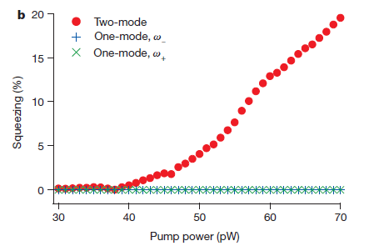
Measurements and Observations
Two-mode Squeezing
two-mode and single mode field squeezing

Slide 11
Conclusion & Comments

Slide 12
Thank you !

