Slide 1
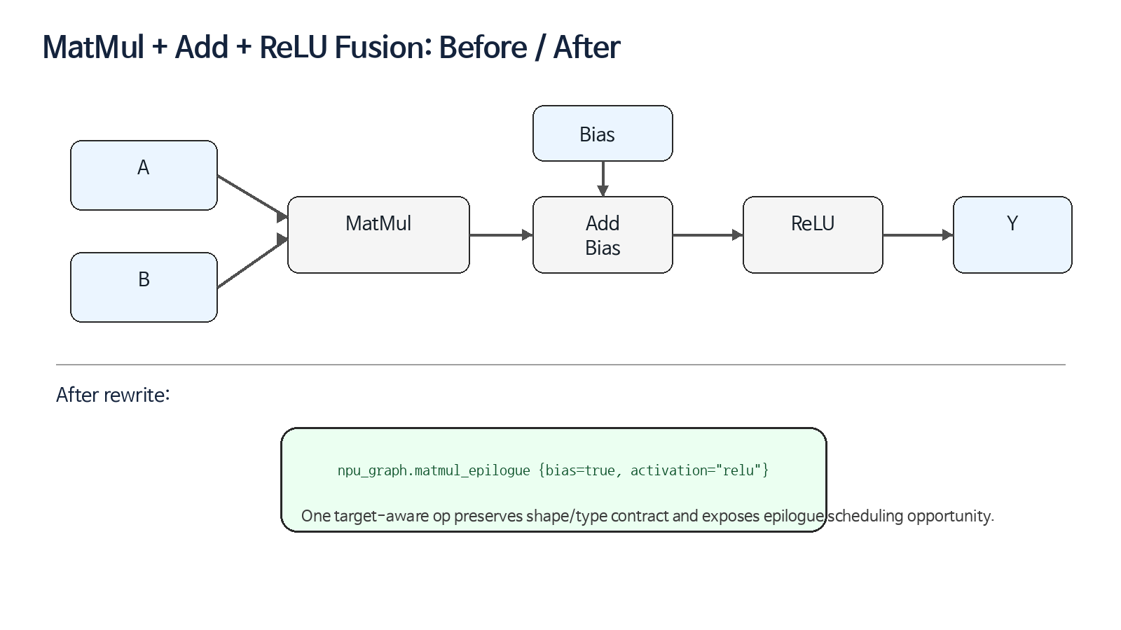
Lecture 10
Rewrite Pattern
MatMul + Add + ReLU Fusion Pattern Design for NPU Compiler
Lecture 10 | 01

Slide 2
오늘의 위치
9강: Pass Infrastructure - pass를 등록하고 pipeline을 설계
10강: Rewrite Pattern - pass 내부에서 IR을 실제로 바꾸는 최소 단위
11강: Dialect Conversion - legality와 conversion target 기반 lowering
Lecture 10 | 02

Slide 3
Learning Objectives
RewritePattern / OpRewritePattern / PatternRewriter 역할 구분
match phase와 rewrite phase를 분리해 안전한 pattern 작성
Greedy driver의 worklist/fixpoint 동작 이해
MatMul+Bias+ReLU fusion contract 설계
FileCheck positive/negative regression test 작성
Lecture 10 | 03

Slide 4
Why Rewrite Pattern Matters for NPU
NPU compiler 성능은 작은 graph rewrite의 품질에 크게 의존
fusion은 intermediate tensor lifetime과 DRAM traffic을 줄임
단, target epilogue/quant/layout contract를 증명하지 못하면 correctness bug
좋은 pattern은 “왜 match 실패했는가”까지 설명 가능
Lecture 10 | 04

Slide 5
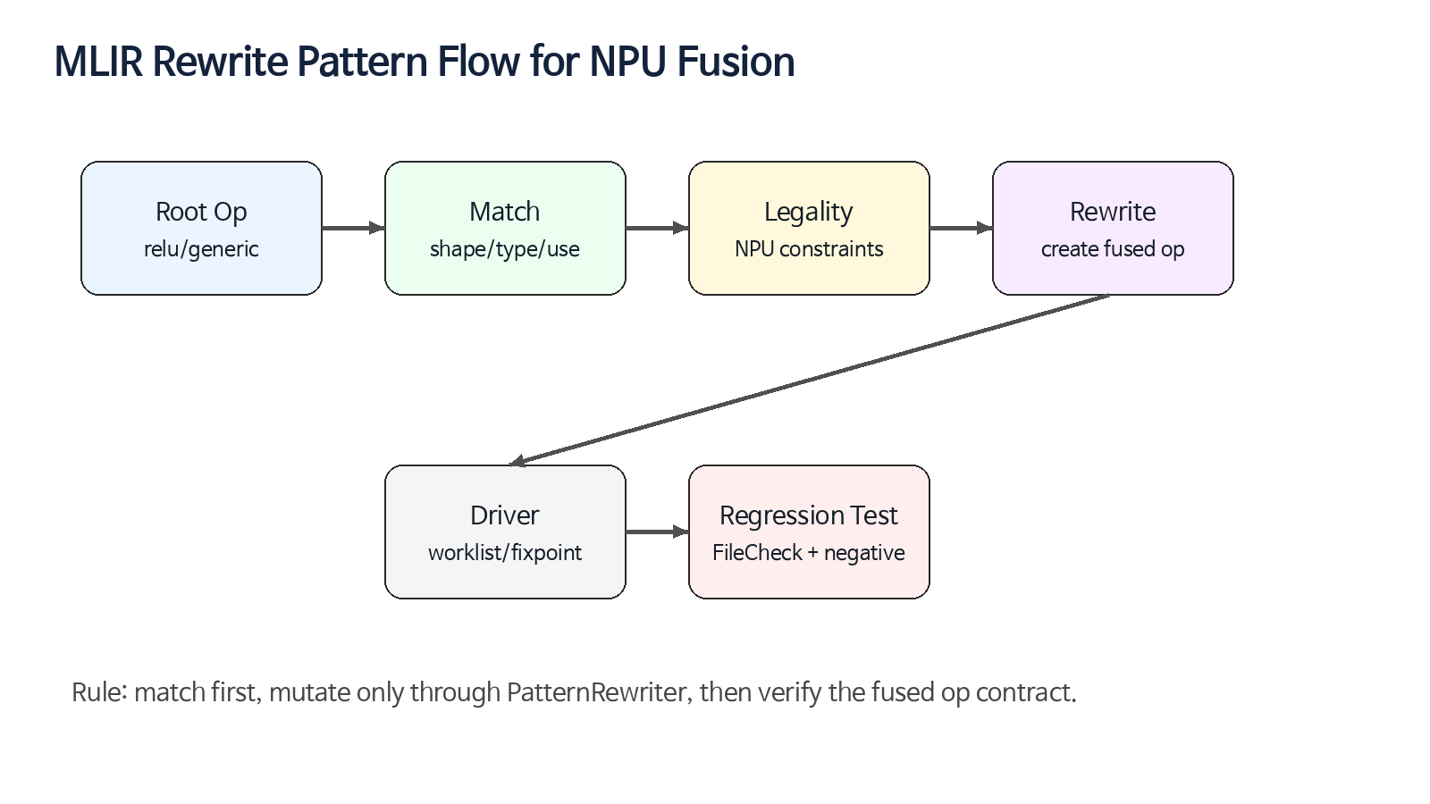
Pattern Rewriting Framework
Pattern Definition: root op, predicates, rewrite action, benefit
Pattern Application: driver, worklist, cost model, fixpoint
RewritePatternSet에 pattern을 모아 pass에서 실행
NPU 예: ReLU root에서 AddBias와 MatMul producer chain을 역방향 match
Lecture 10 | 05

Slide 6
RewritePattern Anatomy
Root operation name: 가능하면 명시
PatternBenefit: local priority signal
matchAndRewrite: match와 mutation을 한 함수에서 수행
Debug name/label: pattern filtering과 debug log에 필요
Bounded recursion: self-applicable pattern이면 명시
Lecture 10 | 06

Slide 7
PatternRewriter Rules
IR mutation은 반드시 PatternRewriter API로 수행
성공 전에는 IR을 변경하지 않음
실패 시 notifyMatchFailure로 이유를 남김
root op는 replace / erase / in-place update 중 하나로 처리
direct erase 또는 raw mutation은 driver state를 깨뜨릴 수 있음
Lecture 10 | 07

Slide 8
matchAndRewrite Discipline
1. root op 확인
2. producer/operand chain 확인
3. one-use / side-effect / dominance 확인
4. shape / dtype / layout / quantization 확인
5. target capability 확인
6. fused op 생성 후 replace/erase
Lecture 10 | 08

Slide 9
Good vs Bad Rewrite
Good: 모든 조건이 증명된 뒤 rewriter.create + replaceOp
Good: 실패 사유가 구체적인 notifyMatchFailure
Bad: match 중간에 op 생성 후 실패
Bad: one-use 확인 없이 producer erase
Bad: target-specific fusion을 canonicalization에 숨김
Lecture 10 | 09

Slide 10
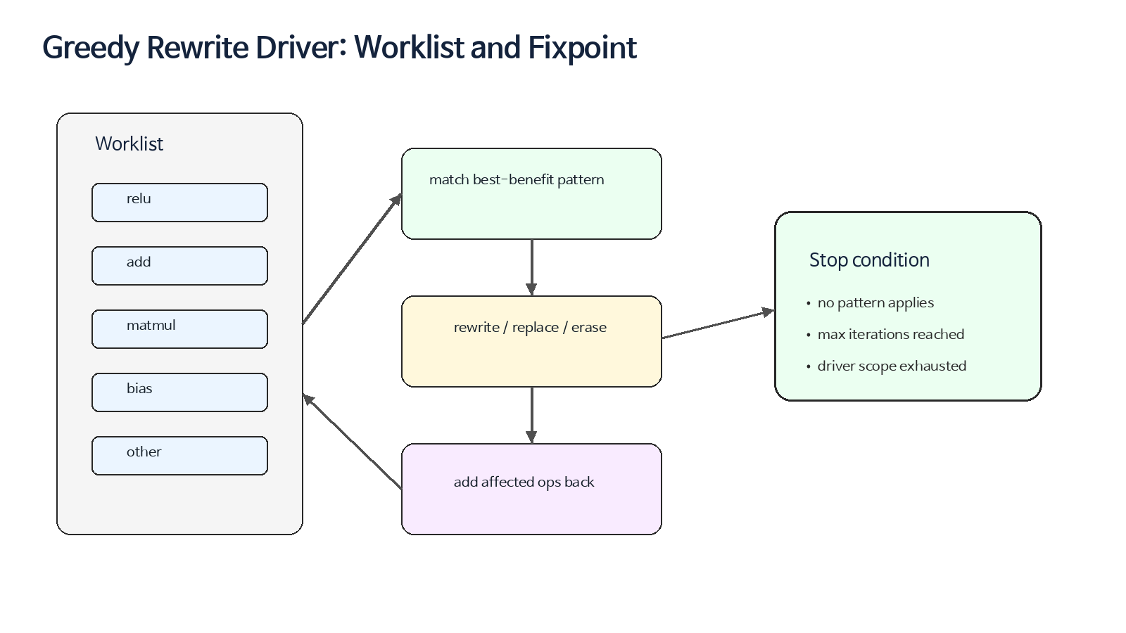
Greedy Driver Overview
worklist 기반으로 op를 방문
benefit이 높은 pattern을 지역적으로 적용
수정/생성된 op는 다시 worklist에 들어갈 수 있음
fixpoint 또는 iteration limit에서 종료
cyclic rewrite는 bug로 취급해야 함
Lecture 10 | 10

Slide 11
Pattern Benefit Strategy
더 구체적인 pattern에 더 높은 benefit
MatMul+Bias+ReLU > MatMul+Bias > Add identity
benefit은 target legality를 대체하지 않음
낮은 benefit이라도 canonicalization이 먼저 필요할 수 있음
Lecture 10 | 11

Slide 12
Canonicalization vs Optimization
Canonicalization: IR을 단순하고 안정적인 형태로 정리
Optimization: target contract와 성능 목표를 반영
Pass correctness는 canonicalize 존재에 의존하면 안 됨
NPU fusion은 별도 optimization pass로 두는 것을 권장
Lecture 10 | 12

Slide 13
Fusion Target: MatMul + Add + ReLU
Input: MatMul result에 bias add 후 ReLU 적용
Output: npu_graph.matmul_epilogue
Benefit: intermediate tensor 제거, epilogue scheduling, DRAM traffic 감소
Risk: broadcast/quant/layout/one-use 조건 미확인 시 correctness bug
Lecture 10 | 13

Slide 14
Root Op 선택
권장 root: ReLU output op
이유: final result를 replacement 결과로 바로 대체 가능
producer chain: ReLU -> AddBias -> MatMul
consumer 기준으로 pattern 전체를 닫기 쉬움
Lecture 10 | 14

Slide 15
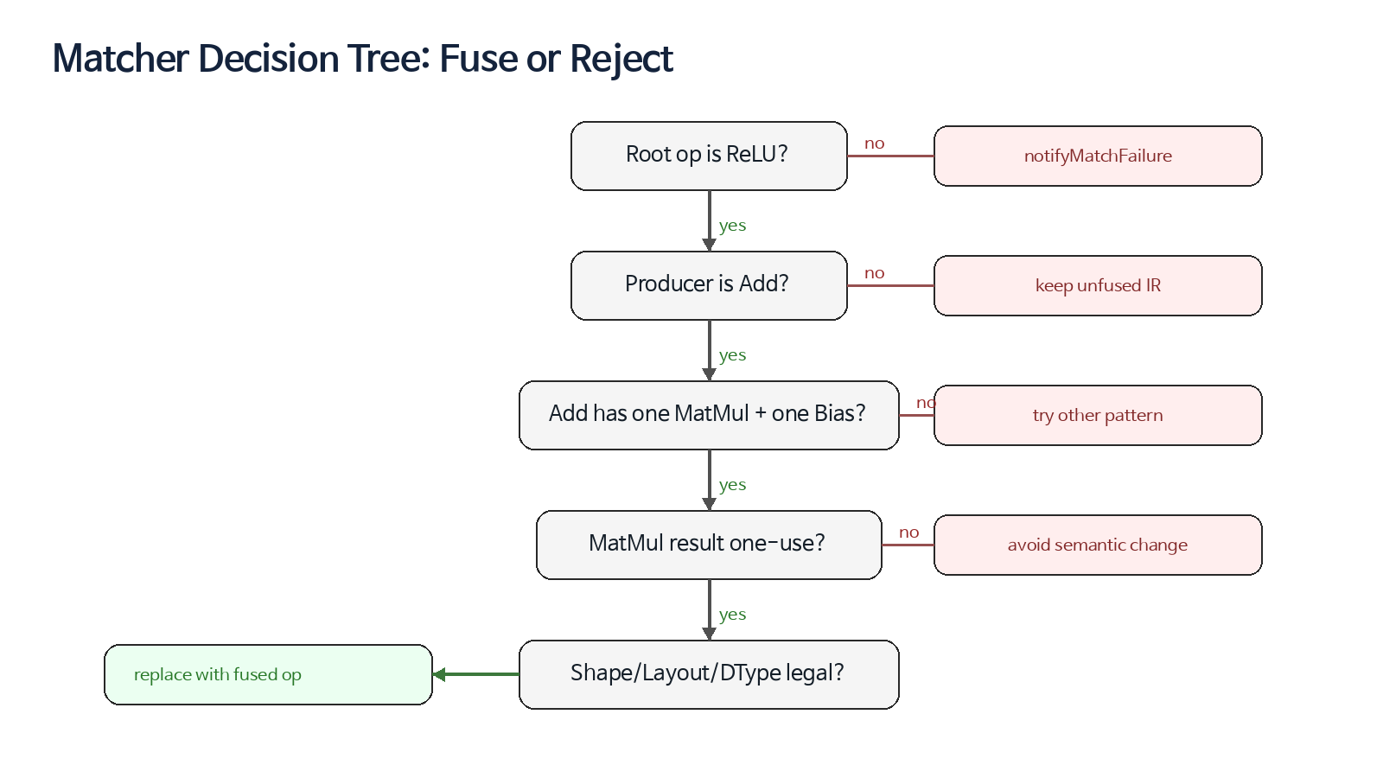
Matcher Decision Tree
root ReLU 확인
producer AddBias 확인
MatMul + Bias operand classification
producer one-use 확인
shape/layout/dtype target legality 확인
모든 조건이 통과해야 rewrite
Lecture 10 | 15

Slide 16
Semantic Checks
ReLU가 정확히 max(x, 0)인지 확인
Add가 bias broadcast인지 elementwise residual add인지 구분
MatMul contraction semantics가 target kernel과 일치
side-effecting op 또는 ordering dependency 없음
Lecture 10 | 16

Slide 17
Use-Def Checks
MatMul result one-use
AddBias result one-use
replacement result type equals ReLU result type
shared producer는 negative test로 보호
clone-based fusion은 별도 cost model과 semantic proof 필요
Lecture 10 | 17

Slide 18
Shape / Layout Checks
bias shape: scalar, [N], 또는 target-supported broadcast
output rank와 static/dynamic dim policy
lhs/rhs transpose 또는 packed layout attribute
layout transform cost가 fusion benefit을 상쇄하지 않는지 확인
Lecture 10 | 18

Slide 19
DType / Quantization Checks
FP32/BF16/FP16 path: activation 위치 비교적 단순
INT8/INT4 path: accumulator, requant, saturation, clamp 위치 중요
per-tensor/per-channel scale support 확인
activation이 requant 전/후 어디에 들어가는지 ABI와 kernel에 맞춤
Lecture 10 | 19

Slide 20
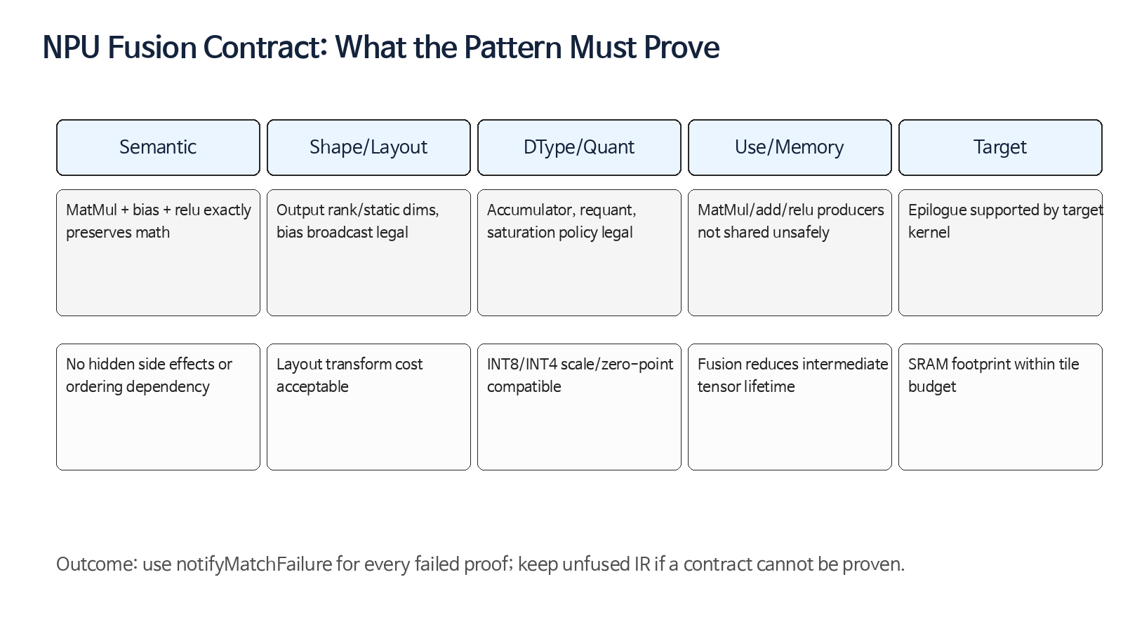
NPU Fusion Contract
fusion pattern은 target contract를 증명하는 작은 verifier
증명 실패 시 unfused IR 유지가 안전한 기본값
diagnostic reason은 compiler tuning의 핵심 데이터
contract는 op verifier와 pass test로 중복 방어
Lecture 10 | 20

Slide 21
Replacement Op Design
npu_graph.matmul_epilogue(lhs, rhs, bias)
attributes: activation, layout, accumulator, quant policy
result type: original ReLU output type
location: fusedLoc(matmul, add, relu)
later lowering: npu_kernel.matmul + DMA/barrier + runtime descriptor
Lecture 10 | 21

Slide 22
C++ Pattern Skeleton
struct FuseMatMulBiasReluPattern : OpRewritePattern<linalg::GenericOp> { LogicalResult matchAndRewrite(linalg::GenericOp relu, PatternRewriter &rewriter) const override { if (!isReluGeneric(relu)) return rewriter.notifyMatchFailure(relu, "not relu"); auto add = getSingleProducerOfType<linalg::GenericOp>(reluInput); if (!add || !isAddBiasGeneric(add)) return rewriter.notifyMatchFailure(relu, "not add bias"); if (!matmul->hasOneUse() || !add->hasOneUse()) return rewriter.notifyMatchFailure(relu, "shared producer"); auto fused = rewriter.create<npu_graph::MatmulEpilogueOp>(...); rewriter.replaceOp(relu, fused.getResults()); rewriter.eraseOp(add); rewriter.eraseOp(matmul); return success(); } };
Lecture 10 | 22

Slide 23
Failure Diagnostics
notifyMatchFailure(relu, "root is not ReLU")
notifyMatchFailure(add, "cannot classify matmul and bias")
notifyMatchFailure(relu, "producer result is shared")
notifyMatchFailure(relu, "unsupported bias broadcast")
notifyMatchFailure(relu, "quantization policy not representable")
Lecture 10 | 23

Slide 24
Pass Skeleton
void runOnOperation() override { RewritePatternSet patterns(&getContext()); patterns.add<FuseMatMulBiasReluPattern>(&getContext()); GreedyRewriteConfig config; config.useTopDownTraversal = true; config.maxIterations = 10; if (failed(applyPatternsGreedily(getOperation(), std::move(patterns), config))) signalPassFailure(); }
Lecture 10 | 24

Slide 25
PDL / Declarative Matching
PDL can describe graph-shaped pattern matching declaratively
Native constraints can handle target legality predicates
C++ rewrite callback can create fused target op
Useful for prototyping and pattern library readability
Lecture 10 | 25

Slide 26
Testing Strategy
Positive: fused op appears, old ops disappear
Negative: shared producer, unsupported bias, unsupported dtype do not fuse
Diagnostic: failure reason is stable enough for debugging
Stress: dynamic shape, multi-user, layout mismatch, quant mismatch
Lecture 10 | 26

Slide 27
FileCheck Template
// RUN: mlir-opt %s --npu-fuse-epilogue | FileCheck %s // CHECK-LABEL: func.func @matmul_bias_relu // CHECK: "npu_graph.matmul_epilogue" // CHECK-SAME: activation = "relu" // CHECK-NOT: linalg.generic // Negative case: // CHECK-LABEL: func.func @shared_matmul_result_must_not_fuse // CHECK-NOT: "npu_graph.matmul_epilogue"
Lecture 10 | 27

Slide 28
Debug Recipe
Run pass with --mlir-print-ir-after-change
Use -debug-only=greedy-rewriter when available
Use pattern debug labels to filter
Reduce test with specific positive/negative examples
Add verifier checks to fused op
Lecture 10 | 28

Slide 29
Integration in NPU Pipeline
After canonicalize/cse and graph cleanup
Before bufferization and target memory scheduling
Before layout is fully frozen, but after enough shape inference
Follow with npu_graph legality check and cost model pass
Lecture 10 | 29

Slide 30
Common Mistakes
one-use omission
broadcast semantics confusion
dtype/quant clamp order mismatch
cyclic rewrite via inverse patterns
pattern benefit used as a substitute for legality
only positive tests
Lecture 10 | 30

Slide 31
Exercise A
Annotate root/producers/operands in 01_linalg_matmul_add_relu_before.mlir
Mark which op is replaced and which ops are erased
Write 5 notifyMatchFailure reasons
Lecture 10 | 31

Slide 32
Exercise B
Complete C++ helper checklist
isReluGeneric
isAddBiasGeneric
isMatMulGeneric
classifyAddInputs
checkShapeDTypeLayoutForTarget
Lecture 10 | 32

Slide 33
Exercise C
Design test matrix
Positive: fp32, bias vector, supported layout
Positive: int8 with legal requant
Negative: shared MatMul result
Negative: unsupported broadcast/layout/dtype
Lecture 10 | 33

Slide 34
Homework
Submit 1-page Fusion Pattern Spec
Complete pass skeleton with pattern registration
Write 3 positive and 5 negative FileCheck tests
Define runtime descriptor fields for fused epilogue
Lecture 10 | 34

Slide 35
Takeaways
Rewrite pattern is the smallest executable compiler optimization unit
Safe matching is more important than aggressive fusion
NPU fusion must prove semantic + target legality
Debuggability comes from good failure reasons and negative tests
Next: Dialect Conversion and legal op sets
Lecture 10 | 35

Slide 36
References
MLIR Pattern Rewriter documentation
MLIR Canonicalization documentation
MLIR Dialect Conversion documentation
MLIR Quickstart Rewrites tutorial
MLIR Greedy Pattern Rewrite Driver API
Lecture 10 | 36

