Slide 1
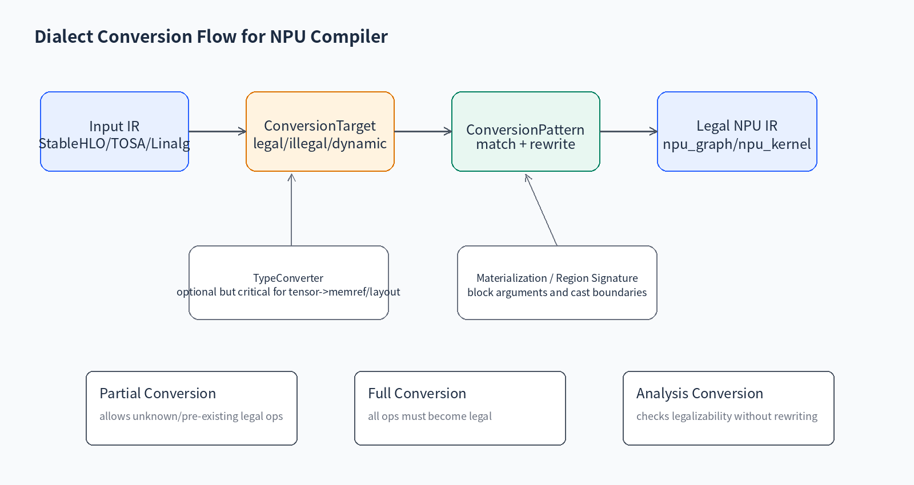
Lecture 11 Dialect Conversion
NPU legal op set과 unsupported op lowering
MLIR NPU Compiler - Lecture 11 | 01

Slide 2
오늘의 위치
• 09 Pass Infrastructure: pass pipeline 설계
• 10 Rewrite Pattern: local fusion/cleanup
• 11 Dialect Conversion: legal/illegal boundary 정의
• 12 Bufferization: tensor -> memref memory boundary
MLIR NPU Compiler - Lecture 11 | 02

Slide 3
Learning Objectives
• ConversionTarget으로 NPU legal op set을 정의한다
• dynamic legality로 shape/dtype/layout 제약을 encode한다
• ConversionPattern으로 unsupported op를 낮춘다
• TypeConverter와 region signature conversion의 역할을 설명한다
• positive/negative regression test를 작성한다
MLIR NPU Compiler - Lecture 11 | 03

Slide 4
왜 Dialect Conversion인가?
• RewritePattern은 “바꿀 수 있으면 바꾸기”에 가깝다
• Dialect Conversion은 “이 boundary 이후 무엇이 legal인가?”를 명시한다
• NPU compiler에서는 target capability contract가 pass의 성공/실패 기준이 된다
MLIR NPU Compiler - Lecture 11 | 04

Slide 5
Dialect Conversion 구성 요소
• ConversionTarget: legal/illegal/dynamic legality
• RewritePatternSet: illegal op를 legal op sequence로 변환
• TypeConverter: type/block argument/materialization 처리
• applyPartialConversion / applyFullConversion / applyAnalysisConversion
MLIR NPU Compiler - Lecture 11 | 05

Slide 6
Conversion Flow
MLIR NPU Compiler - Lecture 11 | 06

Slide 7
ConversionTarget = Target Contract
• addLegalDialect: dialect 전체를 legal로 등록
• addLegalOp: 특정 op만 legal로 등록
• addIllegalOp / addIllegalDialect: 반드시 변환되어야 하는 op 지정
• addDynamicallyLegalOp: op property 기반 legality 지정
MLIR NPU Compiler - Lecture 11 | 07

Slide 8
Static vs Dynamic Legality
• Static legality: op name/dialect만 보고 판단
• Dynamic legality: shape, dtype, layout, quant attr, target feature를 검사
• NPU에서는 대부분 dynamic legality가 필요하다
MLIR NPU Compiler - Lecture 11 | 08

Slide 9
Recursive Legality
• 어떤 op의 region 내부를 “이미 legal한 island”로 취급할 수 있다
• 예: npu_kernel.launch 내부 command sequence를 region 단위로 보호
• 잘못 쓰면 내부 illegal op가 숨어서 final lowering을 깨뜨린다
MLIR NPU Compiler - Lecture 11 | 09

Slide 10
Conversion Mode #1 - Partial
• 명시적으로 illegal인 op를 가능한 만큼 legalize
• unknown/pre-existing legal op는 남을 수 있음
• NPU progressive lowering에 적합: graph 일부만 target op로 변환
MLIR NPU Compiler - Lecture 11 | 10

Slide 11
Conversion Mode #2 - Full
• 모든 op가 target에서 known legal이어야 성공
• final boundary에 적합: runtime/ABI emission 전
• unsupported op가 남으면 signalPassFailure
MLIR NPU Compiler - Lecture 11 | 11

Slide 12
Conversion Mode #3 - Analysis
• IR을 바꾸지 않고 legalizable 여부를 분석
• NPU capability report와 fallback planning에 적합
• “이 모델이 우리 NPU에서 돌 수 있는가?”를 빠르게 판단
MLIR NPU Compiler - Lecture 11 | 12

Slide 13
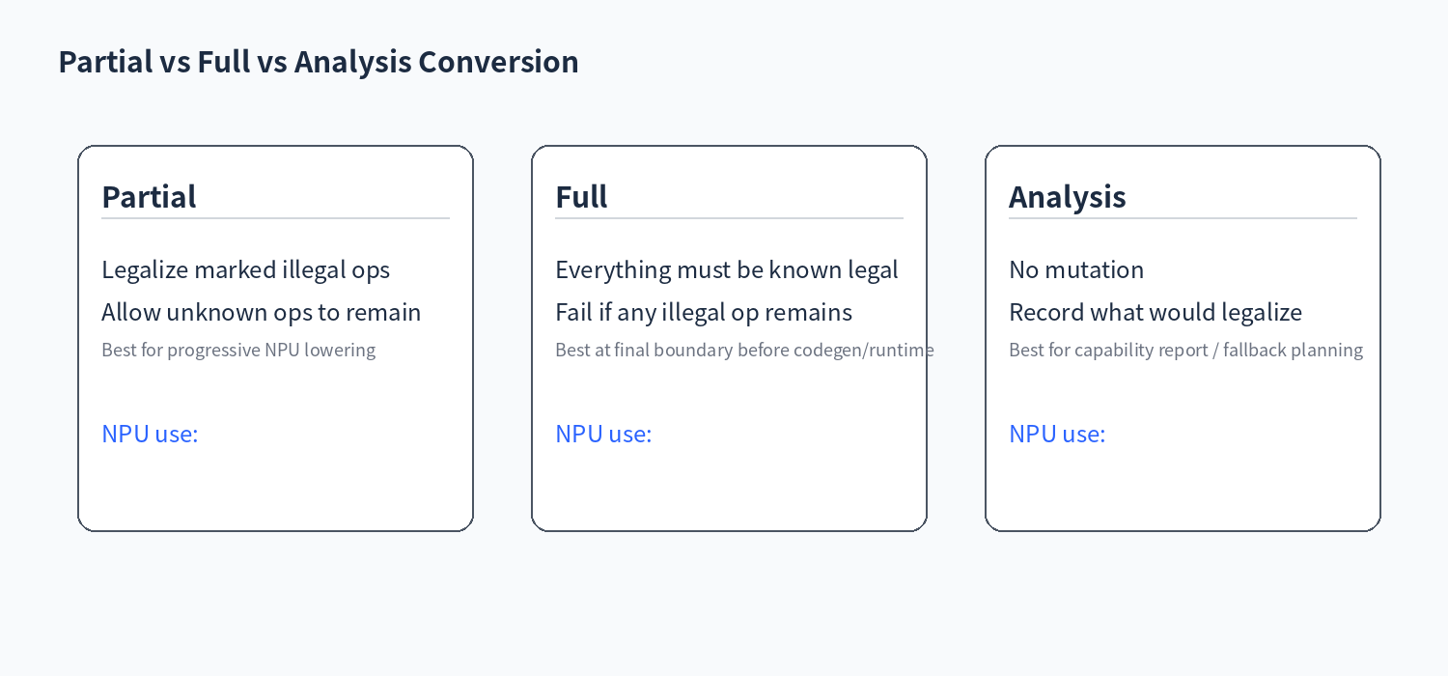
Conversion Modes 비교
MLIR NPU Compiler - Lecture 11 | 13

Slide 14
ConversionPattern vs RewritePattern
• ConversionPattern은 remapped operand adaptor를 받는다
• TypeConverter가 operand/result type을 바꾼 경우 adaptor를 사용해야 한다
• illegal op를 legal op로 바꾸는 것이 목적이다
MLIR NPU Compiler - Lecture 11 | 14

Slide 15
Adaptor를 써야 하는 이유
• original operand: old type일 수 있음
• adaptor operand: conversion framework가 remap한 legal type
• NPU layout/type conversion 후 original operand를 쓰면 verifier failure가 발생할 수 있다
MLIR NPU Compiler - Lecture 11 | 15

Slide 16
TypeConverter 핵심
• Type mapping: tensor -> memref/custom descriptor
• Argument conversion: block argument와 function signature 수정
• Materialization: legal/illegal boundary에 필요한 cast/bridge op 생성
• NPU에서는 layout/memory-space/ABI contract와 연결된다
MLIR NPU Compiler - Lecture 11 | 16

Slide 17
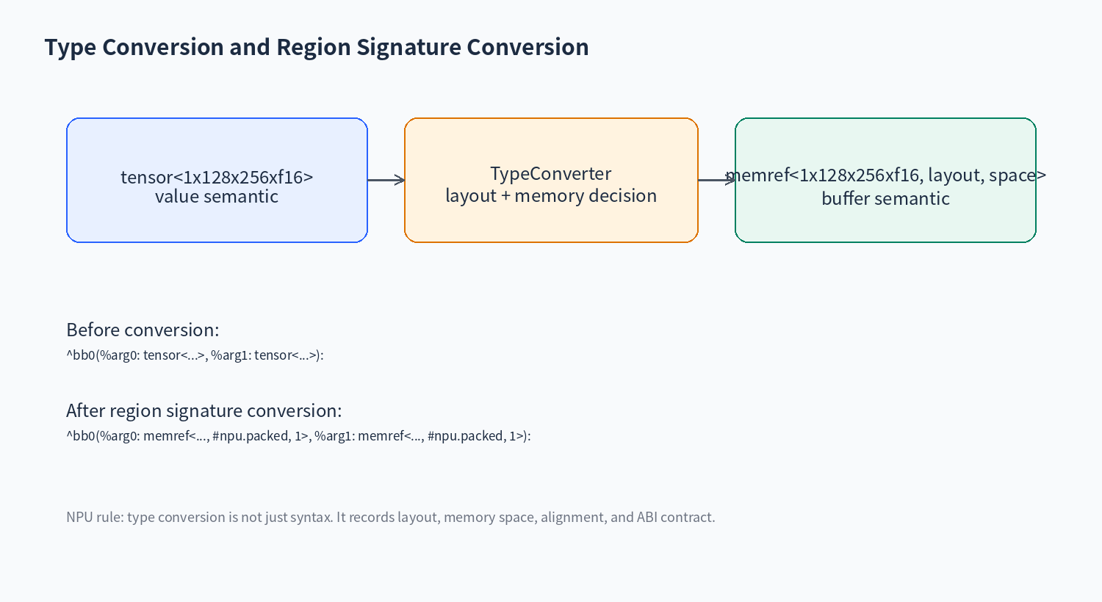
Type Conversion 예시
MLIR NPU Compiler - Lecture 11 | 17

Slide 18
NPU Legal Op Set은 이름 목록이 아니다
• op name + shape policy + dtype policy + layout policy + target feature
• latency/energy/SRAM fit 조건도 compiler decision에 반영
• legal op set은 compiler와 hardware microarchitecture의 contract이다
MLIR NPU Compiler - Lecture 11 | 18

Slide 19
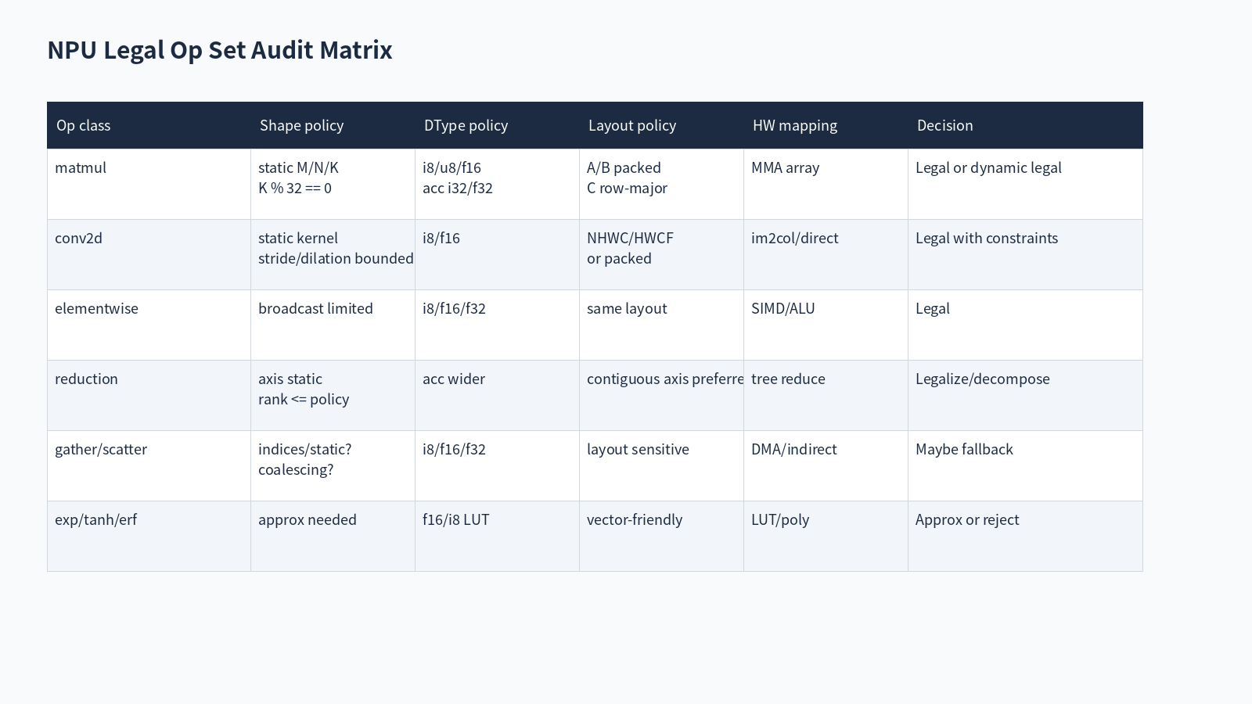
Legal Op Set Matrix
MLIR NPU Compiler - Lecture 11 | 19

Slide 20
MatMul Dynamic Legality 예시
• M/N/K static
• K multiple matches MMA tile
• A/B layout is packed or packable
• accumulator type is i32/f32
• epilogue kind is supported: none/bias/relu/gelu_lut
MLIR NPU Compiler - Lecture 11 | 20

Slide 21
Conv2D Dynamic Legality 예시
• NHWC/HWCF or compiler-supported packed layout
• kernel/stride/dilation bounds satisfied
• group/depthwise support checked separately
• SRAM footprint fits tile policy
MLIR NPU Compiler - Lecture 11 | 21

Slide 22
Reduction Dynamic Legality 예시
• axis must be static
• rank and reduction length within hardware policy
• accumulator precision defined
• reduction axis should be contiguous or cheaply transposable
MLIR NPU Compiler - Lecture 11 | 22

Slide 23
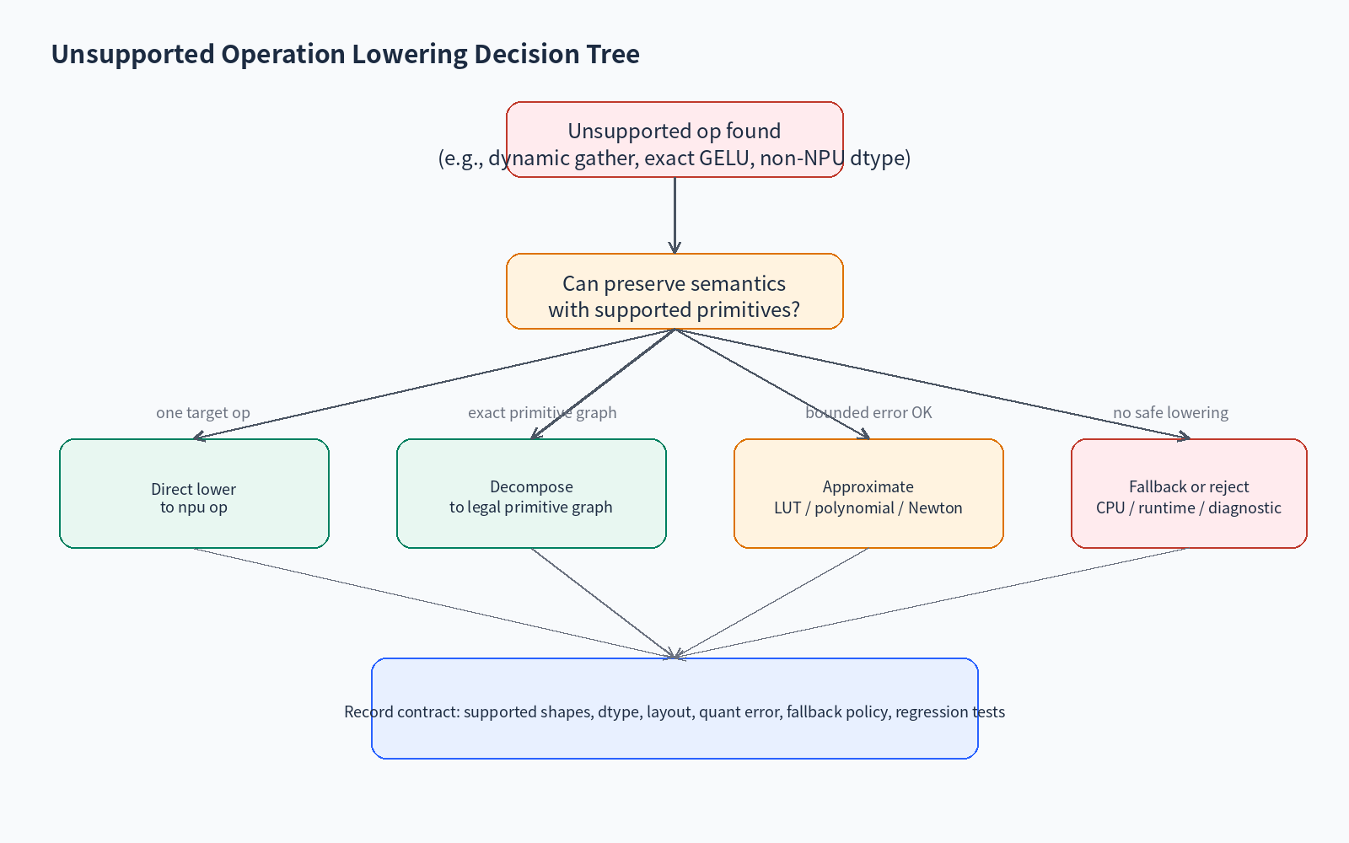
Unsupported Op Decision Tree
MLIR NPU Compiler - Lecture 11 | 23

Slide 24
Case Study A - GELU
• Exact erf/tanh may be unsupported on edge NPU
• Lowering options: tanh polynomial, LUT, piecewise linear, CPU fallback
• Compiler must record accuracy budget and calibration domain
MLIR NPU Compiler - Lecture 11 | 24

Slide 25
Case Study B - LayerNorm rsqrt
• rsqrt may be approximated by LUT + Newton iteration
• epsilon placement affects numerical compatibility
• fusion with preceding/following ops can reduce DRAM traffic
MLIR NPU Compiler - Lecture 11 | 25

Slide 26
Case Study C - Gather/Scatter
• Irregular memory access may break DMA coalescing
• If indices are static: precompute or transform layout
• If dynamic and uncoalesced: fallback may be better than NPU execution
MLIR NPU Compiler - Lecture 11 | 26

Slide 27
Pass Skeleton 구조
• Define ConversionTarget
• Mark legal/illegal/dynamic legal ops
• Populate conversion patterns
• Apply partial/full conversion
• signalPassFailure on illegal leftovers
MLIR NPU Compiler - Lecture 11 | 27

Slide 28
C++ Pseudocode
• ConversionTarget target(ctx);
• target.addLegalDialect<npu_graph::NPUGraphDialect>();
• target.addDynamicallyLegalOp<npu_graph::MatMulOp>(predicate);
• patterns.add<LowerUnsupportedGelu, LowerLayerNorm>(typeConverter, ctx);
• applyPartialConversion(module, target, patterns);
MLIR NPU Compiler - Lecture 11 | 28

Slide 29
Negative Diagnostics
• Unsupported dtype: emit clear message
• Unsupported dynamic shape: tell which dimension is dynamic
• Unsupported layout: suggest pack/transpose pass
• Unsupported accuracy: require fallback or calibration flag
MLIR NPU Compiler - Lecture 11 | 29

Slide 30
FileCheck Strategy
• CHECK-NOT: unsupported op should disappear
• CHECK: target npu op appears
• CHECK-SAME: important attrs preserved
• negative test: -verify-diagnostics for unsupported case
MLIR NPU Compiler - Lecture 11 | 30

Slide 31
Integration in NPU Pipeline
• After canonicalize/decompose/fusion
• Before bufferization when tensor-level semantics are still available
• May run multiple times: graph legalization, kernel legalization, runtime legalization
MLIR NPU Compiler - Lecture 11 | 31

Slide 32
Common Mistakes
• Using RewritePattern where conversion legality is needed
• Declaring entire dialect legal too early
• Forgetting dynamic legality predicates
• Using original operands instead of adaptor operands
• No negative tests for unsupported model cases
MLIR NPU Compiler - Lecture 11 | 32

Slide 33
Exercise A
• Fill NPU legal op set table for matmul/conv/reduce/gather/gelu
• Mark each as legal, dynamic legal, decompose, approximate, or fallback
MLIR NPU Compiler - Lecture 11 | 33

Slide 34
Exercise B
• Write ConversionTarget skeleton for npu_graph legalization
• Add at least two dynamic legality predicates
• Define unsupported op diagnostics
MLIR NPU Compiler - Lecture 11 | 34

Slide 35
Exercise C
• Lower MatMul + Bias + unsupported GELU to npu_graph.matmul_epilogue with gelu_lut
• Write before/after MLIR and FileCheck expectations
MLIR NPU Compiler - Lecture 11 | 35

Slide 36
Takeaways
• Dialect Conversion turns target capability into compiler-enforced legality
• NPU legal op set must include shape/dtype/layout/quant/memory policy
• Unsupported op handling is a product decision: exact, approximate, fallback, or reject
• Good diagnostics and negative tests are mandatory for production NPU compilers
MLIR NPU Compiler - Lecture 11 | 36

Slide 37
References
• MLIR Dialect Conversion
• MLIR Toy Tutorial Ch.5/Ch.6
• MLIR Language Reference
• MLIR Pattern Rewriter
MLIR NPU Compiler - Lecture 11 | 37

