Slide 1
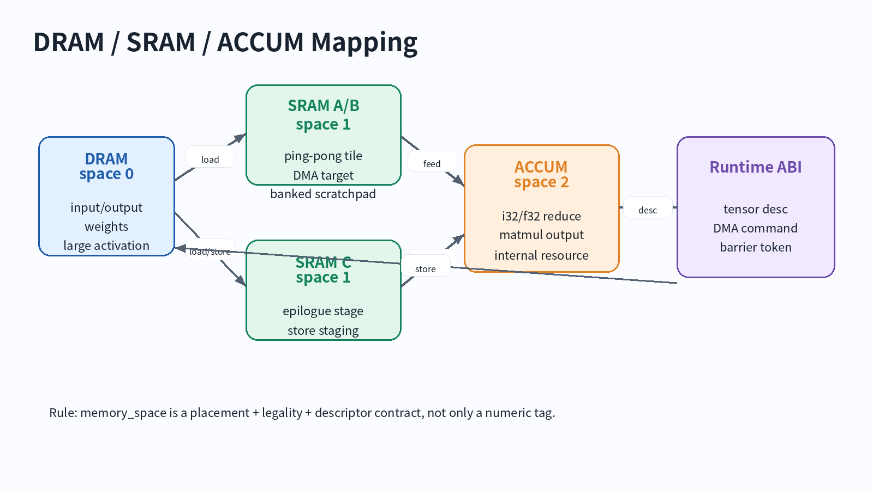
Lecture 13
MemRef, Layout, Memory Space
DRAM/SRAM/Accumulator mapping for NPU Compiler
MLIR NPU Compiler | Lecture 13 | 1

Slide 2
오늘의 위치
12강: tensor -> memref bufferization
13강: memref layout and memory-space contract
14강: vector dialect and tensorization
NPU compiler에서는 13강이 memory architecture boundary다.
MLIR NPU Compiler | Lecture 13 | 2

Slide 3
Learning Objectives
MemRef type을 shape/type/layout/memory-space로 분해한다.
strided layout과 affine map을 NPU address generation으로 해석한다.
DRAM/SRAM/ACCUM memory space를 target ABI contract로 설계한다.
MatMul tile buffer의 placement, footprint, descriptor를 작성한다.
layout/memory-space verifier와 FileCheck test를 설계한다.
MLIR NPU Compiler | Lecture 13 | 3

Slide 4
왜 중요한가?
NPU 성능은 data movement에 먼저 막힌다.
layout은 DMA burst, vector load, bank conflict를 결정한다.
memory space는 allocation pool, lifetime, command buffer ABI를 결정한다.
잘못된 memref lowering은 extra copy 또는 scalarized access로 이어진다.
MLIR NPU Compiler | Lecture 13 | 4

Slide 5
Tensor vs MemRef
Tensor: immutable value semantics, high-level transform에 적합
MemRef: storage semantics, allocation/view/lifetime 명시
Bufferization 이후에는 placement decision이 visible해야 함
NPU backend는 memref type을 kernel ABI로 읽는다.
MLIR NPU Compiler | Lecture 13 | 5

Slide 6
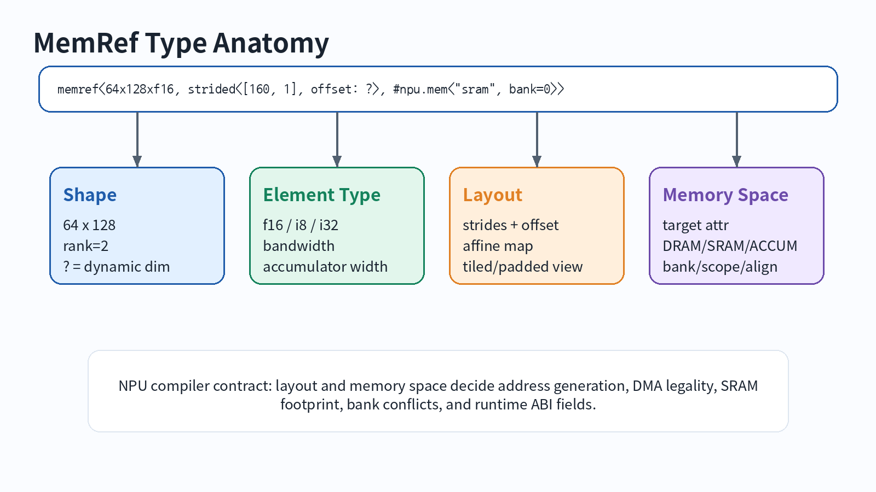
MemRef Type Anatomy
MLIR NPU Compiler | Lecture 13 | 6

Slide 7
MemRef Type Syntax
memref<64x128xf16> memref<64x128xf16, strided<[160, 1], offset: 0>> memref<?x?xf16, strided<[?, ?], offset: ?>> memref<64x128xf16, strided<[160,1], offset:0>, 1> memref<64x128xf16, strided<[160,1], offset:0>, #npu.mem<"sram", bank=0>>
MLIR NPU Compiler | Lecture 13 | 7

Slide 8
MemRef는 pointer가 아니다
base pointer 외에도 offset, sizes, strides가 필요하다.
dynamic shape/stride는 runtime descriptor field로 남는다.
layout이 identity가 아니면 plain C pointer ABI로 충분하지 않다.
NPU descriptor 설계는 memref lowering의 일부다.
MLIR NPU Compiler | Lecture 13 | 8

Slide 9
Layout이 의미하는 것
logical index -> physical storage metadata mapping
strided form: offset + strides
affine map: tiled/padded/swizzled layout 표현 가능
NPU address generator와 DMA descriptor의 입력
MLIR NPU Compiler | Lecture 13 | 9

Slide 10
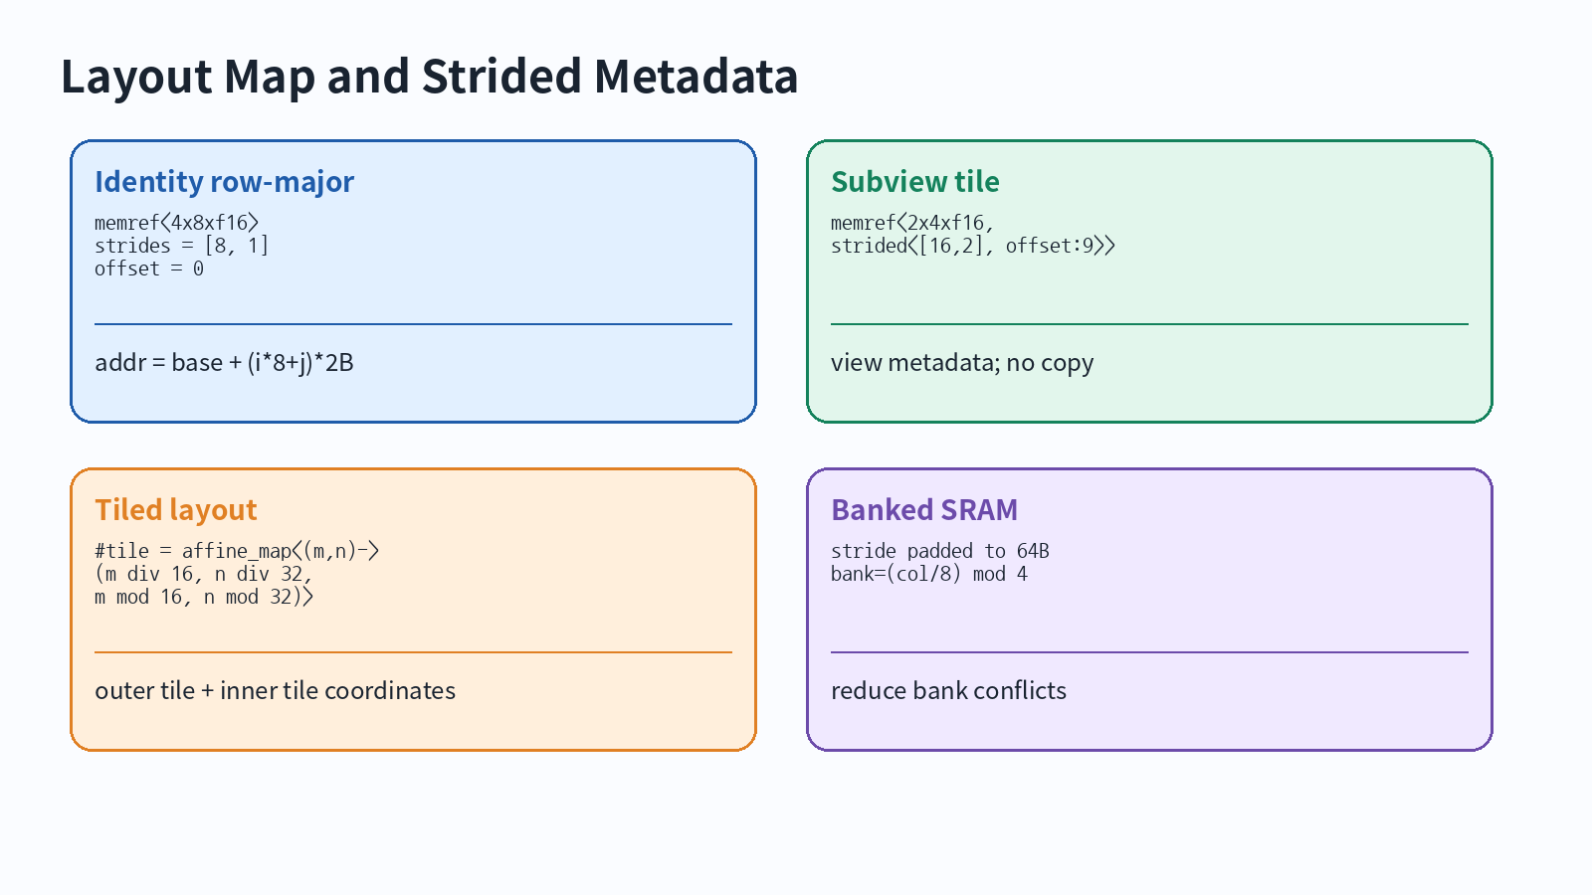
Layout Map Examples
MLIR NPU Compiler | Lecture 13 | 10

Slide 11
Strided Address Formula
linear_index = offset + sum_i(index_i * stride_i) byte_address = base + linear_index * sizeof(element) Example: memref<64x128xf16, strided<[160, 1], offset: 0>, 1> addr(i,j) = base + (i*160 + j) * 2
MLIR NPU Compiler | Lecture 13 | 11

Slide 12
Subview = tile view
memref.subview는 reduced-size view를 만든다.
offsets/sizes/strides를 바꾸지만 data copy를 의미하지 않는다.
tile view를 먼저 만든 뒤 DMA lowering이 copy command를 만든다.
edge tile은 dynamic sizes로 표현될 수 있다.
MLIR NPU Compiler | Lecture 13 | 12

Slide 13
Metadata operations
memref.transpose: strided metadata permutation
extract_strided_metadata: base/offset/sizes/strides 추출
reinterpret_cast: descriptor 재구성
runtime descriptor lowering에서 유용한 bridge op
MLIR NPU Compiler | Lecture 13 | 13

Slide 14
Memory Space 관점
MLIR memref memory space는 target-specific attribute
단순 숫자가 아니라 allocation/placement/ABI contract
DRAM/SRAM/ACCUM/CONST semantics를 verifier가 알아야 함
custom attribute가 bank, align, scope 표현에 유리함
MLIR NPU Compiler | Lecture 13 | 14

Slide 15
NPU Memory Space Mapping
MLIR NPU Compiler | Lecture 13 | 15

Slide 16
Memory Space Examples
// Course convention: 0=DRAM, 1=SRAM, 2=ACCUM memref<1024x1024xf16, 0> // DRAM tensor memref<64x128xf16, 1> // SRAM tile memref<64x64xi32, 2> // ACCUM tile // Real backend style memref<64x128xf16, strided<[160,1], offset:0>, #npu.mem<"sram", bank=0, align=64, scope="tile">>
MLIR NPU Compiler | Lecture 13 | 16

Slide 17
DRAM Space Contract
host/runtime-visible tensor storage
DMA source/sink for activations and weights
alignment and address range must be legal
large tensors generally stay here until tiled
MLIR NPU Compiler | Lecture 13 | 17

Slide 18
SRAM Space Contract
scratchpad tile buffer with explicit lifetime
bank assignment and double buffering are compiler decisions
layout padding may trade footprint for bandwidth
illegal escape to function boundary should be diagnosed
MLIR NPU Compiler | Lecture 13 | 18

Slide 19
ACCUM Space Contract
matmul/reduction accumulator resource
usually wider dtype: i32/f32
may not be byte-addressable or host-visible
epilogue/requant must consume before store staging
MLIR NPU Compiler | Lecture 13 | 19

Slide 20
Memory Space Cast vs DMA
memory_space_cast can alias same underlying memory with a different memref type
DMA copy moves data between spaces
Do not use cast as a substitute for DMA
bubble-down-memory-space-casts can simplify generic/default casts
MLIR NPU Compiler | Lecture 13 | 20

Slide 21
MatMul Tile Mapping Pseudo IR
%a_tile = memref.alloc() {alignment = 64} : memref<64x128xf16, 1> %b_tile = memref.alloc() {alignment = 64} : memref<128x64xf16, 1> %c_acc = memref.alloc() {alignment = 64} : memref<64x64xi32, 2> %c_sram = memref.alloc() {alignment = 64} : memref<64x64xi8, 1> // npu.dma_load A -> a_tile // npu.dma_load B -> b_tile // npu.matmul a_tile, b_tile -> c_acc // npu.requant c_acc -> c_sram // npu.dma_store c_sram -> C
MLIR NPU Compiler | Lecture 13 | 21

Slide 22
Footprint Formula
A_tile = Mt * Kt * sizeof(A)
B_tile = Kt * Nt * sizeof(B)
C_acc = Mt * Nt * sizeof(accum)
SRAM_total = pingpong*(A+B) + C_stage + tags + padding
MLIR NPU Compiler | Lecture 13 | 22

Slide 23
Tile Size Heuristics
SRAM fit is necessary but not sufficient
prefer Kt that maximizes data reuse
align rows to DMA burst and vector lane width
pad strides to reduce bank conflicts when needed
MLIR NPU Compiler | Lecture 13 | 23

Slide 24
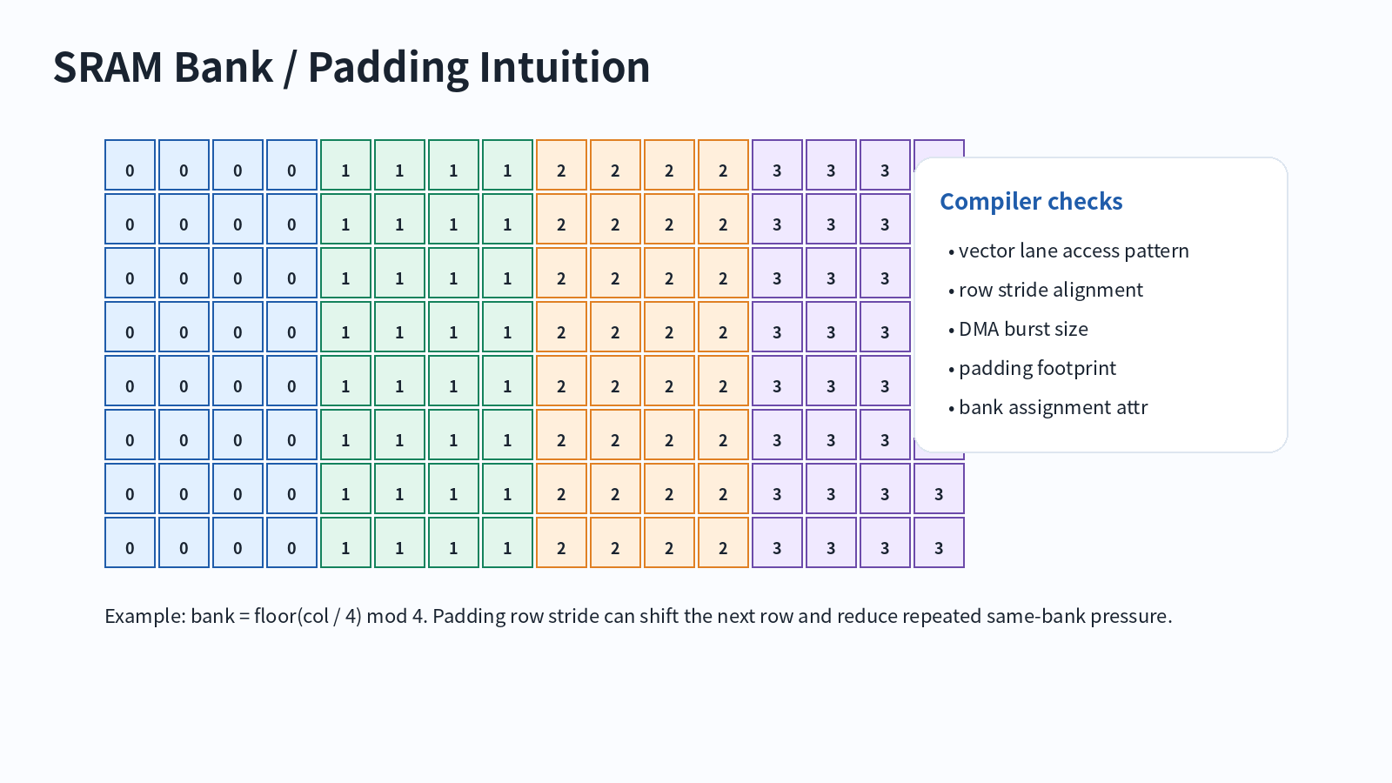
SRAM Banking and Padding
MLIR NPU Compiler | Lecture 13 | 24

Slide 25
Runtime Descriptor
rank, sizes, strides, dtype, memory_space are descriptor fields
static-only kernels may bake constants into command opcode
dynamic shape kernels need runtime descriptor metadata
layout_id is compact but less flexible than raw strides
MLIR NPU Compiler | Lecture 13 | 25

Slide 26
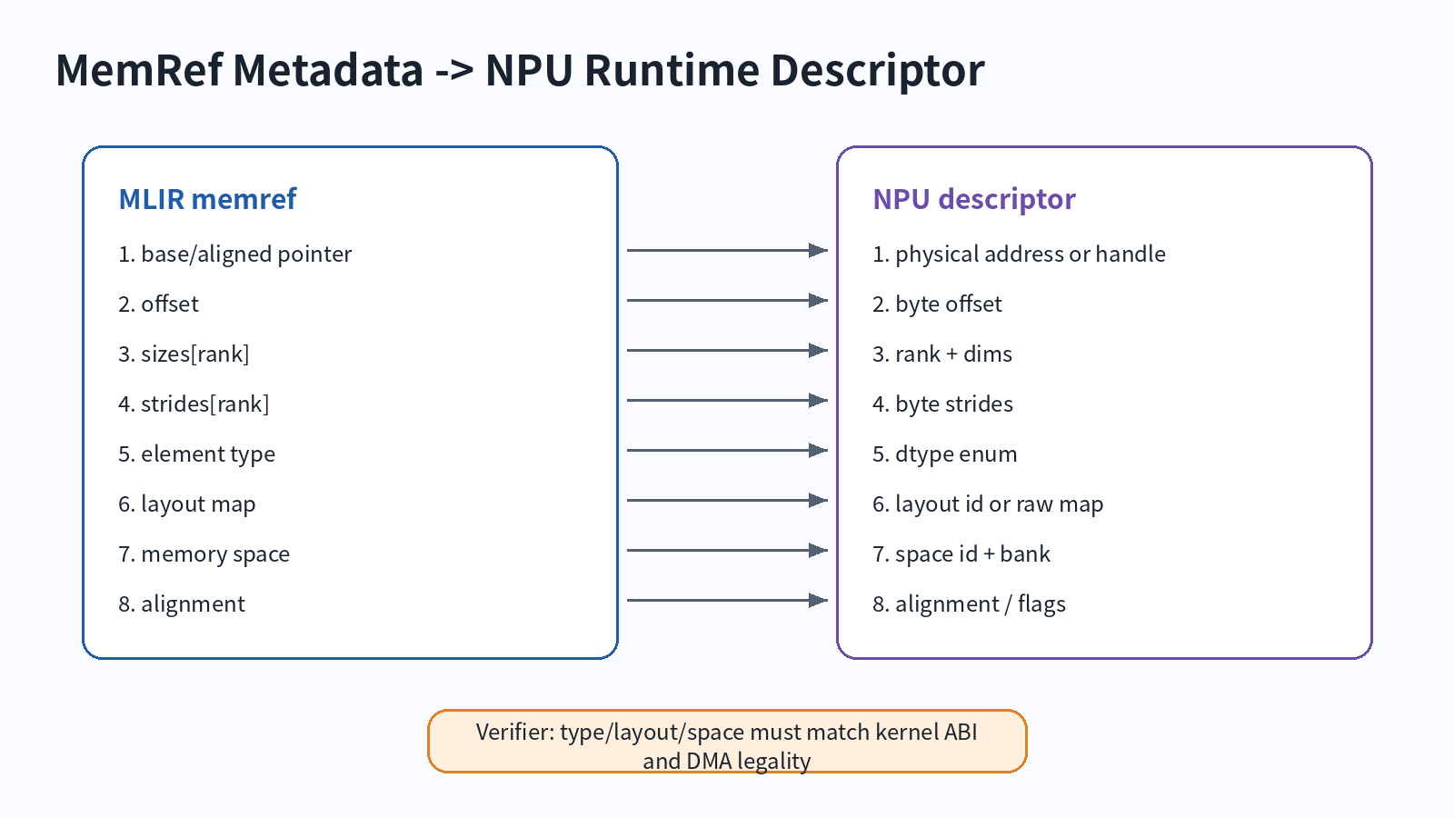
Runtime Descriptor Lowering
MLIR NPU Compiler | Lecture 13 | 26

Slide 27
Pass Design
Classify buffers by role: input/output/weight/tile/accum/tag
Analyze lifetime and capacity before rewriting types
Assign layout and bank together, not independently
Emit diagnostics for unsupported layout or illegal escape
MLIR NPU Compiler | Lecture 13 | 27

Slide 28
Recommended Pass Position
one-shot-bufferize
npu-classify-buffers
npu-assign-memory-spaces
npu-propagate-layout
npu-insert-dma
npu-lower-runtime-descriptors
MLIR NPU Compiler | Lecture 13 | 28

Slide 29
Verifier Checklist
shape/layout/type match kernel contract
SRAM allocations fit capacity and lifetime plan
ACCUM buffers do not escape illegally
DMA source/destination spaces and alignment are legal
dynamic offset/stride metadata is preserved
MLIR NPU Compiler | Lecture 13 | 29

Slide 30
FileCheck Strategy
CHECK expected memory space on alloc/subview types
CHECK-NOT unexpected memref.copy
negative test for unsupported layout
test dynamic descriptor fields after lowering
test memory_space_cast cleanup when expected
MLIR NPU Compiler | Lecture 13 | 30

Slide 31
Exercise A: MemRef Annotation
Annotate shape, dtype, layout, dynamic metadata, memory space
Write one verifier rule for each field
MLIR NPU Compiler | Lecture 13 | 31

Slide 32
Exercise B: Subview Tile Descriptor
Create 64x128 tile view at M/K offset
Compute result offset, sizes, strides
Mark what becomes DMA descriptor field
MLIR NPU Compiler | Lecture 13 | 32

Slide 33
Exercise C: MatMul Memory Map
Map A/B/C buffers to DRAM/SRAM/ACCUM
Calculate SRAM and ACCUM footprint
Choose bank and alignment policy
Write runtime descriptor draft
MLIR NPU Compiler | Lecture 13 | 33

Slide 34
Common Mistakes
Treating memref as a raw pointer
Using memory_space_cast when DMA copy is required
Letting ACCUM buffers escape to host-visible ABI
Lowering layout too early into scalar address arithmetic
Ignoring dynamic strides in descriptor ABI
MLIR NPU Compiler | Lecture 13 | 34

Slide 35
Takeaways
MemRef is the NPU storage contract after bufferization
Layout controls address generation and data movement efficiency
Memory space is target-specific and must be verified
DRAM/SRAM/ACCUM mapping is correctness + performance + ABI
Next: Vector Dialect and tensorization to NPU matmul
MLIR NPU Compiler | Lecture 13 | 35

Slide 36
References
MLIR MemRef Dialect
MLIR Data Layout Modeling
MLIR Passes and memory-space cast cleanup
MLIR Builtin Dialect - MemRef type
MLIR FAQ - MemRef is not only a pointer
MLIR NPU Compiler | Lecture 13 | 36

