Slide 1
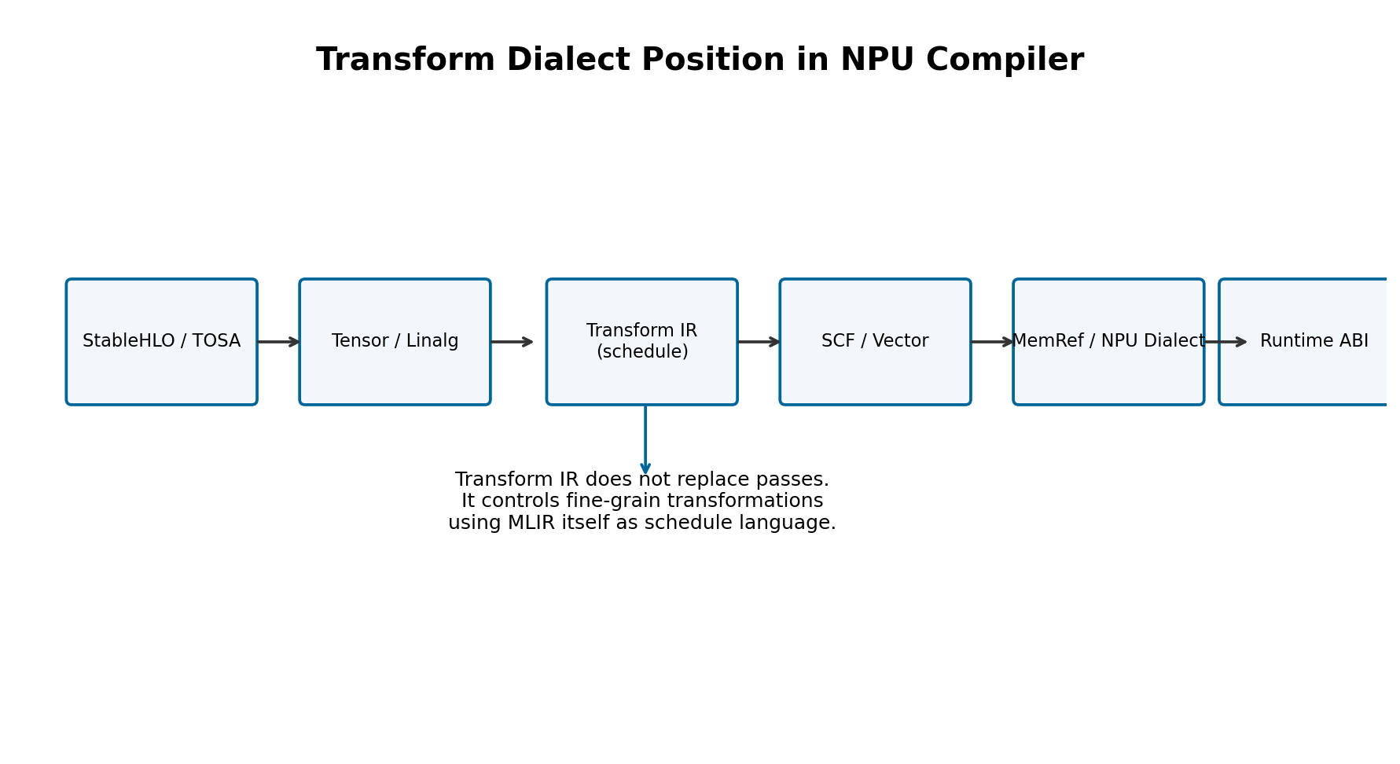
Lecture 15. Transform Dialect
tile / fuse / vectorize schedule IR for AI & NPU Compiler

Slide 2
오늘의 위치
14강: vector.contract -> NPU matmul mapping
15강: schedule itself as MLIR IR
16강: quantization policy and requant lowering

Slide 3
Learning Objectives
Transform Dialect의 payload IR, transform IR, handle, parameter 개념을 설명한다.
Linalg MatMul/Conv에 대해 tile, fuse, vectorize schedule을 IR로 표현한다.
schedule IR을 NPU tile shape, SRAM footprint, accumulator type, DMA policy와 연결한다.
transform-interpreter 기반 실행 흐름과 regression test 전략을 설계한다.

Slide 4
왜 Transform Dialect인가?
NPU schedule은 op semantics와 HW constraints 사이의 contract입니다.
Pass pipeline만으로는 특정 op/loop에 다른 schedule을 주기 어렵습니다.
Transform IR은 tile/fuse/vectorize 의사결정을 재현 가능한 IR로 기록합니다.

Slide 5
Pass vs Pattern vs Transform
Pass: 넓은 범위에 반복 적용되는 compiler stage
Pattern: local DAG rewrite와 canonicalization
Transform: payload IR의 특정 op set을 handle로 잡아 순서 있는 변환을 지시

Slide 6
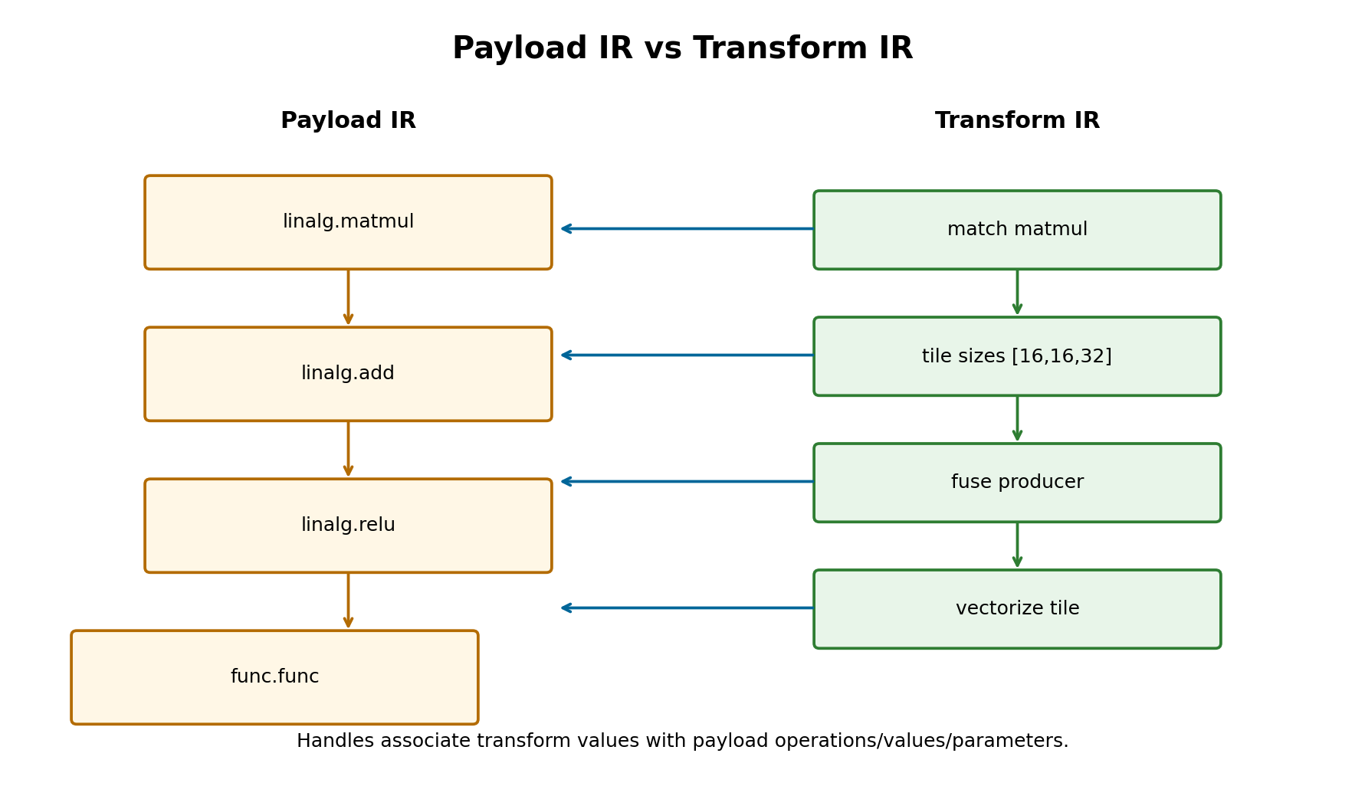
Payload IR vs Transform IR

Slide 7
Handle / Value / Parameter
operation handle: payload op set을 가리킴
value handle: payload SSA value set을 가리킴
parameter: tile size, vector size 같은 attribute-time value

Slide 8
Execution Model
top-level transform op에서 시작
scope payload op에 적용
sequence body의 transform op를 순서대로 실행
mutation op는 보통 입력 handle을 consume하고 새 handle을 반환

Slide 9
Failure Modes
silenceable failure: precondition 실패, fallback 가능
definite failure: postcondition/semantic violation
NPU에서는 unsupported tile/layout/shape를 silenceable로 다루는 경우가 많음

Slide 10
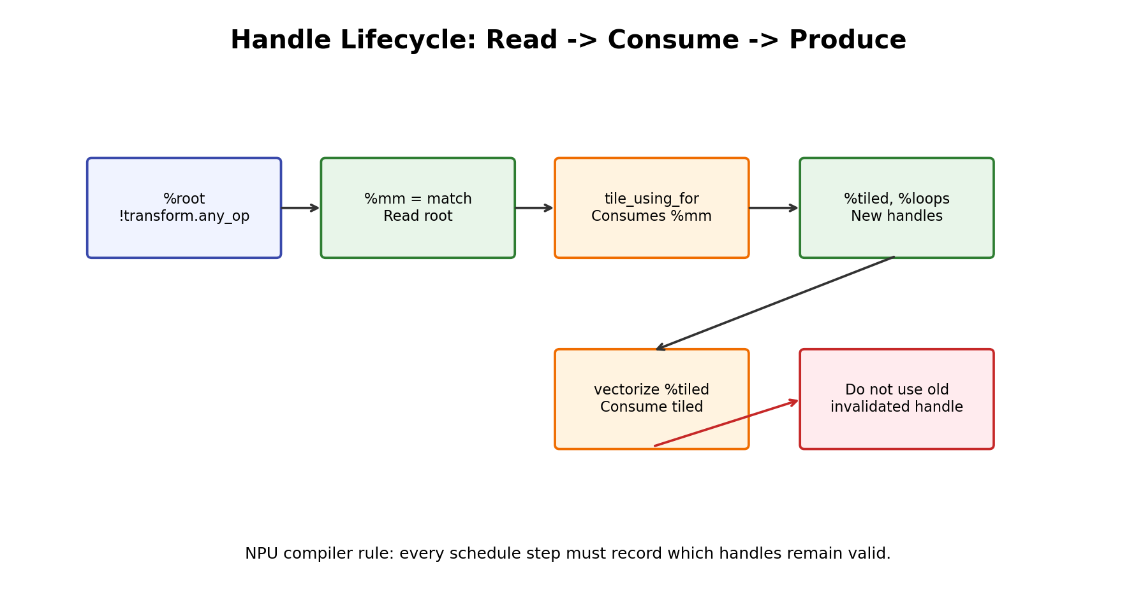
Handle Invalidation

Slide 11
Named Sequence
transform.named_sequence는 reusable schedule macro
entry point는 보통 __transform_main
NPU에서는 matmul_schedule, conv_schedule, epilogue_schedule로 분리

Slide 12
Interpreter Pass
-transform-interpreter가 named sequence를 실행
debug payload root tag로 적용 범위를 좁힘
CI에서는 transform IR + FileCheck로 schedule 회귀 테스트

Slide 13
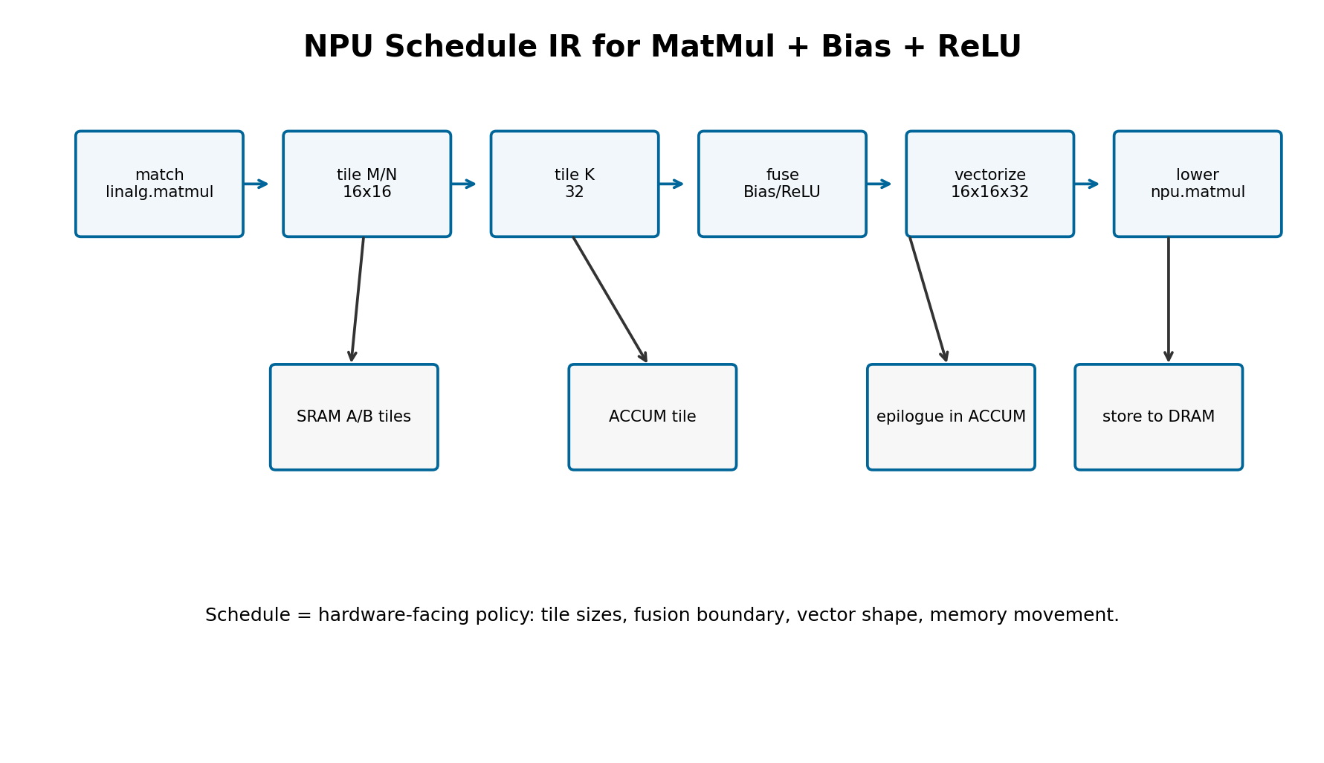
NPU 관점의 Schedule IR

Slide 14
Structured Ops와 Linalg
Linalg structured ops는 indexing_maps와 iterator_types가 명확함
tile/fuse/vectorize transform이 성숙한 영역
NPU compiler schedule 실습의 가장 좋은 시작점

Slide 15
Tile using for
Item | Compiler meaning | NPU meaning
target | Linalg op implementing TilingInterface | MatMul/Conv op candidate
tile sizes | static or dynamic sizes | native tile or SRAM tile
results | tiled op + generated loops | new handles for later schedule
risk | partial tiles and invalid old handles | peel/mask/fallback policy

Slide 16
Tile using forall
parallel tile 분배에 적합
thread/block mapping이 있는 backend에 유용
edge NPU에서는 cluster/core partitioning 모델과 연결 가능

Slide 17
Fuse into containing op
Item | Compiler meaning | NPU meaning
producer | op feeding consumer tile | bias/requant/relu producer
container | loop/tile operation | tile-local accumulator scope
benefit | compute only needed slice | reduce DRAM traffic
risk | higher local pressure | SRAM/register pressure

Slide 18
Vectorize
이미 적절히 tiled된 Linalg op를 vector form으로 변환
vector size는 native tile shape와 일치시켜야 함
partial tile은 mask/fallback/peeling 정책 필요

Slide 19
Transform Pipeline Example
Pseudo schedule - check exact syntax against your MLIR revision
// Transform IR schedule sketch.
// Syntax is close to upstream MLIR but may need adjustment for a specific LLVM/MLIR revision.
// Check upstream Transform Dialect docs and examples/transform tests for exact current spelling.
module attributes {transform.with_named_sequence} {
transform.named_sequence @__transform_main(%root: !transform.any_op)
attributes {transform.readonly} {
// 1. Select the MatMul payload operation.
%matmul = transform.structured.match ops{["linalg.matmul"]} in %root
: (!transform.any_op) -> !transform.any_op
// 2. Tile M/N/K to the NPU native tile shape.
// M=16, N=16, K=32 for INT8xINT8->INT32 accumulator.
%tiled_matmul, %loops:3 = transform.structured.tile_using_for %matmul
tile_sizes [16, 16, 32]
: (!transform.any_op) -> (!transform.any_op, !transform.any_op, !transform.any_op, !transform.any_op)
// 3. Match epilogue op and fuse it into the containing loop/tile when legal.
%epilogue = transform.structured.match ops{["npu_graph.bias_relu"]} in %root
: (!transform.any_op) -> !transform.any_op
// Pseudo: exact fusion target depends on the generated loop/tile handles.
// %fused, %new_loop = transform.structured.fuse_into_containing_op %epilogue into %loops#0
// : (!transform.any_op, !transform.any_op) -> (!transform.any_op, !transform.any_op)
// 4. Vectorize the tiled MatMul. It can later be tensorized to npu_kernel.matmul.
transform.structured.vectorize %tiled_matmul vector_sizes [16, 16, 32]
: !transform.any_op

Slide 20
MatMul Schedule Case Study
M,N,K = 128,128,64
native tile = 16x16x32
INT8 input, INT32 accumulator
epilogue: bias + requant + relu

Slide 21
NPU Tile Shape Policy
compute array utilization
SRAM A/B tile footprint
ACCUM buffer size
DMA burst alignment
edge tile handling

Slide 22
SRAM Footprint Policy
A_tile = M_tile x K_tile x bytes(A)
B_tile = K_tile x N_tile x bytes(B)
C_acc = M_tile x N_tile x bytes(acc)
double buffering budget 포함

Slide 23
Epilogue Fusion Policy
Bias/ReLU/Requant는 accumulator locality를 활용
LayerNorm처럼 reduction이 필요한 op는 별도 schedule 검토
fusion은 correctness + register/SRAM pressure 균형

Slide 24
Vectorization Policy
vector.contract가 npu.matmul으로 tensorize 가능한 shape인지 확인
mask vectorization은 hardware support 여부 필요
fallback은 split/unroll 또는 CPU path

Slide 25
Bufferization Boundary
tile/fuse/vectorize는 가능하면 tensor land에서 수행
bufferization 후에는 memref layout/memory space 제약이 강해짐
NPU schedule은 bufferization 전에 대부분 결정

Slide 26
Schedule Parameters
Schedule-as-data makes NPU policies reviewable
# NPU schedule spec generated from Transform Dialect design exercise.
schedule_name: matmul_bias_relu_int8
payload_match:
op: linalg.matmul
lhs_type: tensor<MxKxi8>
rhs_type: tensor<KxNxi8>
acc_type: tensor<MxNxi32>
policy:
outer_tile: {M: 64, N: 64, K: 64}
inner_tile: {M: 16, N: 16, K: 32}
vector_contract: {lhs: "16x32xi8", rhs: "32x16xi8", acc: "16x16xi32"}
epilogue_fusion: [bias, requant, relu]
memory:
A_tile_space: SRAM0
B_tile_space: SRAM1
C_acc_space: ACCUM
double_buffer: true
fallback:
unsupported_layout: repack_or_cpu
k_remainder: split_or_mask
dynamic_shape: runtime_tile_selection
checks:
max_sram_bytes_per_core: 262144
max_accumulator_bytes: 65536
require_dma_alignment_bytes: 64

Slide 27
Matching Strategy
operation name match: linalg.matmul, linalg.generic
attribute/type filtering: dtype, layout, quant
payload root scope를 좁혀 unintended rewrite 방지

Slide 28
PDL / foreach_match 개념
PDL로 complex match를 표현 가능
foreach_match는 matcher/action pair를 순회 적용
NPU에서는 pattern별 schedule library 설계에 유용

Slide 29
Debugging Recipe
transform.print로 handle 확인
-transform-dialect-check-uses로 use-after-free 탐지
small payload IR부터 FileCheck 작성
negative test: unsupported shape/layout

Slide 30
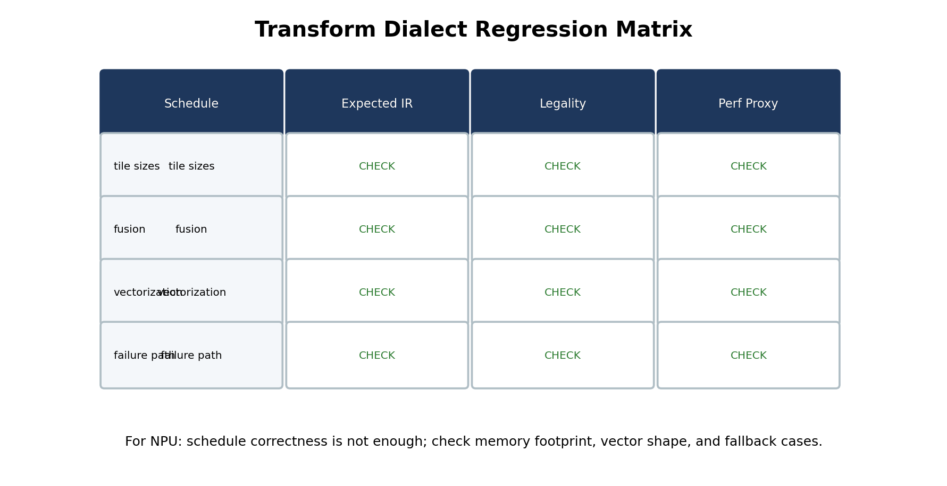
Regression Test Matrix

Slide 31
Failure and Fallback
shape가 native tile과 다르면 peel/mask/split 선택
layout mismatch는 transpose/repack 또는 fallback
schedule failure는 diagnostic이 설명 가능해야 함

Slide 32
Custom NPU Transform Ops
Out-of-tree extension sketch
// Pseudo C++ skeleton for an out-of-tree NPU Transform Dialect extension.
// This is a teaching artifact, not a drop-in build file.
#include "mlir/Dialect/Transform/IR/TransformDialect.h"
#include "mlir/Dialect/Transform/Interfaces/TransformInterfaces.h"
namespace npu {
class NPUTransformDialectExtension
: public mlir::transform::TransformDialectExtension<NPUTransformDialectExtension> {
public:
NPUTransformDialectExtension() {
// declareGeneratedDialect<npu::NPUKernelDialect>();
// registerTransformOps<ScheduleMatmulTileOp, PromoteToSramOp, TensorizeToNpuOp>();
}
};
}
// Design sketch:
// npu.schedule.matmul_tile %target {m=16, n=16, k=32}
// npu.schedule.promote_to_sram %tile {space="SRAM0", double_buffer=true}
// npu.schedule.tensorize_to_npu %vector_contract {instruction="mma_i8_i32"}

Slide 33
실습 A - Handle Annotation
payload IR에서 linalg.matmul/add/relu를 찾기
각 transform handle이 어떤 payload op set을 가리키는지 표 작성
consume 이후 사용 금지 handle 표시

Slide 34
실습 B - Tile/Fuse/Vectorize
MatMul schedule transform IR 작성
tile size 16x16x32 적용
bias/relu fusion 위치 결정
vector size와 npu tile shape 매핑

Slide 35
실습 C - NPU Schedule Spec
schedule parameter table
SRAM footprint table
fallback policy
FileCheck regression plan

Slide 36
Common Mistakes
old handle을 계속 사용
tile size만 보고 memory footprint를 무시
vectorize를 너무 일찍 적용
schedule IR과 pass pipeline 책임 혼동

Slide 37
Homework
MatMul+Bias+ReLU schedule IR 완성
Conv2D NHWC/HWCF schedule variant 작성
unsupported K remainder case negative test 작성

Slide 38
Takeaways
Transform Dialect는 schedule을 IR로 만드는 도구
NPU compiler에서는 tile/fuse/vectorize policy를 재현 가능하게 관리
handle lifetime과 failure mode를 테스트해야 함

Slide 39
References
MLIR Transform Dialect: https://mlir.llvm.org/docs/Dialects/Transform/
MLIR Transform Dialect Tutorial: https://mlir.llvm.org/docs/Tutorials/transform/
Transform Tutorial Chapter 1: https://mlir.llvm.org/docs/Tutorials/transform/Ch1/
Transform Tutorial Chapter H - Halide Schedule: https://mlir.llvm.org/docs/Tutorials/transform/ChH/
MLIR Linalg Dialect: https://mlir.llvm.org/docs/Dialects/Linalg/

