Slide 1
Lecture 16
Quantization for AI/NPU Compiler
INT8/INT4 requantization
Accumulator width and saturation
MLIR quant dialect -> TOSA rescale -> NPU qkernel
MLIR/NPU Compiler - Lecture 16 | 01

Slide 2
오늘의 위치
11강: legal op set
12강: bufferization
13강: memory space/layout
14강: vector tensorization
15강: transform schedule
16강: numeric contract for integer NPU
MLIR/NPU Compiler - Lecture 16 | 02

Slide 3
Learning Objectives
Uniform quantization 수식을 compiler contract로 해석
!quant.uniform, qcast/dcast/scast 읽기
INT8 MatMul accumulator와 requantization 설계
INT4 weight packing과 group scale policy 정의
negative test로 overflow/rounding/layout 오류 잡기
MLIR/NPU Compiler - Lecture 16 | 03

Slide 4
왜 NPU Compiler에서 Quantization이 중요한가?
TOPS/W와 bandwidth는 낮은 bit-width에서 크게 개선
정확도는 scale/zero-point/rounding/saturation에 민감
compiler가 qparams, layout, DMA, ABI를 함께 관리해야 함
Numeric bug는 functional test에서는 늦게 드러남
MLIR/NPU Compiler - Lecture 16 | 04

Slide 5
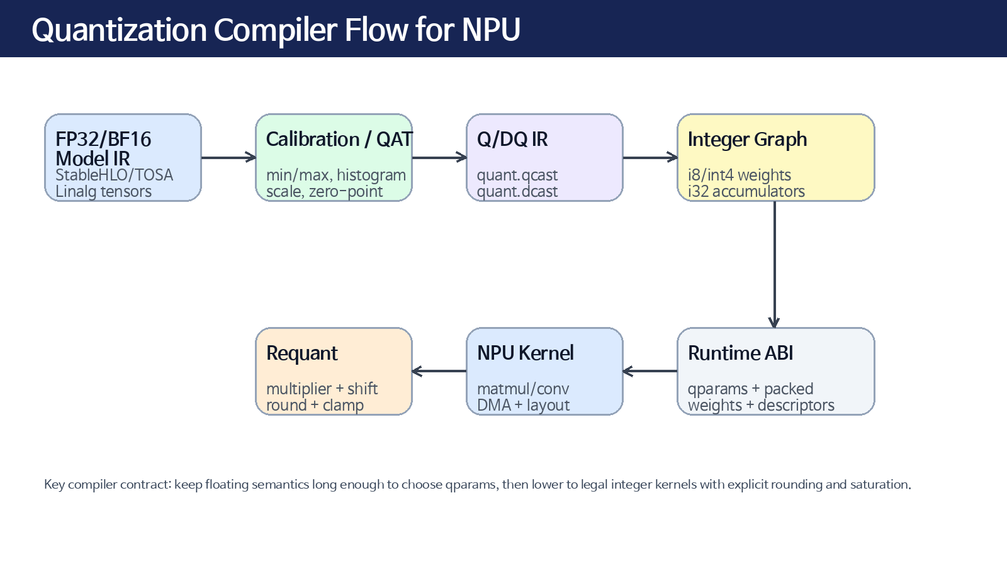
Quantization Compiler Flow
MLIR/NPU Compiler - Lecture 16 | 05

Slide 6
Uniform Quantization
q = clamp(round(x / scale) + zero_point) x_hat = (q - zero_point) * scale scale: real-space step size zero_point: exact real zero code
MLIR/NPU Compiler - Lecture 16 | 06

Slide 7
Fixed-point vs Affine
Fixed-point: signed scaled integer
Affine: shifted integer space with zero_point
Conv/MatMul zero padding 때문에 zero exactness가 중요
NPU는 affine operand를 scaled operand로 보정 후 MAC
MLIR/NPU Compiler - Lecture 16 | 07

Slide 8
MLIR Quant Dialect
!quant.uniform encodes stored type, expressed type, scale, zero point
Per-layer, per-channel/per-axis, sub-channel/blockwise variants
qcast: expressed -> quantized
dcast: quantized -> expressed
scast: quantized type <-> integer storage type
MLIR/NPU Compiler - Lecture 16 | 08

Slide 9
Example: !quant.uniform
!quant.uniform<i8:f32, 0.03125:-3> tensor<64x!quant.uniform<i8:f32, 0.03125:-3>> tensor<64x128x!quant.uniform<i8:f32:1,{0.02,0.03,...}>>
MLIR/NPU Compiler - Lecture 16 | 09

Slide 10
Q/DQ Boundary
qcast/dcast pair는 quantization intent를 IR에 보존
integerizable subgraph를 찾는 marker 역할
fallback boundary와 accuracy debug가 쉬워짐
너무 일찍 integer lowering하면 fusion/layout 판단이 어려움
MLIR/NPU Compiler - Lecture 16 | 10

Slide 11
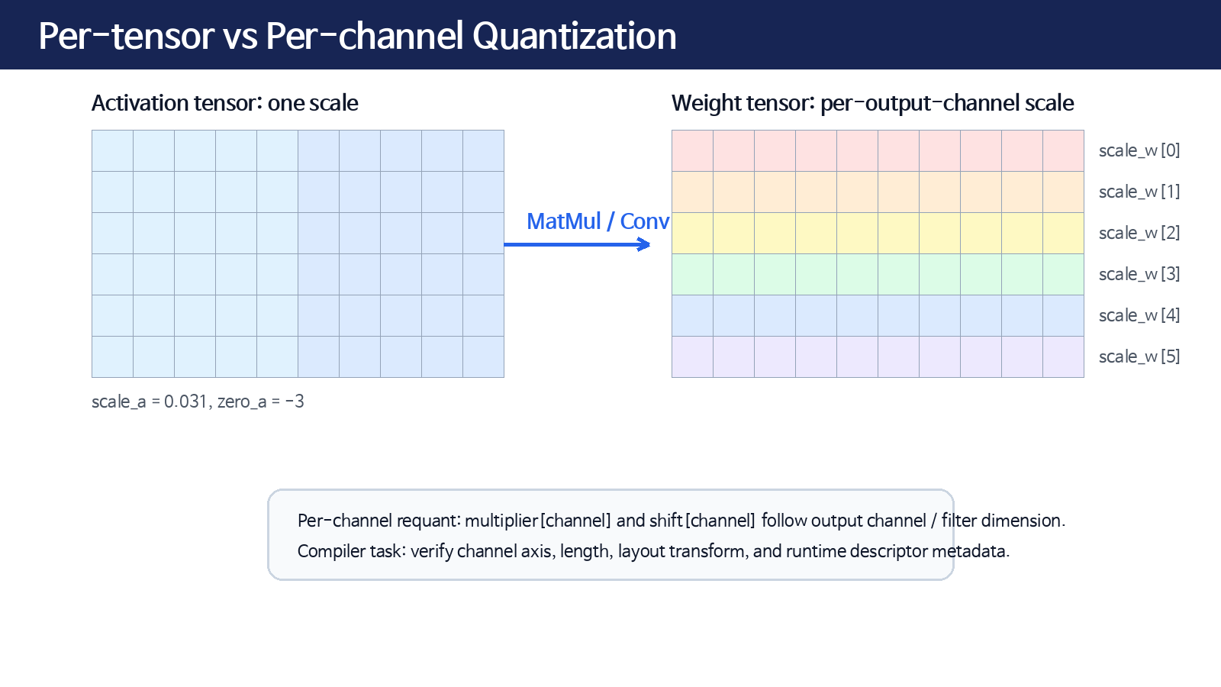
Per-tensor vs Per-channel
MLIR/NPU Compiler - Lecture 16 | 11

Slide 12
Blockwise / Group Quantization
INT4 weight-only quantization에서 자주 사용
group_size = 32/64/128 등
scale layout = per output channel x per K group
Compiler must align group boundary with packed weight layout
MLIR/NPU Compiler - Lecture 16 | 12

Slide 13
INT8 MatMul Equation
acc[m,n] = Σ_k (qa[m,k]-za) * (qw[k,n]-zw[n]) real_y = sa * sw[n] * acc + bias_real[n] qy = clamp(round(real_y / sy) + zy)
MLIR/NPU Compiler - Lecture 16 | 13

Slide 14
Bias Scale Contract
bias_i32[n] usually represents bias_real / (sa * sw[n])
Per-channel weight scale -> per-channel bias scale
Verifier: bias dtype, scale, channel axis, shape
Mismatch causes silent accuracy loss
MLIR/NPU Compiler - Lecture 16 | 14

Slide 15
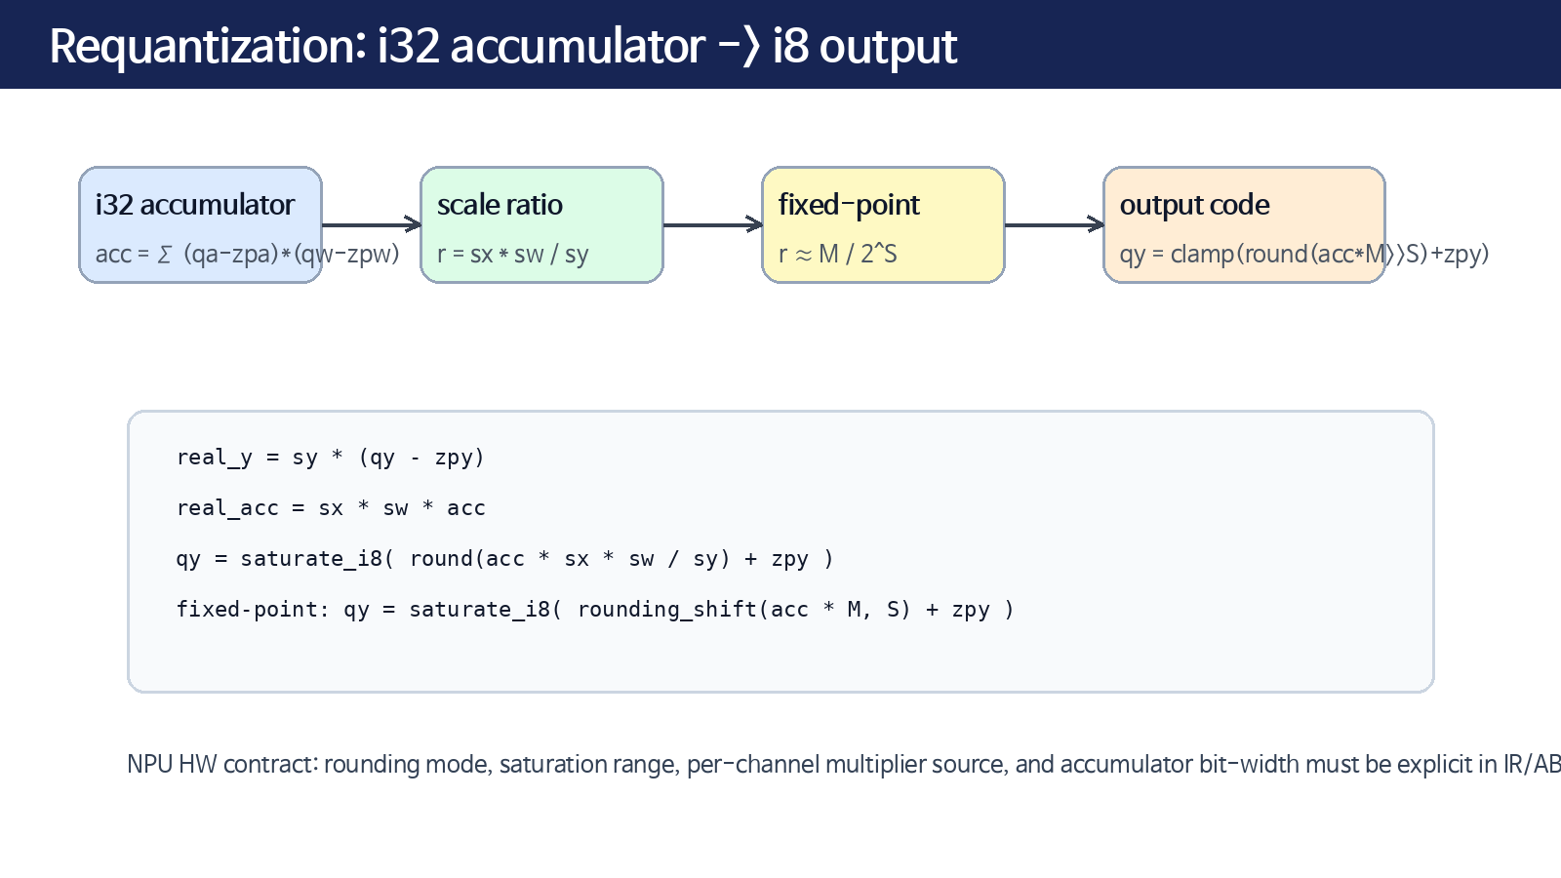
Requantization
MLIR/NPU Compiler - Lecture 16 | 15

Slide 16
TOSA Rescale
tosa.rescale represents integer multiply, add, shift
Attributes include scale32, rounding_mode, per_channel, input/output unsigned
Operands include multiplier, shift, input_zp, output_zp
Good bridge from tensor IR to integer NPU kernels
MLIR/NPU Compiler - Lecture 16 | 16

Slide 17
Rounding Modes
RNE / round-to-nearest-even
away-from-zero or framework-specific rounding
two-stage rounding for some framework compatibility
Changing rounding can shift quantized outputs by 1 LSB
MLIR/NPU Compiler - Lecture 16 | 17

Slide 18
Saturation Semantics
i8 range: [-128, 127] or restricted [-127, 127]
u8 range: [0, 255]
int4 signed: [-8, 7] or symmetric [-7, 7]
Clamp range must match target kernel and quant type
MLIR/NPU Compiler - Lecture 16 | 18

Slide 19
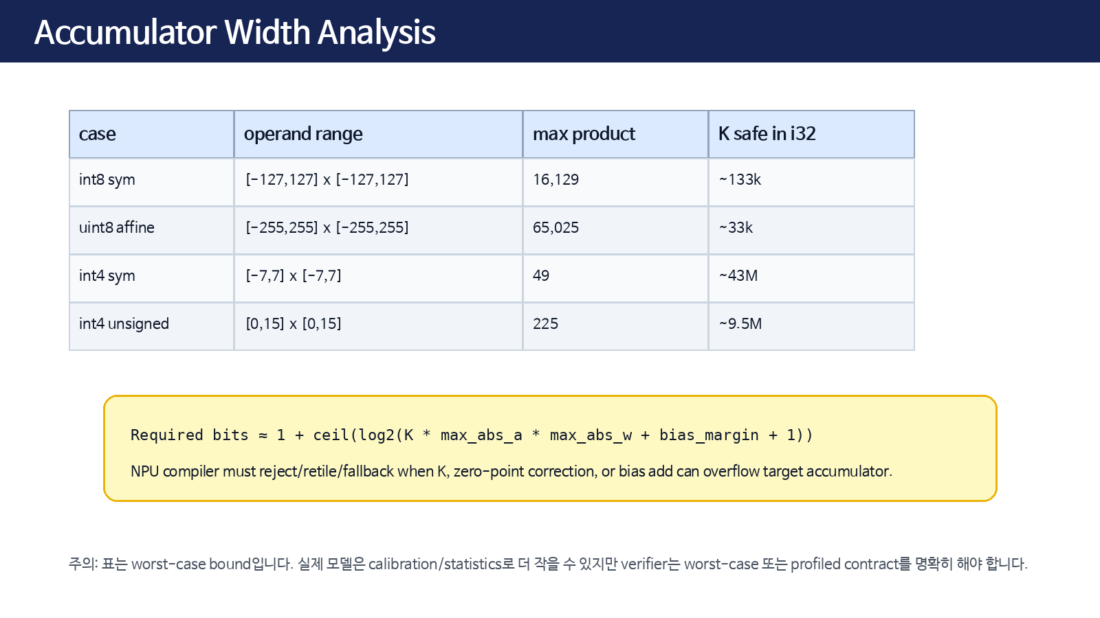
Accumulator Width
MLIR/NPU Compiler - Lecture 16 | 19

Slide 20
Zero-point Correction
Σ(qa-za)(qw-zw) expands into four terms Need row sums / column sums when za or zw are nonzero Symmetric weights simplify correction Precompute weight sums when possible
MLIR/NPU Compiler - Lecture 16 | 20

Slide 21
Symmetric vs Asymmetric
Symmetric: zero_point=0, simpler MAC path
Asymmetric: better range utilization for activations
Weights often symmetric per-channel
Activations often affine per-tensor
MLIR/NPU Compiler - Lecture 16 | 21

Slide 22
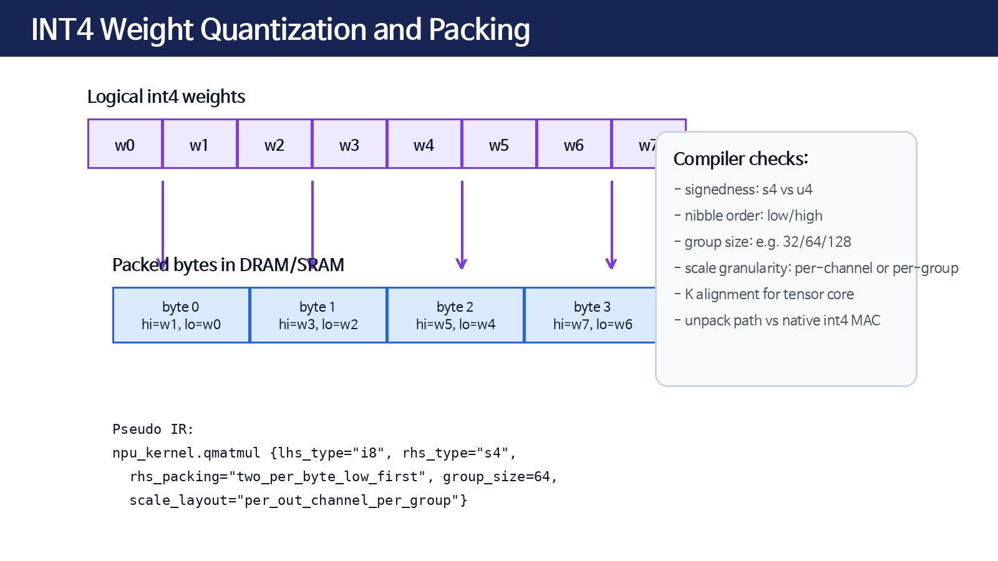
INT4 Overview
MLIR/NPU Compiler - Lecture 16 | 22

Slide 23
INT4 Packing Contract
signedness: s4 / u4
nibble order: low-first or high-first
K alignment: native tile K multiple
group_size and qparams layout
DMA burst/padding requirements
MLIR/NPU Compiler - Lecture 16 | 23

Slide 24
npu_kernel.qmatmul Contract
lhs_type, rhs_type, acc_type
lhs_scale, rhs_scale, output_scale
zero points and per-channel axis
multiplier/shift tensors
packing, rounding, saturation
MLIR/NPU Compiler - Lecture 16 | 24

Slide 25
Quantization Pipeline
stats import -> qparams assignment
insert/recognize QDQ
propagate/canonicalize QDQ
integerize legal subgraphs
materialize requant
pack weights and emit runtime descriptors
MLIR/NPU Compiler - Lecture 16 | 25

Slide 26
Where to Lower?
Before bufferization: better graph rewrite and fusion
After layout propagation: qparams axis is stable
Before runtime ABI: weight packing and descriptors
Do not mix semantic QDQ and physical storage too early
MLIR/NPU Compiler - Lecture 16 | 26

Slide 27
FileCheck Strategy
CHECK presence of qmatmul and rescale
CHECK-NOT unexpected dequantize in integer kernel
CHECK multiplier/shift rank and per_channel attr
negative test unsupported group size / overflow
MLIR/NPU Compiler - Lecture 16 | 27

Slide 28
Numerical Golden Tests
Compare against FP reference with tolerance
Use edge values: min/max, zero, saturation boundary
Test per-channel qparams and layout-transposed tensors
Lock rounding mode exactly
MLIR/NPU Compiler - Lecture 16 | 28

Slide 29
Exercise A
Given min/max, compute scale and zero_point
Quantize sample vector and dequantize it
Measure max absolute quantization error
Explain impact on layer output
MLIR/NPU Compiler - Lecture 16 | 29

Slide 30
Exercise B
Annotate !quant.uniform types
Insert qcast/dcast for activation and weights
Use scast to expose integer storage
Write FileCheck lines
MLIR/NPU Compiler - Lecture 16 | 30

Slide 31
Exercise C
For INT8 MatMul K=4096, compute worst-case accumulator bound
Choose i32 or i48 accumulator
Decide split-K/fallback policy
Document verifier rule
MLIR/NPU Compiler - Lecture 16 | 31

Slide 32
Exercise D
Design INT4 weight packing policy
Define group_size and scale layout
Write npu_kernel.qmatmul attributes
Create negative test for misaligned K
MLIR/NPU Compiler - Lecture 16 | 32

Slide 33
Common Mistakes
Using per-channel scale after layout transpose without remapping axis
Dropping zero-point correction
Unspecified rounding mode
Bias scale mismatch
Assuming int4 packing order from byte dump
MLIR/NPU Compiler - Lecture 16 | 33

Slide 34
Takeaways
Quantization is a numeric ABI, not only dtype conversion
MLIR quant types preserve expressed/stored mapping
tosa.rescale models integer requantization
Accumulator and saturation must be verified
INT4 requires packing + qparams co-design
MLIR/NPU Compiler - Lecture 16 | 34

Slide 35
References
MLIR Quant Dialect: https://mlir.llvm.org/docs/Dialects/QuantDialect/
MLIR Quantization Design: https://mlir.llvm.org/docs/Quantization/
MLIR TOSA Dialect: https://mlir.llvm.org/docs/Dialects/TOSA/
MLIR Passes: https://mlir.llvm.org/docs/Passes/
MLIR/NPU Compiler - Lecture 16 | 35

