Slide 1
Lecture 17 - Fusion, Layout Propagation
AI/NPU Compiler를 위한 MLIR
Transformer MLP fusion 후보 분석
산출물: fusion/layout/cost contract + pseudo IR
1/35

Slide 2
오늘의 위치
14강 Vector/Tensorization: native tile로 mapping
15강 Transform Dialect: schedule IR
16강 Quantization: numeric contract
17강: fusion/layout decision으로 NPU performance를 결정
2/35

Slide 3
Learning Objectives
Fusion을 legality + cost + layout contract로 정의
Transformer MLP에서 fusion 후보를 체계적으로 분류
Layout propagation과 materialization boundary 설계
SRAM/ACCUM footprint와 traffic saving 계산
FileCheck 기반 regression test 작성
3/35

Slide 4
왜 Fusion인가?
Physical AI edge NPU는 DRAM bandwidth가 성능 병목인 경우가 많음
Intermediate tensor write/read 제거가 latency와 power를 줄임
Epilogue를 accumulator/SRAM 내부에서 처리하면 command 수와 DMA가 감소
단, fusion이 live range와 SRAM pressure를 증가시킬 수 있음
Rule: fusion must reduce traffic without violating SRAM, layout, or numeric contracts.
4/35

Slide 5
Fusion의 세 수준
Op fusion: IR에서 semantic op를 결합
Kernel fusion: 하나의 NPU kernel로 lowering
Command fusion: command buffer에서 DMA/compute/barrier를 결합
각 수준마다 verifier와 test가 달라야 함
5/35

Slide 6
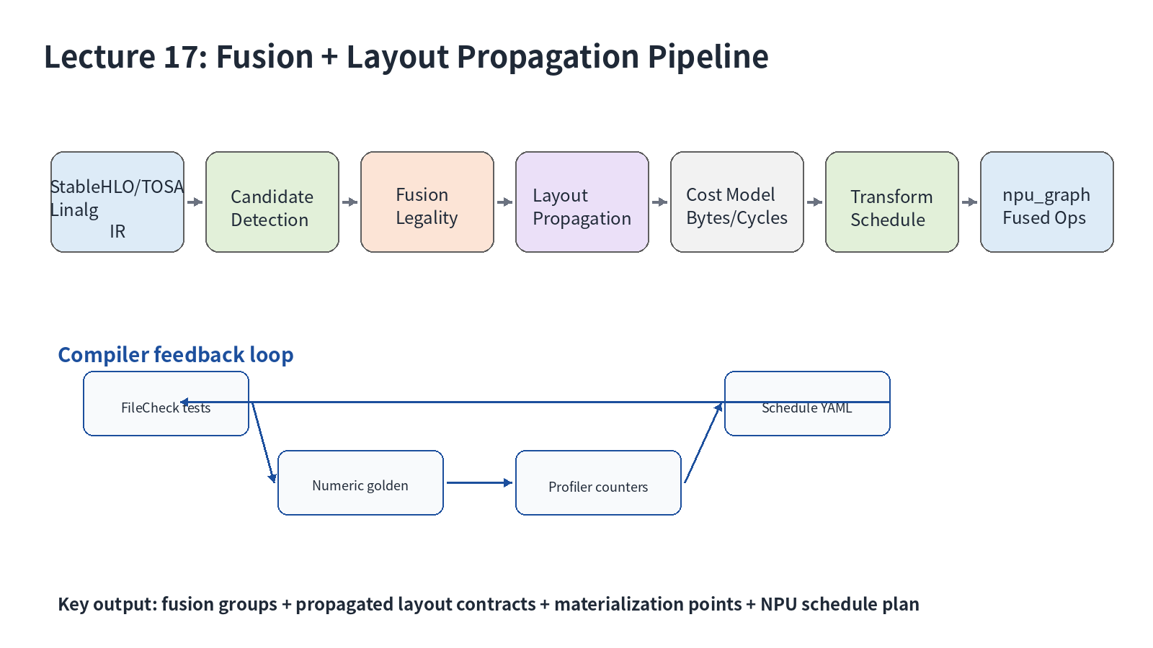
Fusion Pipeline Overview
6/35

Slide 7
Transformer MLP 구조
Classic: X -> GEMM1 -> Bias -> GELU -> GEMM2 -> Bias
Gated: gate/up projection -> SiLU -> Mul -> output projection
MLP intermediate는 H보다 4x 이상 커서 traffic 영향이 큼
7/35

Slide 8
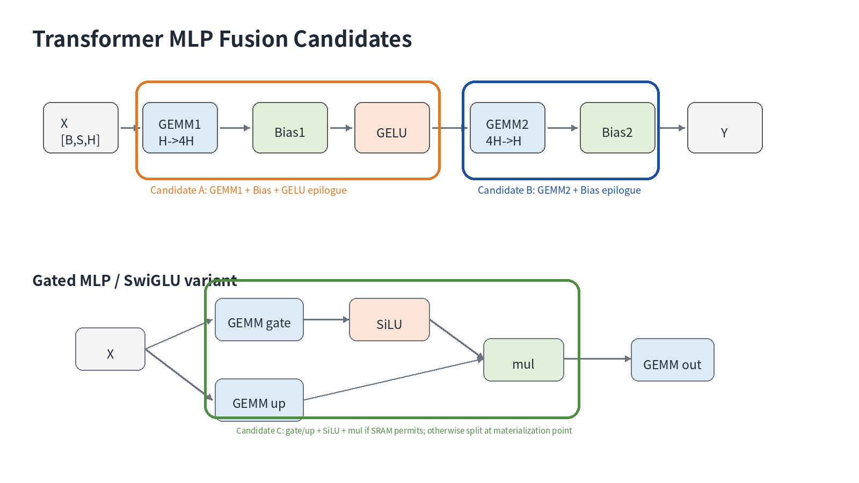
MLP Fusion Candidates
8/35

Slide 9
Legality != Profitability
Legal: shape/dtype/layout/quant 조건을 만족
Profitable: saved traffic and cycles > extra live range/repack cost
NPU compiler는 두 조건을 분리해 debug해야 함
Keep legality and profitability as separate debug-visible decisions.
9/35

Slide 10
Fusion Legality Fields
rank/static shape/dynamic dims
dtype and accumulator type
broadcast semantics
per-channel quant axis
layout compatibility
single-use or profitable multi-use
10/35

Slide 11
Use-Def 기반 후보 탐지
Root op를 activation 또는 consumer matmul로 잡음
Producer chain을 거슬러 matmul/bias/elementwise 패턴 확인
multiple consumer는 cost model로만 허용
IR mutation 전에는 match-only로 실패 조건 수집
11/35

Slide 12
Layout Propagation 개념
Logical shape와 physical layout을 분리
Elementwise/view-like op는 layout-preserving인 경우가 많음
Consumer preferred layout을 producer로 역전파 가능
불가피한 boundary에서만 explicit materialization 삽입
12/35

Slide 13
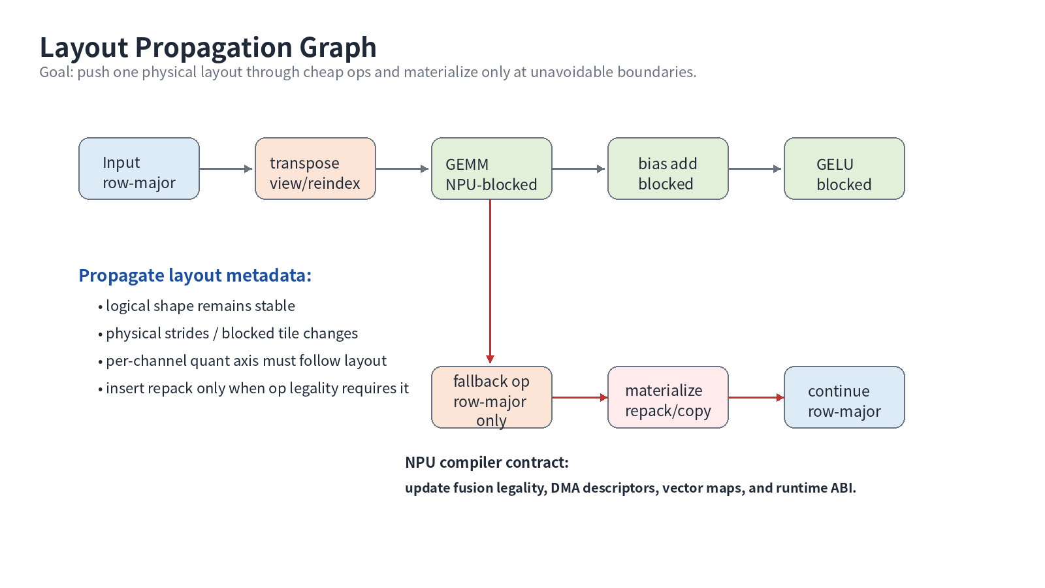
대표 Layout
13/35

Slide 14
Layout Propagation Rules
Propagate through elementwise, relu/gelu/silu approximation, scalar mul
Propagate through reshape if view-like and axis mapping known
Stop at unsupported reduction/gather/scatter/fallback
Insert npu_graph.layout_materialize with reason attr
14/35

Slide 15
Quantization Axis 문제
Per-channel scale axis가 layout 변경 후에도 정확해야 함
N dimension blocking은 channel axis를 유지하는지 검증 필요
INT8/INT4 pack layout은 scale layout도 함께 정의해야 함
Mismatch는 silent accuracy bug가 될 수 있음
Quant axis mapping is part of layout propagation, not an afterthought.
15/35

Slide 16
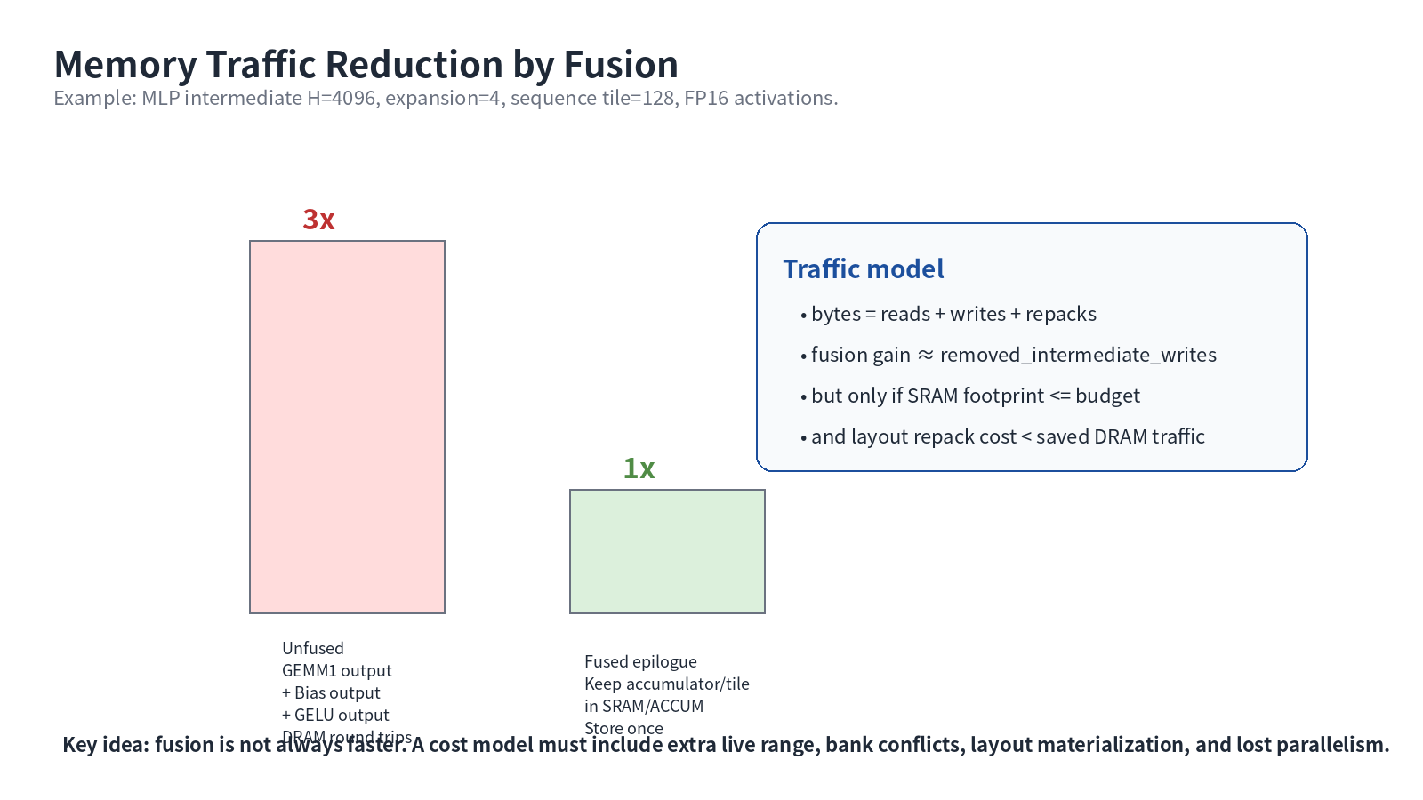
Cost Model: Traffic
16/35

Slide 17
Cost Model: SRAM/ACCUM
Input/weight/output tile + accumulator + epilogue temp + double buffer
SwiGLU는 gate/up branch live range가 길어짐
ACCUM tile precision이 SRAM보다 더 제한적일 수 있음
Spill 발생 시 fusion benefit이 크게 감소
17/35

Slide 18
Cost Model: Cycles
compute cycles = MAC / effective TOPS
DMA cycles = bytes / effective bandwidth
bank conflict and tensor core occupancy 포함
critical path는 max(compute, DMA) + barrier overhead
18/35

Slide 19
Classic MLP Case Study
GEMM1 output: [tokens, 4H]로 큼
Bias+GELU는 ideal epilogue fusion 후보
GEMM2는 GELU output layout을 input layout으로 요구
Blocked activation을 GEMM2까지 유지할지 cost model로 결정
19/35

Slide 20
SwiGLU Case Study
Gate and up projections produce two large intermediates
SiLU(gate) * up는 tile-local fusion 후보
두 branch 동시 live range가 SRAM을 압박
branch streaming 또는 split materialization 정책 필요
20/35

Slide 21
Weight Prepack
Static weight는 compile/deploy time prepack 가능
Dynamic weight는 runtime cache와 invalidation 정책 필요
Prepack layout은 tensorization map과 DMA descriptor에 반영
Quant scale/zero-point도 packed axis에 맞춰 저장
Weight prepack changes runtime ABI and model packaging.
21/35

Slide 22
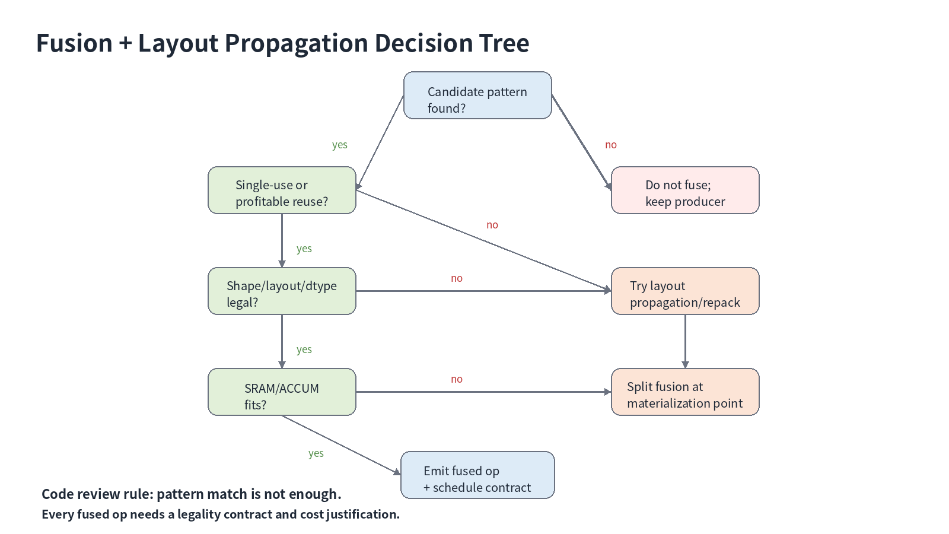
Pass Design
22/35

Slide 23
IR Contract: fused op
epilogue attr: bias_gelu_tanh, bias_relu, requant_clamp
layout attrs: lhs/rhs/out
accumulator attr: fp32/int32
fusion_id/debug metadata
materialization reason attrs
23/35

Slide 24
Transform Dialect와 연결
Transform IR로 tile/fuse/vectorize 순서를 명시
Fusion decision은 transform schedule parameter가 될 수 있음
Schedule YAML과 transform IR을 연결하면 autotuning에 유리
Payload IR과 schedule IR을 분리해 review 가능
24/35

Slide 25
Testing Strategy
Positive: fused op 생성과 attr 확인
Negative: unsupported shape/layout/quant에서는 no fusion
CHECK-NOT: unfused bias/activation 제거
materialization op count 제한
numeric golden test로 approximation 검증
Tests should catch both over-fusion and missed materialization.
25/35

Slide 26
Debug Recipe
1. print candidate groups
2. print legality failure reason
3. print layout propagation trace
4. print cost model table
5. compare profiler counters with expected bytes
26/35

Slide 27
Common Failure #1
Pattern은 맞지만 broadcast axis가 다름
Bias shape [M,N] vs [N] 차이
잘못 fuse하면 semantic bug
Verifier에서 broadcast contract를 검사
27/35

Slide 28
Common Failure #2
Layout propagation 후 per-channel quant axis mismatch
Scale tensor layout 업데이트 누락
INT8/INT4 requant에서 accuracy regression
Axis mapping metadata를 mandatory로 둠
28/35

Slide 29
Common Failure #3
Fusion으로 live range가 증가해 SRAM spill 발생
Traffic saving보다 spill/repack이 더 큼
Cost model 없이 greedy fusion 금지
Negative performance test 필요
29/35

Slide 30
실습 A
01_transformer_mlp_before.mlir을 읽고 fusion candidate를 표시
root op, producer chain, consumer chain 작성
multiple-use 여부 표시
30/35

Slide 31
실습 B
Layout propagation graph 작성
blocked layout을 어디까지 유지할지 결정
materialization point와 reason attr 정의
31/35

Slide 32
실습 C
07_memory_traffic_calculator.py 실행
unfused vs fused writes 비교
SRAM budget을 바꿔 fallback decision 작성
32/35

Slide 33
실습 D
npu_graph.matmul_epilogue pseudo IR 작성
epilogue/layout/accumulator/fusion_id attr 포함
FileCheck positive/negative test 작성
33/35

Slide 34
Takeaways
Fusion is a contract, not just a rewrite
Layout propagation removes hidden copy/repack overhead
Transformer MLP is the best practice case for NPU fusion analysis
Cost model must include bytes, cycles, SRAM, layout, quantization
Final output: fused pseudo IR + layout propagation graph + cost table.
34/35

Slide 35
References
MLIR Linalg Dialect
MLIR Transform Dialect
MLIR Data Layout Modeling
MLIR MemRef Dialect
MLIR Transform Tutorial Chapter 0
35/35

