Slide 1
Lecture 18 - Custom NPU Dialect
Topic: npu.matmul / npu.dma / npu.barrier ODS design
Goal: turn hardware contracts into verifiable MLIR ops
Output: ODS skeleton, verifier checklist, FileCheck tests
MLIR NPU Compiler - L18

Slide 2
오늘의 위치
1-17강: IR, dialect, pass, bufferization, vector, transform, quant, fusion
18강: target-specific NPU dialect bring-up
19강: runtime/ABI/codegen
MLIR NPU Compiler - L18

Slide 3
Learning Objectives
Explain why custom NPU dialect is needed
Define op contracts with ODS/TableGen
Design npu.matmul, npu.dma, npu.barrier
Plan verifier and tests
MLIR NPU Compiler - L18

Slide 4
Why Custom Dialect?
Generic IR cannot encode every target hazard
NPU kernels need tile shape, memory space, DMA order
Dialect provides namespace + target contract
Bad dialect design causes brittle lowering
MLIR NPU Compiler - L18

Slide 5
Boundary Principle
npu_graph: semantic fusion/layout/quant
npu_kernel: tile/DMA/barrier/accumulator
npu_rt: command buffer and descriptor ABI
Do not mix packet binary details too early
MLIR NPU Compiler - L18

Slide 6
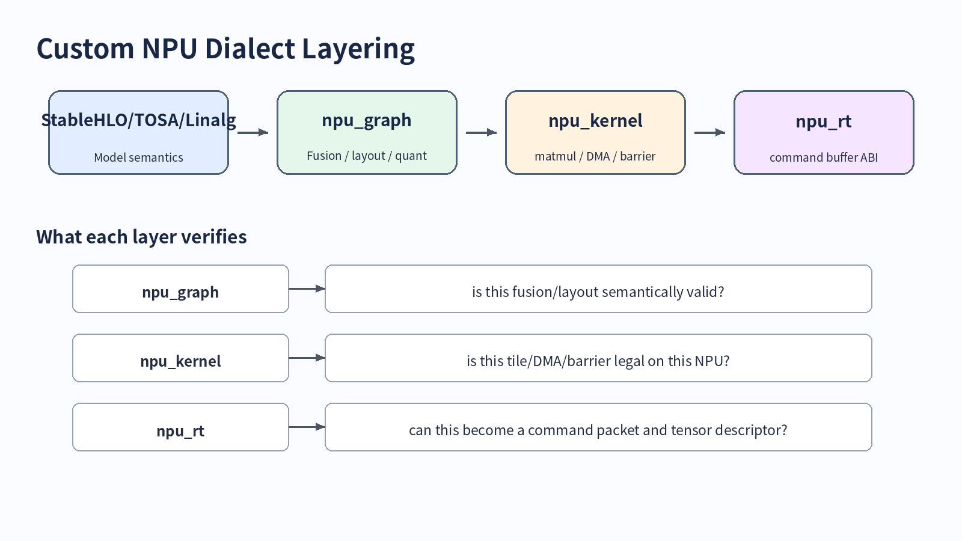
NPU dialect layer diagram
MLIR NPU Compiler - L18

Slide 7
ODS = Single Source of Truth
Operation name and namespace
Operands/results/attributes
Traits/interfaces
Assembly format
Verifier hook
MLIR NPU Compiler - L18

Slide 8
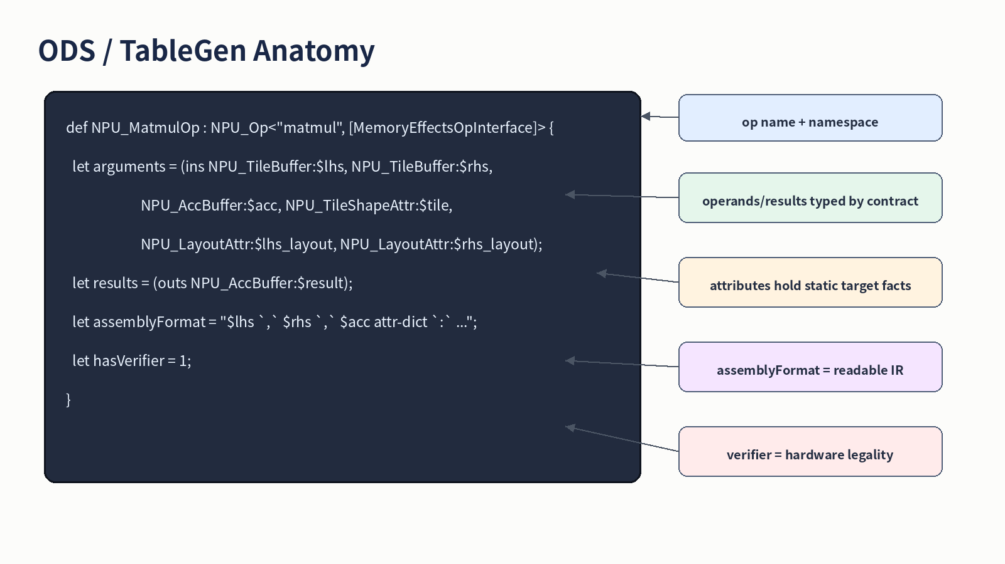
ODS Anatomy
MLIR NPU Compiler - L18

Slide 9
Minimal File Layout
include/NPU/IR/NPUOps.td
include/NPU/IR/NPUTypes.td
lib/NPU/IR/NPUDialect.cpp
lib/NPU/IR/NPUOps.cpp
test/NPU/IR/*.mlir
MLIR NPU Compiler - L18

Slide 10
npu.matmul Contract
def NPU_MatmulOp : NPU_Op<"matmul", [MemoryEffectsOpInterface]> {
let arguments = (ins NPU_TileBuffer:$lhs,
NPU_TileBuffer:$rhs,
NPU_AccBuffer:$acc,
NPU_TileShapeAttr:$tile,
NPU_LayoutAttr:$lhs_layout,
NPU_LayoutAttr:$rhs_layout);
let results = (outs NPU_AccBuffer:$result);
let hasVerifier = 1;
}
MLIR NPU Compiler - L18

Slide 11
npu.matmul Must Verify
M/N/K supported by target engine
element type pair is legal
lhs/rhs layout matches dataflow
accumulator width and epilogue policy explicit
MLIR NPU Compiler - L18

Slide 12
npu.dma Contract
def NPU_DmaOp : NPU_Op<"dma", [MemoryEffectsOpInterface]> {
let arguments = (ins AnyType:$source, AnyType:$dest,
NPU_DmaDirectionAttr:$direction,
I64Attr:$elements,
OptionalAttr<I64Attr>:$stride);
let results = (outs NPU_Token:$token);
let hasVerifier = 1;
}
MLIR NPU Compiler - L18

Slide 13
npu.dma Design Choices
Token model: easy dependency analysis
Tag-buffer model: close to memref.dma_start/wait
Token can lower to hardware tag later
Be explicit: bytes vs elements
MLIR NPU Compiler - L18

Slide 14
npu.barrier Contract
def NPU_BarrierOp : NPU_Op<"barrier", [MemoryEffectsOpInterface]> {
let arguments = (ins Variadic<NPU_Token>:$tokens,
NPU_BarrierScopeAttr:$scope);
let results = (outs);
let assemblyFormat = "$tokens attr-dict `:` type($tokens)";
let hasVerifier = 1;
}
MLIR NPU Compiler - L18

Slide 15
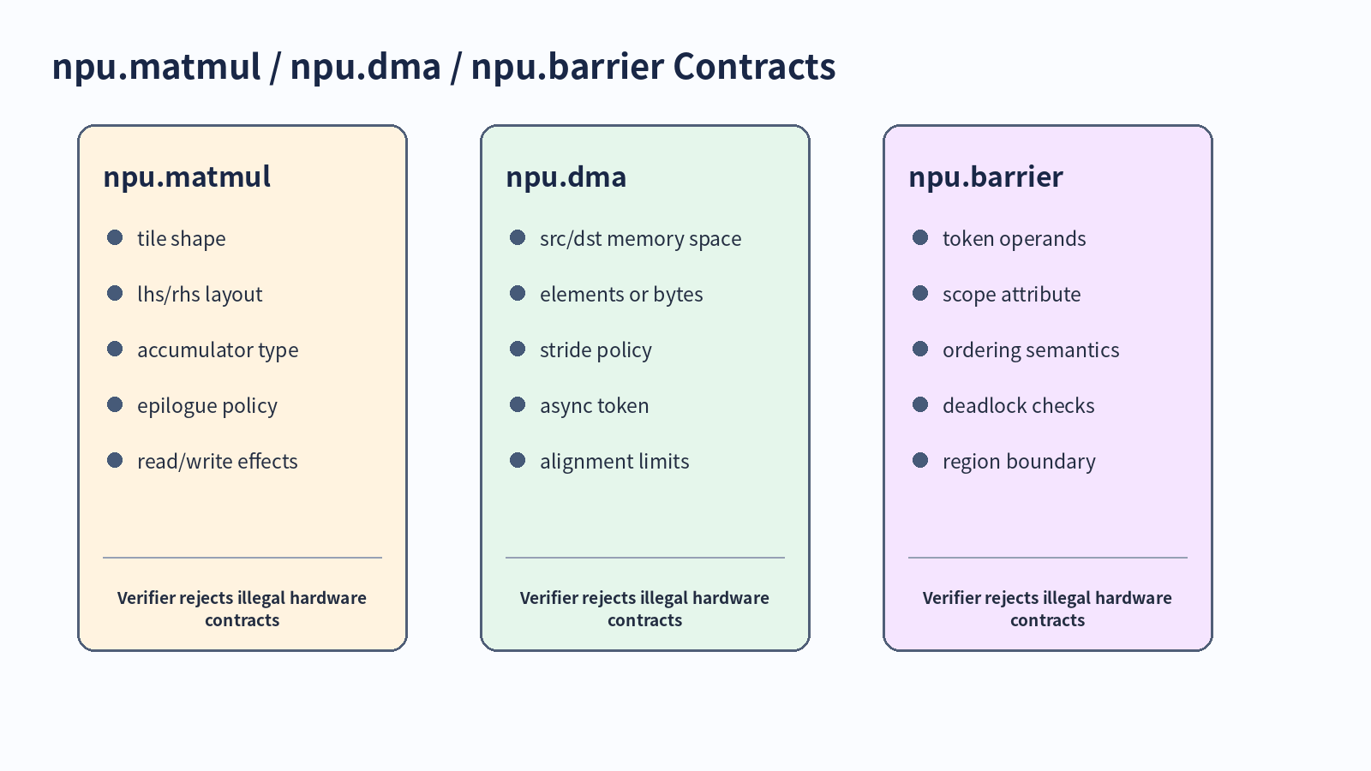
Operation Contracts Summary
MLIR NPU Compiler - L18

Slide 16
Types and Attributes
!npu.tile_buffer, !npu.acc_buffer, !npu.token
#npu.tile<m,n,k>
#npu.layout<mk|kn|blocked>
#npu.mem_space<dram|sram|accum>
MLIR NPU Compiler - L18

Slide 17
Attribute vs Operand
Attribute: static hardware fact
Operand: dynamic/data-dependent value
Type: storage/value contract
Wrong classification hurts canonicalization
MLIR NPU Compiler - L18

Slide 18
Traits and Interfaces
MemoryEffectsOpInterface for command effects
InferTypeOpInterface when result type is derivable
Custom interfaces for target capability queries
Traits for structural promises
MLIR NPU Compiler - L18

Slide 19
Assembly Format
Readable IR improves debugging
Generic form helps diagnose parser bugs
Expose important contract fields
Avoid opaque attr-dict-only design
MLIR NPU Compiler - L18

Slide 20
Verifier Strategy
Reject illegal IR, not slow IR
Check shape/type/layout first
Check target capability last
Emit diagnostics with failed HW rule
MLIR NPU Compiler - L18

Slide 21
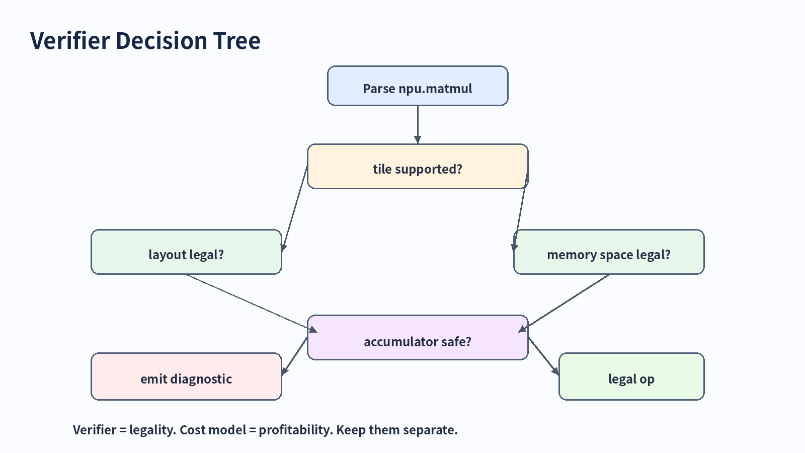
Verifier Decision Tree
MLIR NPU Compiler - L18

Slide 22
Canonicalization Hooks
Remove redundant barriers only with dependency proof
Fold repeated static attrs
Canonicalize layout aliases
Do not reorder commands blindly
MLIR NPU Compiler - L18

Slide 23
Testing Matrix
Parser/printer round-trip
Generic form test
Negative verifier diagnostics
Lowering pass tests
Command hazard tests
MLIR NPU Compiler - L18

Slide 24
Lowering into NPU Dialect
vector.contract -> npu.matmul
memref/subview/copy -> npu.dma when crossing memory spaces
dependency analysis -> npu.barrier
npu commands -> runtime packet in lecture 19
MLIR NPU Compiler - L18

Slide 25
Case Study: MatMul Tile
M=16, N=16, K=32
lhs: SRAM tile layout mk
rhs: SRAM tile layout kn
acc: ACCUM tile i32
MLIR NPU Compiler - L18

Slide 26
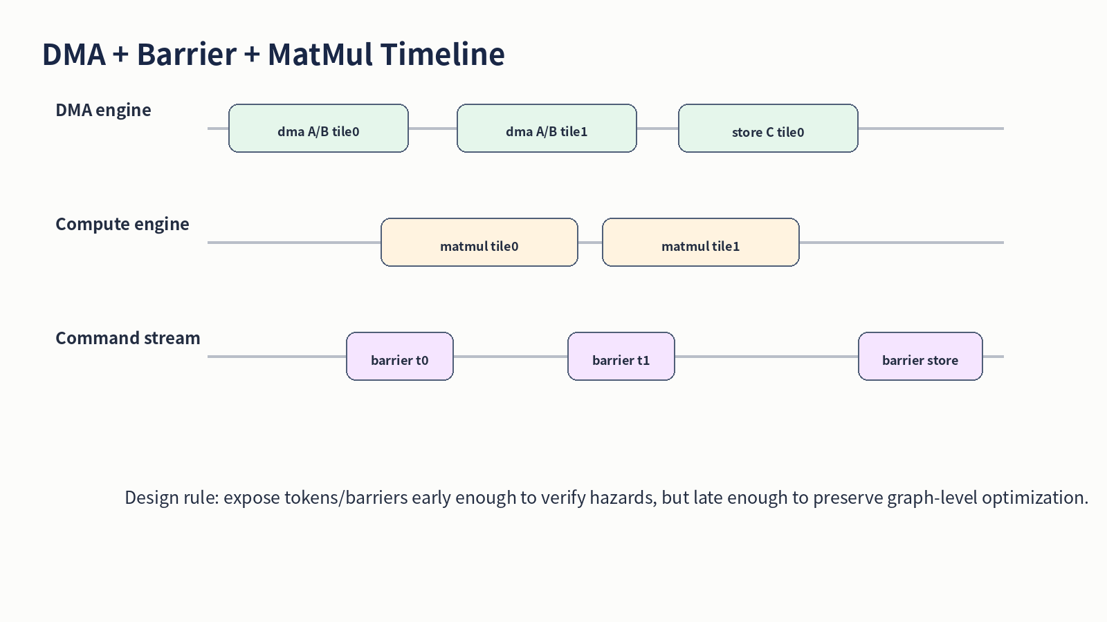
DMA + Barrier Timeline
MLIR NPU Compiler - L18

Slide 27
CMake and Build
add_mlir_dialect(NPUOps npu)
mlir_tablegen for op declarations/definitions
Dialect library depends on IncGen target
Tool registers the dialect
MLIR NPU Compiler - L18

Slide 28
Common Mistake #1
Putting profitability in verifier
Verifier should reject illegal IR only
Cost model should choose schedules
Fallback should remain possible
MLIR NPU Compiler - L18

Slide 29
Common Mistake #2
Encoding packet binary too early
Use semantic command fields first
Lower packet format at runtime boundary
Keeps transformations readable
MLIR NPU Compiler - L18

Slide 30
Common Mistake #3
Implicit DMA/compute ordering
Use token/barrier contract explicitly
Avoid depending on operation order only
Test hazards in CI
MLIR NPU Compiler - L18

Slide 31
Exercise A
Classify fields for npu.matmul
Mark verifier fields
Mark cost model fields
MLIR NPU Compiler - L18

Slide 32
Exercise B
Write ODS skeleton for npu.dma
Choose token vs tag-buffer model
Add memory effect interface plan
MLIR NPU Compiler - L18

Slide 33
Exercise C
Write positive parser/printer test
Write negative unsupported tile test
Write negative empty barrier test
MLIR NPU Compiler - L18

Slide 34
Takeaways
Custom dialect is a target contract
ODS is the source of truth
Verifier turns HW limits into compiler diagnostics
npu.matmul/dma/barrier prepare runtime codegen
MLIR NPU Compiler - L18

Slide 35
References
MLIR Defining Dialects
MLIR ODS
MLIR Creating a Dialect
MLIR MemRef Dialect
MLIR Testing Guide
MLIR NPU Compiler - L18

