Slide 1
Lecture 20
Capstone: Mini NPU Compiler Design Spec
AI / NPU Compiler를 위한 MLIR 실전 통합 프로젝트

Slide 2
오늘의 위치
1-19강에서 배운 MLIR IR, dialect, pass, bufferization, vectorization, runtime ABI를 하나의 설계로 통합합니다.
최종 산출물은 실행 가능한 compiler가 아니라, 구현 가능한 Mini NPU Compiler Design Spec입니다.
평가 기준은 correctness, architecture fit, optimization, implementation plan, validation입니다.
MLIR NPU Lecture 20

Slide 3
Learning Objectives
20강 전체에서 배운 MLIR 개념을 하나의 NPU compiler architecture로 통합한다.
StableHLO/TOSA 입력에서 npu_runtime command buffer까지 이어지는 lowering boundary를 설계한다.
legal op set, dialect contract, transform schedule, bufferization/memory plan, runtime ABI를 문서화한다.
FileCheck, negative test, cost model, demo script까지 포함한 검증 가능한 compiler design spec을 작성한다.
MLIR NPU Lecture 20

Slide 4
Capstone Problem Statement
Transformer MLP 또는 MatMul+Bias+Activation을 target NPU에 맞게 lower합니다.
입력 IR, legal op set, pass pipeline, schedule, memory plan, custom dialect, runtime ABI를 명확히 정의합니다.
FileCheck와 negative verifier test, cost model로 설계가 검증 가능해야 합니다.
MLIR NPU Lecture 20

Slide 5
Recommended Workload Choices
Option A: MatMul + Bias + ReLU/GELU
Option B: Transformer MLP - two matmuls plus activation
Option C: SwiGLU MLP - gate/up projection, elementwise activation/mul, down projection
Scope를 작게 잡고 compiler contract를 깊게 작성하는 것이 목표입니다.
MLIR NPU Lecture 20

Slide 6
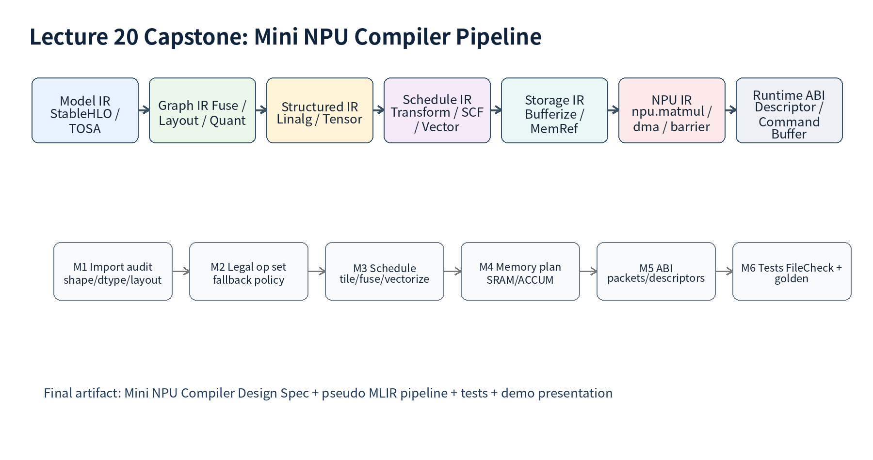
Capstone Pipeline

Slide 7
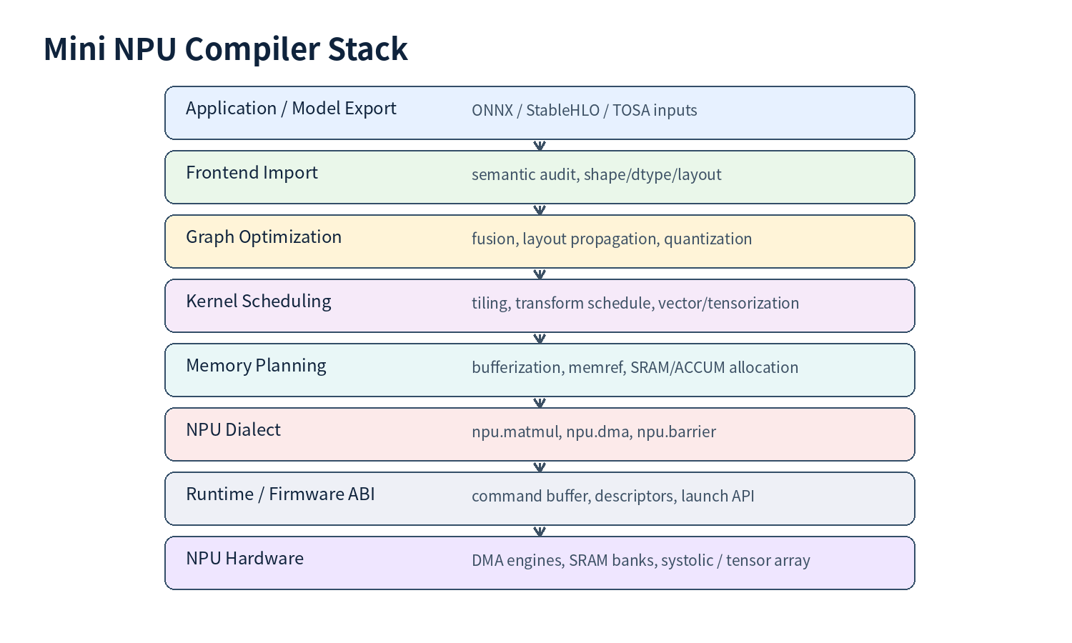
Mini NPU Compiler Stack

Slide 8
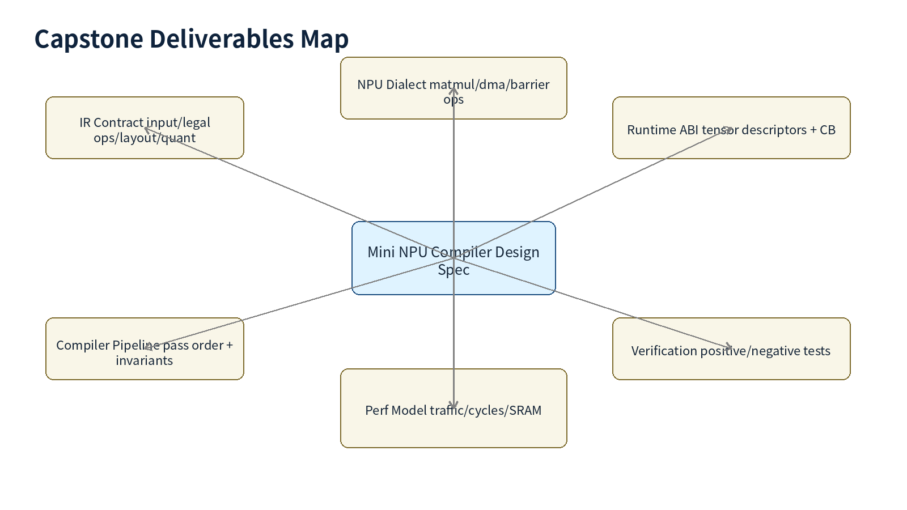
Deliverables Map

Slide 9
Deliverables Checklist
Deliverable | Content | Evidence
Design Spec | input/legal/pipeline/dialect/runtime/test | 8-12p document
Pipeline Spec | pass order, anchors, invariants | YAML or markdown
Pseudo MLIR | before/after + npu_kernel/npu_rt | MLIR snippets
Runtime ABI | descriptor + packet schema | manifest YAML
Validation | FileCheck + negative + cost model | test files + outputs

Slide 10
Target NPU Assumptions
Native tile: 16x16x32 for INT8 GEMM
Memory spaces: DRAM, SRAM, ACCUM
Explicit async DMA and barrier token model
Runtime artifact: descriptor table + command buffer
MLIR NPU Lecture 20

Slide 11
Input IR Contract
Choose StableHLO, TOSA, or Linalg as semantic input.
Define shape, dtype, layout, quantization, and dynamic shape policy.
Unsupported cases must produce a clear diagnostic or fallback.
MLIR NPU Lecture 20

Slide 12
Legal Op Set Design
Legal op set is not only op names.
Dynamic legality depends on shape, dtype, layout, quant metadata, tile/tail policy.
Every unsupported op needs one of: decompose, approximate, materialize, fallback, reject.
MLIR NPU Lecture 20

Slide 13
Pass Pipeline Draft
import-semantic-audit
canonicalize + cse
decompose-composites
legalize-to-npu-graph
fuse-epilogues + propagate-layout + quant
schedule + bufferize + memory-space
lower-to-npu-kernel + emit-runtime-abi
MLIR NPU Lecture 20

Slide 14
IR Boundary Table
StableHLO/TOSA: frontend semantic contract
npu_graph: graph fusion/layout/quant contract
Linalg/Tensor: structured transformation contract
MemRef/Vector/SCF: storage/schedule contract
npu_kernel/npu_rt: target/runtime contract
MLIR NPU Lecture 20

Slide 15
Schedule IR
Represent tile/fuse/vectorize decisions explicitly.
Use Transform Dialect, schedule YAML, or custom npu.schedule ops.
Schedule must include edge tiles, double buffering, layout packing, epilogue policy.
MLIR NPU Lecture 20

Slide 16
SRAM Footprint Formula
DB * (M*K*bytes(A) + K*N*bytes(B)) + M*N*bytes(ACC)
For 16x16x32 INT8/INT32 with double buffering: 3072 bytes per tile
Use footprint to reject or retile schedules.
MLIR NPU Lecture 20

Slide 17
Fusion Policy
Fuse only when semantics, layout, dtype, quant, and use-count are legal.
MatMul+Bias+Activation is a strong candidate.
Layout conflict or quant mismatch should materialize or fallback.
MLIR NPU Lecture 20

Slide 18
Layout Propagation Policy
Keep layout abstract at graph/tensor level as long as useful.
Materialize transpose/repack only when unavoidable.
Document which ops preserve, require, or change layout.
MLIR NPU Lecture 20

Slide 19
Quantization Policy
Define accumulator width and saturation semantics.
Bias scale must match input_scale * weight_scale.
Requant must specify rounding, shift, zero-point, per-channel axis.
MLIR NPU Lecture 20

Slide 20
Bufferization Policy
Bufferize after fusion and schedule decisions when possible.
Track alias, lifetime, copy count, and memory_space.
Unexpected memref.copy should be a regression test.
MLIR NPU Lecture 20

Slide 21
NPU Dialect Ops
npu.matmul: compute tile contract
npu.dma: asynchronous data movement contract
npu.barrier: dependency and visibility contract
npu.requant/epilogue: numeric contract
MLIR NPU Lecture 20

Slide 22
Verifier Invariants
Tile shape must be supported or tail policy must exist.
Memory spaces must match op contract.
Barrier tokens must enforce DMA/compute ordering.
Unsupported dtype/layout must emit deterministic diagnostic.
MLIR NPU Lecture 20

Slide 23
Runtime ABI
Tensor descriptor table
Command buffer header and packet schema
Version/capability query
Artifact manifest and relocation policy
MLIR NPU Lecture 20

Slide 24
Command Buffer Packets
DMA_LOAD / DMA_STORE
MATMUL / EPILOGUE / REQUANT
BARRIER / FENCE
Descriptor references and dependency tokens
MLIR NPU Lecture 20

Slide 25
FileCheck Strategy
Positive: fused matmul epilogue appears.
Negative: unsupported tile/dtype/layout emits error.
ABI: descriptor and packet fields are present.
No unexpected memref.copy after bufferization.
MLIR NPU Lecture 20

Slide 26
Cost Model Minimum
SRAM footprint
DRAM traffic
MAC count and approximate cycles
copy/repack cost
fallback penalty
MLIR NPU Lecture 20

Slide 27
Demo Structure
Show input workload.
Show before/after IR at 3 boundaries.
Show final command buffer schema.
Show tests and cost model.
Explain tradeoffs and next steps.
MLIR NPU Lecture 20

Slide 28
Common Mistake #1
Trying to support too many ops.
Better: one workload, clear legality, strong tests.
MLIR NPU Lecture 20

Slide 29
Common Mistake #2
Lowering too early to memref/runtime.
Better: preserve tensor/linalg semantics until fusion/schedule decisions are made.
MLIR NPU Lecture 20

Slide 30
Common Mistake #3
No negative tests.
Better: invalid tile, unsupported layout, missing barrier, ABI version mismatch.
MLIR NPU Lecture 20

Slide 31
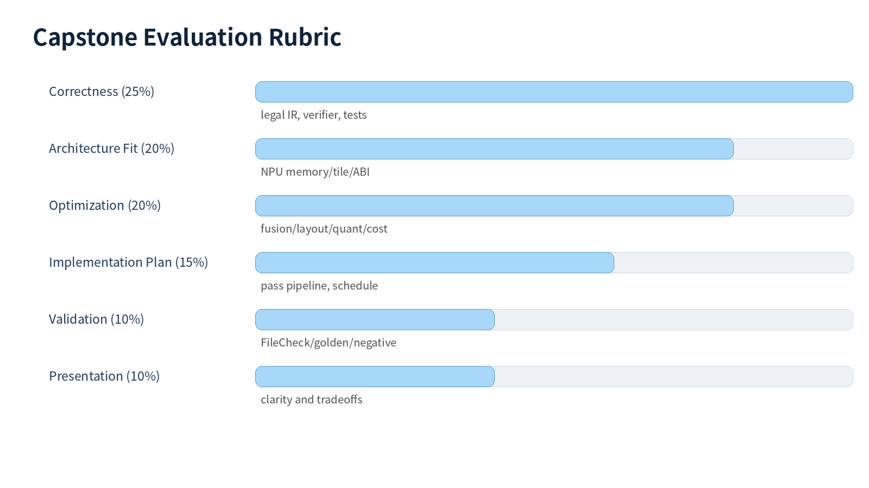
Evaluation Rubric

Slide 32
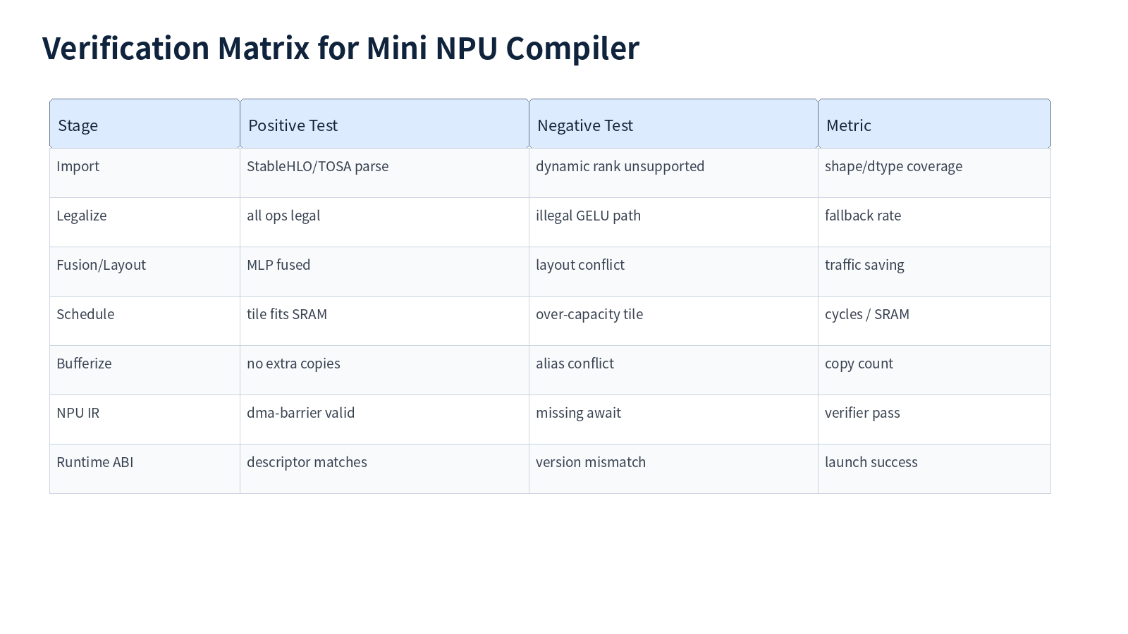
Verification Matrix

Slide 33
Exercise A - Workload Definition
Choose one workload and define shapes, dtypes, layout, quantization.
Write target NPU assumptions.
Identify unsupported cases.
MLIR NPU Lecture 20

Slide 34
Exercise B - Pipeline Spec
Write pass order and anchors.
For each pass, define input IR, output IR, invariant, test.
MLIR NPU Lecture 20

Slide 35
Exercise C - NPU Dialect Contract
Define npu.matmul, npu.dma, npu.barrier.
Separate operands, results, attributes, types, verifier rules.
MLIR NPU Lecture 20

Slide 36
Exercise D - Runtime ABI
Define tensor descriptor fields.
Define command buffer header and packet types.
Add ABI version and capability query.
MLIR NPU Lecture 20

Slide 37
Exercise E - Validation Plan
Write one positive FileCheck test.
Write one negative verifier test.
Run cost model and include output.
MLIR NPU Lecture 20

Slide 38
Submission Format
Design spec: 8-12 pages
Pseudo MLIR and YAML specs
Tests and cost model
10-minute presentation
MLIR NPU Lecture 20

Slide 39
Takeaways
MLIR is valuable because it lets you place each compiler decision at the right abstraction level.
NPU compiler design is a set of contracts: semantic, scheduling, memory, numeric, runtime.
The capstone output should be implementable, testable, and explainable.
MLIR NPU Lecture 20

Slide 40
References
MLIR LangRef / Pass Management / Dialect Conversion / Transform / Linalg / Bufferization
StableHLO specification
MLIR TOSA dialect
MLIR Target LLVM IR documentation
MLIR NPU Lecture 20

