Slide 1
IDENTITY-BASED ENCRYPTION USING KEY UPDATE-CSP
SRM University
Department of Computer Science and Engineering
Kattankullathur, Chennai , Tamil Nadu 603203
Name: Prabhunath Yadav
Reg No: 1031210334
Branch:CSE Name:Ashish Jangu
Reg No: 1031210332
Branch: CSE
Under the guidance of Mr. M. RAJASEKARAN

Slide 2
Introduction
Identity to public key encryption, which is proposed to simplify Key Based Encryption (IBE) is an interesting alternative management in a certificate-based Public Key Infrastructure (PKI) by using human-intelligible identities (e.g., unique name, email address, IP address, etc) as public keys. Therefore, sender using IBE does not need to look up public key and certificate, but directly encrypts message with receiver’s identity. Accordingly, receiver obtaining the private key associated with the corresponding identity from Private Key Generator (PKG) is able to decrypt such ciphertext.
Though IBE allows an arbitrary string as the public key which is considered as an appealing advantages over PKI, it demands an efficient revocation mechanism. Specifically, if the private keys of some users get compromised, we must provide a mean to revoke such users from system. In PKI setting, revocation mechanism is realized by appending validity periods to certificates or using involved combinations of techniques.
The CSPs cloud-based services such as Amazon’s EC2 and Microsoft’s Windows Azure could then simply update all the private keys by using the traditional key update technique and transmit the private keys back to unrevoked users.
We propose a scheme to offload all the key generation related operations during key-issuing and key-update, leaving only a constant number of simple operations for PKG and eligible users to perform locally

Slide 3
Objective or Scope:
Using identity as a public key by PKG reduce its burden of extra processing in public Key generation.
To reduce the burden of PKG in updating private keys.
Reduce the revoke overhead of PKG in case of key compromise.

Slide 4
Problem statement
As the no users are exponentionally increasing the burden of providing separate public key by PKG which cause bottleneck problem at pkg.
The burden to update private key and revocation of user on key compromise issues are the major problems of PKG

Slide 5
Identity-Based Encryption (IBE) is an alternative to public key encryption which simplifies the public key at Public Key Infrastructure (PKI). However, the only drawback of IBE is the overhead computation at Private Key Generator (PKG) during revocation of user. In traditional PKI setting efficient revocation has been well studied, but the cumbersome management of private keys is precisely the burden that IBE strives to alleviate. In this paper, objective to tackle the critical issue of identity revocation, we introduce outsourcing computation into IBE for the propose to reduce the overburden at PKG. Our scheme offloads most of the key generation related operations during key-issuing and key-update processes to a Key Update Cloud Service Provider, leaving only a constant number of simple operations for PKG and users to perform locally. This goal is achieved by using KU-CSP: we employ a hybrid private key which is a combination of identity component and time component for each user.
ABSTRACT

Slide 6
Base paper work description
Author:Jin Li, Jingwei Li, Xiaofeng Chen, Chunfu Jia and Wenjing Lou
Title of Paper:Identity-Based Encryption with Outsourced Revocation in Cloud Computing
Algorithms:
1. Setup : The setup algorithm takes as input a security parameter and outputs the public key and the master key . Note that the master key is kept secret at PKG. 2. KeyGen : The private key generation algorithm is run by PKG, which takes as input the master key and user’s identity . It returns a private key corresponding to the identity 3. Encrypt : The encryption algorithm is run by sender, which takes as input the receiver’s identity and a message to be encrypted. It outputs the ciphertext . 4. Decrypt : The decryption algorithm is run by reciever, which takes as input the cipher text and his/her private key.
5.Revoke : The revocation algorithm run by PKG takes as input revocation list ,a time list and the set of identities to be revoked. It output an updated time period as well as the updated RL and TL
6.KeyUpdate : The key update algorithm run by KU-CSP takes as input–a revocation list , an identity , a time period and the outsourcing key for identity . It outputs user’s updated time component in private key if his identity does not belong to , otherwise, outputs .

Slide 7
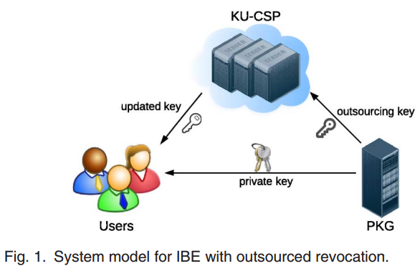
System model

Slide 8
Drawback
1) PKG has to generate a key pair for all the nodes on the path from the identity leaf node to the root node, which results in complexity logarithmic in the number of users in system for issuing a single private key. 2)The size of private key grows in logarithmic in the number of users in system, which makes it difficult in private key storage for users.

Slide 9
Advantages
1) with the aid of KU-CSP, user needs not to contact with PKG in key-update, in other words, PKG is allowed to be offline after sending the revocation list to KU-CSP.
2) No secure channel or user authentication is required during key-update between user and KU-CSP.
3Therefore, key update efficiency at PKG is able to be significantly reduced from linear to the height of such binary tree. .

Slide 10
PROPOSED SYSTEM
In this paper, we introduce outsourcing computation into IBE revocation, We propose a scheme to offload all the key generation related operations during key-issuing and key-update, leaving only a constant number of simple operations for PKG and eligible users to perform locally.
In our scheme, as with the suggestion that we realize revocation through updating the private keys of the unrevoked users. But unlike that work which trivially concatenates time period with identity for key generation/update and requires to re-issue the whole private key for unrevoked users, we propose a novel collusion-resistant key issuing technique: we employ a hybrid private key for each user, in which an AND gate is involved to connect and bound two sub-components, namely the identity component and the time component.
At first, user is able to obtain the identity component and a default time component (i.e., for current time period) from PKG as his/her private key in key-issuing. Afterwards, in order to maintain decrypt ability, unrevoked users needs to periodically request on key-update for time component to a newly introduced entity named Key Update Cloud Service Provider (KU-CSP). Compared with the previous work [4], our scheme does not have to re-issue the whole private keys, but just need to update a lightweight component of it at a specialized entity KU-CSP. We also specify that
Advantages
1) with the aid of KU-CSP, user needs not to contact with PKG in key-update, in other words, PKG is allowed to be offline after sending the revocation list to KU-CSP.
2) No secure channel or user authentication is required during key-update between user and KU-CSP.

