Slide 1

REALM: Retrieval-Augmented Language Model Pre-Training
2024.09.30

Slide 2

Agenda
Introduction
Overview
Background
Model
Result

Slide 3
Introduction
Recent LM pre-training method can learn world knowledge implicitly. (e.g. BERT, RoBERTa)
It makes difficult to determine what knowledge is stored in the networks and where.
Furthermore, storage space is limited to capture more knowledge.
So we introduce REALM pre-training, with textual knowledge retriever
Before making each prediction, LM uses the retriever to retrieve docs from a large corpus. (aka. retrieve-then-predict)
Learning this model end-to-end (backpropagating through a retrieval step with performance-based signal)
“The __ at the top of the pyramid” → “The pyramidon on top allows for less material higher up the pyramid”

Slide 4
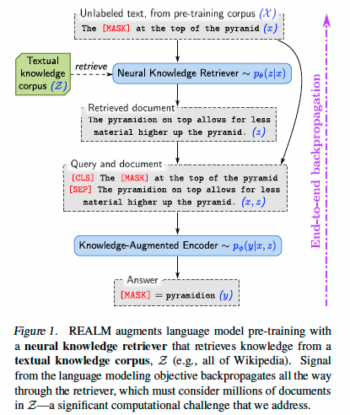
Overview
Main Contribution
Jointing Retriever & Reader for end-to-end model
Prior works demonstrated benefit of using discrete retrieval steps, but they did not use for pre-training and used only non-learned retrievers.
Retrieve-then-predict
Neural Knowledge Retriever : Query → relevant document
Knowledge-Augmented Encoder : retrieved doc → answer
Pre-training & fine-tuning
MLM in Pre-training
Open-domain QA in fine-tuning

Slide 5
Background
Language Model pre-training
Goal of pre-training is to learn useful representations of language from unlabeled text.
We focus on the masked language model (MLM) which is popularized by BERT
e.g. x = “The [MASK] is the currency [MASK] the UK” → y = (“pound”, “of”)
Open-domain QA
e.g. “What is the currency of the UK” → “pound”
“Open” refers to the fact that the model does not receive a pre-identified document that is know to contain the answer, unlike traditional reading comprehension (RC) tasks such as SQuAD.

Slide 6
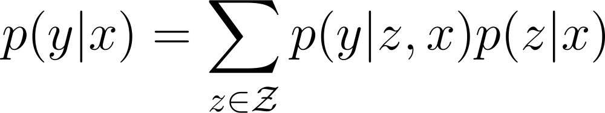

Model : generative process
REALM decomposes $p(y|x)$into two steps (retrieve & predict)
For given input $x$, we first retrieve helpful document $z$ from a corpus $𝒵$ : $p(z|x)$
Then, condition both $x$, $z$ to generate the answer $y$ : $p\left(y\right| z, x)$
To obtain the overall likelihood of generating $y$, we treat $z$ as a latent variable and marginalize over all possible documents.

Slide 7
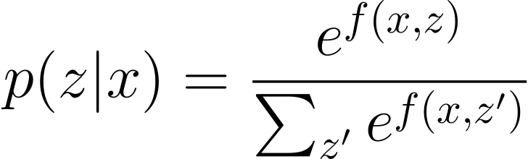
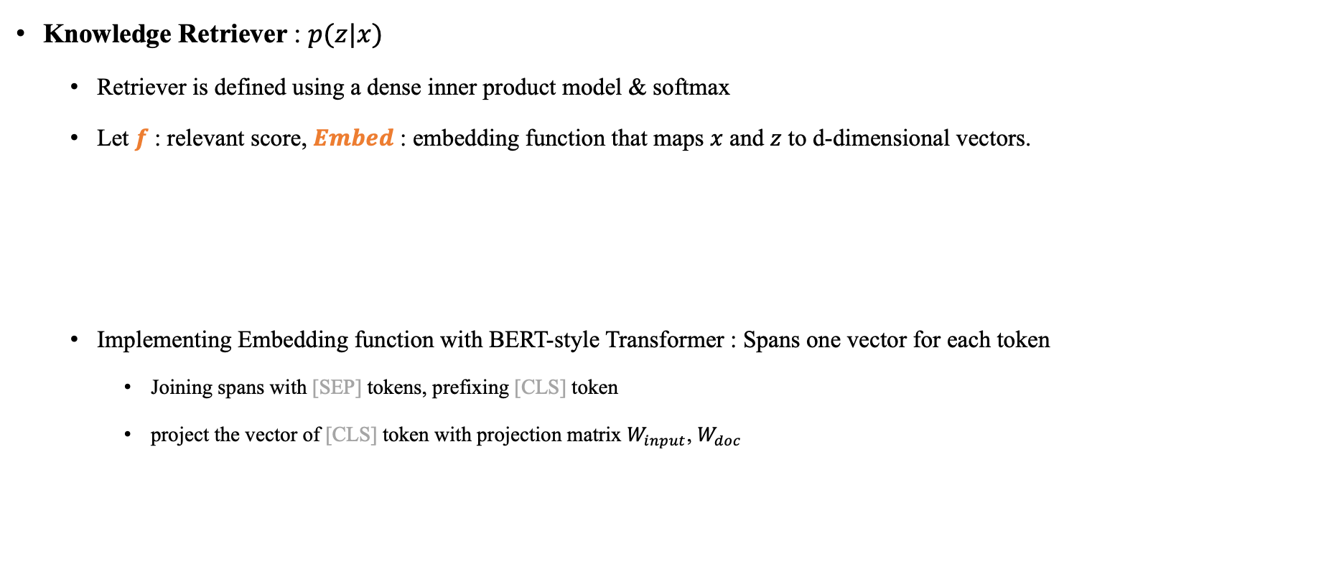
Model Architecture
Knowledge Retriever : $p(z|x)$
Retriever is defined using a dense inner product model & softmax
Let $f$ : relevant score, $Embed$ : embedding function that maps $x$ and $z$ to d-dimensional vectors.
Implementing Embedding function with BERT-style Transformer : Spans one vector for each token
Joining spans with [SEP] tokens, prefixing [CLS] token
project the vector of [CLS] token with projection matrix $W_{input}$, $W_{doc}$

Slide 8
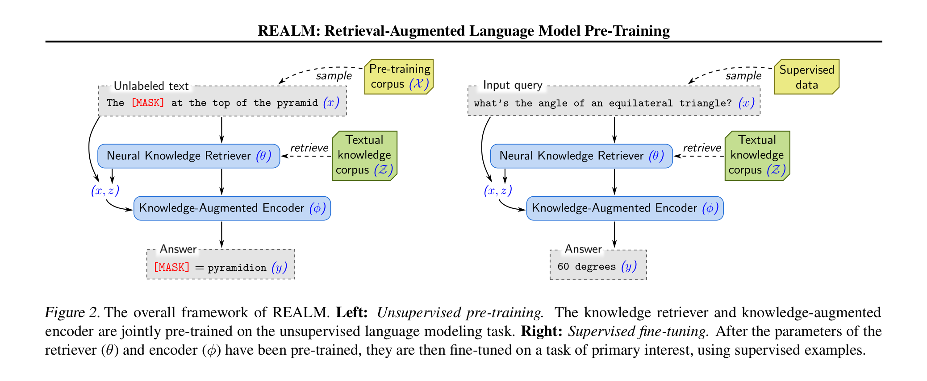

Model Architecture
Knowledge Augmented Encoder : $p\left(y\right| z, x)$
Joining x and z into a single sequence and feed it to Transformer. (For Cross-attention)
Architecture for pre-training and fine-tuning differs slightly

Slide 9
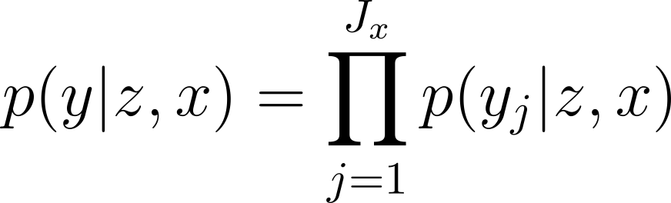
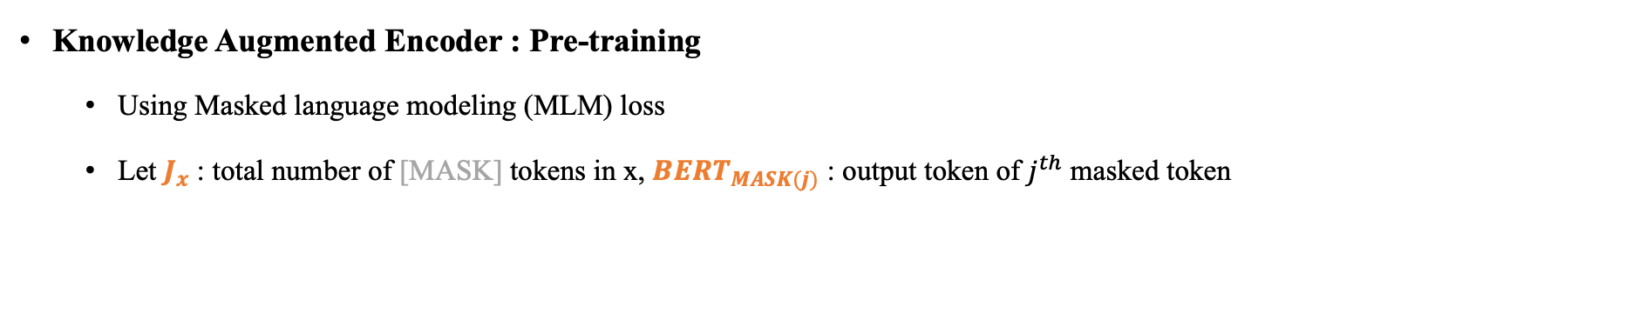
Model Architecture
Knowledge Augmented Encoder : Pre-training
Using Masked language modeling (MLM) loss
Let $J_{x}$ : total number of [MASK] tokens in x, ${BERT}_{MASK(j)}$ : output token of $j^{th}$ masked token

Slide 10
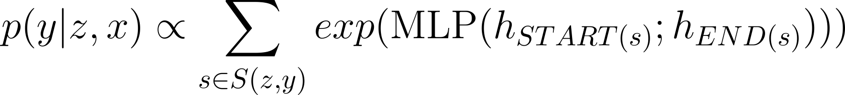
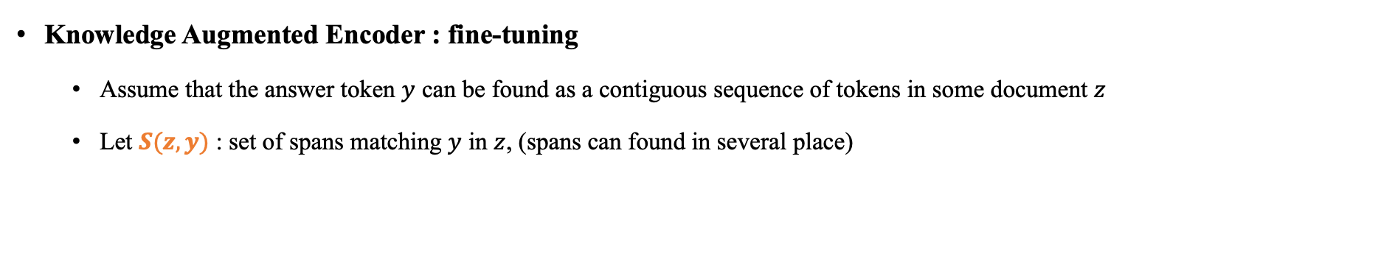
Model Architecture
Knowledge Augmented Encoder : fine-tuning
Assume that the answer token $y$ can be found as a contiguous sequence of tokens in some document $z$
Let $S(z, y)$ : set of spans matching $y$ in $z$, (spans can found in several place)

Slide 11
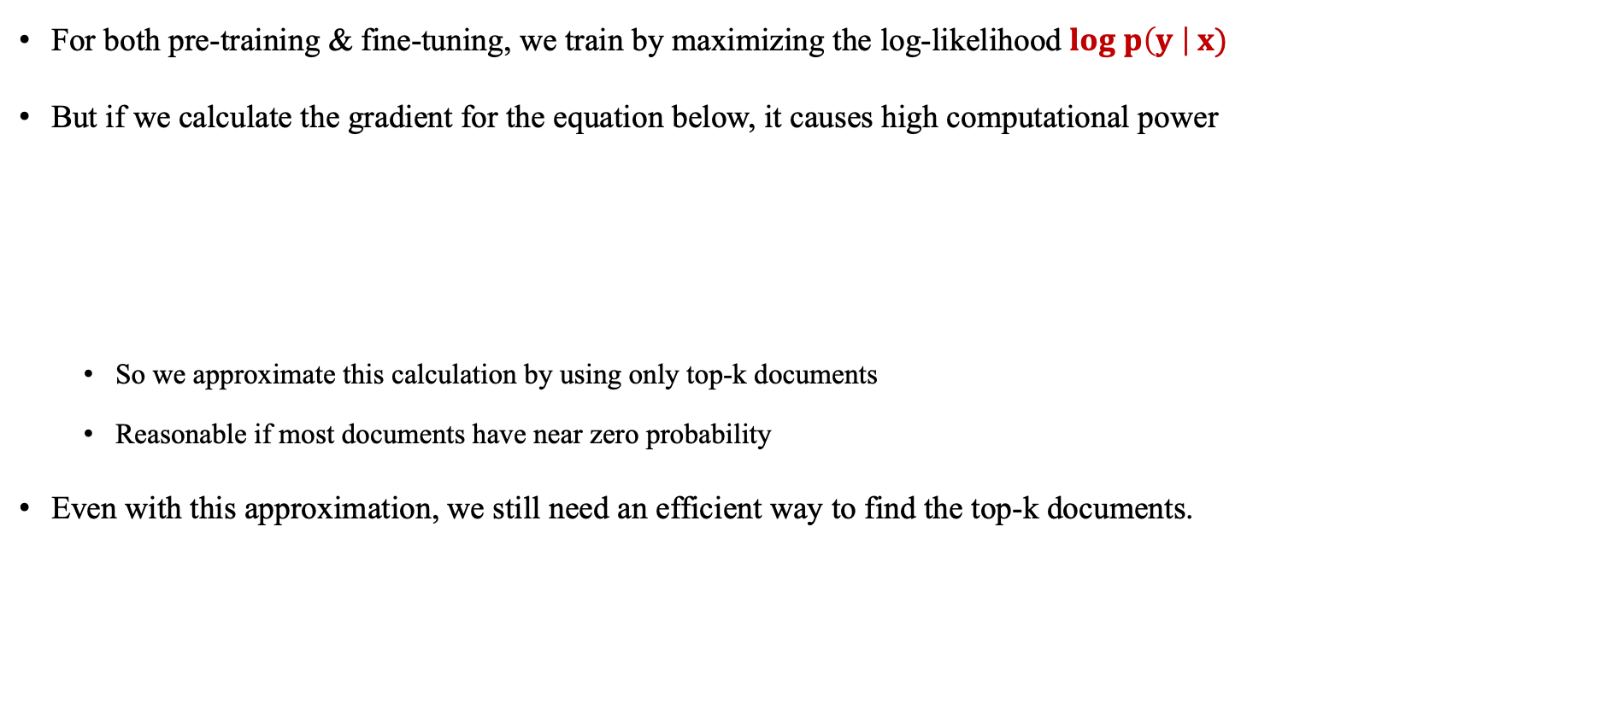
Model : Training
For both pre-training & fine-tuning, we train by maximizing the log-likelihood $log p\left(y \right| x)$
But if we calculate the gradient for the equation below, it causes high computational power
So we approximate this calculation by using only top-k documents
Reasonable if most documents have near zero probability
Even with this approximation, we still need an efficient way to find the top-k documents.
MIPS (Maximum Inner Product Search) Algorithm

Slide 12
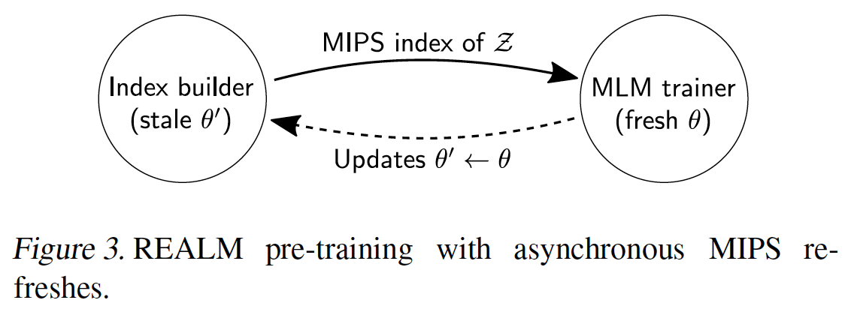

Model Training
Implementing asynchronous MIPS refreshes
To employ MIPS, we must pre-compute ${Embed}_{doc}(z)$ for every $z∈ 𝒵$ and construct an efficient search index over these embeddings. (e.g. LSH, ANN, ScaNN)
But these data (index) will be “stale” during the training process
Our Solution is to “refresh” the index by asynchronously re-embedding and re-indexing all docs every several training steps.

Slide 13
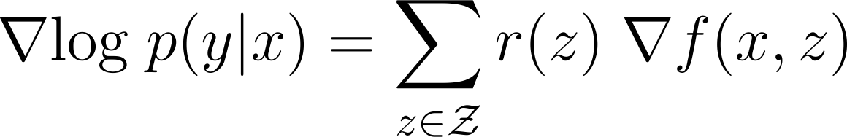

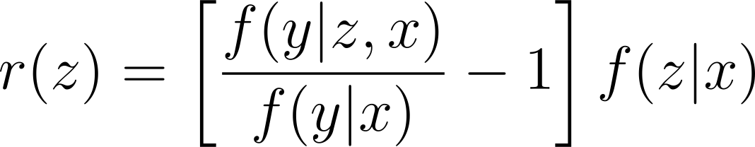

Model Training
What does the retriever learn? (IOW, How can retriever learn by end-to-end learning?)
If the probability for predicting $y$ with condition $x$, $z$ is larger than that of only with $x$, the gradient will be positive.
That is, if $z$ is helpful for predicting $y$, it will be rewarded.
Mathematical something..

Slide 14
Model : injecting inductive bias
Several additional strategies that guide the model towards meaningful retrievals. (In pre-training)
Salient span masking
To focus on examples x that require world knowledge, we mask salient spans such as “United Kingdom” or “July 1969”
Using BERT-based tagger trained on CoNLL-2003 dataset & regular expression
Null document
Even with salient span masking, not all masked tokens require world knowledge to predict.
Adding null document to the top-k documents, it can help predicting tokens which does not need additional information.

Slide 15
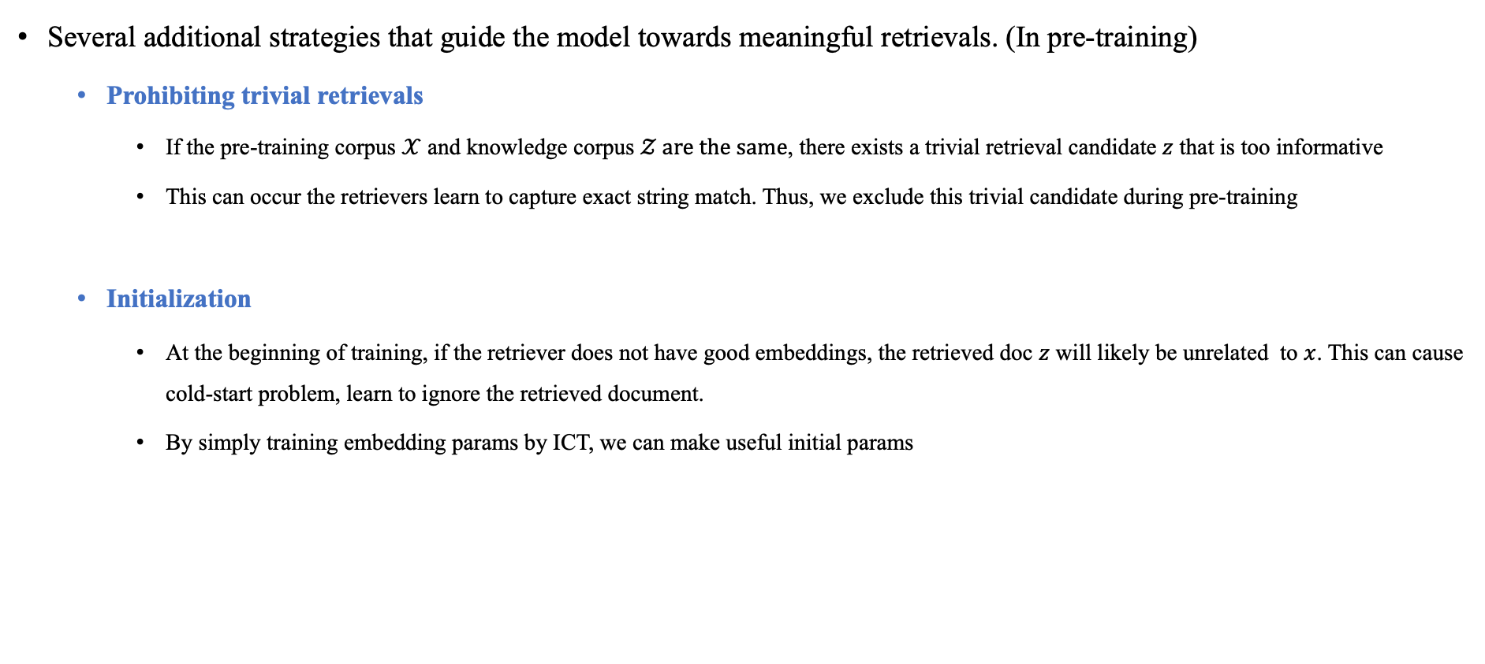
Model : injecting inductive bias
Several additional strategies that guide the model towards meaningful retrievals. (In pre-training)
Prohibiting trivial retrievals
If the pre-training corpus $𝒳$ and knowledge corpus $𝒵 are the same$, there exists a trivial retrieval candidate $z$ that is too informative
This can occur the retrievers learn to capture exact string match. Thus, we exclude this trivial candidate during pre-training
Initialization
At the beginning of training, if the retriever does not have good embeddings, the retrieved doc $z$ will likely be unrelated to $x$. This can cause cold-start problem, learn to ignore the retrieved document.
By simply training embedding params by ICT, we can make useful initial params

Slide 16
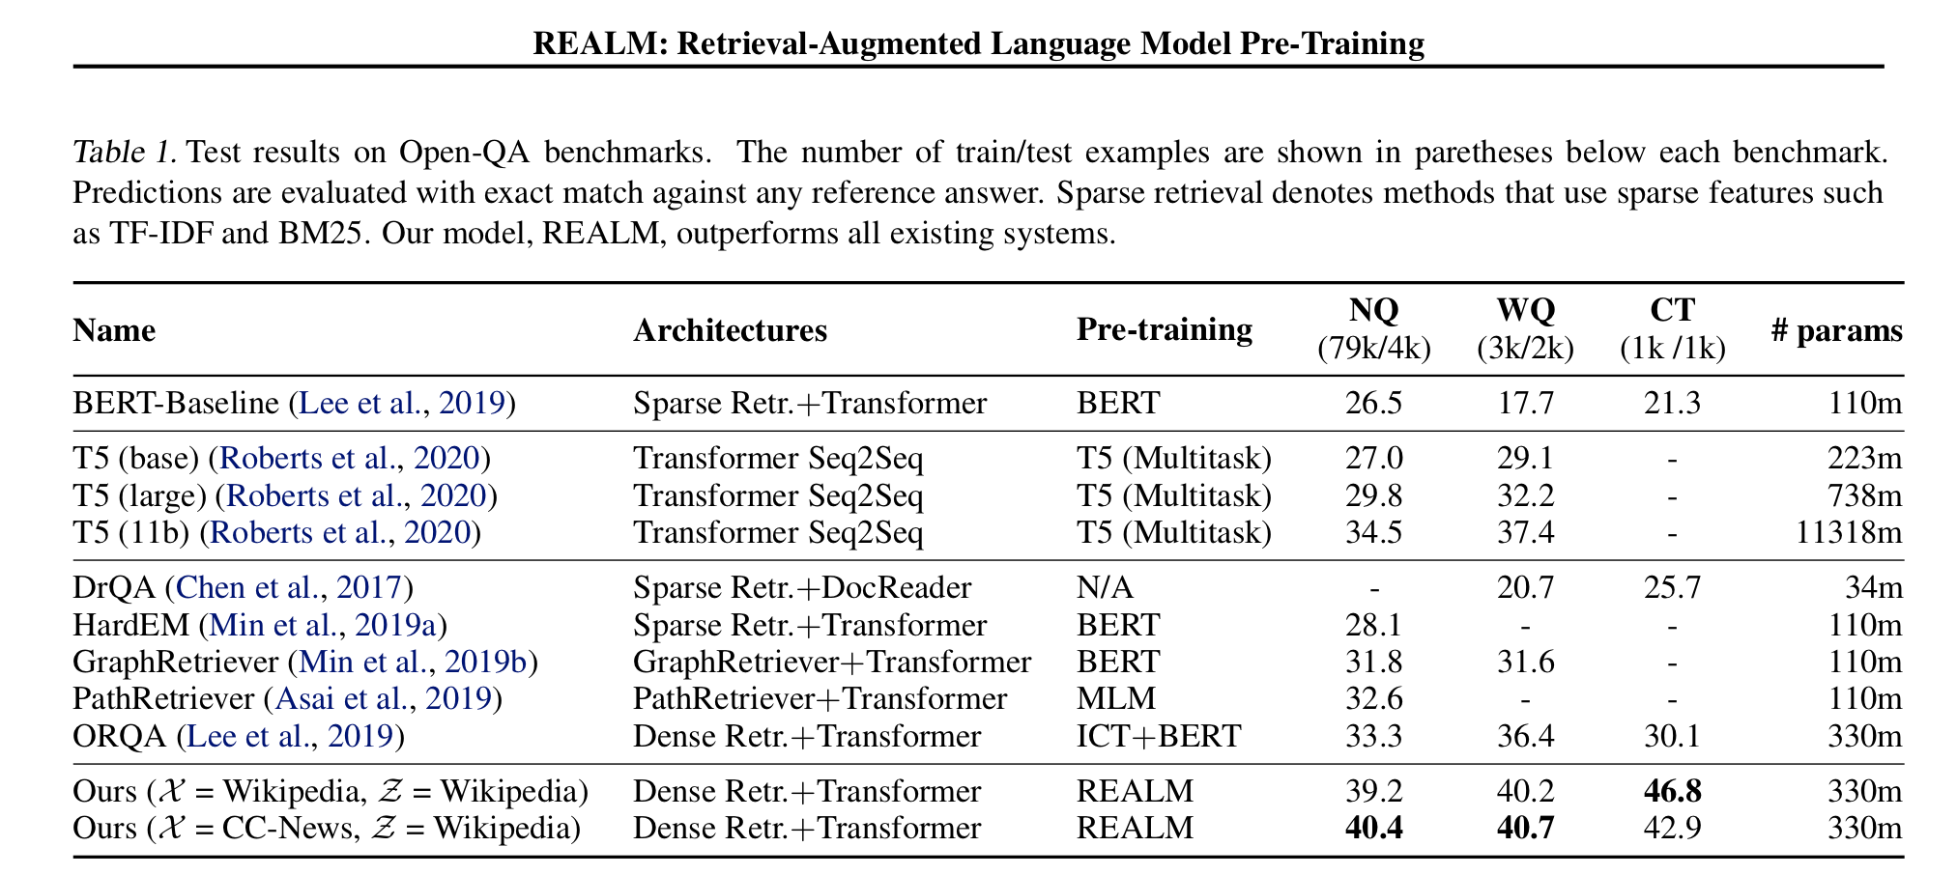
Result
Using Only top-5 passage & 30 times smaller model than T5(11b) model.

Slide 17
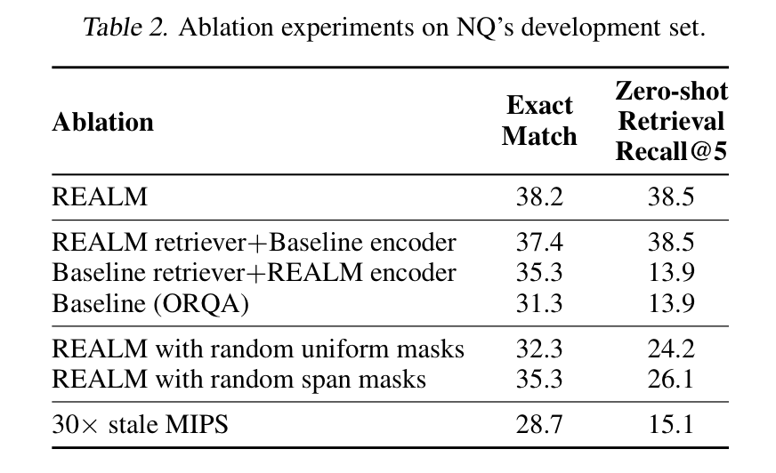
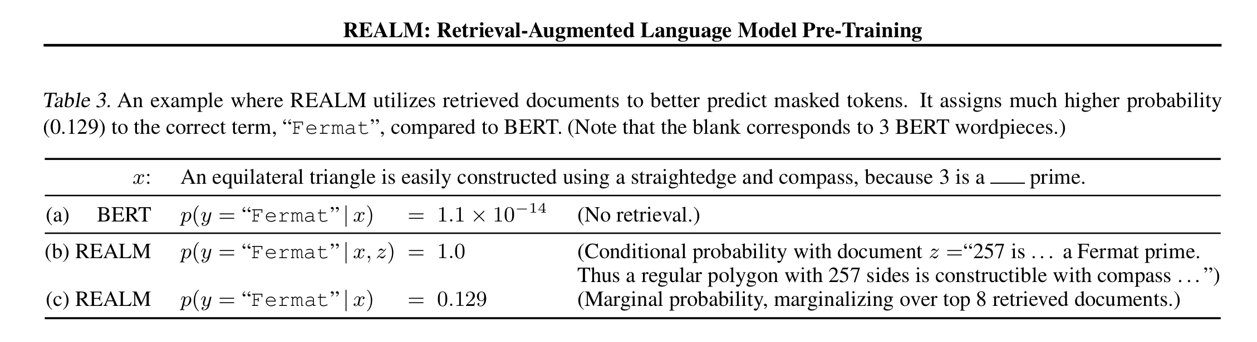
Result
Ablation Study
Retriever + Encoder
Masking Method
Refreshing frequency

