Slide 1
AI StoryBook
[Logo] ## Illustrate your imaginations to others

Slide 2
The Problem
Teen manga fans and writers wait 1 week to 1 month per illustrated chapter.
Manual creation is slow, costly, and requires professional skills.
DIY AI tools lack fixed style and long-range character/story consistency.

Slide 3
Our Solution
{‘One-click ranobe-to-manga’: ‘generate 5–20 pages per chapter in minutes.’}
Long-range character and plot consistency across chapters and runs.
Fixed, reusable style packs and story-structure control.
Built-in paneling, speech bubbles, and right-to-left layout.

Slide 4
Demo 1: Shadow Slave (Manga Style)

Slide 5
Input
Text: “A frail-looking young man with pale skin and dark circles…”
Image:
Output

Slide 6
Demo 2: The Boy and the Magic Van (Children’s Book)

Slide 7
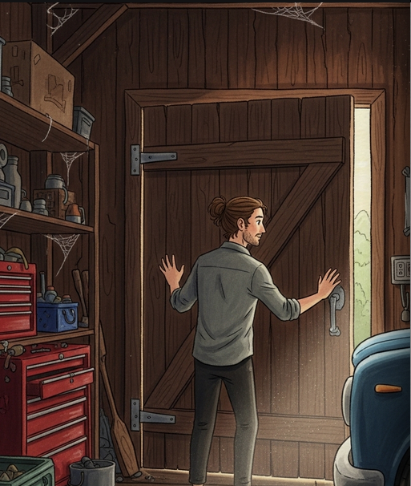
Input
Text: “Misi found an old, blue van in a dusty, cobweb‑filled garage…”
Image:
Output

Slide 8
Market Opportunity
TAM: $16–20B (Global B2C creators/fans + B2B small publishers)
SAM: $1.5–2.5B
SOM: $40–60M (3-yr reachable)

Slide 9
Business Model
{‘Pay-per-chapter’: ‘$2.99 (5 pages), $9.99 (20 pages).’}
Marketplace for style packs and publisher revenue sharing/licensing.

Slide 10
Roadmap
Short Term
Public beta, 10+ styles, 20-page chapters, EN↔JP translation.
Long Term
Style marketplace, exports, publisher API pilots, early video/animatics.

Slide 11
Meet the Team
Abdulazizbek Gainazarov - Data Scientist
Work at WizzAir, Bachelor’s Degree in CS.
Bálint Décsi - Data Engineer
Work at Deutsche Telekom IT Solutions HU, Master’s degree in Data Science for ML.

Slide 12
The Ask
$15k in API or GPU credits, publisher intros, legal regulations advice.

Slide 13
Thank You!
Let’s build the future of storytelling together.

