Slide 1
AI StoryBook
Translate text to comics
Notes:
© Copyright Showeet.com – Creative & Free PowerPoint Templates
1

Slide 2
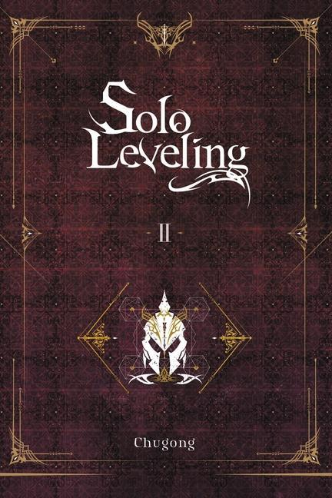

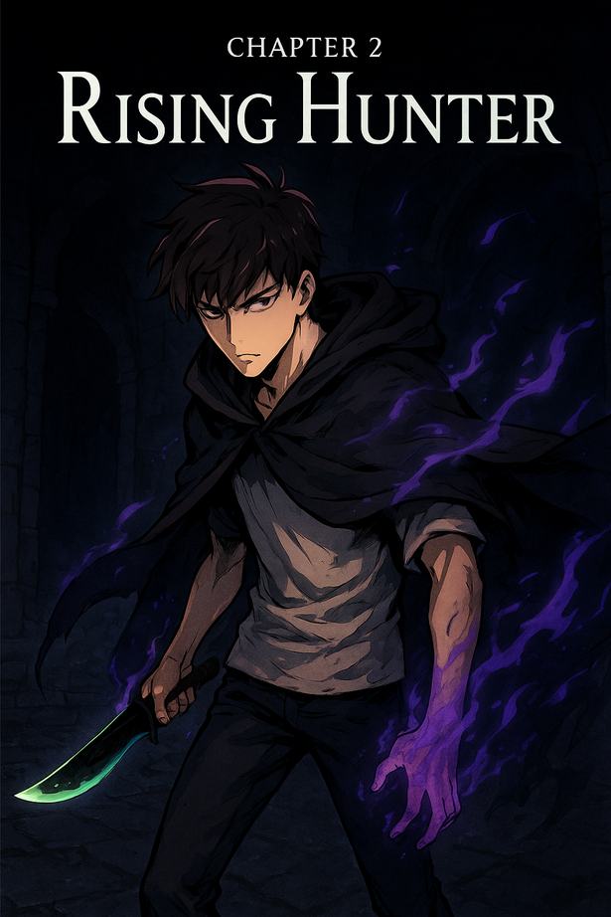

Book for plot
Comics for art
Comics by us

Slide 3
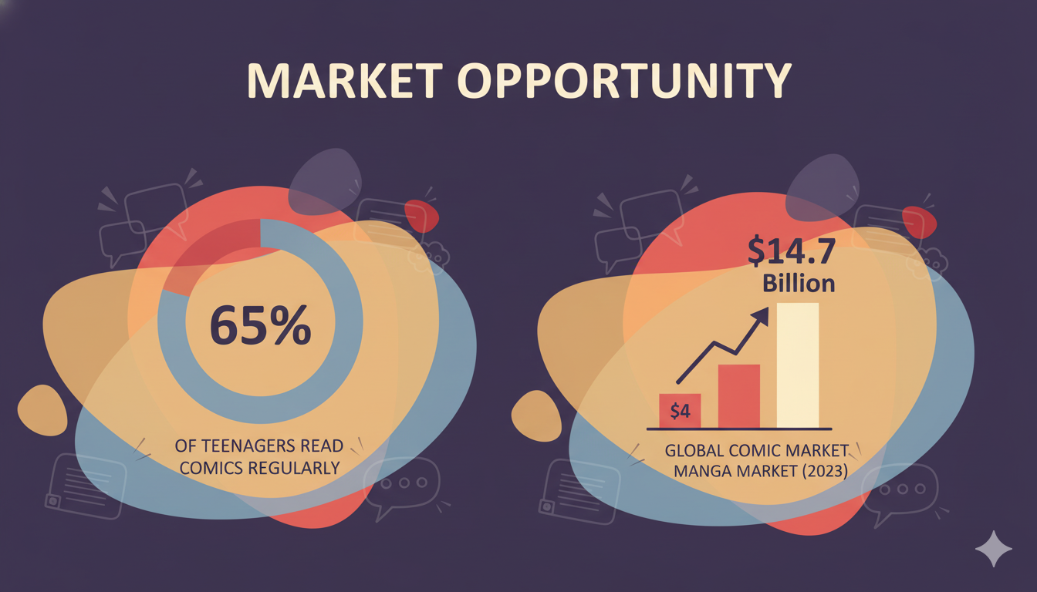

Slide 4
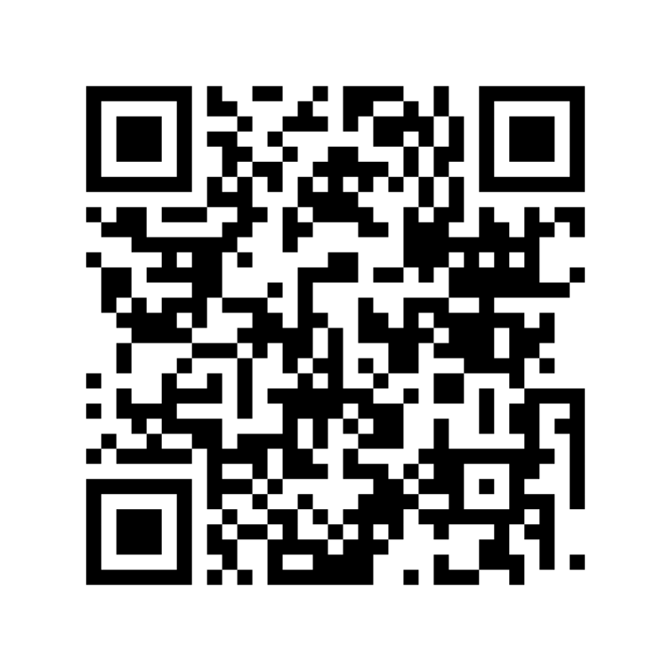
Our Solution + Demo
Whole Book in 5 Minutes
01
Consistent Characters and Art Style
02
Plot and Message Preservation
03
Notes:
© Copyright Showeet.com – Creative & Free PowerPoint Templates
14

Slide 5
Competition & Differentiation | Fast | Consistency | Styles | Many Chapters
GenAI + manual |  |  | Yes
Gemini Storybooks |  | No
OpenAI tools |  |  | Yes
AI StoryBook | 1 min | Yes | Yes
Notes:
© Copyright Showeet.com – Creative & Free PowerPoint Templates
20

Slide 6
01
AI StoryBook
Tired of waiting for new chapters? Continue on your own!
One‑click turns light novels into consistent, styled manga.
MVP live: 5‑page chapters from 1k–1.5k words in ~5 minutes.
Notes:
© Copyright Showeet.com – Creative & Free PowerPoint Templates
11

Slide 7
The Problem
01
Teen manga fans/writers wait 1 week–1 month per illustrated chapter
02
Manual creation
03
DIY AI tools lack fixed style and long‑range character/story consistency.
4
Notes:
© Copyright Showeet.com – Creative & Free PowerPoint Templates
4

Slide 8
04
Product Features
Style packs with consistent look; multi‑chapter character continuity.
Upload your images with text to align style or inject characters—make the hero look like you.
Panel layout engine, speech bubbles, chapter structuring, export formats.
Notes:
© Copyright Showeet.com – Creative & Free PowerPoint Templates
11

Slide 9
05
Innovation: Why We Win
Long‑range character and plot consistency across chapters and runs.
Fixed, reusable style packs and story‑structure control.
Cost/time: ~5 minutes vs weeks;
~$4/20 pages now → ~$0.04/20 pages with local GPUs.
Notes:
© Copyright Showeet.com – Creative & Free PowerPoint Templates
11

Slide 10







Market Opportunity & Business Model & Pricing
TAM ~$16–20B
SAM ~$1.5–2.5B
SOM (3‑yr reachable) ~$40–60M.
Global B2C creators/fans + B2B small publishers
Future: marketplace for style packs; publisher revenue share/licensing
Pay‑per‑chapter: $2.99 (5 pages), $9.99 (20 pages); 1 free 5‑page on signup
Initial focus: light‑novel‑to‑manga and teen creator communities
IP policy: licensed/user data; inspired‑by styles; no artist mimicry.
Notes:
© Copyright Showeet.com – Creative & Free PowerPoint Templates
17

Slide 11


Scalability
Fine‑tuned Autoregressive Transformers/LoRA style packs, character embeddings, retrieval for continuity; layout & speech engine.
Today via OpenAI/Google APIs; switchable to local GPUs when available.
Costs: ~$1 per 5 pages now (~$4/20p) → ~$0.04/20p; partner API in ~6 months.
01
06
02
Tech
05
03
04
Notes:
© Copyright Showeet.com – Creative & Free PowerPoint Templates
18

Slide 12

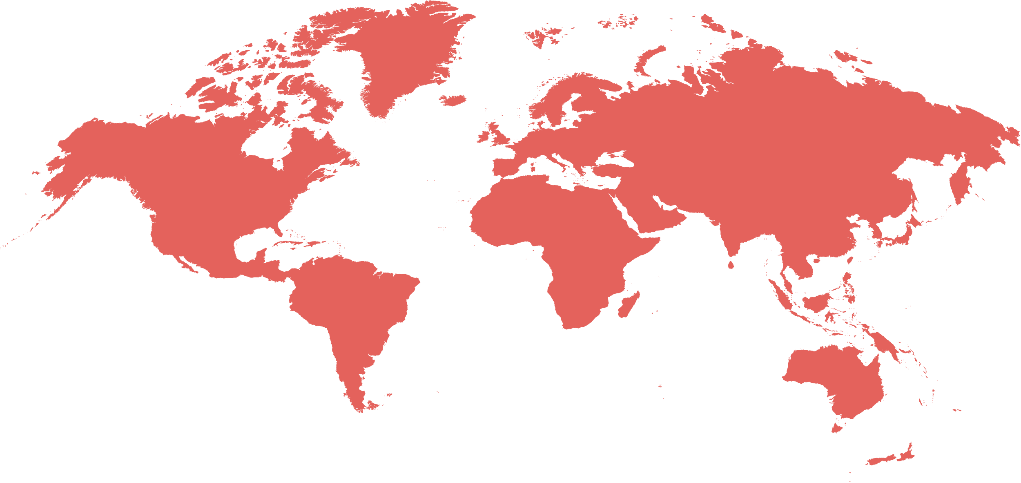
Go‑To‑Market
Self‑serve web beta; community growth via Discord/Reddit/anime subs, WebNovel
Outreach to Webtoon/Tapas creators; university anime/manga clubs
YouTube/TikTok creator partnerships; publisher pilots in progress.
Notes:
© Copyright Showeet.com – Creative & Free PowerPoint Templates
21

Slide 13
Traction & Team
Abdulazizbek Gainazarov – Data Scientist:
Work at WizzAir
Education: Bachelor’s Degree, Computer Science
Bálint Décsi – Data Engineer:
Work: Deutsche Telekom IT Solutions HU
Education: Master's degree, Data science for machine learning
MVP:
Supports 1 manga style + basic children’s storybooks;
20 chapters generated;
Waitlist 20; pilots in progress.
Demo: sample PDF linked;
Public web beta 1 month
More styles and 10k‑word runs this year
Notes:
© Copyright Showeet.com – Creative & Free PowerPoint Templates
24

Slide 14
Roadmap, Results & Ask
0–6 mo: Public beta, 10+ styles, 20‑page chapters,
10k‑word runs, EN↔JP;
6–24 mo: style marketplace, exports, publisher
API pilots; visual‑novel builder, early video/animatics.
Outcomes:
Y1 ~1,500 paying creators, ~5 publisher pilots, ARR ~$300k;
Y2 ~6,000/15, ~$1.6M;
Y3 ~20,000/40, ~$6M.
What we need: $15k in API or GPU credits, publisher intros, legal regulations advice;
Photo credit: PeterArreola via Pixabay (Creative Commons Zero license)
Notes:
© Copyright Showeet.com – Creative & Free PowerPoint Templates
23

Slide 15

Thank You !
Hope you like this pitch :)
© Copyright Showeet.com
Notes:
© Copyright Showeet.com – Creative & Free PowerPoint Templates
25

